Slide 1
High Bandwidth DAQ Systems for the Intensity Frontier
Mark Convery
January 10, 2013

Slide 2
Introduction
The next Intensity Frontier experiments present interesting DAQ challenges
Rare Decay experiments (ORKA, Mu2e)
Will have 10x-100x higher rates than predecessors from the 80’s and 90’s
Previous trigger strategies no longer applicable
Streaming (triggerless) DAQ presents promising solution, but requires high bandwidth
Leveraging industry progress
Long Baseline Neutrino Experiment
High channel count
High background (if at the surface)
Streaming DAQ also desirable

Slide 3
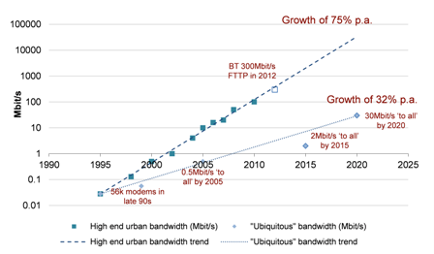
Moore’s Law of Bandwidth (Butter’s Law)
Fortunately bandwidth has become extremely important commercially
Follows its own Moore’s Law
Butter’s Law: Bandwidth in a fiber increases by 50%/year
Along with processing and storage improvements allows new trigger/DAQ strategies
Leveraging this new hardware in HEP experiments may have high development costs

Slide 4
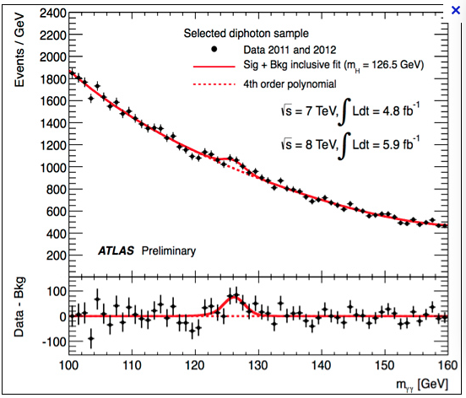
Uses of High Bandwidth Systems

Slide 5
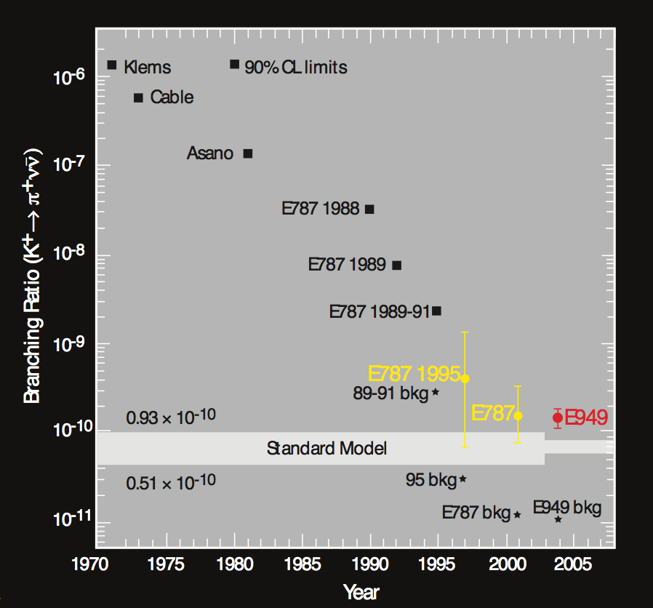
Example Rare Decay: K⁺->π⁺νν
“Golden” Kaon decay mode
Extremely clean in SM
Sensitive to many forms of NP
Experimentally challenging
Stopped K+ is the only proven technique. (In-flight decay technique being studied at NA62)
Thought to be limited by accidentals to ~1 MHz stopped K+ rate

Slide 6
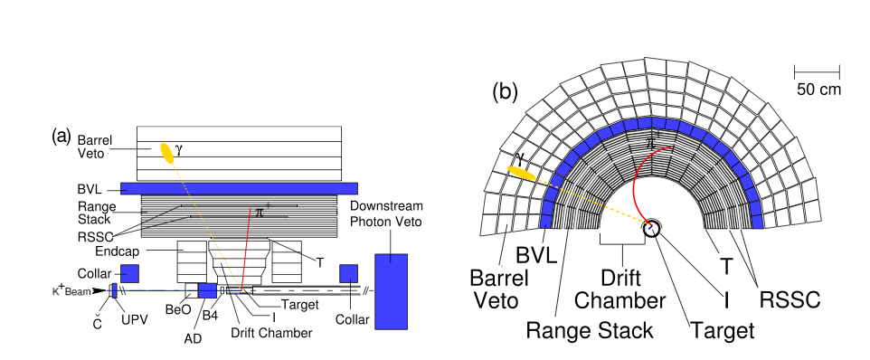
Stopped K⁺ Technique
Used by BNL E787/949 (~0.7 MHz stopping K+ rate)
Proposed for FNAL ORKA (~5 MHz stopping K+ rate)
Advantages
Well defined COM gives excellent kinematic background rejection
Stopped pion allows 10⁻⁶ mis-ID through observation of pi->mu->e
~4π photon veto coverage relatively easy to achieve
Disadvantages
Inherently “slow” technique since must wait for K, pi, mu decays -> sensitive to accidentals
π⁰ photons relatively low energy

Slide 7
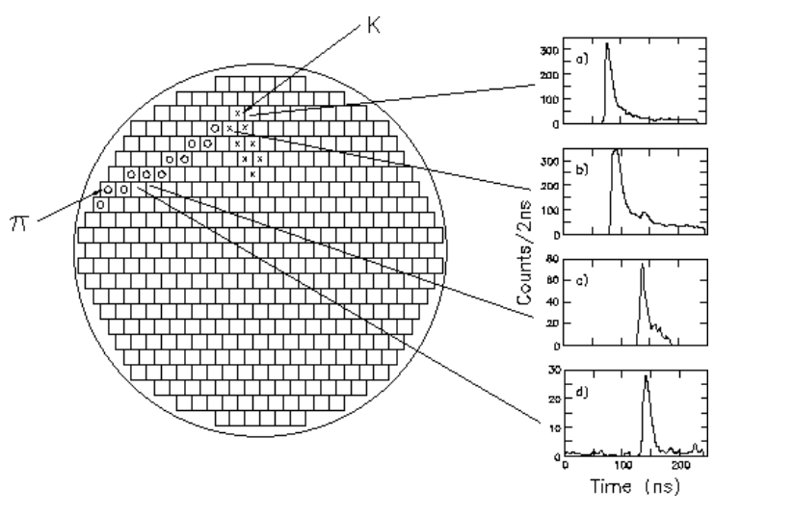
Accidental Sensitivity at the Trigger Level
One example: “Delayed Coincidence” between K track in target and pi track in Range Stack to identify stopped K⁺
E787/949 used one target signal and one range stack signal
Need to wait for several K+ lifetimes (12 nS)
Works well if incident rate < 1MHz
Loses rejection power if rates >>1 MHz
Solution-> Higher segmentation at trigger level
Most easily done in software (triggerless system)

Slide 8
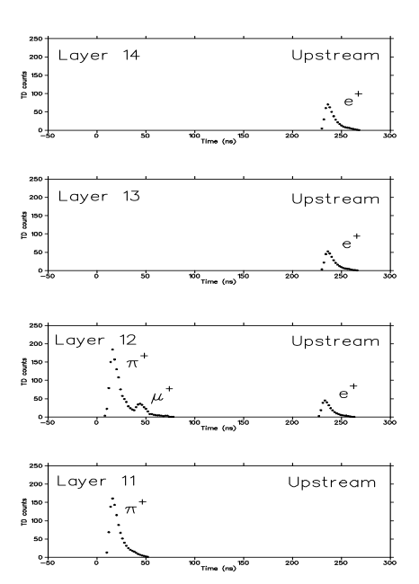
Efficiency Loss at the Trigger Level
One example: detection of π->μ decay gives excellent π ID
Needs analysis of PMT waveform to pick out μ pulse
In trigger hardware, cut on height to width ratio -> loss of efficiency
In software, could do detailed pulse fit
Also significant deadtime losses mitigated by streaming trigger
Pi stop and decay
Transient digitizer data

Slide 9
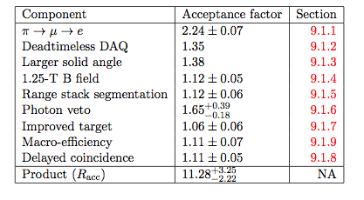
ORKA Experiment Proposal
Proposes to continue stopped K⁺ technique with 100x better sensitivity than E787/949
Improvements come from
Higher K⁺ stopping rate (8x)
Improved detector/trigger/analysis (11x)
High-speed (streaming) DAQ necessary for both

Slide 10
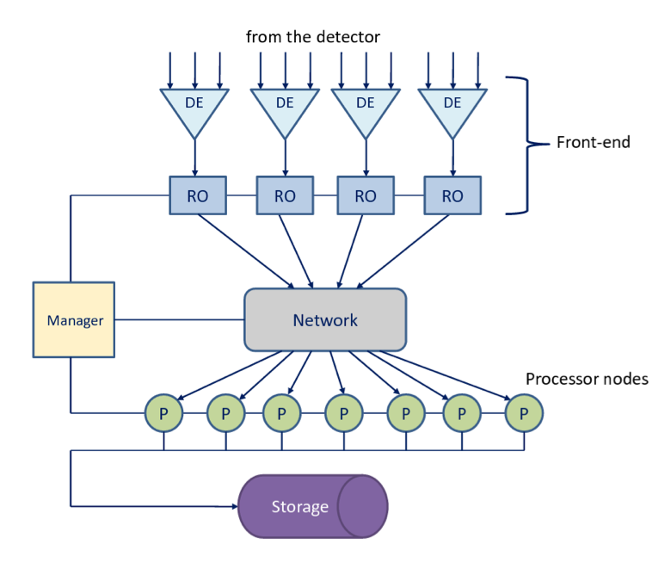
ORKA DAQ Proposal
Propose to read full events into processor farm before any event selection
Triggerless system removes trigger deadtime
Allows higher rates without accidental losses
Reduces trigger inefficiencies due to better algorithms
Required bandwidth>400 Gbytes/sec

Slide 11
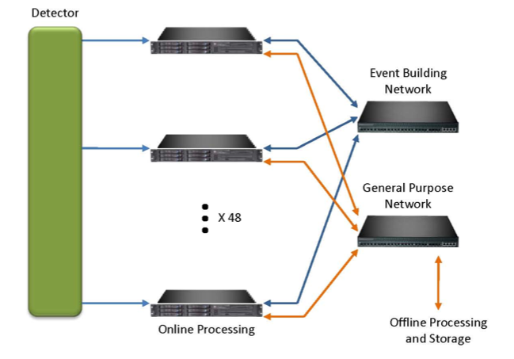
MU2E DAQ Proposal
Mu2e also proposes streaming (triggerless) DAQ system
Plan is to run tracking code in software for event selection
Not yet clear if feasible. May need to have some rejection in FPGA
Total bandwidth: 30 Gbytes/second

Slide 12
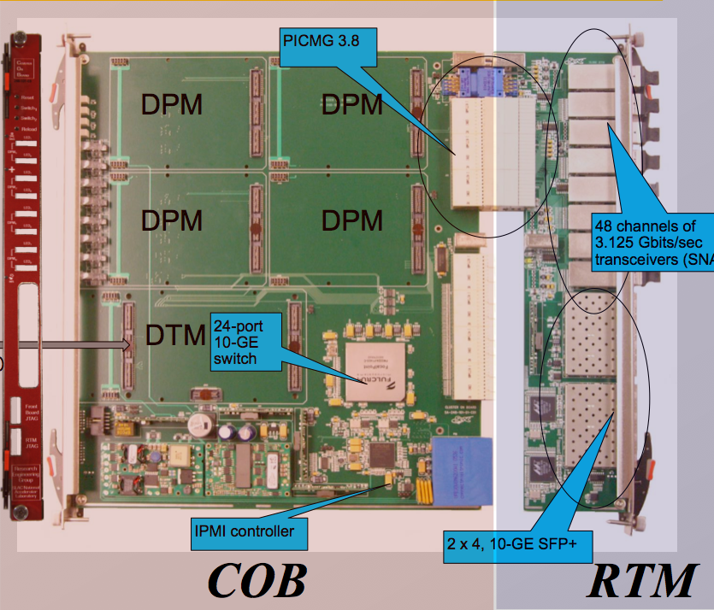
SLAC-Developed RCE System
A set of generic DAQ tools using modern switching and processing hardware
Reconfigurable Cluster Element (RCE) based on Xylinx Virtex-5 chip
ATCA infrastructure used
Rear Transition Module (RTM) is a “personality” board unique to each application
Leverages industrial hardware and Detector R&D-funded hardware, firmware and software work
Currently being used in:
ATLAS CSC, Heavy Photon Search, LSST, LCLS, etc.
Proposed for LBNE, etc.
See also, G.Haller Talk

Slide 13
R&D For Next Generation
Current version to be used for several experiments
Goal for next phase is that for 14-slot shelve (crate)
Provide 112 RCE’s
112 10G Ethernet nodes capable of operating IP protocols
Nearly 500,000 DMIPS of generic processing (Dhrystone)
Over 100 TMACS of DSP processing
Nearly 500 Gbytes of data buffering
Over 700 channels of detector input
Over 7 Tbits/s input bandwidth
112 channels of 10G Ethernet output
Over 1 Tbits/s data output bandwidth
14 COB internal Ethernets
Nearly 14 Tbits/s COB internal switching bandwidth
One full-mesh backbone connecting network
Over 7 Tbits/s switching network between networks
Target cost for one fully instrumented slot ~ $10k
From G. Haller’s
Talk Friday Session H

Slide 14
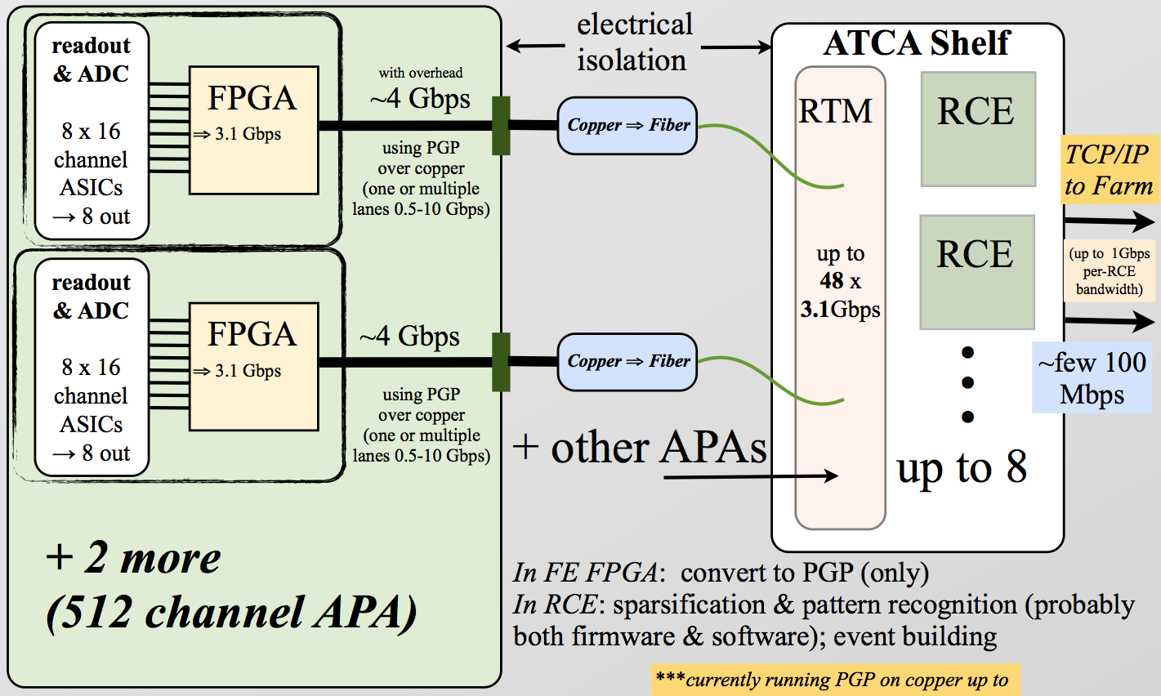
Possible Application to LBNE LArTPC
Baseline DAQ assumes aggressive sparsification inside cryostat
Reduces needed bandwidth to ~30 Mbps per APA
Use of high-bandwidth system could move sparsification to RCE’s
More flexible system with many advantages

Slide 15
Conclusion
High-bandwidth (streaming) DAQ systems are an enabling technology for Intensity Frontier experiments
Allow to maintain (and improve) performance in the face of ever increasing rates
Fantastic industrial progress means costs are the same (or lower) than traditional system
SLAC is building and supporting a set of tools that leverage this progress and make it available with low incremental development cost
Such systems may have application even in traditionally low-rate experiments (like LBNE).

