Slide 1
New Materials for High Energy Physics Missions With Applications in Accelerators, Detectors, and Sensors
Joint CPAD and Instrumentation Frontier Community Meeting
1/9/2013 – 1/11/2013
Argonne National Laboratory
Building 362 Auditorium
Dr. Michael J. Pellin
Argonne Distinguished Fellow
PSE

Slide 2
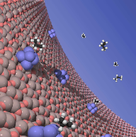

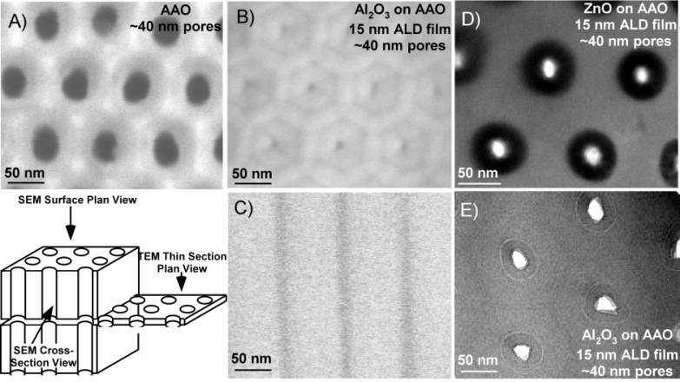
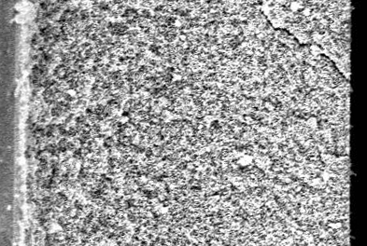
Collaborators
Atomic Layer Deposition
Jeff Elam, Alex Martinson, Joe Libera (Striping), Argonne National Laboratory
SRF Materials
Thomas Proslier , James Norem, Argonne
John Zasadzinski, IIT
Lance Cooley, Fermi National Laboratory
Channel Plates
Henry Frisch, LAPPD Group, A. Mane, J. Elam
Solar Architectures
Alex Martinson, Tom Hamann, Chaiya Prasittichai, Joe Hupp, Northwestern University (Today)
Michael DeVries, Justice Alabonson, Rikki DeMara, Vanessa Williams, Stacey Standridge
Gary Wiederecht , Leo Ochola (CNM)
Sub-nanometer Catalysis
Stephan Vajda, Argonne National Laboratory
Randy Winans, Byeongdu Lee, Greg Ballentine, Soenke Seifert, Argonne National Laboratory (GISAXS)
Peter Zapol, Michael Sternberg, Larry Curtiss, Argonne National Laboratory (Theory)
Catalysis
Peter Stair, Harold Kung, Mayfair Kung

Slide 3
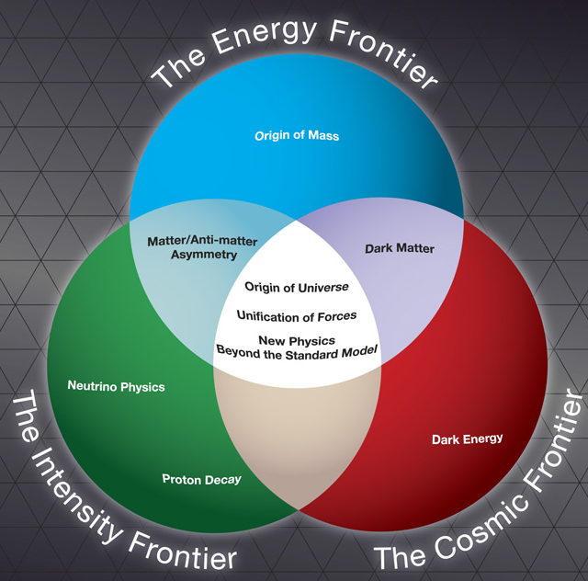
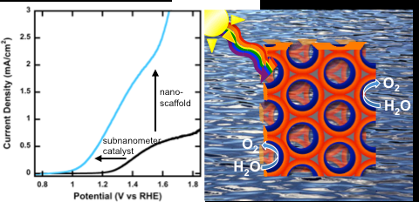
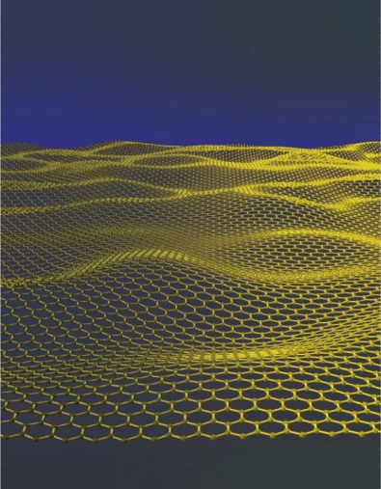
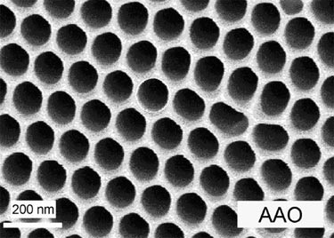
For well designed instruments, material properties often limit measurements and cost
Three examples (there are many more opportunities):
Superconducting RF Accelerators
Channel Plates
Transition Edge Sensors
High payoff, but takes time. Does take
advantage of significant recent synthesis
investment.
Risk can be mitigated with high quality theory and analytical measurement.
Notes:
Material properties limit many important HEP measurements. Material research can lead to transformational improvements in such instrumentation. Proof by anectdote – three material development efforts in which argonne has played a role.
It’s a good time for such an effort since the past decade had seen enormous progress in both materails, understanding and in analysis. This mitigates the risk.

Slide 4
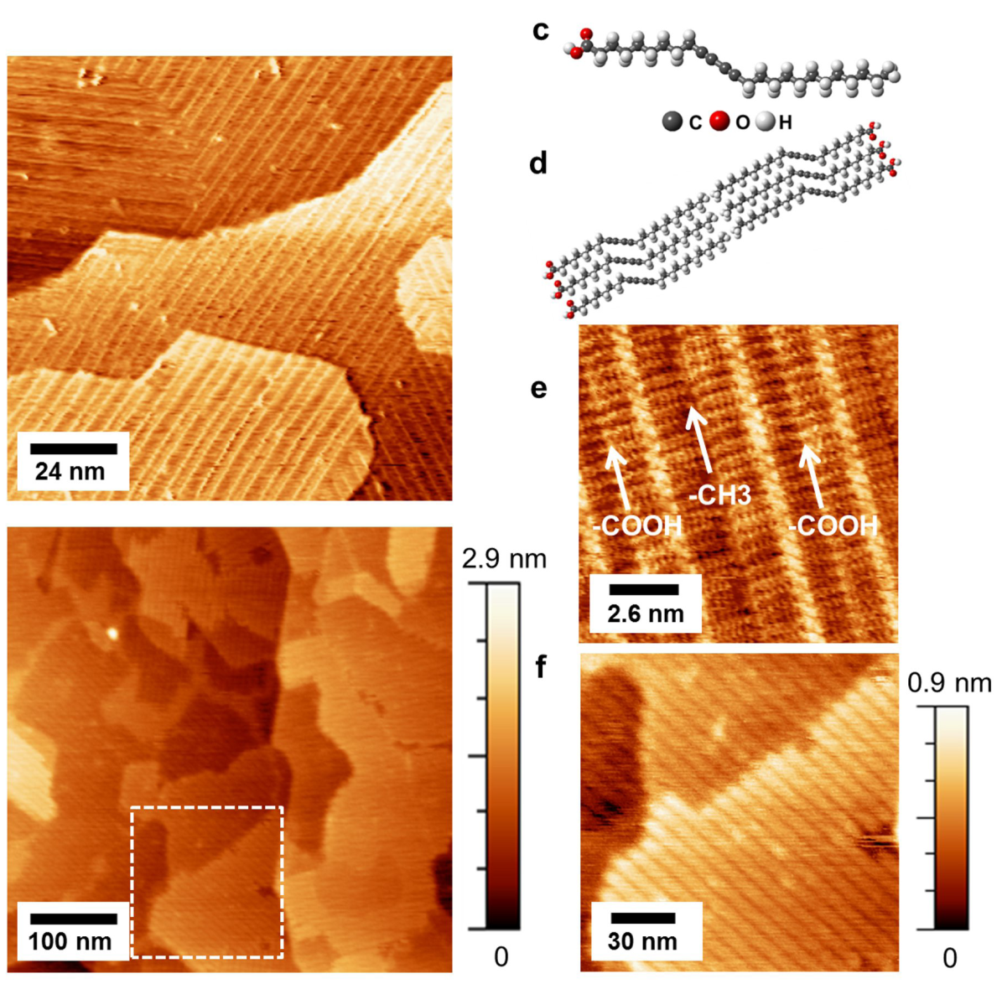
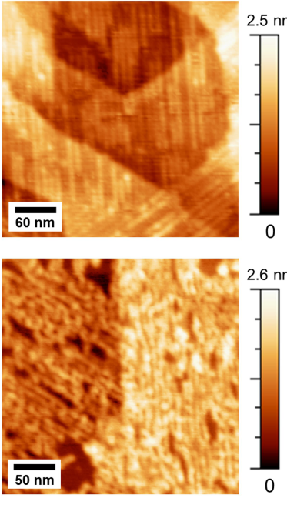
Materials Development is aided by remarkable, new analytical tools
Much of the risk is mitigated by the use of detailed analytical tools that reveal meso and nanoscale order
Graphene is a remarkable new conductor with wide applicability including as particle detector
Self-assembled monolayer of 10,12-pentacosadiynoic acid (PCDA) on epitaxial
graphene
Molecularly resolved UHV STM image of PCDA/EG
5 Monolayers of Al₂O₃ by Atomic Layer Deposition
Assembly at the nanoscale!
Thinnest capacitor
High conductivity electrodes
High Dielectric Constant Insulator
Alaboson, Sham, Kewalramani, Johns, Deshpande, Chien, Bedzyk, Elam, Pellin, Hersam Nano Letters 2013 in press.
Notes:
Control and analysis of new materials, material forms, and meso scale structures is unprecedented. Facilites exist to be used. Here’s an example of a recent paper that demonstrates to power of these techniques

Slide 5
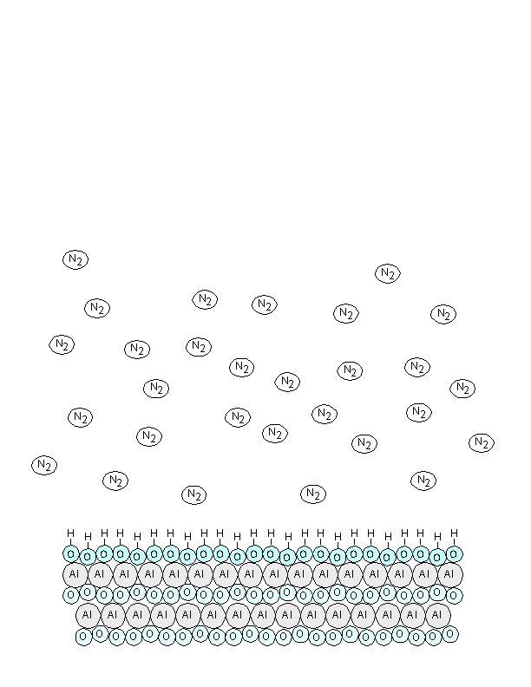
A Short Course on Atomic Layer Synthesis (ALD)
ALD: Alternating surface/molecule rxns
  MOCVD: partly gas phase rxns
  PVD preformed pieces + surface reassembly
Al₂O₃ is the poster child for ALD
A) Al(CH₃)₃+ Surface-OH ->
Surface-O-Al(CH₃) + 2CH₄
B) Surface-O-Al(CH₃) + H₂O ->
Surface-O-Al-OH + CH₄
Sequential Saturated Self-Limiting Surface Reactions
  Exquisite Thickness Control
  No Line-of-Sight Dependence
  Low Temperature Fabrication
Notes:
Atomic Layer Deposition is a technique (we started working with it 10 years ago) that lhas gained wide acceptance rapidly. It has many unique aspects, among them is an inherent scalabilty.

Slide 6
Atomic Layer Deposition of ZnO Films
A)
Diethyl Zinc
(DEZ)
CH₃CH₃
ZnCH₂CH₃
OH
Zn(CH₂CH₃)₂
O
B)
Water
OH
CH₃CH₃
ZnCH₂CH₃
H₂O
Zn
O
O
ZnO ALD Monitored Using
In Situ Quartz Microbalance
ZnO ALD Thickness Measured Using Ex Situ Stylus Profiler
Growth Occurs in Discrete Steps
Superb Thickness Control
ZnO Thickness (Å)
ZnO Thickness (Å)

Slide 7
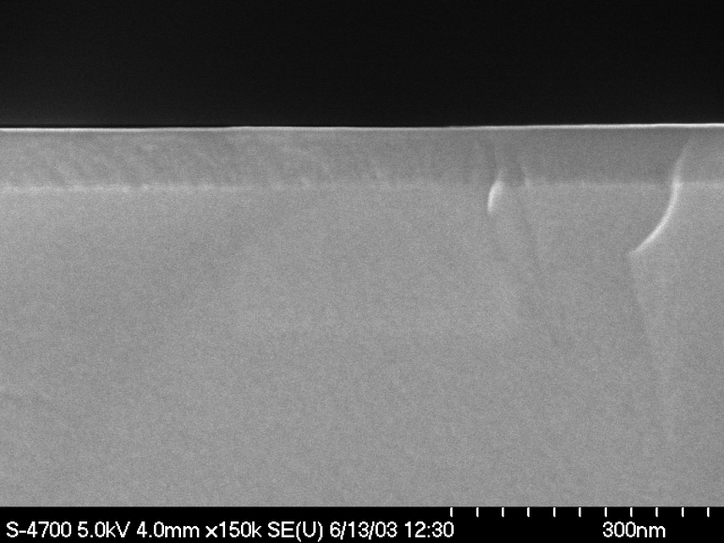
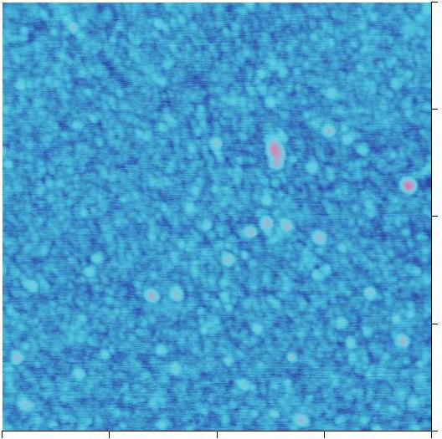
ALD Al₂O₃ Films
SEM
4000
Ellipsometry
ALD Al₂O₃
Si(100)
3000
Thickness (Å)
2000
1000
Growth Rate =
1.29 Å/Cycle
1.0 μm
0
AFM
0
1000
2000
3000
AB Cycles
0.75
ALD Film Properties:
Thickness linear with AB Cycles
Very flat and conformal
Extremely smooth
RMS roughness independent of Cycle #
0.50
0.25
RMS=3 Å
0.75
0
0
0.25
0.50
1.0 μm

Slide 8
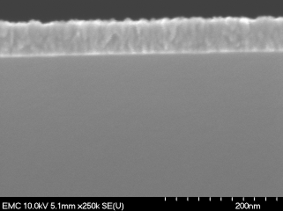
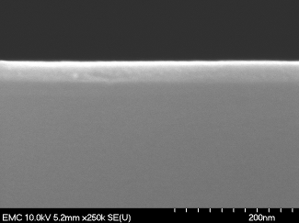
Controlling ZnO ALD
DEZ + Ozone → ZnO
ZnO
ZnO (100)
Si
150°C
250°C
150°C
ZnO
100°C
Si
50°C
50°C
Smooth, amorphous ZnO at 50°C
Martinson, A. B. F., J. W. Elam, J. T. Hupp and M. J. Pellin (2007).
"ZnO Nanotube Based Dye-Sensitized Solar Cells." Nano Lett. 7(8): 2183-2187.

Slide 9
Demonstrated ALD Reactions
Oxide
Nitride
Element
S/Se/Te
Ph/As
C
F
Dopant

Slide 10
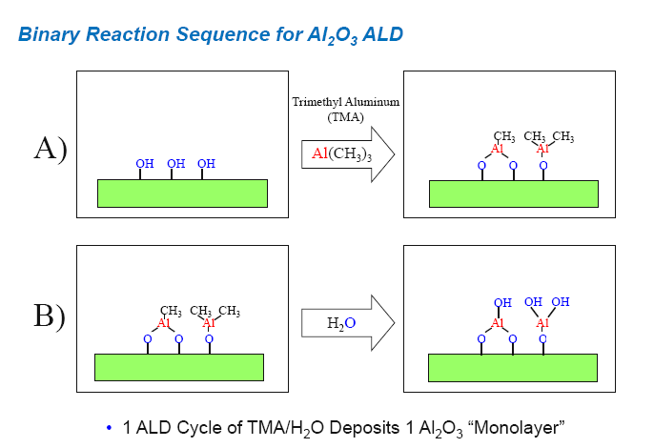
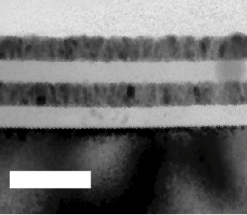
ZnO
Al₂O₃
ZnO
Al₂O₃
100 nm
Argonne workshop: Bar Ilan University-Oct 2010

Slide 11
NbSi in Silicon High Aspect Ratio Trench
ALD is very good at coating non-planar surfaces

Slide 12
For well designed instruments, material properties often limit measurements and cost
Three examples (there are many more opportunities):
Superconducting RF Accelerators
Channel Plates
Transition Edge Sensors
High payoff, but takes time.
Risk can be mitigated with high quality theory and analytical measurement.

Slide 13
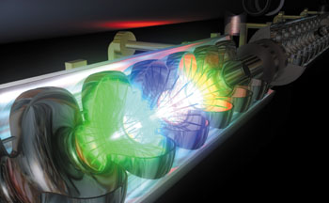
Superconducting Radio-Frequency (SRF)
SRF Cavity Needs:
Higher Gradients, Currents
Lower operational costs
  Operating Temperature
  Dissipation
Lower Capital Costs – Nb, fabrication, etc.
RF electromagnetic field inside the cavity:
screening currents -> dissipation
-> performance
Performance limitations: fundamental understanding of dissipation mechanisms.
Atomic Layer Deposition: synthesizing new materials and application to RF cavities.

Slide 14
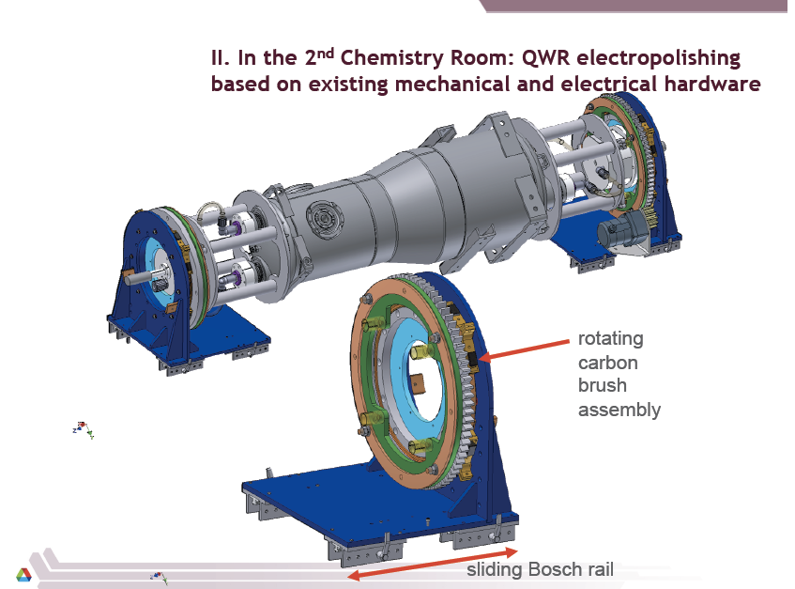

SRF Locally

Slide 15
Niobium surfaces are complex, important, and currently poorly controlled at the nm level
Inclusions,
Hydride precipitates
Surface oxide
Nb₂O₅ 5-10 nm
Residue from chemical processing
45 nm
RF depth
Interface: sub oxides NbO, NbO₂
often not crystalline
(niobium-oxygen “slush”)
Interstitials dissolved in niobium (mainly O, some C, N, H)
e⁻ flow only in the top 45 nm
Clean niobium
Grain boundaries
Probe the surface superconductivity
SRF film workshop-Oct 2010

Slide 16
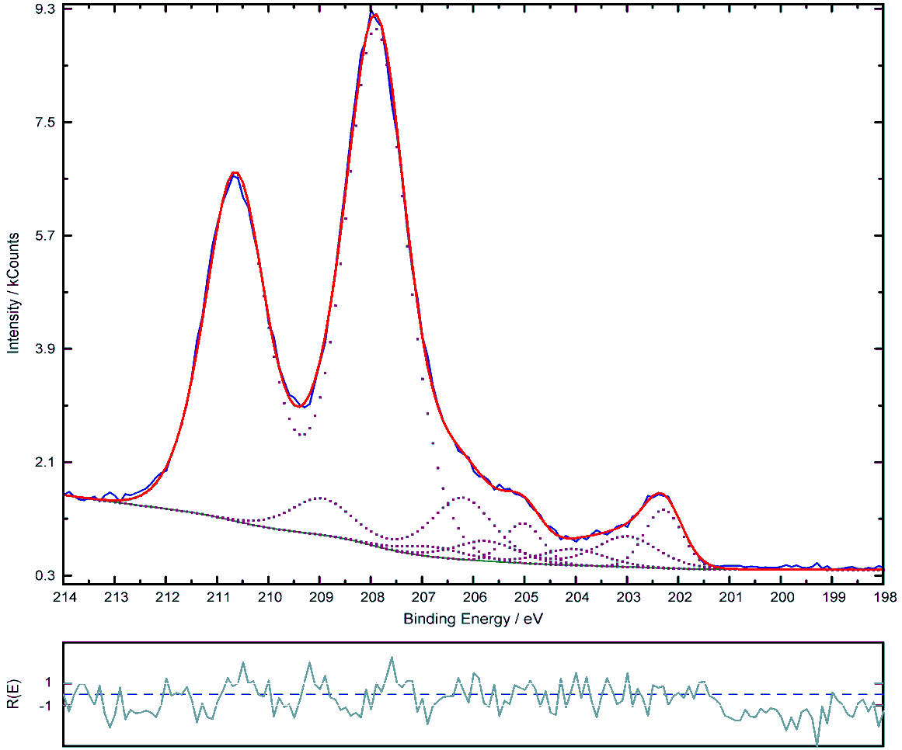
XPS - a Surface Probe of Nb Oxidation
Dielectric Nb₂O₅
Nb₂O_{5-δ}, NbO_{2-δ} are antiferromagnetic
NbO_{x} (0.2 < x < 2) is
Metallic
NbO_{x} precipitates
(0.02 < x < 0.2)
Nb₂O₅
NbO_{x}
Nb
Cavity Grade, electro-polished
Large-grain Nb sample coupons
SRF Cavities despite processing have complex oxide surfaces
Many of these oxides are electronically active.
Mike Pellin

Slide 17
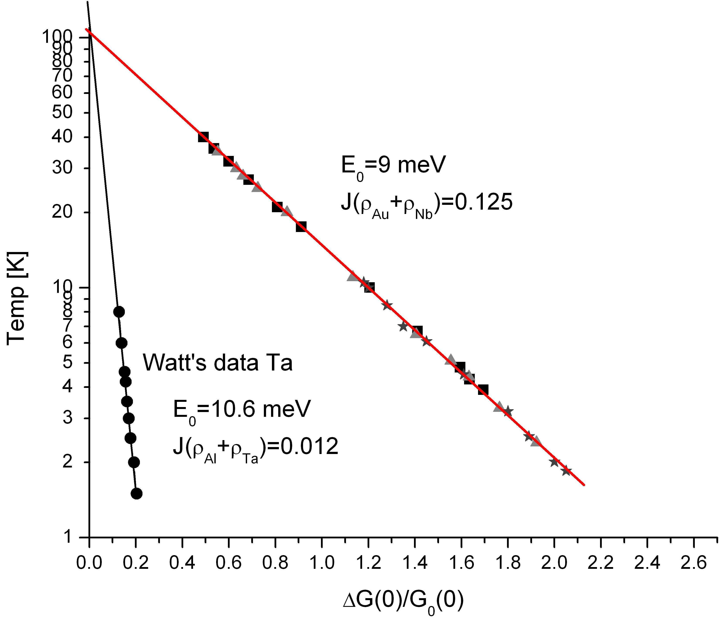
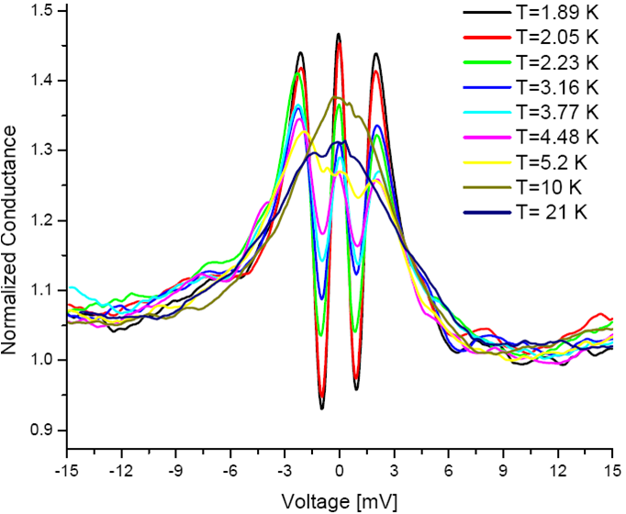
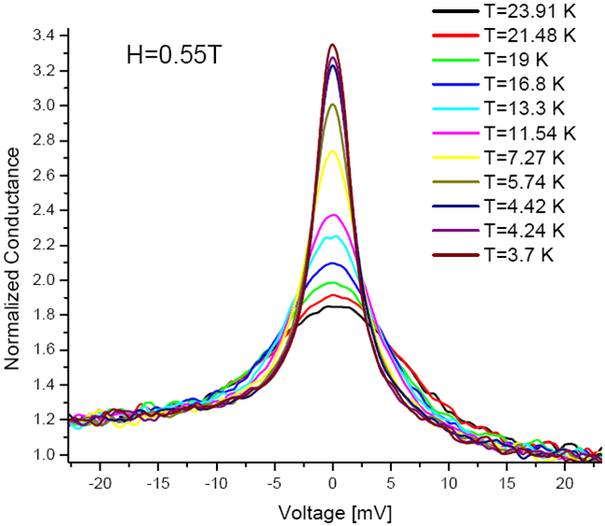
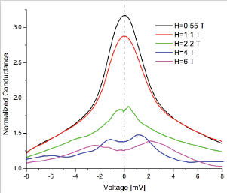
Measure of the surface superconductivity: Point contact
Shiba theory
fits with Appelbaum theory ->
Magnetic impurities in the oxides
J>0 -> antiferromagnetic coupling
-First time measured on Nb oxides
Δ=g.µ _{B} .H -> g = 3.5
0.1-0.2% of magnetic impurities

Slide 18
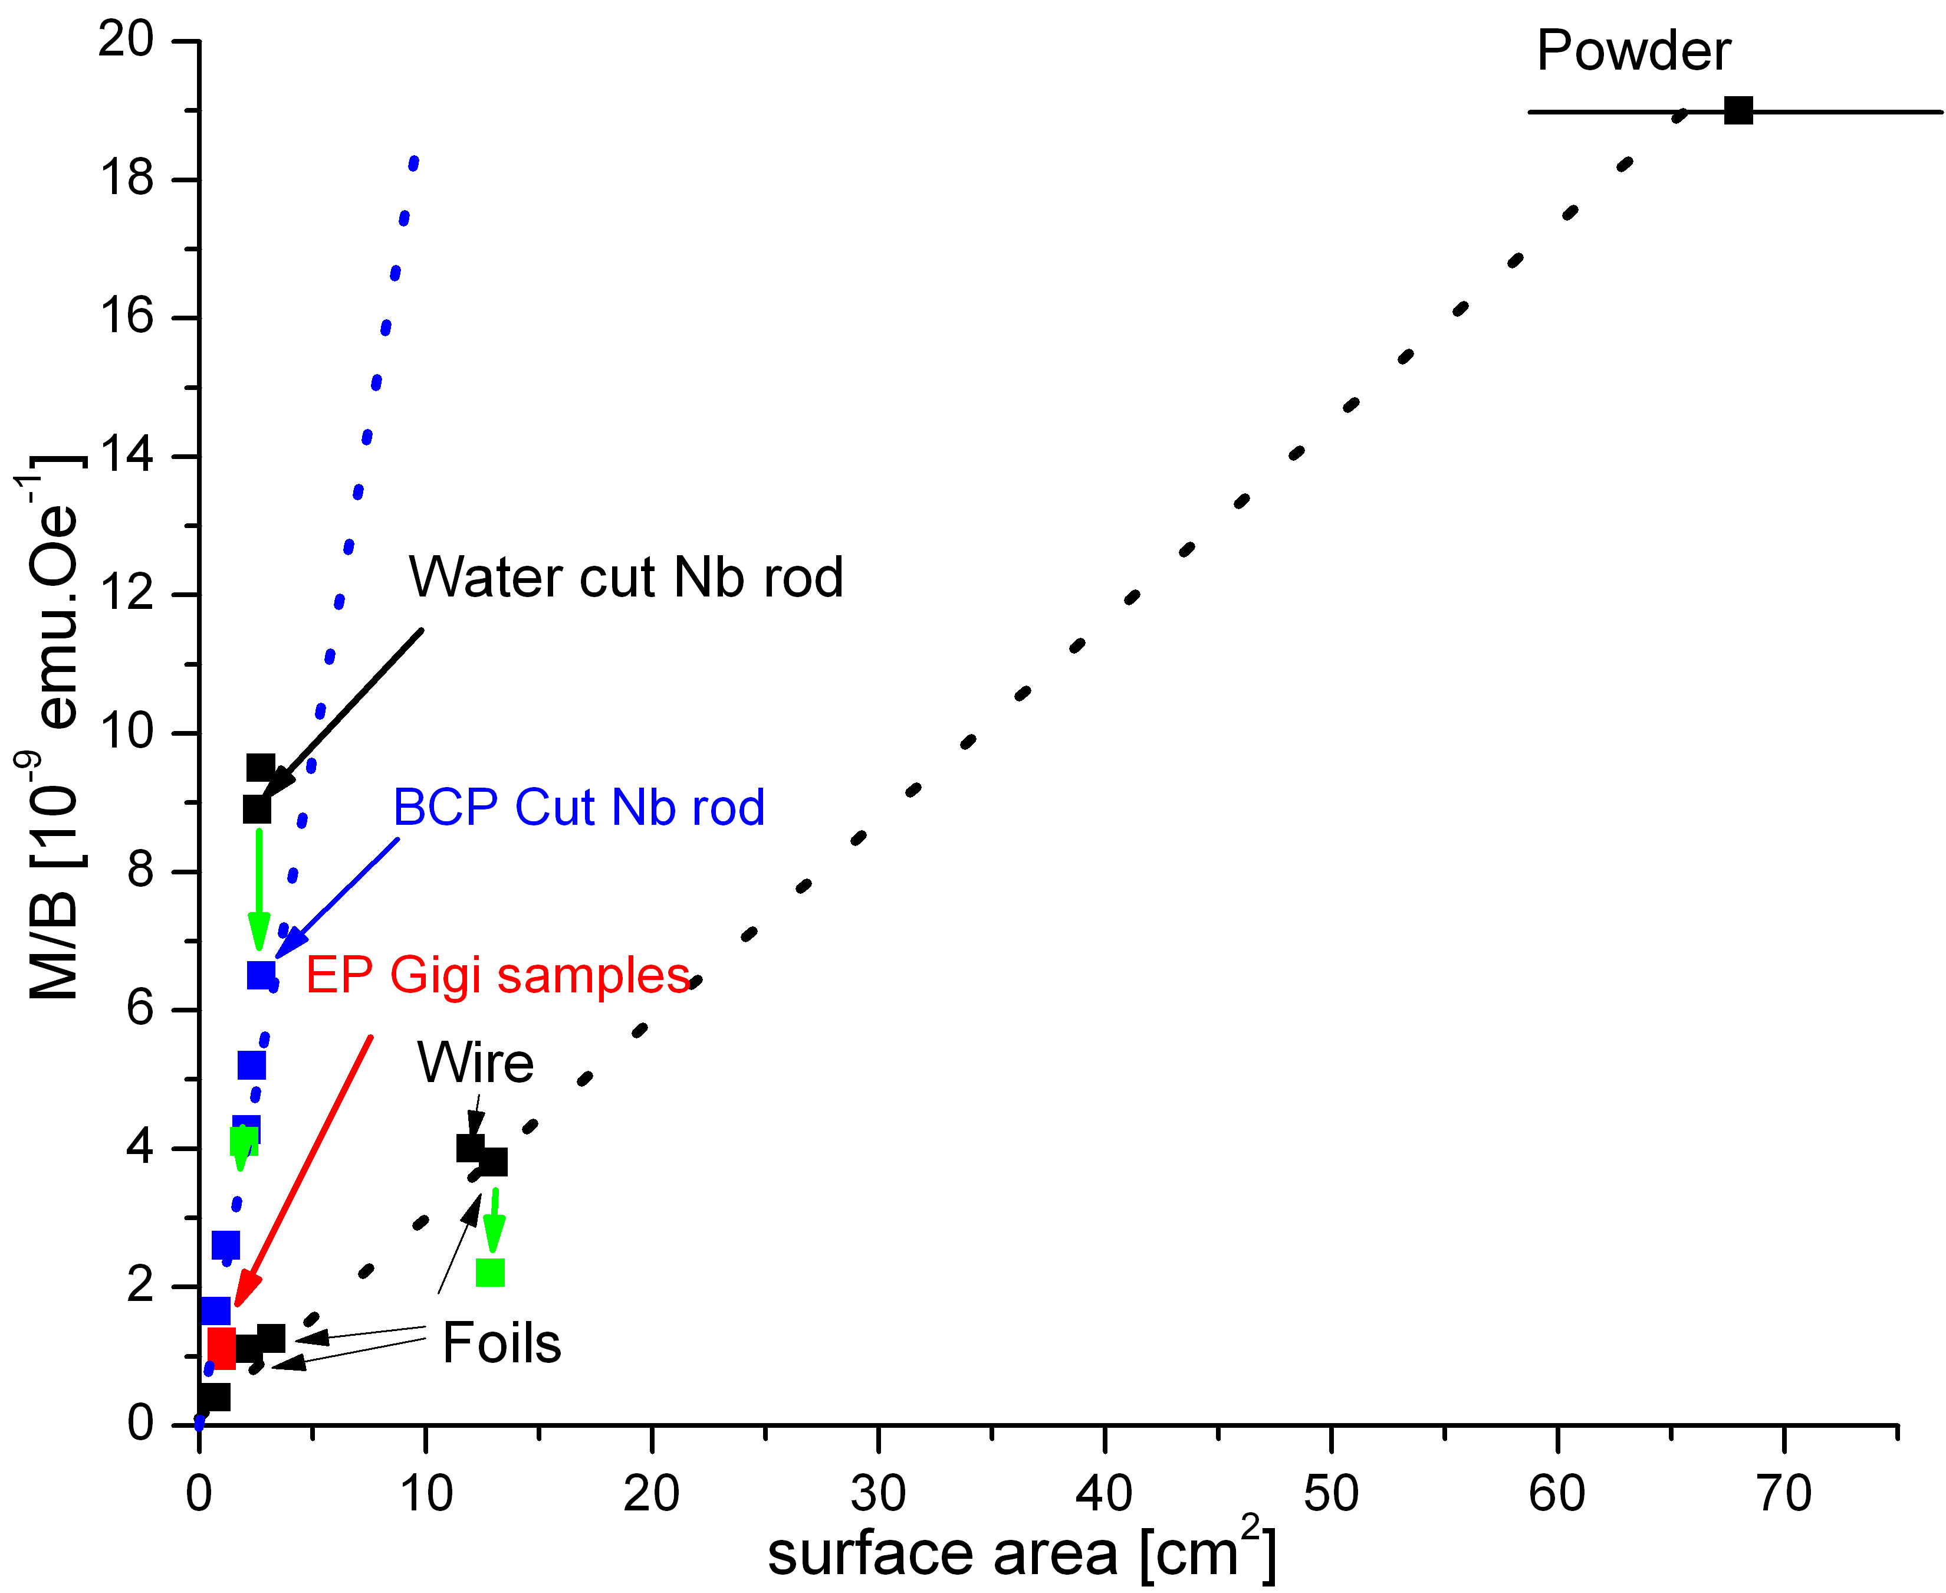
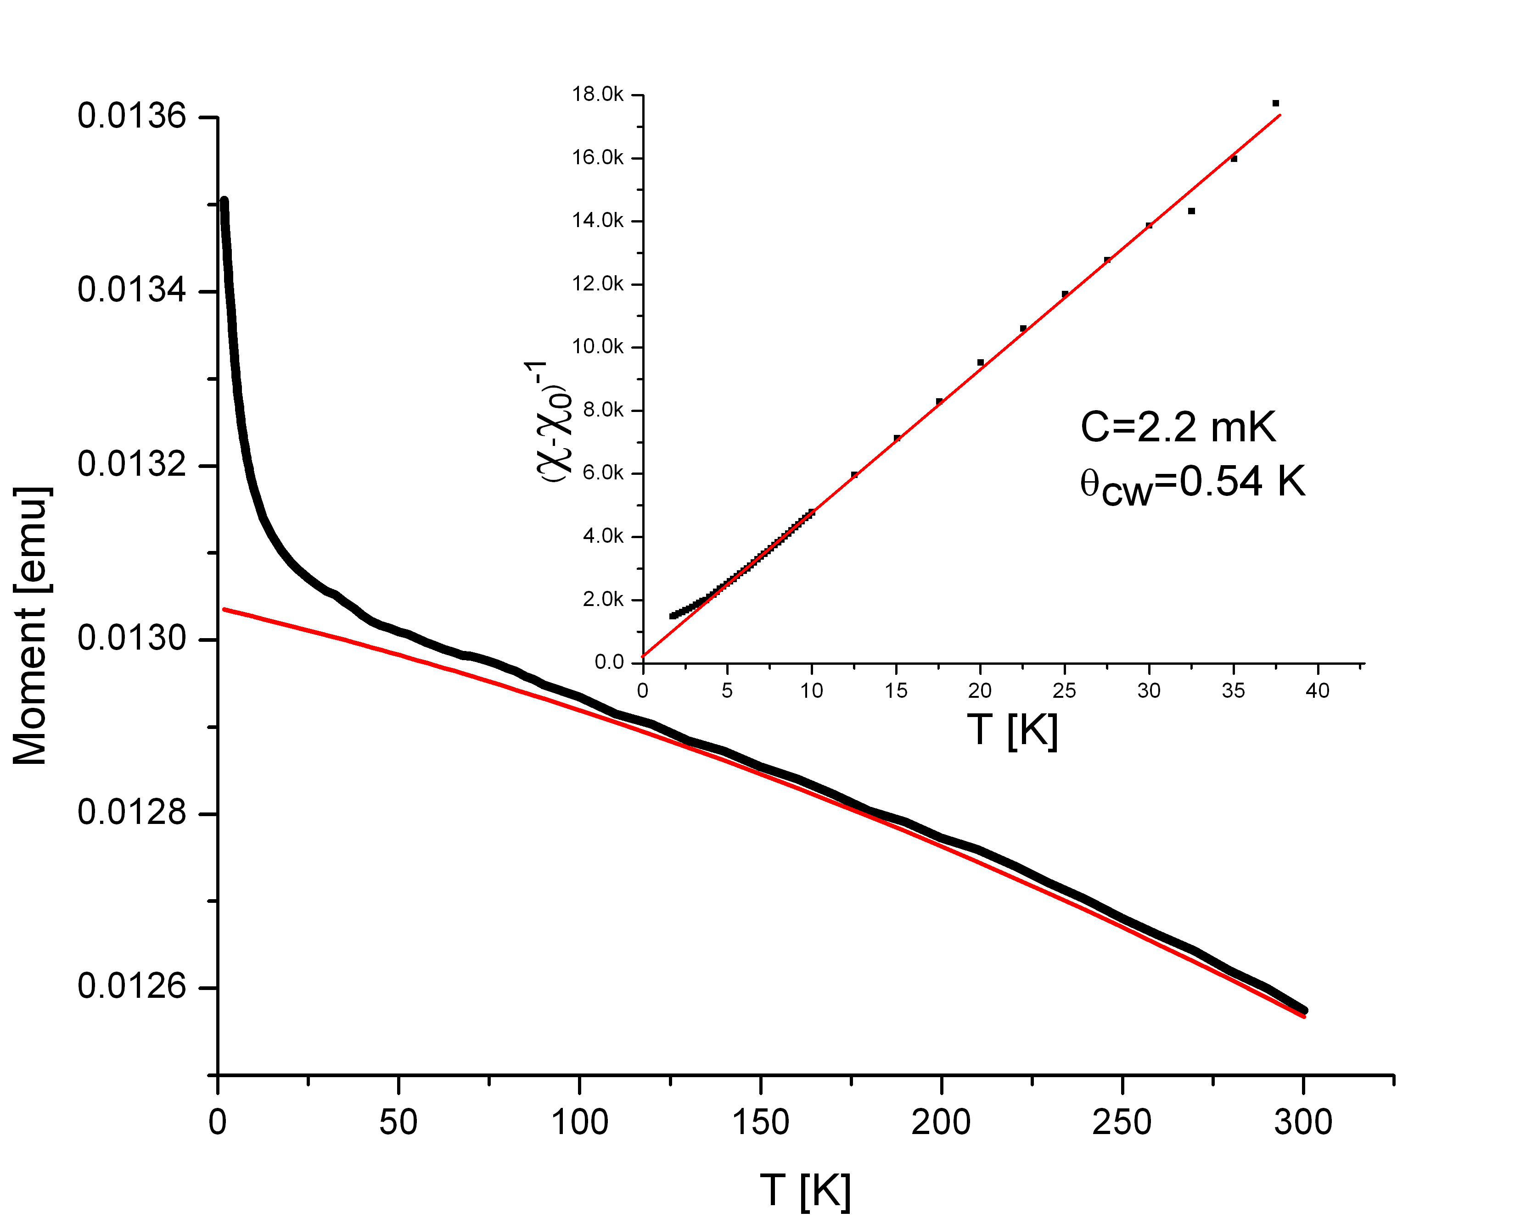
Experimental evidences of Magnetism:
Superconducting Quantum Interference Device (SQUID)
χ= χ₀ + C/(T+ θ_{CW})=M/(B.Vol)
Background: Pauli term χ₀[T]
Linear dependence-> surface magnetism:
0.8% of magnetic impurity.

Slide 19
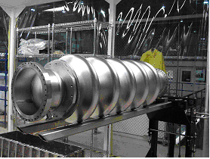
ALD is a precision synthetic method whose properties allow scaling!
Superconducting RF (SRF) provides efficient, high-gradient accelerators at high duty-factor.
SRF accelerator cavities are a success story.
Key SRF Parameters: gradient and Q

Slide 20
A Simple Test?
A Nb cavity coated by a single Nb₃Sn
layer of thickness d = 50nm and an
insulator layer in between
If the Nb cavity can withstand H_{i} = 150mT,
then the external field can be as high as
H₀ = 324mT
H_{i} = 150mT
Nb
d
Lower critical field for the Nb₃Sn layer with d = 50 nm and ξ = 3nm: H_{c1} = 1.4T is much higher than H₀
A single layer coating more than doubles the breakdown field with no vortex penetration, enabling E_{acc}∼ 100 MV/m

Slide 21
The basis to build new cavity layered structures that allow transformationally higher gradients is set
Layered structures raise the critical magnetic field at which vortex losses form.
ALD allows fabrication of such structures with atomic scale precision without regard to aspect ratio of the object.
We need to develop ALD synthetic chemistries for superconducting material growth (expect plasma ALD to help)
Al
Nb
Nb
NbTiN
NbTiN
NbTiN
AlN
AlN
AlN
AlN
Accomplishing this goal would also allow using the narrow current flow region to advantage. Layered structures with Al cavities for instance.

Slide 22
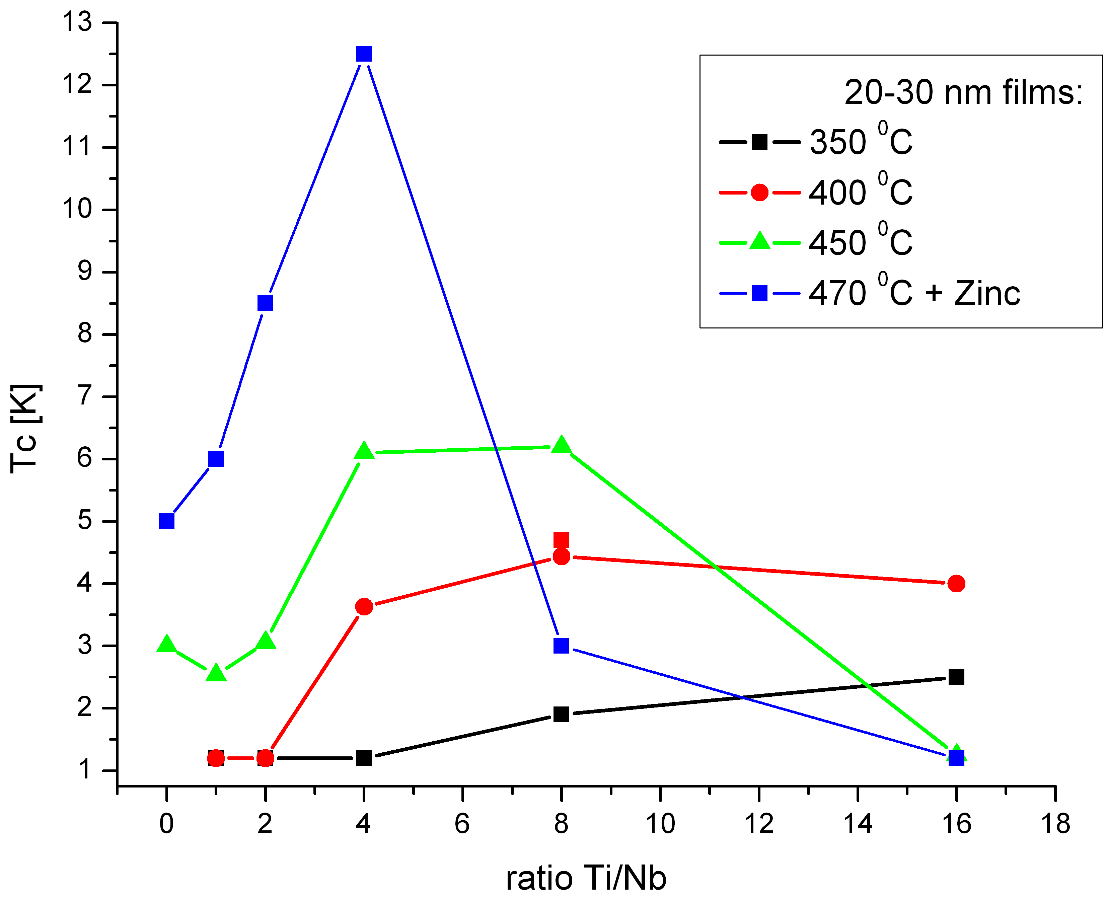
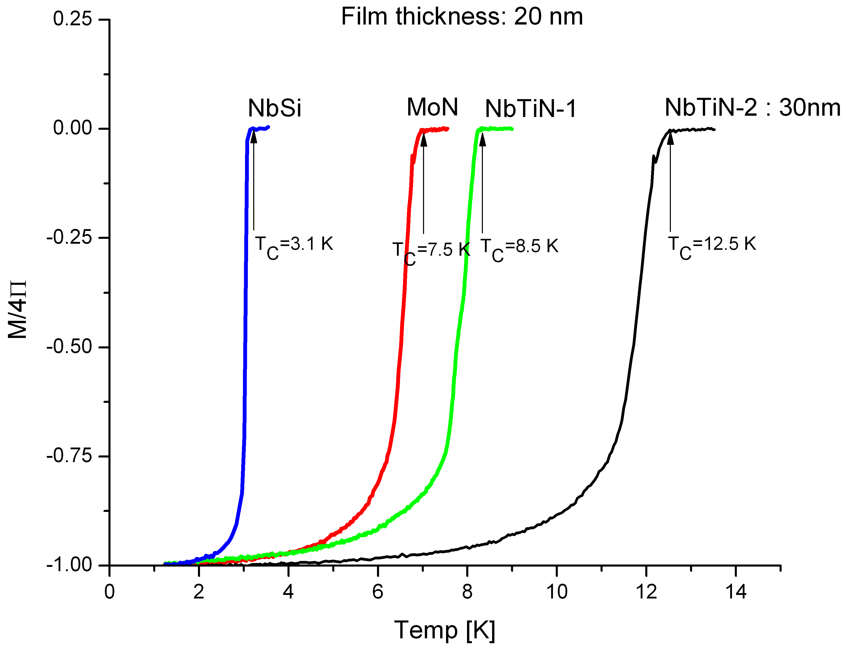
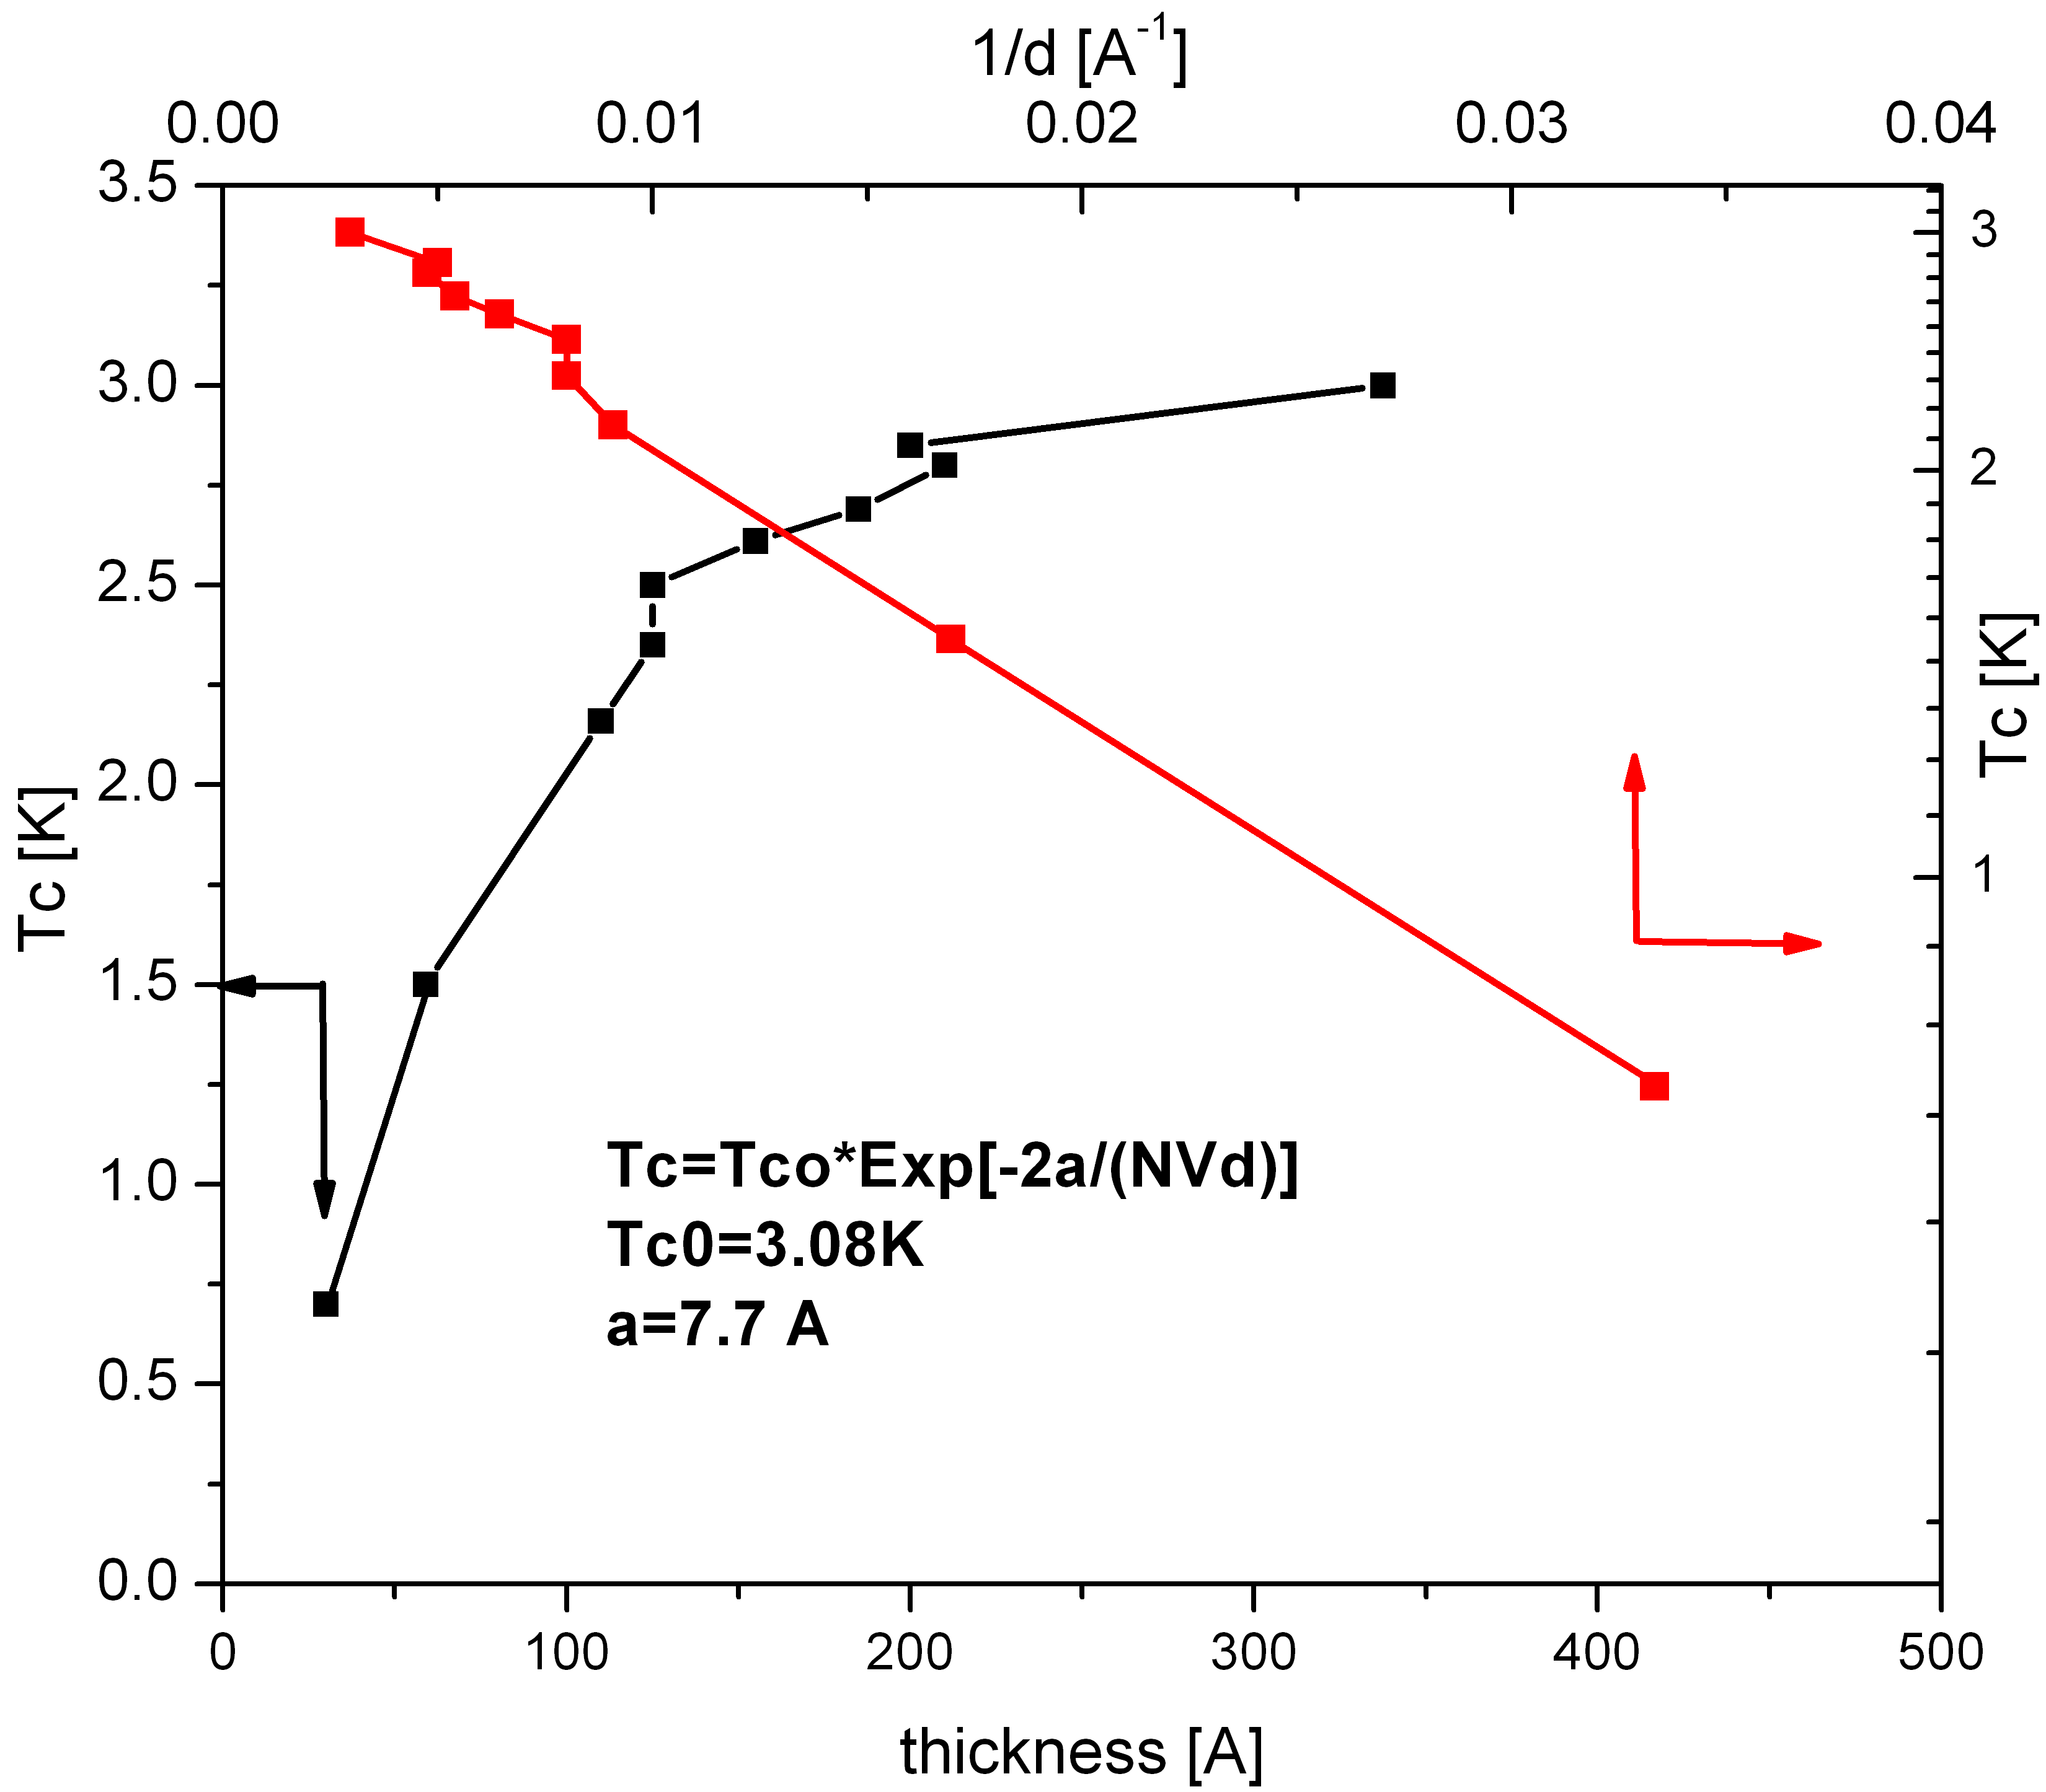
ALD survey results:
Superconducting properties homogeneous > 50 cm
Tune Tc with the film thickness & chemical composition
-> bolometers
New compounds: MgB₂ and Pnictides
New precursors and chemistry.
Fundamental investigation of “2D” supercond. films:
Ch. Strunk, V.Vinokur
-> Super-Insulators
Argonne workshop: Bar Ilan University-Oct 2010

Slide 23
Status
SRF ALD Cavity Coating Facility Operating
Test coupon structures
  Exhibit improved lower critical fields (first material to extend Nb’s lower critical field)
  Coupons show low RRR
First Cavities have been coated
  Initial shake out
  Waiting for
Opportunities
  Extension to High Tc materials (H_{c1}->H_{c})
  Non Nb base materials

Slide 24
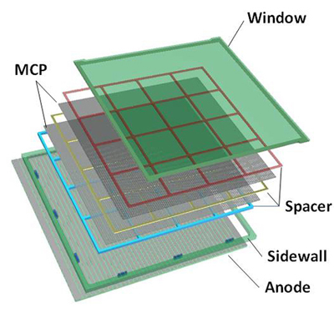
For well designed instruments, material properties often limit measurements and cost
Three examples (there are many more opportunities):
Superconducting RF Accelerators
Microchannel Plate Detectors
Transition Edge Sensors
H. Frisch & LAPPD group

Slide 25
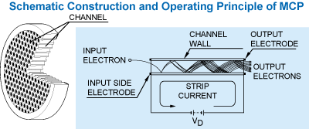
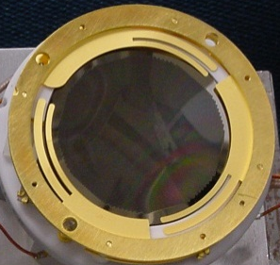
Microchannel Plate Detectors
History
  Built in the late 1960’s for low light imaging (night vision)
  Remarkable Performance
    10⁶⁻⁷ gain
    Dark Count <10 per minute
  Leaded Glass tubes are continually stretched to produce an array of 10 μm holes
Essentially no change in design since then
Issues
  Cost –> $10K/cm²
  Limited Size

Slide 26
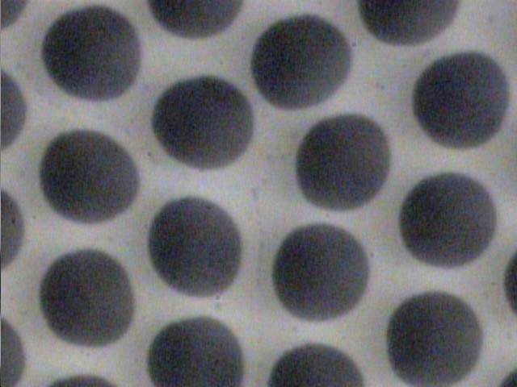
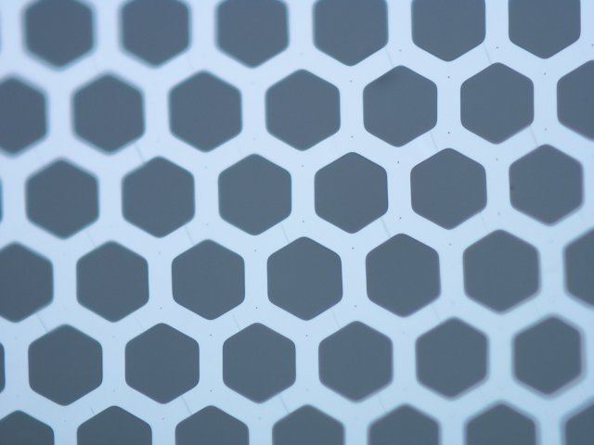
New Detectors, Old Geometries
Incom Glass Substrate
Inexpensive
higher open area
Conventional Pb-glass MCP:
Current design
10-20 μm
Chemically produced and treated Pb-glass does 3-functions:
Provide pores
Resistive layer supplies electric field in the pore
Pb-oxide layer provides secondary electron emission
Separate the three functions:
Hard glass substrate provides pores;
Tuned Resistive Layer (ALD) provides current for electric field
Specific Emitting layer provides SEE

Slide 27
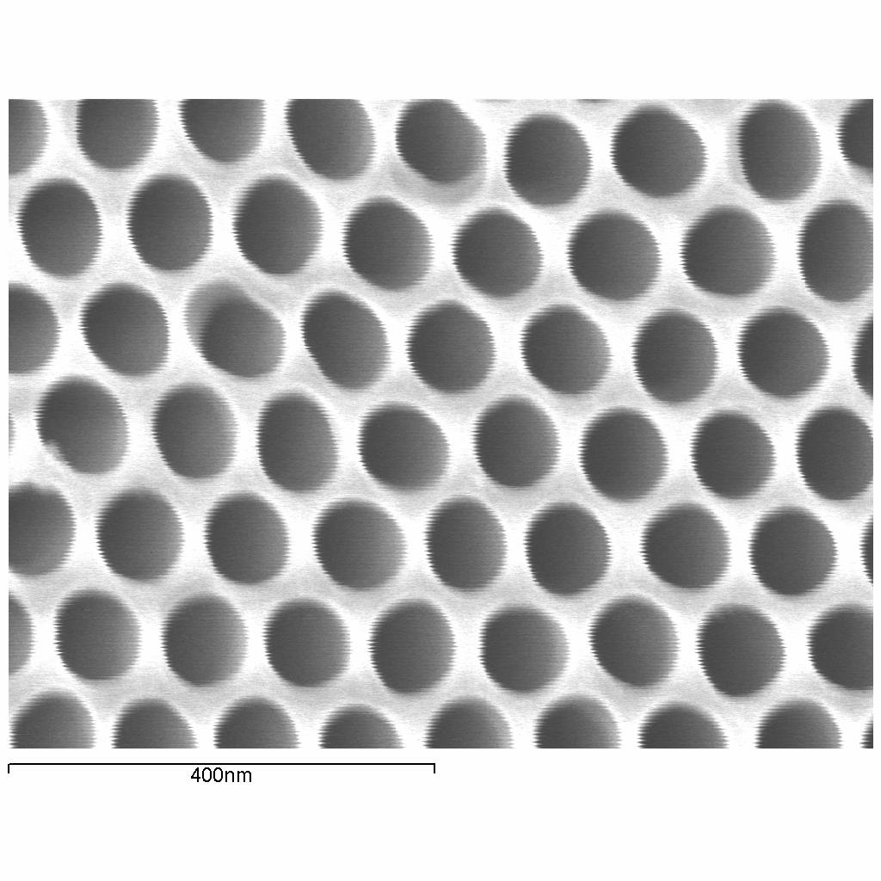
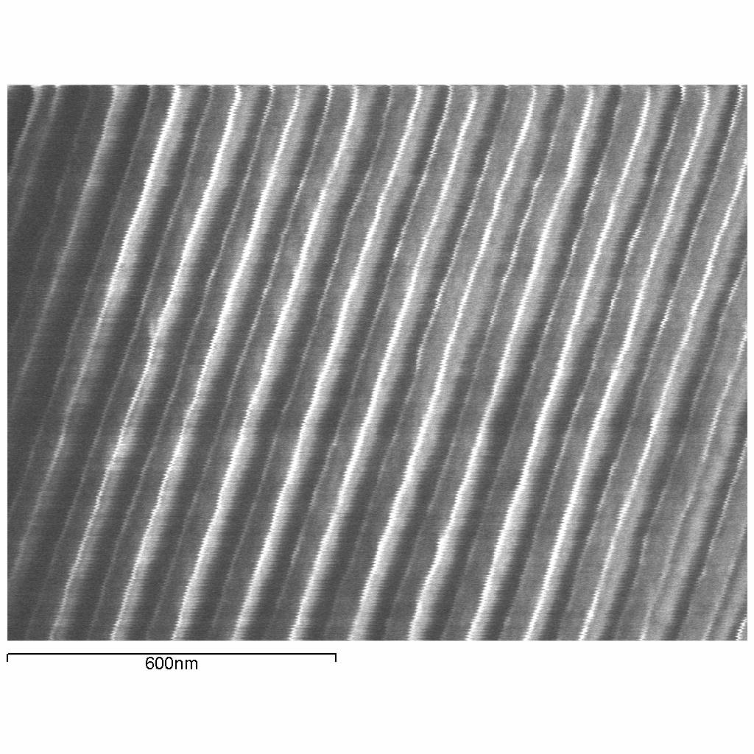
Taking Advantage of Saturating, Self-Limiting:
Functionalizing the insides of stuff
Anodic Aluminum Oxide (AAO)
30 to 100 um thick
Pore spacing ~ 100 nm, pore size ~ 80 nm
Vary pore size with controlled acid etch

Slide 28
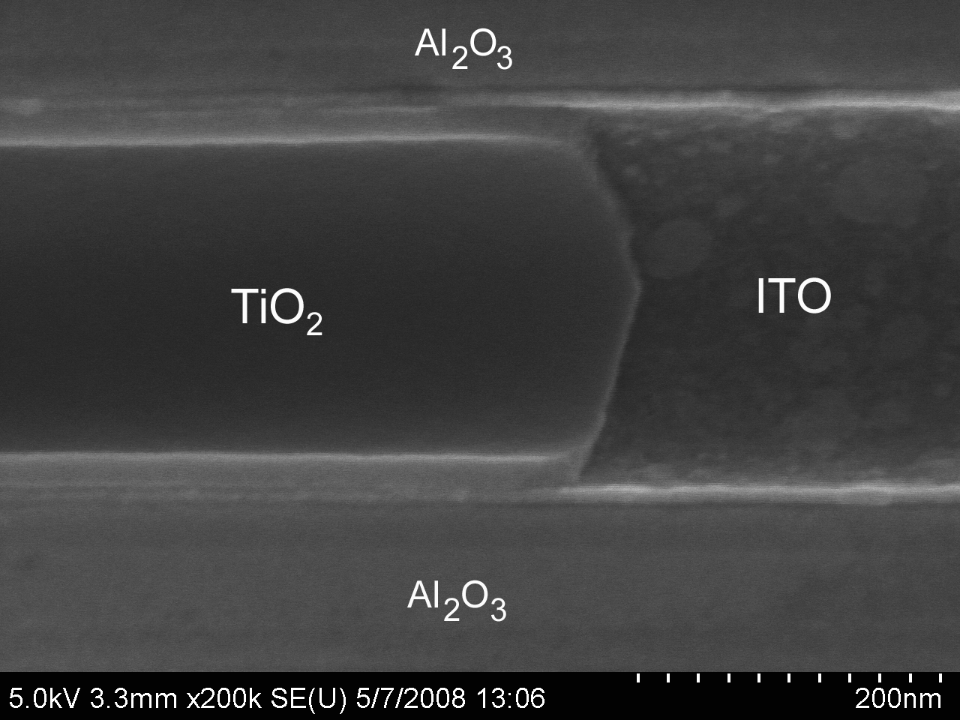
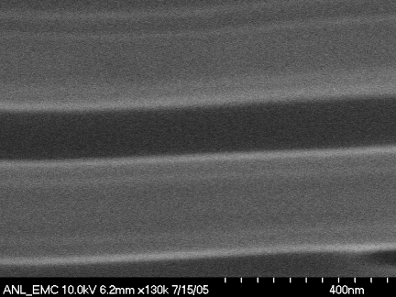
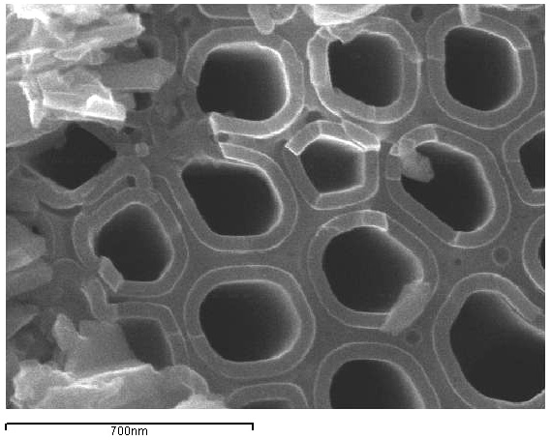
Combining AAO and ALD
Conformal deposition of a wide variety of metals and metal oxides
Extraordinary control over layer thickness
pore
TiO₂
Al₂O₃ pore wall
TiO₂

Slide 29
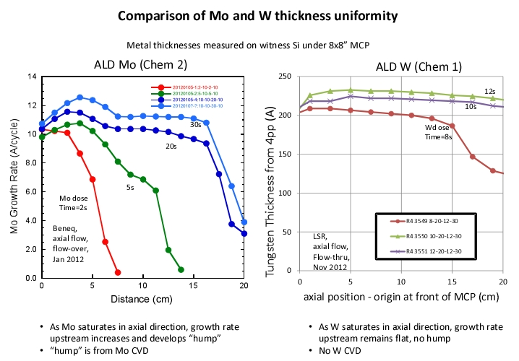

Slide 30
Status
8x8 plates giving high gain and exhibiting exceptional stability – on inexpensive substrates
Uniformity is improving (rapidly now).
Opportunities (now enabled by initial investment)
  Layered structures with improved secondary electron emission
  Graded resistance coatings to enhanced current draw & recovery rate

Slide 31
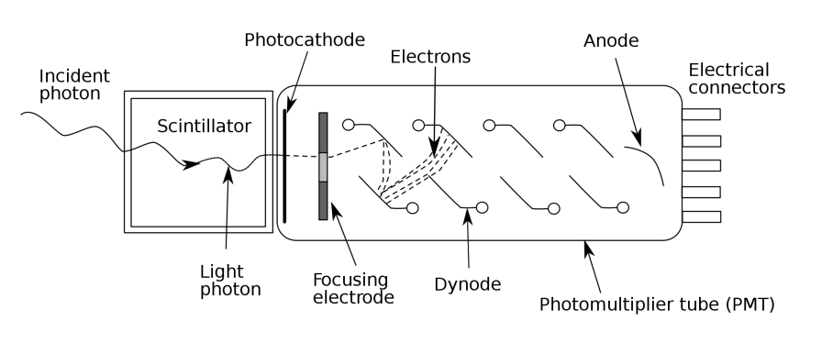
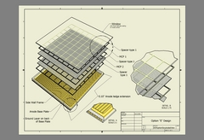

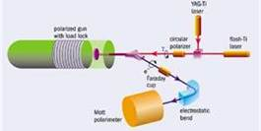
Photocathodes -light-sensitive (negatively charged) electrode that emits electrons
Light Detection
  Quantum Yield (e⁻/photon)
  Timing (phasing) to ~10⁻¹² s
  Signal to Noise
  Always semiconductors
Solar Photovoltaics
  Quantum Yield (e⁻/photon)
  Efficiency (Voltage/photon)
  Angles (scattering)
  Always semiconductors
Accelerators
  Emittance
  Total Charge/cm²
  Metals & Semiconductors

Slide 32
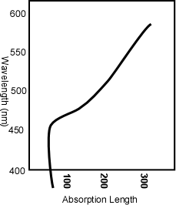
Microchannel Plate Detectors - Photocathodes
Issues
  Efficiency
  Specificity
  Lability
  Cost
Window
Empty States
hν
Φ
No States
Filled States

Slide 33
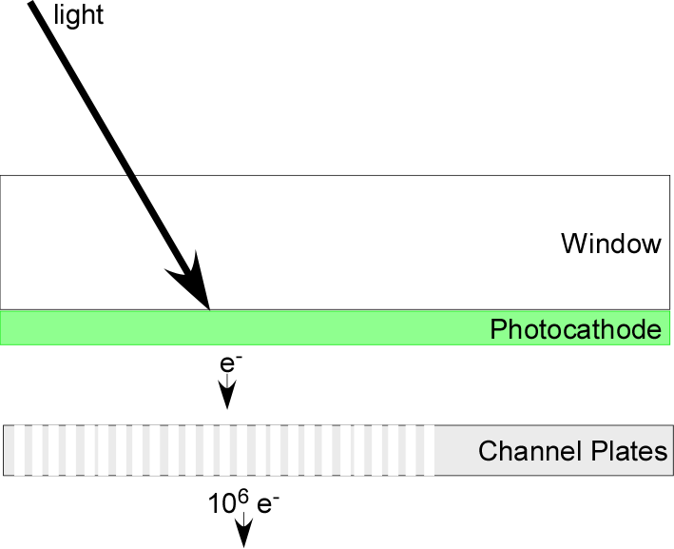
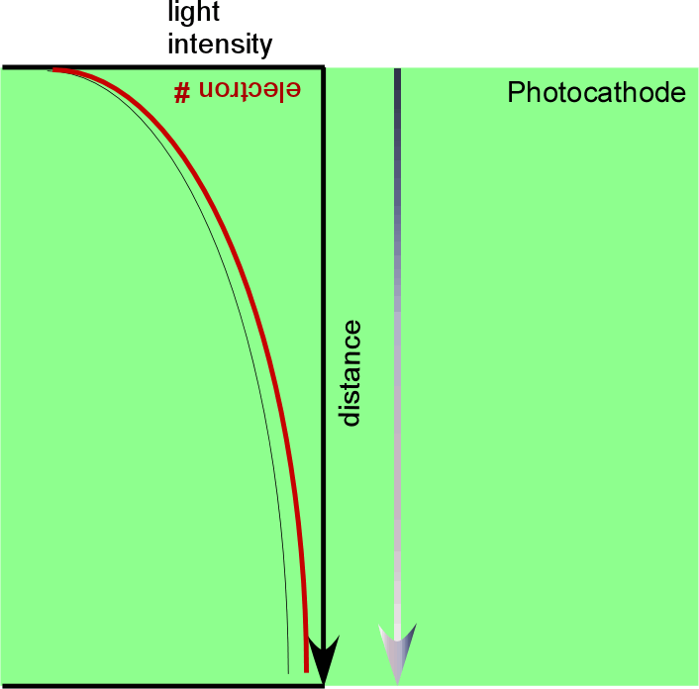
Detector work has many places that new materials & methods can significantly enhance performance
Photocathodes – current status
  Bi-alkali materials
    Best conversion of photons to electrons (still ~30% quantum efficiency)
    Require careful growth control
    Very sensitive to ambient
  Summary: more art than science (expensive!)
Scientific Issue
  Efficient absorption requires photocathode thicknesses of order micron
  Efficient photoelectron harvesting lengths rarely exceed 10 nm’s

Slide 34
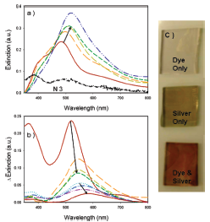

The Problem With Photocathodes –
Photon Absorption Length vs Electron escape depth
Key Factors in optimizing Cathode Efficiency
Window should be transparent
Photocathode should absorb and produce an electron in the solid
Electron should be close to the surface
Surface work function should allow the “excited” electron to escape (but not all the rest of the electrons.
1 monolayer dye
Window
Empty States
hν
Φ
No States
Filled States

Slide 35
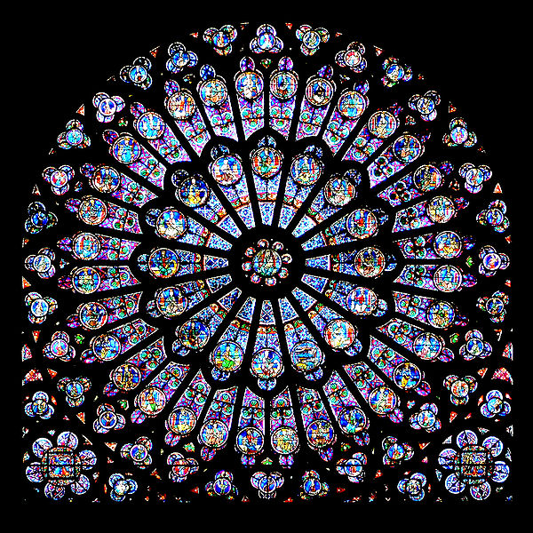
Plasmon – What is it?
In a conductor, the free electrons move around the fixed ionic cores to cancel externally applied fields.
Oscillatory fields like light waves have resonance conditions. These conditions dominate the absorption properties of good metals.
The proper resonance conditions depend of particle size or surface features.
For visible light this is <400 nm.
Gothic stained glass rose window of Notre-Dame de Paris. The colors were achieved by colloids of gold nano-particles

Slide 36
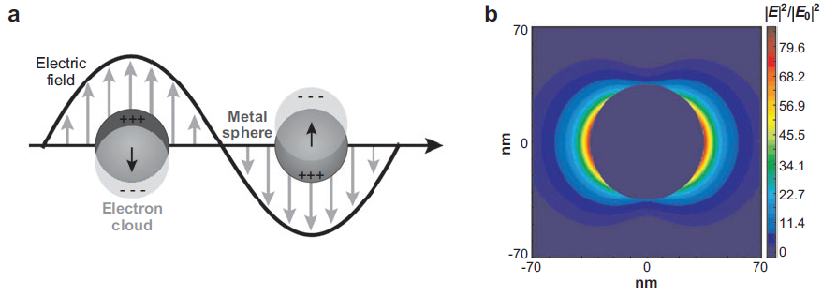
Surface Plasmon – 35 nm Ag Particles
Illustration of the localized surface plasmon resonance effect.
Extinction efficiency (ratio of cross section to effective area) of a spherical silver nanoparticle of 35-nm radius in vacuum |E|² contours for a wavelength corresponding to the plasmon extinction maximum. Peak |E|² = 85.

Slide 37
Plasmonics with particles
1 monolayer dye
No polarization or angle dependence
Color dependence controlled by particle size
AgCl solution bubbled with H₂
Dye Absorption
Spectrum
Dye Absorption
Spectrum with 20 nm Ag

Slide 38
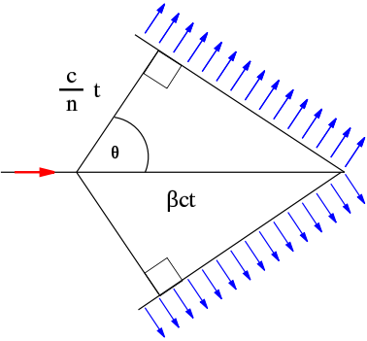


Surface Polarized Plasmons (SPP’s) – a method to use the specific properties of Cherenkov Radiation
Resonance Conditions for flat films (momentums must be matched)
An aligned detector will only produce signal from a specific source angle

Slide 39



Modeling
Standard transfer matrix approach for stratified media (Matlab)
Ellipsometry allows for accurate determination of optical constants
ALD enables sub-nanometer thickness control
Predicts up to 33% EQE with ZnO or 25% with TiO₂ using conventional Ru-dye

Slide 40

Does it work?
Predicted (lines) and measured (symbols) photoelectrode reflectance as a function of illumination angle at several stages of device fabrication: Glass/silver (green), glass/silver/ZnO (blue), and glass/silver/ZnO/dye/electrolyte (grey).
Lessons learned:
Must be exquisitely flat
No strike
Need to carefully control all dielectrics
As little AgO as possible

Slide 41



Does it work?
Yes, for ZnO
EQE = 17% (34×)
V_{OC} = 0.9 V

Slide 42


The main (only) idea to use the unique aspects of Cherenkov light
Reflected 450 nm light
w/out Gold Film
BK7
glass
β = v_{p} / c
Cherenkov Radiation
with Gold Film (50 nm)
Photocathode
hυ-> e-
Ag Particles
Ag Arrays
Ag Films

Slide 43


A photocathode
β = v_{p} / c
e⁻

Slide 44


For well designed instruments, material properties often limit measurements and cost
Three examples (there are many more opportunities):
Superconducting RF Accelerators
Microchannel Plate Detectors
Transition Edge Sensors
High payoff, but takes time.
Risk can be mitigated with high quality theory and analytical measurement.

Slide 45
Transition Edge Sensors
A transition-edge sensor is a thermometer made from a superconducting film operated near its transition temperature Tc.
It is an example of a class of sensors that use the dramatic changes in materials properties around a phase transition to enhance signal level
  milliKelvin temperature changes can lead to large changes in resistance
  Sensitive to any wavelength absorbed
  Ideal for Cosmic Microwave Detection
Volodymyr Yefremenko, Gensheng Wang, Aaron Datesman, John Pearson, and Valentyn Novosad

Slide 46

Perforated approach to the thermal conductance

Slide 47






Design of the Dual-Polarization TES Detector
~5 mm window
Mo/Au proximity effect bilayer TES
Detector in WG mount
E/M simulation

Slide 48

Competencies Required for Success
World-class Science
Staniszewski et al.,”GALAXY CLUSTERS DISCOVERED WITH A SUNYAEV-ZEL'DOVICH EFFECT SURVEY”, ApJ, vol. 701, p. 32, 10 Aug. 2009
Materials Science
APPLICATION: Detectors for the South Pole Telescope!
Low-Noise Superconducting Electronics
Advanced Microfabrication

Slide 49
Transition Edge Sensors – “SOME SPECULATION”
A transition-edge sensor is a thermometer made from a superconducting film operated near its transition temperature Tc.
It is an example of a class of sensors that use the dramatic changes in materials properties around a phase transition to enhance signal level
  milliKelvin temperature changes can lead to large changes in resistance
  Sensitive to any wavelength absorbed
  Ideal for Cosmic Microwave Detection
Valerie Vinokur, T. Baturina

Slide 50
SUPERCONDUCTOR – SUPERINSULATOR DUALITY
Ψ=|Ψ|exp(iφ)
Wave function of superconducting electrons
|Ψ|²=N_{s}
Uncertainty principle: ΔN_{s}Δφ≥1
One can find a way of fixing the
uncertainty in charge over all the
system breaking the phase loose (via the macroscopic
Coulomb blockade): the charge flow
Is blocked: superinsulation
In a superconductor the phase is
fixed: Δφ=0, charge is undefined
and flows without expending
energy
In a metal the phase fluctuates
V. Vinokur, T. Baturina, et al
Nature 452, 613 (2008).
Existence of superinsulation inevitably follows
from the existence of superconductivity

Slide 51



An Experimental Program in Low Temperature Physics
2D tunable superconducting
weak link systems
Synchronized Andreev Transmission
Resonant transmission occurs at
Voltages V=Δ/e, Δ/2e, Δ/4e, Δ/8e…
Binary logics
N. M. Chtchelkatchev, T. I. Baturina,
A. Glatz, and V. M. Vinokur
Phys. Rev. B 82, 024526 (2010)
Notes:
Superinsulation is an exciting new materials property discovered by a DMSE sponsored research program. Recent work much of it suggested theoretically and recently experimentally verified leads us to believe that this is a rich and exciting endeavor that could grow much more quickly if anchored by an experimental program at Argonne.

Slide 52



transition to superinsulating state
transition to superconducting state

Slide 53
For well designed instruments, material properties often limit measurements and cost
Three examples (there are many more opportunities):
Superconducting RF Accelerators
Channel Plates
Transition Edge Sensors
High payoff, but takes time.
New materials can lead to transformational science!

