Slide 1
Facilities for Detector R&D
Erik Ramberg
Fermilab
9 January, 2013

Slide 2
The spectrum of particle detection in HEP
Energy regimes:
1 meV: ν masses & decay: STJ, MMC
1 eV: astrophysics photometry: TES, CCD, MKID
1 KeV: X-ray physics; dark matter: Pixel Arrays, Crystals
1 MeV: Solar/supernova ν : Water cerenkov, Liquid Scint.
1 GeV: ν osc., rare decays: LAr, Straw tubes
1 TeV: Colliders EW, SUSY: Silicon strips, calorimetry
1 PeV: Cosmic rays: Ground arrays, satellites
Particle species commonly encountered:
Photon, electron, proton, kaon, neutron, muon, neutrino, ‘Phonon’, ‘quasi-particles’, nuclei, ions, etc.
As this shows, particle physics (more than any other field) has an immense reach in energies and particle species to detect. Because of this, the field has had a rich tradition of detector innovation and development.
To support this wide research environment, there must be a corresponding set of test and research facilities.

Slide 3
Types of Facilities Required for Detector R&D
Test Beams
Electron, Photon, Proton, Neutrons, Ions
Irradiation
Gamma, Neutrons, Charged particles
Nuclear reactor test areas
Cryogenic test beds
Liquid Argon, Liquid Helium
High Magnetic Fields
Underground Lab Space
Low Background Counting
Laser interferometry
Metrology
Clean Rooms for Sensor Fabrication
Thin Film Fabrication
Sputtering, Atomic Layer Deposition
Low Mass Mechanical Structures
Engineering and Technical Resources
Support for Simulation of detectors
Test Stand Equipment
Typically modular components, oscilloscopes, etc.
We should try to comprehensively describe the U.S. infrastructure
in each of these areas during (or before) Snowmass

Slide 4
National HEP Lab Facilities Document (developed as part of 2012 DOE detector review)
We should get similar information from all national labs
(Sandia, Los Alamos, ORNL, PNNL, Jefferson, NIST) as well as listing substantial infrastructure at the universities

Slide 5
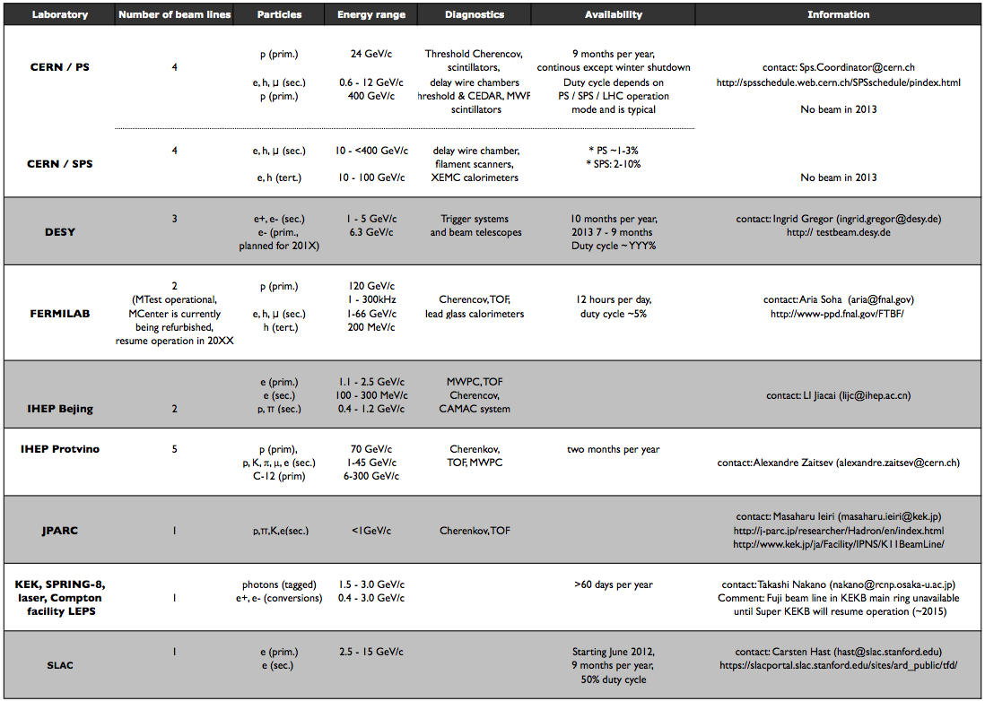
High Energy Charged Particle Test Beams
Test beam is a crucial part of detector testing
Only 2 high energy test beam facilities in U.S.
Experience says that both will soon be fully occupied.

Slide 6
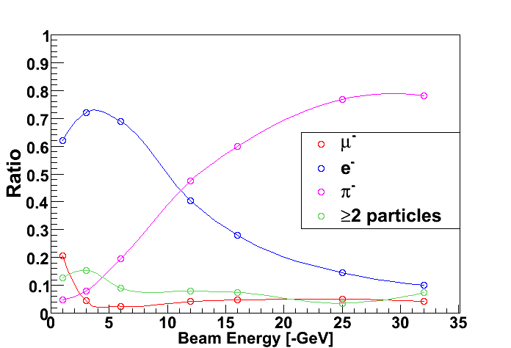
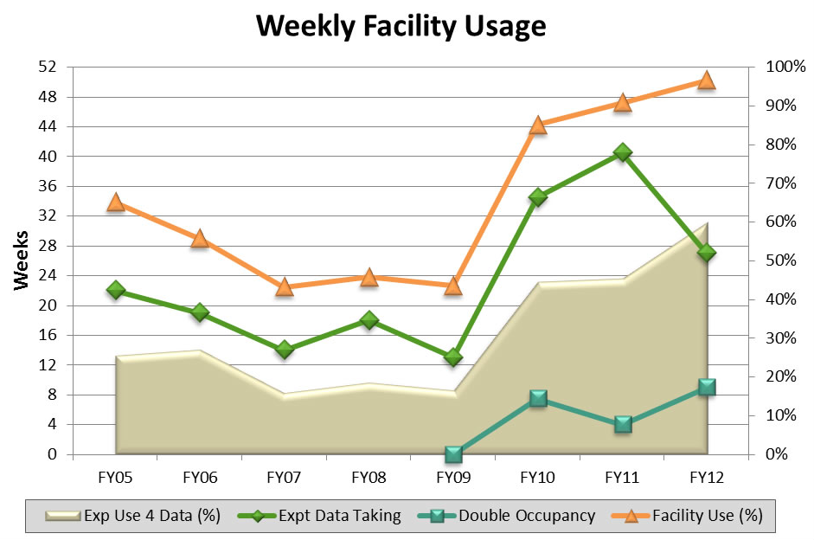
Fermilab Test Beam Facility
Runs off of Main Injector 120 GeV proton primary beam. Primary targets in beamline provide for secondary undifferentiated beam from 1-66 GeV.
Rates are 10 Hz – 100,000 Hz
One 4 second spill per minute, 24 hours a day
Open to all groups who negotiate a Memorandum of Understanding with the various divisions within Fermilab

Slide 7
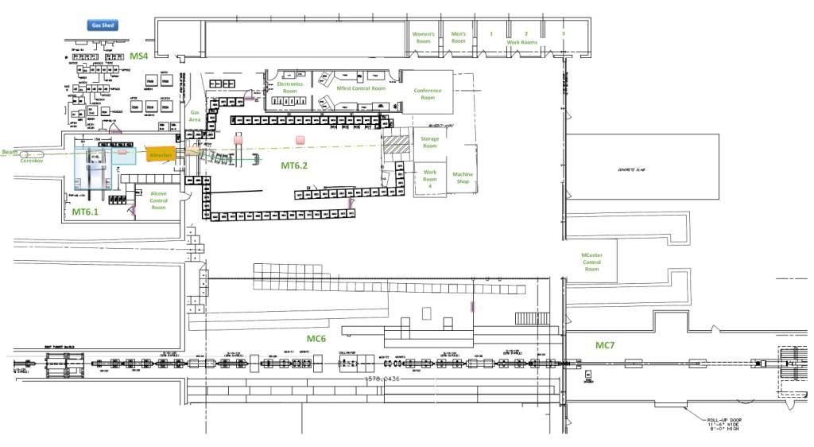
Tertiary spectrometer to be moved to MCenter
MTest and MCenter layout as part of a unified Fermilab Test Beam Facility
Environmental controlled area for silicon tests
Space for large calorimetry tests
Electronics room for MCenter
Installed cable route
Walkway to MC7
This section of pipe has been removed for users.

Slide 8
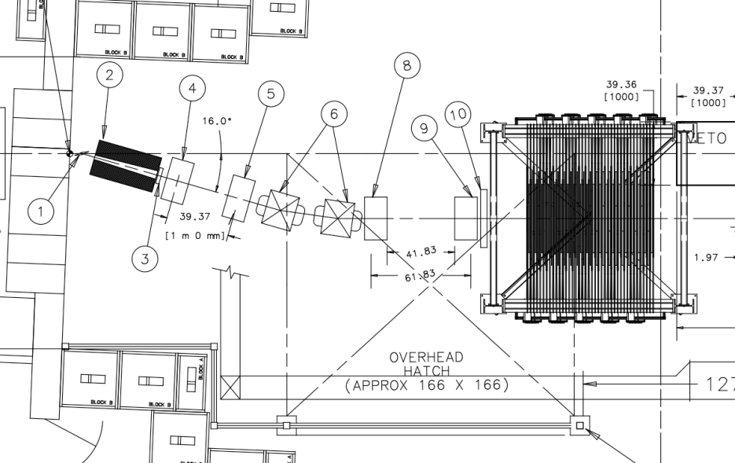
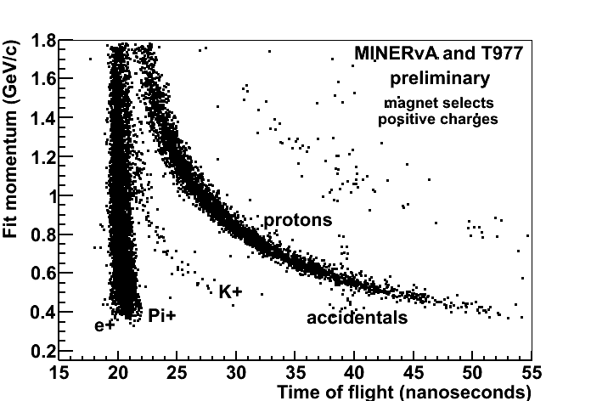
Accommodating Low Energy Users
The lowest energy we can realistically deliver with the secondary beam is ~1 GeV.
In 2008, T-977 MINERvA experiment requested pions with momentum as low as 200 MeV/c
To accommodate this request, Fermilab created a secondary target and tertiary beam spectrometer

Slide 9
SLAC End Station Test Beam (ESTB)
Shares beam time with LCLS
Electron energies from 1-15 GeV
Rates from 1 particle/bunch to 0.25 nC at 5 Hz repitition
Plans for hadron production and possibly tagged photon
Excellent for machine interface testing as well as detector testing
User’s meeting last August: this last year:

Slide 10
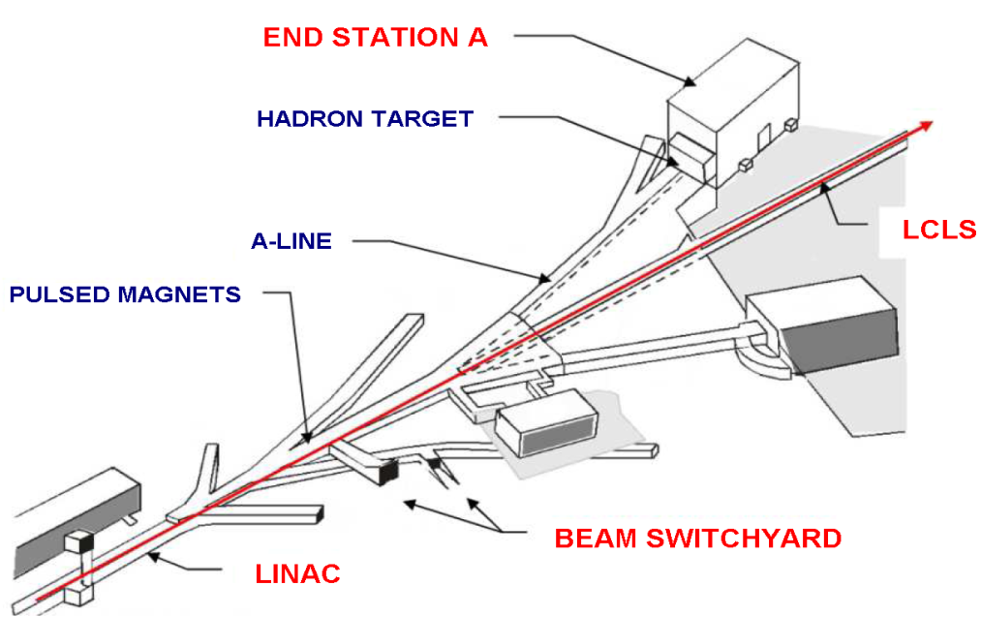
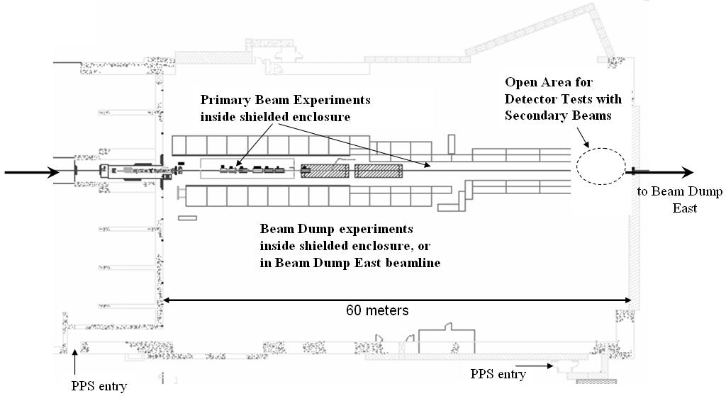
LCLS and ESA
Use pulsed kicker magnets in the beam switchyard to send beam into ESA.
Beam
The operation of SLAC ESTB and FNAL MCenter this year will help alleviate the expected backup in U.S. test beam activites

Slide 11
A Word about CERN Test Beams
Wow!

Slide 12
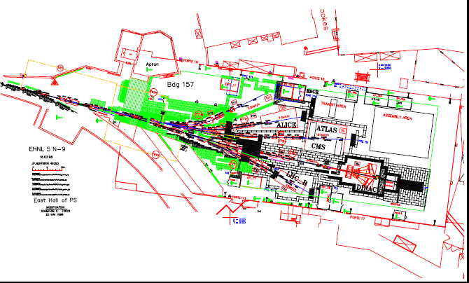
East Area PS Test Beams

Slide 13
Irradiation Facilities
The HL-LHC detector upgrades demand an incredible rate and dose capability, that MUST be tested in high irradiation areas. Total doses will exceed 10¹⁶ particles per square cm in the vertex region.
There are several classes of high dose irradiation
Radioactive source: typically neutrals (i.e. photon and neutron)
Argonne
BNL
University Departments
Accelerated beam: protons, electrons, neutrons
LBNL 88” cyclotron for protons or ions
LANSCE 800 MeV proton beam
Fermilab – several areas: MT3 (120 GeV), MTA (400 MeV), Neutron Therapy (10 MeV)
Proton therapy machines (such as Loma Linda)
Back scattered photons
HIGS at Duke University
Nuclear reactor
Sandia – Annual Core Research Reactor
See Sally Seidel’s talk on facilities
at Sandia and Los Alamos in tomorrow’s
facilities session

Slide 14
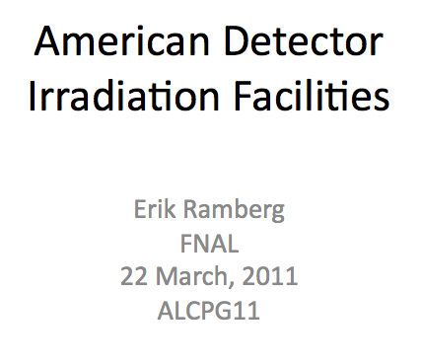
Irradiation Facility Documentation
CERN RD50 organization has created a nice summary of Euro-centric irradiation facilities. We need this for the U.S.
Talk at ALCPG, 2011 on this subject is a starting point, but is by no means comprehensive.
Descriptions of each of the facilities should include:
Species and dose capability
Machine status
Support Infrastructure
Contact person and directions for application
Cost

Slide 15
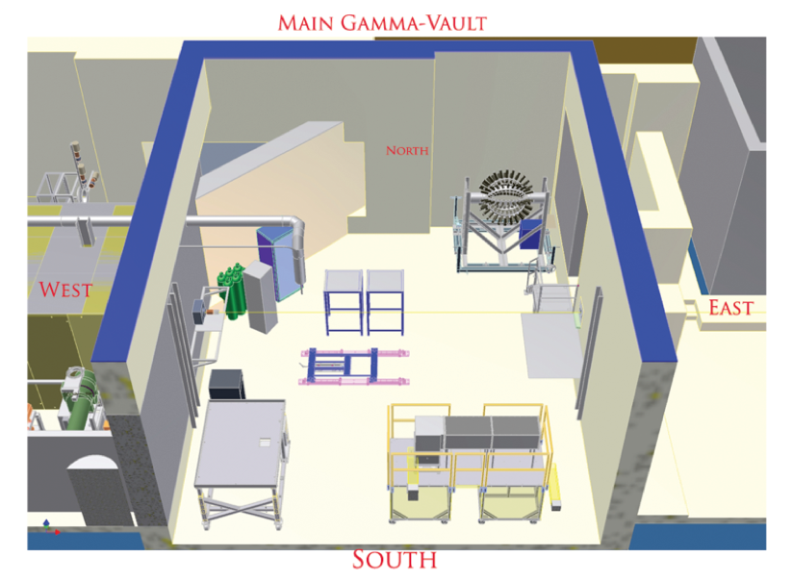
High Intensity, High Energy γ’s
HIGS (“High Intensity Gamma Source”
Triangle Universities
Compton Backscattered off of electrons in Duke Electron Storage Ring
Energies between 1‐100 MeV
Order of 5% energy spread
Fluxes on the order of 10⁸ per sec
Other facilities
U.Mass. Lowell Radiation Laboratory: 100 rad to 2 Mrad per hour

Slide 16
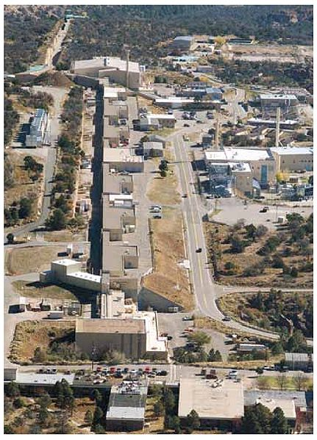
High Intensity, Low Energy Protons and Neutrons
LANSCE=‘Los Alamos Neutron Science Center’
Has supported users for decades with several dedicated facilities:
Proton Radiography:
800 Mev protons
1 to 5E11 protons per pulse at 1 Hz
Lujan Neutron Scattering
Tungsten spallation with beam currents of 100 microamps
Pulse rate of 20 Hz
Cryogenic and high magnetic field capability

Slide 17
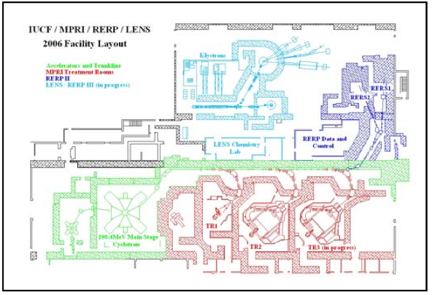
High Intensity, Low Energy Protons (cont.)
Indiana University ISAT (“Integrated Science and Accelerator Technology”)
Proton Cyclotron 30-200 MeV
Flux 1E02 to 1E11 protons/cm2/sec
2-30 cm diameter beam
Fermilab has a new area (MTA) that supports high intensity 400 MeV protons into a user area (see talk tomorrow)

Slide 18
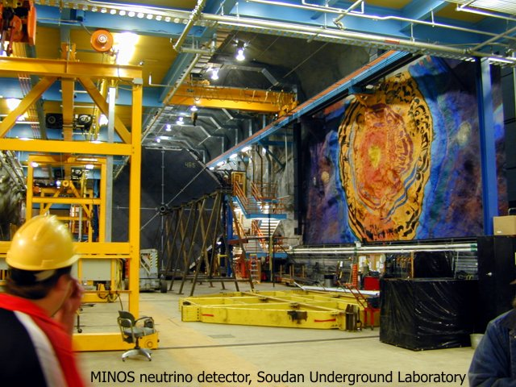
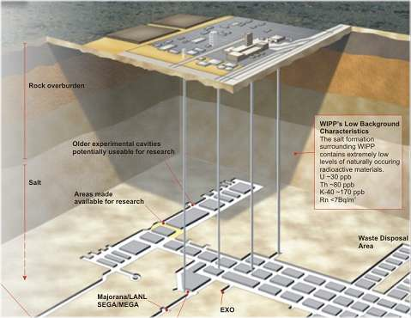
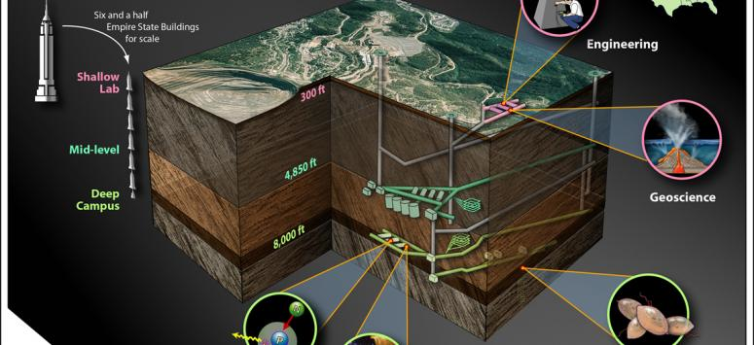
Underground labs
The only way to shield against cosmic ray induced backgrounds in test detectors is to locate them underground. There are a limited number of underground labs in the U.S. :
Soudan
WIPP
Sanford
MINOS
See Prisca Cushman’s talk in the next session for summary of underground labs

Slide 19
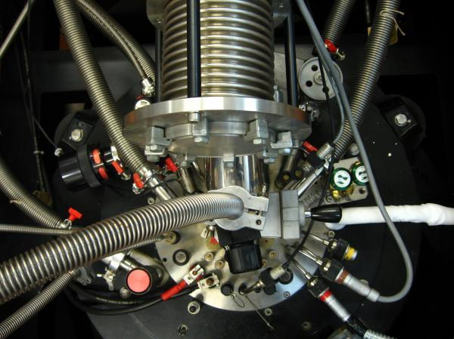
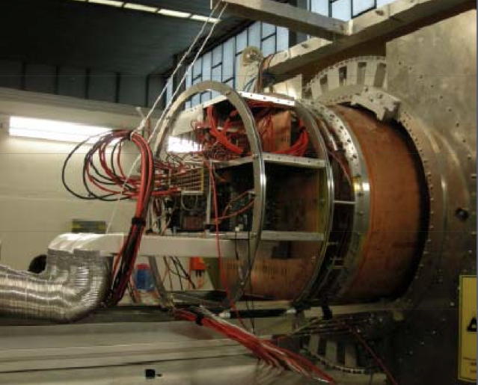
Supporting Cryogenic and High Magnetic Field Detectors
Special temperature conditions are needed for many styles of detectors:
CCD, Liquid Argon TPC, Germanium crystals, etc., can use liquid nitrogen, which most institutions can host.
Others, like TES, MKID and STJ need milliKelvin temperatures (He3 dilution refrigerator, adiabatic demagnetization), which can require a large investment.
Is sharing cryogenic infrastructures needed to support detector research?
Magnetic fields
Very high magnetic fields can reduce the size of collider detectors and, thus, their costs. Work with National High Magnetic Field Lab?
Need to test for detector characteristics (e.g. photodetector efficiencies, or TPC track diffusion) in high magnetic field levels (>2 Tesla)
Ideal to have a large bore solenoid magnet for use in a test beam in the U.S., such as at DESY facility
ANL Dilution Refrigerator for Thin Film Studies
Large TPC prototype for ILC, inserted into DESY magnet

Slide 20
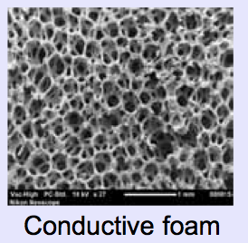
Low Mass Structural Engineering
Low mass support and cooling structures are crucial for ILC and HL-LHC
Good example of state of the art in support structures comes from the Composites Lab at LBNL.
(Yale and BNL studies of carbon foam)

Slide 21
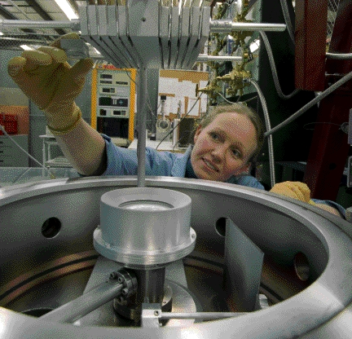
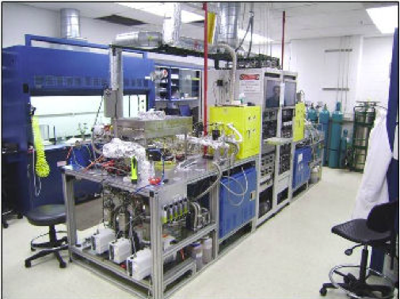
Vacuum Deposition, Thin Film Coatings and ALD
FNAL facility for thin films
High demand from outside Fermilab
Vacuum deposited thin films of precise thickness from sputtering or evaporation.
Film thickness as small as 10 Å to 2 micron or thicker.
Other capabilities include fiber polishing and splicing, plasma etch cleaning and vacuum baking and annealing
ANL Atomic Layer Deposition expertise
Currently have three bench-scale ALD thin film deposition reactor systems that were designed and constructed at Argonne.
These unique reactor systems are very flexible and allow to deposit a wide range of materials with atomic level precision onto nearly any substrate.
Also designing larger, application specific reactors.

Slide 22
A National Equipment Pool?
Fermilab is fairly unique in that the lab has stored an enormous number of electronic modules (typically NIM, CAMAC, HV, LV, etc.) that have supported the largest U.S. based experiments in the past.
This equipment pool is called PREP and the lab has in the past provided these modules for checkout to Fermilab users, including off-site use.
Some repair capability used to exist, but has been considerably reduced in staff.
These modules are still viable for test stands, beam tests and small experiments.
A task force was engendered last year to study the utility and cost of keeping PREP in operation and whether it could be expanded into a national program.
Bob Tschirhart will discuss the task force report in the next session.

Slide 23
A National Engineering Resource Sharing Program?
In many cases, engineering resources are scarce for detector R&D
University groups are reducing engineering staffing
National labs give higher priority to more developed, official large scale projects
Can we reserve engineering resources for detector R&D at the labs, open to users who do not have lab specific funding?

Slide 24
Need a clearing house for national detector facility information
Fermilab has a modest detector web page that summarizes our program and facilities: (http://detectors.fnal.gov). It would be good to see this type of page for each of the national labs.
CPAD should create a web page clearing house that comprehensively lists and links to the national facilities, along the lines outlined here.

Slide 25
Facilities discussions during this workshop
Wednesday:
16:00 – Bob Tschirhart – Past, Present and Future of the Fermilab Physics Research Equipment Pool
16:20 – Prisca Cushman – Discussion: Underground Infrastructure of Instrumentation R&D
Thursday:
09:30 – Erik Ramberg – Fermilab Test Beam and Irradiation Capabilities
09:50 – Sally Seidel – LANSCE irradiation capabilities
10:10 – Dave MacFarlane – SLAC Test Beam Capabilities
10:45 – Dave Lissauer – Radiation Facilities at BNL
17:30 – Gil Gilchriese – Facilities Summary
Friday:
15:00 – All – Discussion on Snowmass Document

Slide 26
Summary
The field of particle physics involves a tremendous range of energy and species.
‘Facilities’ to deal with this plethora means much more than test beam or irradiation.
The U.S. has extensive facilities to support detector R&D, each with their own strength.
One thing that is lacking is a comprehensive listing of existing facilities. That should be rectified before/during Snowmass.
Need to address the question of shared national resources, both in manpower and material.

