Slide 1
Radioactive Bi207 Source Simulation for LArTPC Calibration
Luke Saunders
DUNE Calibration Meeting, CERN
Luke Saunders | DUNE Calibration Meeting | July 13th, 2023 1

Slide 2
Presentation Outline
Motivations
General Features
Particle Generation
Treatment of electron decay products
Treatment of photon decay products
Data Cuts
Geometric
Energy
Energy Spectrum Analysis
Waveform Reconstruction
Future Improvements
Luke Saunders | DUNE Calibration Meeting | July 13th, 2023 2

Slide 3
Motivations
Creating a full-fledged simulation modeling the physics in the TPC during Bi207 radioactive decay allows one to confirm and validate experimental data collected.
The simulation can serve as a check on real data, giving further credit to the capabilities of the detector, as well as the methods employed in experimental data analysis.
Python has been chosen due to its increasing popularity, as well as its extensive package library.
This form of the code would eventually be converted into a more computationally powerful language as the Python version is a proof of concept.
Luke Saunders | DUNE Calibration Meeting | July 13th, 2023 3

Slide 4
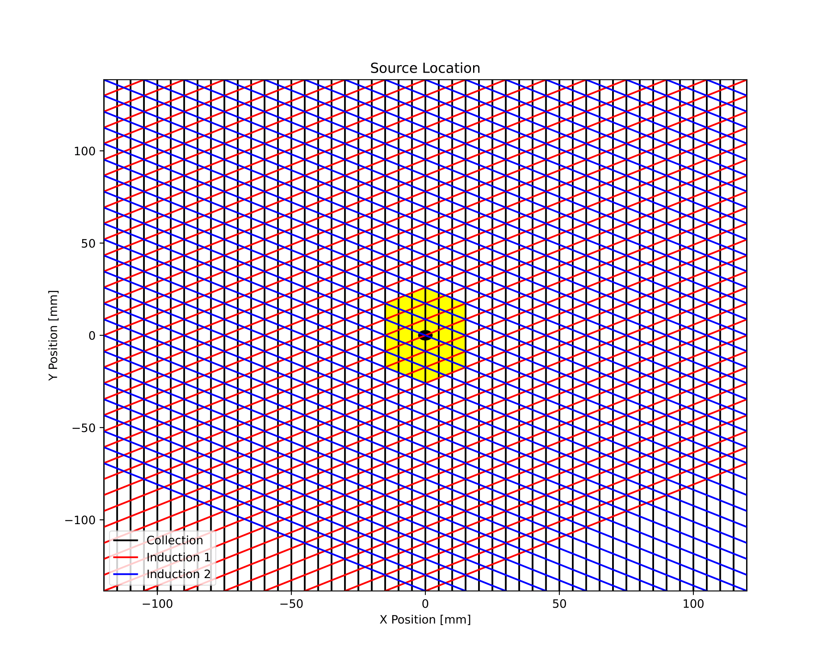
General Features
The current simulation is fully scalable in the following ways: pitch size, strip placement, number of strips, induction 1 and 2 rotation angle, and the placement of the source.
The analysis automatically adjusts to changes made to these parameters.
Variables are all contained within one file for ease of access.
The entirety of the Python simulation is available on a GitLab repository.
Luke Saunders | DUNE Calibration Meeting | July 13th, 2023 4

Slide 5
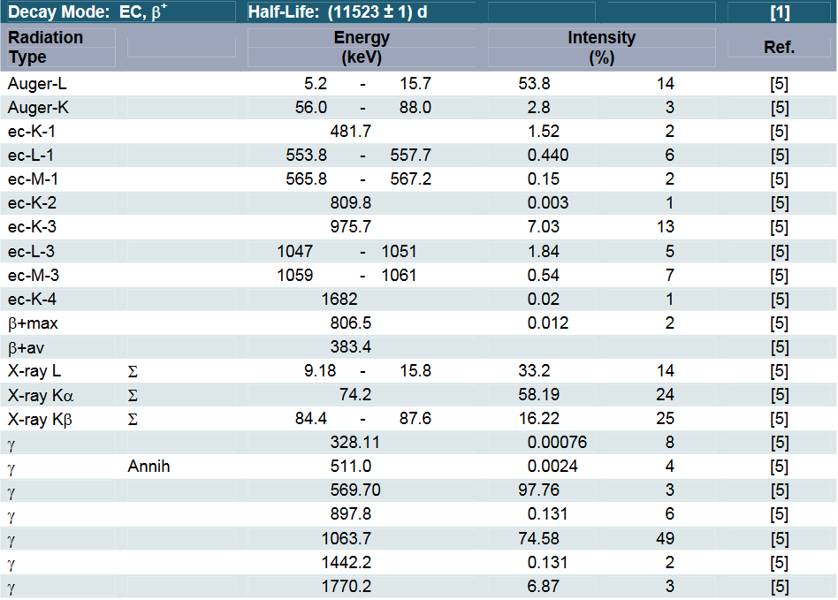
Particle Generation
The radioactive decay of Bi207 is modeled off data given by Eckert & Ziegler [1] as well as NNDC [2].
When discrepancies are present between the two, the data from NNDC is used.
Originally, only a few processes were modeled.
This was due to their high intensity and energy well above the trigger threshold.
All decay products are now modeled.
Luke Saunders | DUNE Calibration Meeting | July 13th, 2023 5

Slide 6
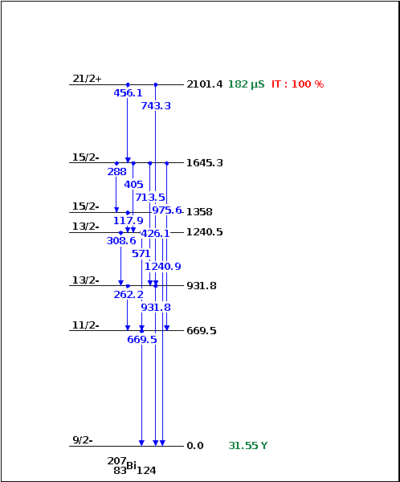
Particle Generation Cont.
The intensities of the decay products are used as probabilities. The sum is normalized, and an event is chosen given this distribution.
The generated particle is then placed randomly on the area of the active source. Electron and photon decay products are treated differently however, and this difference will be discussed in slides 7-10.
Presently, the simulation only focuses on charge, not scintillating light.
Each generated event is independent of all other events. There is currently no correlation between decay methods.
[2]
Luke Saunders | DUNE Calibration Meeting | July 13th, 2023 6

Slide 7
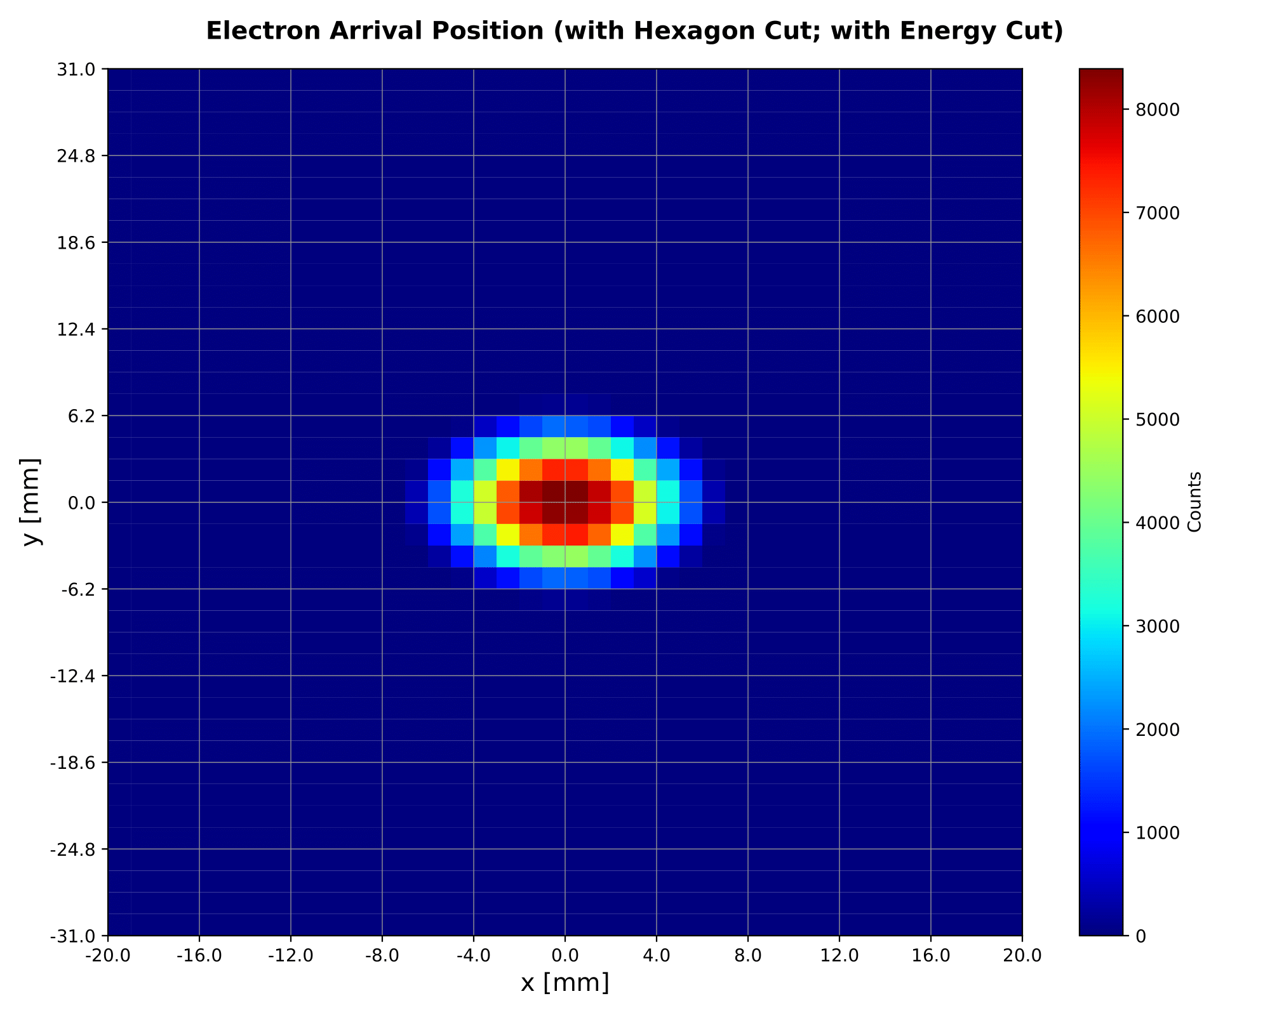
Electron Decay Products
Originally, electrons were treated as point-like objects, generated at the source and then tracked directly up to the detector.
A reasonable approximation; however, the simulation should be as accurate as possible.
The new process is as follows:
Electrons are given a random trajectory (polar and azimuthal angle).
NIST data [3] on the energy deposition of electrons in liquid argon is interpolated and the length of a track is determined.
The track is discretized into segments and using the interpolated data, the ionizing radiation produced in that region can be calculated.
Luke Saunders | DUNE Calibration Meeting | July 13th, 2023 7

Slide 8
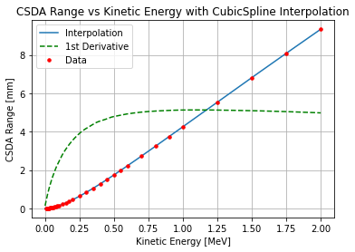
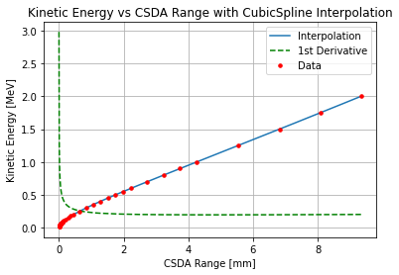
Electron Energy Deposition in Liquid Argon
The data from NIST is interpolated using SciPy’s CubicSpline interpolation method.
E0
E1
$$E1=E0 −\frac{dE}{dx\left(E\right)}∗∆x$$
Luke Saunders | DUNE Calibration Meeting | July 13th, 2023 8

Slide 9
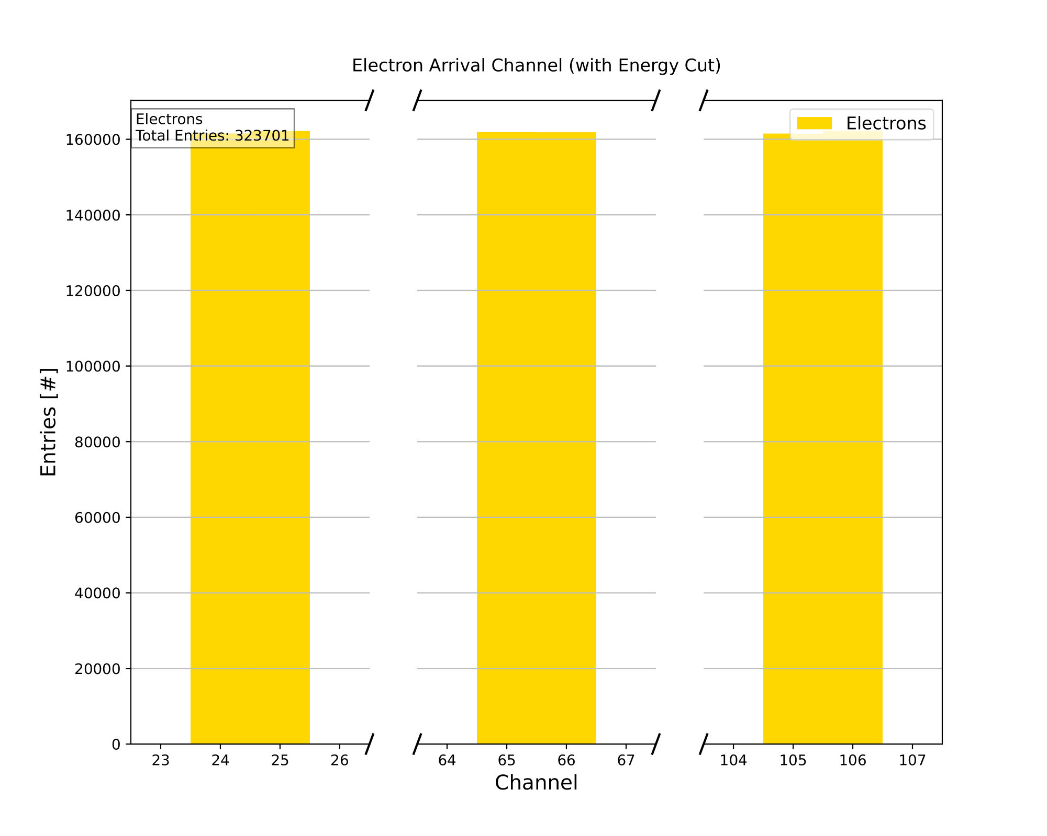
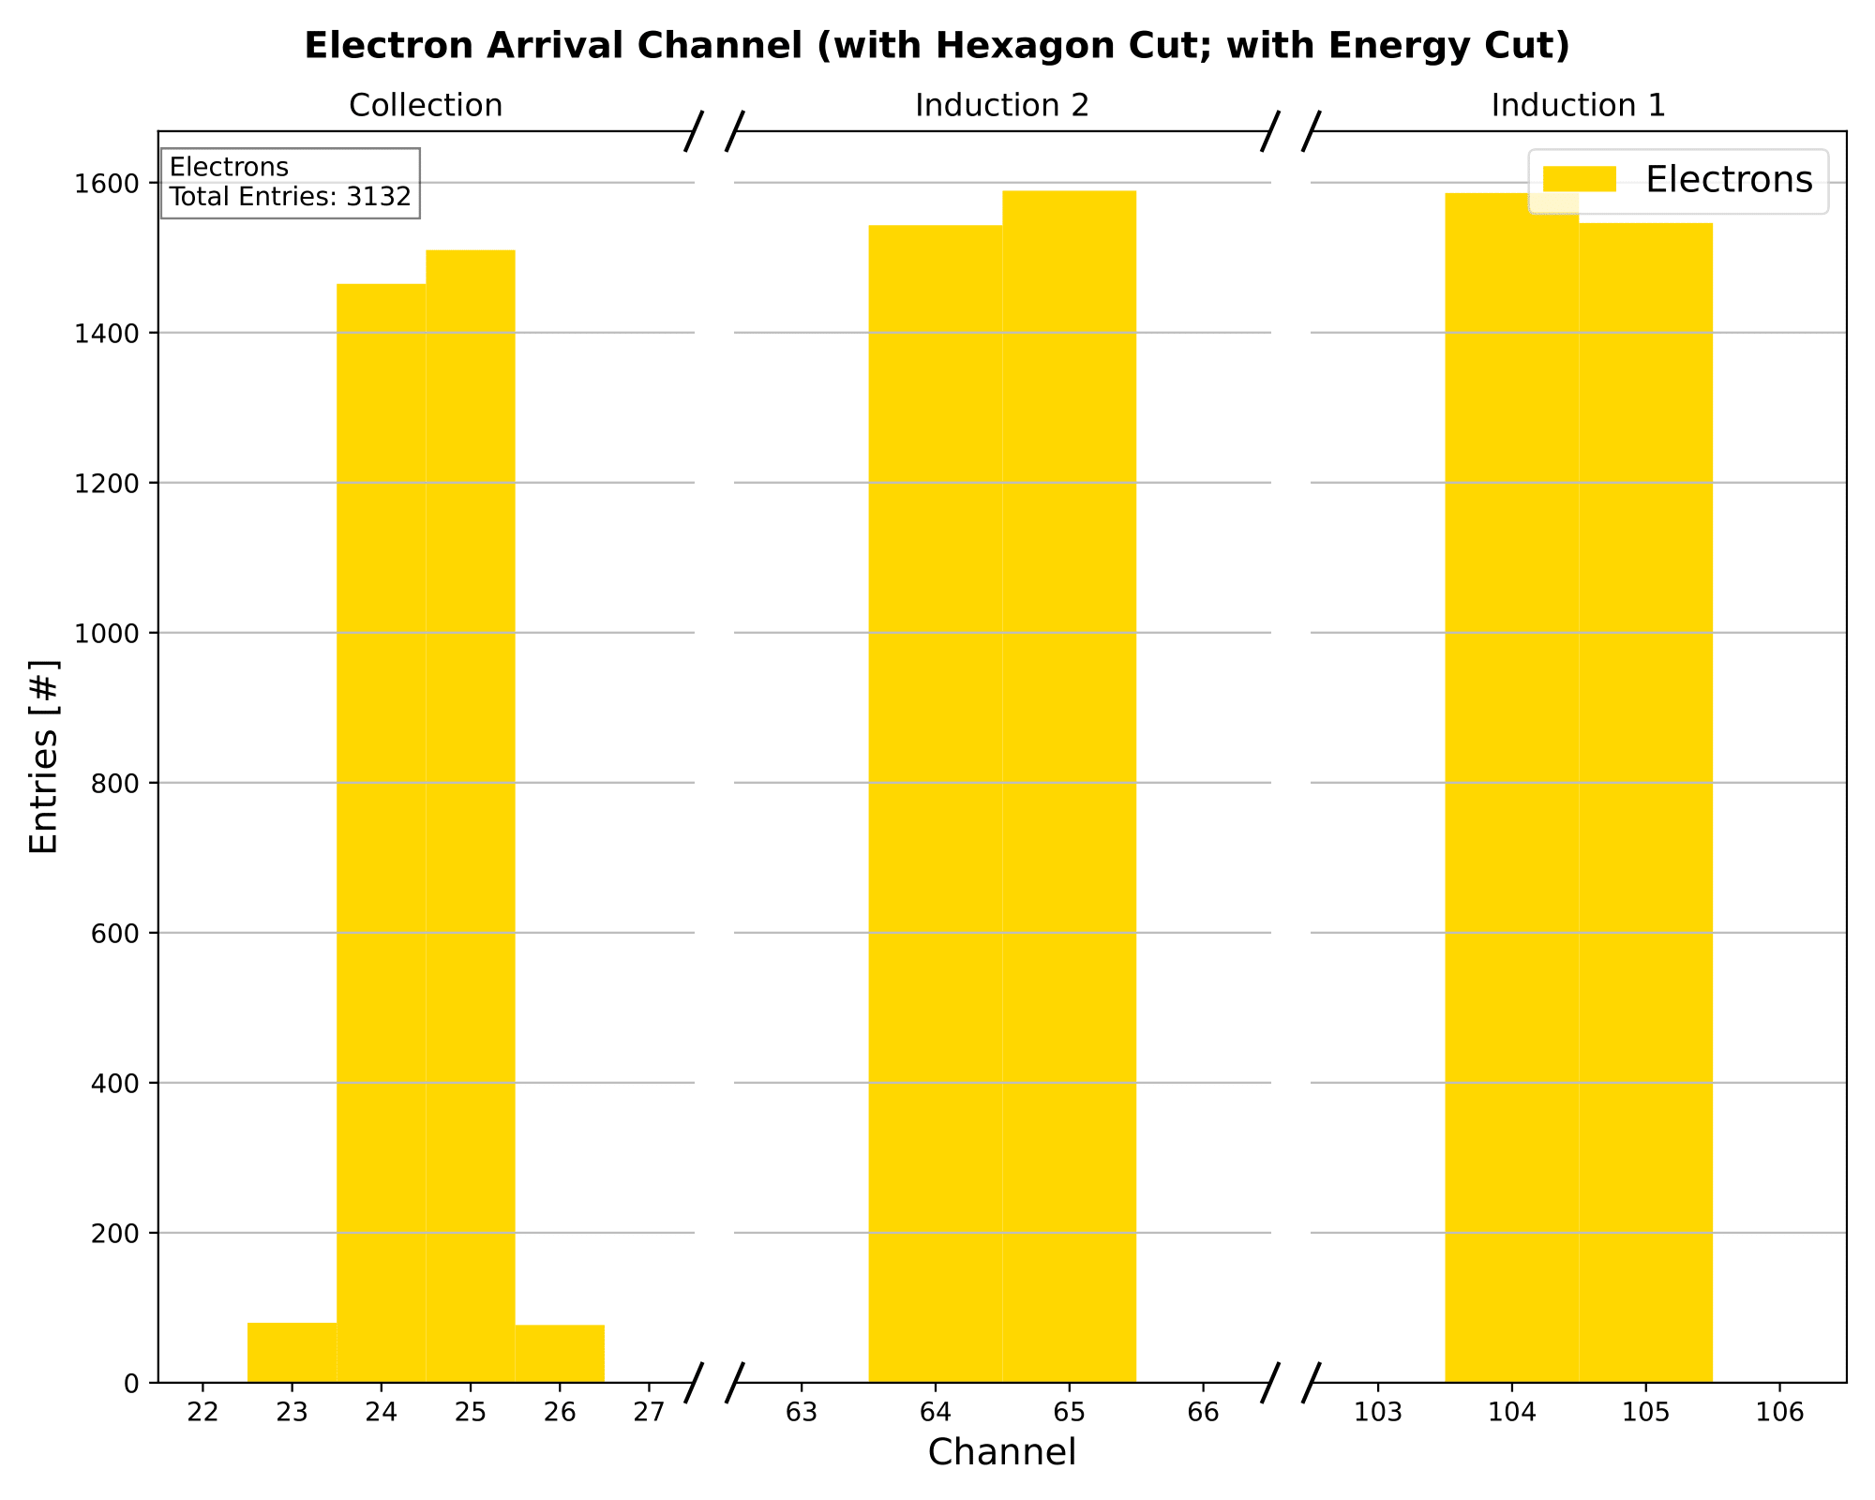
Visualizing the Electron Segmentation
In the experimental data analysis events occur on the channel with the greatest signal peak (where most of the electron cloud passes), the same is done in the simulation. This leads to a small smearing effect in collection.
Electron Cloud
Point-like Electrons
Luke Saunders | DUNE Calibration Meeting | July 13th, 2023 9

Slide 10
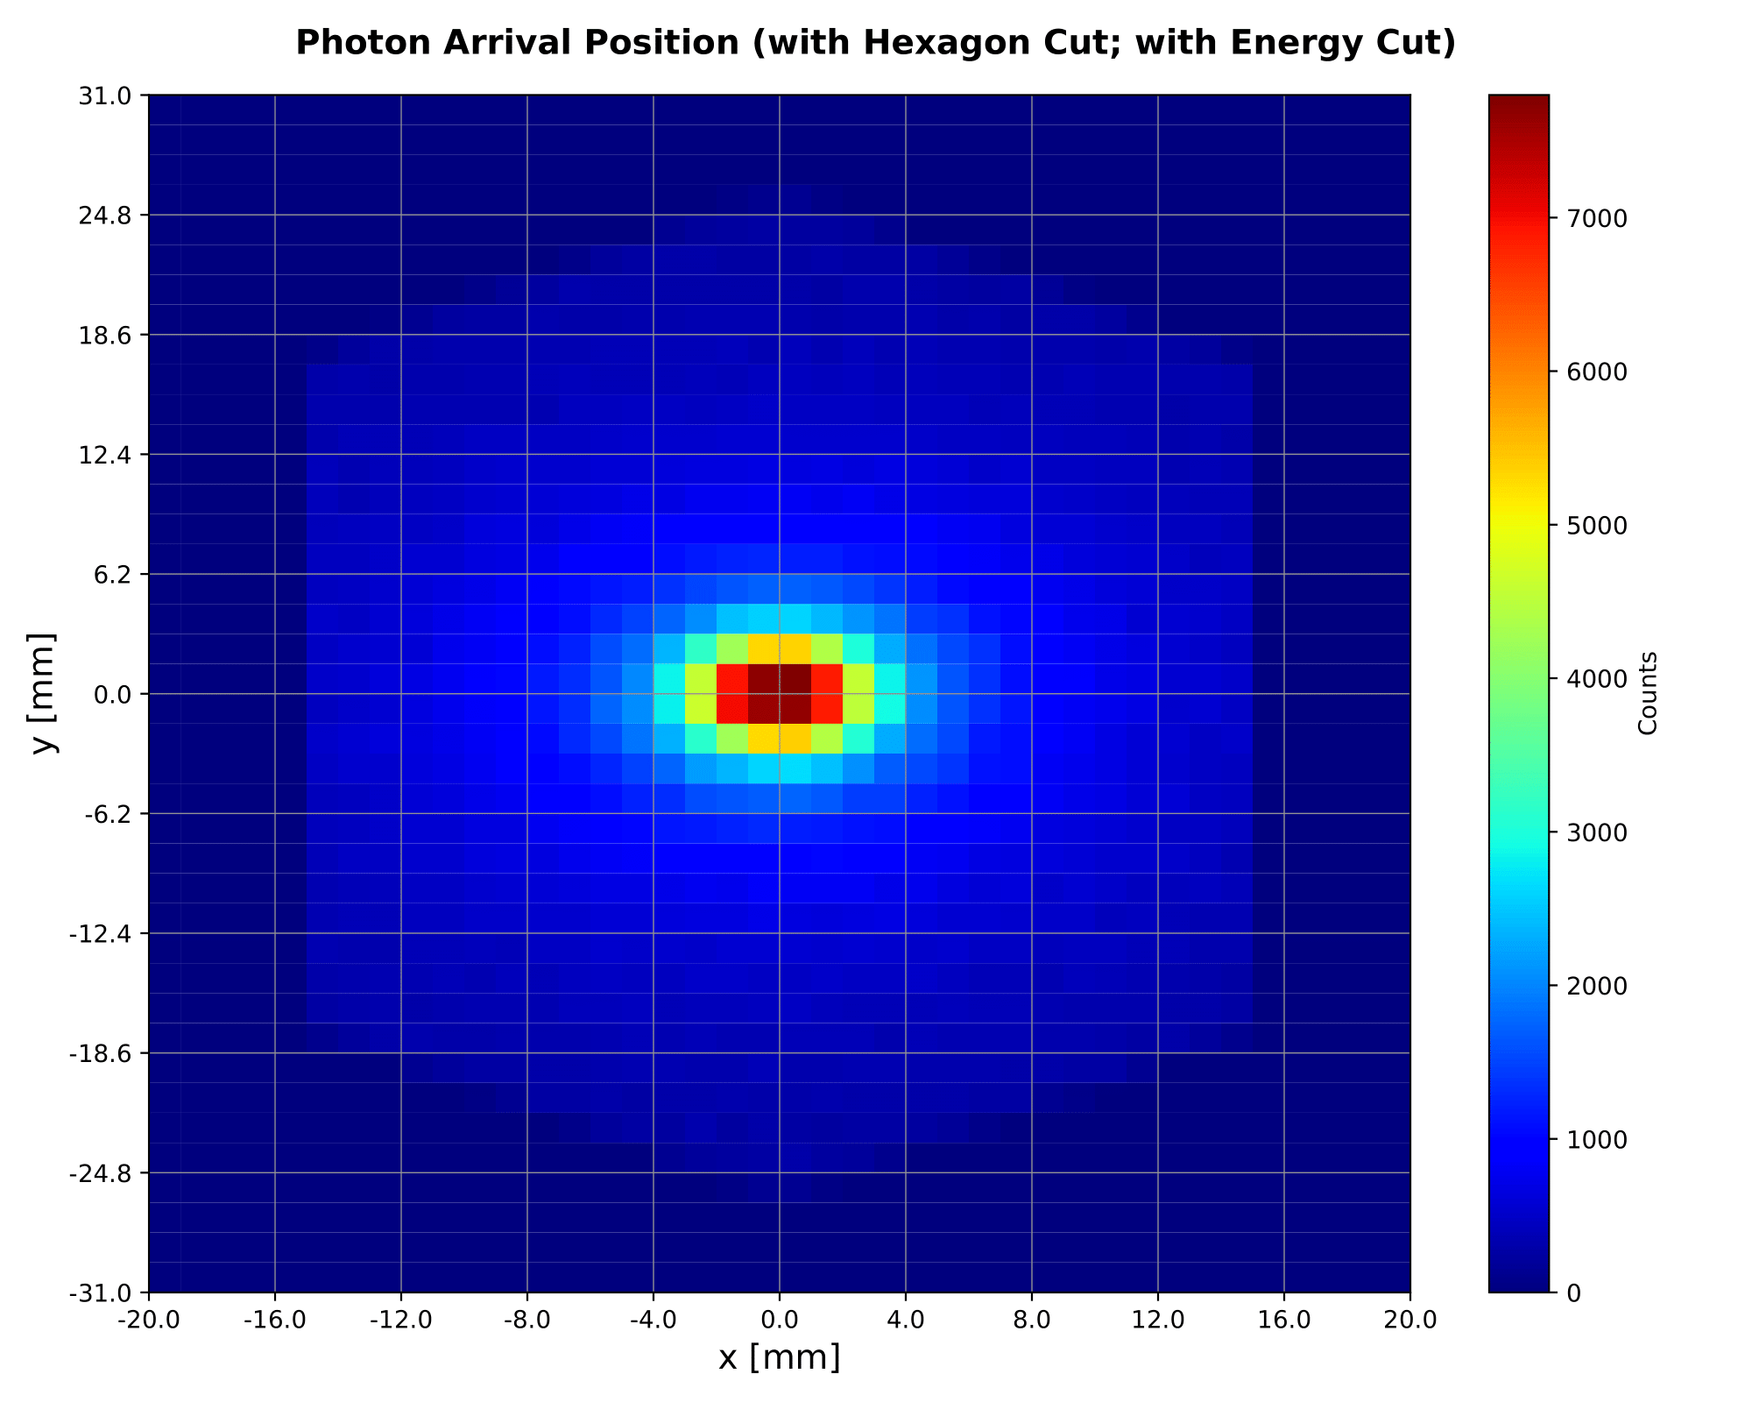
Photon Decay Products
Originally, photons had the process:
Photons are given a random trajectory (polar and azimuthal angle).
Using data from NIST [4], an interaction distance is determined based on its given energy.
The probability distribution for the range of the photon determines the track length.
A Compton scattering interaction occurs and the scattered electron is treated like a point particle that has absorbed some fraction of the photon’s energy.
This method is still applied; however, the simulation is close to implementing continual Compton scattering.
The scattered electron is now treated as an electron cloud, rather than a point-like particle.
Luke Saunders | DUNE Calibration Meeting | July 13th, 2023 10

Slide 11
Data Cuts
The energy cut that occurs is the trigger.
For the given experiment, it is roughly .3 MeV.
Two geometric cuts taken.
The first requires that events occur within the active volume of the TPC.
The second is what will be referred to as the “hexagon cut.”
The hexagon cut ignores channels that do not run directly above the source. The hexagon shape is created from the orientation of the collection, induction 1, and induction 2 strips.
It should be noted that one or more adjacent channels are taken as well, something I will discuss more in detail in the slides 13-16.
Luke Saunders | DUNE Calibration Meeting | July 13th, 2023 11

Slide 12
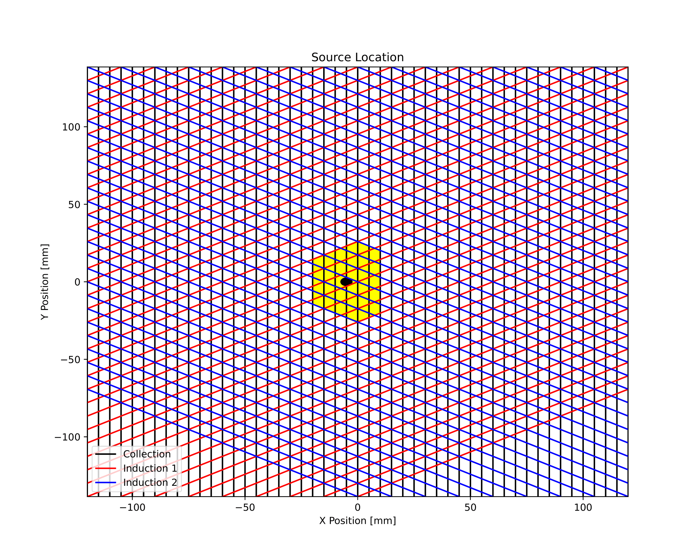
Hexagon Cut Calculation
The hexagon cut automatically updates depending on the position of the source.
The calculation is dependent on whether the lines that define the boundaries of the channels intersect the circle that defines the active source region.
When the source lies perfectly on a strip without intersection, the center point of the source is used.
The number of adjacent channels is fully customizable and does not have to be symmetric around the source.
Luke Saunders | DUNE Calibration Meeting | July 13th, 2023 12

Slide 13
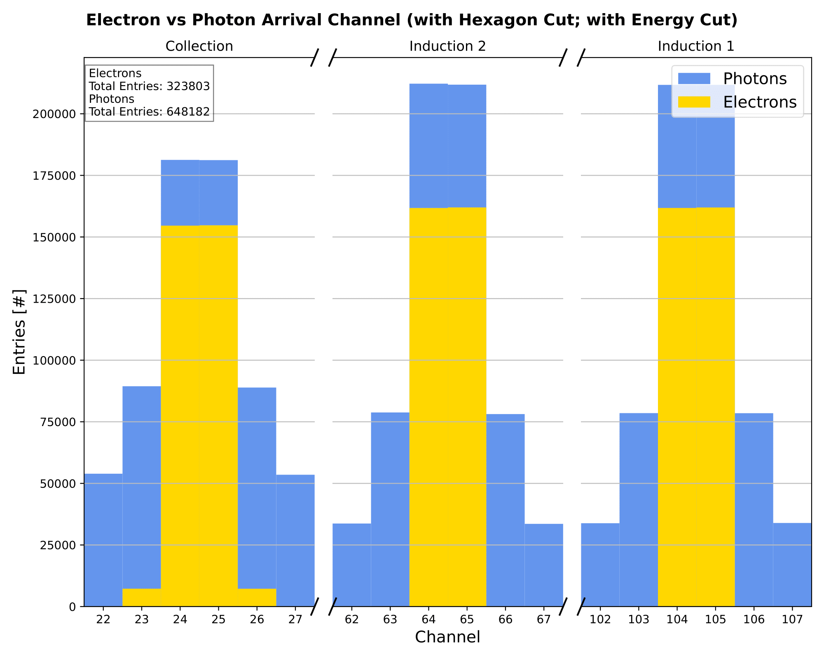
Energy Spectrum Analysis
A central component of the calibration effort with Bi207 is to properly recreate its electron energy decay spectrum.
The simulation can aid in this pursuit as the analysis methods used on real data can be mimicked in the simulation, allowing for a method confirmation.
Assuming adjacent channels, those that do not lie above the source, have similar photon energy spectra, one can scale the average adjacent energy spectrum and subtract it from the central channel(s) in order to remove the photon spectrum (the background).
This is viable since the electron events are almost entirely contained on the central channel(s).
Luke Saunders | DUNE Calibration Meeting | July 13th, 2023 13

Slide 14
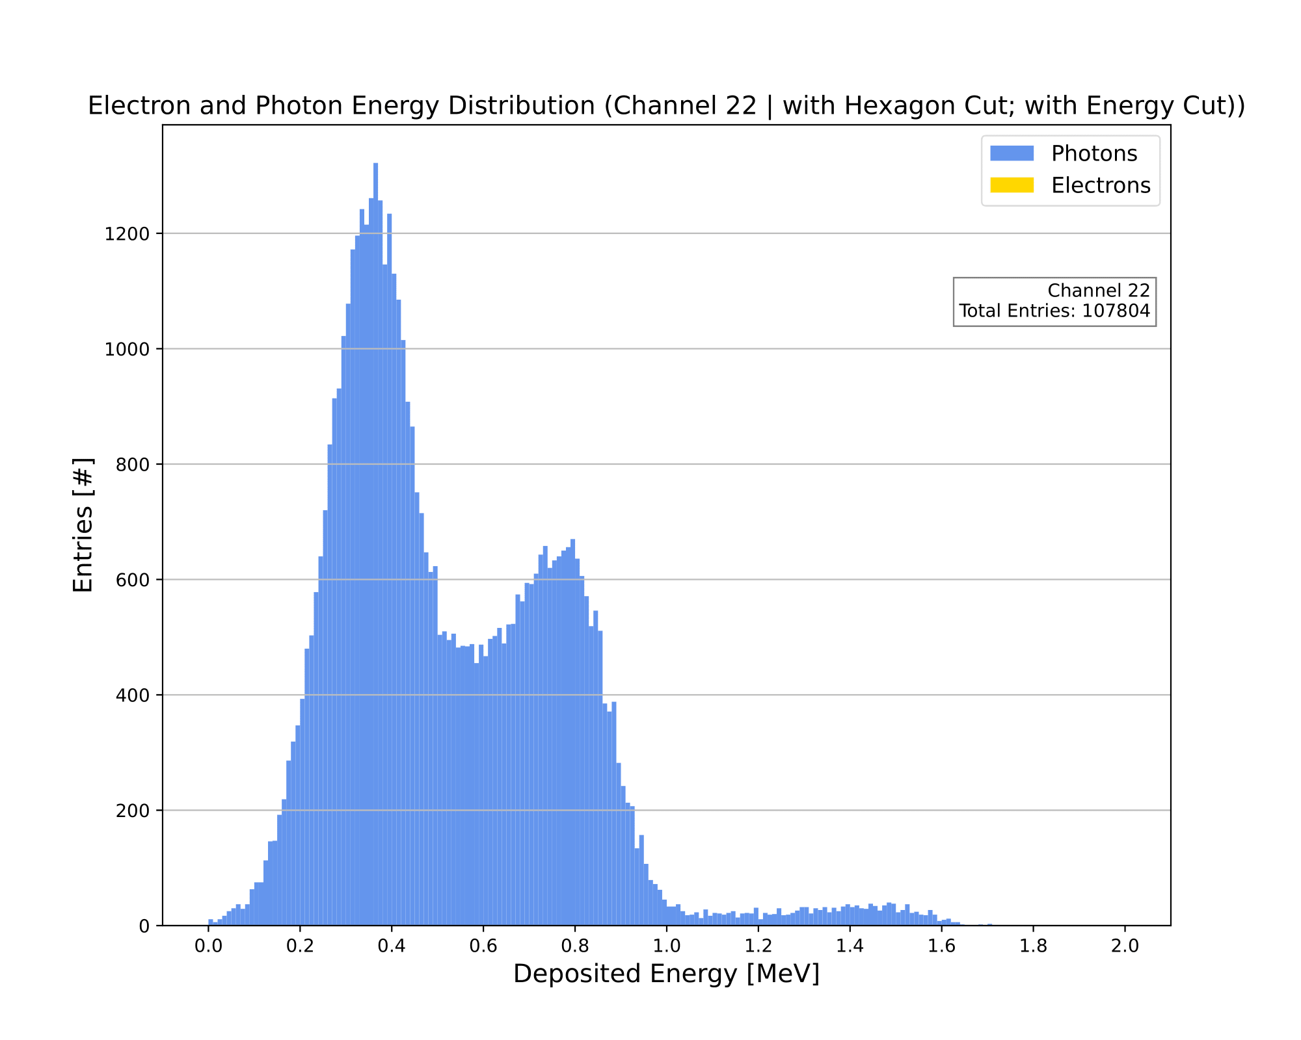
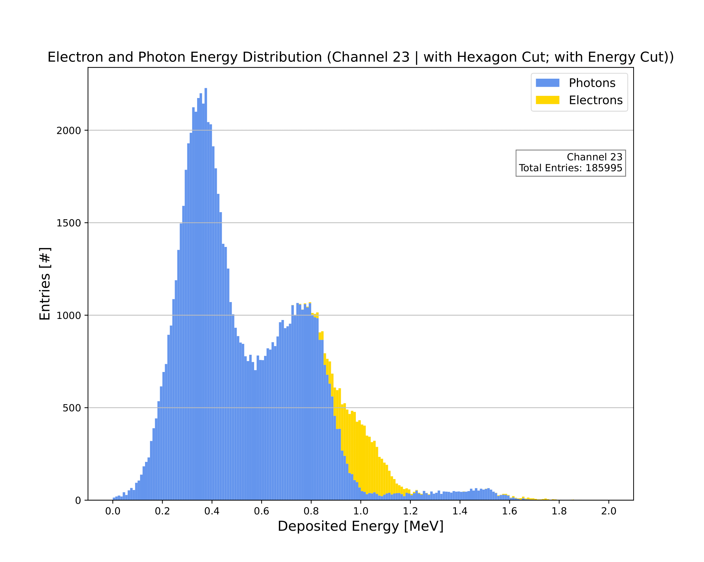
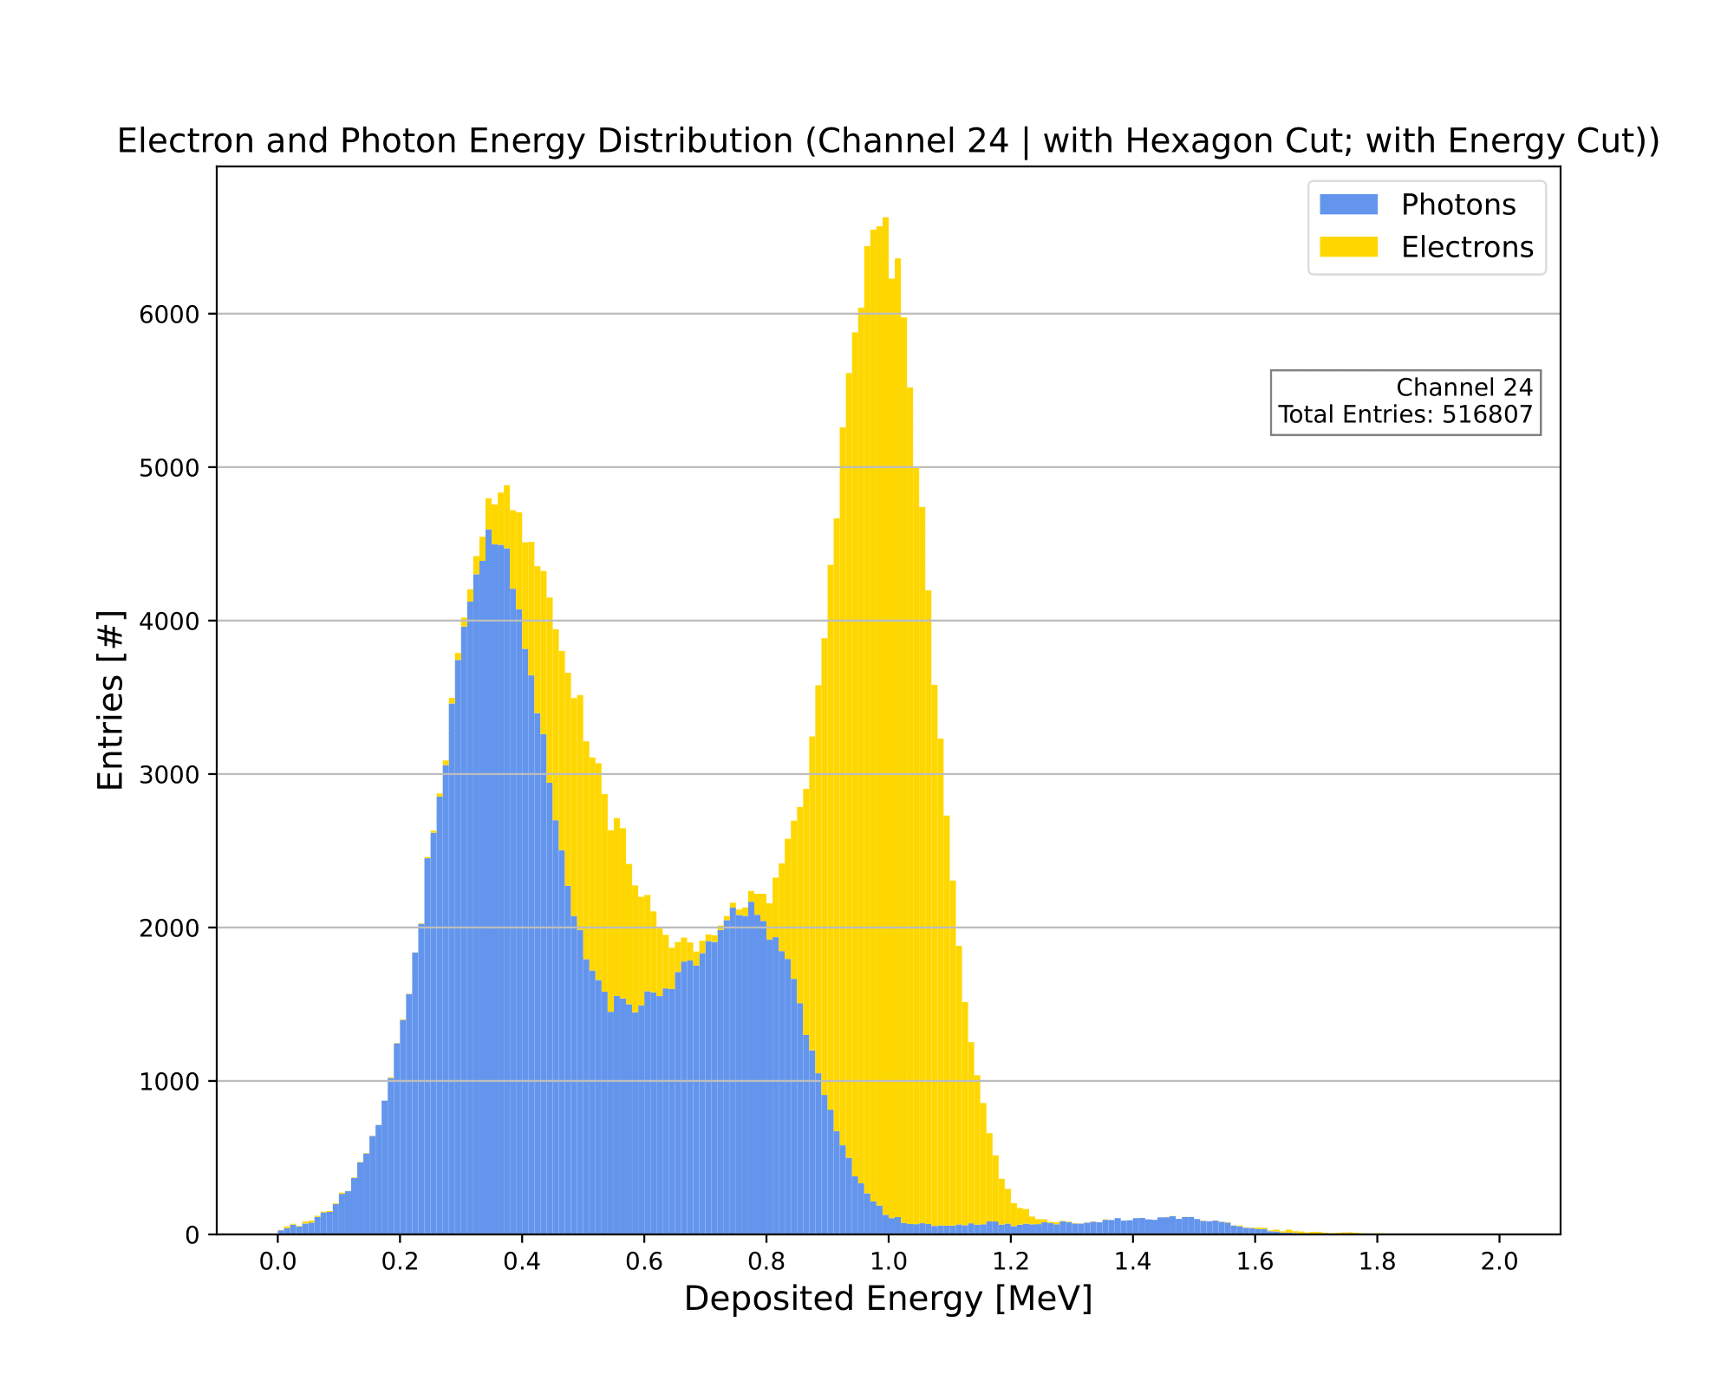
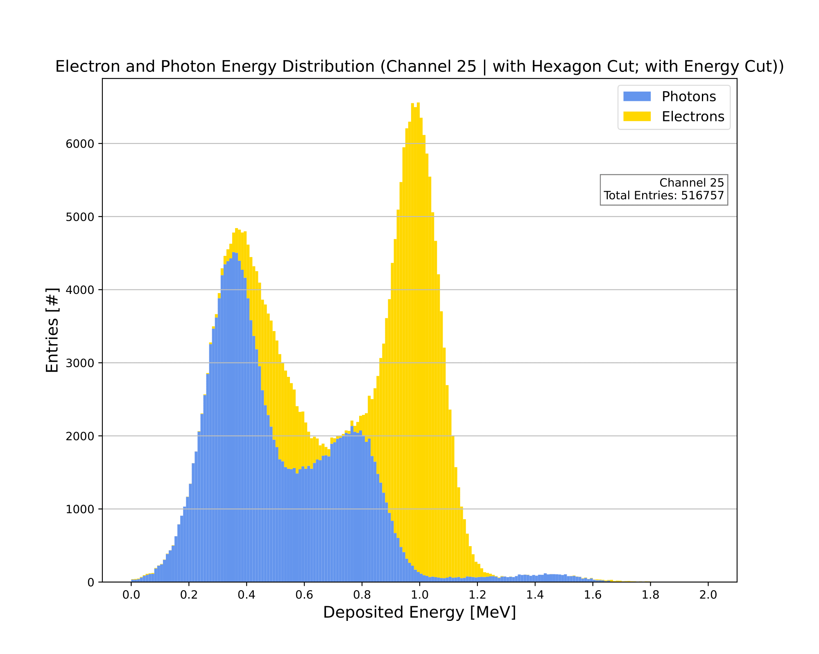
Adjacent and Central Channel Comparison
Adjacent Channel
Adjacent Channel
Central Channel
Central Channel
Adjacent Channel
Adjacent Channel
Luke Saunders | DUNE Calibration Meeting | July 13th, 2023 14

Slide 15
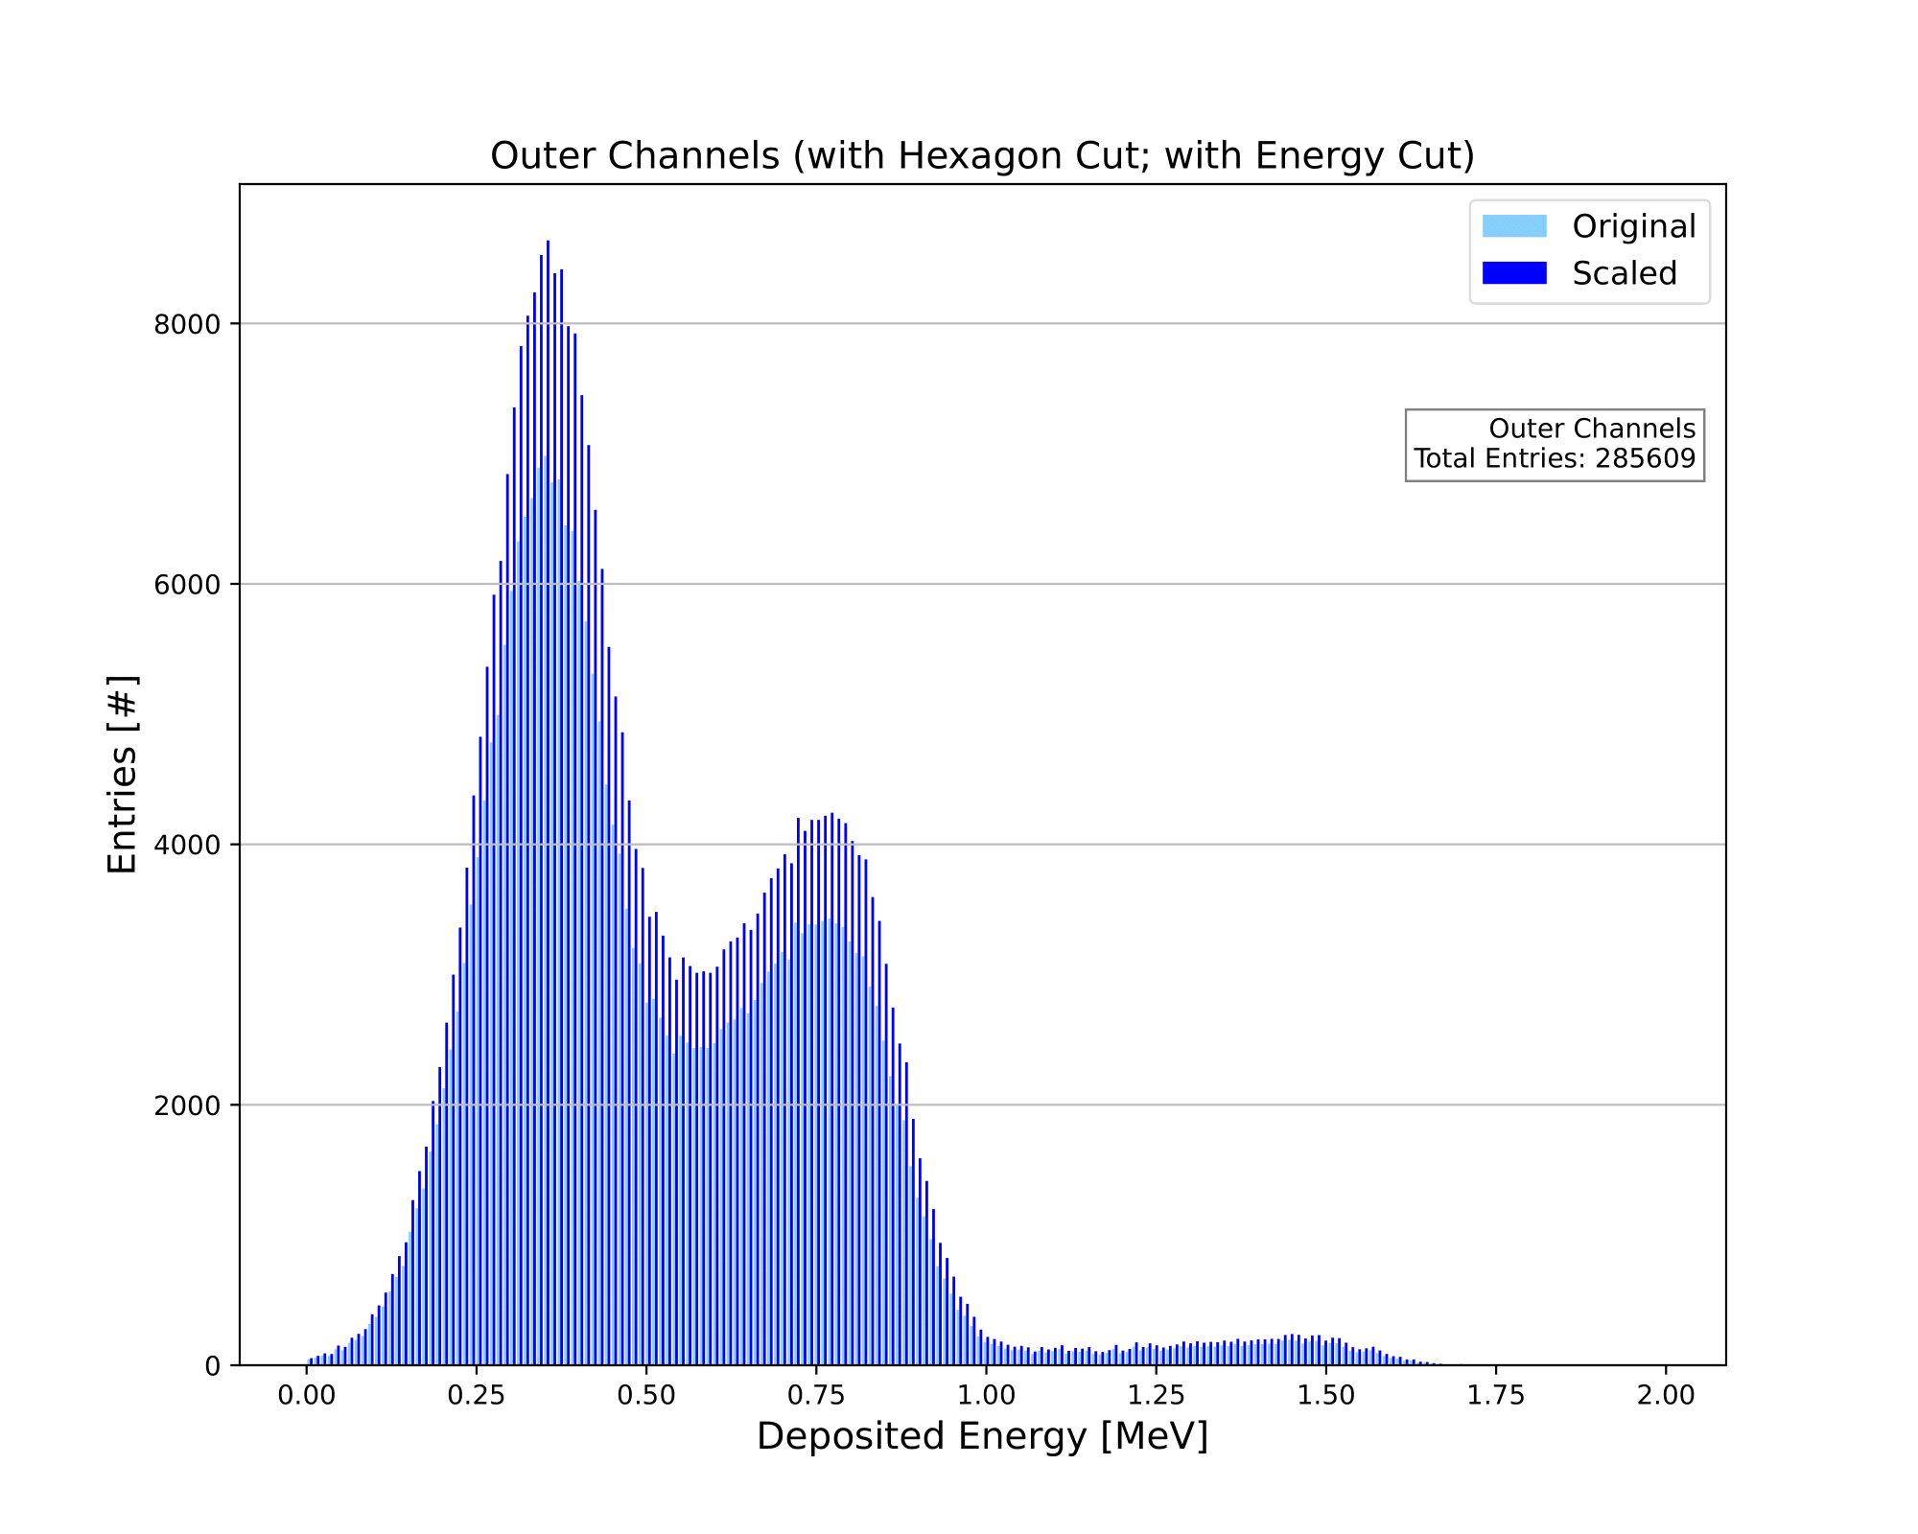
Scaling the Adjacent Channel
By averaging over the adjacent channels’ energy spectra, we can find the outer channel spectrum.
This spectrum can be compared to the average of the inner channel spectra.
It can then be determined how much each bin needs to be scaled for the two spectra to be similarly sized.
Finally, the scaled outer channel spectrum can be subtracted from the inner spectrum, leaving only the energies due to electron decay products from the Bi207.
Luke Saunders | DUNE Calibration Meeting | July 13th, 2023 15

Slide 16
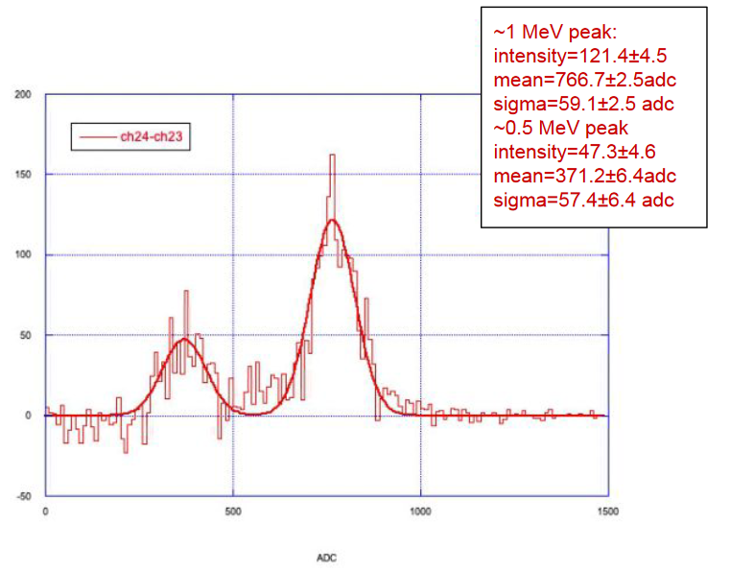
Electron Energy Spectrum Recreation
One can clearly see the similarities between these two plots, meaning that this method of removing the background is viable for calibration purposes.
Simulated Data
Experimental Data (2022)
[F. Dolek (CERN)]
[5]
Luke Saunders | DUNE Calibration Meeting | July 13th, 2023 16

Slide 17
Waveform Reconstruction
The output of experimental data are waveforms; therefore, the simulation should create the same for generated events.
Due to the complex geometry of the perforated PCBs, the field created near the detector planes is quite complex and cannot be calculated analytically.
Presently, the simulation employs a numerical method for solving Laplace’s equation within the TPC, given the boundary conditions of the cathode, as well as the detector planes.
The waveform reconstruction is not currently complete; however, previous work done for slightly different geometries will be discussed in the following slide.
[M. Fani (LANL)]
[6]
Luke Saunders | DUNE Calibration Meeting | July 13th, 2023 17

Slide 18
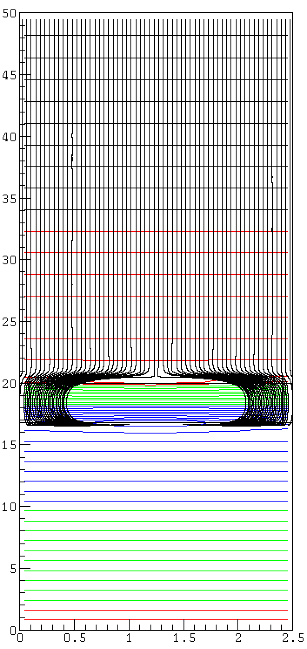
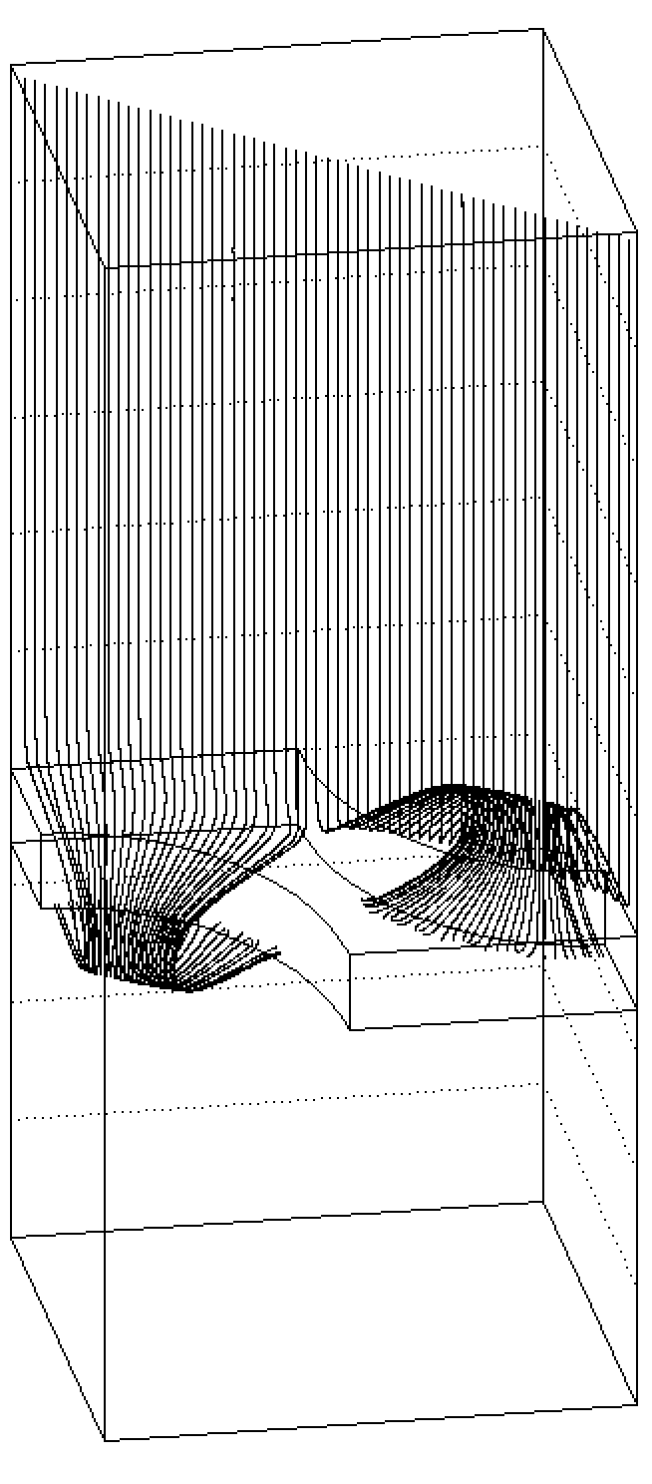
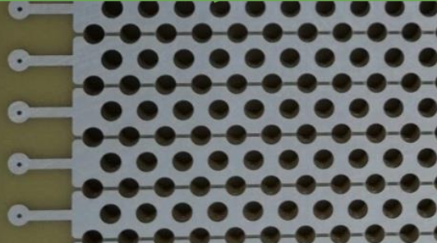
Particle Trajectories
Example of electron trajectories
Once the Laplacian has been solved for the TPC volume, the particle trajectories can be determined.
Z-axis mm
Y-axis mm
Induction
X-axis mm
X-axis mm
[F. Pietropaolo (CERN)]
[7]
Luke Saunders | DUNE Calibration Meeting | July 13th, 2023 18

Slide 19
Shockley-Ramo Theorem
weighting potential
at y = 1.67 mm at y = 0 mm
Employing the Shockley-Ramo theorem, one can deduce the induced charge on each detector channel.
A crucial component for recreating waveforms.
These two plots are 2D slices, plotting x and z at a specific y.
One can see that at distances far from the detector planes, the lines of equal induced charge are nearly straight.
4%
Z-axis mm
6%
8%
Strip # 0 1 2 3
X-axis mm
[F. Pietropaolo (CERN)]
[8]
Luke Saunders | DUNE Calibration Meeting | July 13th, 2023 19

Slide 20
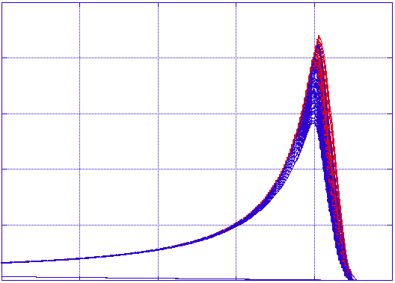
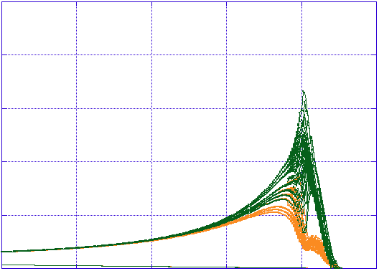
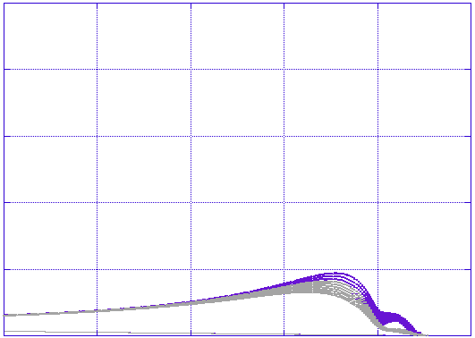
Waveform Reconstruction Examples
Here one sees previously completed waveform reconstruction on collection.
Reproducing these plots is the goal of the current reconstruction effort.
Central Channel
Adjacent Channel
Adjacent Channel
1
Fraction of the charge induced on the strip
0
75
drift time(us)
100
75
drift time(us)
100
75
drift time(us)
100
[F. Pietropaolo (CERN)]
[9]
Luke Saunders | DUNE Calibration Meeting | July 13th, 2023 20

Slide 21
Future Improvements
Completion of waveform reconstruction.
Consideration given to scintillating light, not only charge.
No longer treat generated decay products as entirely independent from one another.
Further refine the probability of certain energy transitions or chains of transitions occurring.
Adding in multiple Coulomb scattering, further increasing the accuracy of the simulated electron clouds.
Luke Saunders | DUNE Calibration Meeting | July 13th, 2023 21

Slide 22
References
[1] – Eckert & Ziegler Bi207 Decay Data
[2] – NNDC Bi207 Decay Data ; Plot on slide 6
[3] – NIST Energy Deposition Data
[4] – NIST Interaction Distance Data
[5] – Experimental Data Plot
F. Dolek. Rd with bi207 source in lartpc. Technical report, CERN, 2023.
[6] – Waveform Plots
M. Fani
[7] – All slide 18 plots
F. Pietropaolo. Simple 3D signal calculation for the perforated anode PCB. Technical report, CERN, 2023.
[8] – All slide 19 plots
F. Pietropaolo. Simple 3D signal calculation for the perforated anode PCB. Technical report, CERN, 2023.
[9] – All slide 20 plots
F. Pietropaolo. Simple 3D signal calculation for the perforated anode PCB. Technical report, CERN, 2023.
Luke Saunders | DUNE Calibration Meeting | July 13th, 2023 22

