Slide 1
Simulating Atom Lensing and Atom Dynamics in Optical Lattices
Tim Kovachy
MAGIS Science & Simulation Meeting
August 9, 2023

Slide 2
Overview
Atom Lensing
  Introduction to atom lensing
  Introduction to the Wigner function
  Using the Wigner function as a tool for analyzing atom lensing sequences
Optical Lattices
  How to make an (accelerating) optical lattice
  Lattice band structure
  Bloch oscillations
  Walkthrough of Mathematica code for simulating dynamics of atoms in an accelerating optical lattice
Outlook: how might we expand on existing tools for use in MAGIS?

Slide 3
Atom Lensing
Optical Collimation:
position
Best-case velocity variance reduction by lens (formula assumes no position-velocity correlations in initial atom cloud)
Lensing from a pulse of light
Atom Lensing:
time
Lens imprints a quadratic phase profile across atom cloud, analogous to the action of an optical lens
Ammann & Christensen, PRL 78, 1997

Slide 4
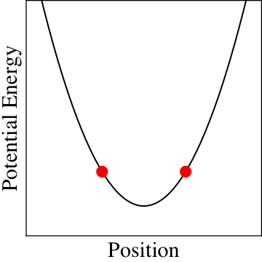
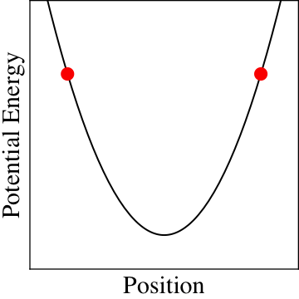
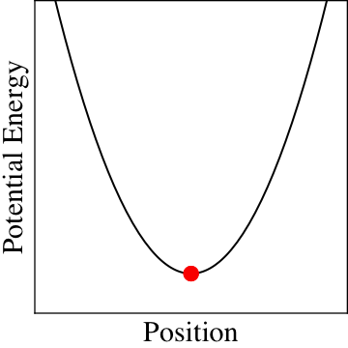
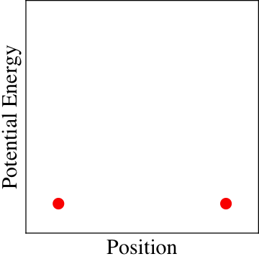
“Thick Lens” Case
Trade Δx for Δp in a harmonic potential
Our analogies with optical lensing have implicitly assumed that we can make a sort of “ray tracing”/“classical trajectory tracing” approximation for keeping track of the atom cloud dynamics
  Is this valid?
  If so, under what conditions?
t = 0
t < t_{Lens}
t = t_{Lens}
t = t_{Lens} + ε
v_{x}
p
p
p
Phase space
x
x
x
Notes:
For most of the cooling sequence, we follow a fairly standard procedure by loading a 3D MOT and then evaporating down to BEC. However, because of our large atom number, we are dominated by chemical potential of a whole micro kelvin. At that point, we have a micro K of temperature. If we were to let the cloud expand from this point, the cloud would end up exceeding our vacuum tube diameter by the end of the interferometer.
So we want to unwind this chemical potential and create a dilute, cold cloud of atoms.
We do this with a method that is related to delta kick cooling, for those familiar with that. In this procedure, we allow the atom to expand in a harmonic potential, to exchange their kinetic energy for potential energy, and then when all the atoms have left is potential energy, we abruptly turn off the trap, leaving a very dilute, cold cloud of atoms. Just what we were looking for. The cooling power you can acheive by this method are limited by the ratio of the initial size of the cloud to the final size. So to get the coldest temperatures, you would want to start with as small a cloud as possible, and then expand in as shallow a bowl as possible.
As the trap evolves there’s an oscillation between the size and the temperature. By the time they’re large, they’re slow and cold and then we turn off the trap
So to solve this, we have another stage of cooling, that is related to delta-kick cooling, for those familiar with that. Essentially we allow the atoms to expand from a point against a harmonic potential. In the ideal case, all the atoms reach their turning point, their position of zero velocity at the same time, which is when we choose to turn off the harmonic trap. The optimal temperature that you can achieve is limited by ratio of the square of the initial size to the final size. So to get the coldest temperatures, you would want to start with as small a cloud as possible, and then expand in as shallow a bowl as possible.
Point out that the mag lens is not just for BECs
Potential energy, ditch ½ mvx^2
x^2
Keep temperature box on there
Possibly make text bigger and ditch vxtlens
\frac{T_f}{T_i} = \left(\frac{\Delta x_i}{\Delta x_f}\right)^2

Slide 5
The Wigner Function
Wigner function definition
For a pure state ( ):
Under integration, gives position/momentum probability density functions
Giese et al., arXiv:1402.0963

Slide 6
The Wigner Function
Real-valued, but can in general take on negative values. Example: Wigner function for 6th excited eigenstate of harmonic oscillator:
Important property: for Hamiltonians at most quadratic in position, Wigner function evolves according to classical Liouville equation
Can solve for full quantum dynamics by keeping track of evolution of classical trajectories in phase space! Close analogy to ray tracing.
Quantum corrections arise for 3rd order and higher potentials
Giese et al., arXiv:1402.0963

Slide 7
Application to Lensing in Stanford EP Apparatus
Transverse lensing potential from AC Stark shift of Gaussian laser beam
Analogy between distance in light optics and time in atom optics
Tuned strength of lens by adjusting for how long laser beam was pulsed on (“thin lens” limit in these experiments)
Though potential was not perfectly quadratic, estimated quantum corrections to measured quantities were negligible
Kovachy, Hogan et al., PRL 114, 143004 (2015): see supplemental material for detailed Wigner function calculations

Slide 8
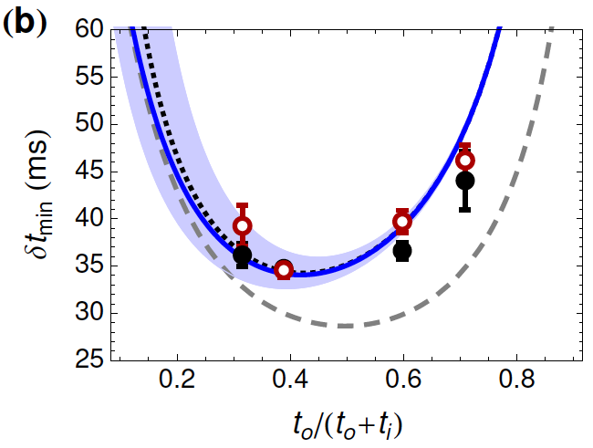
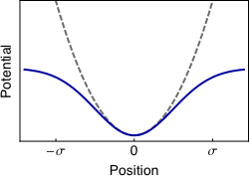
Example: Calculating the Effect of Gaussian Aberrations
Harmonic vs. Gaussian potential
Lens duration required for refocusing
position/time
Kovachy, Hogan et al., PRL 114, 143004 (2015): see supplemental material for detailed Wigner function calculations

Slide 9
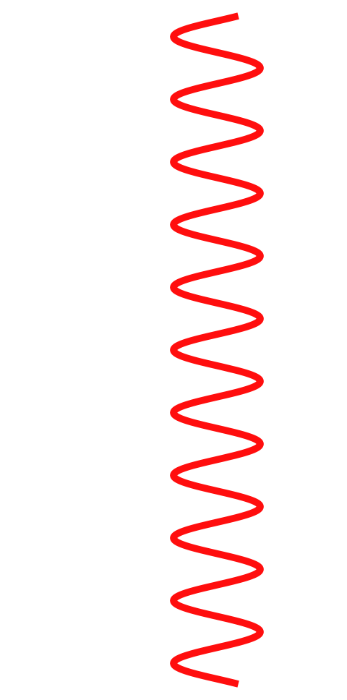
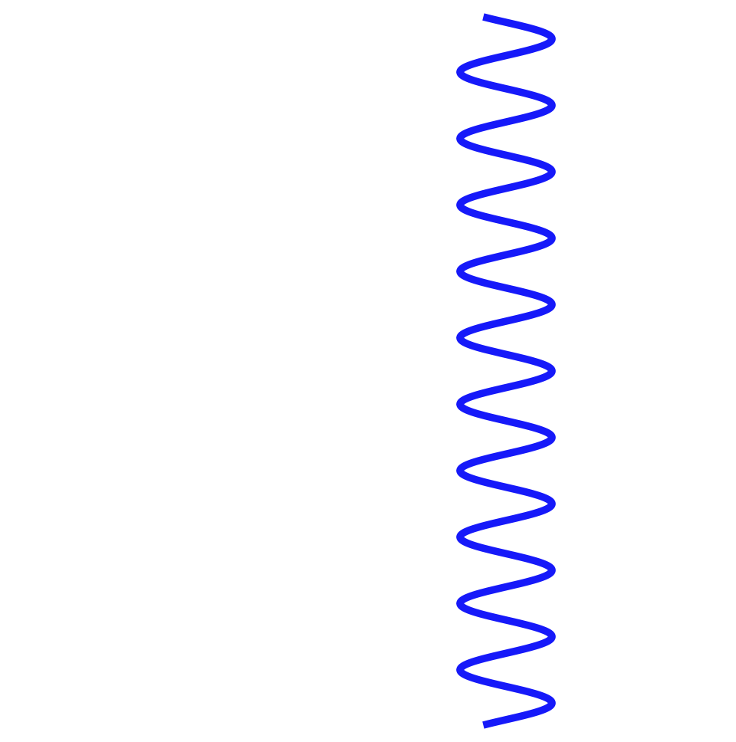
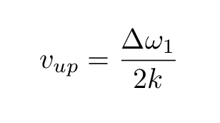
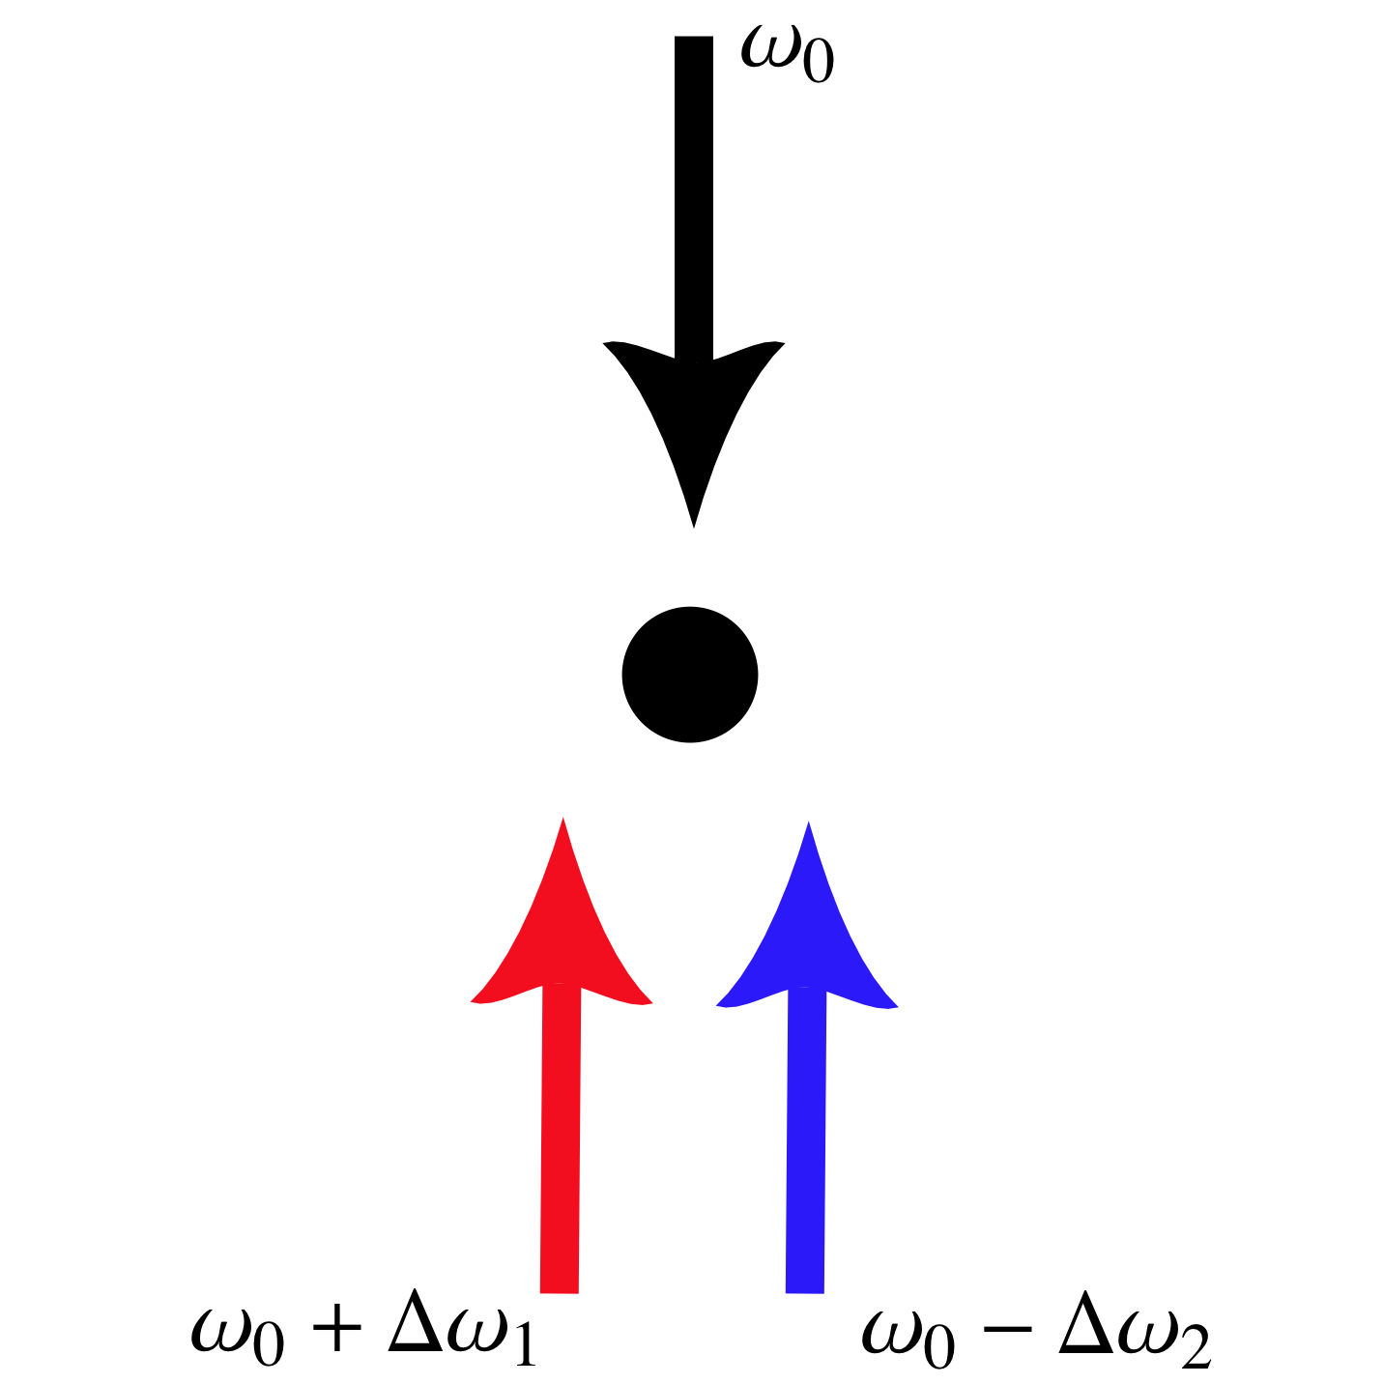
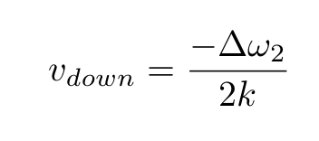
How To Make One (or More) Optical Lattices
Moving standing wave arising from interference of two counterpropagating laser beams detuned from an atomic transition
Periodic potential arises from spatially varying AC Stark shift (proportional to local laser intensity) associated with the detuned standing wave
Lattice velocities controlled by ramping frequency differences between lattice beams
Lattice 1
Lattice 2

Slide 10
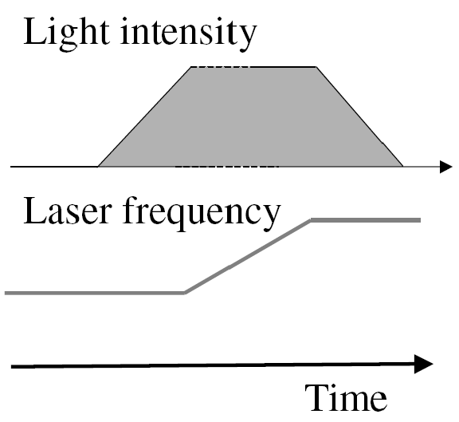
Loading into the Ground State of a Lattice
Set lattice velocity so that it matches the velocity of the part of the atom’s wavefunction we want to address, must match to within one recoil velocity
Adiabatically increase lattice depth to load atom into lattice ground state (experimentally, typical loading times of hundreds of microseconds)
Can drag atom in lattice to control its trajectory
Intuitive picture: atoms trapped in potential minima, ping pong balls in an elevator

Slide 11
Band Structure and Bloch Oscillations
Consider rest frame of lattice subject to an acceleration. Fictitious force F in rest frame. Define quasi-momentum as below:
Energy spectrum of lattice forms discrete bands, each of which are periodic in quasi-momentum
In rest frame of lattice, atom velocity oscillates as a function of time due to force (Bloch oscillations)
In lab frame, atom velocity undergoes acceleration on top of these Bloch oscillations
Peik et al., PRA 55, 2989 (1997)

Slide 12
Optical Lattice Hamiltonian
Counter-propagating individual laser beams with respective Rabi frequencies given by
Lattice potential in the limit of large excited state detuning Δ
Can compute dynamics under this potential in momentum space
Note that only a discrete (though infinite) family of momentum states is coupled, via nearest neighbor coupling

Slide 13
Optical Lattice Hamiltonian
Equivalent way to understand the Hamiltonian—nearest neighbor momentum states coupled by two photon transitions

Slide 14
Lattice Simulation
My simulation code is in Mathematica, using the momentum basis
Will walk through some examples

Slide 15
Outlook
Lensing
  Add quantum corrections?
  Add atom-atom interactions?
Optical Lattices
  Mathematica may not be the ideal platform for more intensive simulations
  Include more levels, perhaps adaptive simulation to center on atom’s velocity without needing to keep track of thousands of states?
  Include spontaneous emission losses
Others in the collaboration may have tools to address some (or all) of these points

