Slide 1
AD - NuStorm Update

Slide 2
FESS Geographic Information System (GIS) Map
N

Slide 3
FESS Geographic Information System (GIS) Map
N

Slide 4
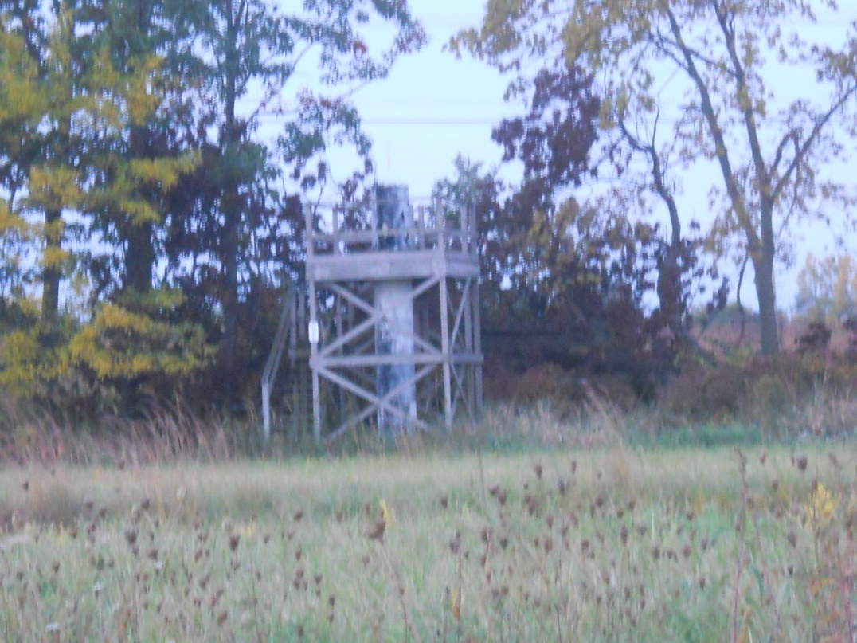
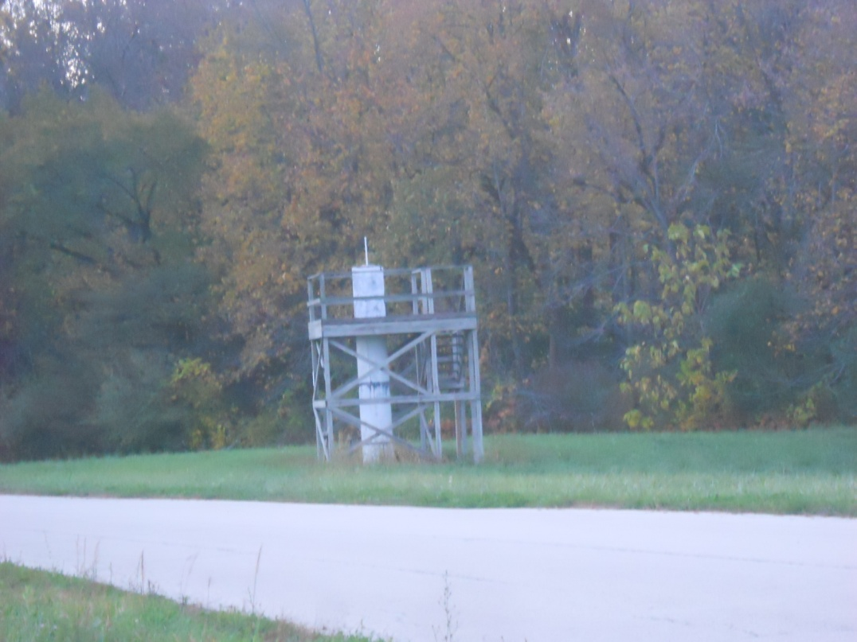
MI-nuStorm Alignment Network
N

Slide 5
MI-40 Area
N

Slide 6
MI-40 Absorber line
Old but not too old Beamsheet
Program ces (A Construction Engineering Survey format) (11/26/91) Wed May 6 14:53:13 1998
Site coordinates for beamline: a120layout.ces.rel
NOTES: Coordinates are given for the entrance of the device in DUSAF coordinate system.
Site +x-axis (EAST); site +y-axis (NORTH); Site z-axis (ELEVATION)
Positive bearing is ccw wrt site EAST.
Pitch is the vertical angle about the x-y plane.
line location typ_code distance x y z brng pitch yaw
[ft] [ft] [ft] [ft] [deg] [deg] [deg]
0000 BEAM MI_ABORT -4.84415 101569.28146 94365.21158 715.72409 27.71271 0.00000 0.00000
0001 Q400 3Q100 -4.84415 101569.28146 94365.21158 715.72409 27.71271 0.00000 0.00000
0002 ~ drift 3.49999 101576.66844 94369.09193 715.72409 27.70853 0.00000 0.00000
0003 K001 K400 9.35968 101581.85616 94371.81653 715.72409 27.70093 0.00000 0.00000
0004 ~ drift 15.56045 101587.34622 94374.69901 715.72409 27.69334 0.00000 0.00000
0005 K002 K400 17.19299 101588.79176 94375.45770 715.72409 27.68578 0.00000 0.00000
0006 ~ drift 23.39377 101594.28262 94378.33872 715.72409 27.67822 0.00000 0.00000
0007 VC001 MIVC 51.67948 101619.33160 94391.47758 715.72409 27.67822 0.00000 0.00000
0008 ~ drift 52.67948 101620.21716 94391.94210 715.72409 27.67822 0.00000 0.00000
0009 Q401 3Q84 53.22114 101620.69684 94392.19371 715.72409 27.67166 0.00000 0.00000
0010 ~ drift 60.22113 101626.89618 94395.44458 715.72409 27.66510 0.00000 0.00000
0011 HC002 MIHC 97.49440 101659.90825 94412.75064 715.72409 27.66510 0.00000 0.00000
0012 ~ drift 98.49440 101660.79393 94413.21493 715.72409 27.66510 0.00000 0.00000
0013 L001 LAM_1 99.45851 101661.64782 94413.66257 715.72409 27.62757 -0.16773 -12.60507
0014 ~ drift 108.64485 101669.78676 94417.92250 715.69720 27.59004 -0.33547 0.00000
0015 Q402 3Q84 109.94229 101670.93666 94418.52338 715.68960 27.63438 -0.37821 0.00000
0016 ~ drift 116.94228 101677.13817 94421.77008 715.64409 27.67873 -0.42095 0.00000
0017 HVP402 LGBPM 117.39519 101677.53927 94421.98046 715.64077 27.67873 -0.42095 0.00000
0018 ~ drift 118.05143 101678.12042 94422.28530 715.63594 27.67873 -0.42095 0.00000
0019 L002 LAM_1 118.80722 101678.78971 94422.63635 715.63039 27.66023 -0.59181 -6.18794
0020 ~ drift 127.99355 101686.92621 94426.90091 715.53550 27.64172 -0.76266 0.00000
0021 L003 LAM_1 130.00511 101688.70817 94427.83414 715.50872 27.62969 -0.93409 -4.01070
0022 ~ drift 139.19144 101696.84694 94432.09437 715.35895 27.61765 -1.10552 0.00000
0023 CM001 CMG_2 141.58953 101698.97180 94433.20603 715.31267 27.62757 -1.29423 3.00803
0024 ~ drift 152.58951 101708.71756 94438.30696 715.06415 27.63748 -1.48293 0.00000
0025 HC001 MRHC 153.58951 101709.60345 94438.77085 715.03826 27.63748 -1.48293 0.00000
0026 ~ drift 154.25617 101710.19408 94439.08008 715.02100 27.63748 -1.48293 0.00000
0027 HC001 MRHC 155.17284 101711.00614 94439.50532 714.99727 27.63748 -1.48293 0.00000
0028 ~ drift 155.83950 101711.59673 94439.81458 714.98001 27.63748 -1.48293 0.00000

Slide 7
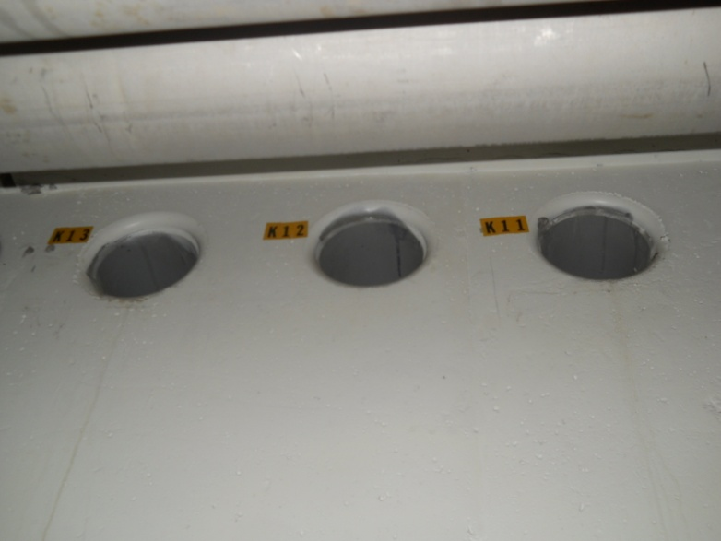
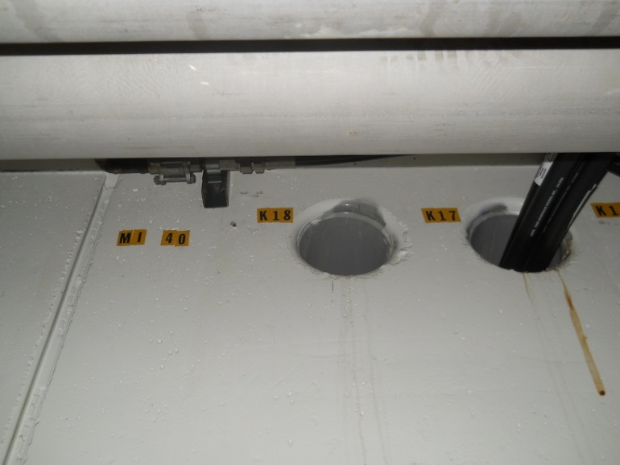
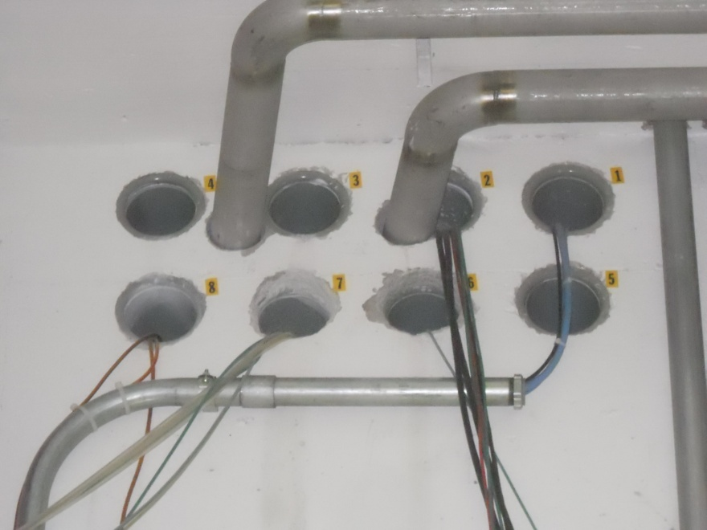
MI-40 Enclosure
Plenty of cable penetrations

Slide 8
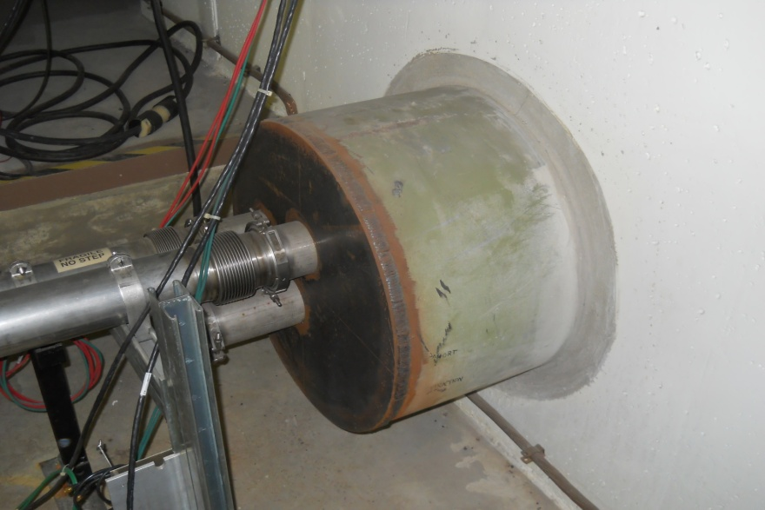
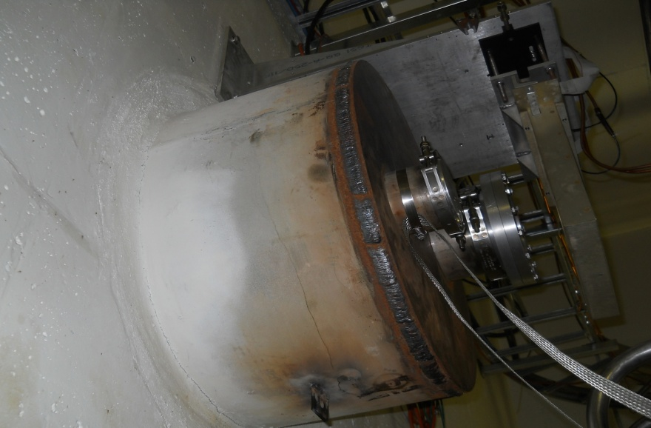
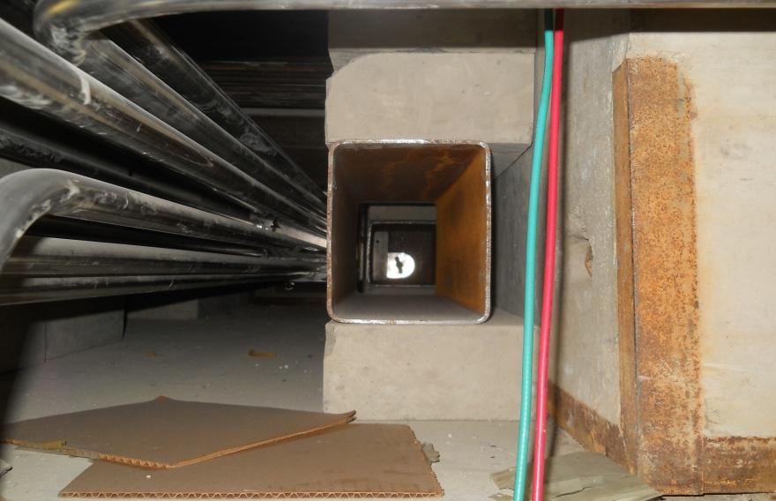
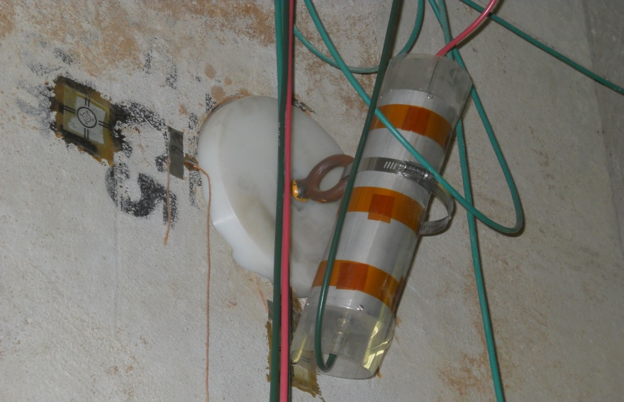
MI-40 Enclosure
Upstream berm pipe
Downstream berm pipe
MI-40 absorber beamline bypass
Poly-plug ??

Slide 9
FESS Shielding Drawings

Slide 10
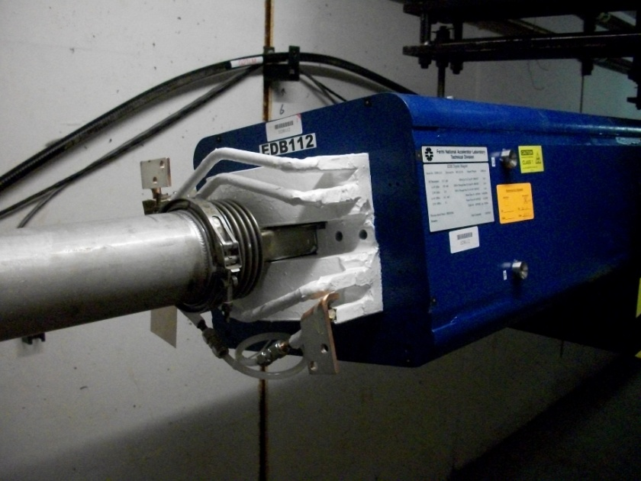
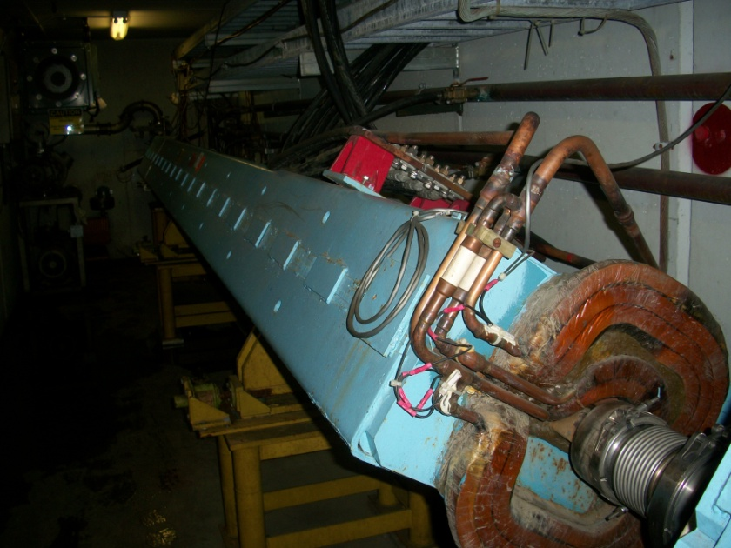
Magnets
EDB vs B2
 | EDB | B2
Length (m) | 3.048 | 6.096
Max Current (Amps) | 1000 | 4000
Max Bend Angle (radians) | 0.00797 | 0.02343
Full Limiting Aperture (mm) | 38.1 | 50.04
New Build | ??? | $250,000

Slide 11
What’s next?
Beamsheet
AMG find as-founds of Berm Pipe flanges
Cost estimates
Magnets
EDBs
Quadrapoles
Instrumentation
BLMs
Multiwires
BPMs
Beam pipe
4” pipe $/foot
Flanges
Clamps
Vacuum
Roughing pumps
Turbo pumps
Ion Pumps

