Slide 1


Development of a Damping-Ring-Free Electron Injector for Future Linear Colliders
Tianzhe Xu
SLAC National Accelerator Laboratory
formerly at Northern Illinois University
AWA Needs and Opportunity Workshop, 8/10/2023

Slide 2
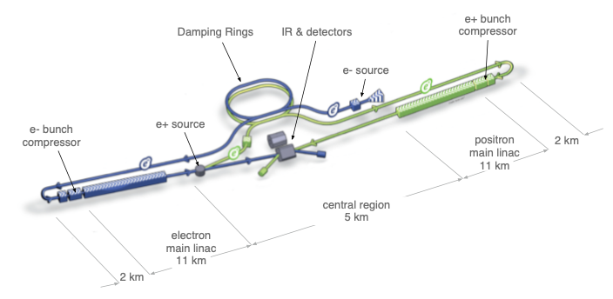



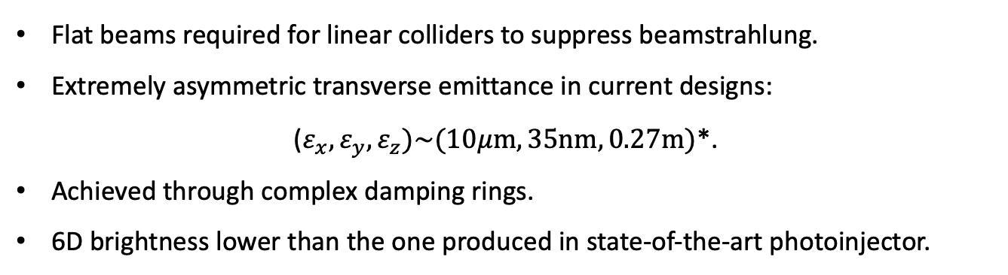


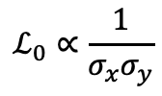
Introduction
Flat beams required for linear colliders to suppress beamstrahlung.
Extremely asymmetric transverse emittance in current designs:
($ε_{x},ε_{y},ε_{z})\sim (10μm, 35nm,0.27m)$*.
Achieved through complex damping rings.
6D brightness lower than the one produced in state-of-the-art photoinjector.
Luminosity:
$$ℒ_{0}∝\frac{1}{σ_{x}σ_{y}}$$
flat beam:
Beamstrahlung parameter:
$$Υ∝\frac{1}{σ_{x}+σ_{y}}$$
$$σ_{y}≪σ_{x}$$
transverse profile of a flat beam
schematic layout of International Linear Collider (ILC)
$$y$$
$$ρ(x,y)$$
$$x$$
From ILC Technical Design Report, 2013.

Slide 3







Emittance repartition in 4D phase space
Round, uncoupled beam
Flat beam
$$ε_{x}$$
$$10 μm$$
Add coupling
$$ε_{x}$$
$$100 μm$$
Round-to-flat
beam transform
(RFBT)
$$ε_{y}$$
$$10 μm$$
$$ε_{y}$$
$$1 μm$$
Manipulation in X, Y

Slide 4


















Emittance repartition in 6D phase space
Round, uncoupled beam
Flat beam
Flat beam with better $ε_{x}$
$$ε_{x}$$
$$10 μm$$
Add coupling
$$ε_{x}$$
$$100 μm$$
$$ε_{x}$$
$$10 μm$$
Emittance
Round-to-flat
beam transform
(RFBT)
$$ε_{y}$$
$$10 μm$$
$$ε_{y}$$
$$1 μm$$
$$ε_{y}$$
$$1 μm$$
Exchange
$$ε_{z}$$
$$10 μm$$
$$ε_{z}$$
$$10 μm$$
$$ε_{z}$$
$$100 μm$$
Manipulation in X, Y
Manipulation in X, Z
Manipulation in X, Y, Z

Slide 5
A Damping-Ring-Free Electron Injector Design

Slide 6
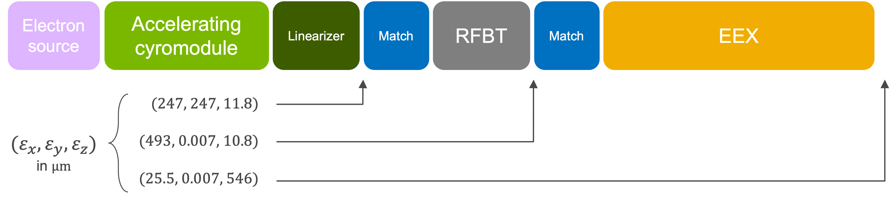
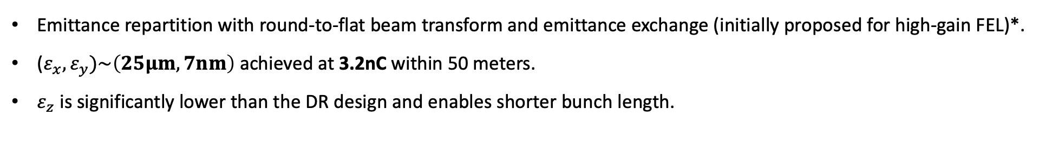
A damping-ring-free injector beamline
Emittance repartition with round-to-flat beam transform and emittance exchange (initially proposed for high-gain FEL)*.
($ε_{x},ε_{y})\sim \left(25μm, 7nm\right)$ achieved at 3.2nC within 50 meters.
$ε_{z}$ is significantly lower than the DR design and enables shorter bunch length.
*P. Emma et al, PhysRevSTAB.9.100702

Slide 7
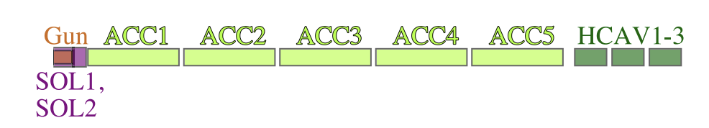
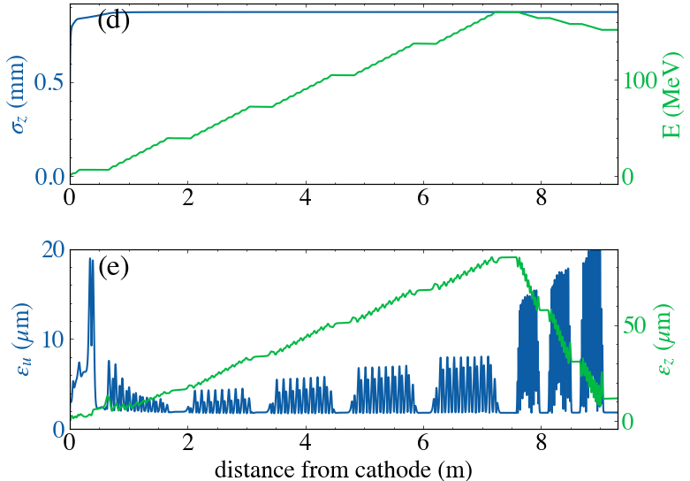
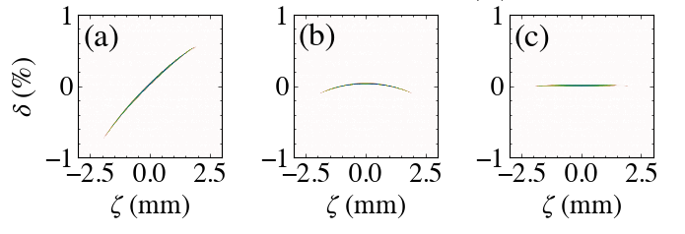
Beam generation
1.3 GHz RF gun operating at 60 MV/m. Ellipsoidal distribution used for emittance preservation.
Linac cavities operated off-crest to minimize final energy spread.
Harmonic cavities for LPS curvature correction.
Longitudinal phase space after L1, L5 and H3
T. Xu et al. Phys. Rev. ST Accel. Beams 26.1 (2023): 014001

Slide 8
Emittance manipulation
RFBT
EEX
Emittance Exchange (EEX)
Round-to-Flat Beam Transform (RFBT)

Slide 9
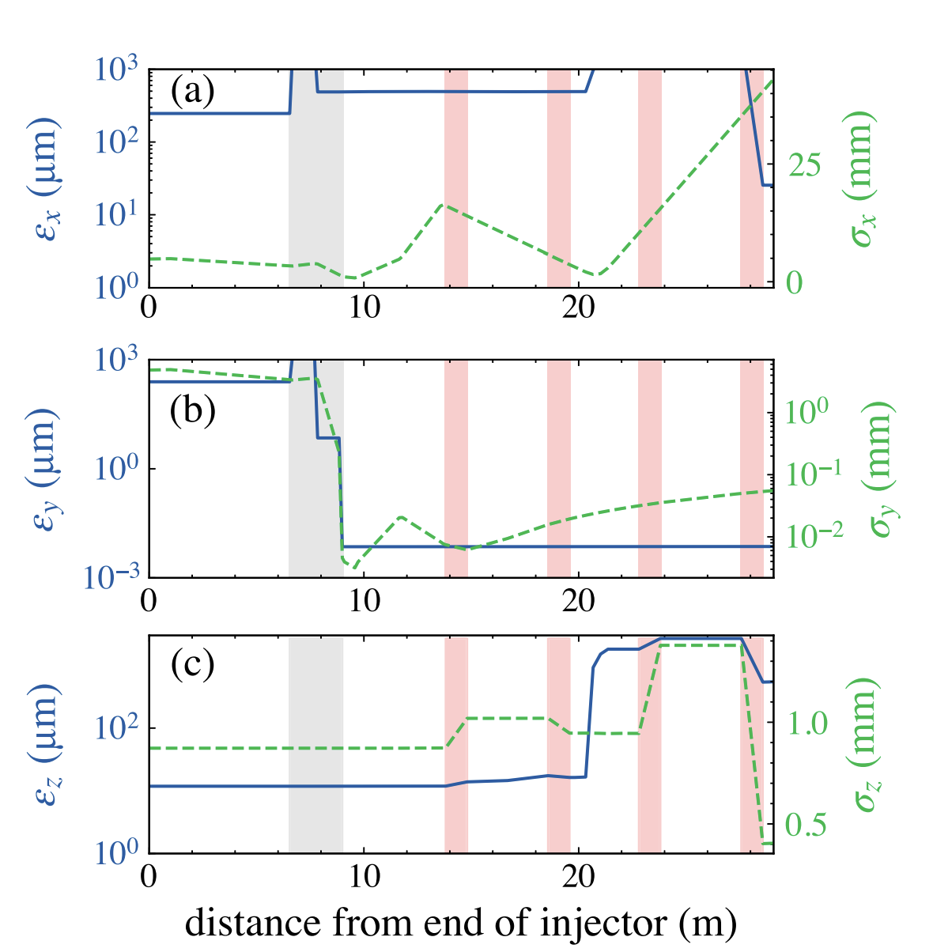
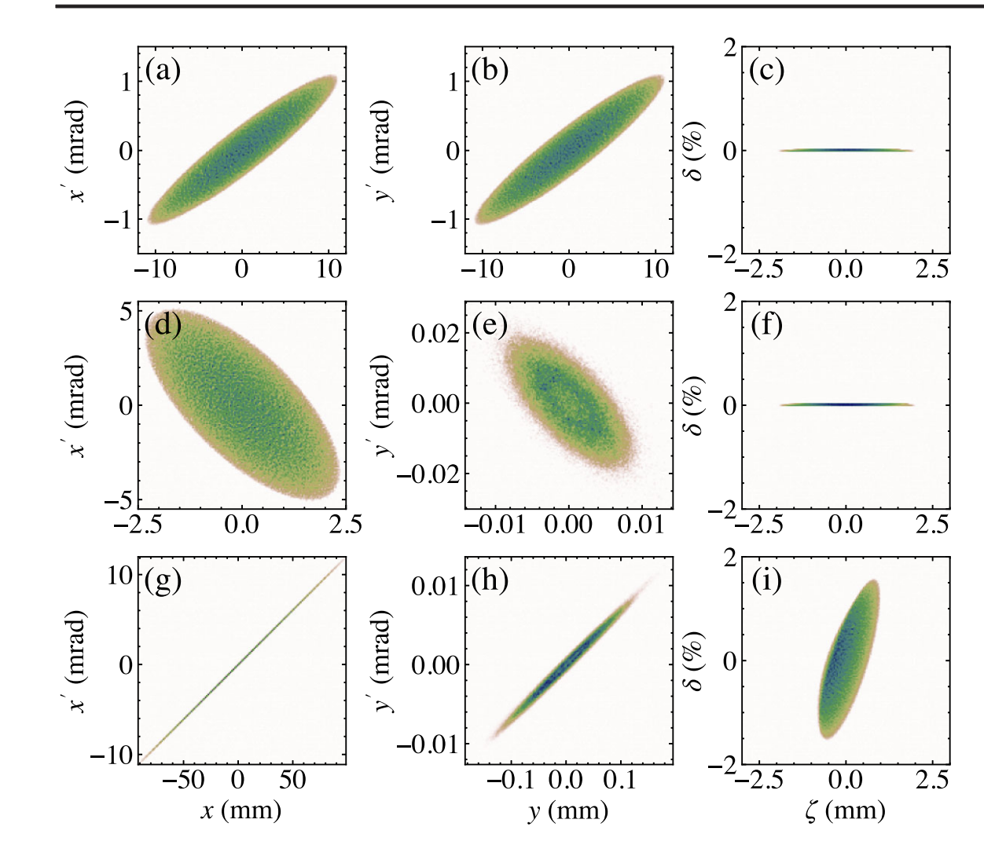
Emittance and phase space evolution
Before RFBT
After RFBT
After EEX

Slide 10

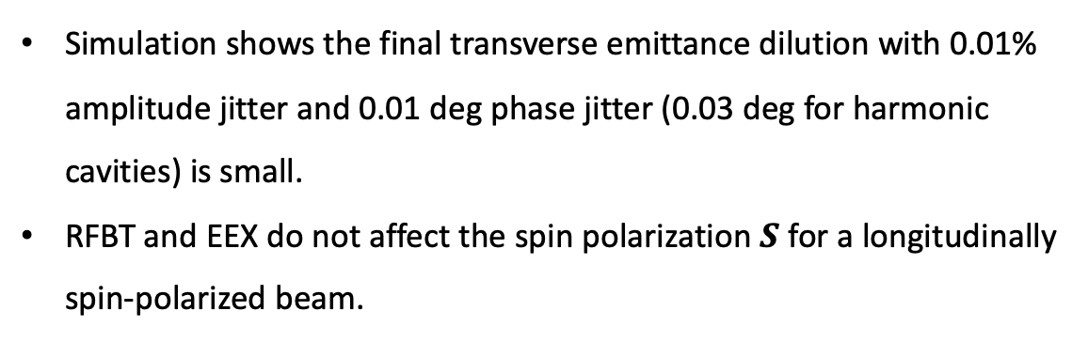
Spin dynamics and jitter study
Simulation shows the final transverse emittance dilution with 0.01% amplitude jitter and 0.01 deg phase jitter (0.03 deg for harmonic cavities) is small.
RFBT and EEX do not affect the spin polarization $S$ for a longitudinally spin-polarized beam.
Evolution of $S$ along RFBT and EEX beamline
Histogram of final horizontal and vertical emittances for 1000 simulations with jitter

Slide 11
Proof-of-Principle Experiments at AWA
4D emittance repartition, ellipsoidal flat beam (demonstrated).
6D emittance repartition, RFBT + EEX (in progress, to be cont’d).

Slide 12
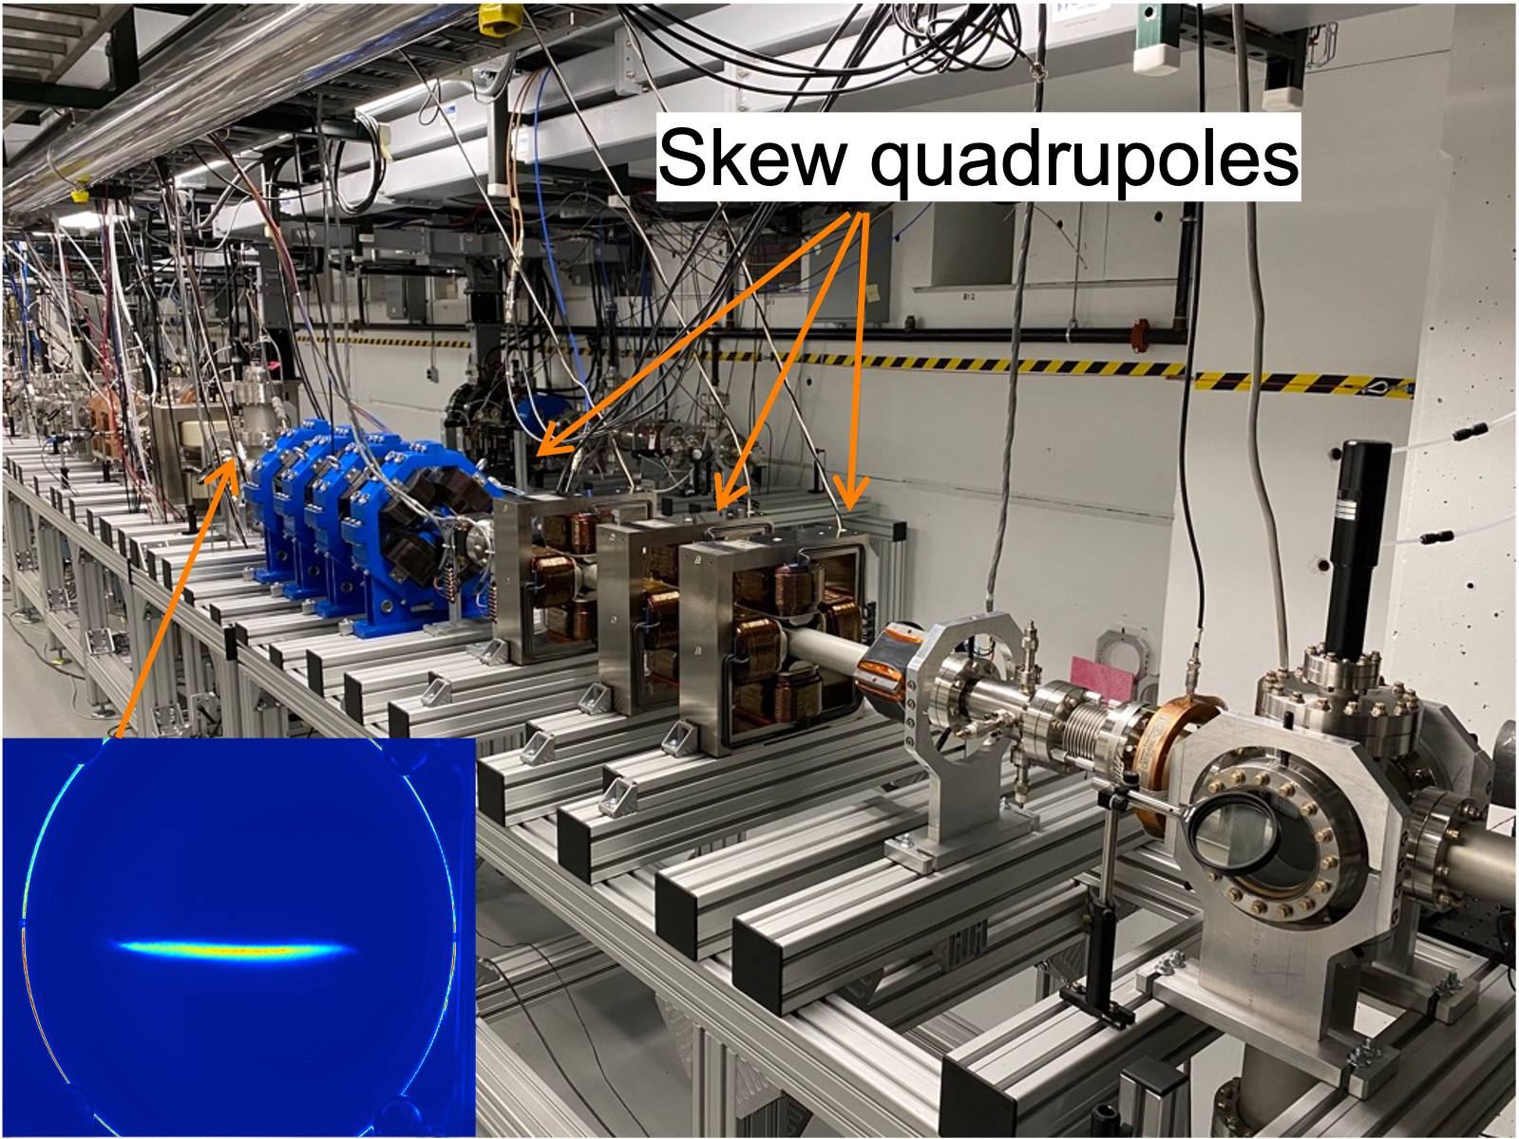
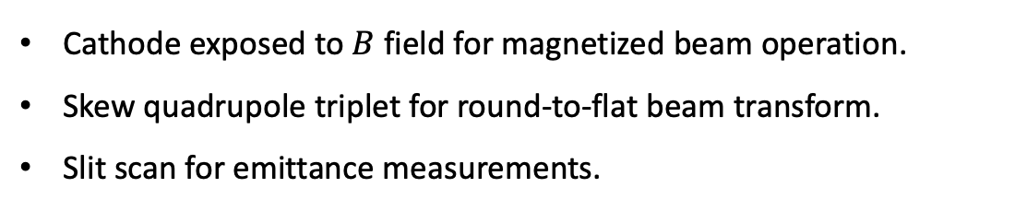
Experimental setup at AWA
Cathode exposed to $B$ field for magnetized beam operation.
Skew quadrupole triplet for round-to-flat beam transform.
Slit scan for emittance measurements.
RFBT beamline at Argonne Wakefield Accelerator
T. Xu et al. Phys. Rev. ST Accel. Beams 25.4 (2022): 044001

Slide 13

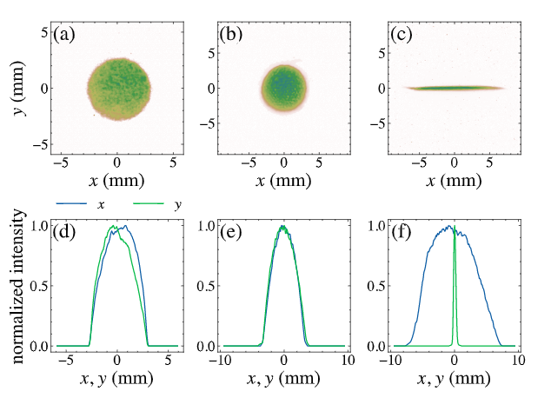
Ellipsoidal flat beam generation
blow-out regime condition:
Ellipsoidal flat beam generation with blow-out scheme (self-expansion of short electron bunch).
Measured transverse and spatiotemporal profiles and projections show ellipsoidal features
Measured profiles and projections
for virtual cathode (laser), round beam and flat beam (electron beam)
Measured spatiotemporal profile and longitudinal phase space

Slide 14





Transverse phase space measurements
$$ε_{+}/ε_{−}\sim 50$$
$$ε_{+}/ε_{−}\sim 200$$
Round/magnetized beam $(y,y’)$
Flat beam $(x,x’)$
Flat beam $(y,y’)$

Slide 15
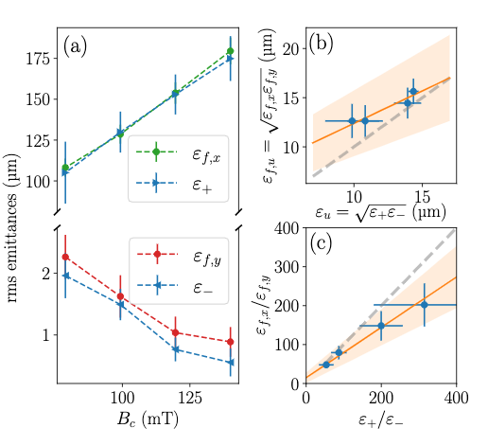
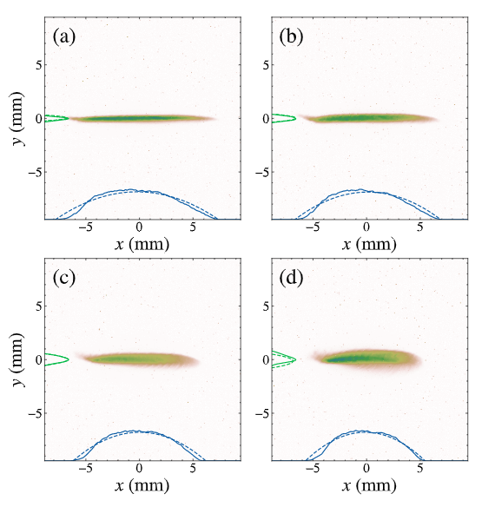
Eigenemittance mapping
Ellipsoidal flat beams with variable transverse emittance ratios up to 200 at 1nC.
Eigen-to-projected emittance mapping demonstrated: $ε_{+}→ε_{x}$, $ε_{−}→ε_{y}$
Transverse profiles and projections of flat beams
with different emittance ratios
Measured eigenemittances and projected emittances for different magnetization

Slide 16
Proof-of-Principle Experiments at AWA
4D emittance repartition, ellipsoidal flat beam (demonstrated).
6D emittance repartition, RFBT + EEX (in progress, to be cont’d).

Slide 17
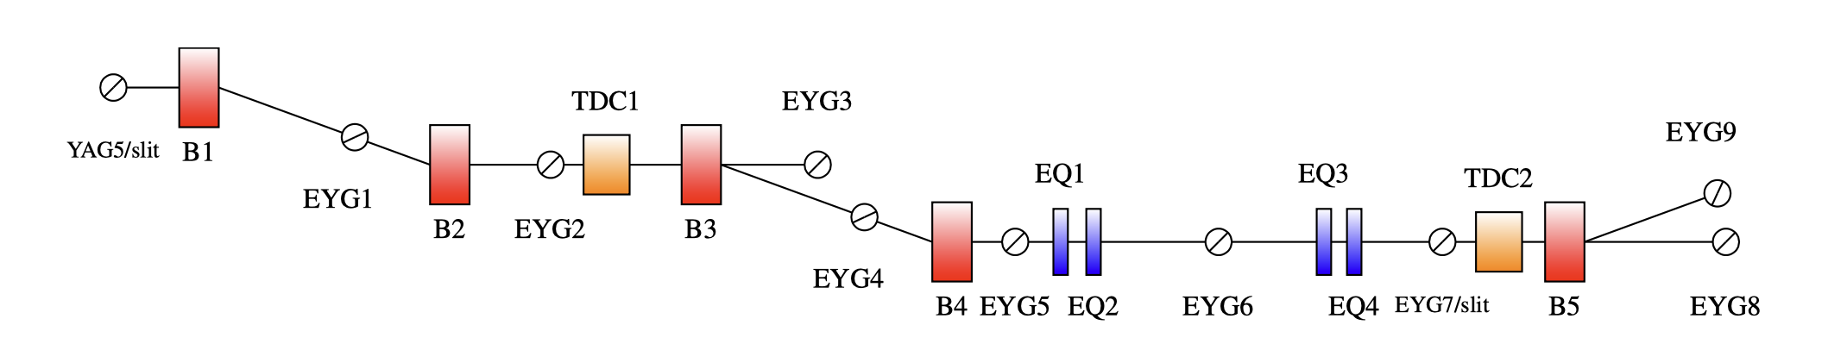
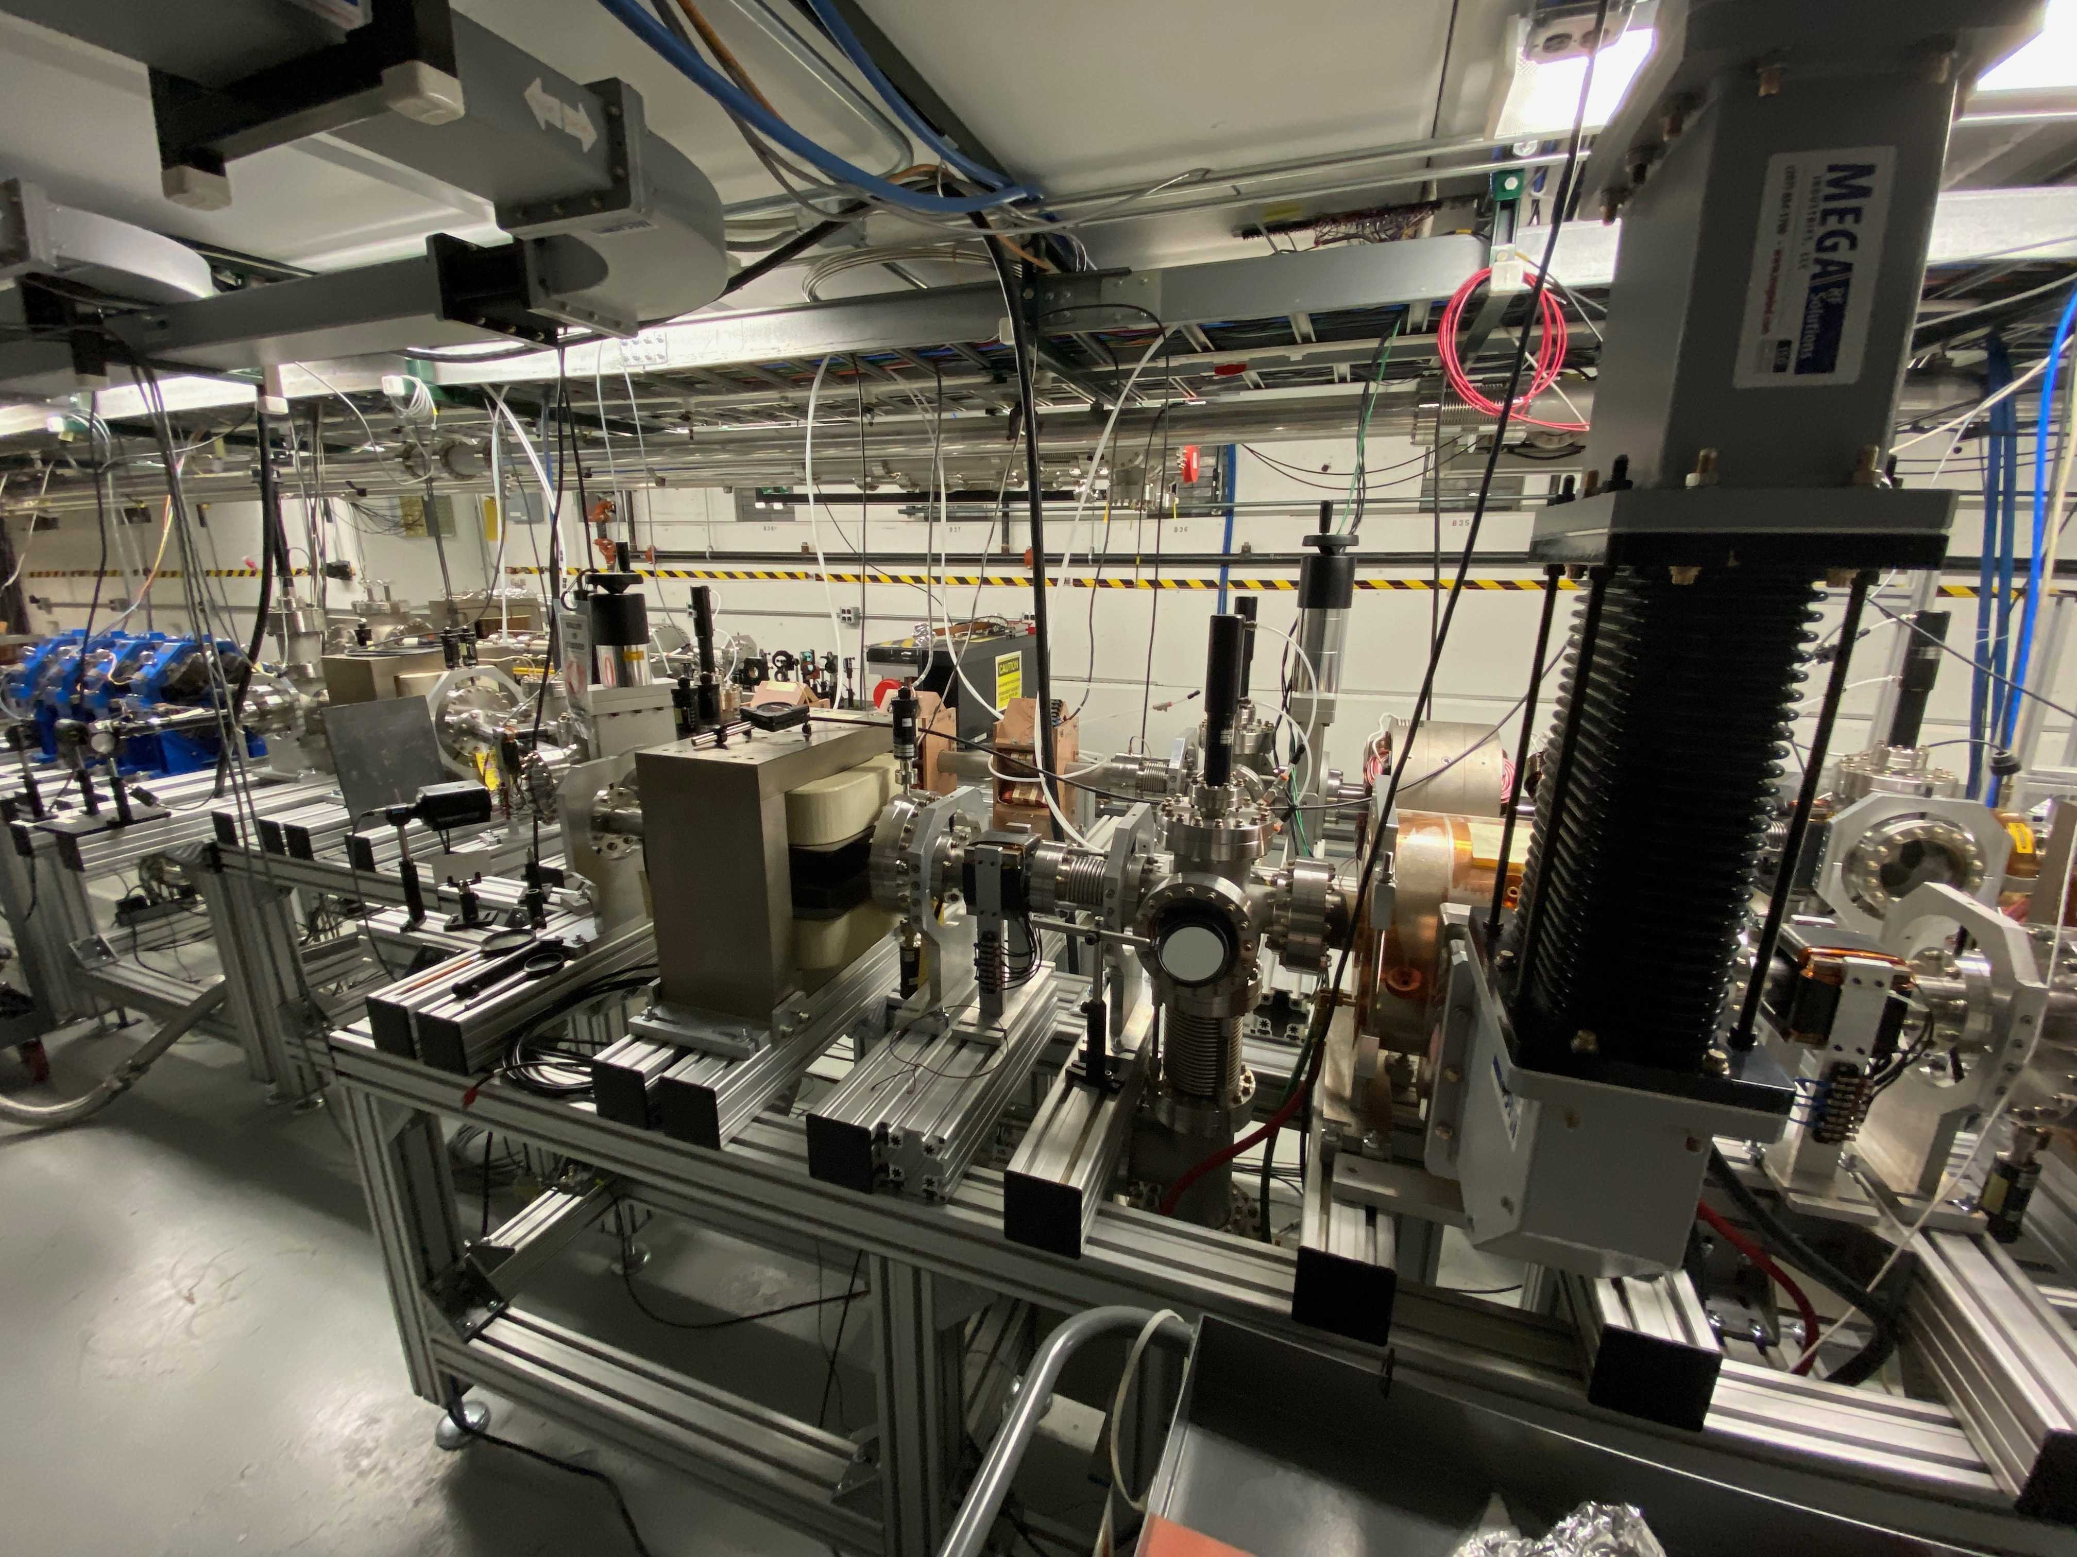
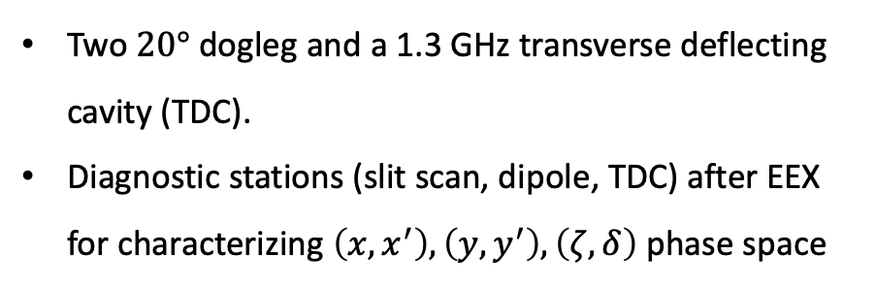
EEX beamline at AWA
Two $20°$ dogleg and a 1.3 GHz transverse deflecting cavity (TDC).
Diagnostic stations (slit scan, dipole, TDC) after EEX for characterizing $\left(x,x^{′}\right), \left(y,y^{′}\right), \left(ζ,δ\right)$ phase space
Beam direction
EEX
Phase space diagnostics

Slide 18
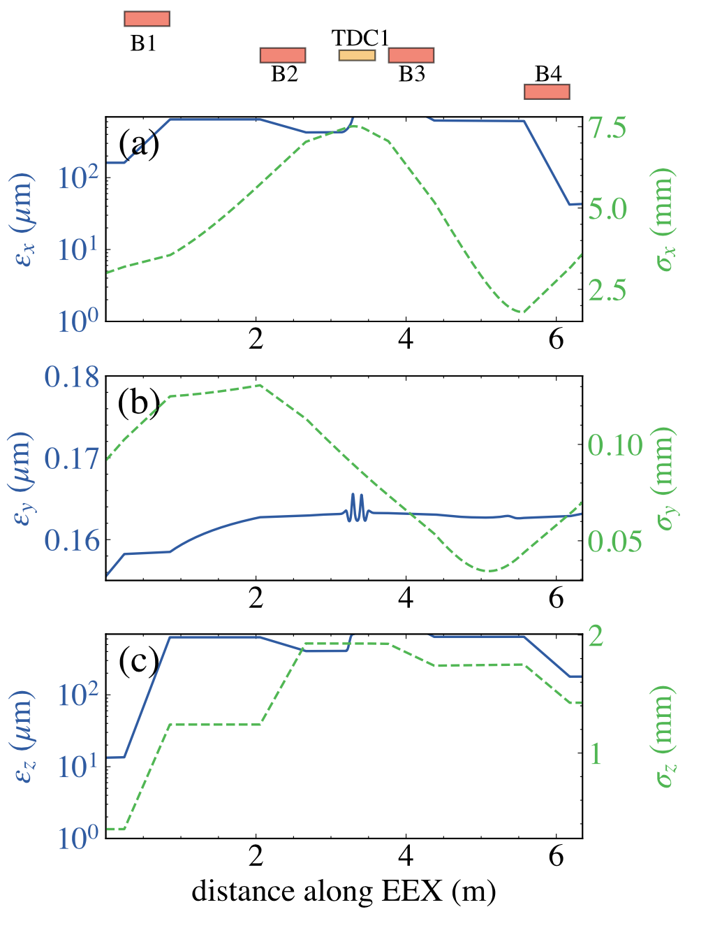









6D emittance repartition at AWA
Simulated emittances and beam sizes evolution in the EEX beamline
$$ε_{x}$$
$$ε_{y}$$
$$ε_{z}$$
Before EEX
(after flat beam transform)
$161.2 μ$m
$0.15 μ$m
$13.4 μ$m
After EEX
$43 μ$m
$0.16 μ$m
$179.3 μ$m

Slide 19
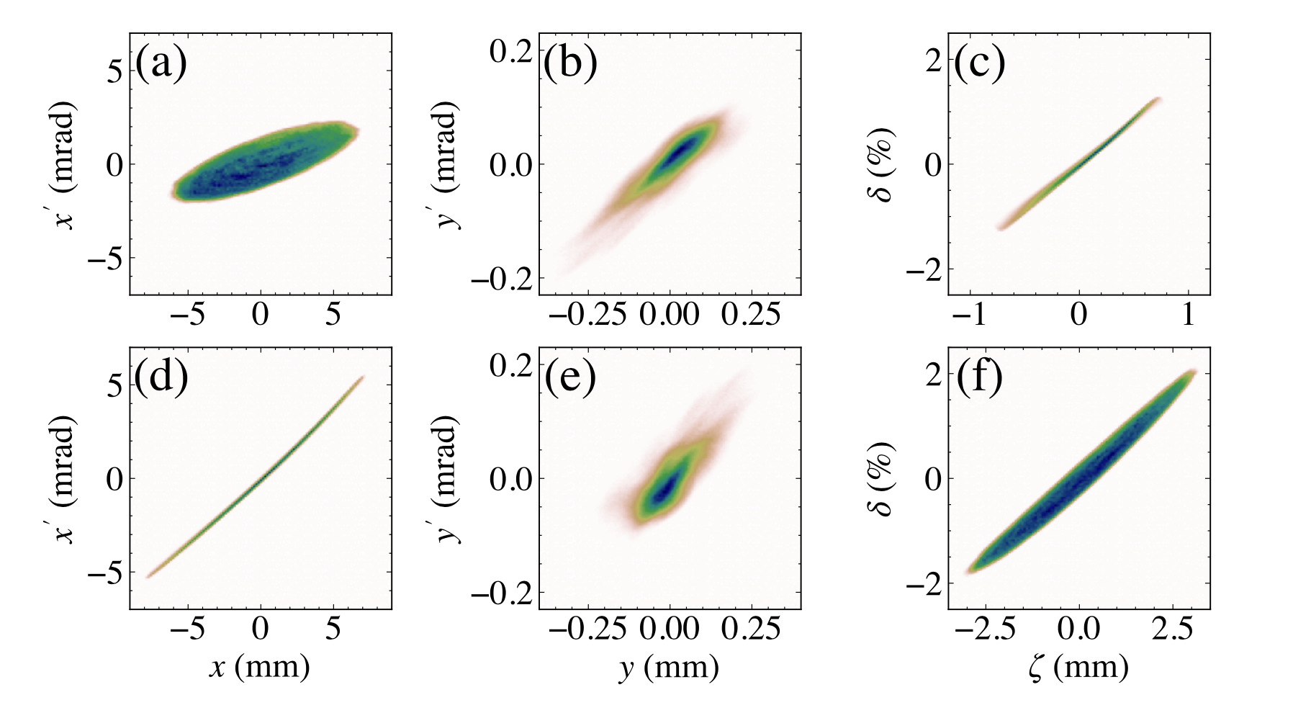
Simulation of 6D phase space evolution
Before exchange
After exchange
Significant reduction of
final horizontal emittance
Preservation of
final vertical emittance

Slide 20
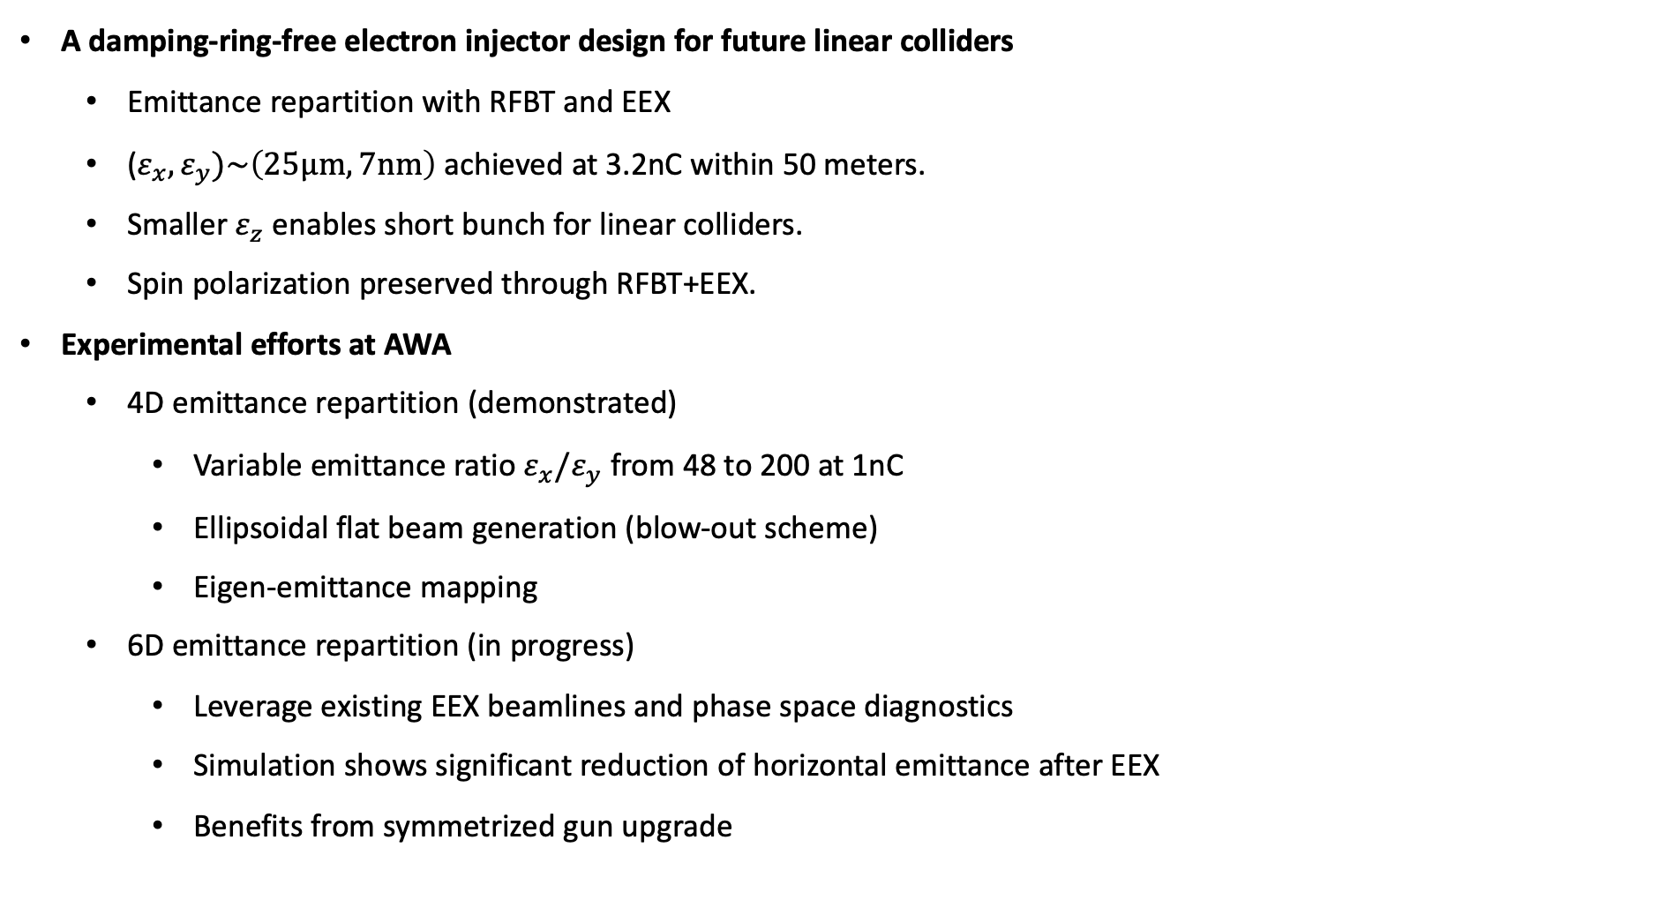
Conclusions
A damping-ring-free electron injector design for future linear colliders
  Emittance repartition with RFBT and EEX
  ($ε_{x},ε_{y})\sim \left(25μm, 7nm\right)$ achieved at 3.2nC within 50 meters.
  Smaller $ε_{z}$ enables short bunch for linear colliders.
  Spin polarization preserved through RFBT+EEX.
Experimental efforts at AWA
  4D emittance repartition (demonstrated)
    Variable emittance ratio $ε_{x}/ε_{y}$ from 48 to 200 at 1nC
    Ellipsoidal flat beam generation (blow-out scheme)
    Eigen-emittance mapping
6D emittance repartition (in progress)
  Leverage existing EEX beamlines and phase space diagnostics
  Simulation shows significant reduction of horizontal emittance after EEX
  Benefits from symmetrized gun upgrade

Slide 21


Acknowledgement
NIU and ANL
Philippe Piot
ANL
Scott Doran
Wanming Liu
Eric Wisniewski
Charles Whiteford
John Power
KEK
Masao Kuriki

Slide 22
Thanks for your attention!

Slide 23
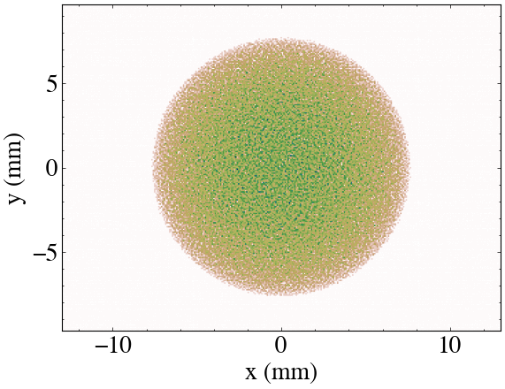
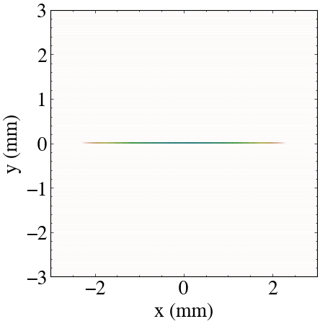


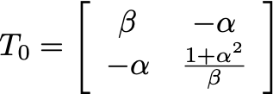

Flat beam transform
round beam
flat beam
Skew quadrupoles

Slide 24
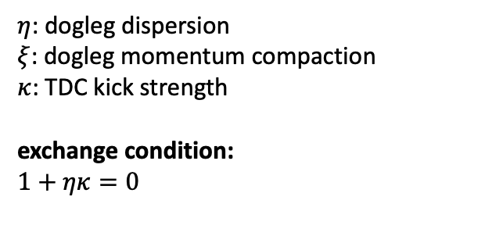
Emittance exchange
Beam direction
$η$: dogleg dispersion
$ξ$: dogleg momentum compaction
$κ$: TDC kick strength
exchange condition:
$$1+ηκ=0$$

