Slide 1
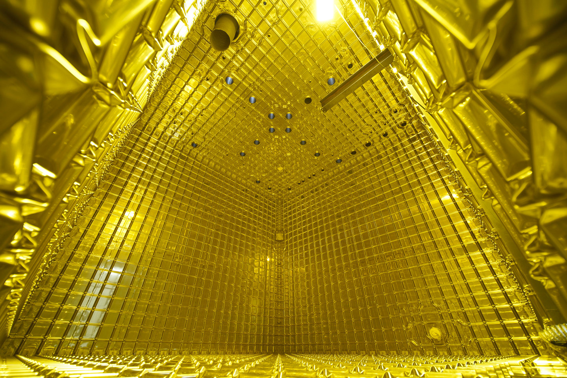



IMPROVING THE MODELLING OF NEUTRINO ENERGY BIAS
11 July 2023
CALLUM COX
Notes:
So, for those of you who don't know me, I'm Callum, Asher's PhD student at Royal Holloway with Alessandro Thea at Rutherford Appleton, and working with the Neutrino Interaction Uncertainty Working Group at CERN.
My working involves improving the modelling of Neutrino Energy Bias.

Slide 2
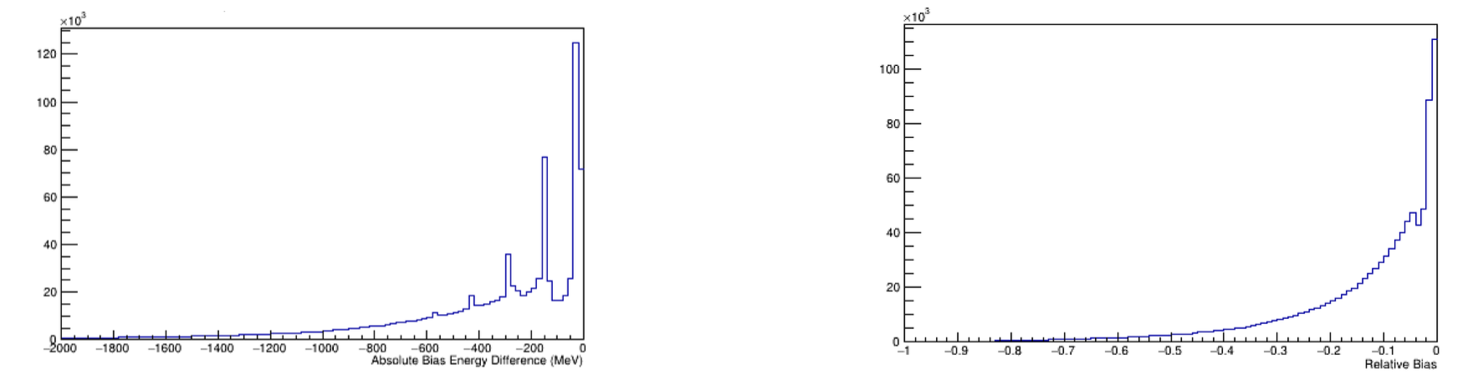
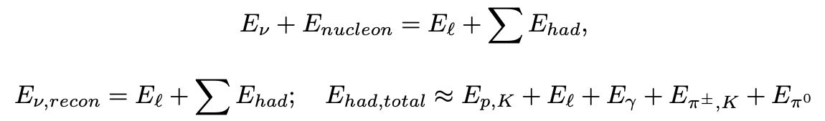
WHAT IS ENERGY BIAS
  We can't measure the energy of neutrinos directly
  Through conservation of energy, we can equate the sum of final state particle energies to initial state
  We should only use the energies of final state particles which we can detect
  The discrepancy between the true neutrino energy, what we should get, compared with what we can measure can be plotted to show the 'absolute bias' of our neutrino energy for that generator
  By taking the ratio of this bias to true neutrino energy, we get 'relative bias' which can allow us to compare between generators more directly
  The bias arises from final state energies we can't directly detect
Absolute
Relative
Notes:
The DUNE detectors don't detect the neutrino energy directly, but what it can do is measure the final state energies after a neutrino interaction. Through conservation of energy, we can reconstruct the initial neutrino energy from the sum of our final state energies for a given interaction. Yet, herein lies the problem because we're unable to directly measure all of the final state energies. However, if we know how by how, in a more direct sense, 'wrong' our generator's model is at reconstructing the energy - then we can account for this bias in our energy reconstruction and correcting for it. Bias can be measured by simply subtracting the 'true' neutrino energy for a given event from the reconstructed energy - giving the absolute bias; or if we divide by the absolute bias for a given event by it's true neutrino energy, we can get the 'relative' bias which can show just how well our model does for comparisons.

Slide 3
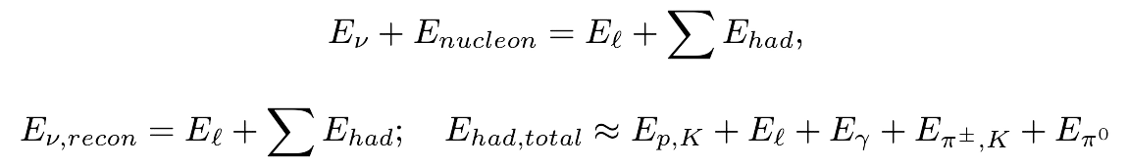
WHAT GOES INTO OUR MODEL
In this reconstruction, we take the sum of lepton energies with the sum of the hadronic energy which we can detect. Hadronic Energy includes the
- kinetic energy of protons
- photon energy
- kinetic energy of charged pions
- total energy of neutral pions
In turn, the energies we can't detect directly include the mass of charged pions, and the kinetic energy of neutrons.
DUNE finds it difficult to detect uncharged particles like neutral pions and neutrons, but neutral pions decay into particles we can detect; we don't know how many charged pions an interaction produces.
Energy bias comprised of a neutron kinetic energy background, and peaks corresponding to events in which charged pions are produced.
'Pion Peaks'
Notes:
DUNE's detectors can detect the final state energies for leptons, kinetic energy of protons, photon energy, kinetic energy of charged pions and total energy of neutral pions.
DUNE's detectors struggle to detect neutral particles like neutral pions and kinetic energy of neutrons. However, neutral pions decay into two photons, which we can detect and calculate over whether it came from a neutral pion decay or not. By contrast, although we can detect the kinetic energy of charged pions by the energy they deposit, we don't actually know how many charged pions there were, and so we don't know what their total mass energy is for a given interaction.
Hence, our model's bias, here, has a series of 'pion peaks' which correspond to events which produce at least 1 pion, separated by a width equal to the mass of a charged pion.

Slide 4
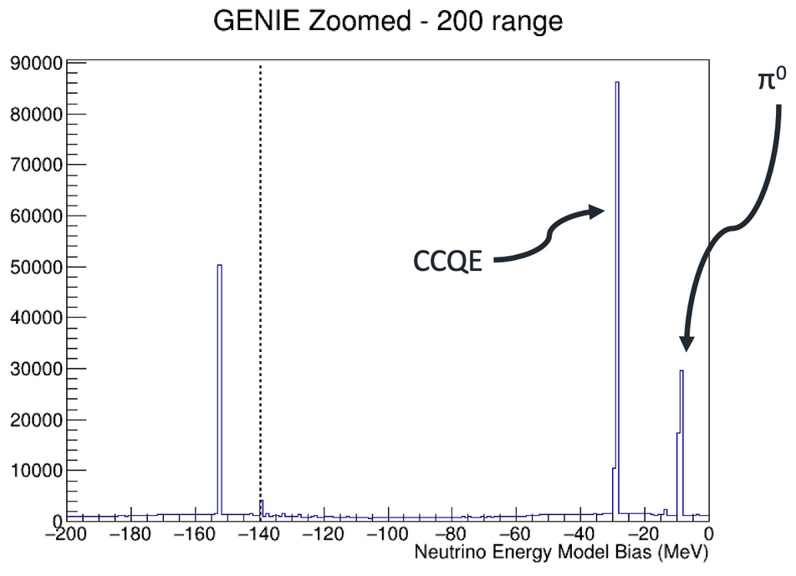
WHAT ENERGY DO WE MISS
We can look to have the generator produce a more localised histogram to see the peak breakdowns to understand what's happening. The first peak, near 0, corresponds to charged-current quasi-elastic interactions' removal energy, not resonant interactions, whilst the small neutral pion peak arises from the removal energy.
CCQE π
0
E
±
π ,m
(139.6 MeV)
±
CC Res 1 π
±
CC Res 2 π
±
CC Res 1 π
Notes:
To understand these peaks, we can zoom in a little bit. The peak close to 0 corresponds to CCQE interactions and neutral pion producing events - although we can detect neutral pions, we still have a slight offset arising from removal energy.
Each successive pion peak corresponds to an event in which an additional charged pion was produced compared to the previous peak. As such, the first offset peak from the CCQE peak corresponds to a charged current resonant pion production, the second offset are interactions with two charged pions produced, the third offset for three, and so on.

Slide 5
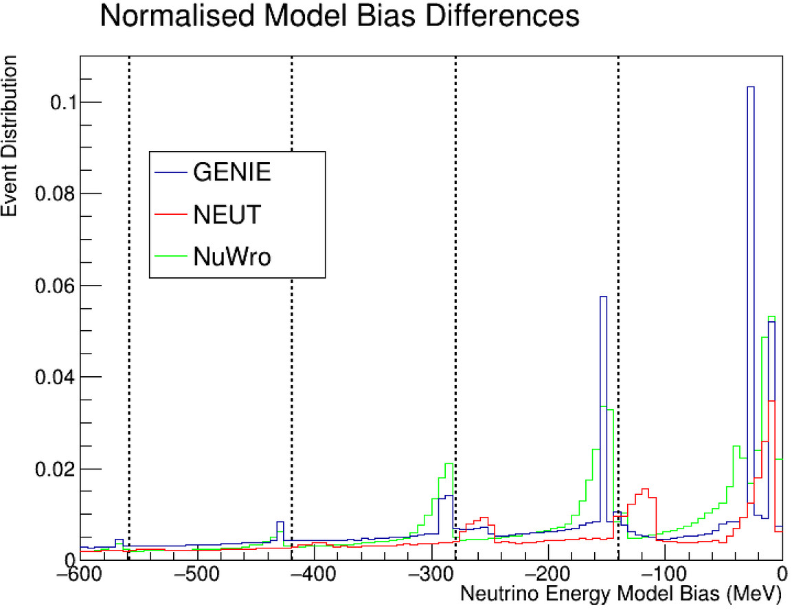
GENERATORS
We should use relative bias, or a normalised absolute bias, in order to do direct comparisons between generators. Here, we have the generators GENIE, NEUT and NuWro.
  Despite looking more precise, GENIE's more defined peaks arise from an assumption that removal energy is degenerate regardless of shell
  NuWro accounts for a distribution of removal energies for the charged pion, leading to a wider peak
  NEUT simulates no removal energy for any events which aren't CCQE - ergo, assuming nucleons are unbound.
Notes:
We can also vary which generators we use, which introduce different assumptions that change our model, ergo our bias.
For example, GENIE makes the assumption that removal energy of a charged pion is degenerate for all atomic shells; compared with NuWro which accounts for a distribution of possible removal energies. This is why NuWro has a wider pion peak, compared to the spike peaks of GENIE. NEUT on the other hand does not simulate any removal energy outwith CCQE events, effectively treating nucleons as unbound. We can change which generator we use for our models to determine which generator is the best fit to what we would expect.

Slide 6
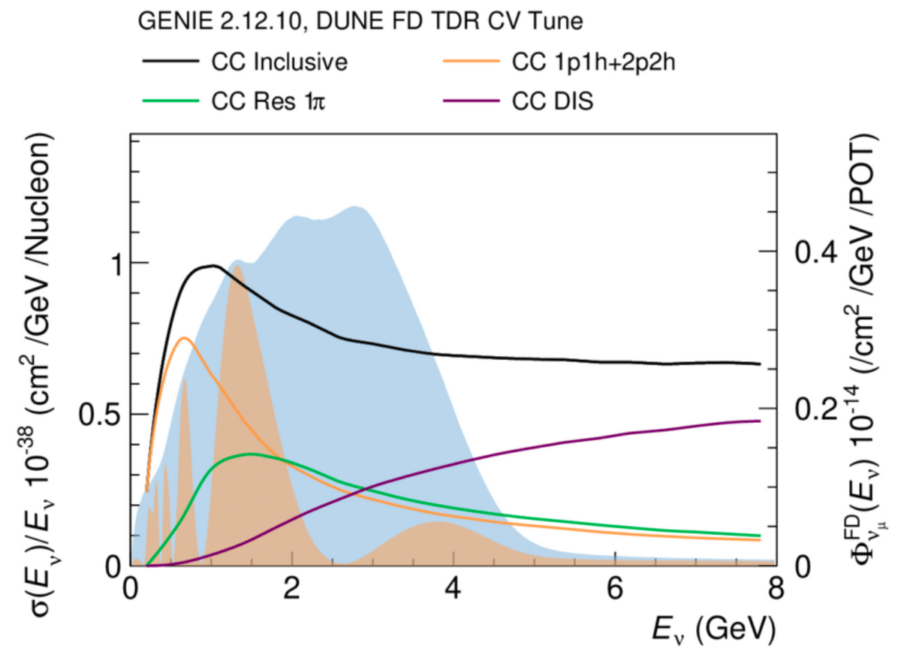
WHY DOES THIS MATTER?
Systematic parameters of Neutrino Flux Φ, cross section σ and detector efficiency ∈ - all of which are functions of neutrino energy E . Our ability to measure oscillation parameters are delimited by the uncertainty constraints on our systematic parameters.
The blue area on the graph corresponds to muon neutrino flux of the near detector; compared to brown for the far detector. Each line corresponds to cross section σ for different interactions. Improving our neutrino energy reconstruction can reduce uncertainties on our measurements of oscillation parameters.
Notes:
With this in mind, the question arises as to why we need to improve neutrino energy modelling in particular. DUNE is interested in measuring the probability at which neutrinos oscillate by measuring a certain number of neutrinos in a given flavour.
This is dependent upon three systematic parameters in particular - the neutrino flux (which is indicative of the number of neutrinos produced); the cross section (which is the liklihood or probability at which said neutrinos interact in our detector); and detector efficiency (which describes how well your detector can detect these interactions). All of these systematic parameters are dependant upon the neutrino energy, and in turn, the neutrino energy which we reconstruct. As a result, delimiting the uncertainty bound on these systematic parameters, which impact our ability to calculate oscillation parameters, can be done via a better reconstructed neutrino energy model.
AKA, better energy model means reducing systematic uncertainties. Furthermore, improving pion tagging can lead to smaller energy biases such that it can move the pion peaks back to 0 bias.

Slide 7
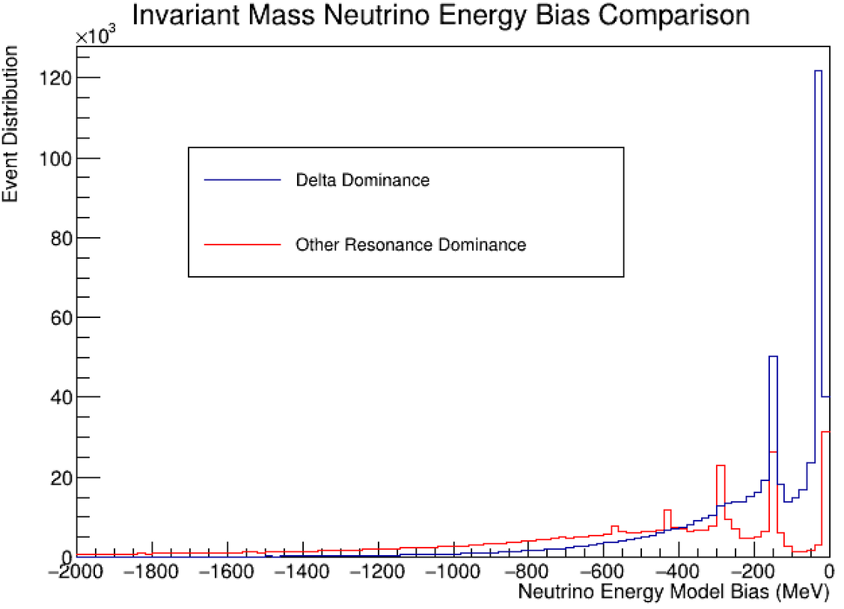
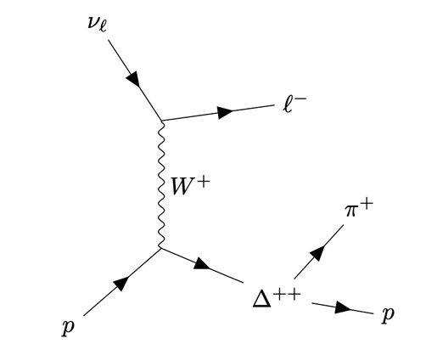
NEXT STEPS
Have different uncertainty parameters for different resonances; varying the resonances separately is important because you induce different neutrino energy biases.
The graph compares the energy bias for interactions with Invariant Mass (W) below (Delta Dominance) and above (non-Delta dominance) 1500MeV to demonstrate this difference.
Next steps will involve utilising the generator's ability to isolate resonances (something you technically can't do outwith) to compare energy bias discrepancies for differing resonances; leading onto eventual work related to form factors.
Notes:
My current plans and immediate next steps are to look at variance in neutrino energy bias induced through different resonances. On the right, the graph shows how the energy bias for interactions in which there is a delta dominance has a discrepancy with the energy bias for resonant interactions in which other particles resonances are dominant.
In turn, GENIE and other generators provide the ability to isolate interactions which arise from a specific resonance - something we can't do in reality, but can take advantage of with a generator. In turn, we can isolate the events which only arise from a Delta resonance, and compare this to other resonant non-Delta interactions. In turn, leading onto my eventual work of improving the form factor for different resonances.

Slide 8
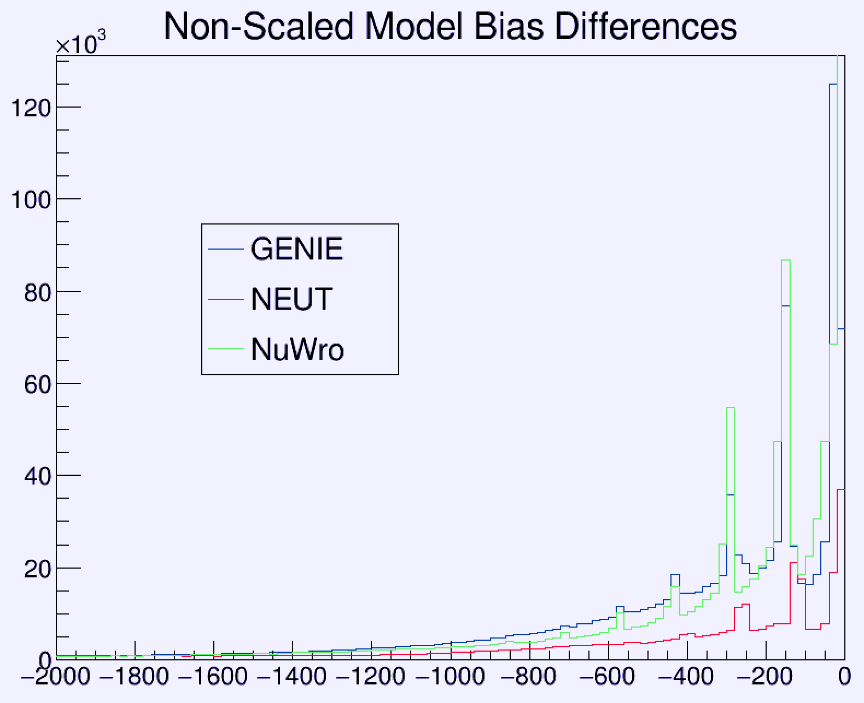
THANKS FOR LISTENING - ANY QUESTIONS?
11 July 2023
CALLUM COX
Notes:
Thanks for listening, are there any questions?

