Slide 1
Kinetic inductance material investigation
erhtjhtyhy
Sergey Kruhlov
PhD Student
Drexel University
August 1st 2023
ANL

Slide 2
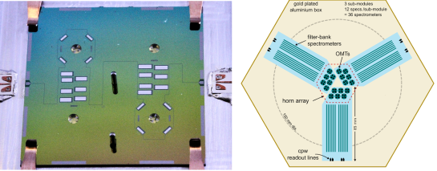
Introduction
Our group in Argonne work with superconducting detectors (MKID)
Superconducting detectors with high kinetic inductance have better sensitivity.
High kinetic inductance devices with strong non-linearity can be used as amplifiers.
Our design of tunable superconducting resonator has the potential of working as quantum limited parametric amplifier

Slide 3
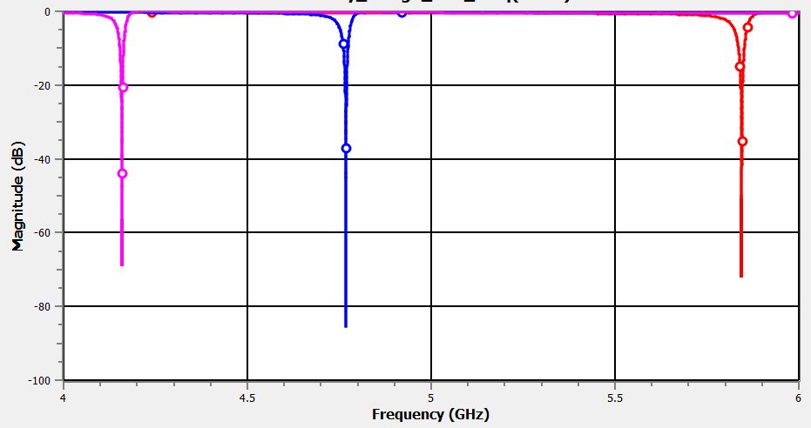
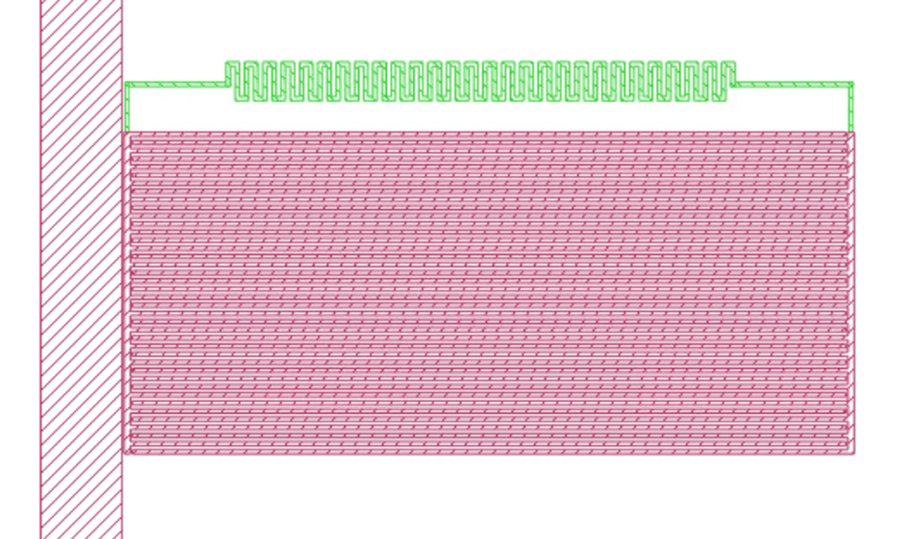
Frequency dependence on inductance
$f=\frac{1}{\sqrt{LC}}$
$L=L_{g}+L_{k}$
$L_{k}=\frac{m_{e}l}{2n_{s}ⅇ^{2}A}$
Appling kinetic inductance will decrease frequency.
10 pH/sq
0 pH/sq
5 pH/sq

Slide 4
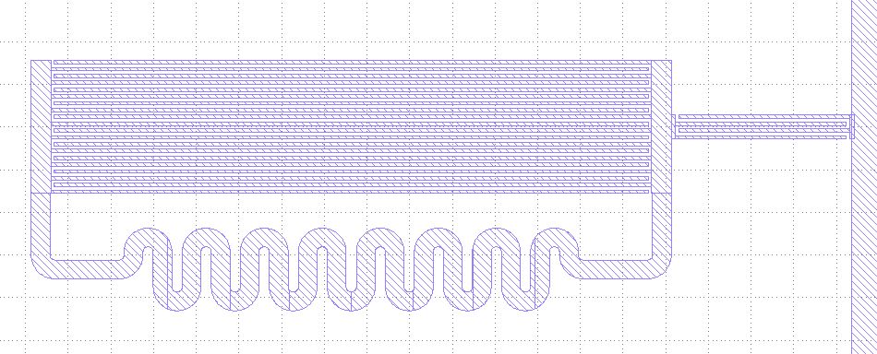
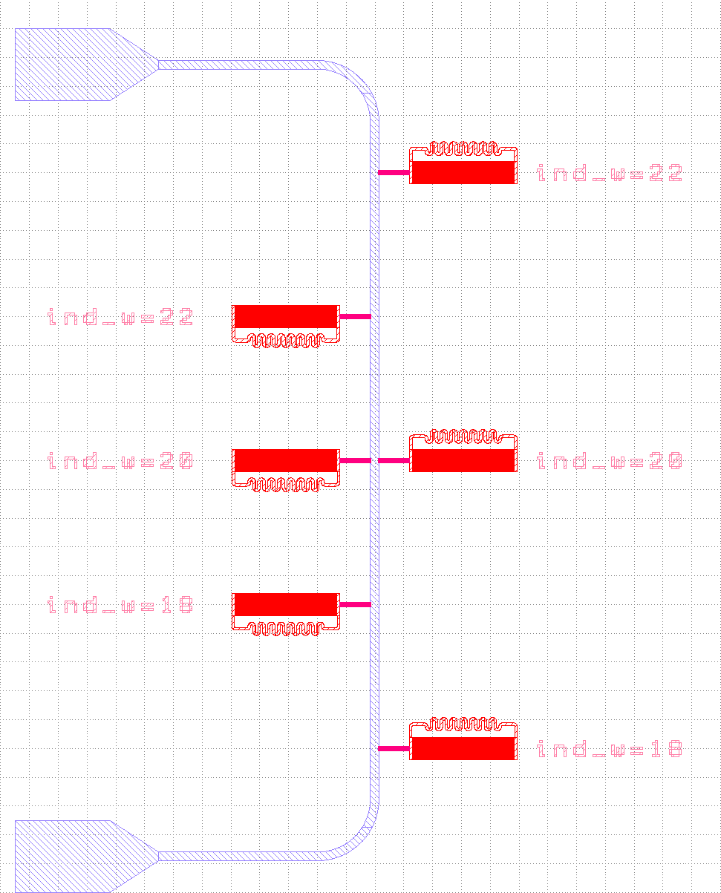
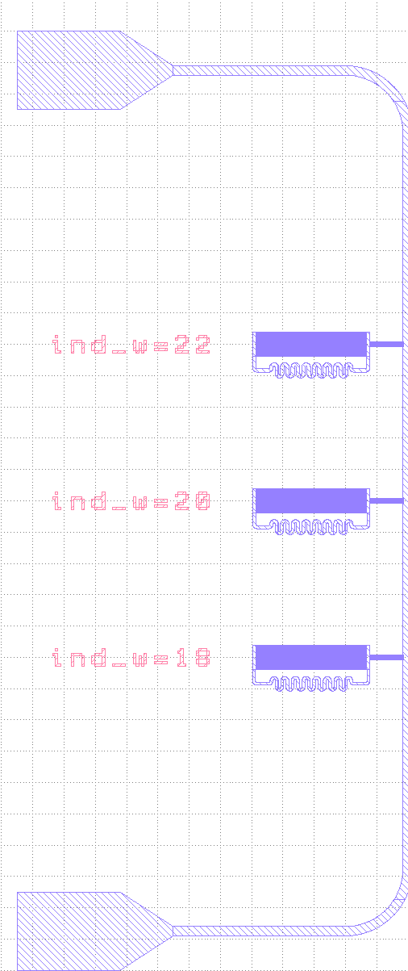
Resonator design
Readout line made from Nb film
For study Lk we use our design with 2 group of resonators
Lk for Nb = 0 pH/sq
Lk for TiN = 15 pH/sq
Changed frequency of each resonator by changed of its inductor width (18um, 20um, 22um)
TiN
Nb

Slide 5
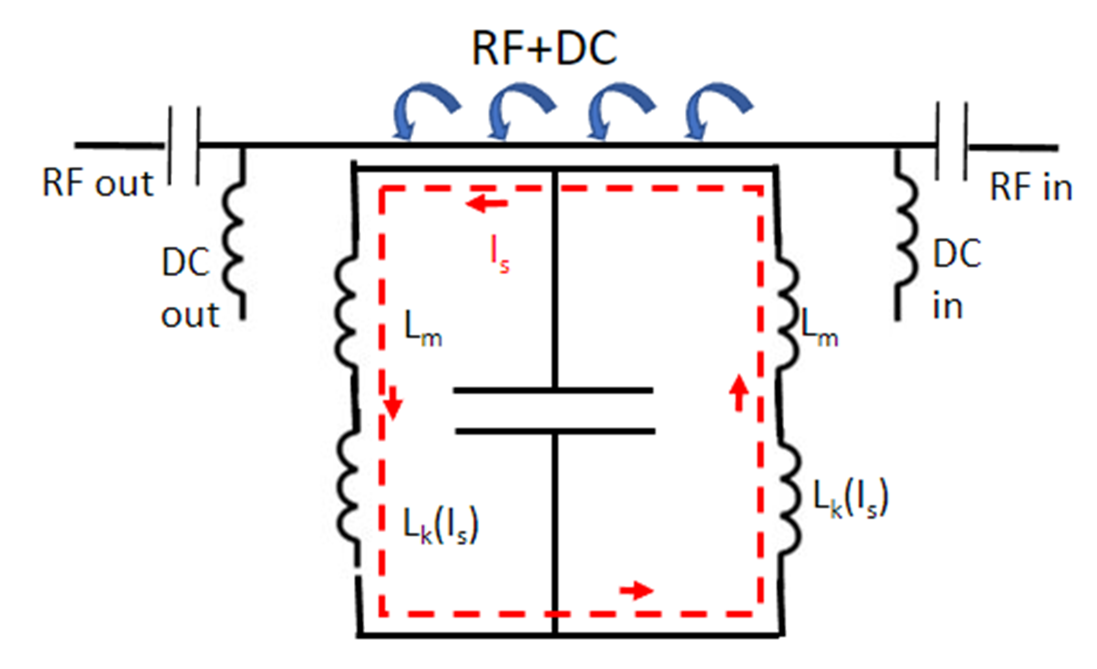
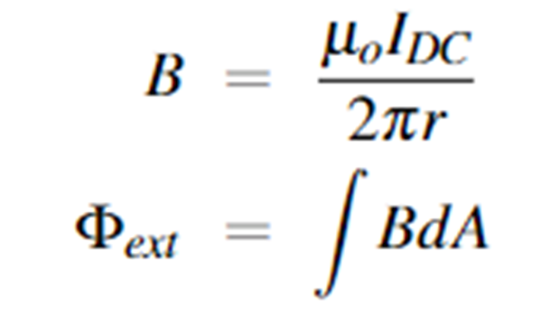
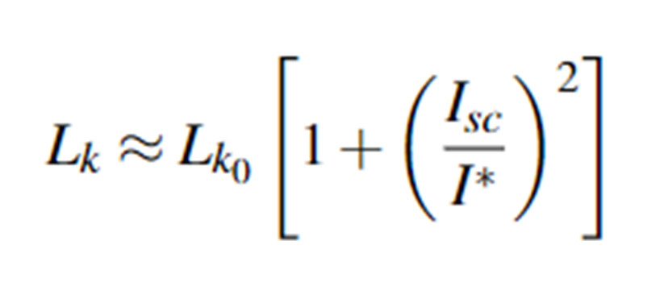
Frequency tuning
Advantage of this system:
B filed resilient
Straight forward fab process
Parametric pumping
Applying DC to system we able to change kinetic inductance

Slide 6
Conclusion
We discussed about kinetic inductance material investigation: frequency dependence on inductance, frequency tuning principle and our own design, what we will use for this study
Thank you for your attention!

