Slide 1
LBNF Nu Beam Windows Radiation Damage R&D Needs
7/20/23
Quinn Peterson
Accelerator Division, Target Systems Department

Slide 2
Overview
Primary Beam Window and Cartridge Assembly
Downstream Decay Pipe Window (DSDP Window)
Upstream Decay Pipe Window (USDP Window)
Summary

Slide 3
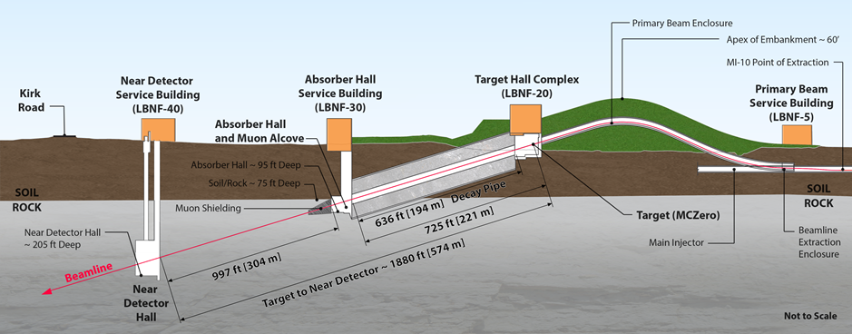
Beam Windows Locations
3 Beam Windows:
  Primary Beam Window
  Upstream Decay Pipe Window (USDP Window)
  Downstream Decay Pipe Window (DSDP Window)
Downstream Decay Pipe Window (DSDP Window)
Primary Beam Window
Upstream Decay Pipe Window (USDP Window)

Slide 4
LBNF Beamline BID Irradiation Environment Parameter Table
Compnent Name | Material | Material Grade | LBNF Primary Beam Power Case (MW) | Required Lifetime (op year) | Peak dpa/year | dpa/life | Peak Fluence/year (p/cm^2) | Fluence/life (p/cm^2) | Mean peak temp (C)
Primary Beam Window | Beryllium | S200FH | 1.2 | 5 | 9.35E-02 | 4.67E-01 | 2.46E+21 | 1.23E+22 | 90
Target windows | Titanium | 6Al-4V Mill Anneal | 1.2 | 1 | 2.50E+00 | 2.50E+00 | 2.46E+21 | 2.46E+21 | 144
Target core | Graphite | IG-430 | 1.2 | 1 | 5.00E-01 | 5.00E-01 | 2.46E+21 | 2.46E+21 | 487
US Decay Pipe Window | Aluminum | 6061-T6 | 1.2 | 5 | 4.55E-01 | 2.27E+00 | - | - | 94
DS Decay Pipe Window | Stainless Steel | S304L | 2.4 | 30 | 1.19E-03 | 3.58E-02 | 2.24E+17 | 6.72E+18 | 107
Hadron Absorber | Aluminum | 6061-T6 | 2.4 | 30 | 3.10E-04 | 9.30E-03 | 2.24E+17 | 6.72E+18 | 70

Slide 5
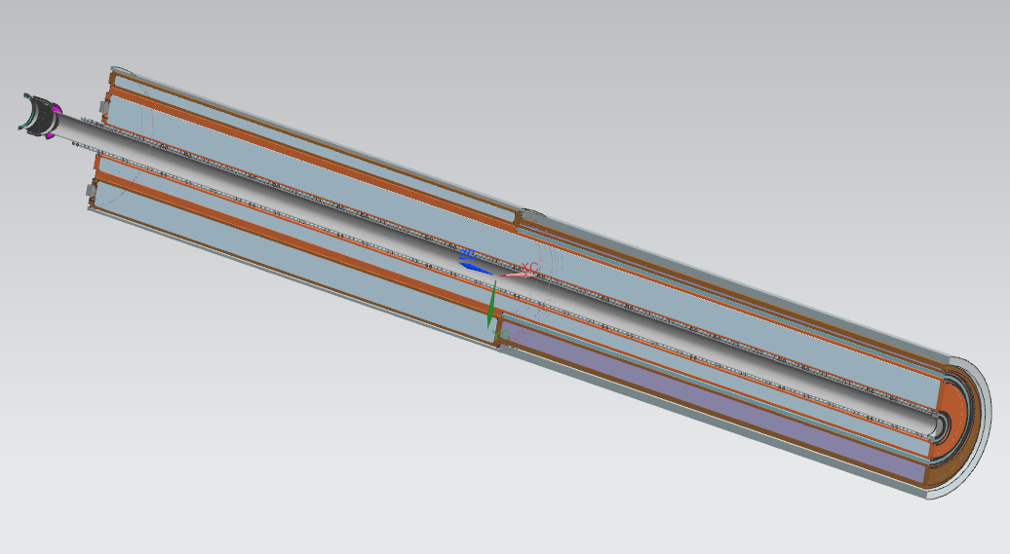
Primary Beam Window

Slide 6



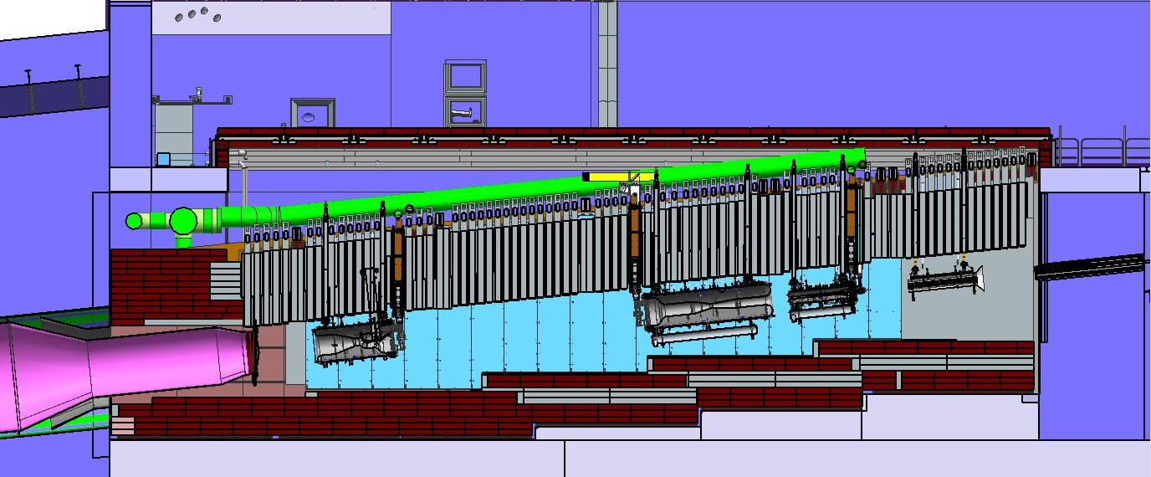
LBNF Target Facility and Upstream Decay Pipe
2.4
?
*
Removable
Steel Shielding
2.4
2.4
Work
Cell
Sealed Hatch Covers
?
*
?
2.4
Decay Region Upstream Window
2.4
?
*
Cooling
Panels
2.4
Horn B
Horn A with Target
Primary Beam Window
Assembly
Steel
Shielding
Horn C
*
Baffle

Slide 7
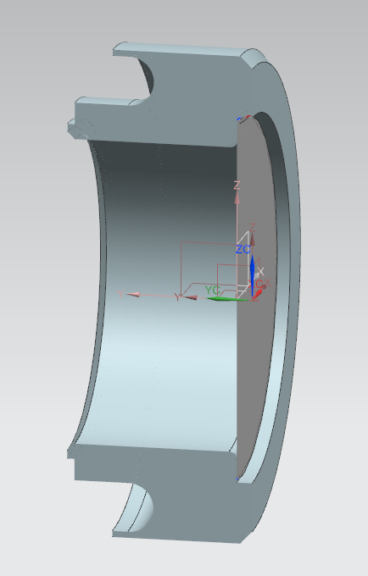
Primary Beam Window
Located directly before the target
Vacuum on the left-hand side
3 psig nitrogen on the right-hand side
Housing is 304 stainless steel
Membrane is beryllium
  S200FH
  Brazed into stainless housing
Water cooling originally present, however, thermal/structural analysis showed it unnecessary.

Slide 8
Thermal and Structural Analysis
A series of thermal analyses were performed to evaluate the effectiveness of cooling the perimeter of the window with liquid cooling at two temperatures (35 C & 7 C) and the case where the boundary condition at the liquid cooling interface was perfectly insulated.
Three different convective boundary conditions were set at the surface of the window of 5, 25, and 250 W/m2-K to evaluate the effect of the cooling from the target pile nitrogen circulation system.
The primary beam window consists of the 316 stainless steel housing with a brazed beryllium membrane with the membrane receiving the energy load

Slide 9
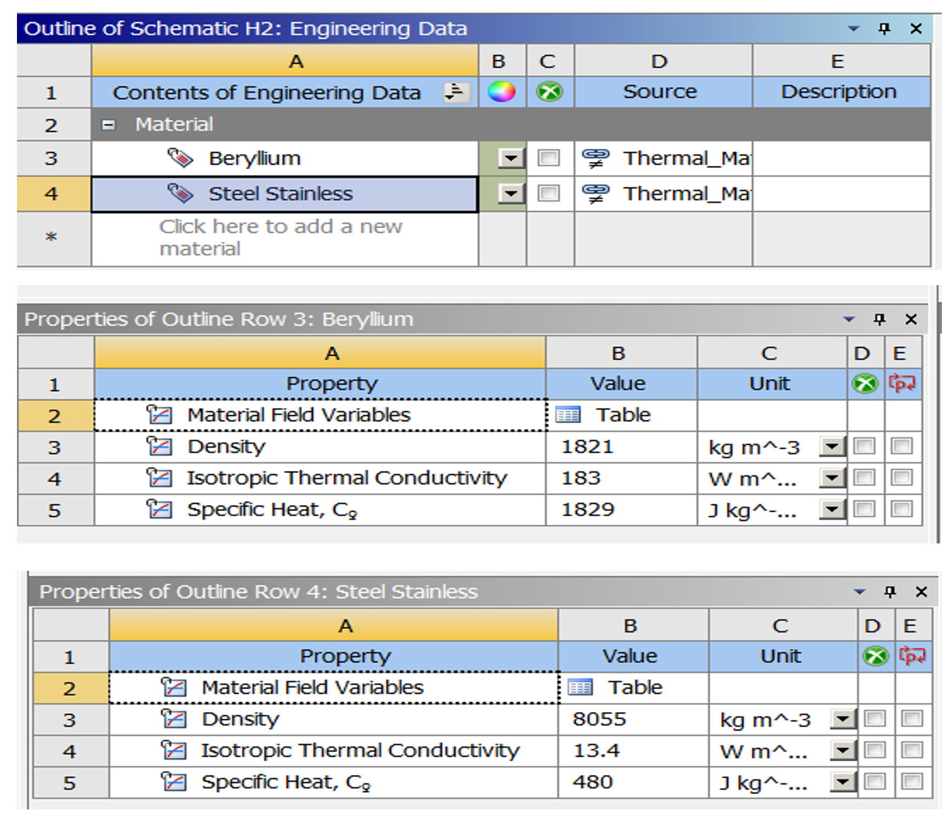
Thermal and Structural Analysis: Material Properties

Slide 10
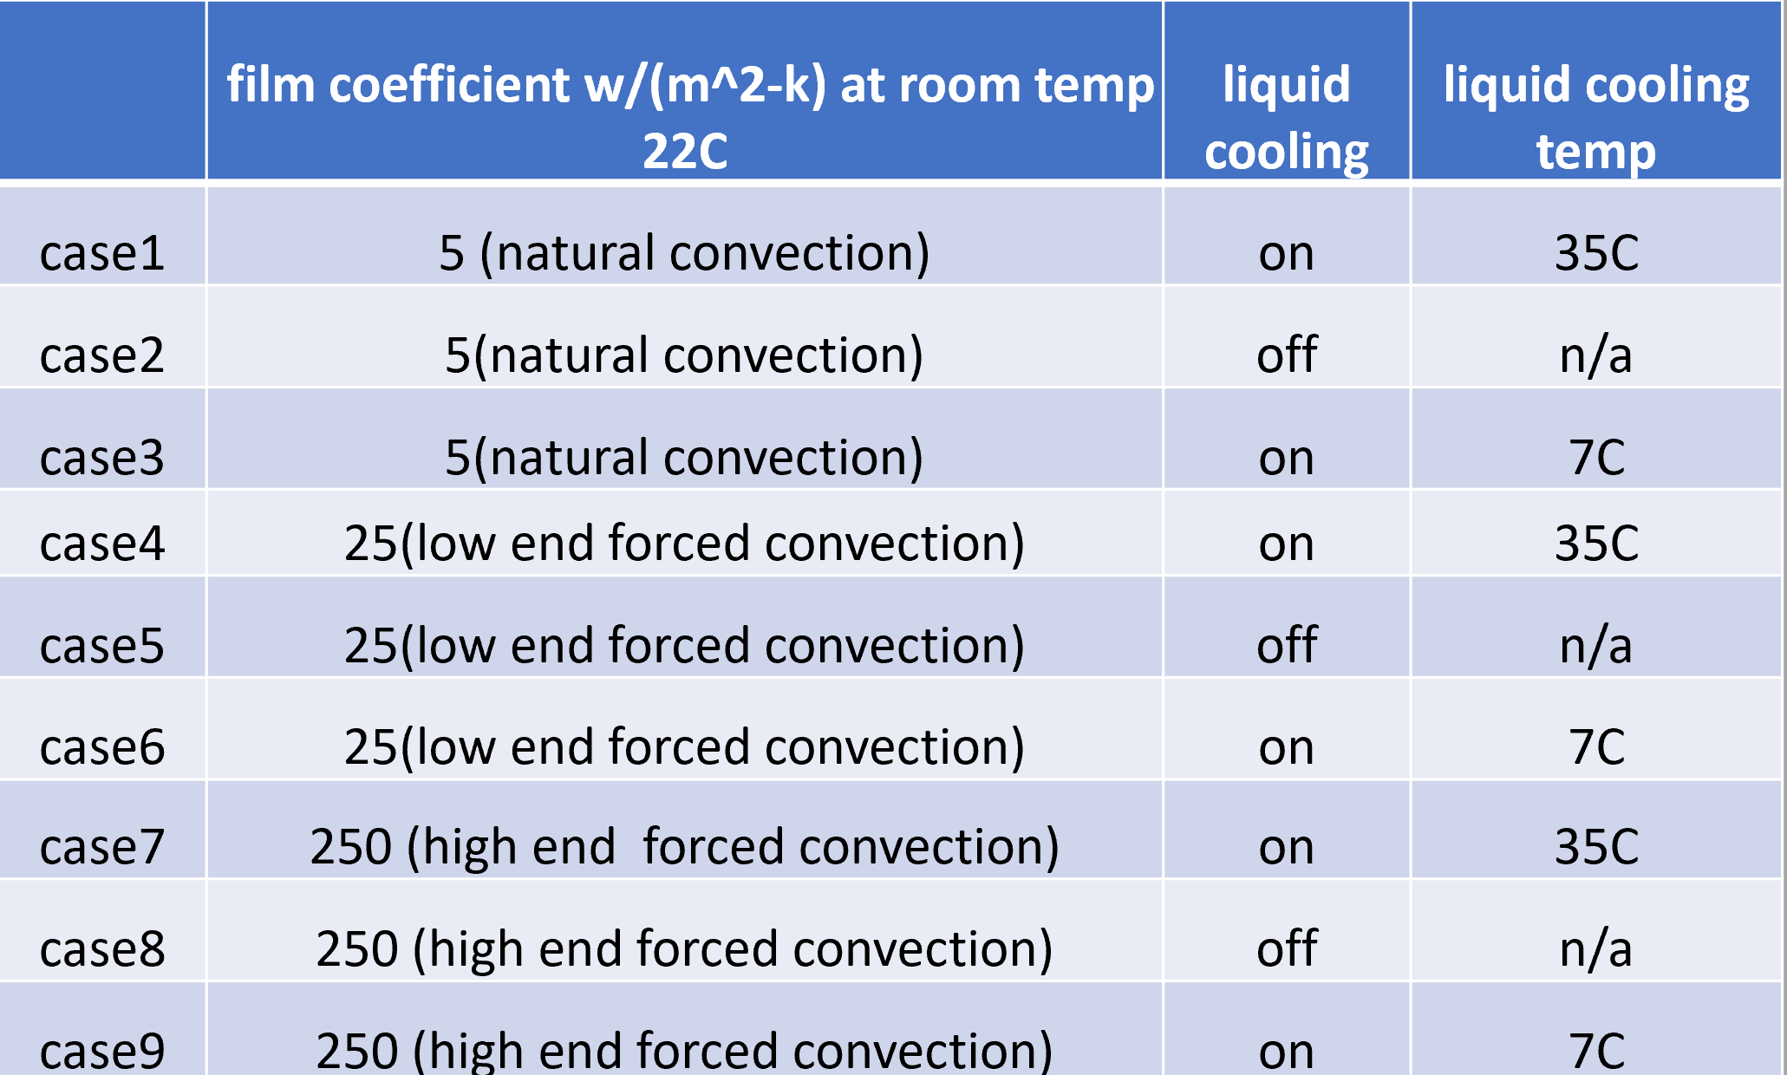
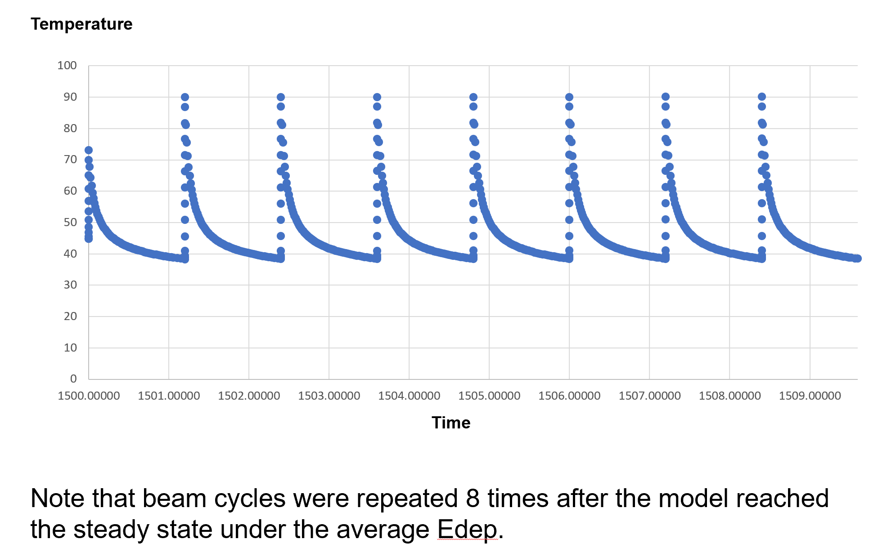
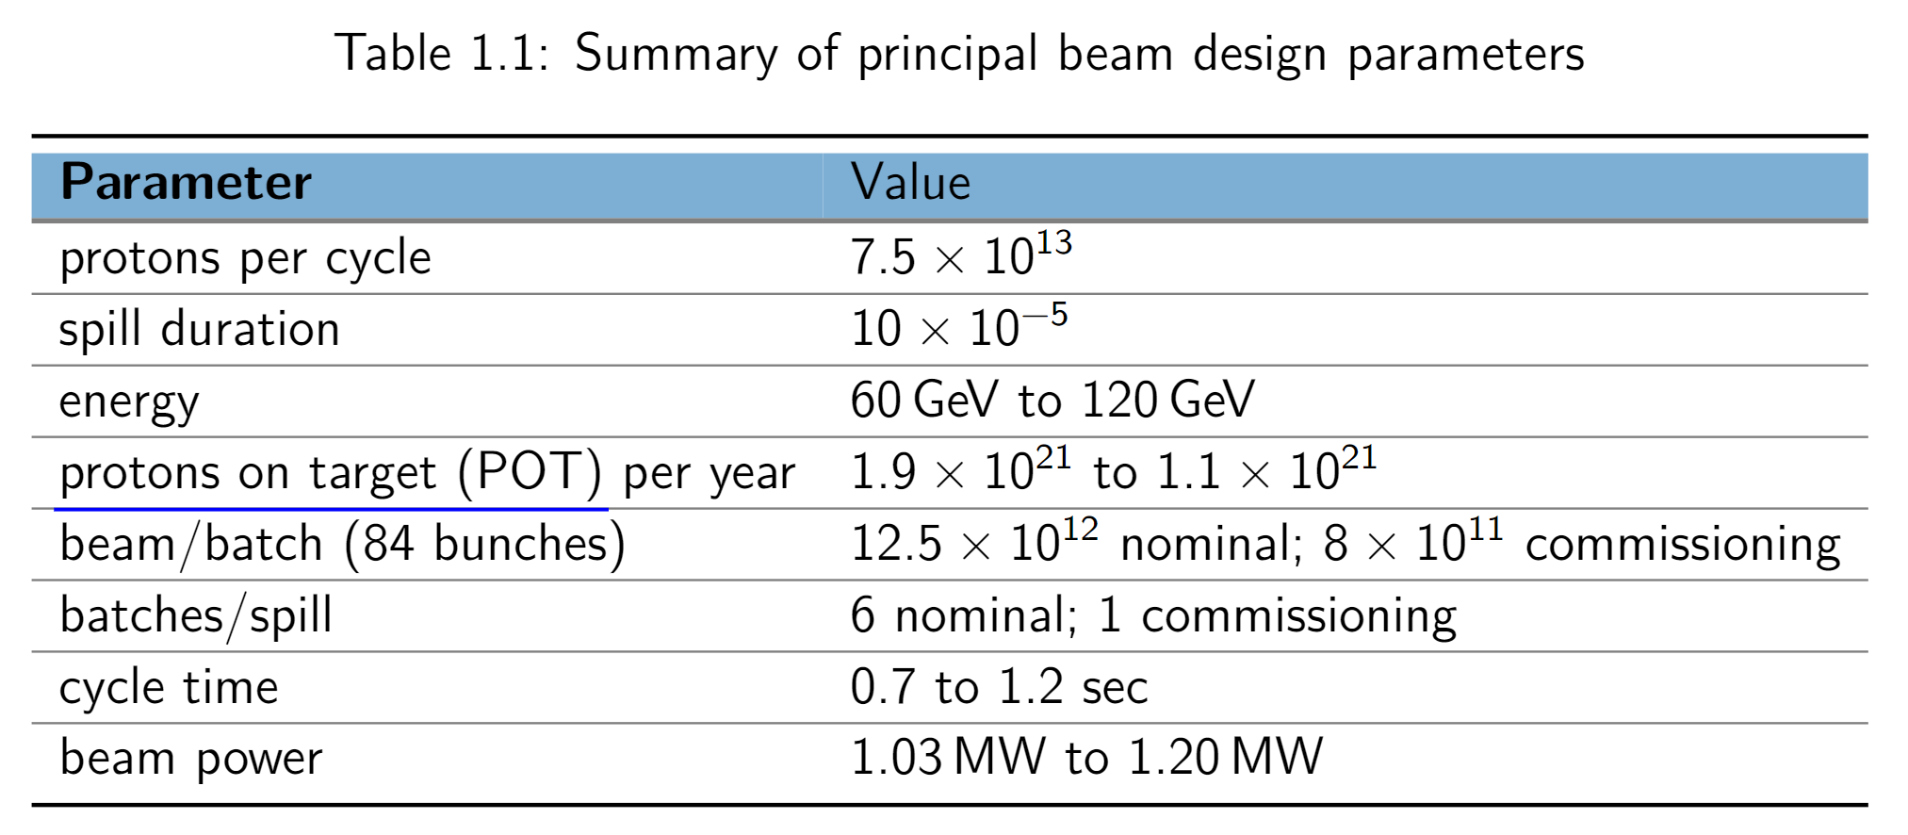
Thermal Analysis: Parameters
Beam Interaction:
Beam radius: 0.267 cm
Protons on Target: 1.10e21
Total Power: 4.11 W
Peak Fluence/year: 2.46e21
DPA/Year: 9.35e-2
Peak Temp: 90 C

Slide 11
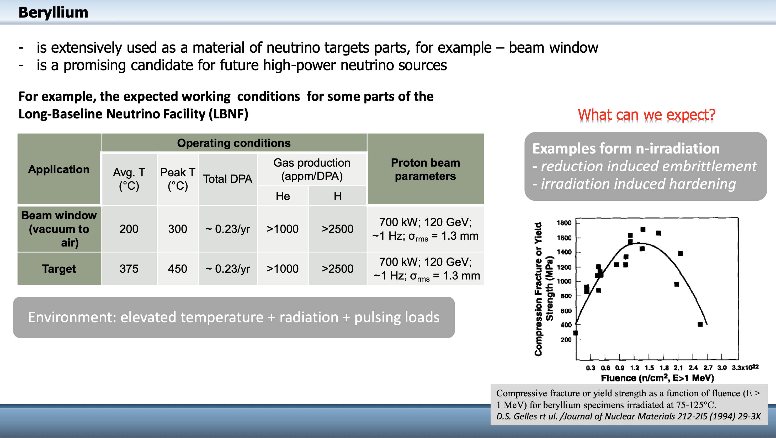
-
Primary Beam Window dpa scaling
Use NuMI 700 kW case (0.23 dpa/yr) and scale by power and beam spot size difference
Results in 0.094 dpa/yr for primary beam window for LBNF at 1.2 MW

Slide 12
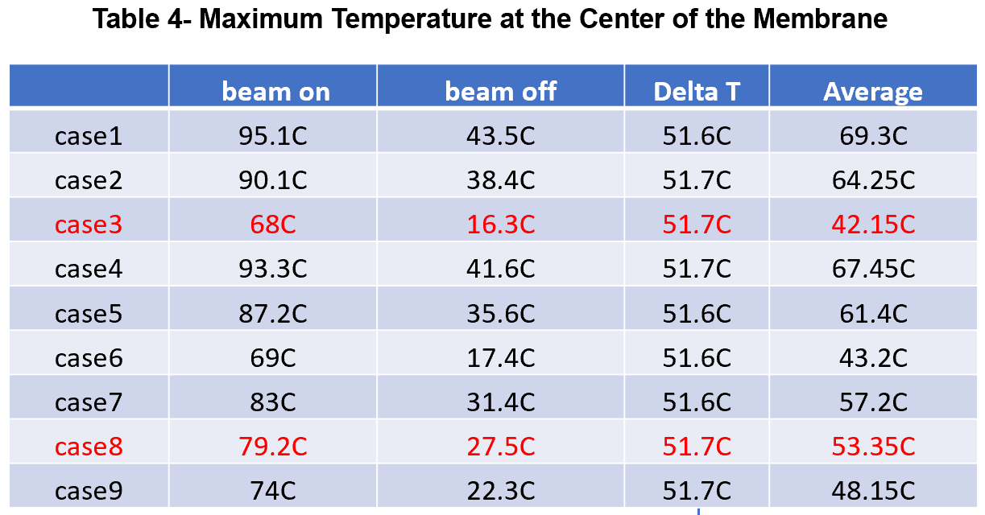
Thermal Results: Center of Membrane
Delta T in all cases was unchanged
Almost no difference in temperature with natural convection vs low end forced convection in cases 3 and 6
Results show that cooling does not offer a substantial enough benefit to warrant implementation
Liquid cooling at 35C shows increased temperature compared to only convection cooling
Optimal cooling configuration shown to be cases 3 and 8
Notes:
Note there is no difference in Delta T in all cases. And that the liquid cooling at 35C should not be considered. The membrane temperature is reversed in case 9 compared to Cases 3&6. This means the high end forced convection should be avoided when liquid cooling is set at 7C. Furthermore, there is almost no difference in temperature with natural convection or low end forced convection in Cases 3&6

Slide 13
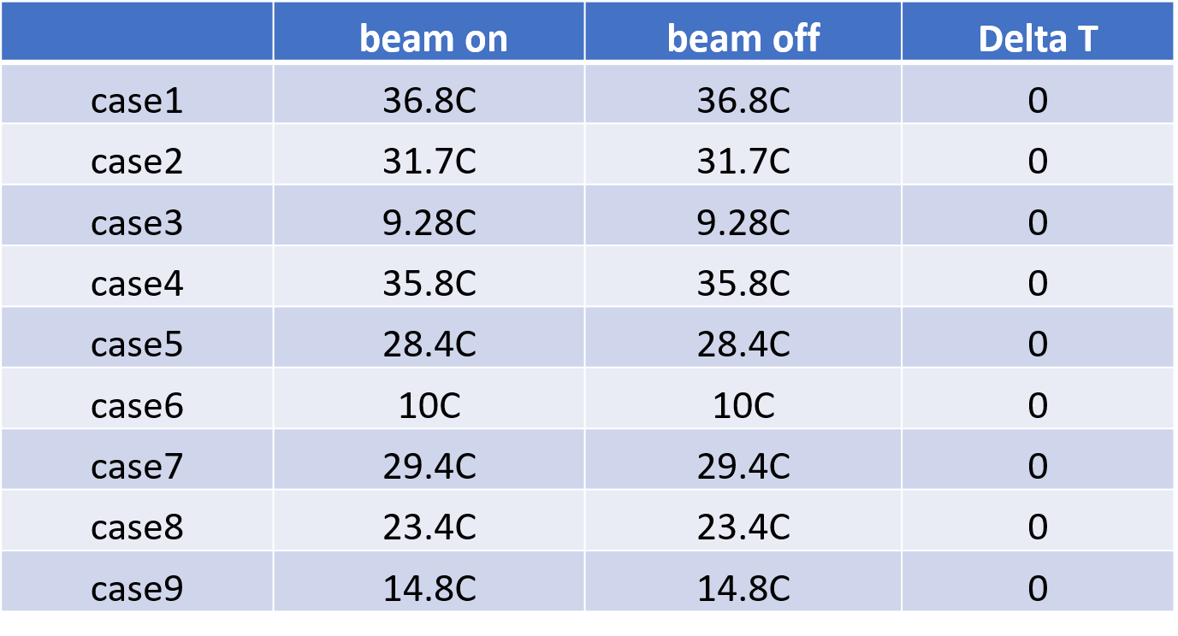
Thermal Results: Connection at Membrane to Housing
No temperature difference when comparing beam on and beam off temperatures for each case.
Liquid and forced convection cooling show no benefit in this region

Slide 14
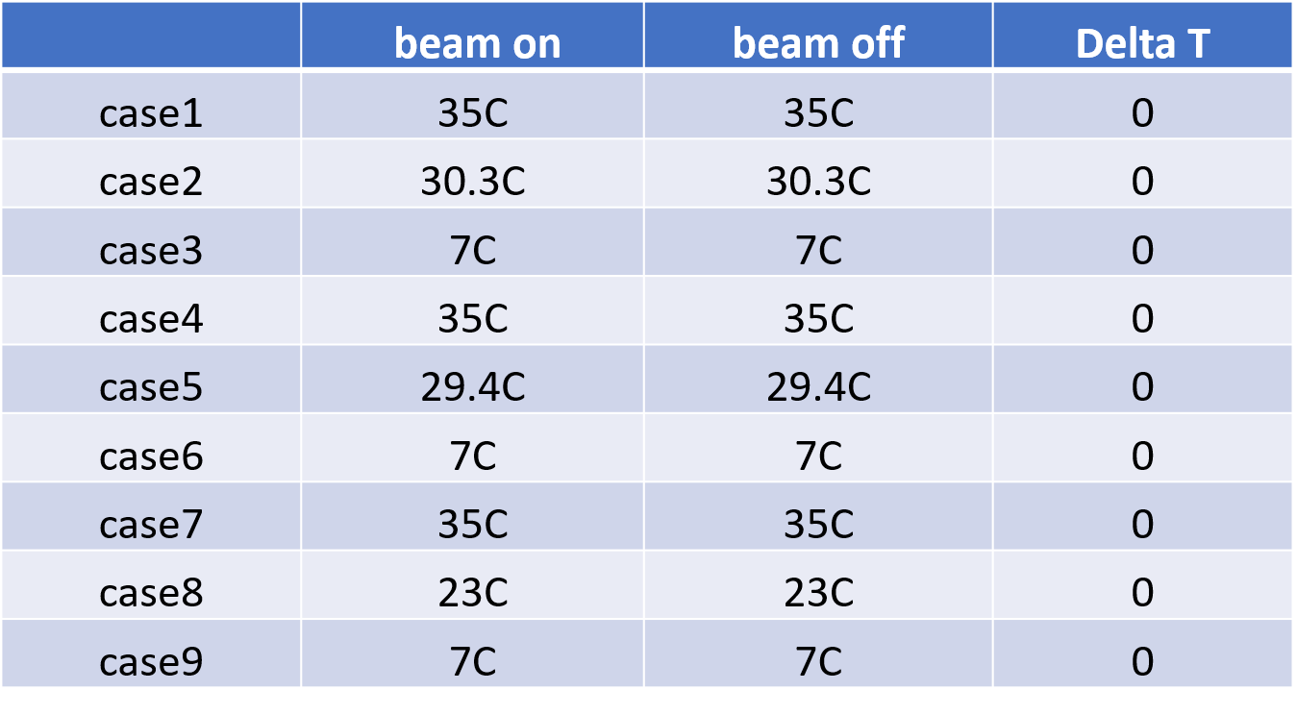
Thermal Results: Liquid Cooling Surface of Housing
No temperature difference when comparing beam on and beam off temperatures for each case.
Liquid and forced convection cooling show no benefit in this region

Slide 15
Thermal Results: Conclusion
Delta T remains consistent across all cases
When liquid cooling is absent, temperature is lowest in case 8 with high forced convection
When liquid cooling is applied, membrane temperature is nearly the same as natural convection or low end forced convection in case 3 and case 6
Case 3 and Case 8 determined to be most favorable conditions and Case 8 was chosen to be pursued so a structural analysis was performed
Notes:
Case 3 is favorable because it is the lowest temperature result out of the liquid cooling cases.
Case 8 is preferable because it is the lowest temperature out of the cases without liquid cooling

Slide 16
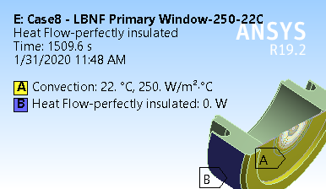
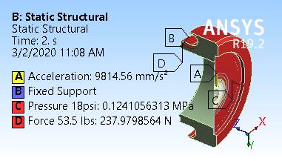
Structural Analysis: Parameters
Structural Requirements:
Allowable stress for 316L
  115 Mpa
Allowable stress for Beryllium
  240 Mpa
Structural Loading
  Pressure against Membrane: 18 psi
  Compressive force on housing: 53.5 lbs

Slide 17
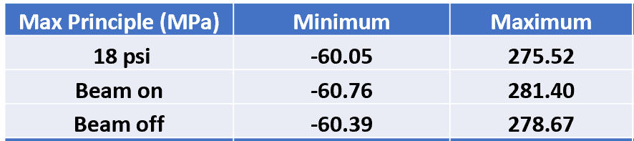
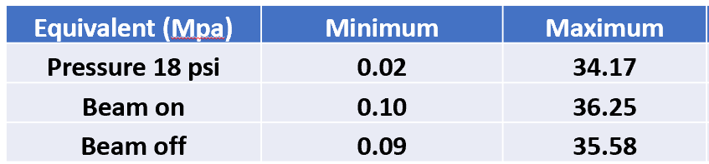
Structural Analysis: Results
Membrane Principal Stress
Structural Requirements:
Allowable stress for 316L
  115 Mpa
Allowable stress for Beryllium
  240 Mpa
Peak Stress for membrane is 17% over allowable leading to fatigue as a possible issue
System is configured to be replaceable in order to study the effects throughout lifetime of experiemnt
Housing Principal Stress

Slide 18
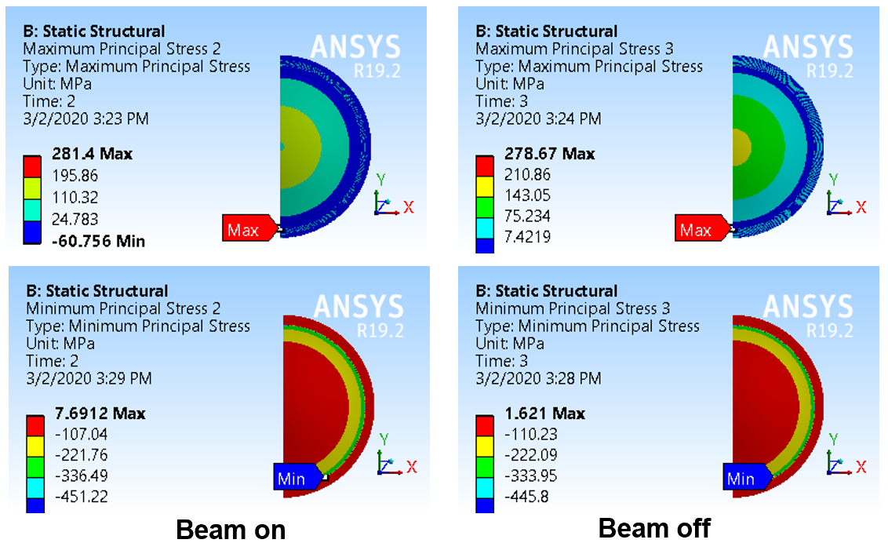
Structural Analysis: Results

Slide 19
Structural Analysis Conclusions
There is very little difference in stress during the beam cycles in both Case 3 and Case 8
There is very little difference in stress and displacement between Case 3 and Case 8
10 C difference in membrane temperature between Case 3 and Case 8 with Case 8 being higher
The highest stress concentration in the Membrane is about 17% above the allowable. Away from these regions, stress is much lower
Highest stress concentration in housing can be eliminated due to sharp corners in the area, but is far lower away these regions
Fatigue may be a concern in the membrane

Slide 20
Analysis and R&D Summary
Results show that convection cooling from Nitrogen is sufficient to cool window and qualify for 1.2 MW operation.
System designed for 1.2 MW operation
  No additional R&D requirements known at this time
  Conservative operation would be to qualify system at lower beam power prior to increasing
    Operational time requested is 6 months to confirm system integrity and evaluation
    Note that there currently is no easy way to inspect window or leak test in situ. Loss of vacuum only indication of problems

Slide 21
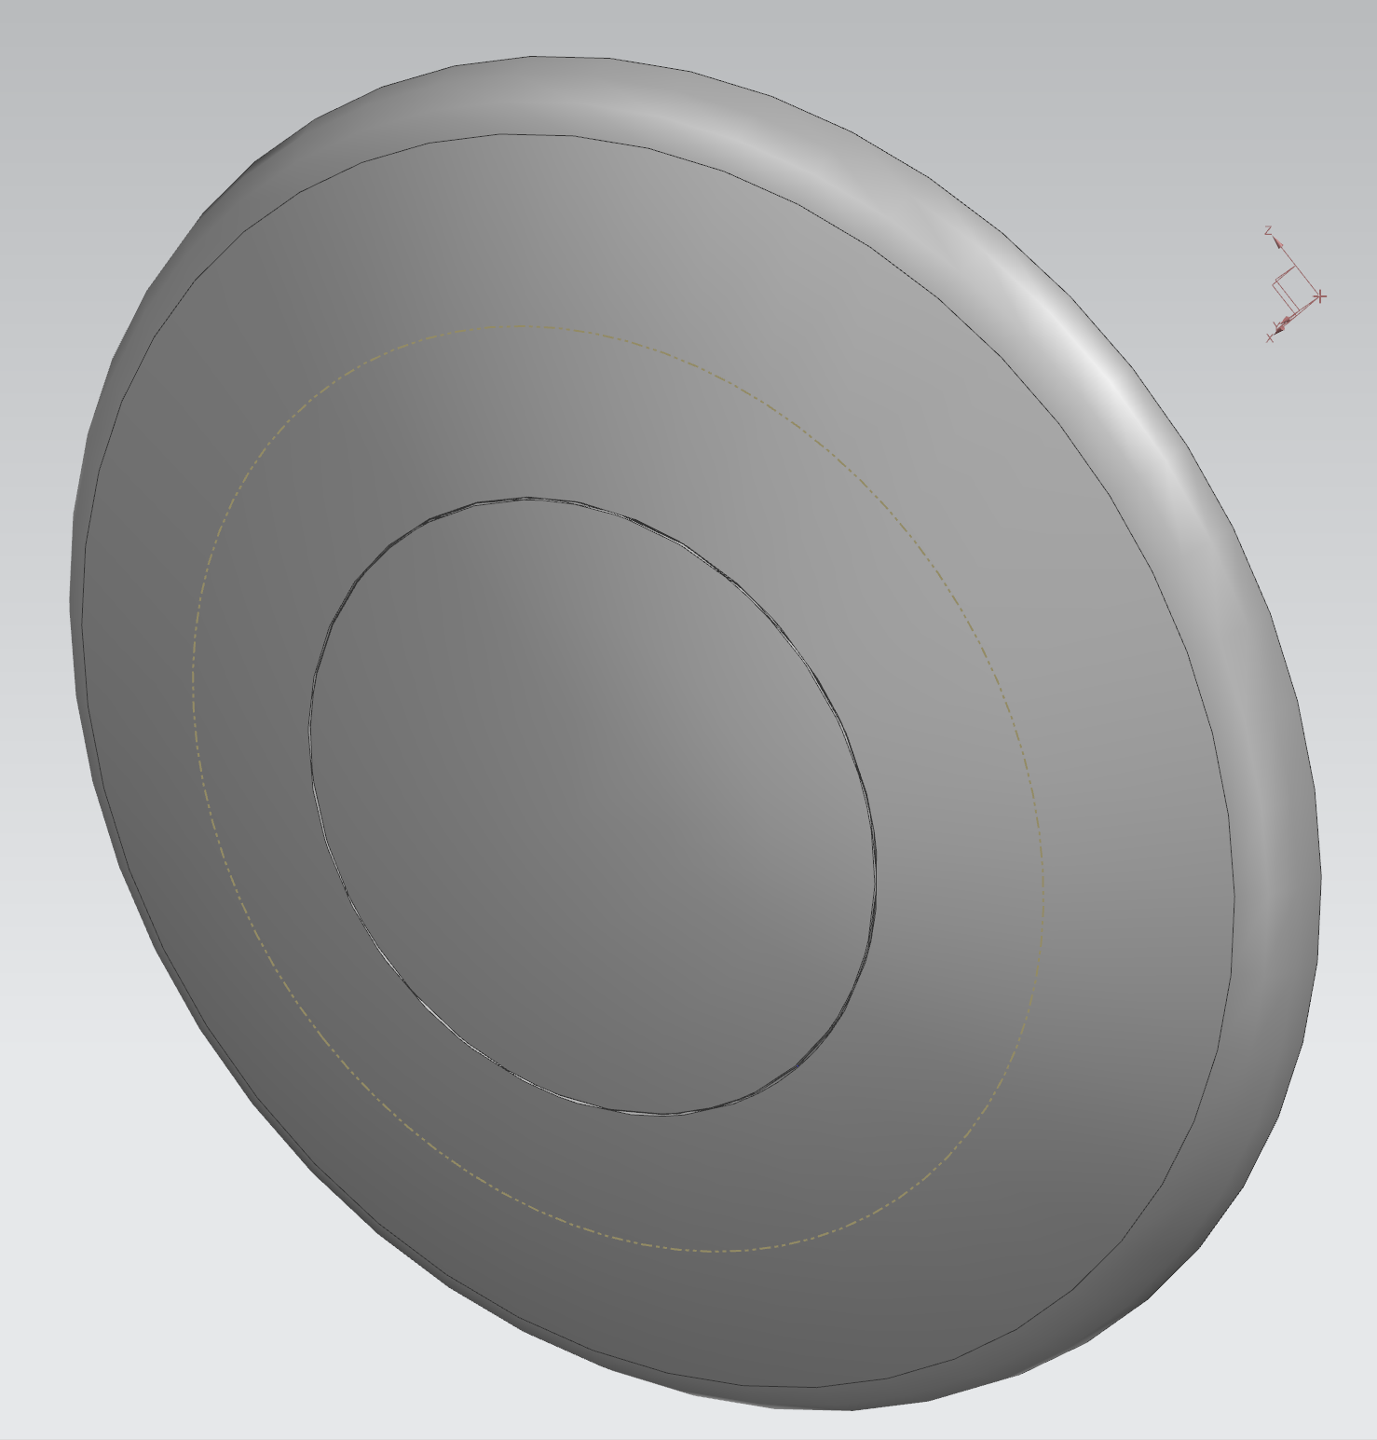
DSDP Window

Slide 22
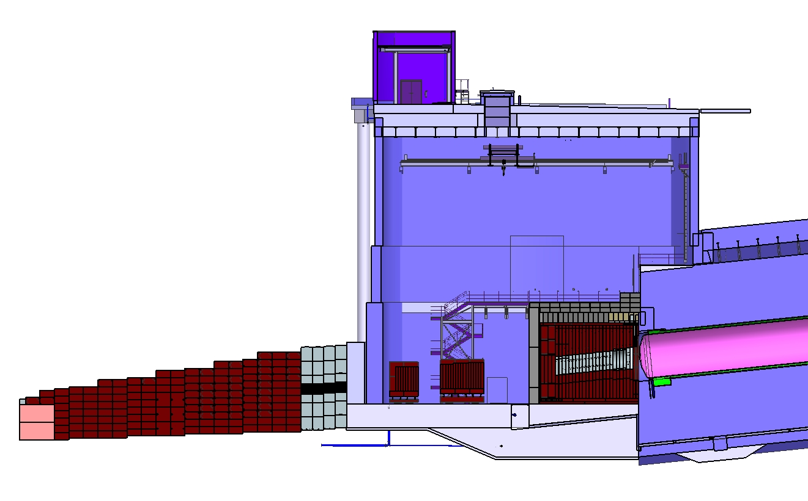
LBNF Absorber Facility and Downstream Decay Pipe
2.4
?
2.4
2.4
Surface
Hatch
*
Absorber
Service
Building
2.4
Absorber
Hall
?
Muon
Monitors
with
Shielding
2.4
Muon
Steel
Shielding
Neutrino Beam
to SURF, SD
2.4
2.4
2.4
2.4
Hadron
Absorber
DS Decay Pipe Window
Decay Region
Nitrogen Cooling
Decay Region
Helium Vessel

Slide 23
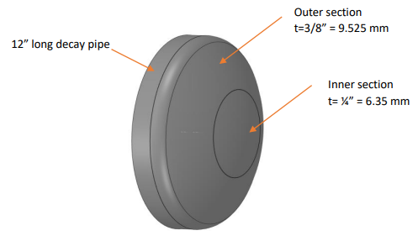
DSDP Window Design Overview
As this “Window” design is a weldment on the downstream end of the Decay Pipe
Window Material: S304L Stainless Steel
Frame Material: A36
Diameter Decay Pipe Connection: 4019.53 mm (13’ – 2.25”)
Outer Section Diameter: 2743.2 mm (9’)
Inner Section Diameter: 1828.8 mm (6’)
Required Lifetime: 30 yrs
Normal Operating Condition Power Deposition
  367 W in the Window
  2.18 kW in the Frame
Peak dpa/year: 1.19e-3
Peak Fluence/year: 2.24e17
  Larger beam spot size is driving factor in reduction of fluence compared to NuMI
Peak Temp: 107 C

Slide 24
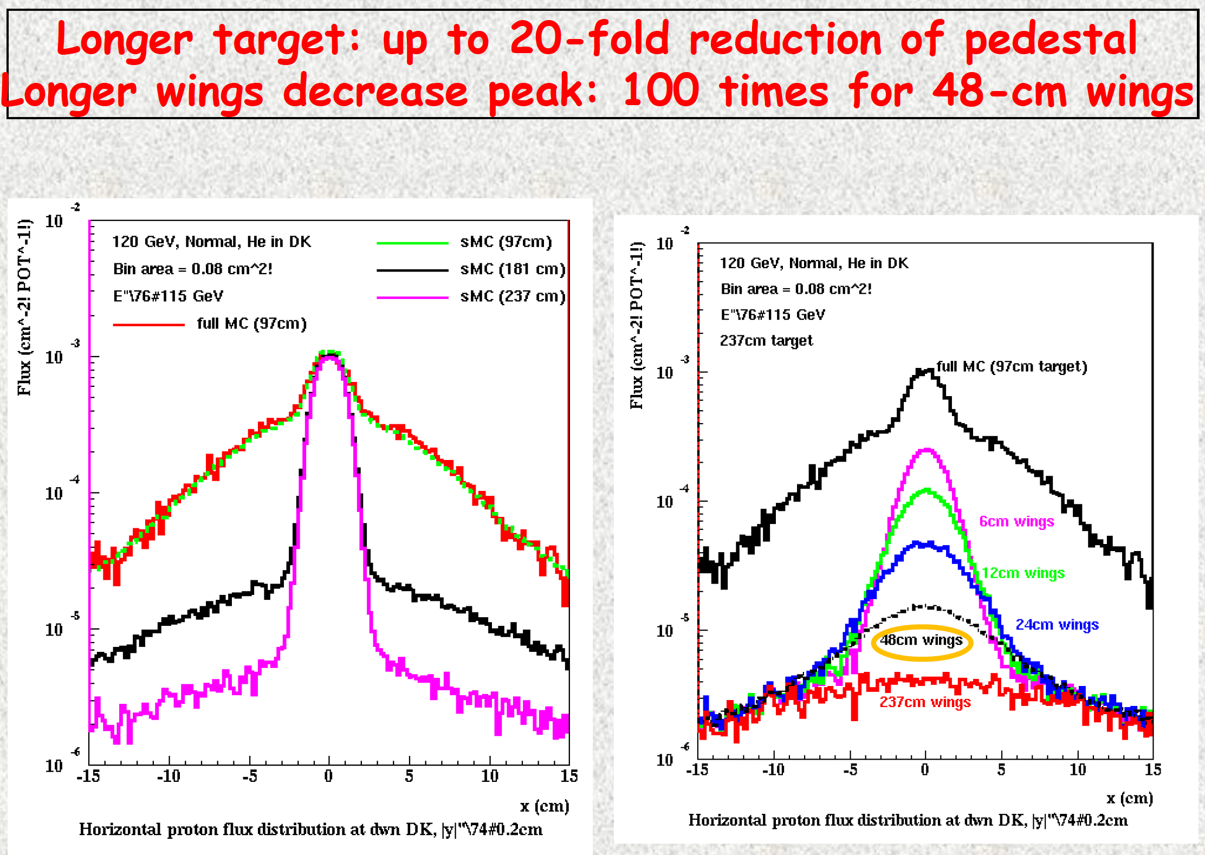
Scaling for larger, cylindrical, shorter target results in 100x’s smaller dpa rates in absorber! (0.031 dpa/yr to 0.00031 dpa/yr)
DS Decay Pipe Window should see same fluence as upstream block in the Absorber
dpa scaled by factor of 3.85 to adjust for stainless steel versus aluminum
0.001 dpa/yr
Full MARS runs for entire beamline are being run, including dpa results.

Slide 25
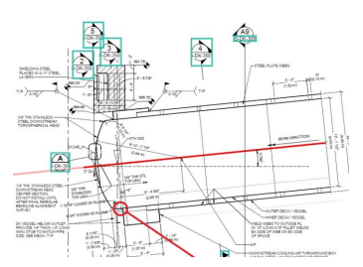
Decay Pipe Downstream Window Analysis Under 2.4 MW
Analysis was conducted to determine the DSDP Window thermal and structural performance for nominal operating and accident condition under 2.4 MW beam power with a 1.5 m Target.
  120 GeV proton beam
  1.2 second spill cycle
  1.5e14 protons/spill
  Maximum use temperature: 348 C (1200 F)

Slide 26
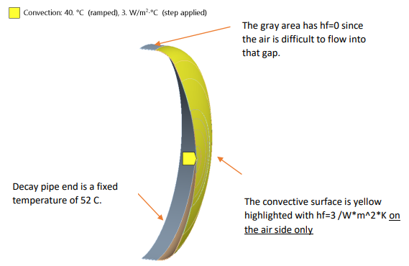
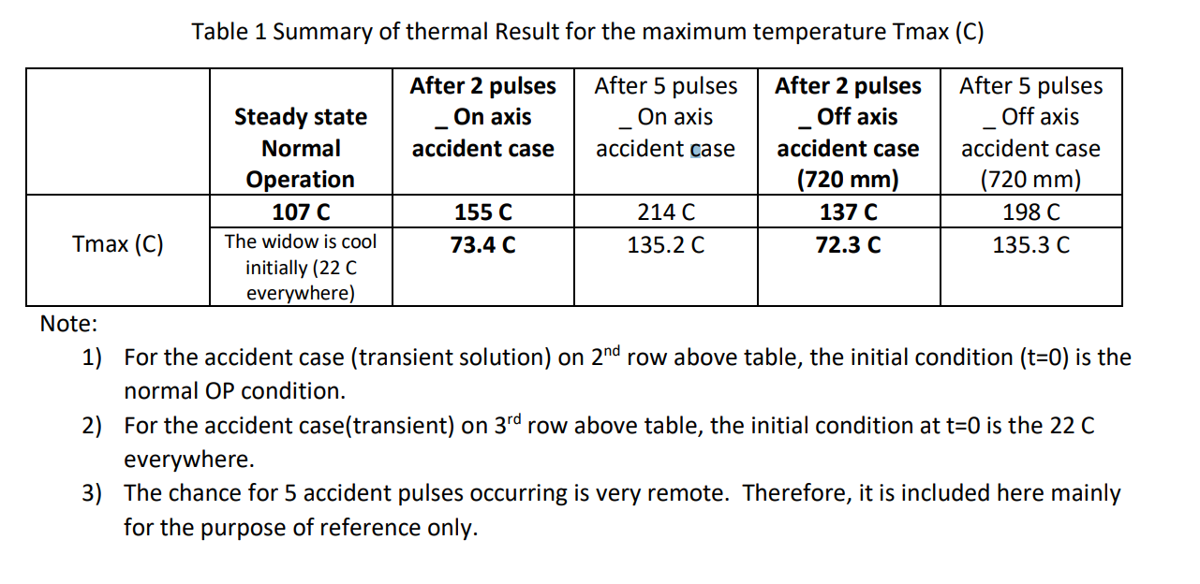
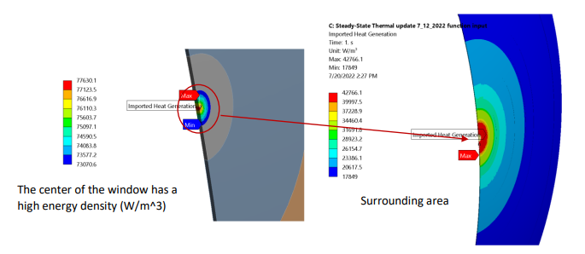
Decay Pipe Downstream Window Analysis Under 2.4 MW
Thermal Results:
  On Axis Tmax after 2 and 5 accident pulses:
    Tmax 2 pulses: 155 C (311 F)
    Tmax 5 pulses: 214 C (417.2 F)
    Tmax change due to pulses: ~23 C/pulse (73.4 F)
    Consistent with theoretical calculations
  Off Axis (72 cm) Tmax after 2 and 5 accident pulses:
    Tmax 2 pulses: 158 C (316.4 F)
    Tmax 5 pulses: 198 C (388.4 F)

Slide 27
Decay Pipe Downstream Window Analysis Under 2.4 MW
Structural Requirements:
  Min. tensile ultimate strength: 70 ksi
  Min. tensile yield strength: 25 ksi
  ASME VIII, Div II, Part 5 Max Stress: 49.5 ksi
  Method:
    1st Load Step: 5 psi internal pressure only
    2nd Load Step: 5 psi + thermal load
    3rd Load Step: 5 psi + thermal load + gravity

Slide 28
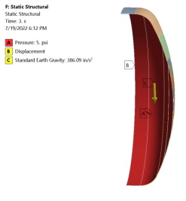
Decay Pipe Downstream Window Analysis Under 2.4 MW
Structural Results:
  On Axis:
    2 pulses: 13.5 ksi
    5 pulses: 28.2 ksi
  Off Axis:
    2 pulses: 10.1 ksi
    5 pulses: 25.2 ksi
  Per ASME VIII, DIV 2, part 5, allowable is 49.5 ksi
  Stress around weld joint area is ~2.2 ksi regardless of normal or accident cases
  Even after severe accident cases, the window remains functional

Slide 29
DSDP Window R&D Conclusions
Analysis was conducted to determine the DSDP Window thermal and structural performance for nominal operating and accident condition under 2.4 MW beam power with a 1.5 m Target.
  Accident condition analysis consisted of 5 beam pulses with no target as critical failure condition
Results show no indication of failure at this accident condition
System is designed for 2.4 MW
  No additional R&D required
Dpa and Fluence taken from absorber and NuMI experience. Full MARS analysis will be conducted

Slide 30
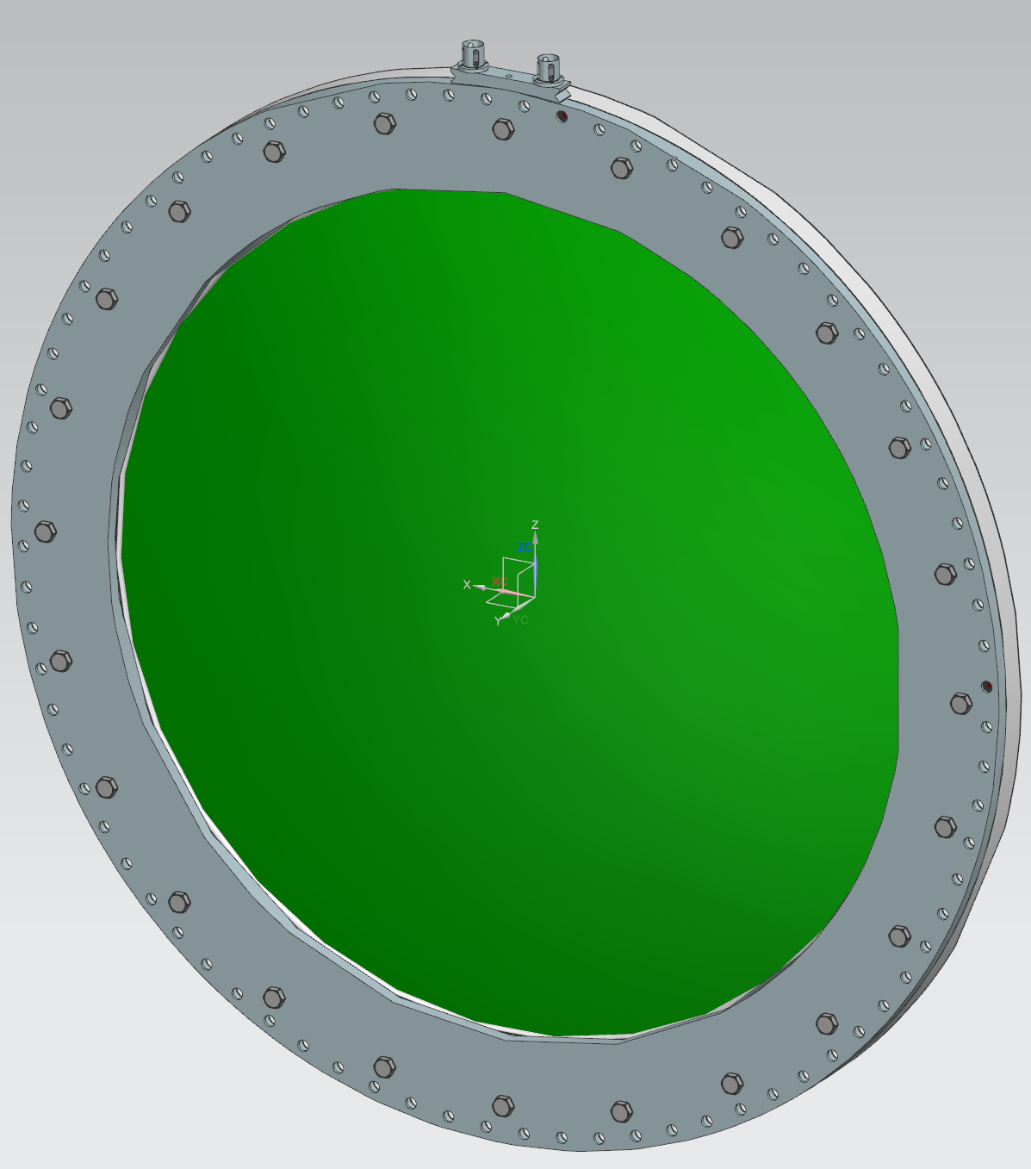
USDP Window

Slide 31
LBNF Target Facility and Upstream Decay Pipe
2.4
?
*
Removable
Steel Shielding
2.4
2.4
Work
Cell
Sealed Hatch Covers
?
*
?
2.4
Decay Region Upstream Window
?
2.4
?
Steel
Shielding
Horn C
Cooling
Panels
2.4
Horn B
Horn A with Target
Baffle
Primary Beam Window
Assembly
*

Slide 32
USDP Window Design Overview
Total Internal pressure against window.
  Ranges from 3 to 5 psig
Bolt hole pattern diameter
  70 in (1.78 m)
Bolts screw into stainless tapped holes in Decay Pipe Snout Flange.
Aluminum Window Diameter:
  1.5 m (~4.9 ft)
Aluminum Window Thickness:
  1.5 mm (~0.06 in)
Outer Flange Diameter:
  1.8 m (~5.9 ft)
Outer Flange Thickness:
  75.8 mm (~3 in)
Window Weight:
  154.59 kg (~341 lbs)
Window is replaceable using Remote Exchanger

Slide 33

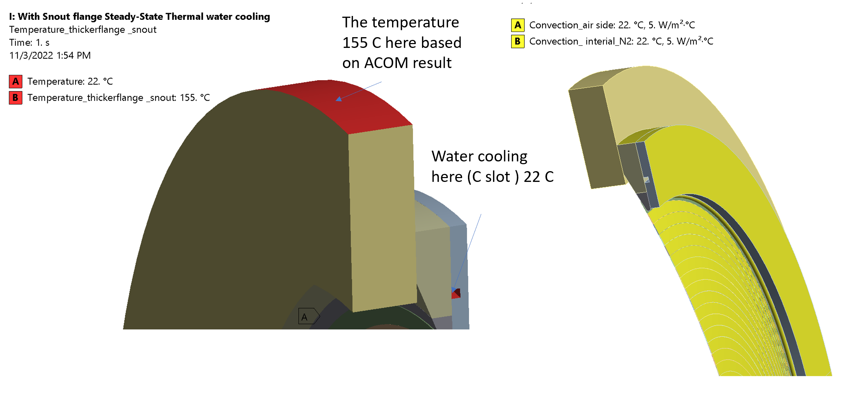
Thermal and Structural Analysis of USDP Window
Analysis was conducted to determine the USDP Window thermal and structural performance for nominal operating and accident condition (5 pulses with bafflette) under 2.4 MW beam power with a 1.5 m Target.
A cooling loop is present for 2 scenarios to compare with 1 case without
  Water cooling 22C held constant at water channel
Beam Interaction:
Peak Fluence/year: Will be found with complete MARS analysis
DPA/Year: 4.55e-1
Peak Temp: 94 C

Slide 34
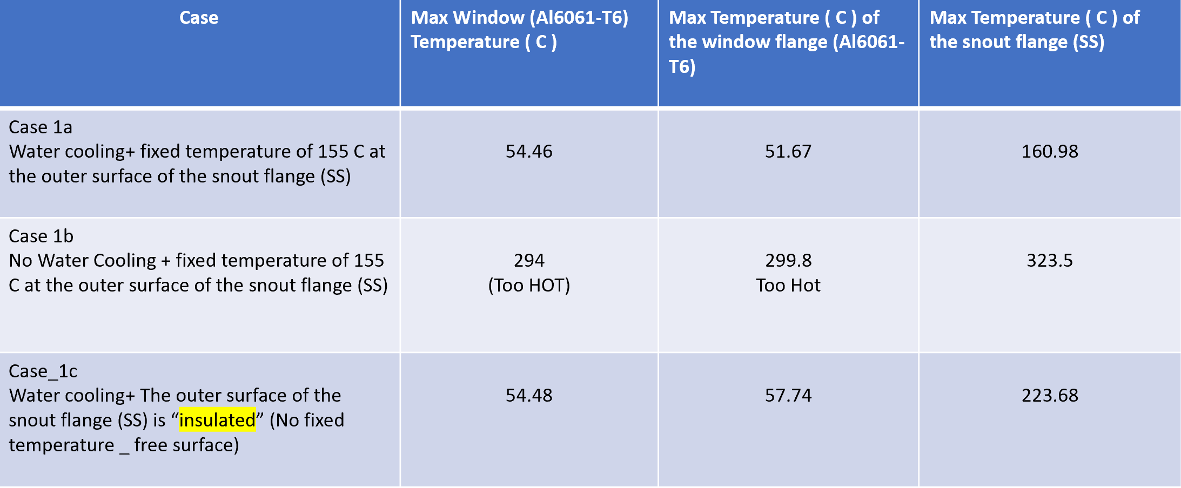
Thermal Results

Slide 35
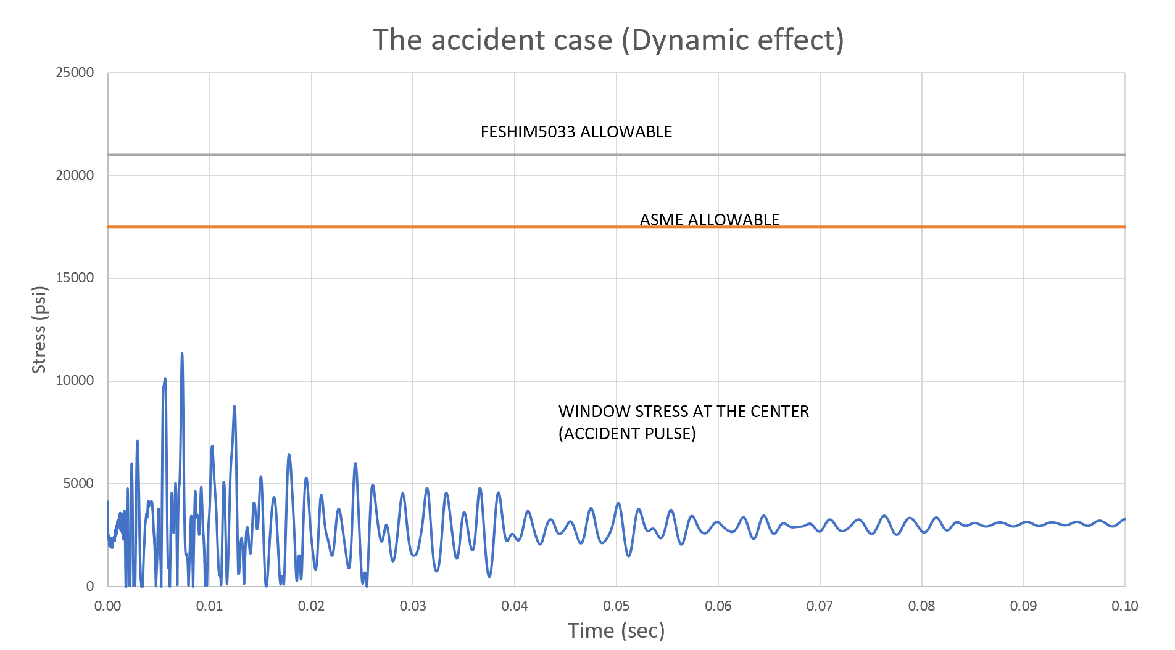
Structural Results
Current design configuration with the inclusion of a cooling loop successfully keeps the stress below ASME allowable as defined by ASME VIII, Div II.
Max Stress Allowable: 120 Mpa
Max Stress Result: 82 Mpa
Further analysis needed in order to determine if fatigue will be an issue in worst accident case with no target

Slide 36
USDP Window R&D Summary
Results show window is sufficient for operation with the inclusion of a sufficient cooling loop.
  R&D for cooling loop already within project scope
  No Target accident case yet to be evaluated
    MARS analysis for this case will be conducted followed by an additional thermal and structural analysis
  Conservative operation would be to qualify system at lower energy before 2.4 MW operation
    Operational time requested is 6 months to confirm system integrity and evaluation
  If window is found to be insufficient during lower energy run time, beryllium centered window is partially designed and is capable of higher beam power than all aluminum
    R&D finalization for this system: 6 months at 0.5 FTE for mechanical engineer
Dpa is a very conservative estimate and will require a full MARS run

Slide 37
Conclusion
Primary Beam Window and Cartridge Assembly has been developed and undergone final design. FEA shows design is sufficient for 2.4 MW operation.
  Conservative time for validation/shake-down is 6 months of operation
  1 week of maintenance shutdown required for possible remote camera inspection
DSDP Window is controlled by AECOM and has undergone FEA which determined that, even under severe accident conditions, there is no threat to functionality and is sufficient for 2.4 MW operation
  Conservative time for validation/shake-down is 6 months of operation
  1 week of maintenance shutdown required for possible remote camera inspection
USDP Window is undergoing design and validation with the inclusion of a cooling loop to support functionality. Initial analysis shows that the presence of a cooling loop is sufficient for functionality at 2.4 MW, even in the bafflette-only accident condition.
  No target accident case still to be evaluated
Validation/shake-down of systems can be done simultaneously while operating at lower beam power

Slide 38
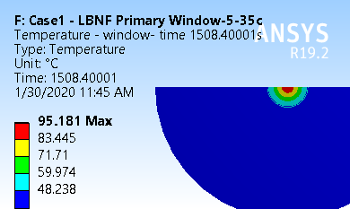
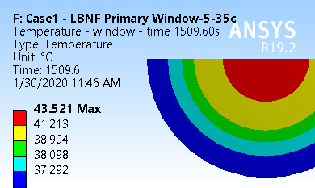
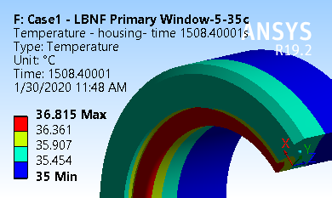
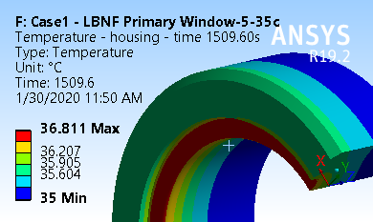
Membrane and Housing Temperature for Case1
Beam on
Beam off
The highest temperature occurs near the center of the membrane.
The highest temperature in the housing occurs near connection between the membrane and the housing.

Slide 39
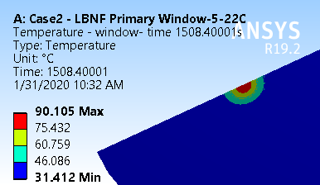
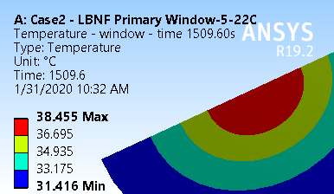
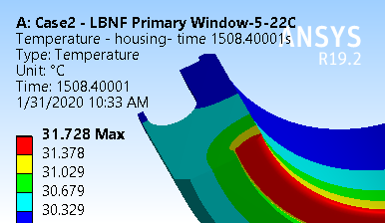
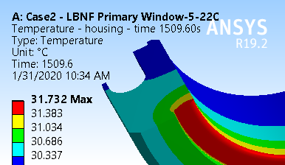
Membrane and Housing Temperature for Case2
Beam on
Beam off
The highest temperature occurs near the center of the membrane.
The highest temperature in the housing occurs near connection between the membrane and the housing.

Slide 40
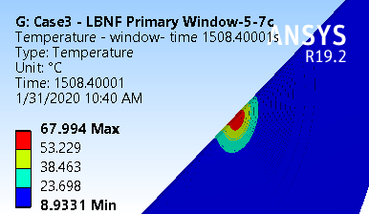
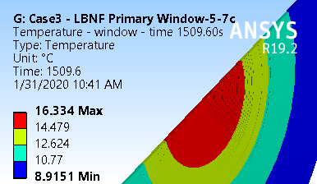
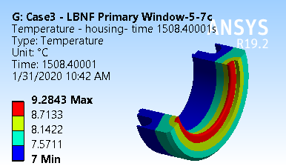
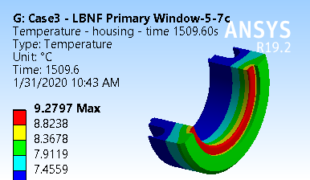
Membrane and Housing Temperature for Case3
Beam on
Beam off
The highest temperature occurs near the center of the membrane.
The highest temperature in the housing occurs near connection between the membrane and the housing.

Slide 41
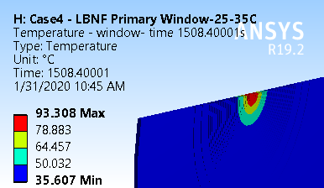
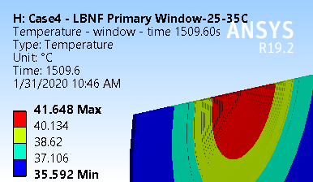
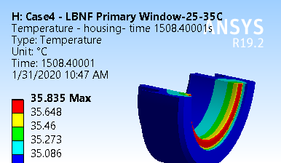
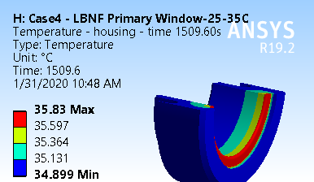
Membrane and Housing Temperature for Case4
Beam on
Beam off
The highest temperature occurs near the center of the membrane.
The highest temperature in the housing occurs near connection between the membrane and the housing.

Slide 42
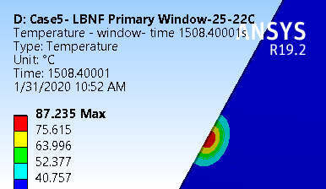
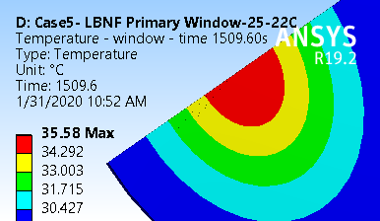
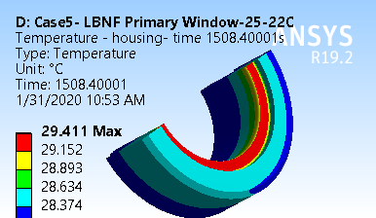
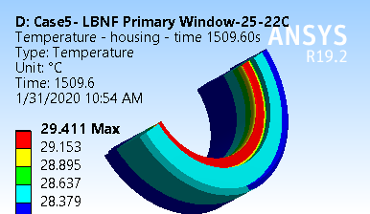
Membrane and Housing Temperature for Case5
Beam on
Beam off
The highest temperature occurs near the center of the membrane.
The highest temperature in the housing occurs near connection between the membrane and the housing.

Slide 43




Membrane and Housing Temperature for Case6
Beam on
Beam off
The highest temperature occurs near the center of the membrane.
The highest temperature in the housing occurs near connection between the membrane and the housing.

Slide 44




Membrane and Housing Temperature for Case7
Beam on
Beam off
The highest temperature occurs near the center of the membrane.
The highest temperature in the housing occurs near connection between the membrane and the housing.

Slide 45




Membrane and Housing Temperature for Case8
Beam on
Beam off
The highest temperature occurs near the center of the membrane.
The highest temperature in the housing occurs near connection between the membrane and the housing.

Slide 46




Membrane and Housing Temperature for Case9
Beam on
Beam off
The highest temperature occurs near the center of the membrane.
The highest temperature in the housing occurs near connection between the membrane and the housing.

Slide 47


