Slide 1
Hypervapotrons for High-Power Accelerator Targets
Jonathan Williams
TSD Topical Meeting - July
20 July 2023

Slide 2
Overview
High Performance Cooling
-Industry Tour of Cooling Solutions
Hypervapotrons
-History & how it works
-Applications
-Targetry
LDRD proposal
-Project overview
-Target Packaging
-Expected issues

Slide 3
High-Performance Cooling - An Industry Tour

Slide 4
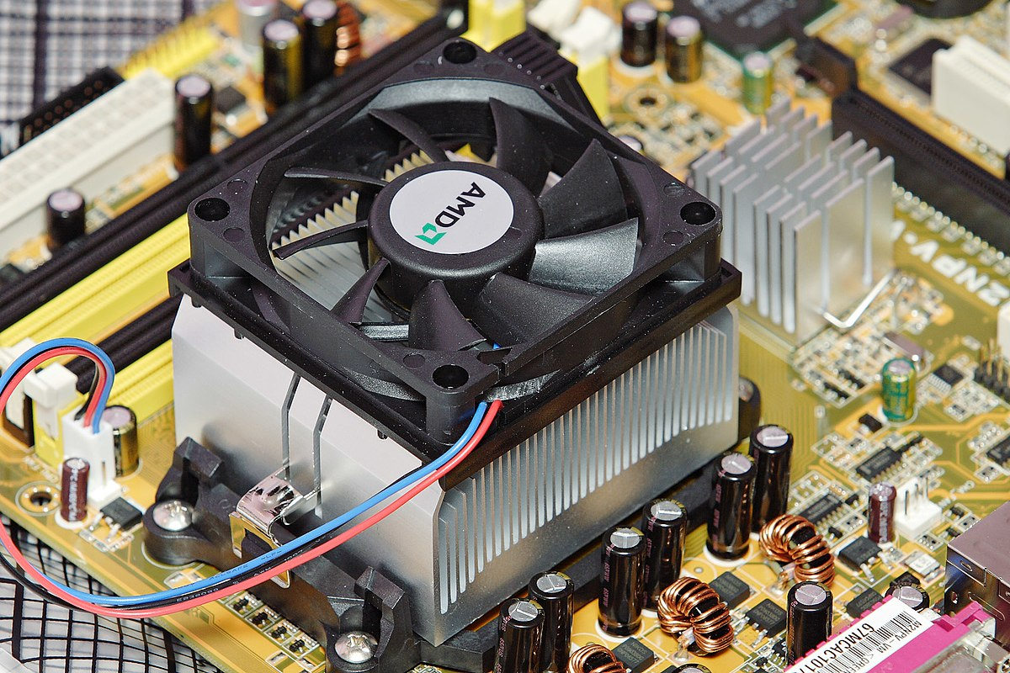
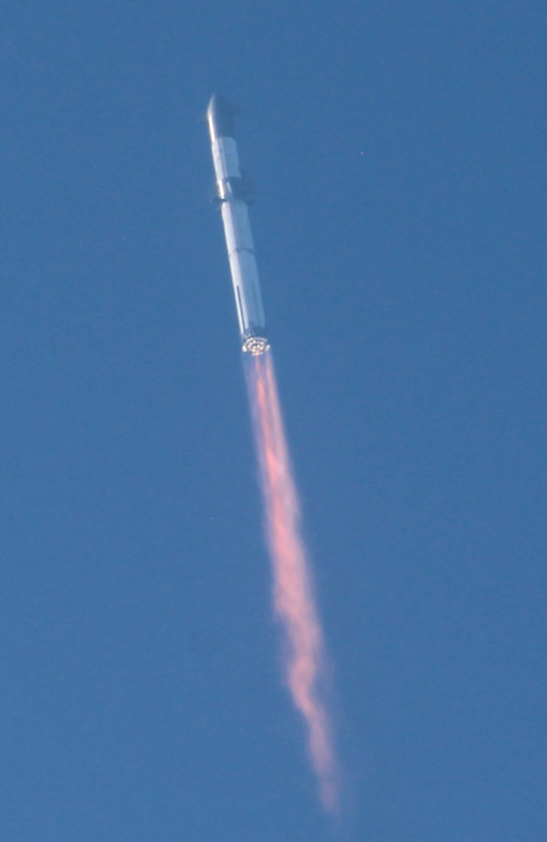
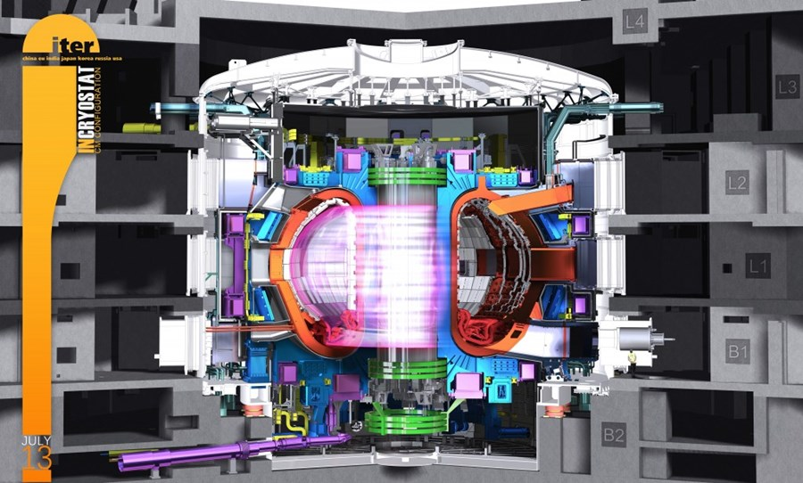
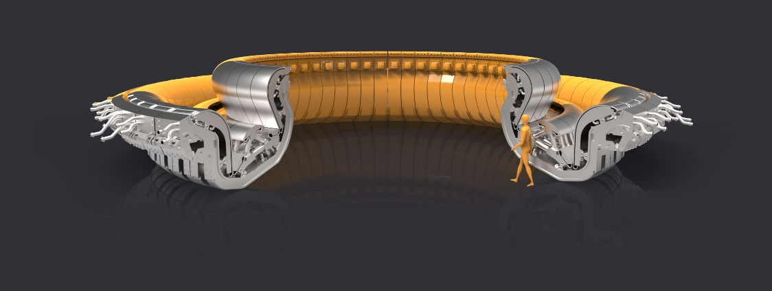
High-Performance Cooling
How to keep things from melting/deforming/exploding?
Heat fluxes from 1 MW/m^2… … to 30+ MW/m^2
Image Sources: Wikipedia, ITER

Slide 5
Air/Water Cooling – Computer Chips
Heat spreaders, fans, fins…
Physically reduce heat flux, spread out hot spots
Water-cooling lines
Microchannels, jet impingement
100 W in 1 cm^2 = 1 MW/m^2
Dies around 1-2 cm^2 are typical of modern processors
Hotter chips, smaller transistors and new process nodes
Image Source: Wikipedia

Slide 6
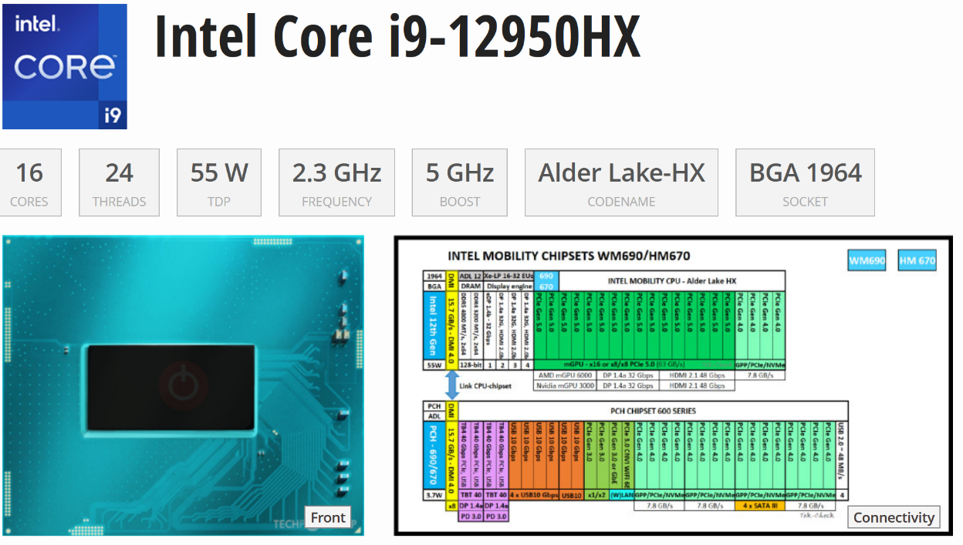
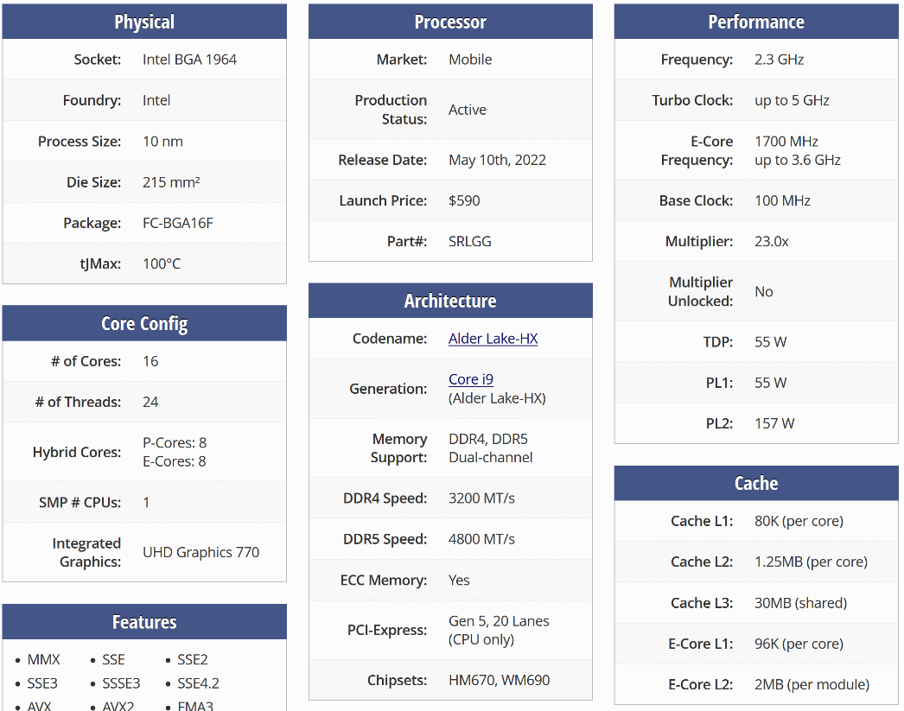
Air/Water Cooling – Computer Chips
Example: My work laptop…
Intel i9-12950HX
TDP of 55W, short-term boost to 157W
2.15 cm^2 die area
157 W in 2.15 cm^2 = 0.73 MW/m^2 heat flux out of the die
Heat spreaders/heat sinks
A very overworked fan…
Image Source: TechPowerUp

Slide 7
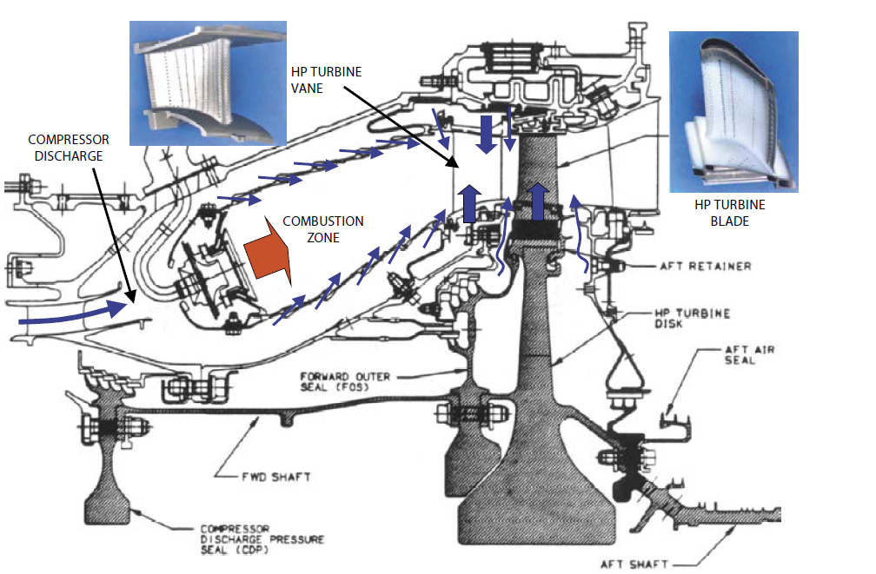
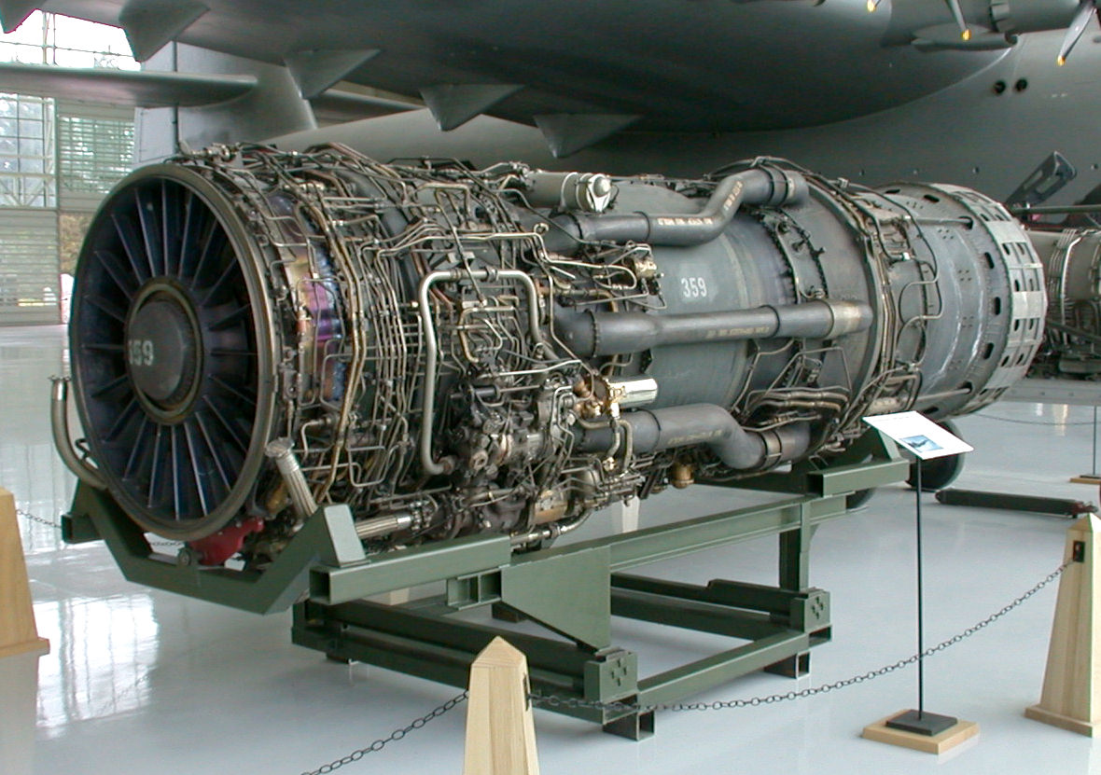
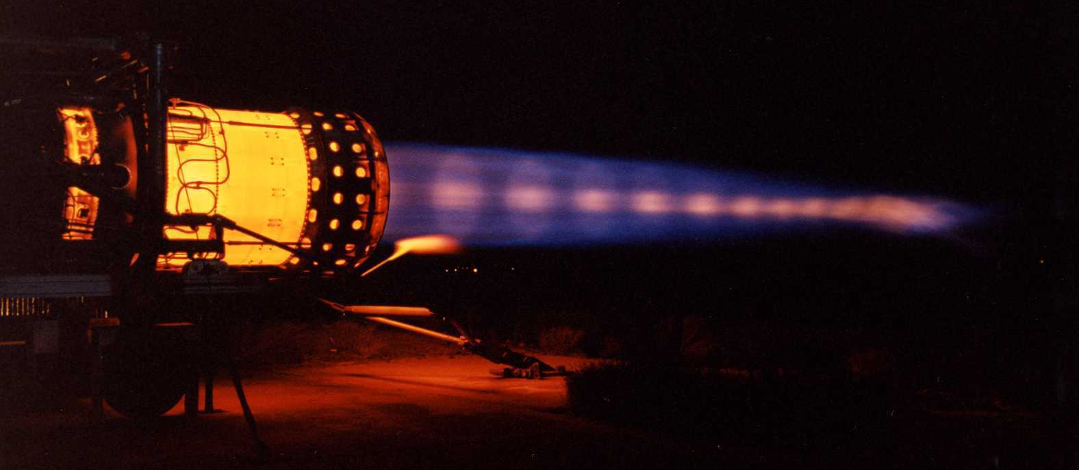
Gas Cooling – Jet Engines
Avoid needing high heat transfer – insulate or use high-temp materials
Film cooling (insulate), metallurgy (directional and single-crystal materials),
Image Source: SoftInWay, Wikipedia

Slide 8
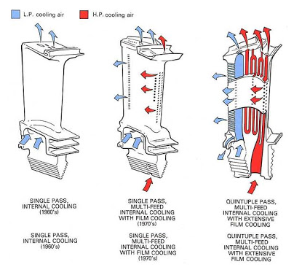
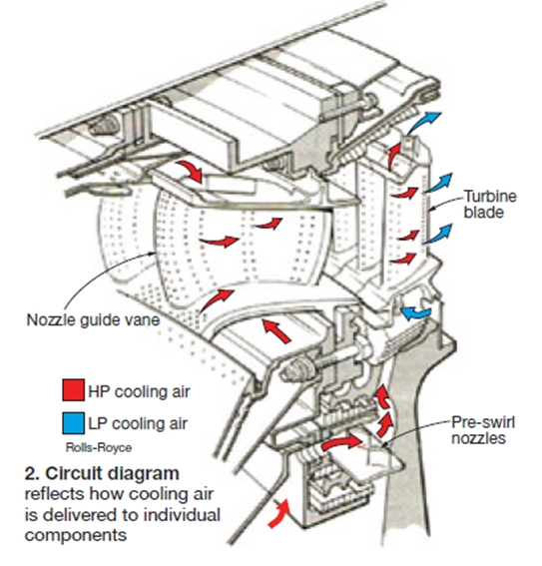
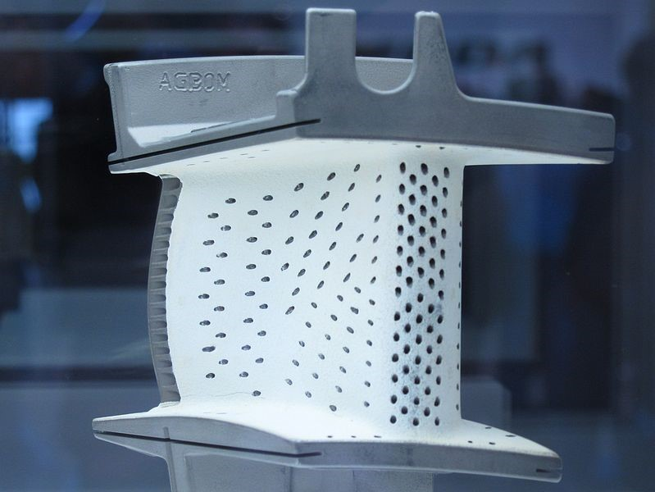
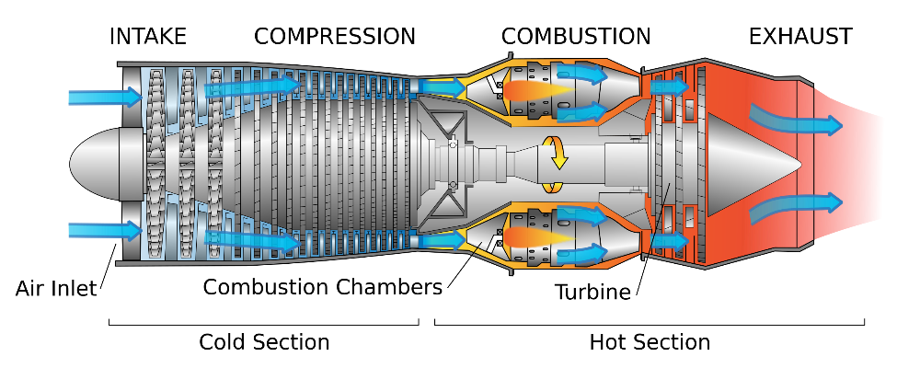
Gas Cooling – Jet Engines
Forced convection – turbulators, impingement liners, film cooling…
High-pressure air from compressor – use for cooling
Image Source: Concepts NREC, Combined Cycle Journal, SoftInWay

Slide 9
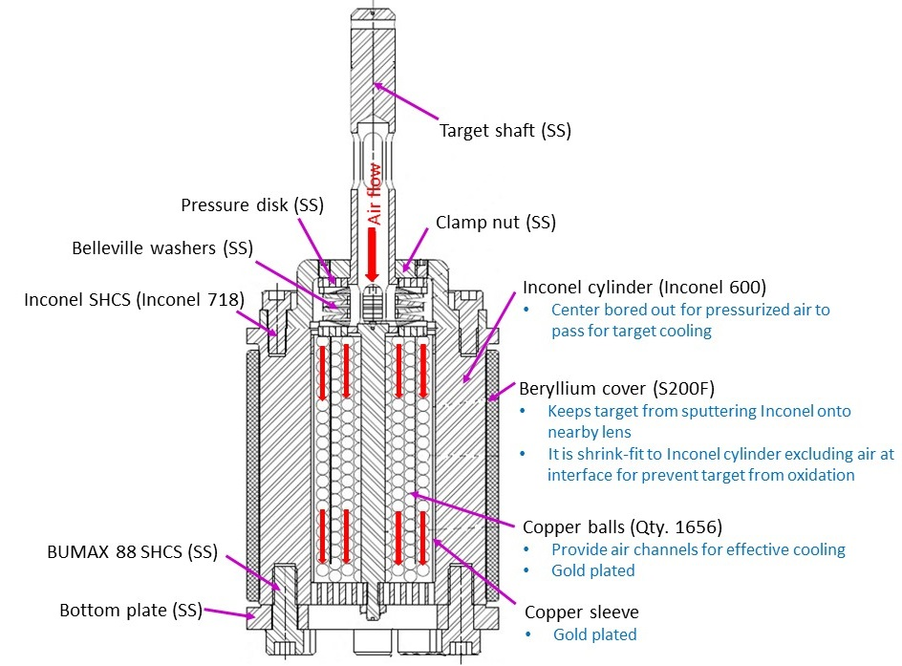
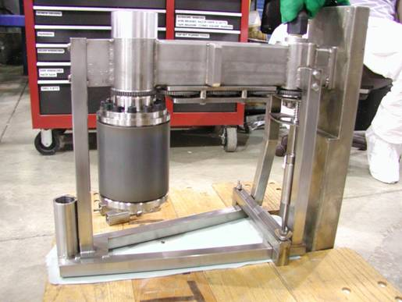
Gas Cooling – AP0 Target
Forced convection – Air

Slide 10
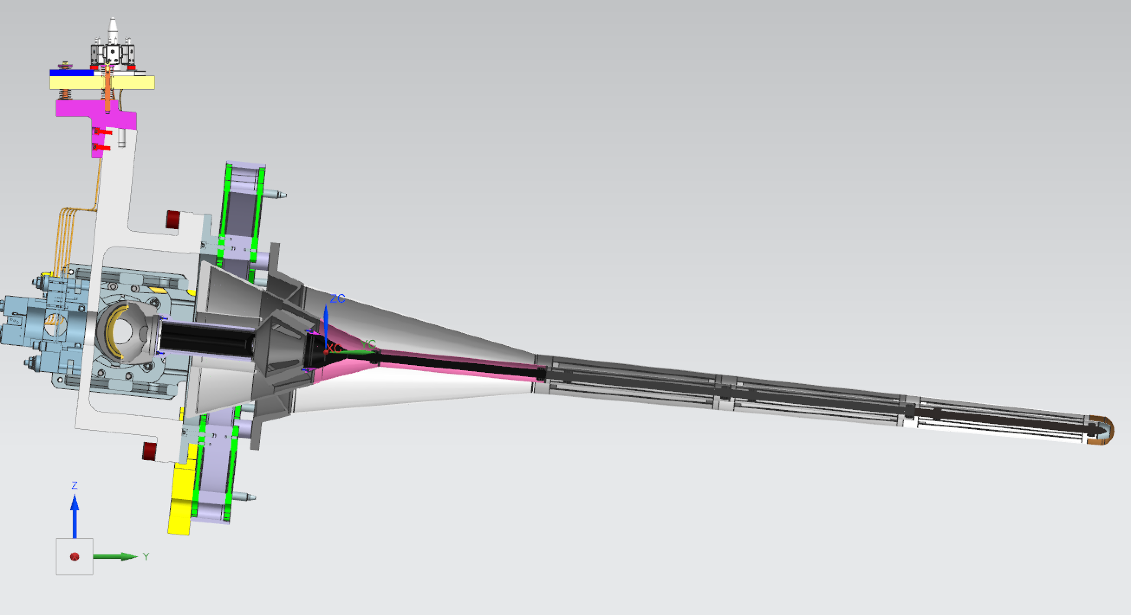
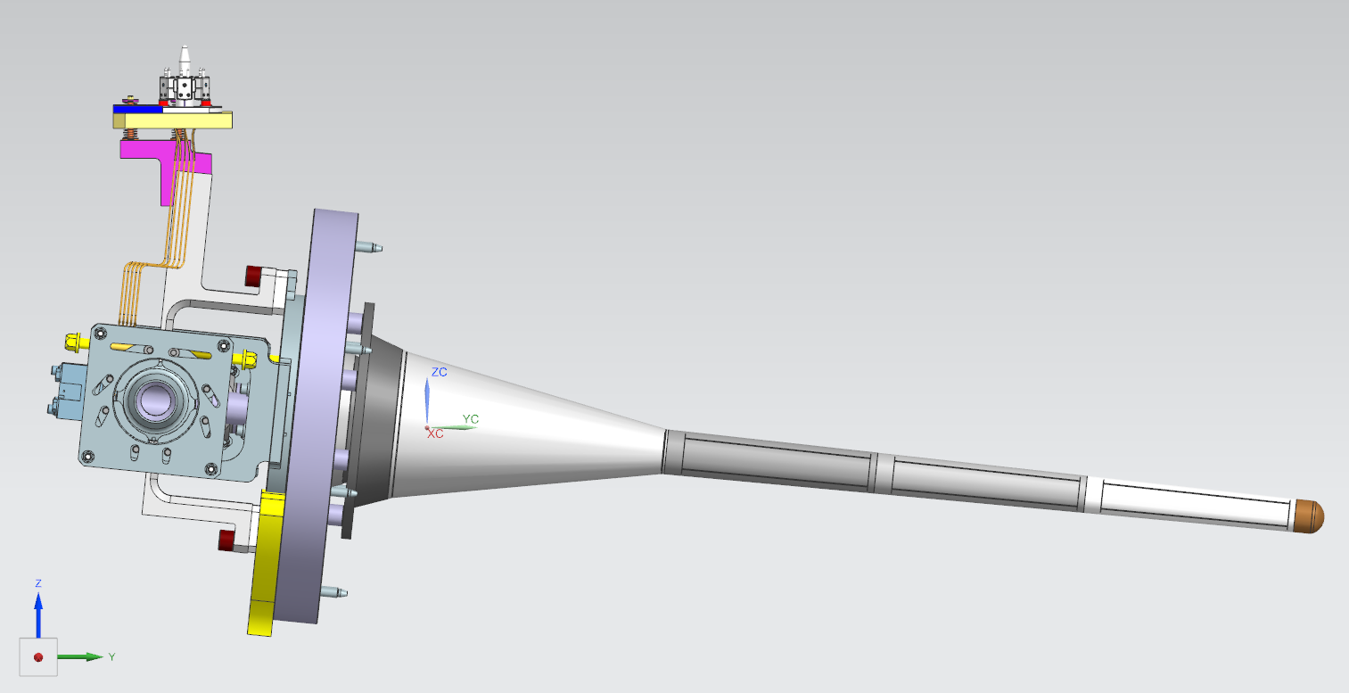
Gas Cooling – LBNF Target
Forced convection – Helium
Radiation affects materials

Slide 11
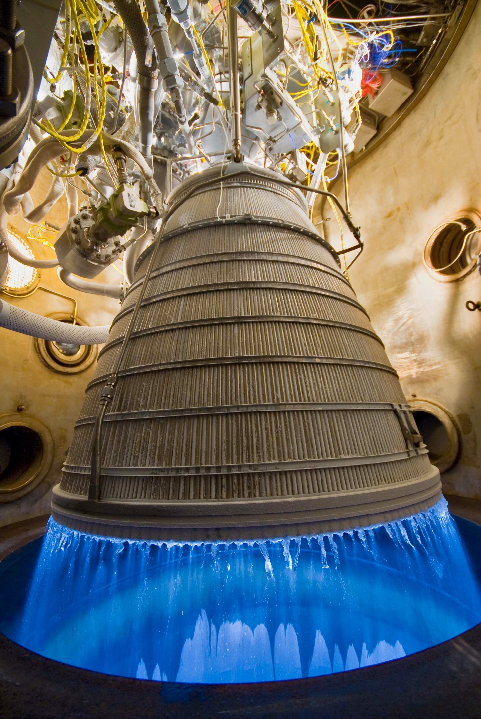
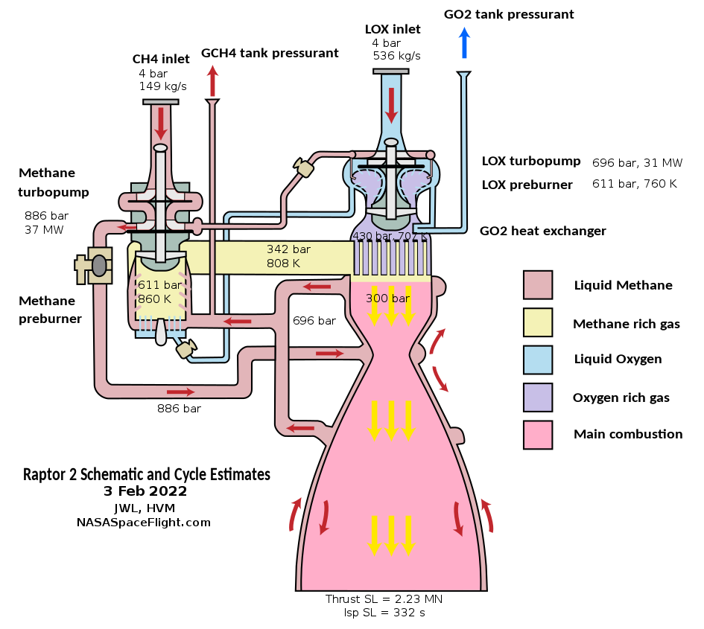
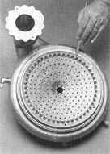
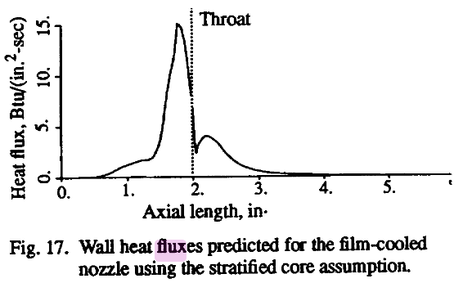
Liquid Cooling – Rocket Engines
Regenerative cooling, cryogens, phase change, film cooling…
1-30+ MW/m^2
Worst near nozzle throat
24.5 MW/m^2
Source: NasaSpaceflight.com, NASA, NASA-TM-106617
Aerojet Rocketdyne RL-10 Altitude Cell Hot Fire Test, Injector face inset

Slide 12
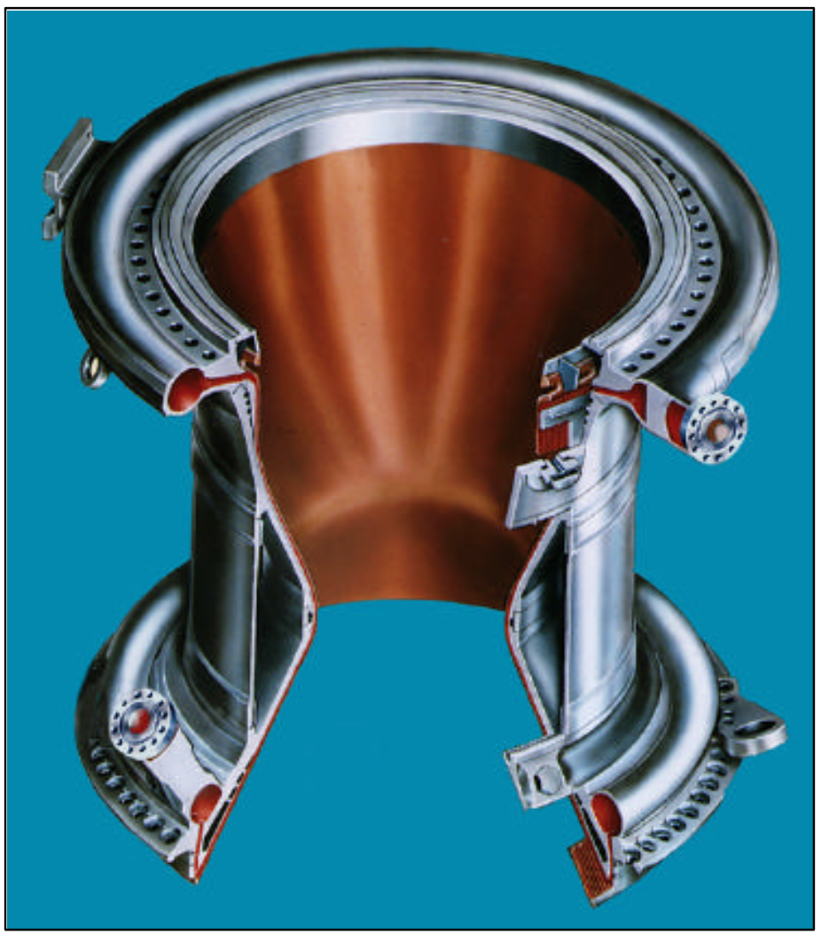
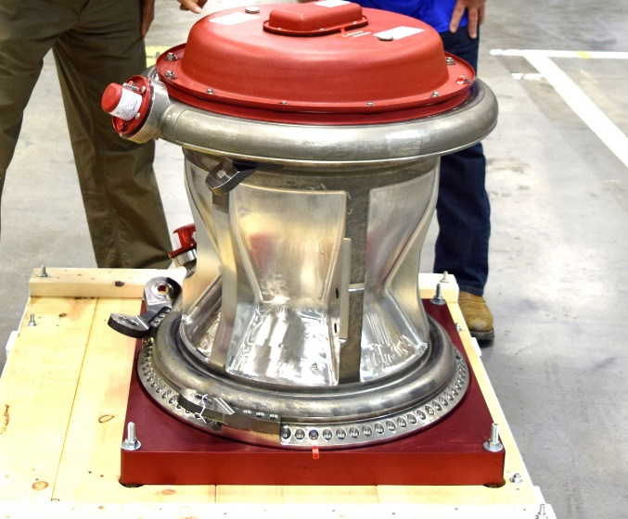
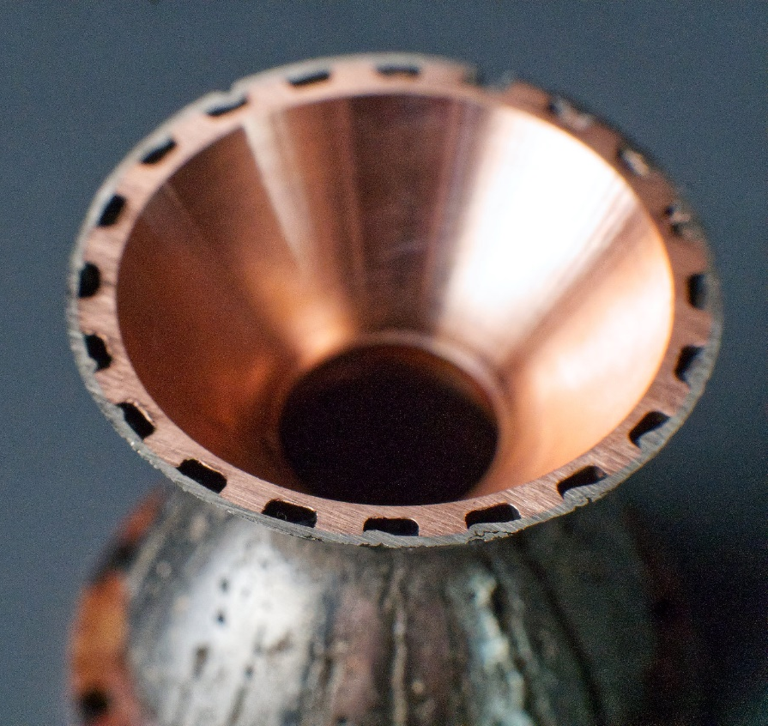
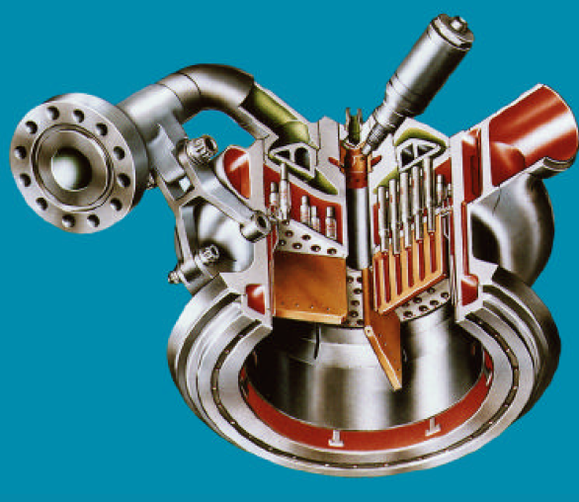
Liquid Cooling – Rocket Engines
Image Source: NASA, Boeing “Space Shuttle Main Engine Orientation”, Breaking Taps (Twitter)

Slide 13
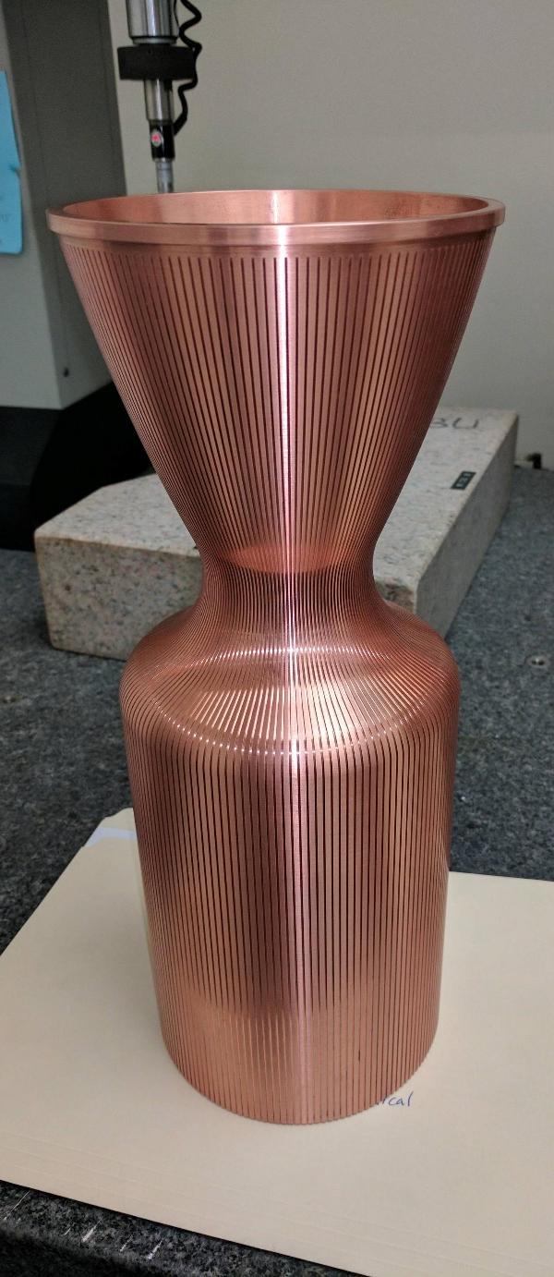
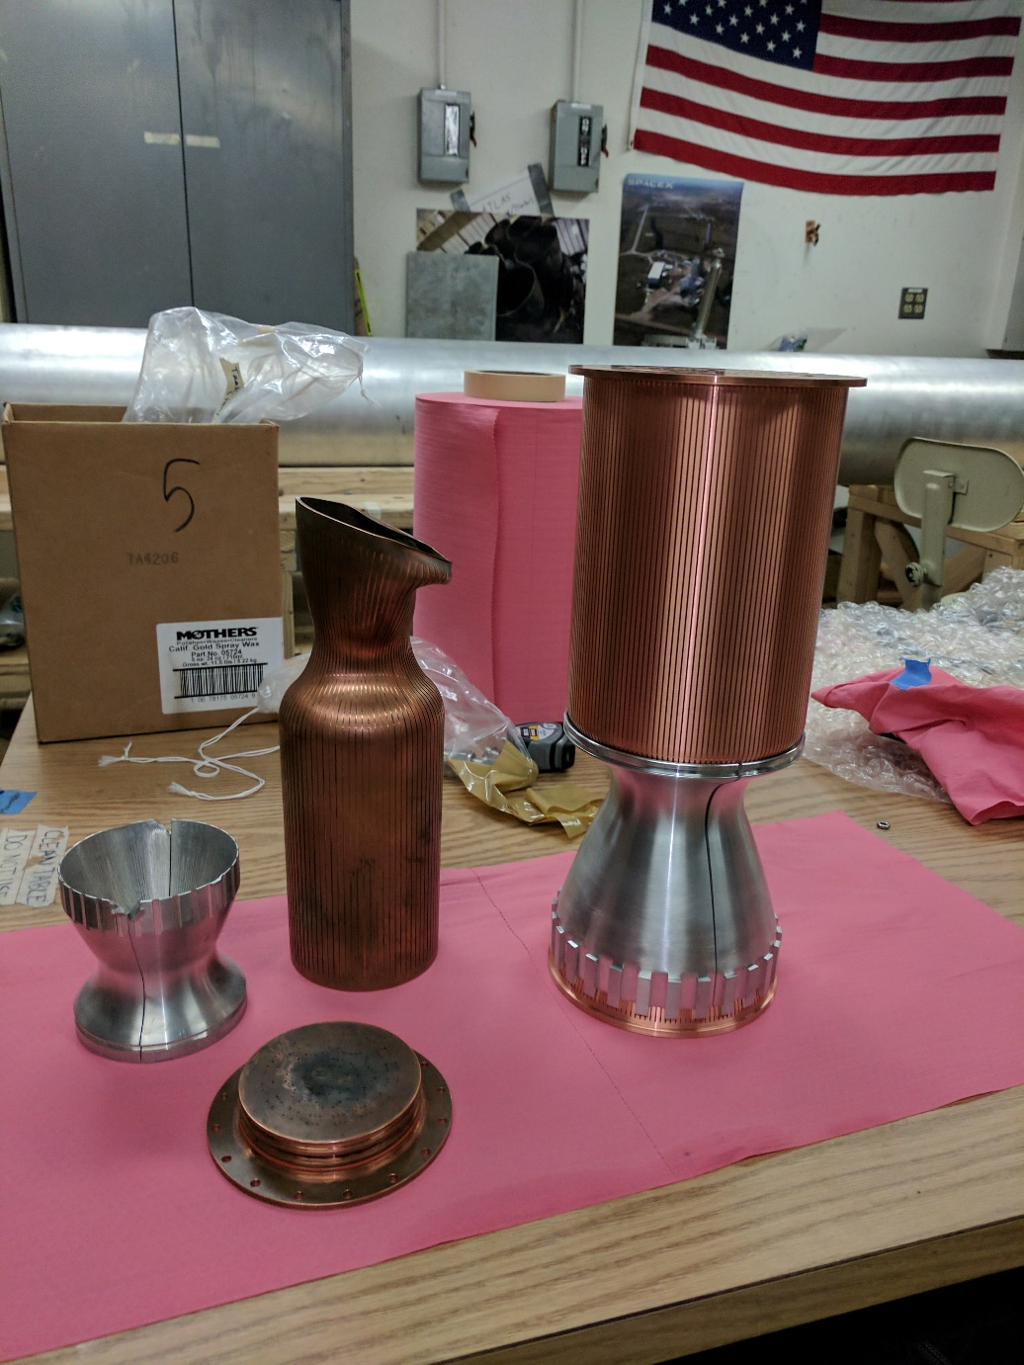
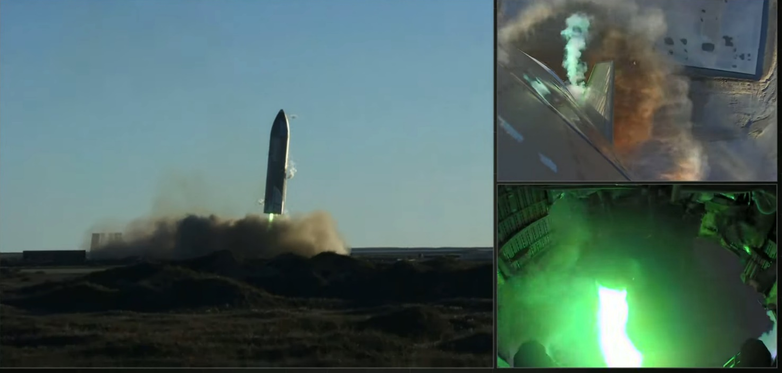
Liquid Cooling – Rocket Engines
Image Source: Boston University Rocket Propulsion Group, SpaceX

Slide 14
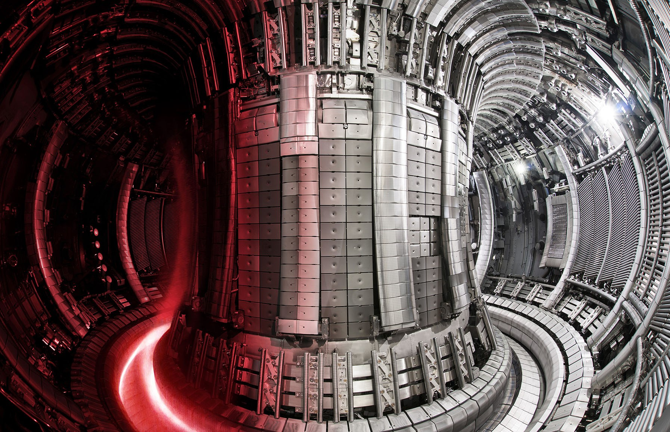
Fusion Research
Image Source: https://www.iter.org/newsline/-/3722

Slide 15
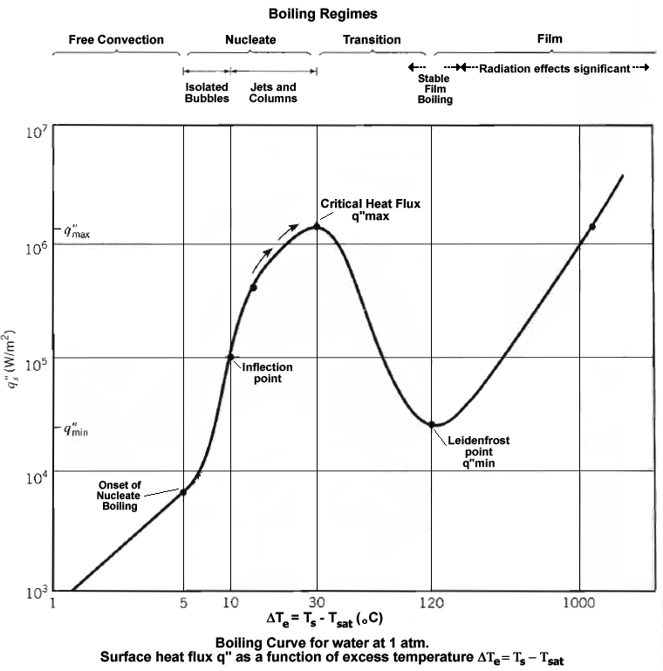
Takeaways
Forced convection gas cooling is widely applicable
Heat spreaders/fin stacks can help, but run into heat transfer limits
Space-constrained applications lean towards liquid cooling (sometimes with phase-change)
Very application-specific, e.g., rocket nozzles, laptop heat pipes
Higher heat fluxes possible with boiling – but adds risk of burnout
Image Source: Wikipedia

Slide 16
Hypervapotron Cooling

Slide 17
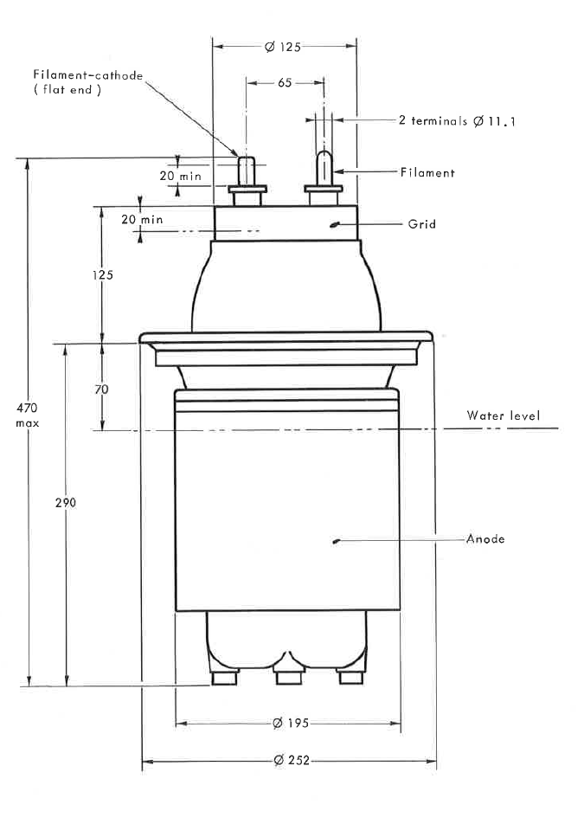
Hypervapotron Cooling - History
Hyper… what?
Cooling technology pioneered by Thompson CSF (now part of Thales-Alenia Group) in the 1950’s
“Vapotron effect”– steady-state, high heat flux cooling, >1MW in some triode tubes
Source: Datasheet TH 480, May 1972, Thompson-CSF

Slide 18
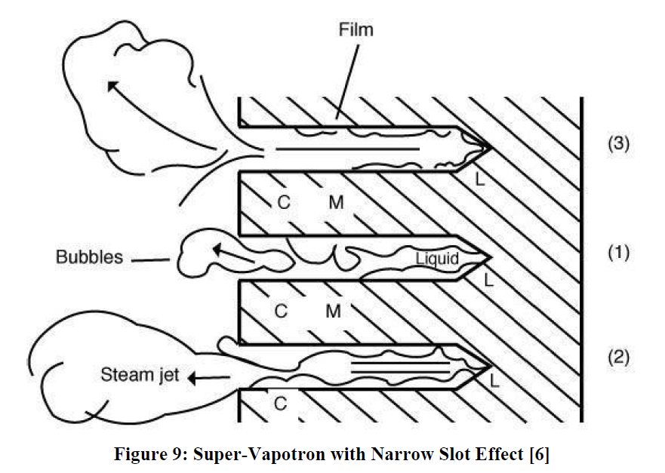
History
SuperVapotron
Water flow parallel to many thin channels (into page) – little/no forced flow within channels
Steam fills channels, then ejects into bulk flow
Channels refills behind the steam jet from along the channel – pulsing operation
Image source: Computational Modelling of the HyperVapotron
Cooling Technique for Nuclear Fusion
Applications, Joseph Milnes, PH.D. Thesis, 2010, Cranfiled University, UK

Slide 19
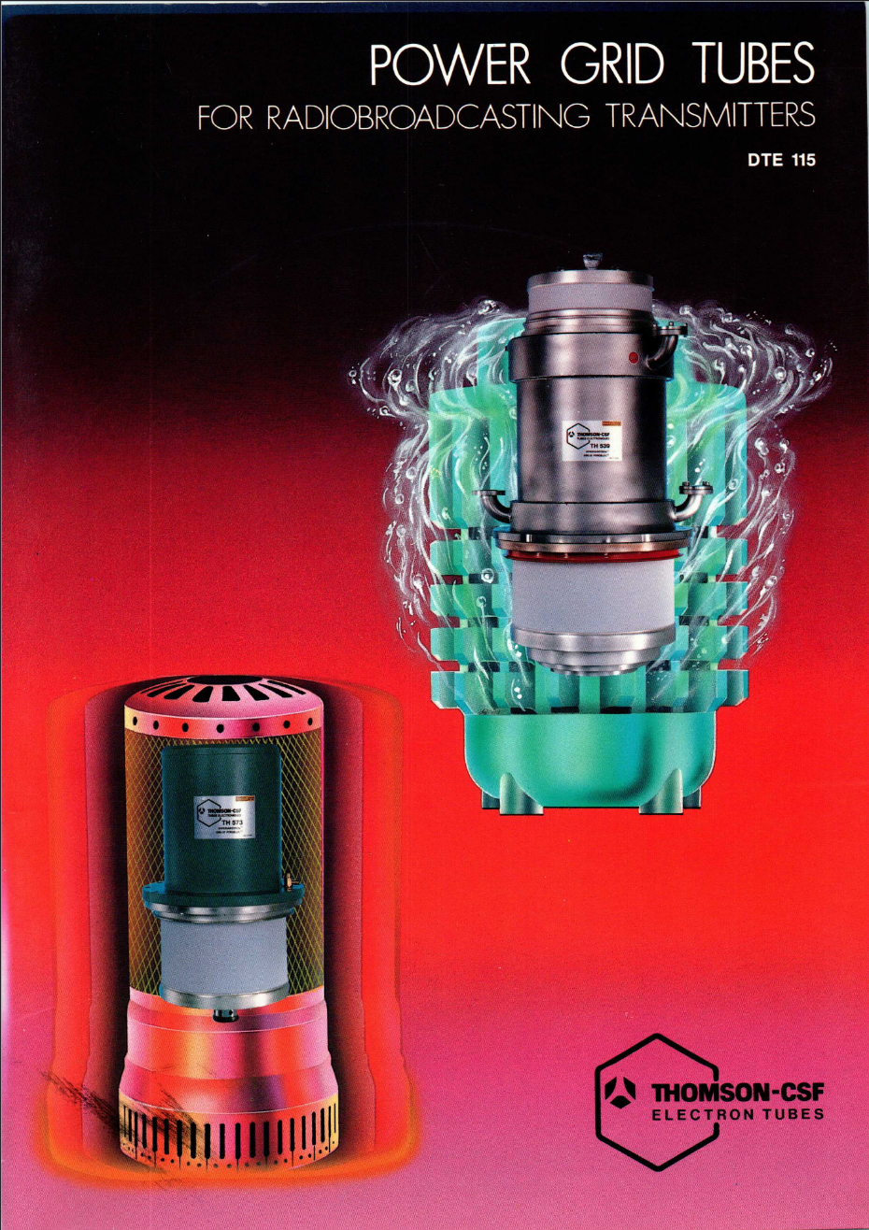
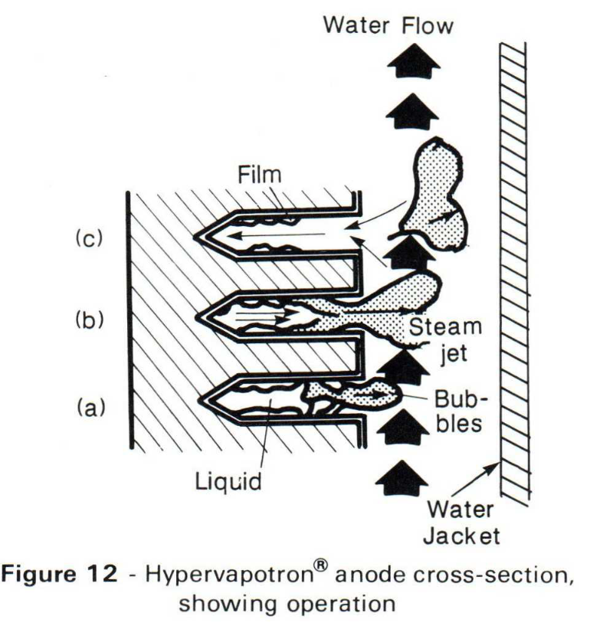
History
HyperVapotron (HVT)
Flow transverse to the fins
Induced recirculation in each groove moves in more water as it boils
Steam condenses in bulk channel flow
Current designs follow this layout
Source:

Slide 20
Performance Comparison
Image source: Milnes, Computational Modeling of the Hypervapotron Cooling Technique for Nuclear Fusion Applications (Thesis, Cranfield Univ., UK)

Slide 21
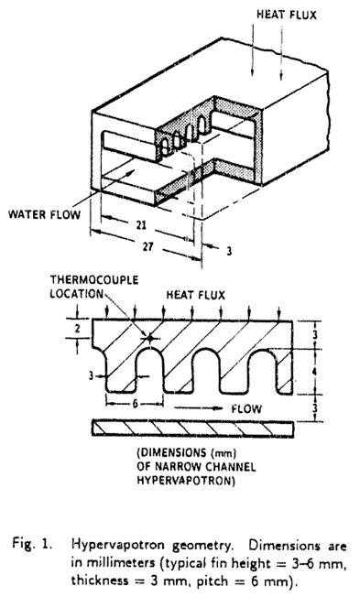
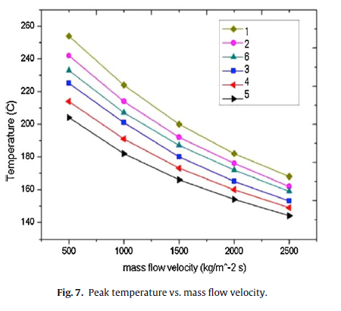
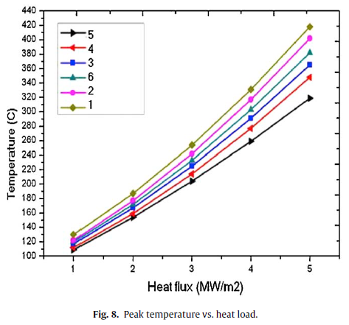
Fins and Channels
Image source: Fusion Engineering and Design 87 (2012) 868–871

Slide 22
Fins and Channels

Slide 23
Flow Visualization
Some dispute in literature over exact steam behavior
May be due to operation in different flow regimes
“High… fluid velocity and subcooling”
High pressure drop/losses
High pumping and refrigeration power
e.g., rocket engines
Source: Cattadori, G. https://doi.org/10.1016/0894-1777(93)90006-5

Slide 24
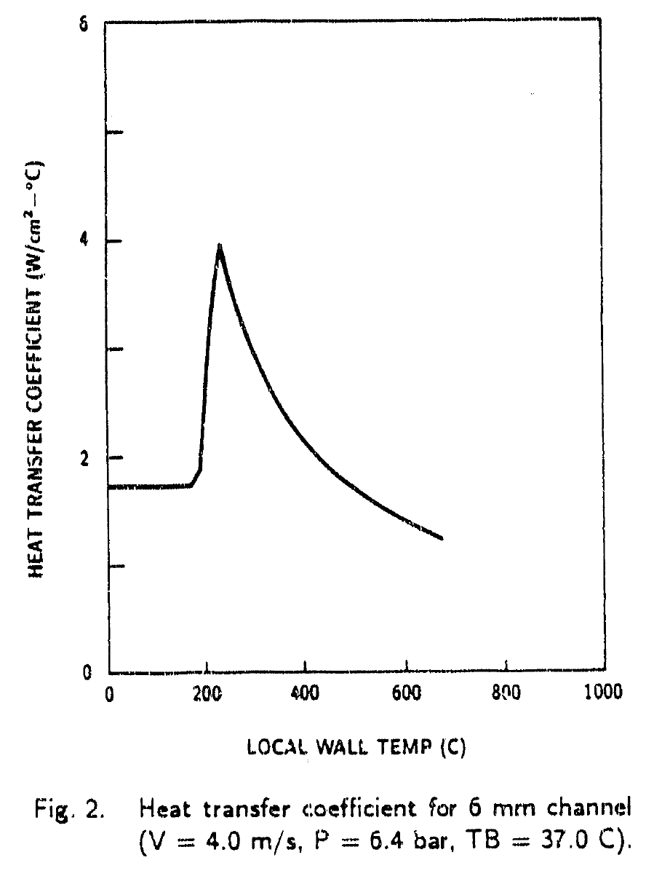
Heat Transfer Coefficient vs. Heat Flux
*Screenshot of a pdf of a microfiche of a conference paper… in a PowerPoint!
Rating for a given HVT generally given as a heat flux in MW/m^2
Heat transfer coefficient has less physical relevance – at least for basic layout
Wide range of coefficients over a single fin, plus boiling heat transfer variation
Bulk properties of the integrated cooler matter – thermal conductivity prevents burnout
Critical heat flux limits any individual point
From the perspective of the incoming heat flux, may be operating above the projected-flat-plate CHF
Increment: 10 kW/(m^2 * K)
Image source: C.B. Baxi, H. Falter. “A Model for Analytical Performance Prediction of Hypervapotron,” General Atomics Project 3467, 1992

Slide 25
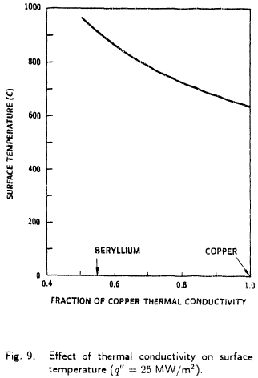
Thermal Conductivity
Copper lets us cheat the system
A part of the cooler already at CHF isn’t doomed – heat can dissipate along the fin to bring more area to its respective CHF
Conduction up the fin ultimately limits – can’t add more area forever, even if it’s all at CHF
Diminishing returns from longer fins
Fluid dynamics into the fin cavity
Decreasing temp along the fin
Image source: C.B. Baxi, H. Falter. “A Model for Analytical Performance Prediction of Hypervapotron,” General Atomics Project 3467, 1992

Slide 26
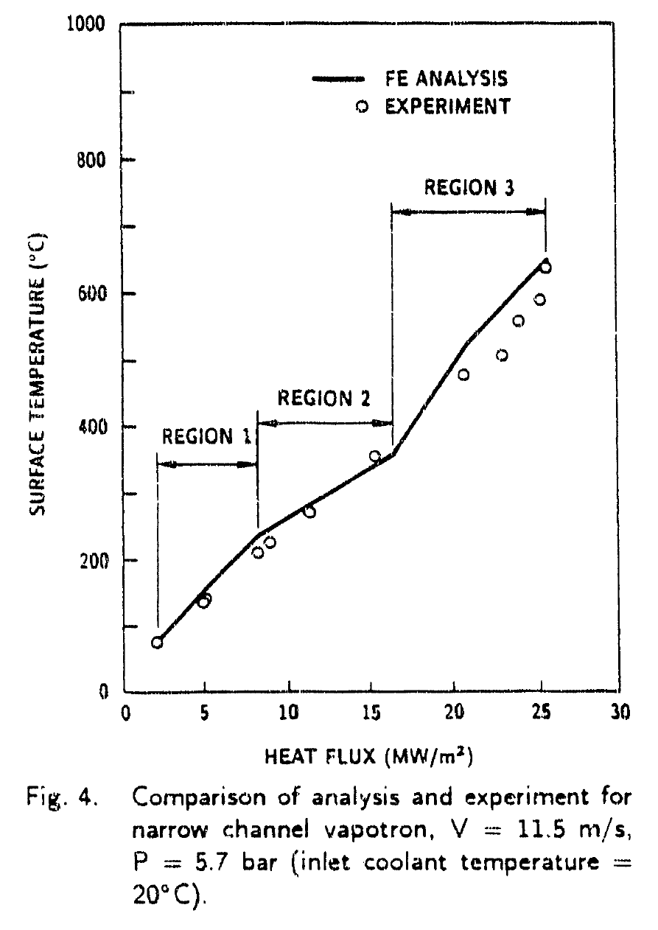
Performance
Three flow regimes
1. Forced convection
2. Nucleate Boiling
3. Critical heat flux (over increasingly large parts of surface)
Image sources: Milnes (thesis), &
C.B. Baxi, H. Falter. “A Model for Analytical Performance Prediction of Hypervapotron,” General Atomics Project 3467, 1992

Slide 27
Regime 1: Forced Convection
Flowing water, recirculation in channels
Nothing too special
I = 73 C
F = 63 C
A = 46 C
Image source: C.B. Baxi, H. Falter. “A Model for Analytical Performance Prediction of Hypervapotron,” General Atomics Project 3467, 1992

Slide 28
Regime 2: Nucleate Boiling
Water starts boiling
Wall is starting to superheat significantly
I = 240 C
F = 200 C
A = 130 C
Image source: C.B. Baxi, H. Falter. “A Model for Analytical Performance Prediction of Hypervapotron,” General Atomics Project 3467, 1992

Slide 29
Regime 3: Critical Heat Flux
Aggressive boiling, stabilized by the recirculating flow and/or steam ejection
I = 620 C
F = 500 C
A = 290 C
Sources: Milnes (thesis). & C.B. Baxi, H. Falter. “A Model for Analytical Performance Prediction of Hypervapotron,” General Atomics Project 3467, 1992

Slide 30
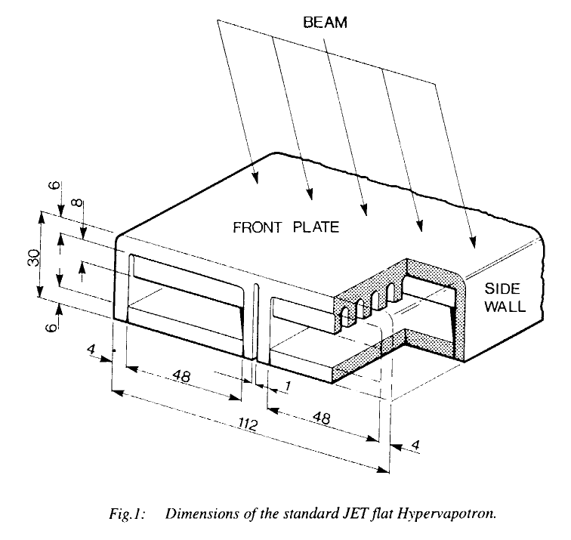
Current Designs
Fusion and high-heat flux applications
JET divertor
JET neutral beam injector –beam dumps, scrapers, and calorimeters
(30 mm x 112 mm, 3m/s, 15 MW/m^2 rating, 10MW/m^2 design point, see image)
ITER High Heat Flux first wall panels
ITER divertor targets (considered, using swirl tubes)
Image source: Falter & Thompson, “Performance of Hypervapotron Beam Stopping Elements at JET”, Report # JET-P(95)13.

Slide 31
Joint European Torus (JET) Divertor
Image Source: https://www.iter.org/newsline/-/3722

Slide 32
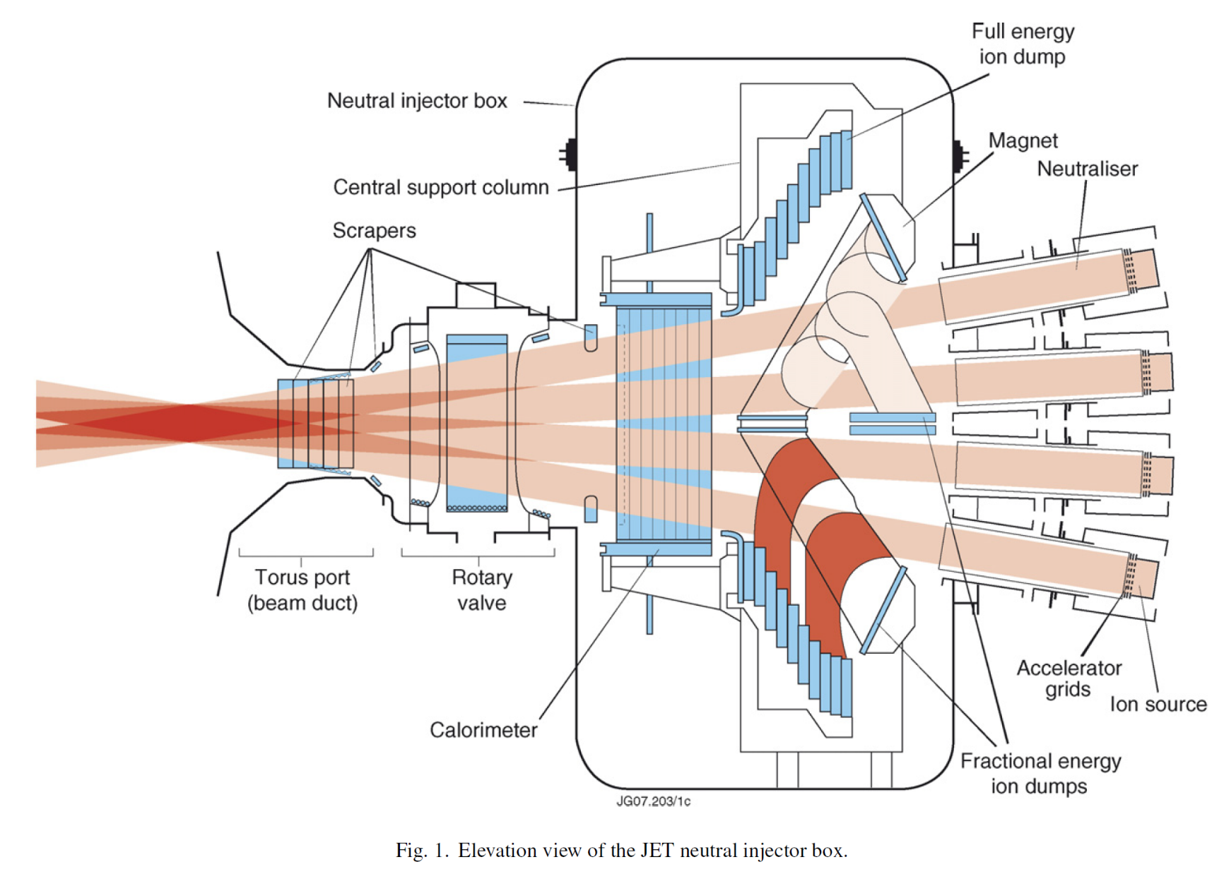
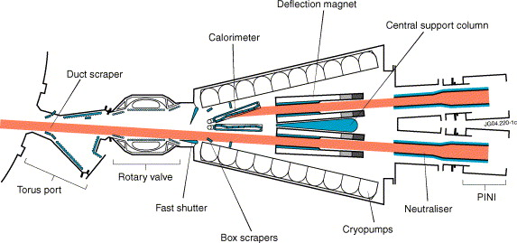
JET Neutral Beam Injector
Image source: https://doi.org/10.1016/j.fusengdes.2005.06.348
Image source: Fusion Engineering and Design 82 (2007) 610–618

Slide 33
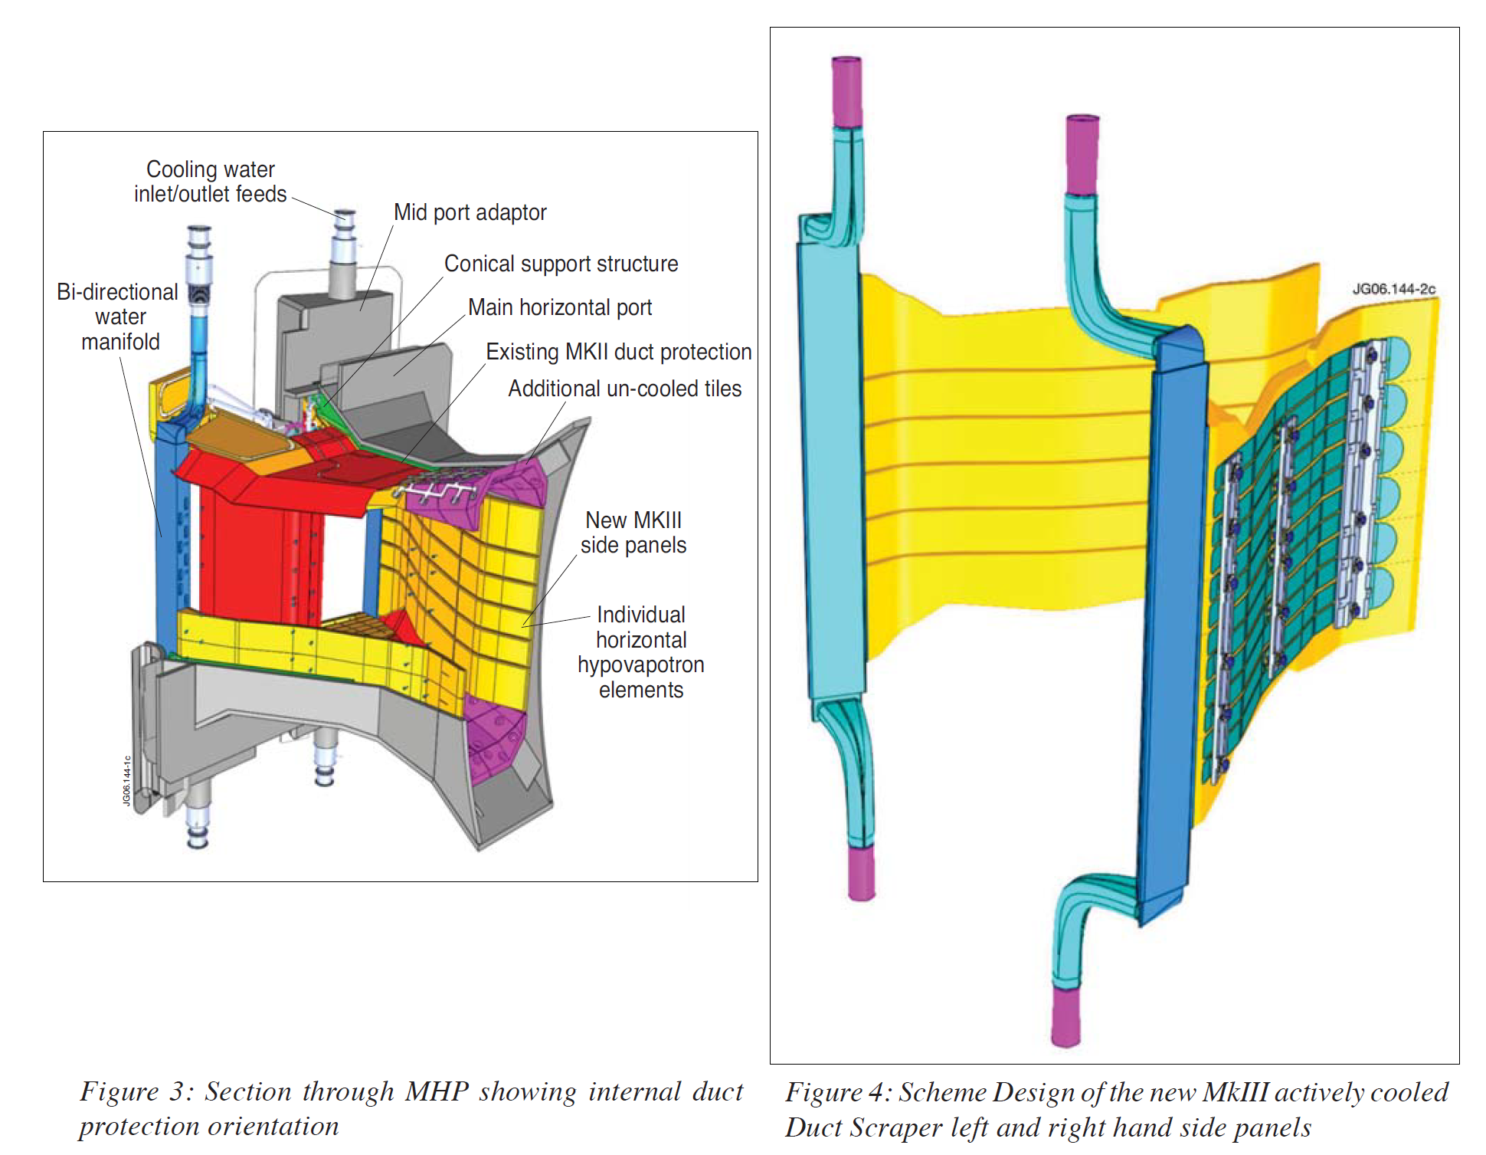
JET Neutral Beam Injector
Inject neutral particles (D₀) – plasma heating and online refueling
HVTs in dumps, calorimeter, and scrapers
34 MW total beam power
130 kV – 8 injectors, up to 60A each (on upgraded injectors)
Image source: Fusion Eng. Des. 82 (2007) 845–852.

Slide 34
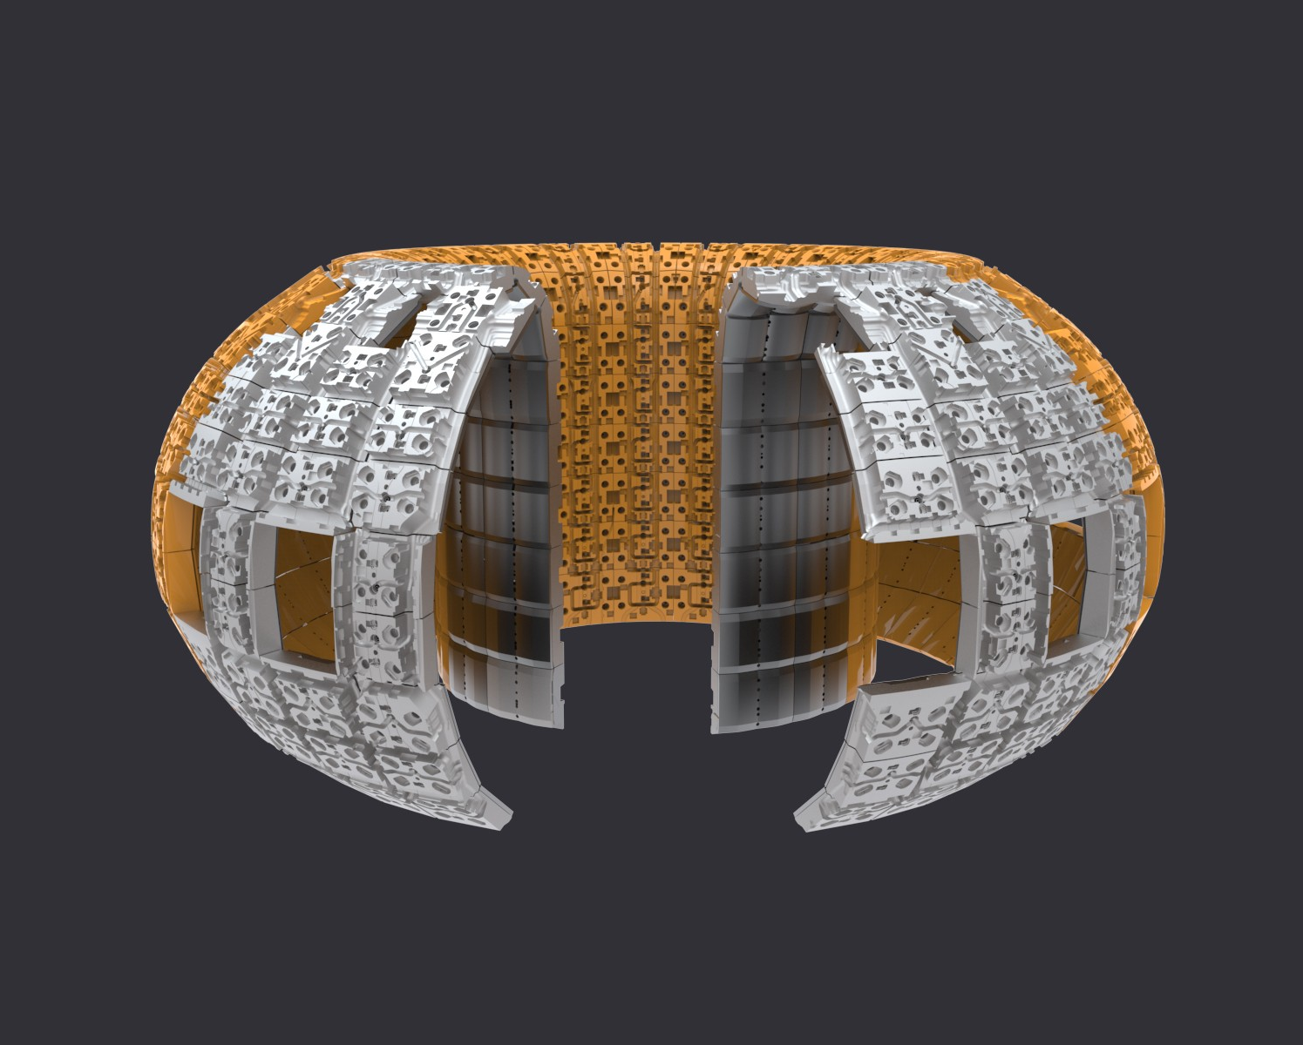
ITER Blanket/First Wall
440 blanket modules - ~610 m^2
Approx. 1m x 1.5m each
Cooling water supply, 4 MPa @ 70C
776 MW total thermal rejection
215 “normal heat flux” panels (cooling pipes) @ 2 MW/m^2
225 “enhanced heat flux” panels (HVTs) @ 4.7 MW/m^2
Image source: https://www.iter.org/mach/Blanket

Slide 35
ITER Blanket/First Wall
Image source: Fusion Engineering and Design 137 (2018) 143–151

Slide 36
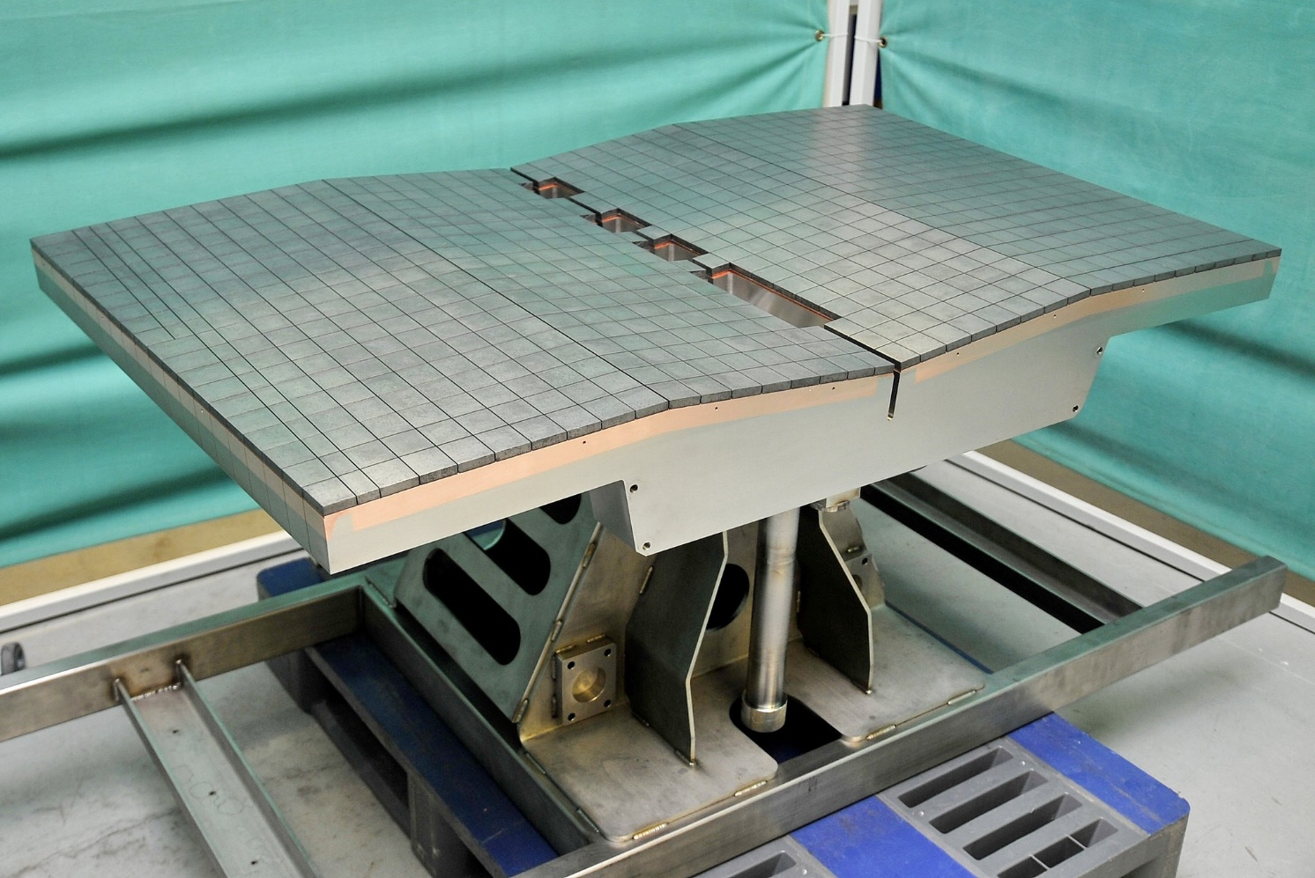
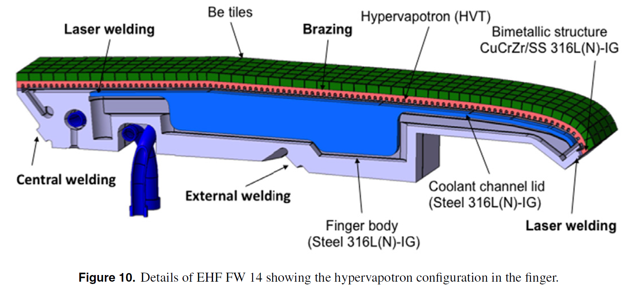
ITER Blanket/First Wall
316L(N)-IG austenitic steel support structure, CuCrZr heat sink, Be tiles
Multiple HVT “fingers” joined into a large panel
Braze, expl. bond, HIP, laser welds…
Image source: A.R. Raffray et al 2014 Nucl. Fusion 54 033004
Image source: https://www.iter.org/newsline/-/3568 “Blanket first wall - Manufacturing kicks off in Europe

Slide 37
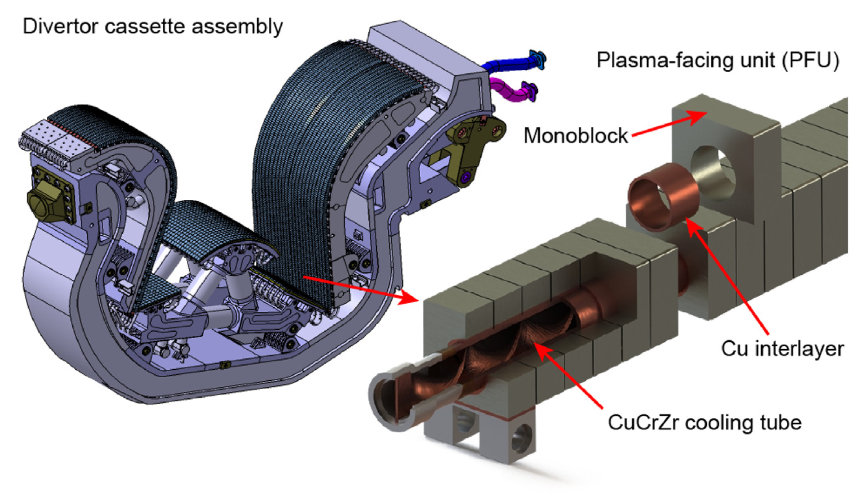
ITER Divertor – Why Not a Hypervapotron?
Reference design is tungsten monoblocks with swirl tubes
HVTs were strongly considered
Difficult to guarantee bond to some materials (e.g., carbon fiber composites)
Higher mass flow and pressure drop per unit heat flux rejected – would need redesign of pumping system
Image source: R.A. Pitts et al. / Nuclear Materials and Energy 12 (2017) 60–74

Slide 38
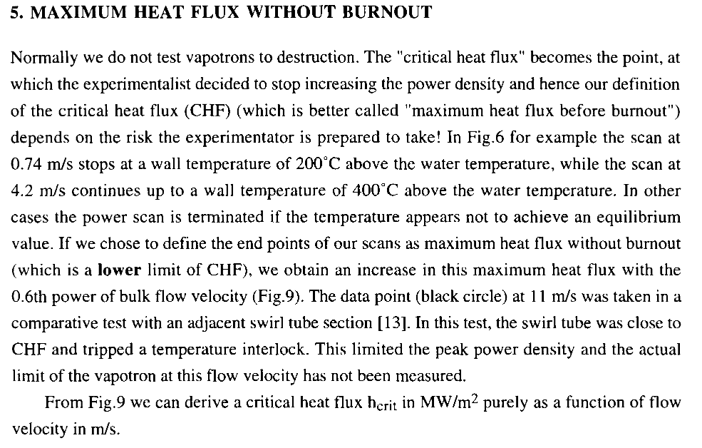
Failure Modes
Direct burnout
Rather difficult…
Delamination of components
Weld/braze failure
Material compatibility, fatigue
JET: 300 HVTs installed in 1984 lasted over 10 years with zero failures
Total: 100 MW of heat rejection
Source: Falter & Thompson, “Performance of Hypervapotron Beam Stopping Elements at JET”, Report # JET-P(95)13.

Slide 39
Failure Modes
When they do burnout, fail at center
Edges are more robust
Attached vs. detached fins
Conduction up sides
More thermal capacity/inertia et edge
Source: Falter & Thompson, “Performance of Hypervapotron Beam Stopping Elements at JET”, Report # JET-P(95)13.

Slide 40
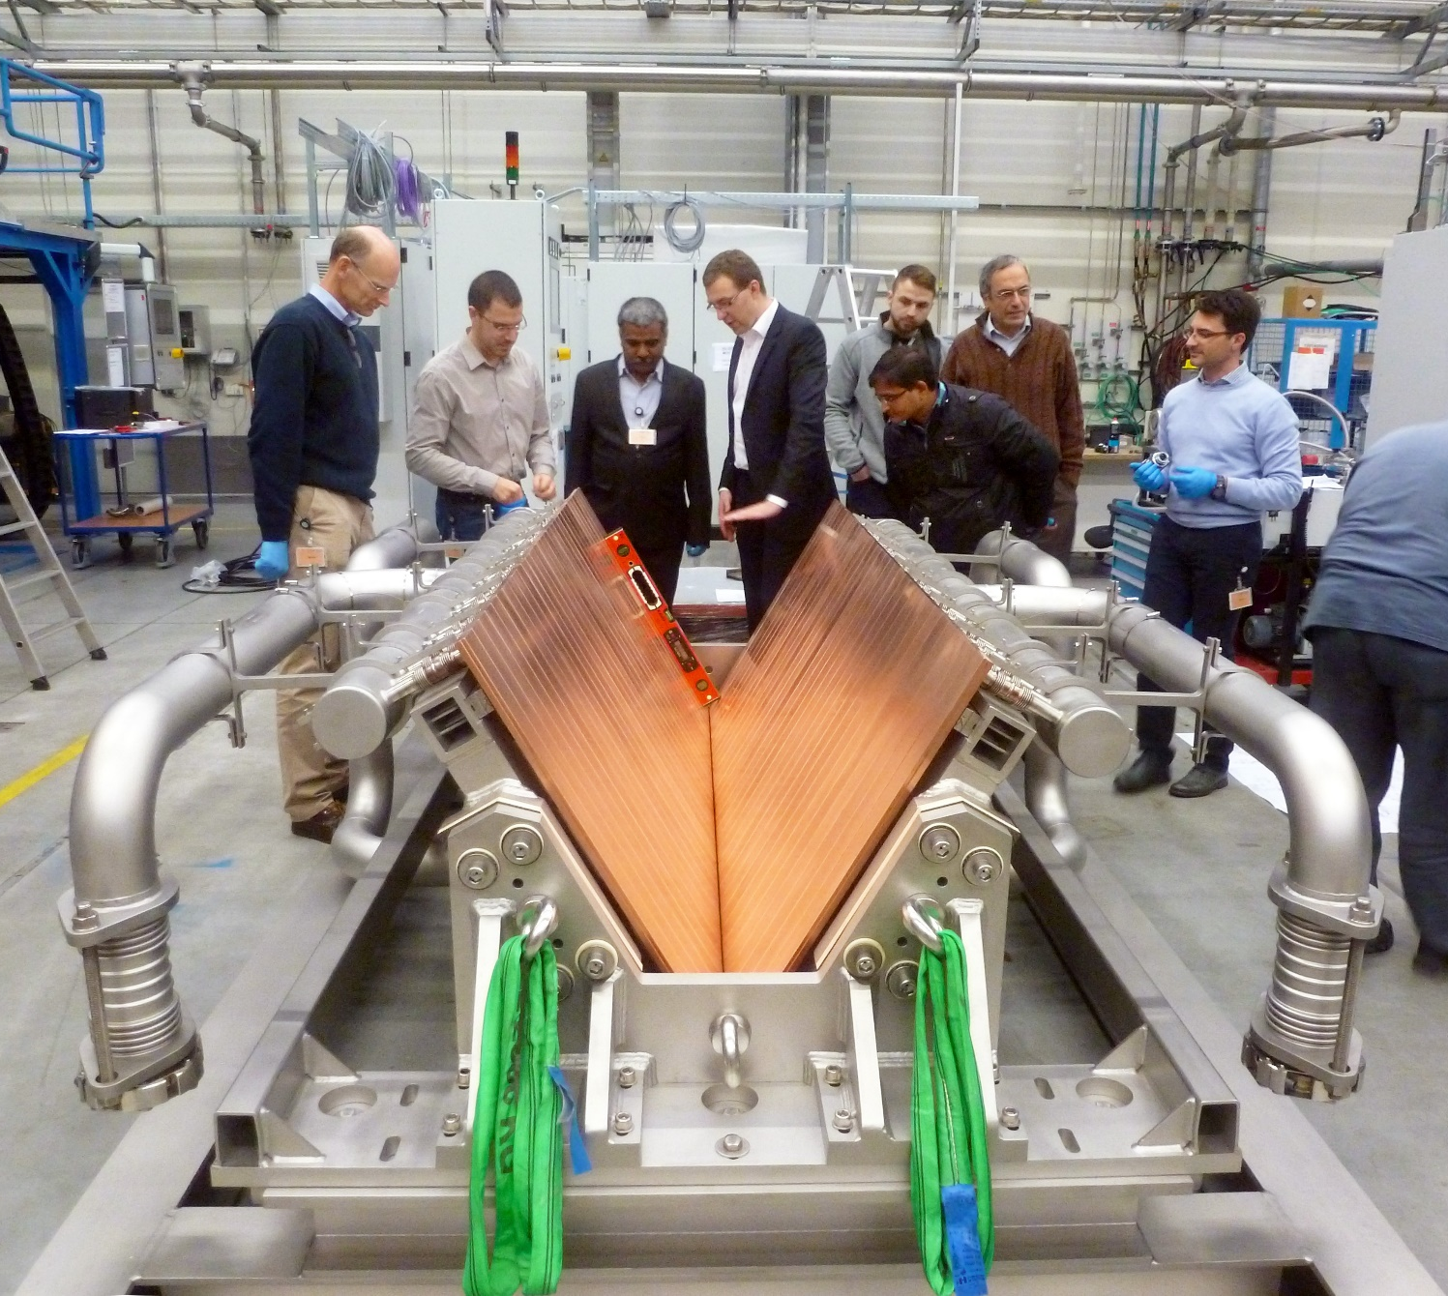
Other Considerations
Accelerator beams are thin – mm scale, even thinner
Rotating targets can distribute heat
NBIs make fairly wide beams – 10+ cm @ keV-scale energy (ITER NBI = 1 MeV)
Energy is already distributed spatially
Angled coolers further reduce heat flux
6.1 MW dump for ITER NBI testbed →
Not a monolithic unit – individual HVT strips joined together
Limits on width of channel, ~50-75 mm
Image source: https://www.iter.org/newsline/-/2097

Slide 41
Radiation Damage
HVTs don’t solve radiation damage – thermals only!
Indirectly, could run at higher temp and anneal out flaws
CuCrZr , Glidcop, OFHC copper
High beam power, not much target material => limited life
Rotating targets provide more material
HVT grooves are sensitive to manufacturing tolerances
balance of cost and geometric complexity
Rad damage could warp geometry

Slide 42
Tradeoffs of Hypervapotrons
The Good
-HVTs give better performance for same thickness
-Tunable – channel depth, fin profiles, water pressure and flow
-Good for wrapping curved surfaces
-Bond target materials to hot side surface
The Bad
-Swirl tubes outperform for a given pumping power (less pressure drop)
-Conceptually simple but complex manufacturing – tolerance sensitive grooves, closeout
-Difficult computationally – phase-change
-Outer material bond can be fatigue-limiting, if not unreliable
Main advantage is compactness combined with (stable) high performance
Main disadvantage is opaque operation – plenty of correlations, but usually bespoke design for application

Slide 43
High Heat Flux Testing
Electron beam heating
High demand, limited test space/availability
Induction heating - volumetric effect
Cheaper, still useful
Cooling – active (water) or inertial
Inertial system needs a large mass to absorb heat without fluid, e.g., large copper heat sink
CFS SPARC using passive cooling and strike point sweep to mitigate heat flux
Image sources: https://www.osti.gov/servlets/purl/1377729, https://www.osti.gov/servlets/purl/1647785 https://doi.org/10.1017/S0022377820001117

Slide 44
LDRD Proposal
Pre-
^

Slide 45
LDRD Proposal
Examine whether hypervapotrons are useful for high-power targetry
Static, rotating arrangements – what works for different physics requirements?
CFD model of HVT – analytical prediction is crucial, especially for nonstandard geometry
Design prototypes – weld layouts, manufacturing, etc.
Design/build test bench – induction heater, pressurized water supply
Test prototypes – different heat loads, calorimetry of coolant, post-test inspections
Report results
2 year project, (~1.1 FTE-year total, $340k M&S) – pre-proposal rough estimate

Slide 46
Target Packaging

Slide 47
HVT Packaging – Static HVT
Bond a strip of target material to HVT hot side (or use CuCrZr)
Stationary, on-axis
Slow translation to distribute radiation damage, extend life
Cylindrical option (flow visualization from earlier) →
p+
p+

Slide 48
Beam/HVT Orientation
p+
Static HVTs could surround a volume of target material, or cool a block from one or more sides
For rotating targets, beam can approach from parallel or perpendicular to rotation axis – and angles between
End-cooled “puck”
Through-flow ring target, similar to AP-0 Inconel rings
Cylindrical shell
Canted ring
Q
Q
p+

Slide 49
Canted Ring
Tilt rotation axis of target ring w.r.t. beam
Illuminated material is hyperboloid of revolution – think flattened Tractricious
Moves some of the illuminated volume closer to the edges -> better cooling
Potentially integrates well with a HVT
Through-flow ring target, similar to AP-0 Inconel rings
Q
Q
p+

Slide 50
HVT Packaging – AP0-like
Rotation axis perpendicular to beam – AP0-like puck
Coolant flow radially inward/outward from rotation axis
Water I/O on same side – cantilever target
Radial-flow HVT has no prior art – possible flow issues
Through-flow ring
Inlet on one side, outlet on other, target ring in center
p+
p+
*Swept meridional view of beam

Slide 51
HVT Packaging – Cylindrical Shell
p+
Rotating cylindrical shell with HVT fins on inside
Axial flow – dividers on hub to keep channel width
Circumferential flow – hard to manifold
Helical flow? Coriolis effects?
p+
p+
p+

Slide 52
HVT Packaging – Neutrinos?
LBNF layout (long target surrounded by coolant) does not suit HVTs well
Lots of material to interact with secondaries – less yield
Cylindrical HVTs have been tested…
NuMI fins might be a better fit?
“Cold rail” with HVTs on the sides/bottom
ITER divertor tests - fatigue issues bonding carbon fiber composites to HVT copper alloy – graphite may have issues
Conduction down the fin would probably limit
Graphite sandwich – HVT on 2 sides? Can beam power be increased enough to compensate for reduced yield?
p+

Slide 53
Issues to Consider
Tritium mitigation in real systems – water close to beam
Seals in rotating flow joints – few options without O-rings (radiation concerns)
Mechanical seals – industry has solutions (dry gas seals)
Labyrinth seals – costly and delicate, controlled leakage
Radial-flow HVTs unproven
CFD
Best for shorter targets – perhaps not ideal for neutrinos
Total water flow must carry away the heat
Size the water system & manifolding appropriately

Slide 54
TSD Applications
“Normal” Applications:
Targets – muon & positron sources?
Beam dumps (esp. high current, low energy)
Other targets?
“Mad Science” Applications:
µ-CF production targets?
Bulk antimatter targets?
“Antiproton Annihilation Propulsion”, R. L. Forward, 1985, report for AFRPL; https://apps.dtic.mil/sti/tr/pdf/ADA160734.pdf

Slide 55
Questions?
If XKCD was in charge of LBNF…
p+
Extraction enclosure at
apex of embankment
Image sources: https://xkcd.com/401/ , https://lbnf-dune.fnal.gov/how-it-works/excavations-and-structures/

