Slide 1
IOTA Proton Injector Update
Dean (Chip) Edstrom
07/14/23

Slide 2
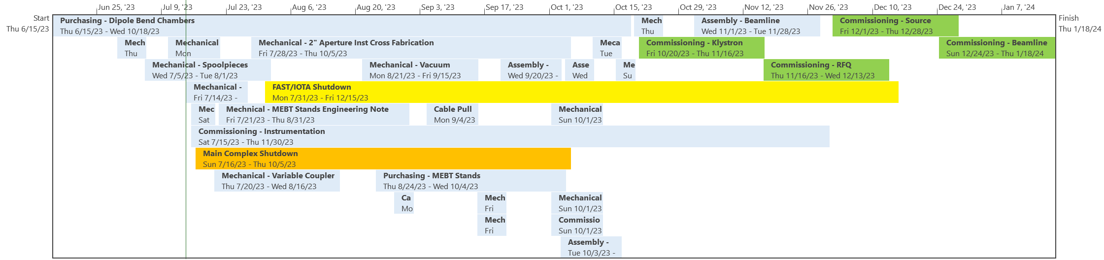
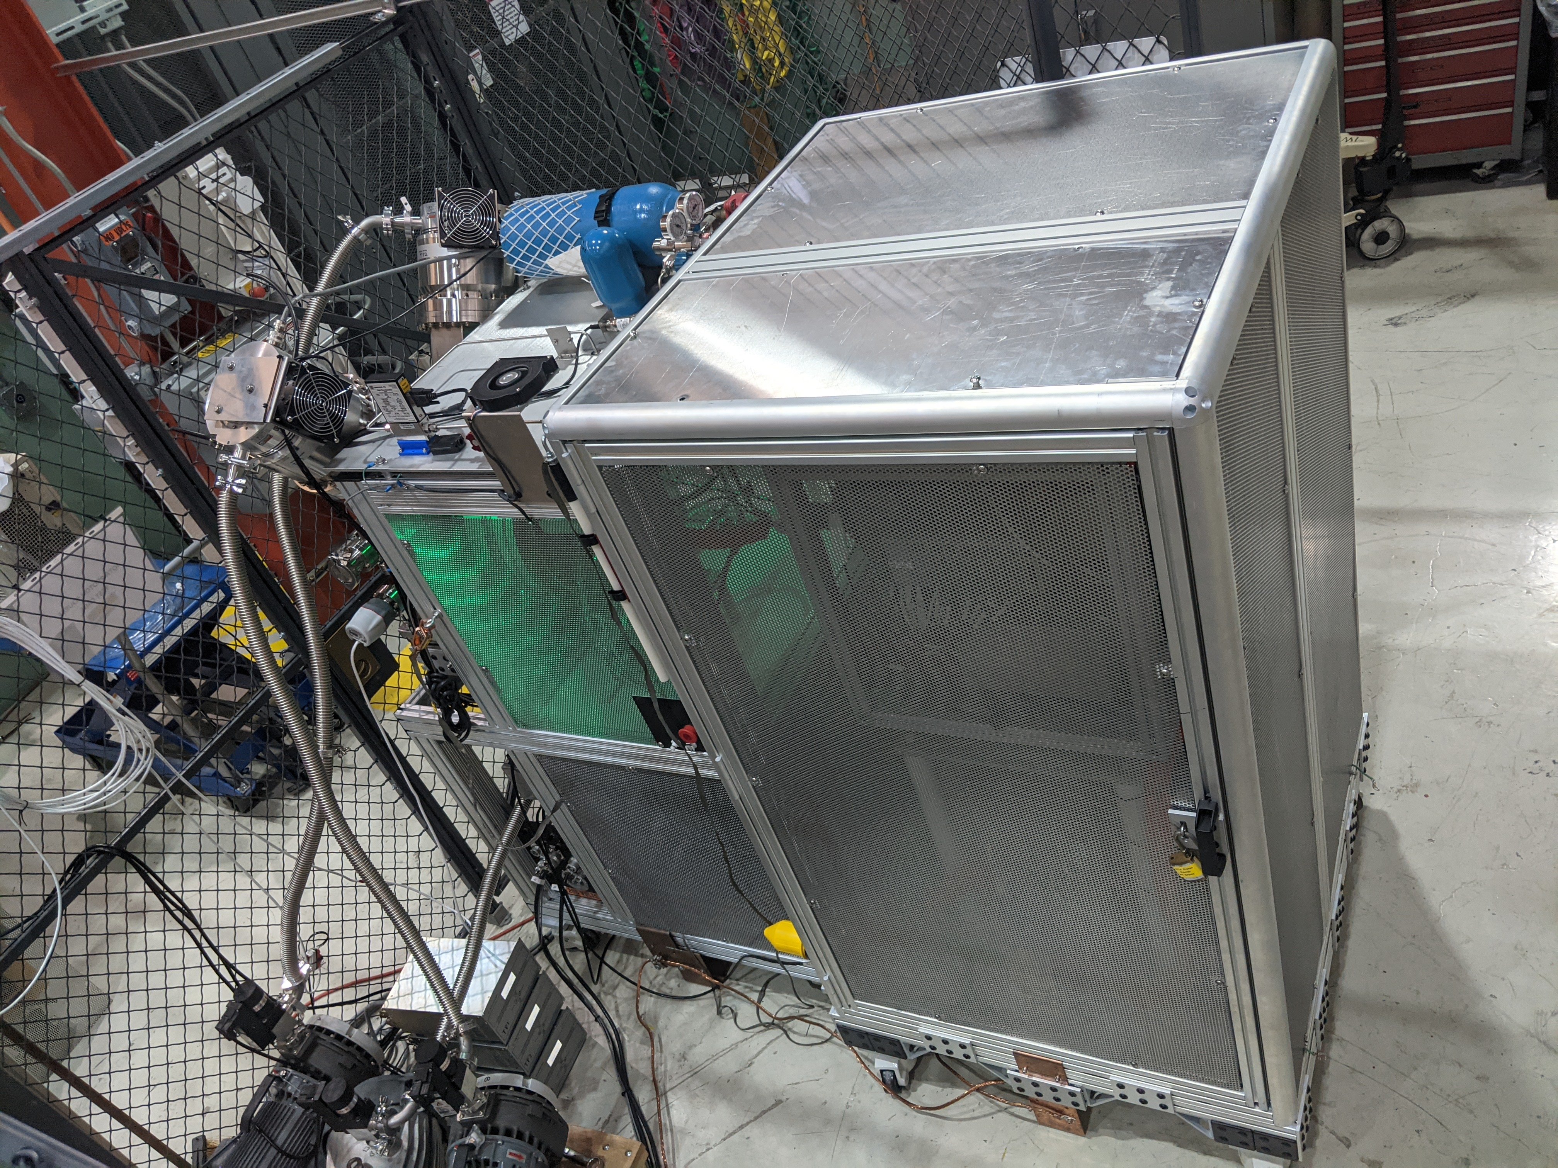
IPI Project Schedule
Action Items:
  Source HV Testing (ORC-2176)
    All reviewer signoffs obtained as of this morning.
    HV testing early next week.
    Hydrogen Distribution Checkout
    HV Enclosure Control Checkout to follow
  Mechanical Engineering
    Engineering Notes: New beamsheet provided by Sasha Romanov to Steve Wesseln
    LCW: Shyamala leaving the lab in August... Des & Maurice will assist
    15-Deg Bend Chamber Req 346933
  Cable Pull
    Meeting with Dave Featherston on 6/26… Radio silence since.
    24-Conductor cable backorder extended to 7/25 at earliest (!!)

Slide 3
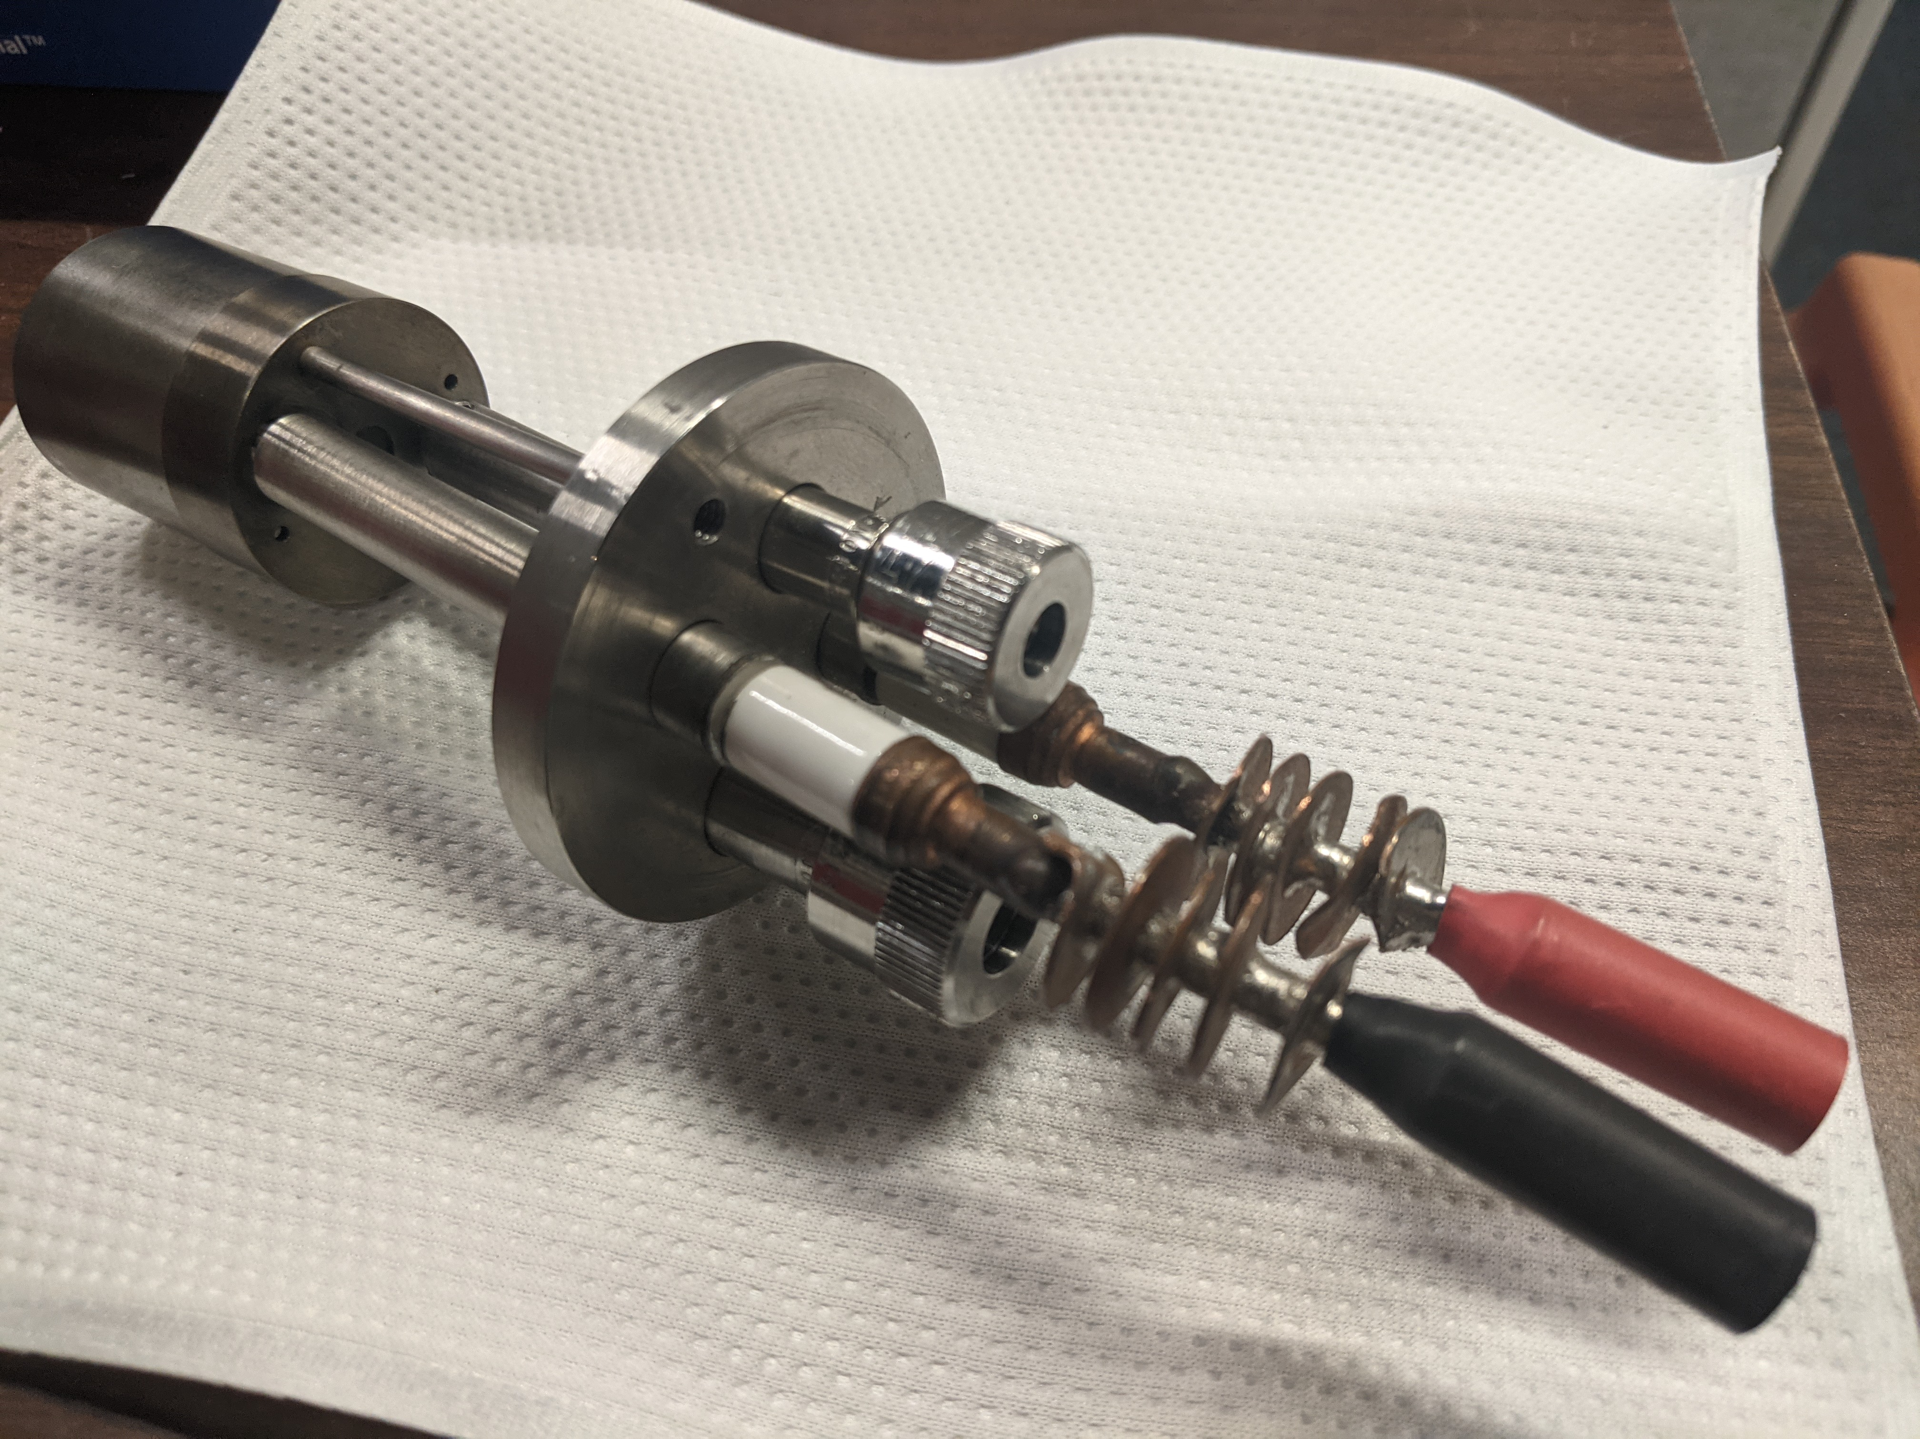
Broken Filament Assembly
Damaged while connecting to the Hydrogen Distribution
Plan Moving Forward:
  Replace mesh on the remaining ‘good’ filament assembly → coat & activate
  Generate a drawing
  Pursue fabrication of new assemblies

