Slide 1
Classifying Superconducting Accelerator Magnet Ramp Data
Finlay Campbell – University of St Andrews - Helen Edwards Intern
Supervisor: Stoyan Emilov Stoynev
20/07/2023
Notes:
Project aim is to study magnet data to better understand what is happening in the magnet as current increases.

Slide 2
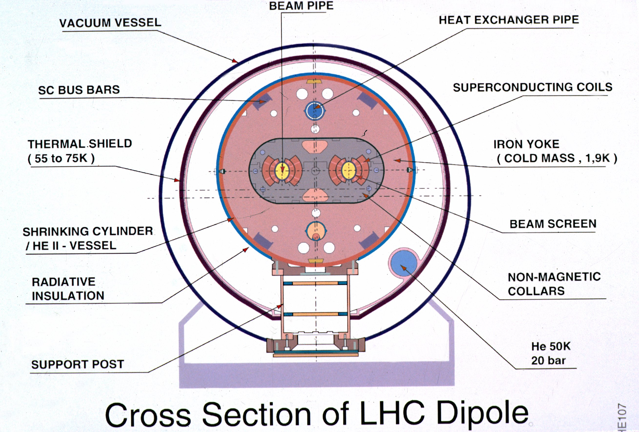
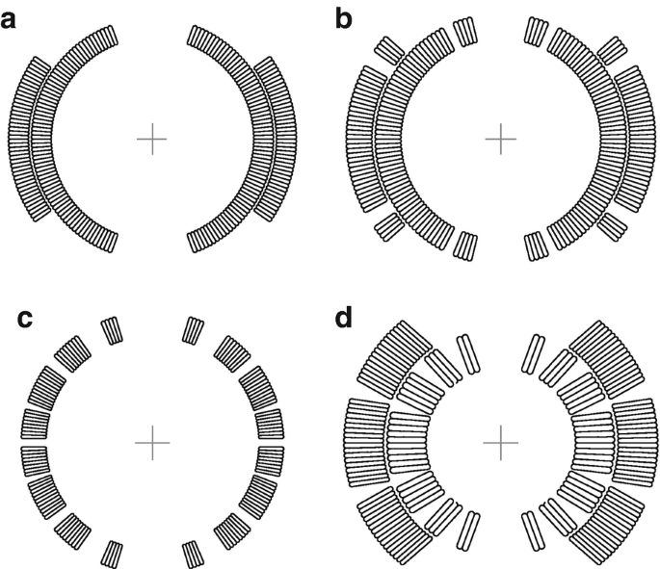
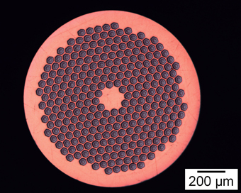
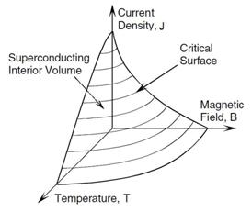
What are Superconducting Accelerator Magnets?
Magnet wire layout
Precise field
High field
Cross section of superconducting wire
Critical surface for a superconductor state.
High Field brings magnet close to a transition to a non superconducting state.
Notes:
Accelerator magnets use superconductors that are liquid helium cooled to low temperatures. This requires a lot of housing and makes the system complex. System is very complex!!!
The conditions for the magnet are harsh with large current dependent forces causing stresses of up to 100-200MPa!!!!!!!! This can cause energy to be locally deposited into the magnet.
Studying superconducting accelerator magnets to increase field that can be precisely controlled.
High Field magnets are near critical surface so a small deposit of energy causes transitions to a normal state. Far from surface the high stresses can still deposit enough energy to quench.
High current running through normal state generates lots of heat and can melt magnet.
Quenches bad!!!

Slide 3
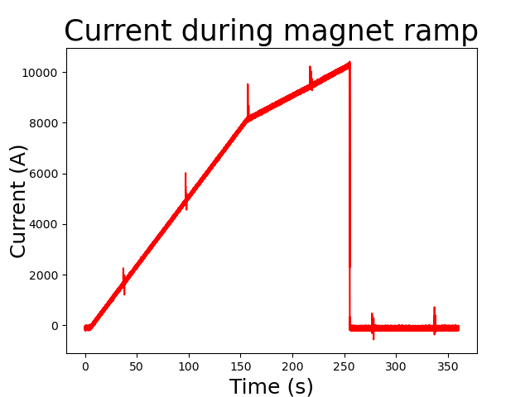
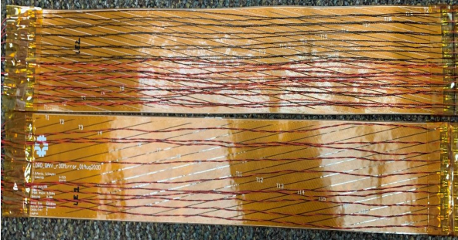
Studying Superconducting Accelerator Magnets
Magnet test conditions
Current
Magnetic Field
What measurements can be taken?
Voltage taps
Acoustics
Quench antenna
Other measurements are possible but not used here.
Notes:
To study the magnet the current is ramped until the magnet quenches. This increases the magnetic field until some part of the superconductor enters a normal state.
During this process quench antennas, microphones and voltage taps are used to measure the magnet.
Voltage taps measure voltage between points on the magnet and give the most direct signal but can also cause short circuits and can give less information aside from at quench.
Microphones pick up the mechanical vibrations in the magnet.
Quench antennas are loops of wire that can measure the change in flux passing through the loop.
Other diagnostics are possible e.g. fiber optics and stain gauges, capacitance.
Real magnets have different current than a ramp.

Slide 4
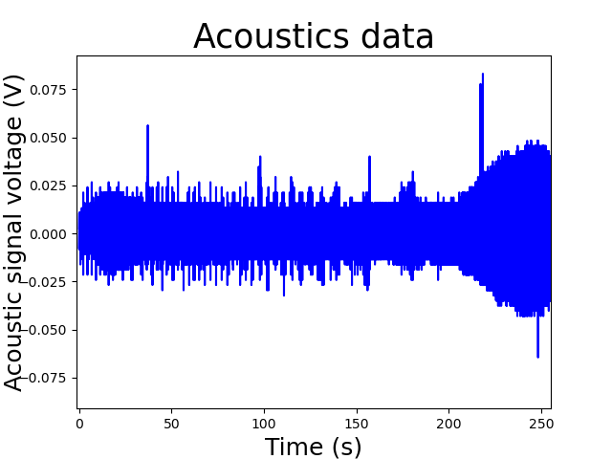
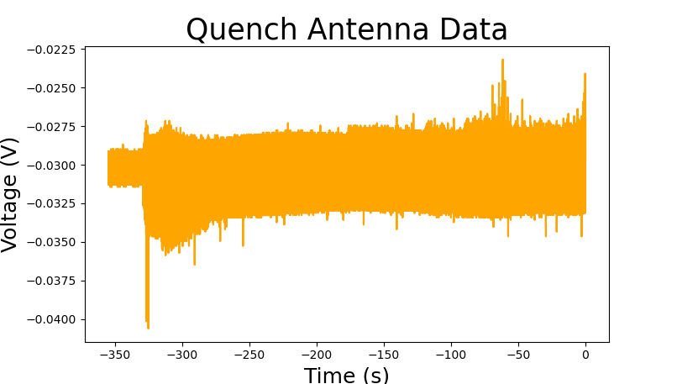
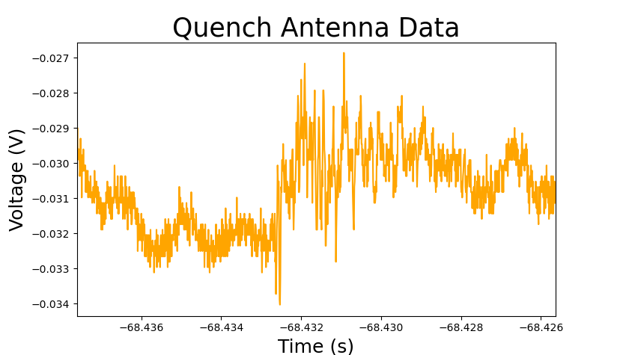
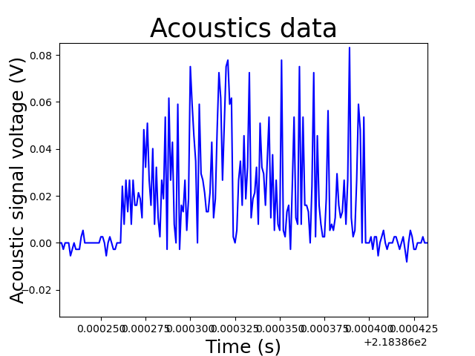
Classifying Superconducting Accelerator Magnets Ramp Data
1MHz sample rate
100kHz sample rate
Better Magnets?
Earlier quench detection?
Study and characterize events.
What causes each event?
Notes:
I will be studying the data from the quench antenna and the microphone to look for and characterize events.
The aim is to identify the causes of different parts of the signal and find which events are involved in normal magnet operation and which are abnormal and may lead to a quench.
Events shown are not typical just chosen at random for characterization.
Quench antenna data can also be used to locate event
Goal 1: Identify events in the data.
Goal 2: Classify these events into common groups.
Goal 3: Study these events to better understand the physical cause. Are any events quench-like? Do any events worsen magnet performance?
A better understanding of the magnet ramp may allow magnet design to be improved to reach higher fields.
AI can also be used in real time to look for events to detect quench earlier.

