Slide 1
Measurements of Energy Losses in Ferrite Samples
Benjamin Gladwyn, University of Cambridge
Supervisor: Robyn Madrak
Helen Edwards Internship - 07/20/2023
bengladwyn/Fermilab: Measuring the properties of Ferrites for RF cavities (github.com)

Slide 2
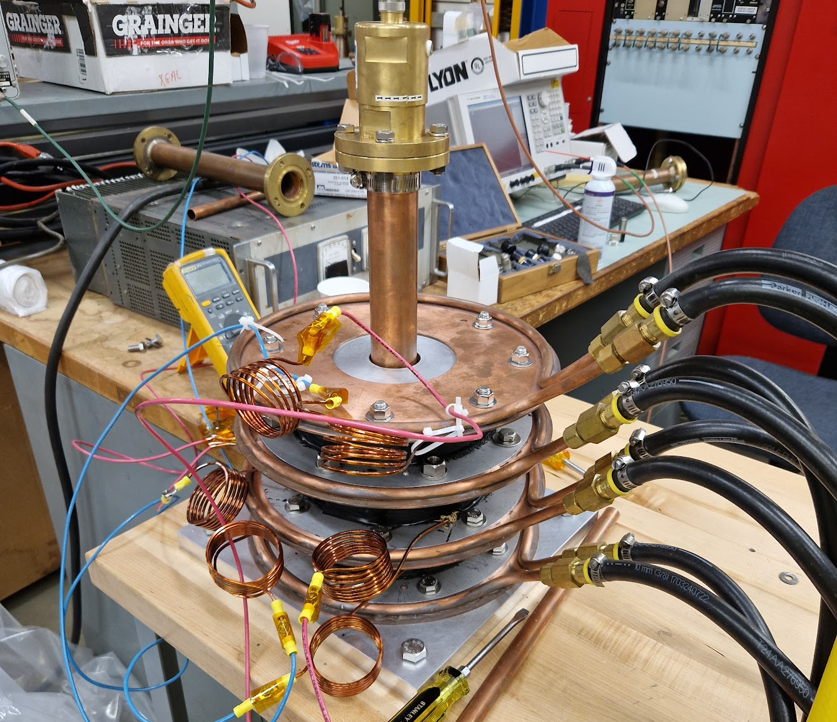
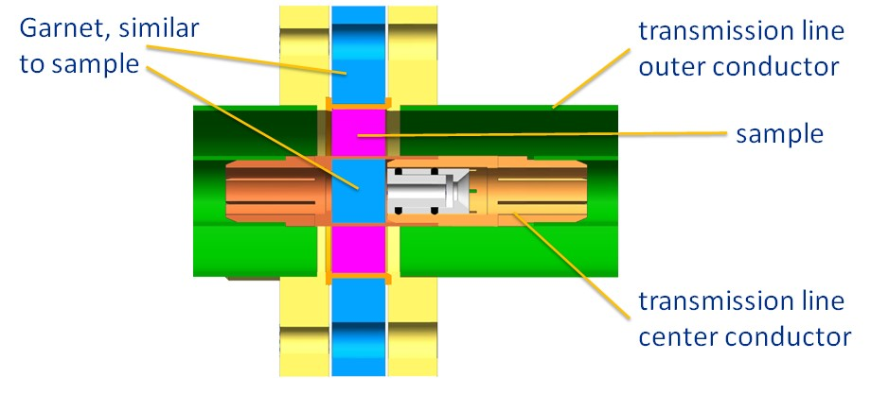
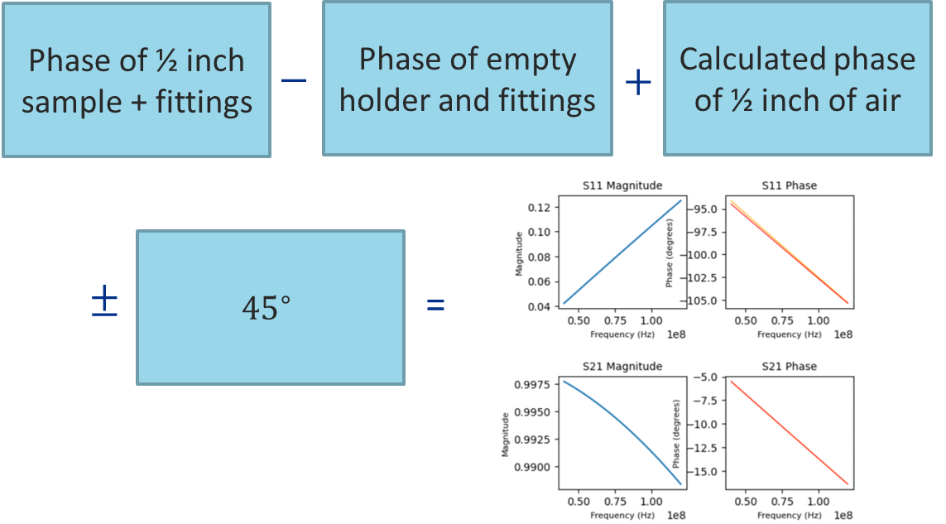
Sample Fixture and the Nicholson-Ross-Weir Method
Fixture enables s-parameter measurements of the garnet sample
Fixture enables s-parameter measurements of the garnet sample
The Nicholson-Ross-Weir Method then allows calculation of complex $ε,μ$

Slide 3
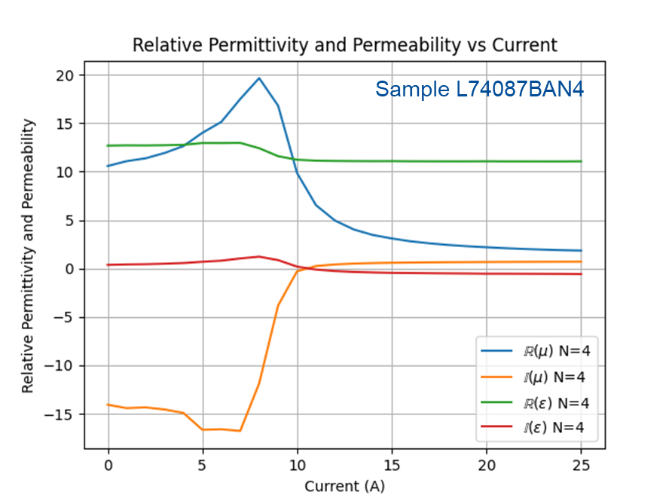
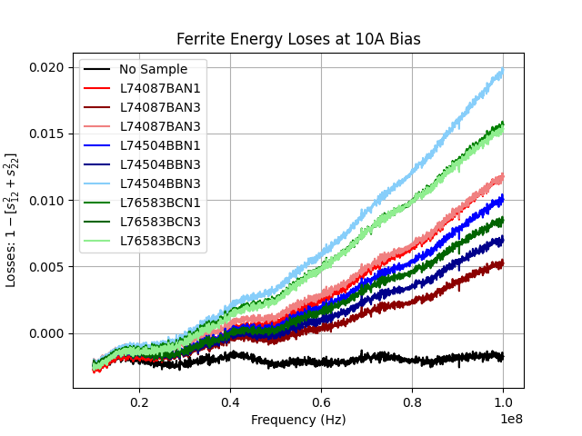
Relative Permittivity and Permeability Measurements
Aim to reduce imaginary components of $μ$ to lower energy losses in RF cavities
Look at three different sample types:
Standard firing
High pressure O2 sintering
Hot isostatic pressing
Dissipative losses are quantified with $1−[s_{12}^{2}+s_{22}^{2}]$, effectively ($1−(T+R)$)
No discernible differences between the batches, only between samples

Slide 4
Recycler Instability Simulations
Benjamin Gladwyn, University of Cambridge
Supervisor: Osama Mohsen
Helen Edwards Internship - 07/20/2023
bengladwyn/FNAL: Recycler instability simulations (github.com)

Slide 5
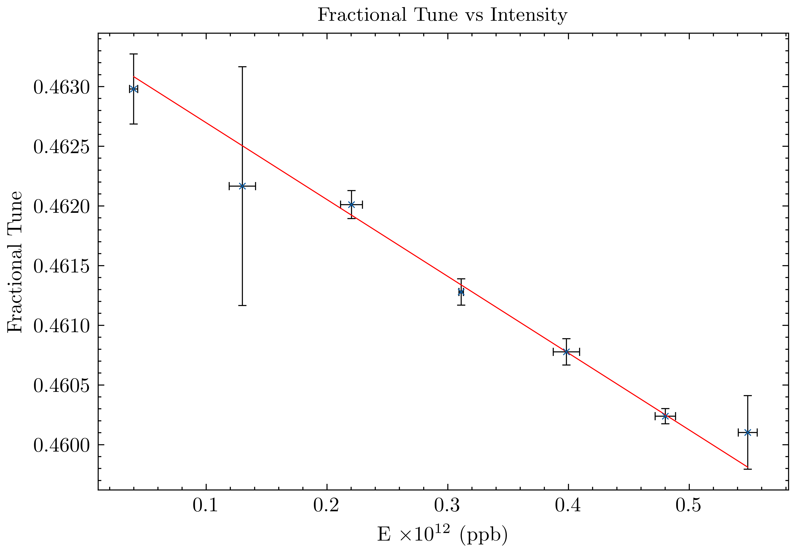
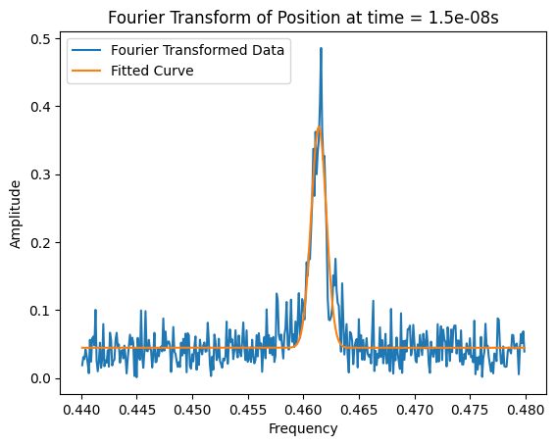
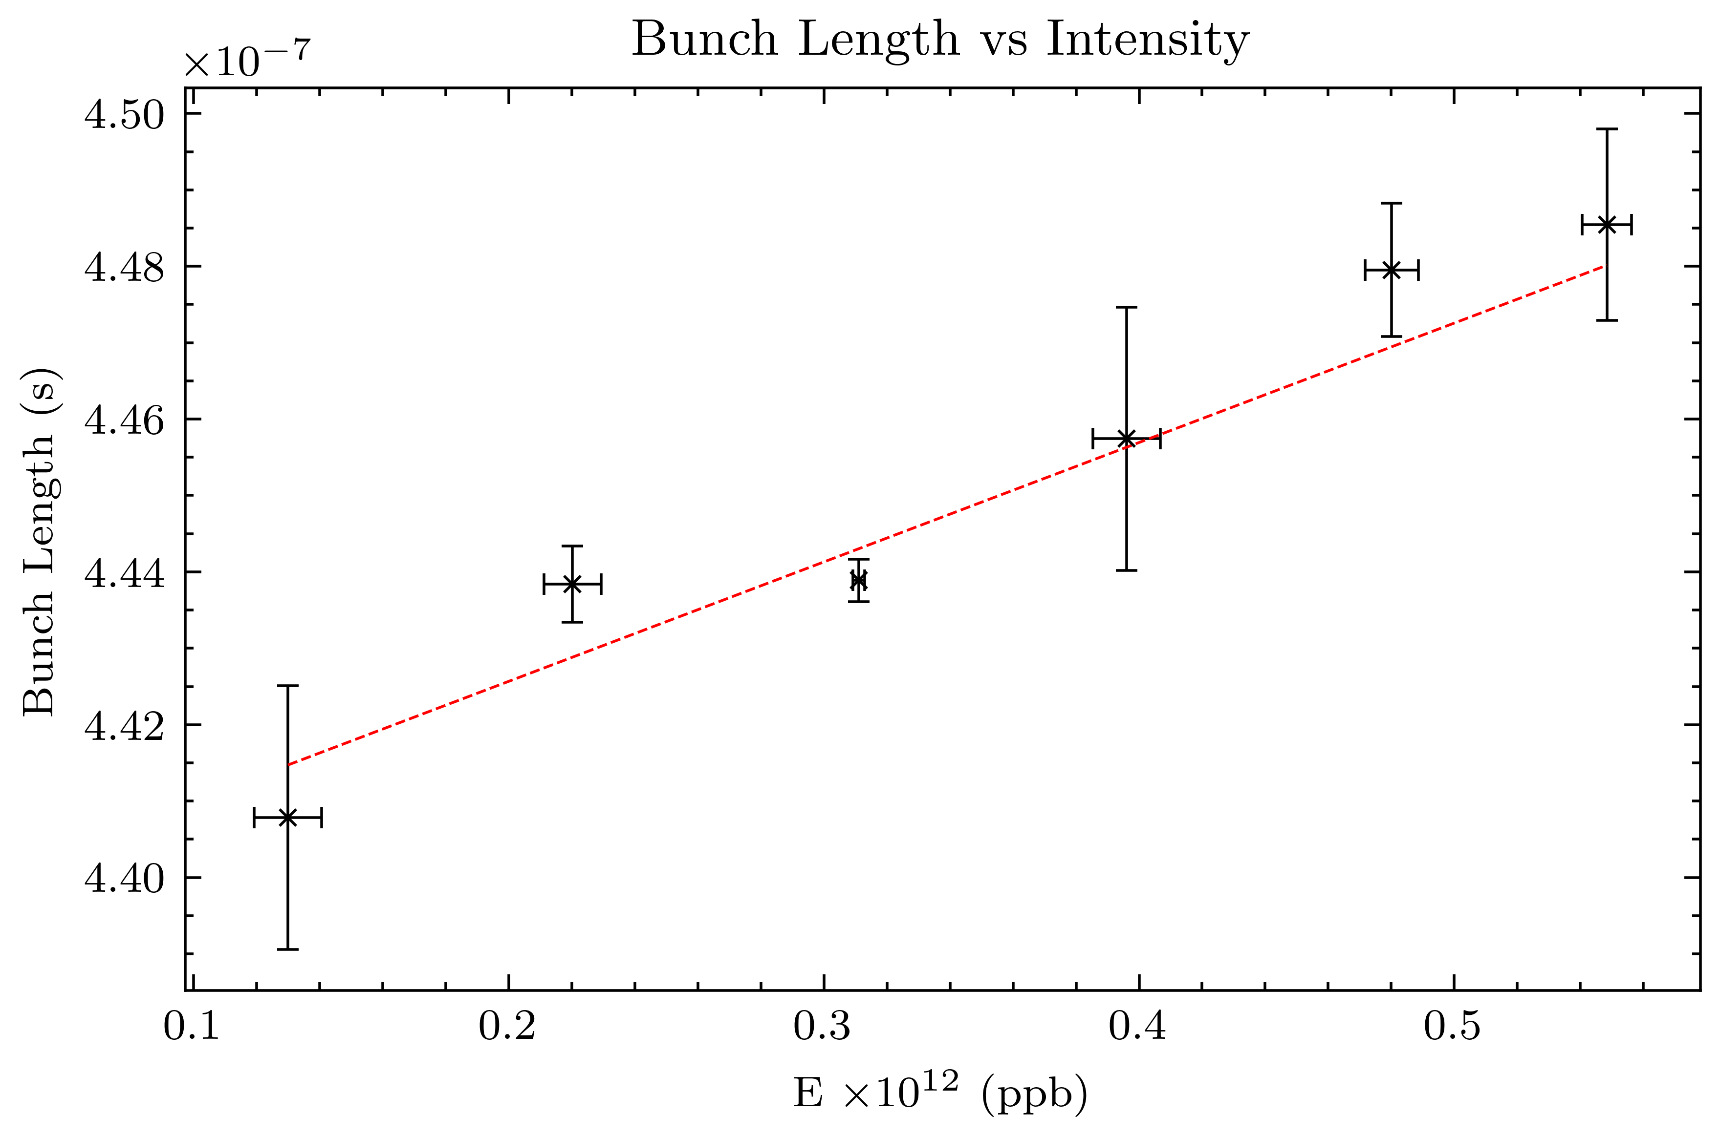
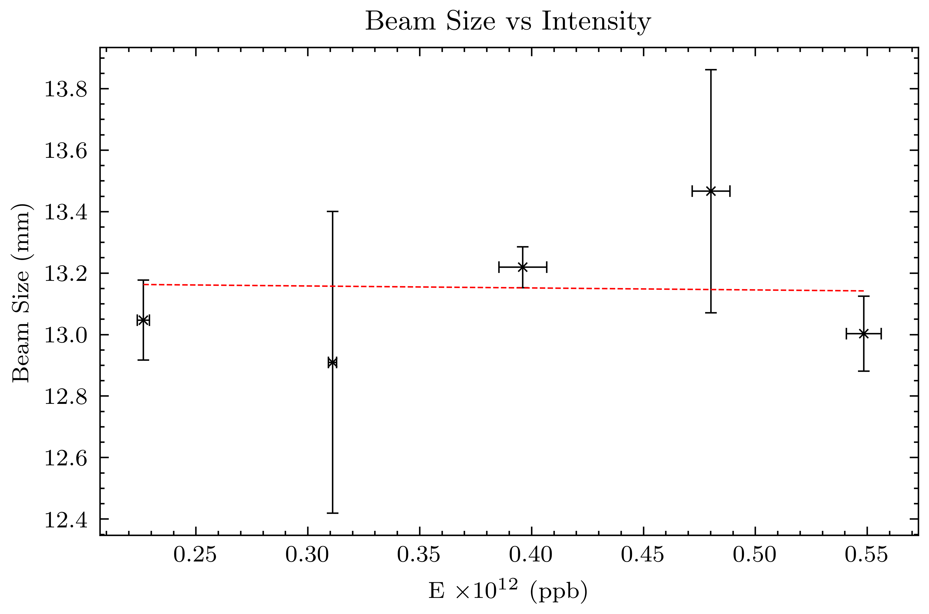
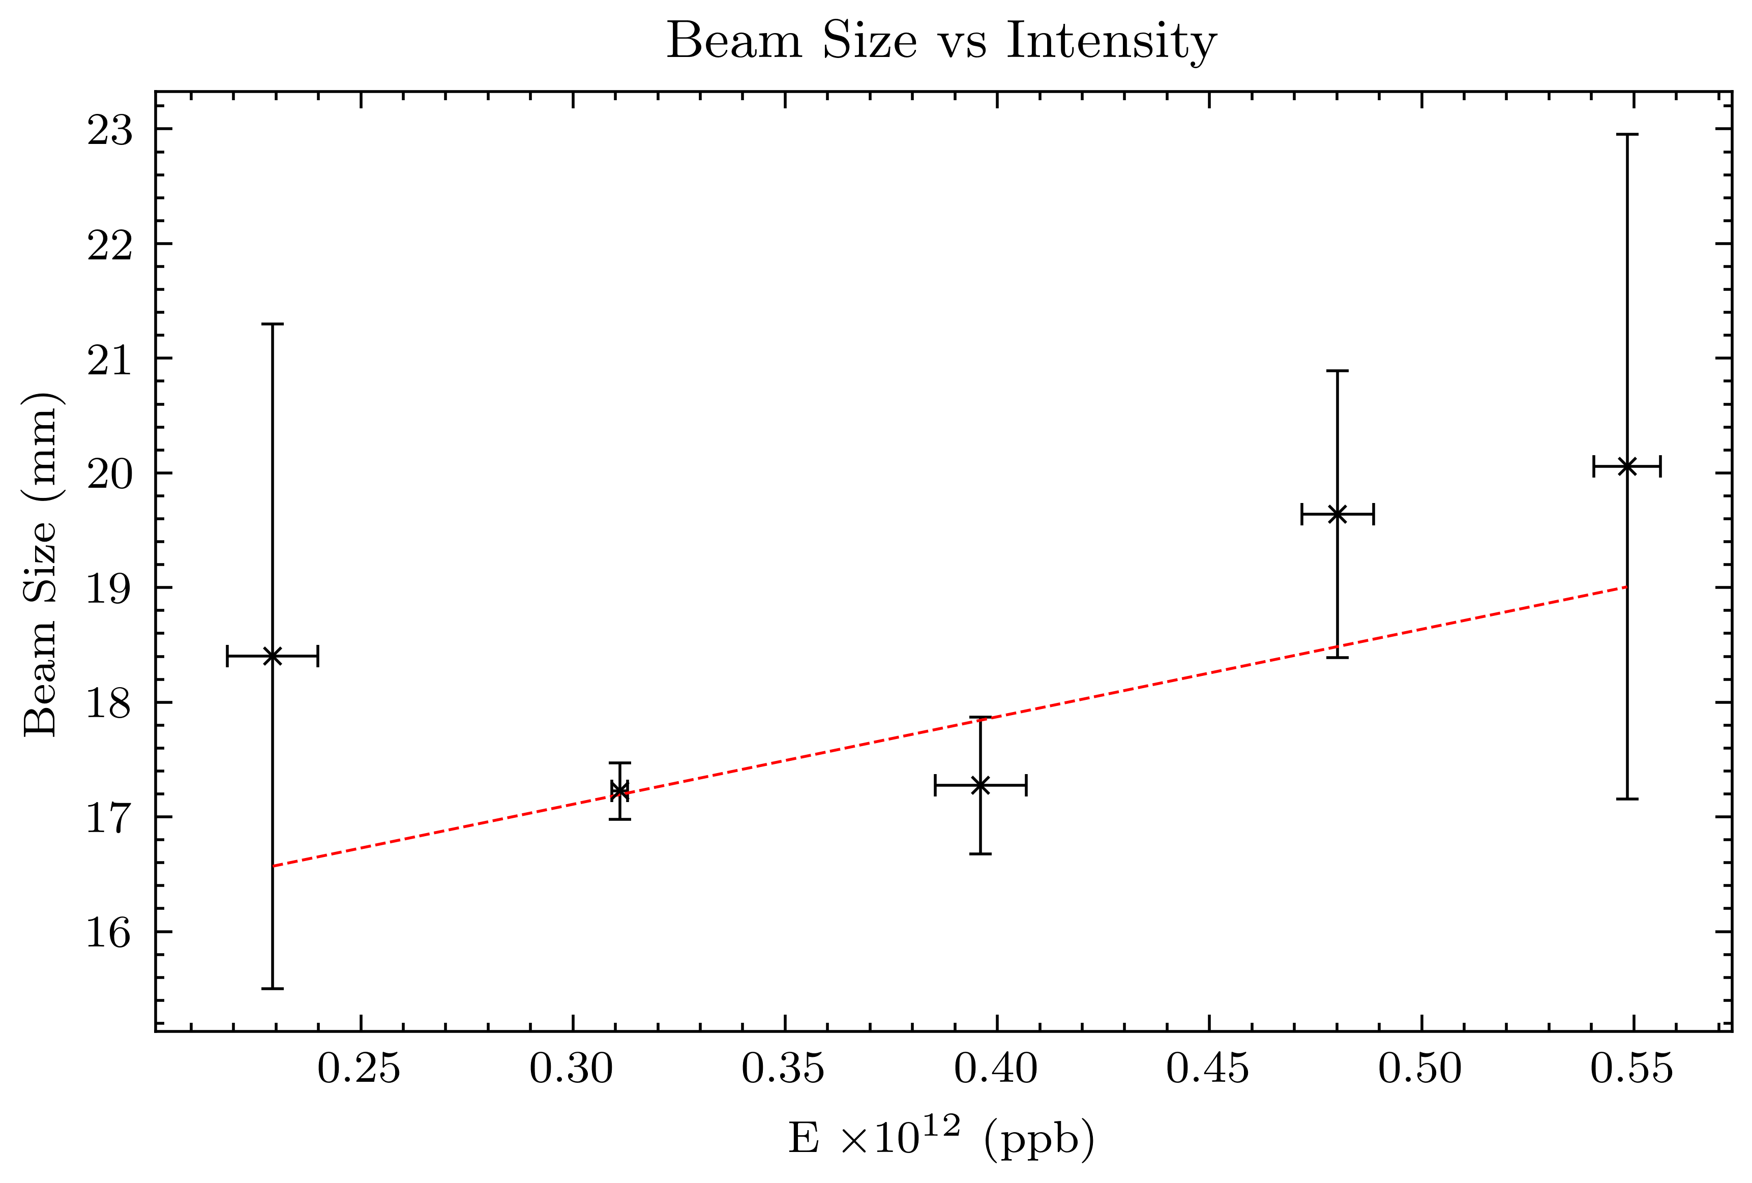
Analysis of Beam Data
Scope data gives position of beam for each turn and a Fourier transform reveals the tune frequency
Wall current monitors show how beam length changes with intensity
Ionization profile monitors indicate how beam size changes with intensity
Horizontal
Vertical
Goals: Use XSuite and PyHEADTAIL to simulate the coherent tune shift

