Slide 1
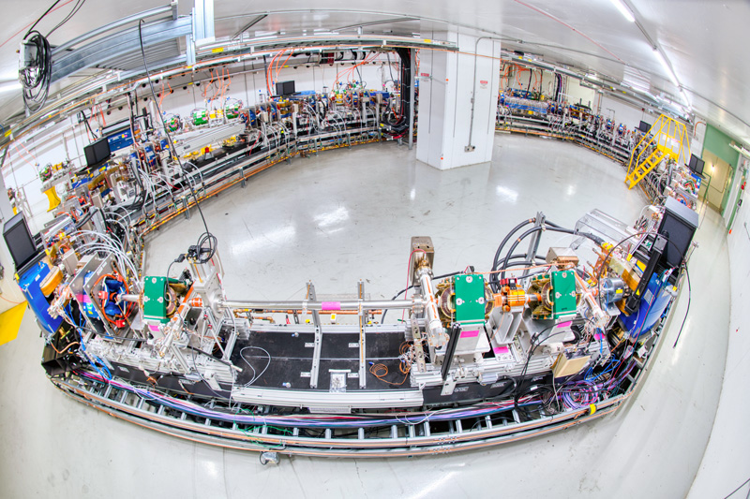
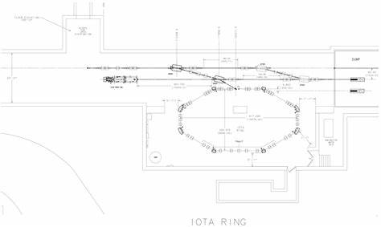
Implementation of non-linear optics in accelerators
Lazare Osmanov
Supervisor: Nilanjan Barenjee
Main goal
Modification of McMillan lens

Slide 2
McMillan lens
Electron lens beam (10 keV)
Main beam
150 MeV e-/2.5 MeV p+
y
s
x
Beams interact with each other
Main beam focuses
System is integrable in 4D
System is not integrable in 6D

Slide 3
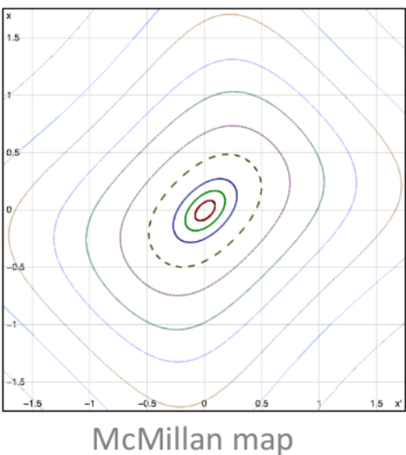
Non-linear integrable system in accelerator
What is integrable system at all?
y
s
Degrees of freedom: 2
Number of conserved quantities: 1
x
Not integrable
$$\left(\begin{matrix}\begin{matrix}x_{i+1} \\ {x′}_{i+1}\end{matrix} \\ \begin{matrix}y_{i+1} \\ {y′}_{i+1}\end{matrix}\end{matrix}\right)=\left(\begin{matrix}\begin{matrix}a & b \\ c & d\end{matrix} & \begin{matrix}0 & 0 \\ 0 & 0\end{matrix} \\ \begin{matrix}0 & 0 \\ 0 & 0\end{matrix} & \begin{matrix}a & b \\ c & d\end{matrix}\end{matrix}\right)\left(\begin{matrix}\begin{matrix}x_{i} \\ x_{i}\end{matrix} \\ \begin{matrix}y_{i} \\ {y′}_{i}\end{matrix}\end{matrix}\right)+\left(\begin{matrix}\begin{matrix}0 \\ K_{m}y_{i+1}\end{matrix} \\ \begin{matrix}0 \\ K_{m}y_{i+1}\end{matrix}\end{matrix}\right)$$
McMillan map

Slide 4
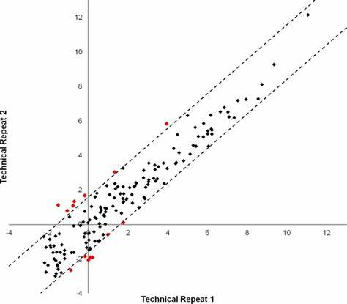
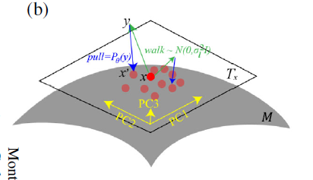
AI Poincare
$$loss\left(θ\right)=\frac{1}{N}\sum_{i=1}^{N}{{\left((pulled point)−x_{i}\right)}^{2}}$$
PCA
We get rid of linear conserved quantities
Adam
Calculation of information less eigenvectors
Conserved quantities

Slide 5
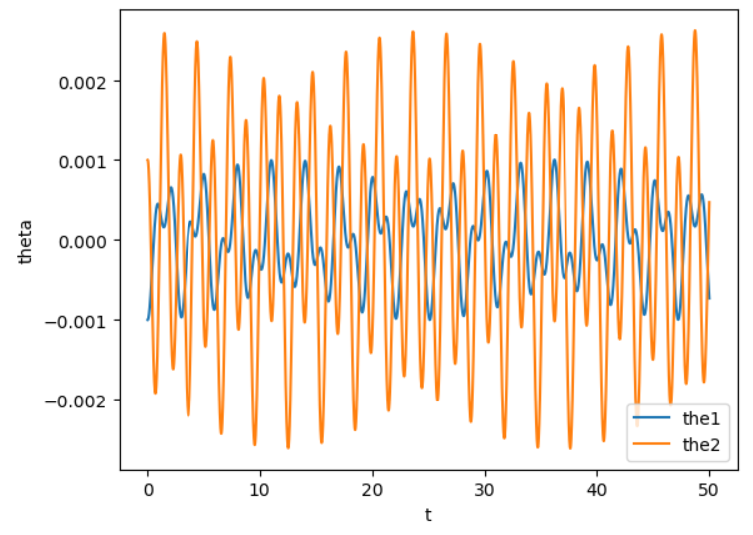
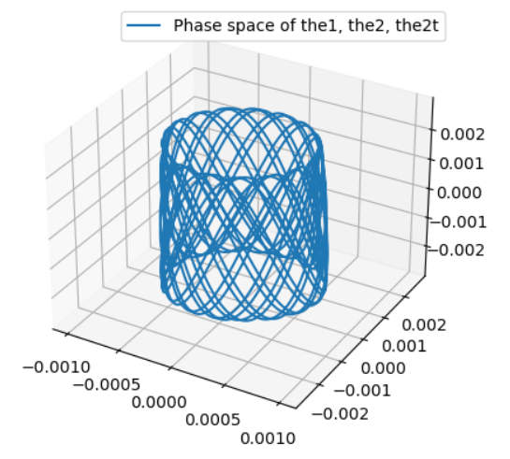
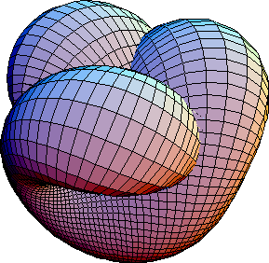
Plans
AI Poincare
Map in 6D
$$\left(\begin{matrix}\begin{matrix}x_{i+1} \\ {x′}_{i+1}\end{matrix} \\ \begin{matrix}y_{i+1} \\ {y′}_{i+1}\end{matrix}\end{matrix}\right)=\left(\begin{matrix}\begin{matrix}a & b \\ c & d\end{matrix} & \begin{matrix}0 & 0 \\ 0 & 0\end{matrix} \\ \begin{matrix}0 & 0 \\ 0 & 0\end{matrix} & \begin{matrix}a & b \\ c & d\end{matrix}\end{matrix}\right)\left(\begin{matrix}\begin{matrix}x_{i} \\ x_{i}\end{matrix} \\ \begin{matrix}y_{i} \\ {y′}_{i}\end{matrix}\end{matrix}\right)+\left(\begin{matrix}\begin{matrix}0 \\ K_{m}y_{i+1}\end{matrix} \\ \begin{matrix}0 \\ K_{m}y_{i+1}\end{matrix}\end{matrix}\right)$$
$$\left(\begin{matrix}\begin{matrix} \\ \end{matrix} \\ \begin{matrix} \\ \end{matrix} \\ \begin{matrix} \\ \end{matrix}\end{matrix}\right)=\left(\begin{matrix}\begin{matrix} & \\ & \end{matrix} & \begin{matrix} & \\ & \end{matrix} & \begin{matrix} & \\ & \end{matrix} \\ \begin{matrix} & \\ & \end{matrix} & \begin{matrix} & \\ & \end{matrix} & \begin{matrix} & \\ & \end{matrix} \\ \begin{matrix} & \\ & \end{matrix} & \begin{matrix} & \\ & \end{matrix} & \begin{matrix} & \\ & \end{matrix}\end{matrix}\right)\left(\begin{matrix}\begin{matrix} \\ \end{matrix} \\ \begin{matrix} \\ \end{matrix} \\ \begin{matrix} \\ \end{matrix}\end{matrix}\right)+\left(\begin{matrix}\begin{matrix} \\ \end{matrix} \\ \begin{matrix} \\ \end{matrix} \\ \begin{matrix} \\ \end{matrix}\end{matrix}\right)$$
How does actually AI Poincare works

Slide 6
Thanks for the attention

Slide 7
PCA
$${projection of x}_{i} on u_{1}=u_{1}^{T}x_{i}$$
$$var=\frac{1}{N}\sum_{i=1}^{N}{{\left(u_{1}^{T}x_{i}−u_{1}^{T}<x>\right)}^{2}}$$
$$var=u_{1}^{T}\left(\frac{1}{N}\sum_{i=1}^{N}{\left(x_{i}−<x>\right){\left(x_{i}−<x>\right)}^{T}}\right)u_{1}$$
$$u_{1}^{T}u_{1}=1$$
$$\frac{d}{du_{1}}\left(u_{1}^{T}Su_{1}+γ\left(1−u_{1}^{T}u_{1}\right)\right)=0$$
$$Su_{1}=γu_{1}$$
$$u_{1}^{T}Su_{1}=γ$$
If eigenvalue is too small we decrease the dimension

