Slide 1
Longitudinal Phase Corrections in the Fermilab LINAC
Sheldon Rego (École polytechnique)
Helen Edwards Summer Internship - First Presentation
20th July 2023
Supervisor: Ralitsa Sharankova (and Michael Wesley)
Notes:
Pretty picture of Wilson Hall

Slide 2
Background on Fermilab LINAC beamline
LINAC beamline:
Pre-accelerator comprises of Ion Source, Low Energy Beam Transport Line (LEBT), RF quadruple (RFQ), Medium Energy Transport Line (MEBT).
Drift Tube LINAC consists of 207 drift tubes spread across 5 tanks, operates at 201.25MHz and accelerates beam to 116.5 MeV.
Transition section consists of buncher and vernier cavity for longitudinal matching.
Side Coupled LINAC has 7 modules, operates at 401.5 MeV and accelerates beam to 401.5 MeV.
Figure 1: Fermilab LINAC overview
Notes:
Important parts: Tanks 1-5 and accelerating modules

Slide 3
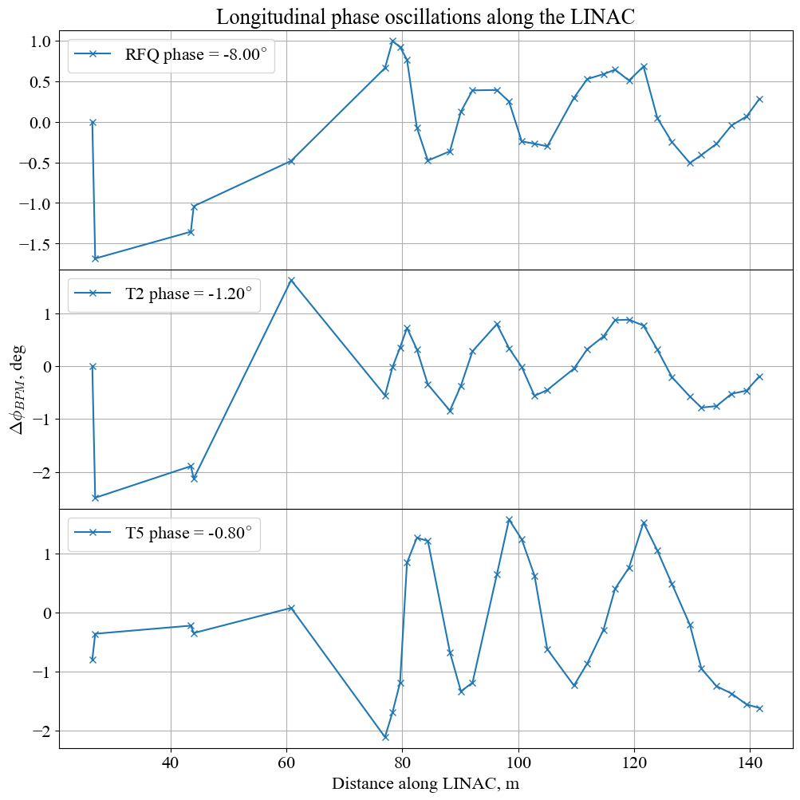
Background on Longitudinal Beam Motion
Shifts in phase tuning of accelerating modules can cause oscillations about a mean longitudinal position.
These phase oscillations are measured by the Beam Position Monitors (BPMs) further down.
Phase tuning of the buncher and tanks 1-5 can be set and produce their own oscillations patterns.
Figure 2: Longitudinal phase oscillations induced by varied (top) RFQ (mid) T2 (bottom) T5 phase setting
Notes:
Changing some tank settings creates some phase oscillations measured by BPMs

Slide 4
Goals
Main goal of project: For a given set of BPM longitudinal phase measurements, find buncher/tank settings to cancel the oscillations.
Possible approaches:
Small oscillation amplitudes: linear regime. Assume linear scaling of oscillation amplitude with tank settings. Apply Least Squares Regression linear fitting of signal to basis of buncher/tanks.
General case: machine learning approach. Train 1D convoluted neural network on oscillation data from buncher/tanks. Use it to predict buncher/tank settings for oscillations from other sources.
Considerations:
Oscillate buncher/tank setting: Fourier analysis of BPM readings.
Natural drift over time: Fits based on particular data may become worse over time.
Try to predict with pair of BPMs and analyze spread for different BPM combinations.
Notes:
Main goal: BPM readings -> buncher/tank settings
Linear approach vs ML approach
Considerations are some of the tasks I’ve been working on

Slide 5
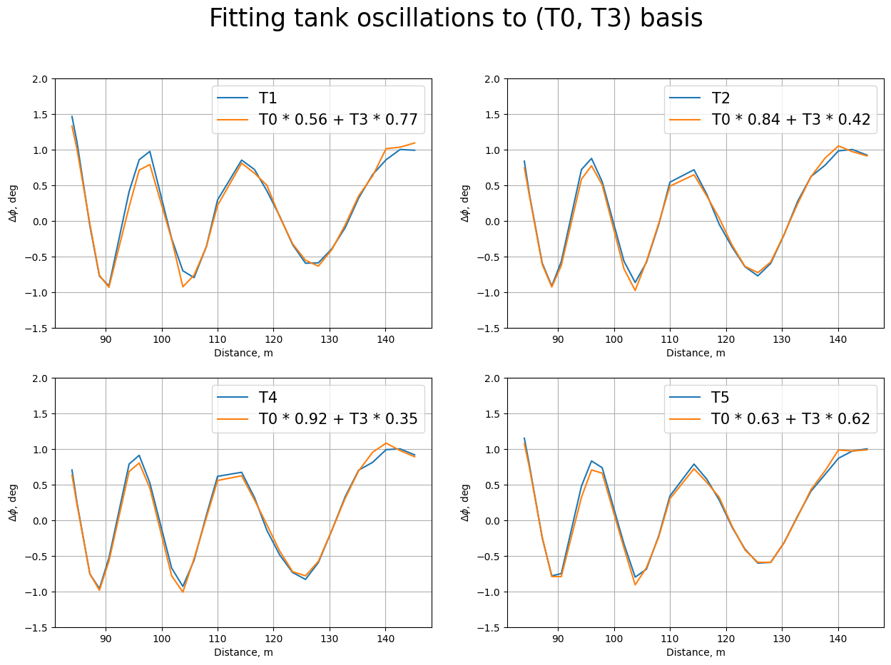
Reduction of Problem to Buncher and T3
Figure 3: Normalized longitudinal phase oscillation pattern of buncher (T0) and tanks in linear regime
Notes:
Shows that everything can be reduced to T0/T3 basis

Slide 6
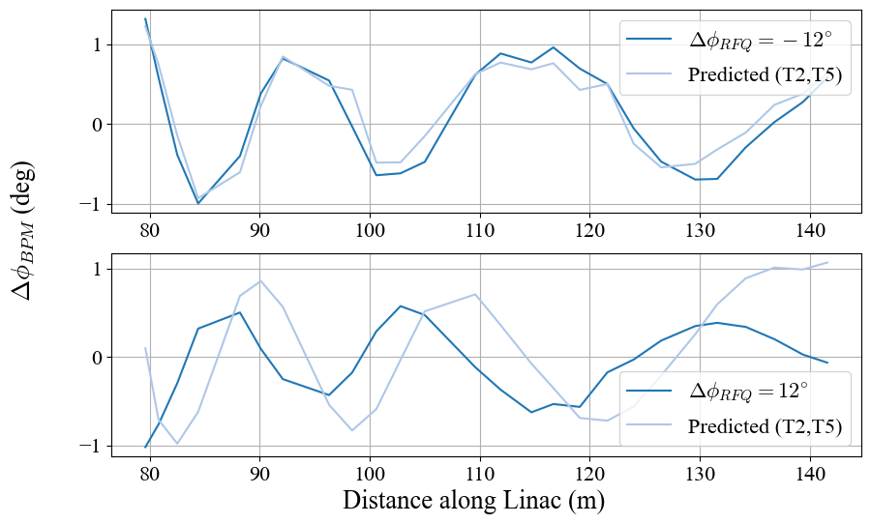
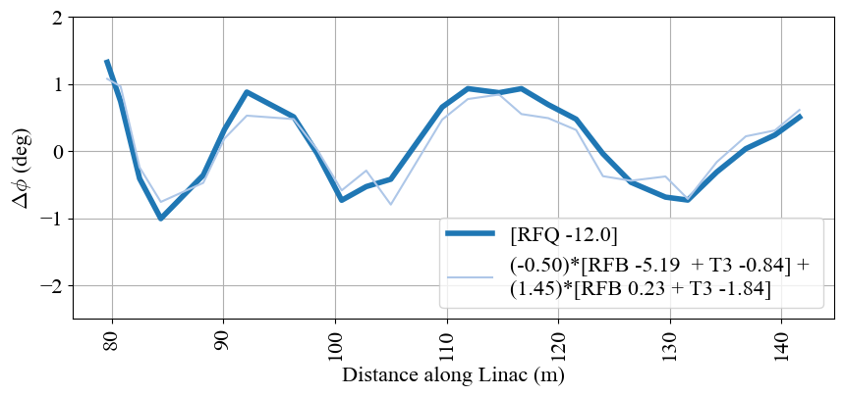
Linear vs non-linear regime
Linear fitting approach:
For small amplitudes, the phase oscillation pattern as measured by BPMs scales linearly with the tank phase tuning value.
Try to express given BPM readings as a linear combination of buncher/tanks
Machine Learning Approach:
Train 1D convolutional neural network on oscillation patterns produced by buncher/tanks
Current progress: mixed results
Figure 4: (left) Linear fitting of (buncher, T3) of given RFQ oscillation (right) 1D CNN predictions of (T2, T5) for given RFQ oscillation
Notes:
Linear fitting approach sorta works, ML approach is very mixed

Slide 7
Thank you
Sheldon Rego
srego@fnal.gov
Notes:
Another pretty picture of Wilson Hall

