Slide 1
Optimizing the recycler RF cavities for the PIP-2 upgrades
Alexandre Roger – Helen Edwards Internship
Supervisor – Rob Ainsworth
Thursday 20th July 2023

Slide 2
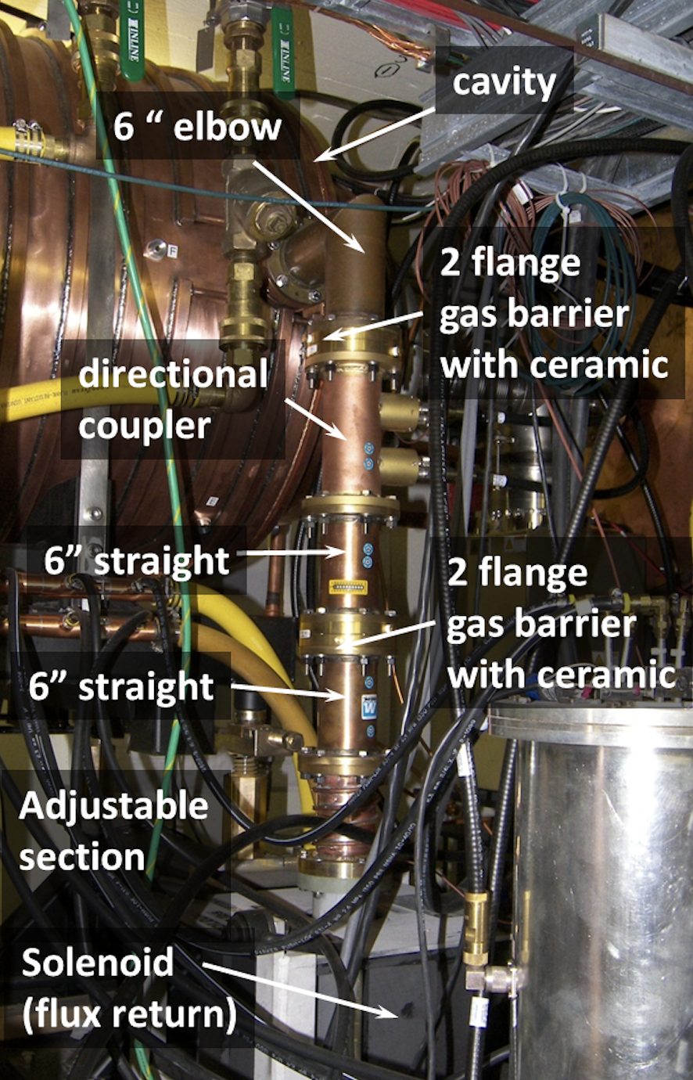
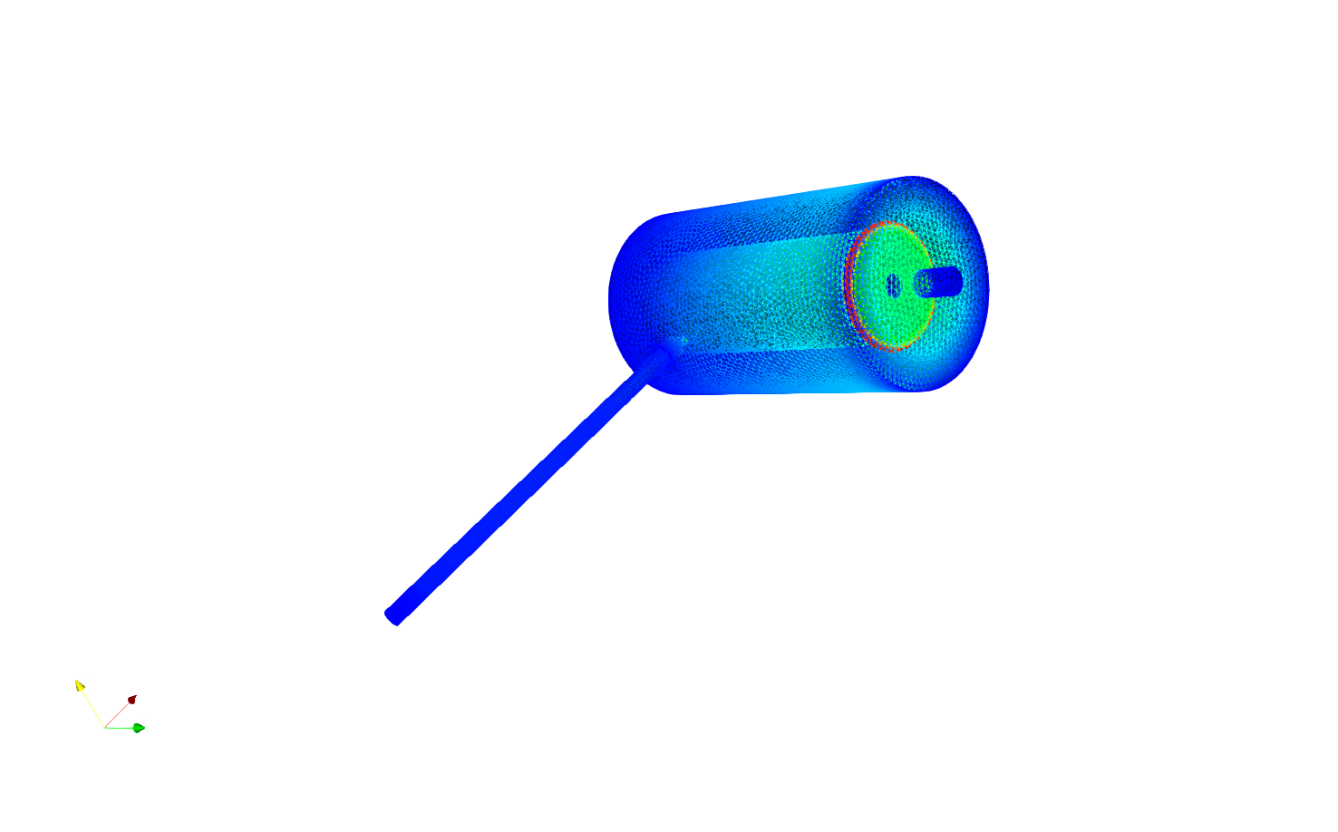
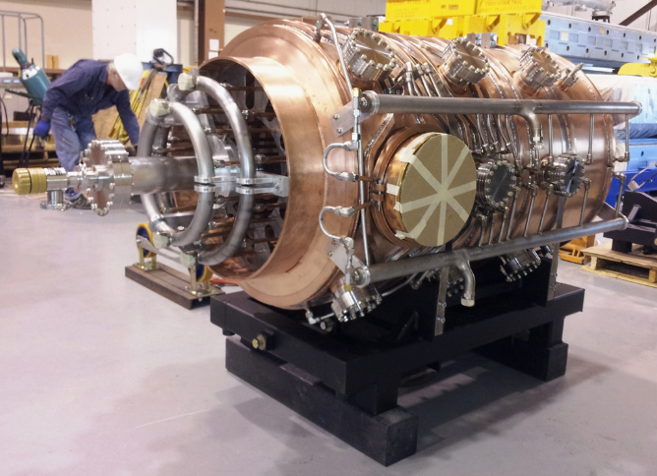
Goal: Optimize the dimensions of the RF cavities to improve the tuning range.
Previously, the tuning range was ~5kHz.

Slide 3
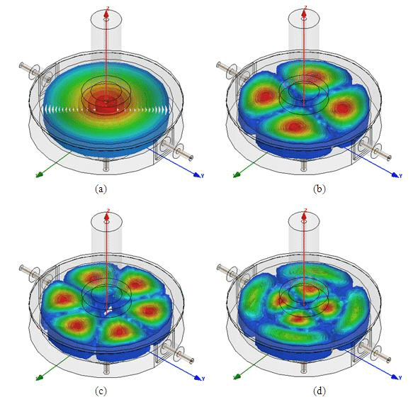
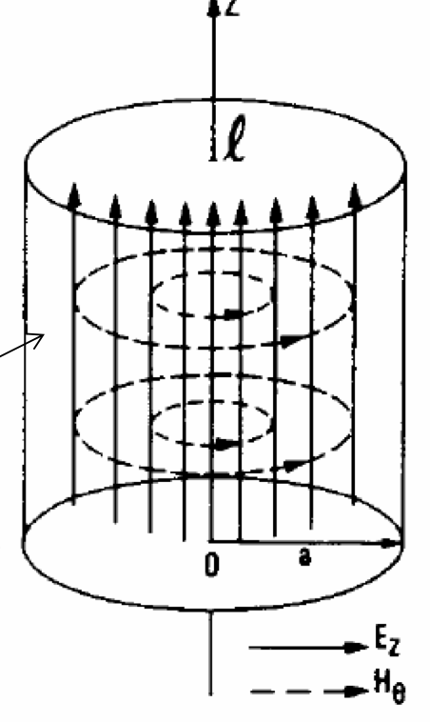
Electromagnetic fields in an infinite cylinder
TE
TM
TEM
HM
TM01
TM21
TM31
TM22

Slide 4
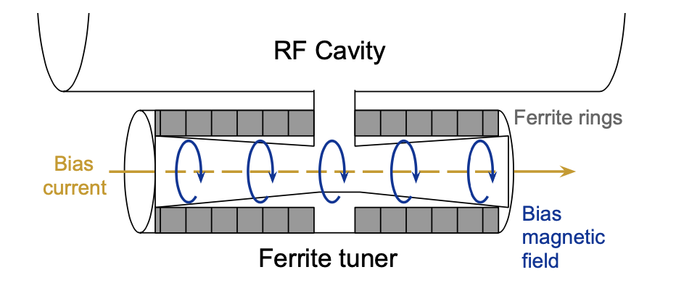
Tuning Range = max f – min f
Ferrite Tuner

Slide 5
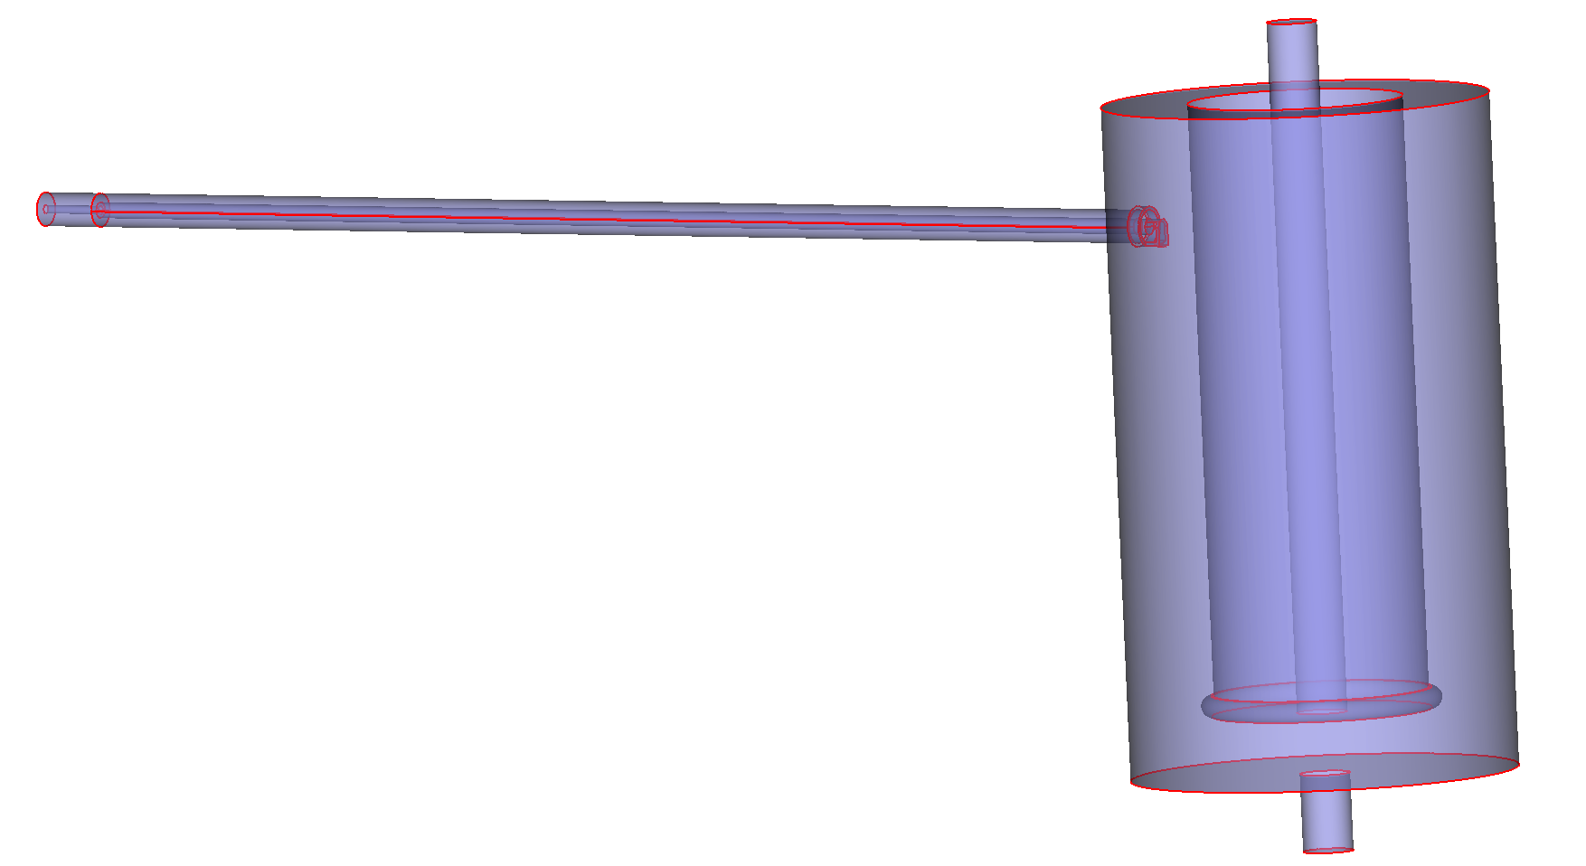
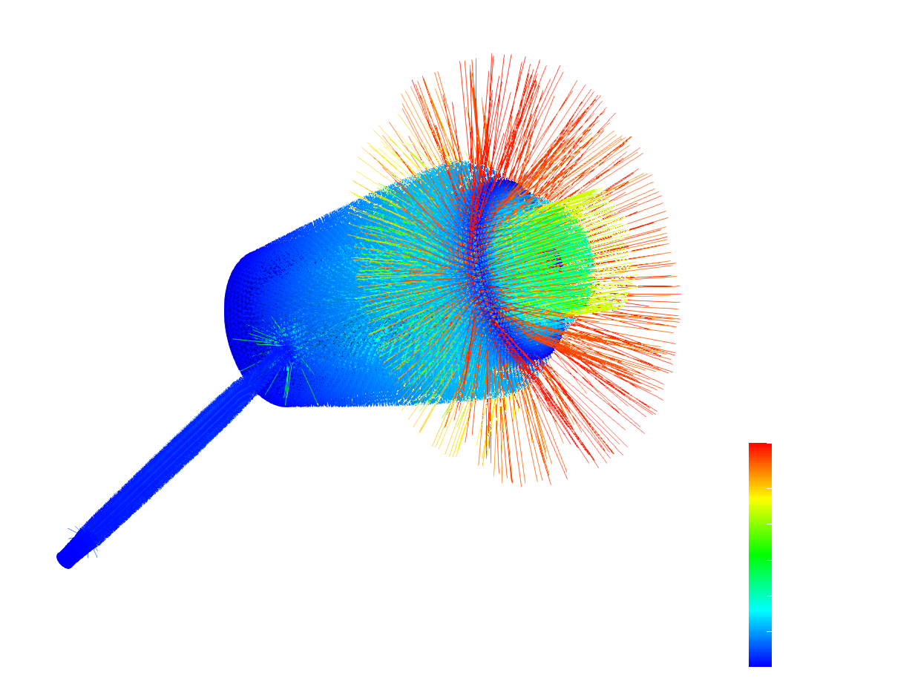
CUBIT
PARAVIEW
NERSC’s newest supercomputer at Berkeley: Perlmutter
Depth
Boundary
Conditions
carefully
chosen
+ a bunch of data
Length

Slide 8
Next:
Dependence of tuning range on μ
Voltage inside tuner (breakdown voltage is the limit)

