Slide 1
Creating a Machine Learning (ML) Surrogate Model of the Main Injector 8 GeV Line (MI8) Beam Collimation System
Ella Wood
Supervisor: Kyle Hazelwood
Helen Edwards Internship Preliminary Project Presentation
20th July 2023

Slide 2
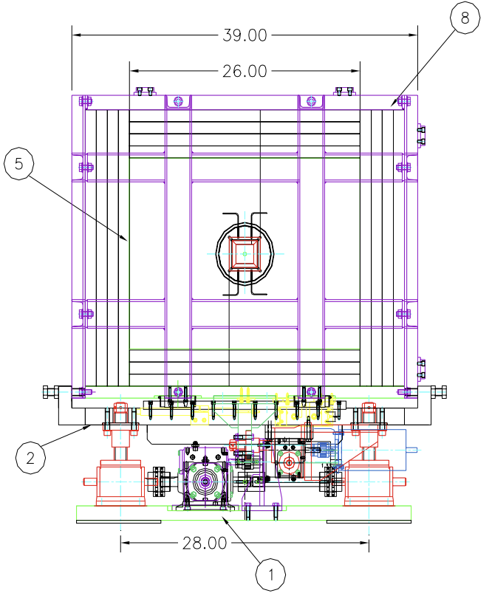
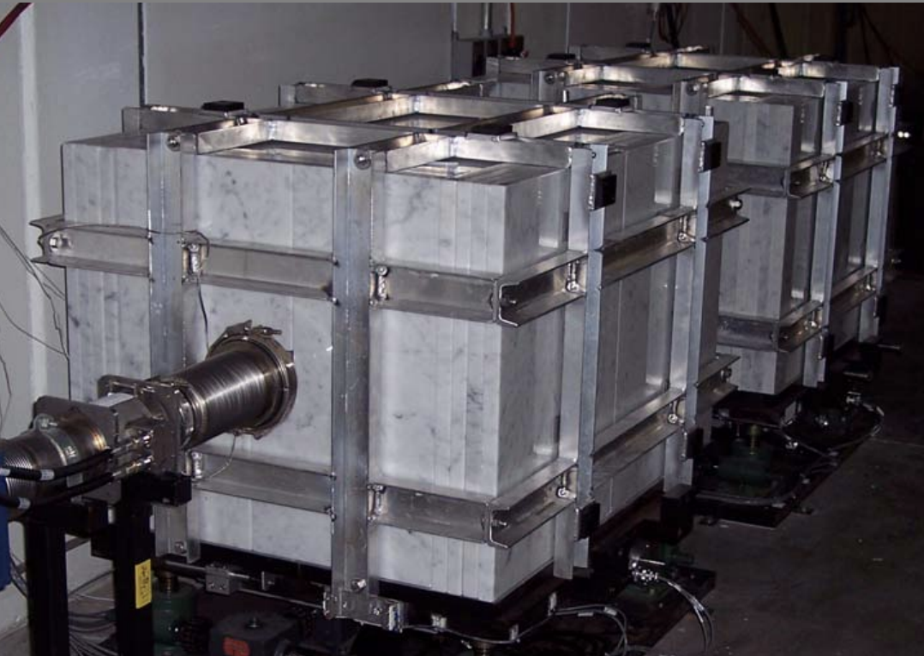
Creating a ML Surrogate Model of the Main Injector 8 GeV Line (MI8) Beam Collimation System
What is MI8?
The transfer line carrying 8 GeV protons from Booster to the Booster Dump, Main Injector, Recycler or Booster Neutrino Beam
What is the ‘beam collimation system’?
First generation of MI8 collimators installed in 2006 when running at lower intensity
Made up of 4 x 20-ton movable marble clad steel blocks positioned in pairs at 836 and 838
Positioned to scrape off the tails of the approximately gaussian transverse beam profile (beam ‘halo’) depositing it into the steel
Why ML?
Aim: create a model to predict impact of collimator positions and beam parameters on loss in MI8 and Recycler and use this to optimize collimation
Huge number of parameters!
8 independent collimator position variables, 12 beam position monitors, beam intensity, 4 multiwire devices, over 200 beam loss monitors throughout MI8 and Recycler
Structure of MI8 collimators from [1] showing baseplate assembly (1) including lifting jacks for vertical motion, support plate assembly (2) for horizontal motion, marble plates (5) and aluminium frame (8).
[1] Sidorov, Vladimir, et al. Mechanical Design of MI8 Collimators. Fermilab-Beams-Doc-2287, 13 June 2006.

Slide 3
How do you create a ML surrogate model of the MI8 beam collimation system?
Collect data
Performed collimation beam study – changing collimator positions at different beam intensities keeping position of the beam fixed using MI8 ‘positions autotune’
Limited by time - motors slow to move 20-ton blocks especially vertically (horizontally ball bearings make process faster)
Collect data from ~300 devices resulting in around ~320 usable metrics
Process data
Pivot data – i.e. rotate so that columns are timestamp + one column per device (required splitting into 11 sections!)
Filter data – remove Nans and sort obvious issues
Deserialize multiwire data – byte strings → usable metrics (mean and standard deviation)
Create extra columns for other helpful metrics including collimator efficiency, Recycler loss sum, MI8 loss sum, MI8 collimator loss sum etc.
Sample of data collected in beam study post processing. Includes collimator efficiency, collimator positions, MI8 and collimator loss sums, Recycler loss sum and sample set of Recycler beam loss monitors.

Slide 4
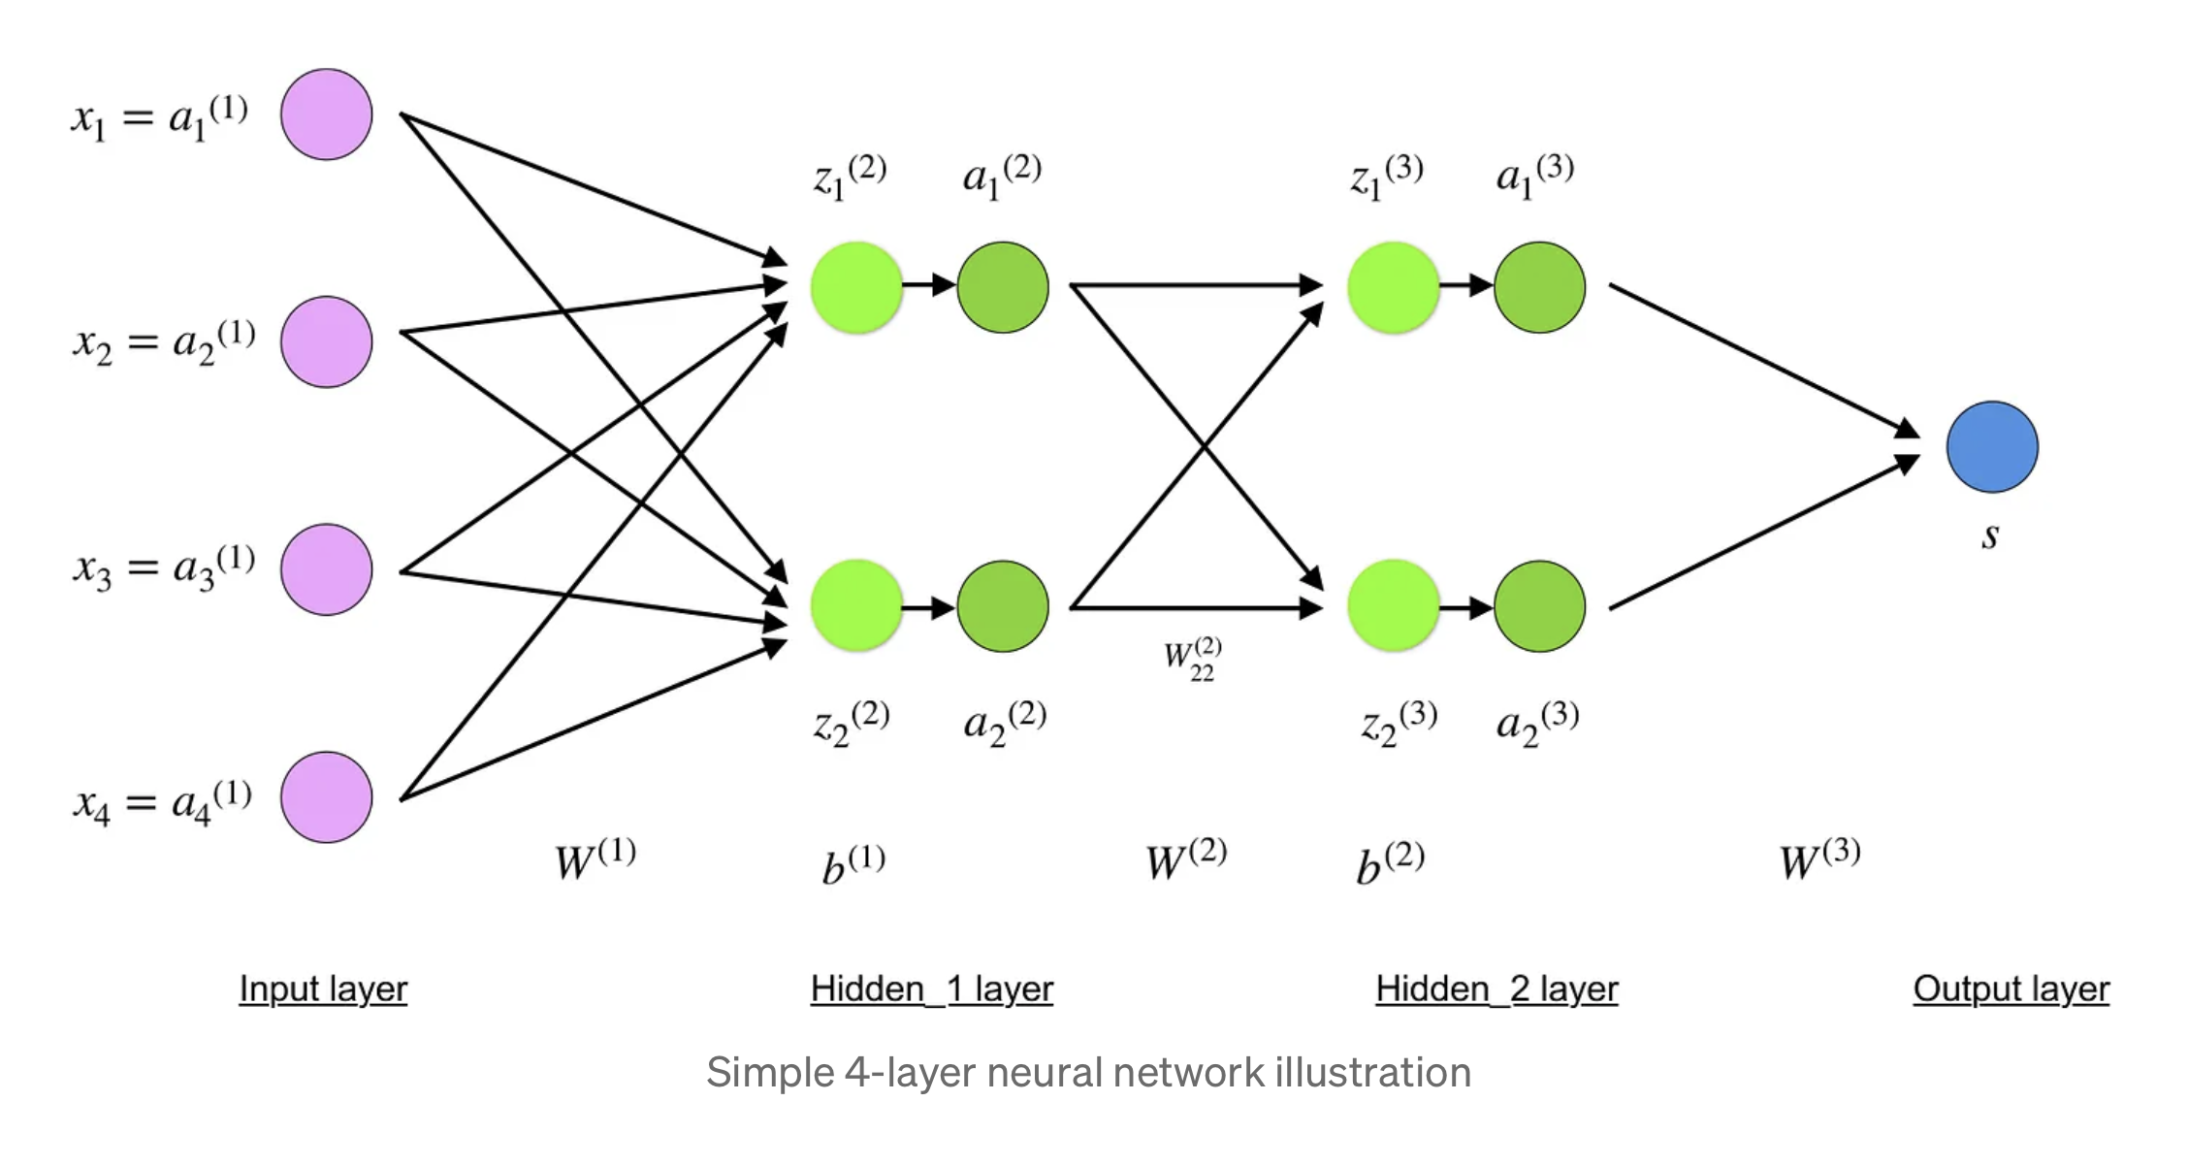
How do you create a ML surrogate model of the MI8 beam collimation system?
Select data, write and train model
Split data into inputs and labels (outputs) for model (supervised ML)
Normalize / standardize data – put on same scale
Use Keras library in Python to create surrogate model
Investigate and try different model architectures
Start with relatively simple model with few labels
Collimator efficiency, Recycler loss sum, MI8 collimator loss sum and MI8 loss sum
Increase complexity once simpler model works
e.g. Add MI8 collimator and some Recycler losses separately
Schematic diagram of a simple 4-layer neural network showing input, output and two hidden layers from [2].
‌
Evaluate and optimize
Optimize surrogate model architecture
Perform hyper-parameter search/tuning
Can take further if have time – depends on success of model!
[2] Simeon Kostadinov (2019). Understanding Backpropagation Algorithm. [online] Medium. Available at: https://towardsdatascience.com/understanding-backpropagation-algorithm-7bb3aa2f95fd.
‌

