Slide 1
PIP-II Laserwire Introduction
Vic Scarpine
PIP-II Beam Instrumentation Laser Wire Final Design Review
May 2, 2024

Slide 2
Outline
Laserwire Basics
PIP-II Laserwire Requirements
PIP-II Laserwire Interfaces
PIP2IT Results
PIP-II Laserwire Overview
PIP-II Laser Hut
PIP-II Laserwire Team
PIP-II Laserwire Locations
PIP-II Laserwire Emittance Monitor

Slide 3
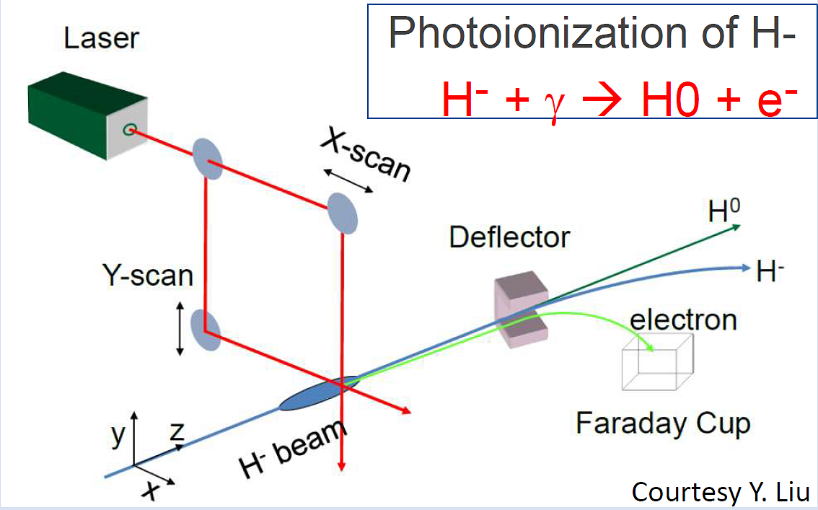
Unique Issues with Profiling in a SC Linac
Beam profile measurements in high-intensity, superconducting H- accelerators are a challenging task.
Damage and contamination of superconducting RF cavity must be prevented at all costs.
Invasive measurements can lead to particle contamination, degraded vacuum, beam loss leading to heating then quenching
This drives the need for non-invasive measurement of both transverse and longitudinal profiles.
Ultra-high vacuum in SC linacs make ionization profile monitors difficult.
The technique of photoionization (H- + γ → H0 + e-) is preferred method for beam profiling.
PIP-II will utilize laser-based profile monitor (laserwires) for transverse and longitudinal profiling where possible.

Slide 4
PIP-II Laserwire Choices and Challenges
Main issues for PIP-II
Small cross section → small signal
3.5 E–17 cm^2 at 1.17 eV (λ = 1064 nm)
PIP-II low beam current → small signal
Laser power limited by damage limit on optical vacuum viewports
High Peak Power Laser (free-space)
More photons per bunch – Pro
More electrons → larger signal
Simple Faraday cup collector
Need free-space transport – Con
Potentially larger power density on vacuum windows – Con
Risk to damage windows → damage SRF cavities
Low Peak Power Laser (fiber)
Less photons per bunch - Con
Less electrons → smaller signal
Laser transport through fibers – Pro/Con
Easier transport but limited power through fibers
Lower peak power density on vacuum windows – Pro
Less risk to SCF
Fiber-based, low-power option was tested at PIP2IT

Slide 5
Requirements
Physics Requirements: ED0010230
Re-released and approved. No changes to laserwire.
Laserwire Functional Requirements: ED0008303
Re-released and approved. No changes to laserwire.
Laserwire Technical Requirements: ED0013714
Changing requirement T-ED0013714-E004 from:
“The free-space optics at each laserwire station shall keep the maximum average optical power density on the vacuum viewports to less than 3 W/cm^{2 “}
To
“The free-space optics at each laserwire station shall keep the maximum average optical energy density on the vacuum viewports to less than 150 mJ/cm² in 10µs and less than 3 J/cm² in 1s“
Note: industry standard is < 10 J/cm² for a single laser pulse. We are requiring a 3x less energy limit. Presently we are designing to keep this limit to 50 mJ/cm² in 10µs and less than 1 J/cm² in 1s.

Slide 6
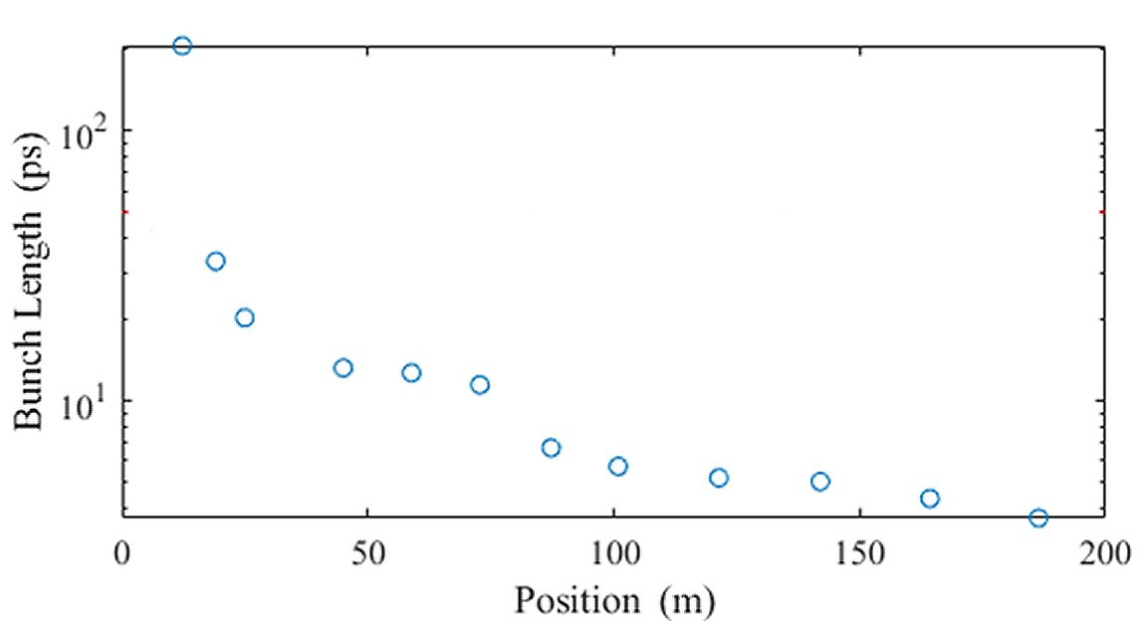
Some Key PIP-II Numbers for Laserwire Design Guidance
Need to make profile measurements with commissioning beam
H- Parameter | Nominal | Commissioning
Beam energy | 2.1 to 800 MeV | 2.1 to 833 MeV
Beam pulse length | 550 μs | 10 μs
Bunch Intensity | 30 pC | 1.2 to 60 pC
Bunch Intensity (particles) | 1.5e8 | 6e7 to 3e8
Beam transverse size (rms) | 2 mm | 1 to 4 mm
Size of measurable region | ±15 mm | ±15 mm
Desirable typical scan time | <3 min | <5 min
Longitudinal bunch length (rms) | 200 to 4 ps | 200 to 4 ps
H- Bunch Length
With small H- beam current, we are optimizing laser pulse overlap with H- beam pulse for each beam energy (see Signal Performance talk) with following guidance:
Laser power on vacuum windows < 150mJ/cm2 per 10µs up to 20Hz
Keep laser power per pulse in linear response region (up to ~100µJ per pulse)
Select laser pulse width to maximize signal (minimize wasted photons)
Select laser pulse pattern to match chopped H- beam pattern (minimize laser power on windows)
Laser pulse rep rate ~10MHz over 10µs up to 20Hz for initial design (minimize difficult laser amplifier design)

Slide 7
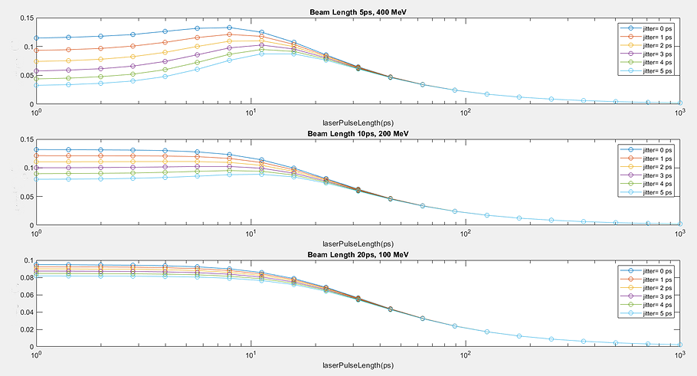
Laser Pulse Length Studies
What is optimal laser pulse length for laserwire system?
May optimize laser pulse length for different H- beam energies
Laser design may allow for this. Under study
Amplitude of the charge profile for different jitter amplitudes, beam lengths and for laser pulse lengths from 1 ps to 1 ns

Slide 8
Laserwire Interfaces
Interfaces identified and being managed though master interface controls document located in Teamcenter ED00010433 and Beam Instrumentation Noninvasive Beam Profile Monitor Interface Specification ED0016036.
WBS 121.03.09
Beam Instrumentation
WBS 121.03.04
LLRF
RF for laser and electronics
WBS 121.03.07
Controls
Timing, motion control and instrument control. Readout of diagnostic data.
WBS 121.04
Installation
Mechanical installation and alignment of detectors and optical transport line.
Power, rack space, cables.
WBS 121.03.06
Vacuum
Cleaning, assembly and vacuum certification of beamline components. Installation of optical transport line vacuum.
WBS 121.03.08
Safety Systems
Laser system safety interlocks
WBS 121.06
Conventional Facilities
Laser huts and laser transport line

Slide 9
PIP2IT Prototype Laser Profile Monitor Measurements
Low peak power fiber-based laser with optical fiber transport
PIP2IT Laser
Fiber Laser:
162.5 MHz pulses locked to RF
12 psec pulses at 1054 nm
Up to 1 W at beamline
~6 nJ per pulse
Faraday cup for electron collection
Laser transport via LMA optical fiber
Longitudinal beam profile with high-gain preamp
Preamp noise requires averaging
Background electrons limit dynamic range of measurement
Vertical beam profile with laser amplitude modulation detection
Potentially very sensitive technique
Sensitivity is proportional to time
Limited by cross-talk effects
Conclusion: Low peak power fiber laser limited by amplifier noise and background → Move to higher peak power laser with free space laser transport.

Slide 10
PIP-II Free-Space Transport Laserwire Design

Slide 11
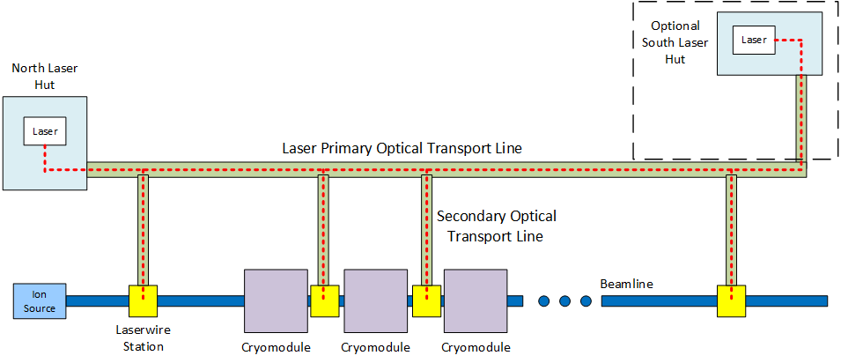
PIP-II Laserwire
Charge #2
Free-space optical transport line above entire PIP-II WFE and Linac
Laser located outside of PIP-II tunnel in laser hut
Transport of laser light through vacuum pipe in PIP-II tunnel
Mirror boxes select which laserwire stations receive laser
Can only select one profile measure location at a time
13 laserwire stations
~200m

Slide 12
Laserwire for PIP-II
Charge #2
Cross sectional view of linac tunnel enclosure showing laser primary optical transport line envelope.
Transport line capable of free-space transport → low-vacuum for safety

Slide 13
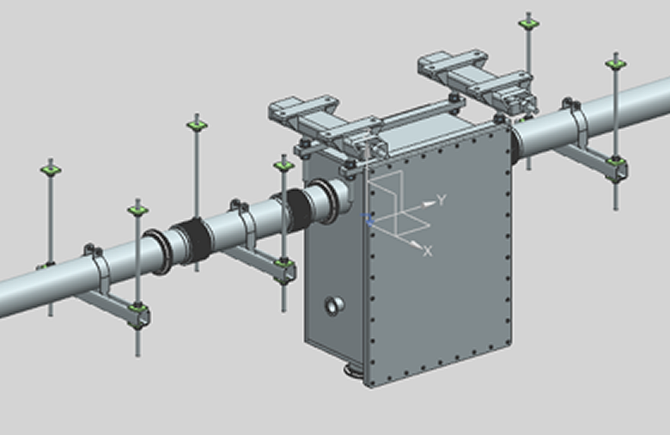
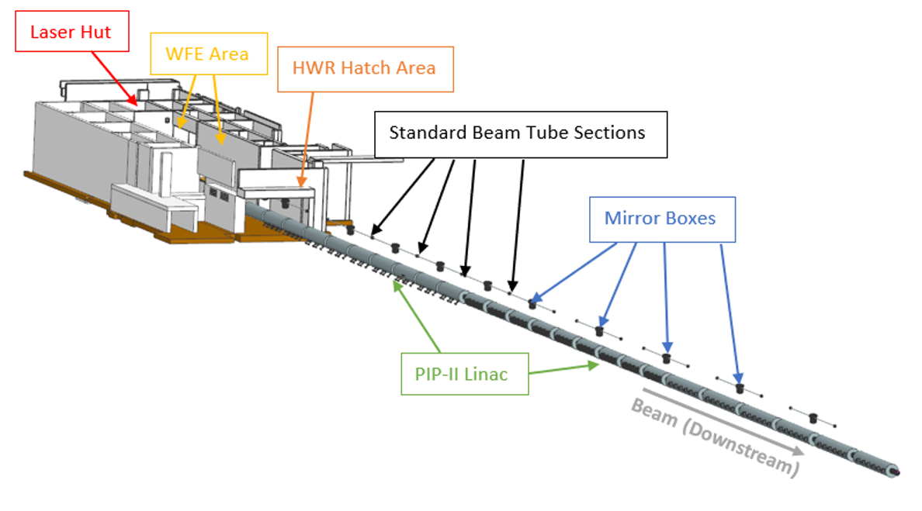
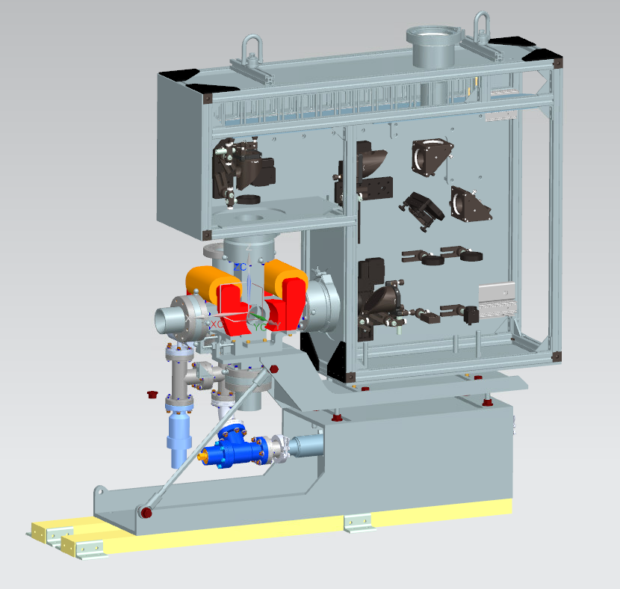
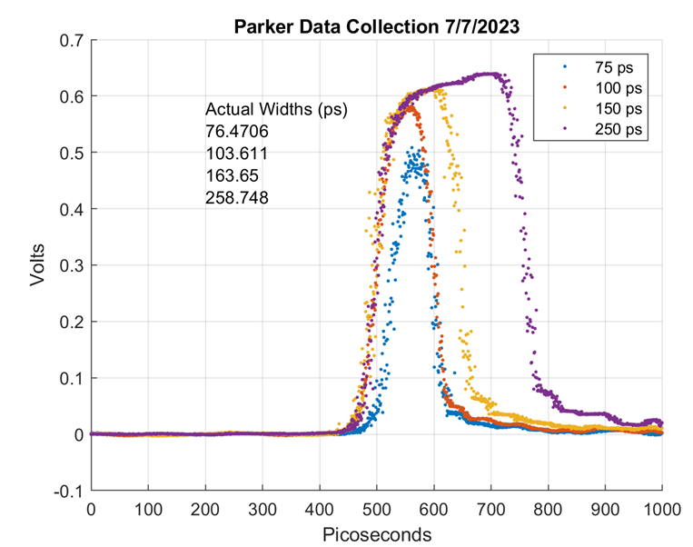
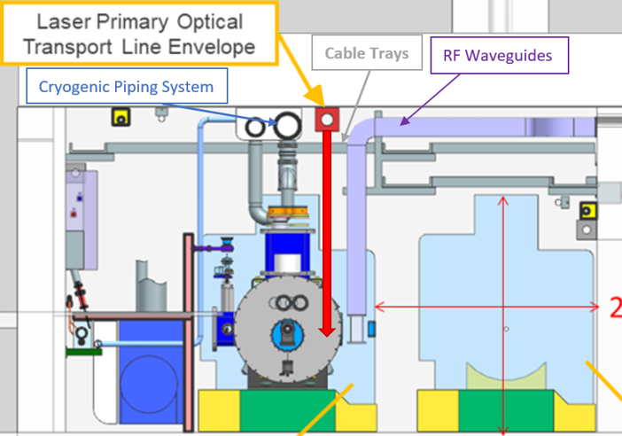
Laserwire Technical Progress
Progress:
Completed much of the design changes recommended from Nov 2022 mini-review of laserwire system.
Laserwire FDR May 2, 2024
Will submit BCR to cover changes
Optical transport line design stable
Beamline design (vacuum chamber, optics box, stand, etc) moving toward final design
Short pulse laser design under development
Lab measurements successful
Mirror Box
Transport Line Talk
Laser Transport Optics and Alignment
Laser System Talk
Mechanical Design Talk

Slide 14
Beamline Mechanical Design Labels
Input Laser Port
Input Optics Box
Faraday Cup Port
Collection Magnets
Removable Optics Breadboard
Output Laser Dumps
Laserwire Stand
Vacuum Pump
Assembly
Beamline Vacuum Chamber

Slide 15
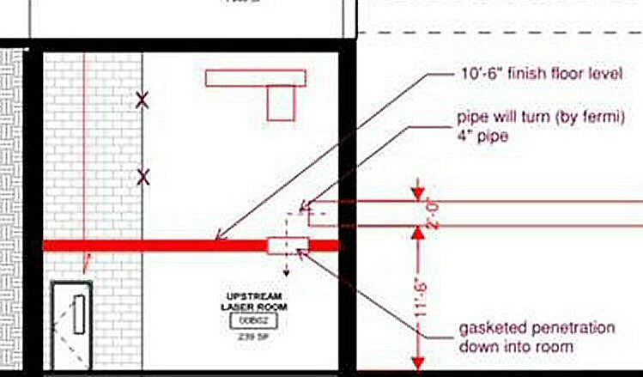
Laser Hut in Conventional Facility Drawings
Top View
Laser hut and optical transport line light-tight and interlocked
RFQ
Side View showing laser hut ceiling penetration and laser transport line

Slide 16
Laserwire Design Team
Project manager and instrument designer
Vic Scarpine, Scientist
Modeling and simulations, magnet design, optics design
Randy Thurman-Keup, Scientist
Sanjini Wijethunga, Postdoc
Laser design and development
Jinhao Ruan, Scientist, Laser Physicist
Parker Landon, Boston University graduate student
Beamline mechanical design (vacuum chamber, stand, optics boxes)
Raul Campos, Mechanical engineer (Dakota Krokosz, ME)
Tiffany Price, Mechanical engineer
Optical transport mechanical design
Bob Steinberg, Mechanical engineer
Project CAM
Sherese Humphrey

Slide 17
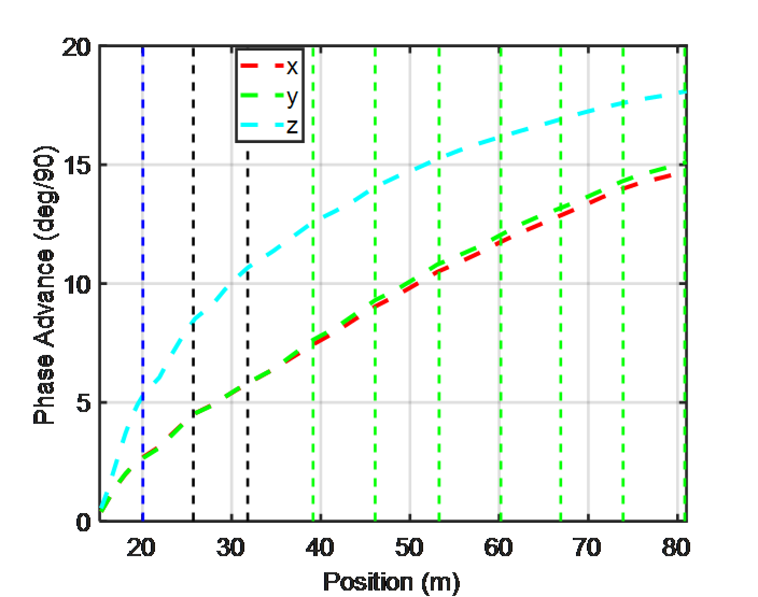
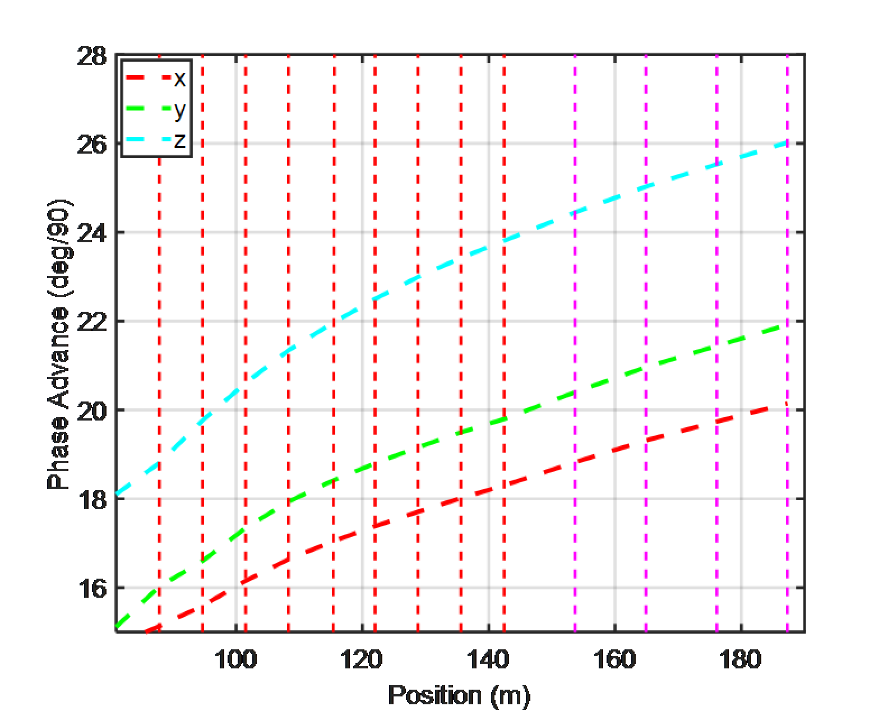
Laserwire Locations in PIP-II SC Linac
Emittance monitor
MEBT
HWR
SSR1
SSR2
LB650
HB650
Laser wire
Most locations finalized in PIP-II accelerator physics lattice file.
Emittance scanner laserwire location being finalized.

Slide 18
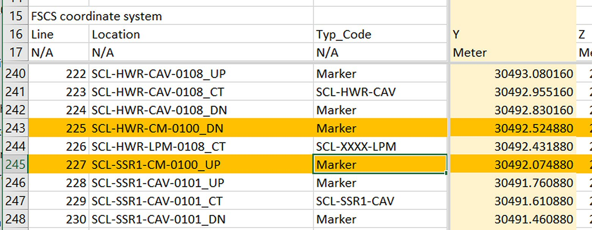
Laserwire Locations in Accelerator Physics Lattice File
1
Accelerator Physics lattice file
1

Slide 19
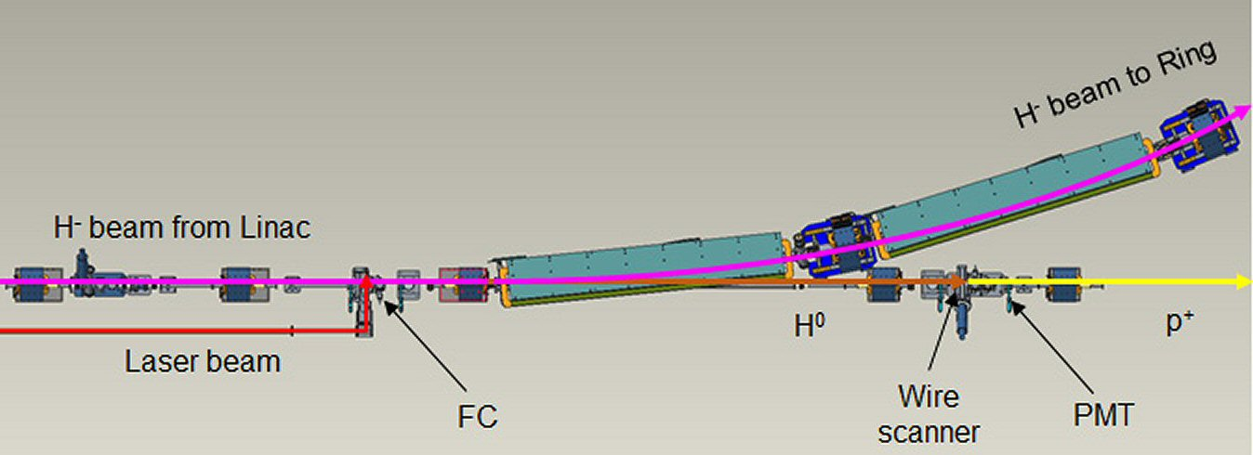
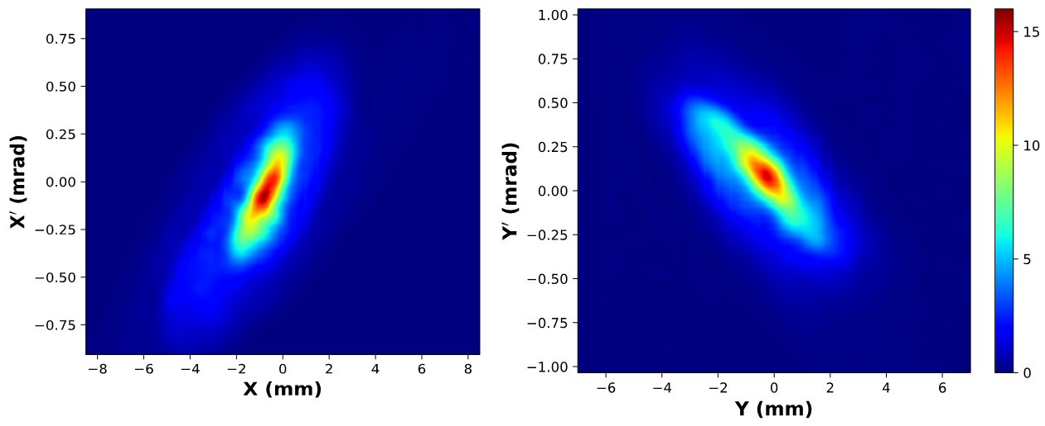
SNS Laserwire Emittance Monitor
Laserwire Emittance Monitor Principle
Use upstream laserwire to measure X profile
Downstream dipole steers H- but H0 goes straight
Use straight ahead detector to measure H0 which is X’ profile
How to measure H0?
H0 very small signal → PMT/EMT
H0 background from beam-beam stripping
How far apart is laserwire from H0 detector?
PMT or EMT
X’
X
SNS Laserwire Emittance Monitor
SNS Emittance Measurements

Slide 20
End of Linac Diagnostics – PIP-II Laser Emittance Monitor
End of linac beam diagnostics being finalized in accelerator physics lattice file
In the process of finalize LW for emittance location and H0 detector location
H0 detector early in design
Wire scanner + collection magnets + EMT
Foresee LW is possible future LW location is additional cryomodules are added
This laserwire is not in PIP-II project scope.
LW H0 detector

Slide 21
Evolution of H0 after Laserwire (from Abhishek)
Use these plot to determine location of downstream H0 detector
If laserwire downstream after 2nd RF separator region then H0 detector can be 10 to 15 meters downstream
A lot of flexibility in placement

Slide 22
Summary
PIP-II Laserwire is a challenging design
PIP2IT experience was invaluable to PIP-II design
Moving to free-space laser transport gives more flexibility to laser profile monitor operation
Allows for optimization of measurement performance
Design of beamline laserwire units, laser optical transport line and laser design meet the PIP-II requirements
Remaining talks will go into details of these designs

