Slide 1
Laser Transport Optics and Alignment
Randy Thurman-Keup
PIP2 Laserwire Final Design Review
May 2, 2024

Slide 2
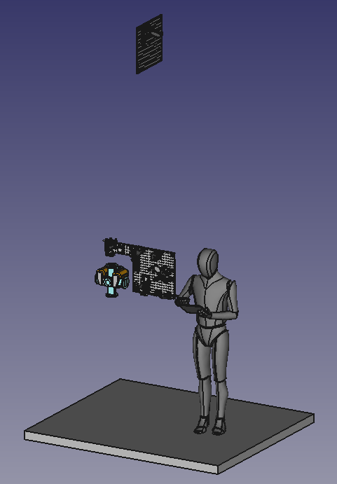
Laserwire Beamline
Vultures-eye View
Mirror Box Optics
Feedback
Station
12+1 Beamline Stations
Laser
Beamline Box Optics
Vacuum Transport Line
Laser Room
H- Beam
Shield Wall

Slide 3
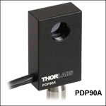
Feedback Box Optics
≥ 2-inch cube beamsplitter
      Alternatively –
Pair of ≥ 3-inch mirrors
1064 nm Laser
Alignment/Feedback Laser
Not 90 degrees to maximize mirror acceptance
Not at focal point
Optical BPM
Optical BPM
Thorlabs Lateral Effect Position Sensor
Notes:
Specify the IR and alignment laser (don’t quantify wavelength)

Slide 4
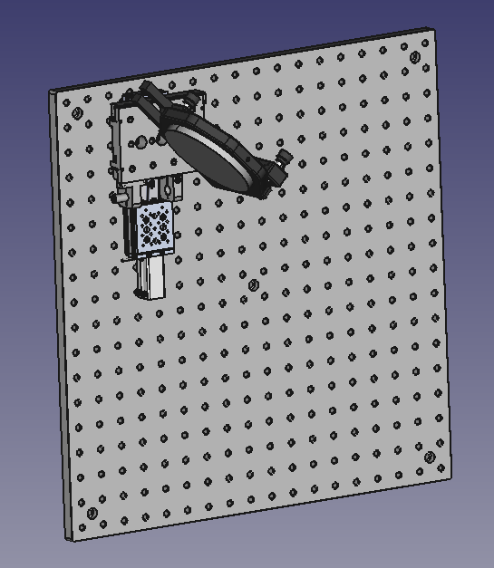
Mirror Box Optics
1
Motorized stage
2
Manual Stage
Laser in Transport Line
2
3
3
Pickoff Mirror
1
Motorized stage to insert pickoff mirror
Manual stage to adjust longitudinal position of downward laser trajectory during alignment
Extra space for potential feedback or monitoring devices

Slide 5
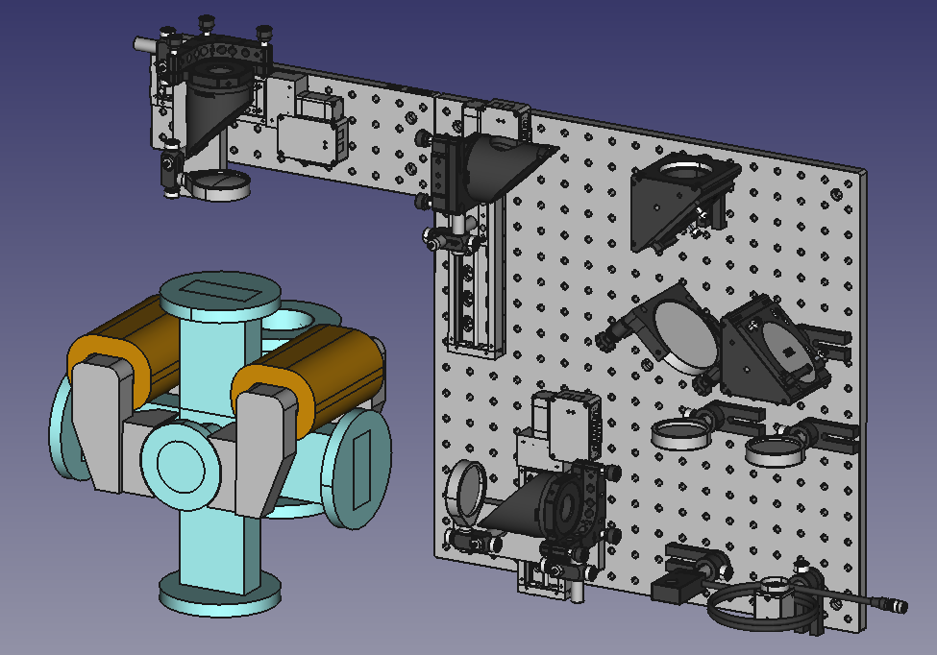
Beamline Box Optics
Laser from Mirror Box
1
Motorized stage
3
2
Sampler (dielectric mirror)
3
3
Mirror
2
1
4
Focus Lens
4
5
Photodiode/BPM
7
3
6
Camera
1
1
7
Beamsplitter
4
4
Detectors may only be there for commissioning
3
H- beam into page
5
6

Slide 6
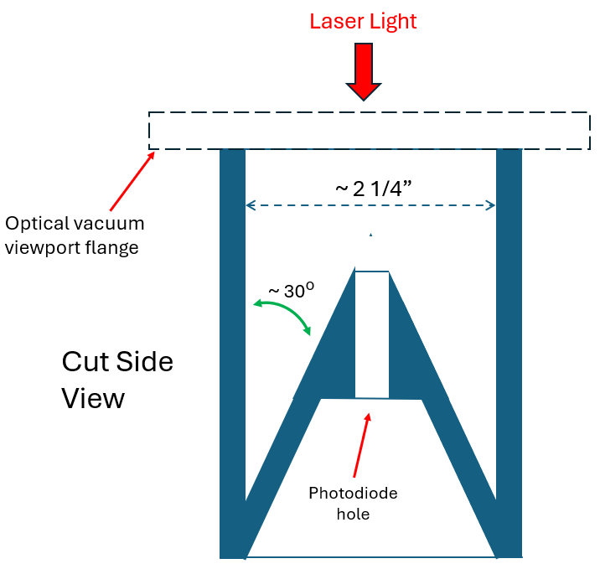
Dump Box
Two located on horizontal and vertical exit windows
Absorber with hole for photodiode
Dump aperture to be same as optical vacuum viewport
Dump interior painted black or black anodized
Interior angle ~ 30 degrees to minimize back reflections
Seal between dump box and optical viewport flange will be light-tight

Slide 7
Laser Transport Optics
Laser Room
Alignment/Feedback (AF)
Laser System
AF
Transport Prep
Transport Vacuum Window
1064 nm
Laser System
1064 nm
Transport Prep
1064/AF
Combiner
Alignment
Path
Mirror Expander
Feedback
Mirror
Bend
Mirror
Linac
12+1 Laserwire Stations
Feedback
Detector
Feedback
Detector
End of Linac
Detector

Slide 8
Laser Transport Optics
Laser Room
Alignment/Feedback (AF)
Laser System
AF
Transport Prep
Transport Prep
1064 nm
Laser System
1064 nm
Transport Prep
Optics to adjust phase space parameters to those needed for transport to end of linac
  Adjust phase space parameters to match expander optics and produce desired lattice for linac transport
  Equalize phase space of transverse planes to eliminate astigmatism using natural astigmatism of lenses
Linac
12+1 Laserwire Stations

Slide 9
Laser Transport Optics
Laser Room
Alignment/Feedback (AF)
Laser System
AF
Transport Prep
Combiner
1064 nm
Laser System
1064 nm
Transport Prep
Optics to combine the two lasers onto the same path
  Likely just a 1064 nm mirror
1064/AF Combiner
Linac
12+1 Laserwire Stations

Slide 10
Laser Transport Optics
Laser Room
Alignment/Feedback (AF)
Laser System
AF
Transport Prep
1064 nm
Laser System
1064 nm
Transport Prep
1064/AF
Combiner
Alignment
Path
Alignment Path
Long reflective path on optical table in laser room to do initial alignment for transport
Linac
12+1 Laserwire Stations

Slide 11
Laser Transport Optics
Laser Room
Alignment/Feedback (AF)
Laser System
AF
Transport Prep
1064 nm
Laser System
1064 nm
Transport Prep
1064/AF
Combiner
Alignment
Path
Mirror Expander
Mirror Expander
Reflective expander to avoid chromatic effects
  e.g. Thorlabs BE06R
Linac
12+1 Laserwire Stations

Slide 12
Laser Transport Optics
Laser Room
Alignment/Feedback (AF)
Laser System
AF
Transport Prep
Transport Vacuum Window
1064 nm
Laser System
1064 nm
Transport Prep
1064/AF
Combiner
Alignment
Path
Mirror Expander
Feedback
Mirror
Feedback Mirror
Piezo mirror to control alignment with feedback from downstream detectors
  e.g. Thorlabs : PDP90A plus KPA101 plus POLARIS-K2S2P
Linac
12+1 Laserwire Stations

Slide 13
Laser Transport Optics
Laser Room
Alignment/Feedback (AF)
Laser System
AF
Transport Prep
Transport Vacuum Window
1064 nm
Laser System
1064 nm
Transport Prep
1064/AF
Combiner
Alignment
Path
Mirror Expander
Feedback
Mirror
Bend
Mirror
Bend Mirror
Mirror located in vacuum above laser room to direct the laser down the transport pipe
Part of initial alignment of transport line
Linac
12+1 Laserwire Stations

Slide 14
Laser Transport Optics
Laser Room
Alignment/Feedback (AF)
Laser System
AF
Transport Prep
Transport Vacuum Window
1064 nm
Laser System
1064 nm
Transport Prep
Detectors used to feedback to the piezo mirror to control alignment
  Feedback uses the AF laser picked off from the transport line in a special box 30 m from the laser room
  A second detector will be placed near the middle of the linac to be used if the first one has insufficient sensitivity
1064/AF
Combiner
Alignment
Path
Mirror Expander
Feedback
Mirror
Bend
Mirror
Linac
12+1 Laserwire Stations
Feedback Detectors
Feedback
Detector
Feedback
Detector

Slide 15
Laser Transport Optics
Laser Room
Alignment/Feedback (AF)
Laser System
AF
Transport Prep
Transport Vacuum Window
1064 nm
Laser System
1064 nm
Transport Prep
1064/AF
Combiner
Alignment
Path
Mirror Expander
Feedback
Mirror
Bend
Mirror
A detector will be placed at the end of the transport line to aid in verification of the alignment
  This detector will be sensitive to the 1064 nm and AF lasers
Linac
12+1 Laserwire Stations
EOL Detector
Feedback
Detector
Feedback
Detector
End of Linac
Detector

Slide 16
Laser Transport Optics
Transport line optical arrangement features a single optical waist generated by an initial collimating section in the laser room
Each laserwire has an insertable pickoff mirror in the mirror box which leads to final focus lenses inside the beamline boxes
Insertable Pickoff Mirror
Final
Focusing Lens
Laser
Optical
Waist
H-
Beamline
Laser
Room
Not to scale

Slide 17
Laser Transport Optics
A single waist but many pickoff points requires an optical evaluation of each laserwire location to ensure that the laser radius has the proper size at all points of interest
  Laser size does not become too large
  (or too small) down the transport
  Does not become too small on vacuum windows
  and optical elements
  Is small enough at the H- intersection
  Plan is ~5 mm
Four different waist sizes
Solid is M² = 1
Dashed is M² = 2
Notes:
Add that we’re looking at using 4 or 5 mm

Slide 18
Laser Transport Optics
Test of sensitivity of optics to ideal collimating lens
  Control of optics via lens position, and stability of optics to small movements in lens position
Size on Lens
Region to avoid
Small size on focus lens → small size on vacuum window
Waist Position
Waist Size
Waist Position
Focus Length ~constant
Focus Size small
Focus Size
Collimating Lens Position
Focus Size
Focus Length
Focus Size (mm)
Focus Length (m)
Waist Size
Size on Lens
Waist Position
Collimating
Lens Position
Focus Length
Waist Position

Slide 19
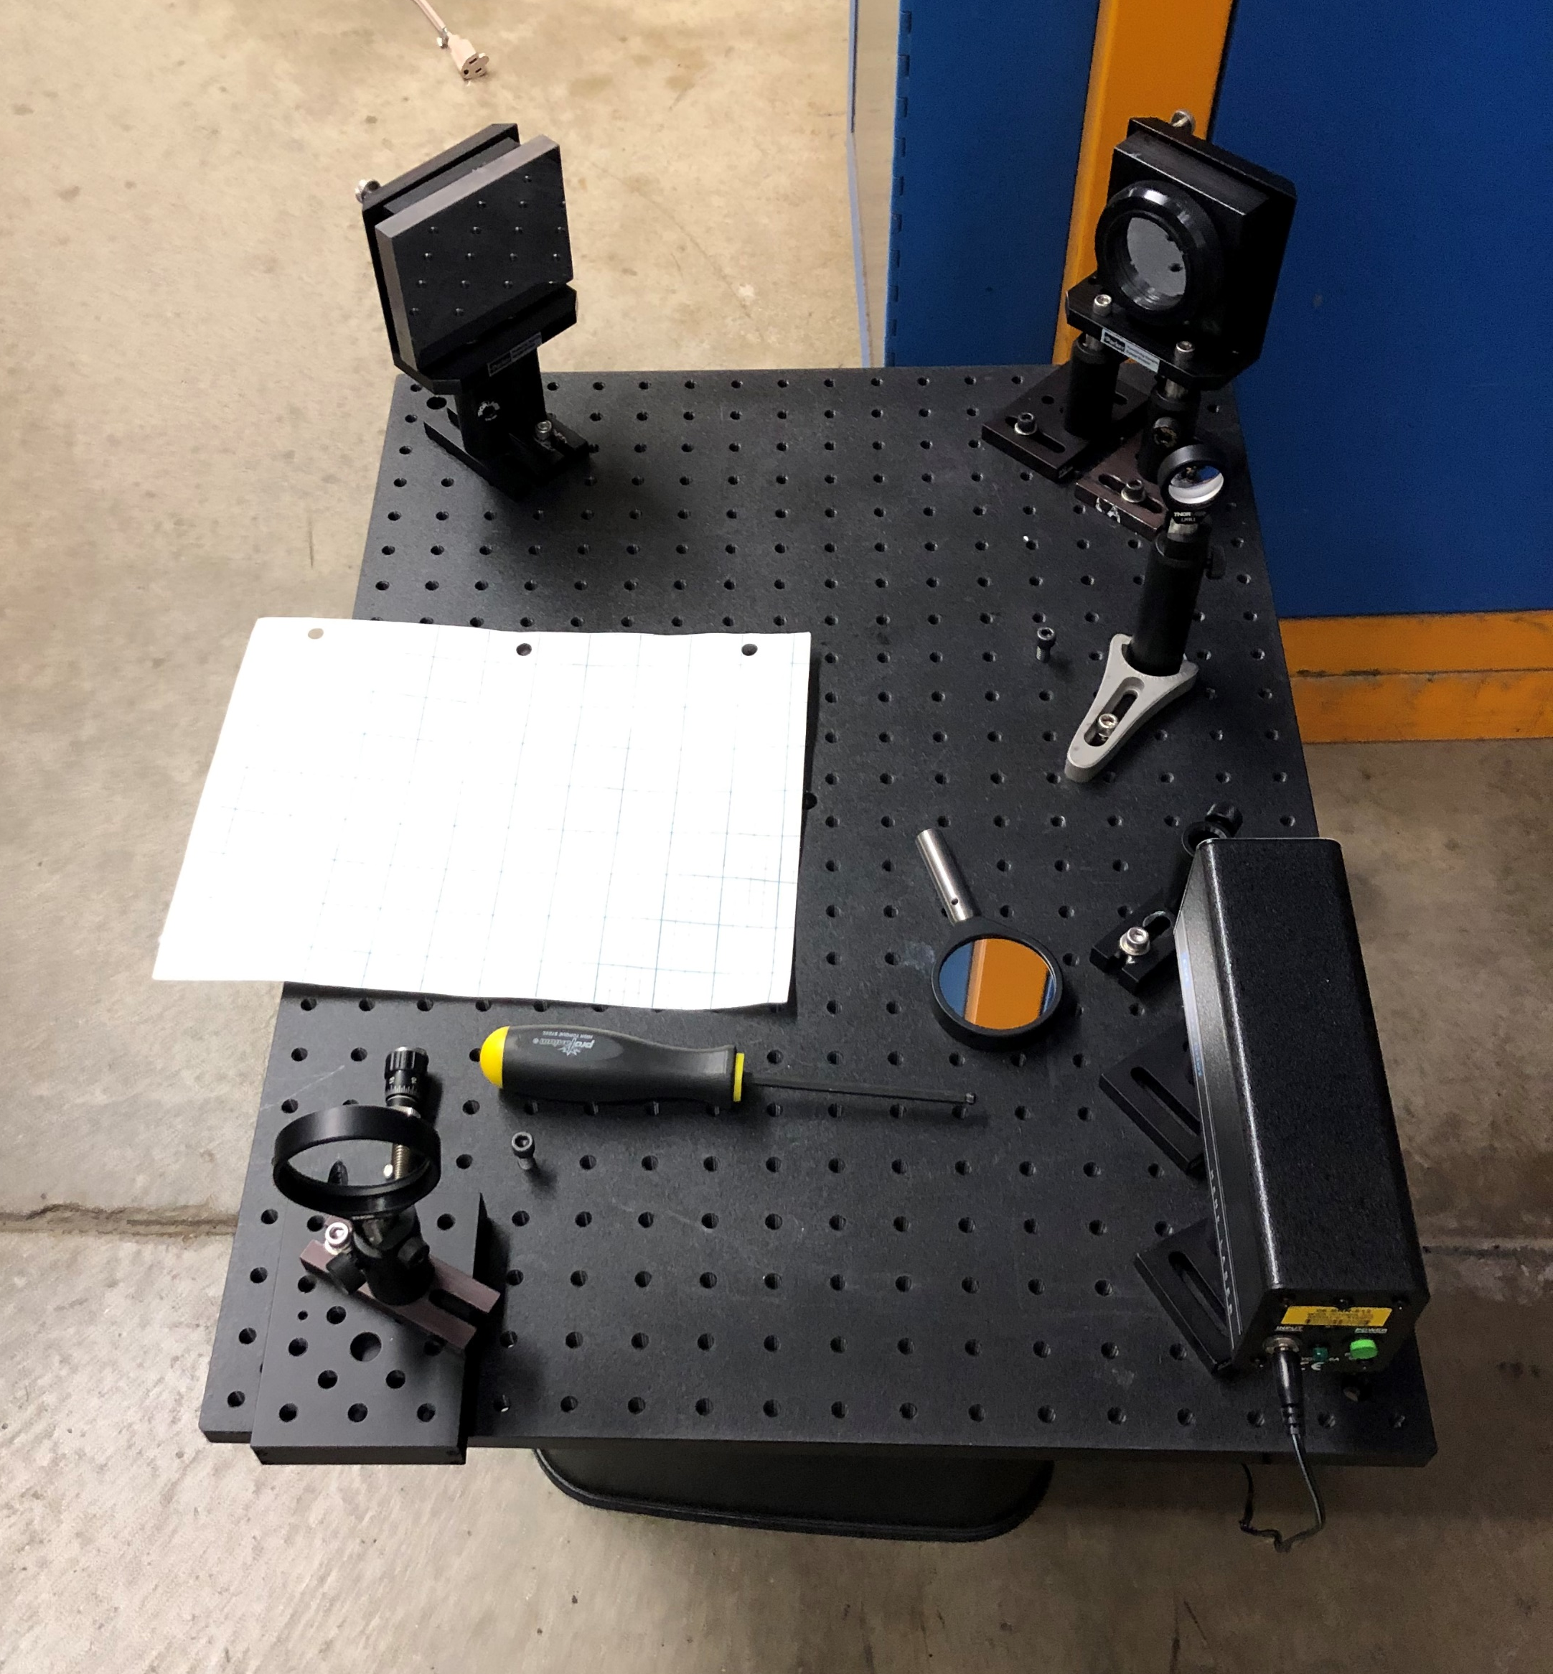
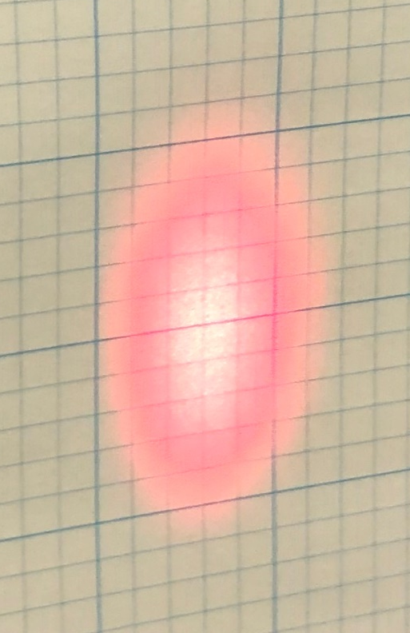
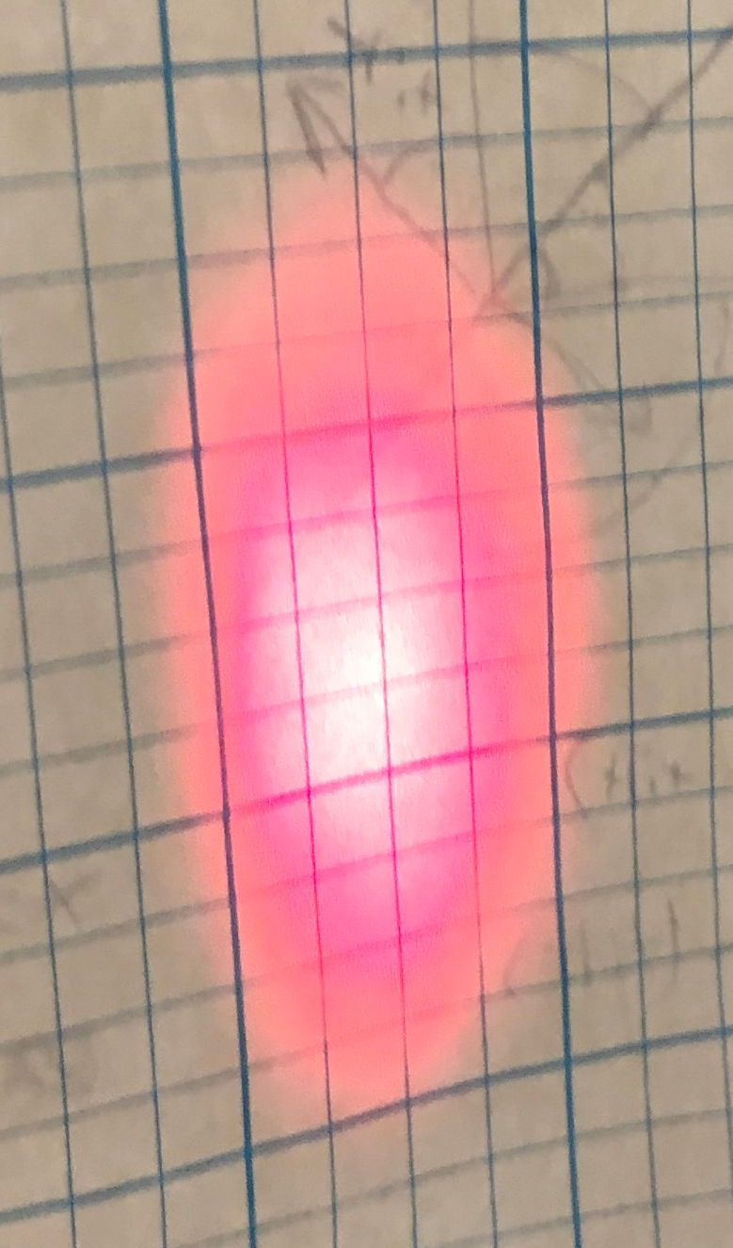
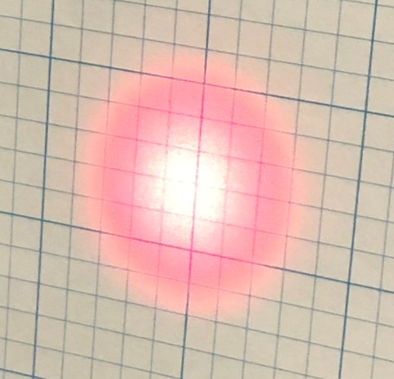
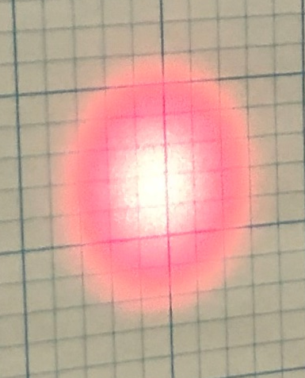
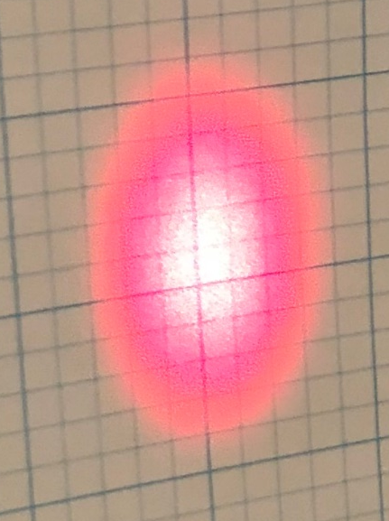
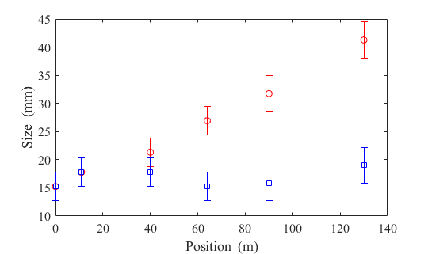
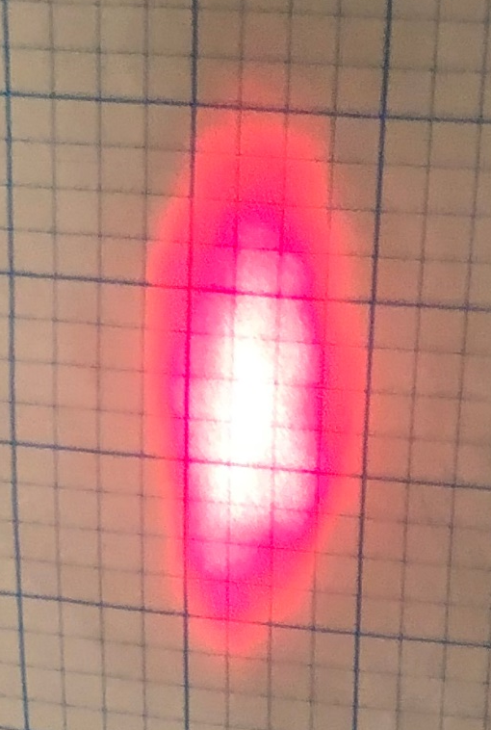
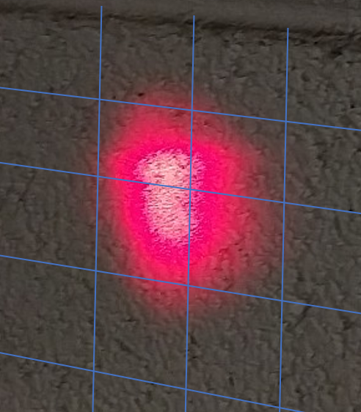
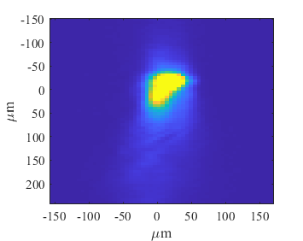
Laser Transport Optics – Test
90 m
64 m
Collimated a HeNe laser over 130 m length
11 m
40 m
Source Point
Expander Lens
1 in
Collimator Lens
130 m
Lens tilted horizontally
Vertical
Second test
Horizontal
1 in
Refocused after 117 m

Slide 20
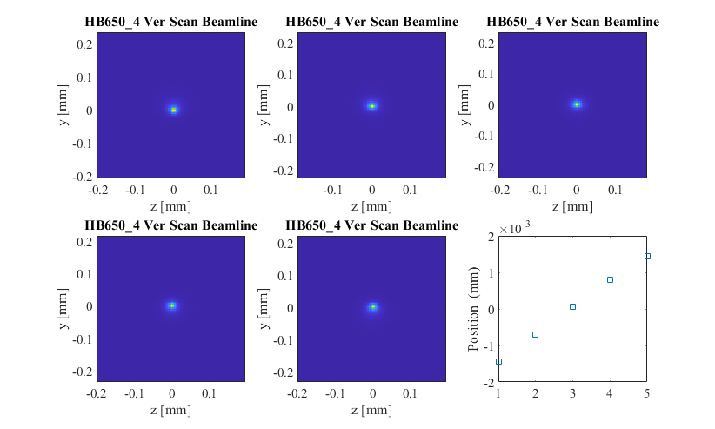
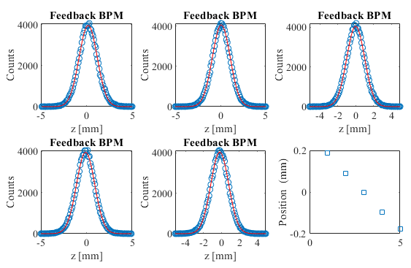
Laser Transport Optics – Feedback
Feedback will be implemented with a detector before the shield wall
  9 mm active area; sub-micron sensitivity
  Approximately 35 m from laser room
  Laser partially focused onto detector
Ray tracing simulations
  Study steering errors corresponding to deflections between +/- 6 mm
  at the end of linac
Thorlabs Lateral Effect Position Sensor
Less than 1% loss of laser beam through components
Size on feedback sensor
Position at
H- beam:
<2 μm variation
Position at feedback sensor

Slide 21
Installation and Alignment – Laser Room
Install transport pipe and mirror housing in laser room structure
Align transport pipe to nominal location relative to beam (Alignment Crew)
Install target at end of linac and align to nominal location relative to beam (Alignment Crew)
Setup laser systems on optical table
Align and focus green laser through complete transport line
Wall
Transport Pipe
Mechanical Supports
Ceiling
Mirror Housing
Ceiling
Wall
Optical Table

Slide 22
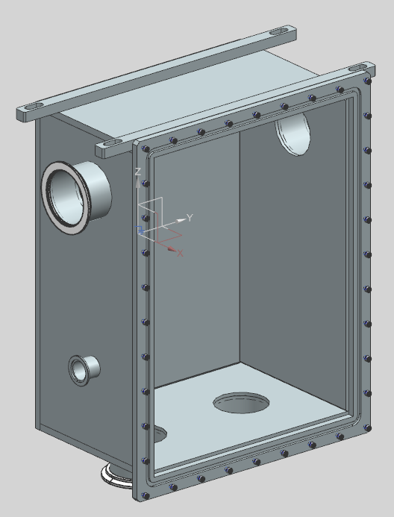
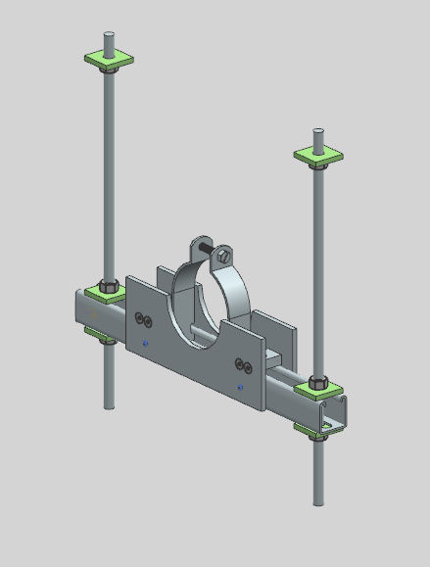
Installation and Alignment – Transport Line
Install shield wall support and align to green laser
Install feedback box and align to green laser
Install mirror boxes
  Align to nominal location relative to beam (Alignment Crew)
  Verify transverse alignment with green laser
Install pipe hangers and align to
green laser
Mirror Box
X
Alignment Laser
Target
(Second one on other side)
X
Alignment Laser
Pipe Hanger

Slide 23
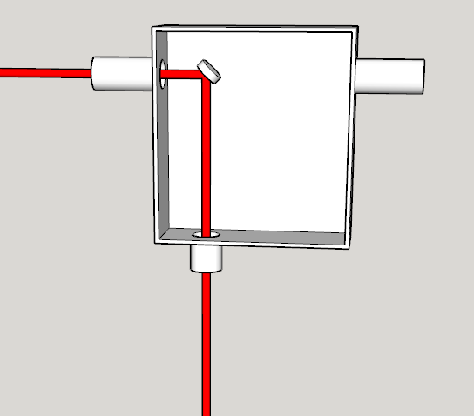
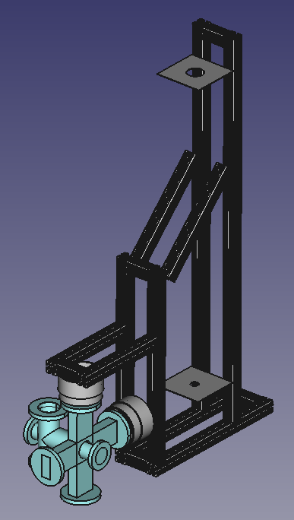
Installation and Alignment – Beamline Box Mount
Install mirror box mirror with longitudinal position adjustment
  Align mirror with alignment laser
Install beamline alignment fixture
  Designed as a sparse replica of actual beamline box
  Allows alignment without bulk of actual box
Adjust mounting to align vacuum flanges
Adjust downward alignment laser trajectory to intercept both targets
Mirror Box
Beamline Alignment Fixture
Laser Targets

Slide 24
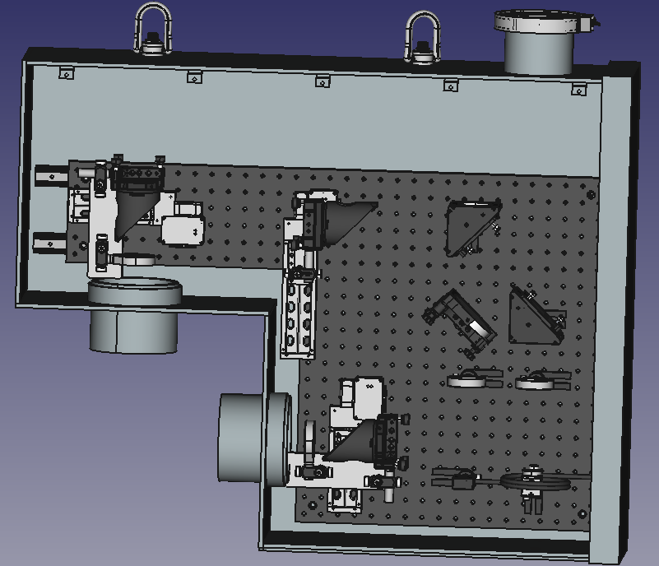
Installation and Alignment – Beamline Box Optics
Alignment of beamline box optics will happen in the laser lab
Utilizes three elements
  An alignment plate that replicates the beamline box mounting plate
  A laser aligned with the alignment plate to replicate the trajectory from the mirror box
  A target also aligned with the alignment plate and positioned at the design location of the beamline
The aligned optics box can then be mounted on the beamline box mount
Alignment Laser
X
Alignment Plate
Laser Target

Slide 25
Summary
Have a design for the transport optics
  Have considered control of the laser
  Have tested the transport over 130 m
Have a procedure for alignment of laser transport and beamline optics
  Transport alignment is coincident with installation of transport line
  Beamline box mounting alignment is done after installation of warm units
  Beamline box optics alignment is done in laser room

Slide 26
Backup Slides

Slide 27
Laserwire Locations
Twelve + one laserwire stations in the PIP2 Linac proper (last not shown below)
The laser room is upstream of the H- source which is at 0 m

Slide 28
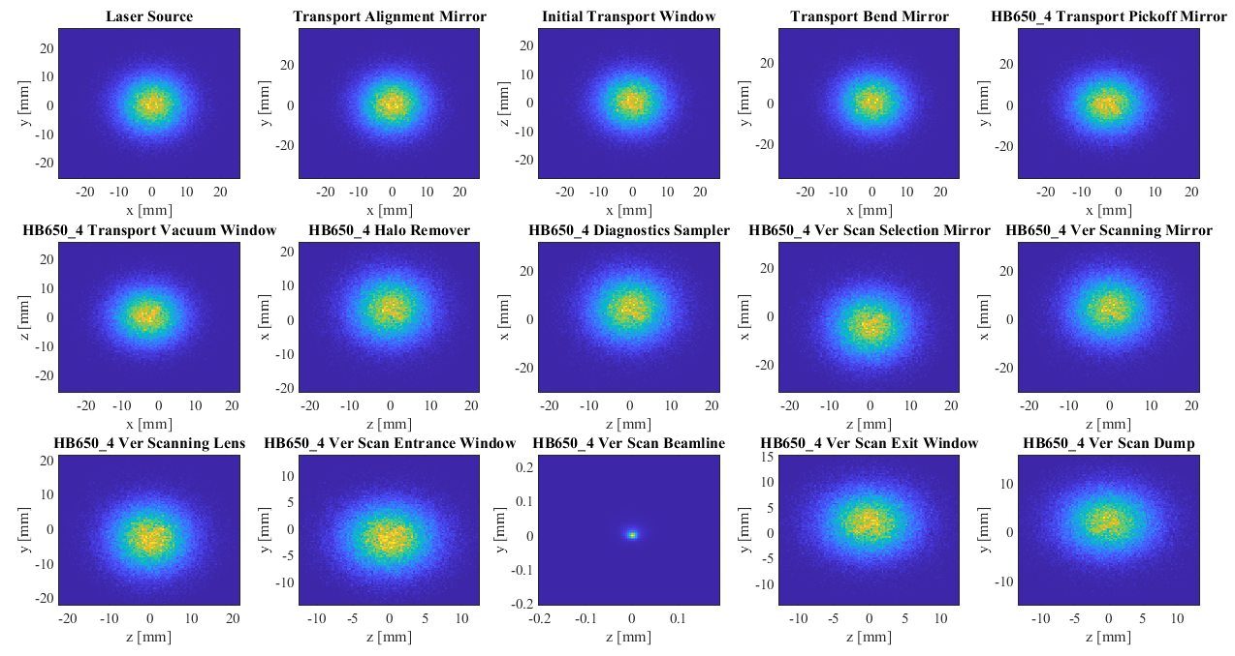
Laser Transport Optics – Feedback
Steering error in x

Slide 29
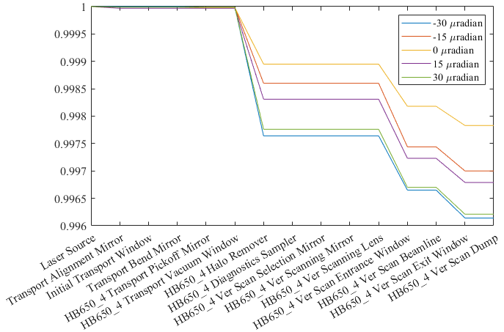
Laser Transport Optics – Feedback
Geometric Acceptance
Loss of laser beam from steering errors

