Slide 1
Signal Performance
Sajini Wijethunga and Randy Thurman-Keup
PIP2 Laserwire Final Design Review
May 2, 2024

Slide 2
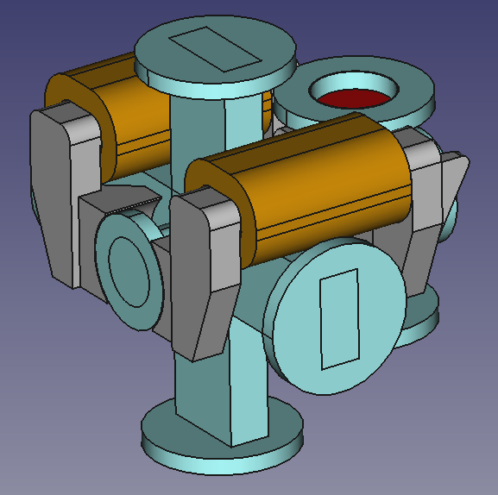
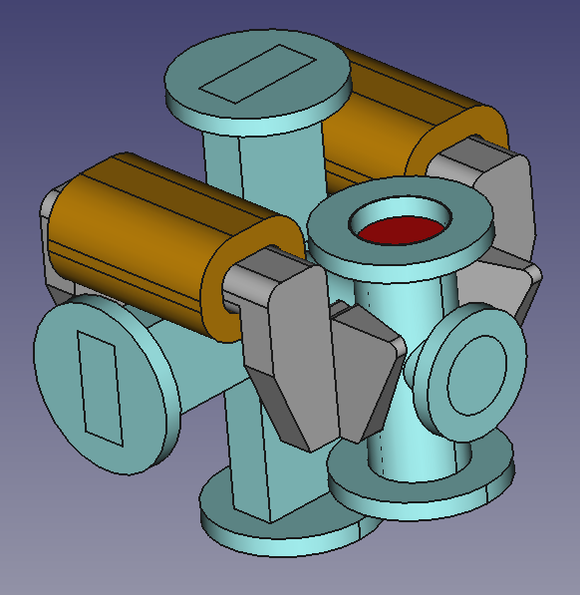
Signal Collection
Stripped electrons are bent by magnetic field and ‘collected’ by faraday cup
Magnet has two pole pairs
  One downstream to collect the electrons
  One upstream to correct the field for the H- beam
Magnet
Laser
Laser
Faraday Cup
H- Beam
H- Beam
Laser
Laser

Slide 3
Simulations
We have used a mix of Matlab, CST, and GEANT4 to accomplish most of the simulation features needed
H- Stripping calculation (Matlab)
  Overlaps the laser with the H- beam
    Laser and H- beam are fully specified in 6-d phase space (some constraints with laser)
  Time evolution of stripping within fixed voxel space around interaction region
    Depletion of H- beam is included
      Laser is not depleted as laser has significantly higher density than H- beam
  Stripping cross section used in each voxel
    Number of stripped electrons in each voxel at each time step are stored
Stripped electron tracking (Matlab + CST)
  Full relativistic 3-d tracking of particles in arbitrary E and B fields using adaptive 4th order Runge-Kutta solver
  E and B fields of H- bunch generated separately and given time dependence during tracking
    No transverse motion of bunch
  E and B fields of external sources typically generated with CST model
Tracking to and through faraday cup with GEANT4 to determine impacts to the signal such as secondary emission and backscattering of the primary electrons

Slide 4
Electron Generation
Particles generated via Matlab code and tracked via Matlab code through the CST-generated magnetic field
Simulated Stripping
Generated Electron Distributions
(taken from H- distributions)

Slide 5
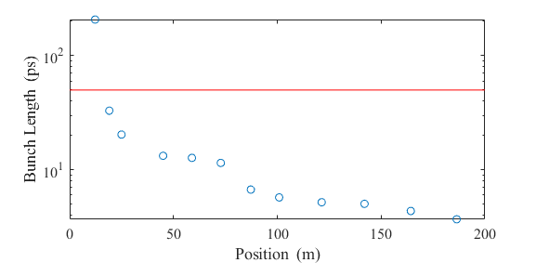
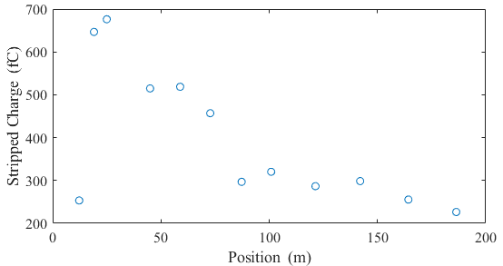
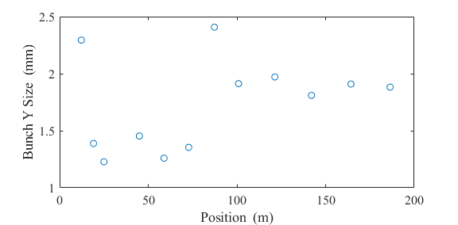
Electron Generation
Stripped charge is function of time and space overlap of laser and bunch
  Laser pulse length is 50 ps rms (this simulation)
  Bunch length goes from 200 ps to 5 ps rms
Here are plots of signal for each laserwire with laser along X and relevant bunch sizes
Laser Pulse Length
Laser pulse length can be optimized for each position
Single Pulse
Decrease dominated by bunch/laser length mismatch

Slide 6
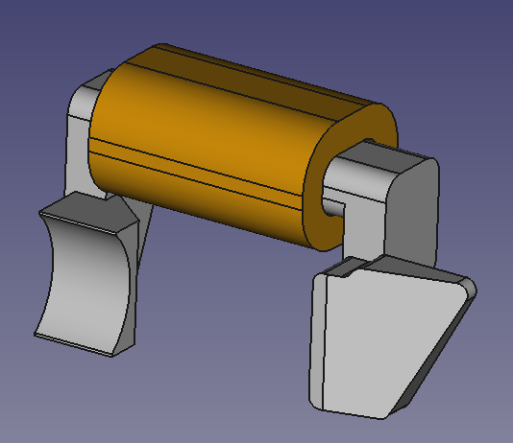
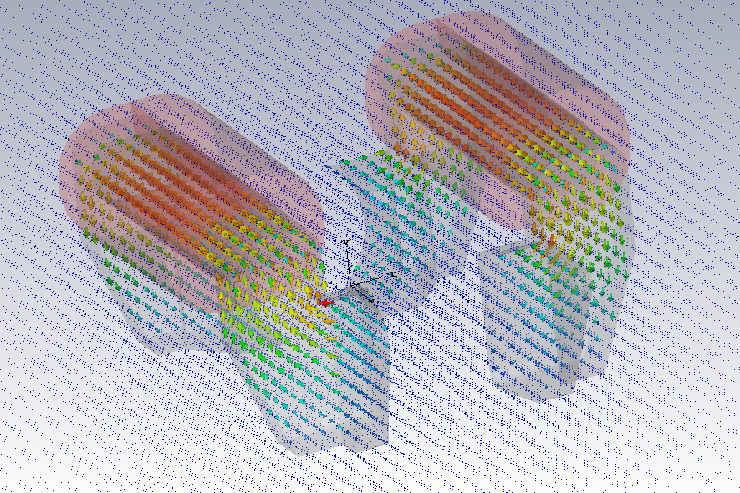
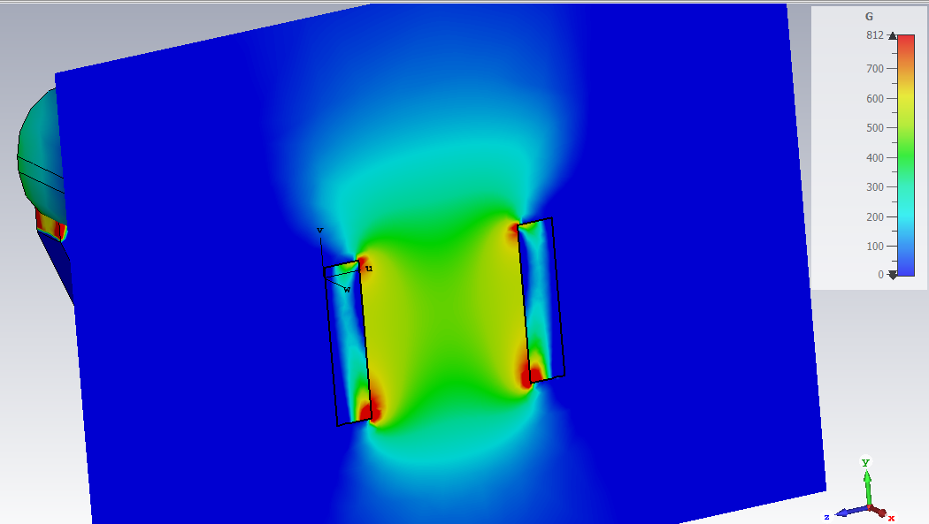
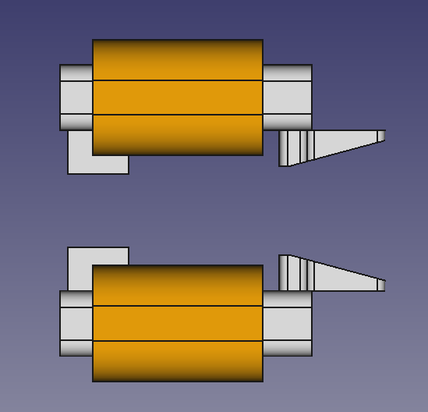
Magnet Design
Magnet was modeled in CST
Angled pole pieces intended to produce quadrupole field to keep electrons from spreading transversely
Angled Poles
Gauss
800
0

Slide 7
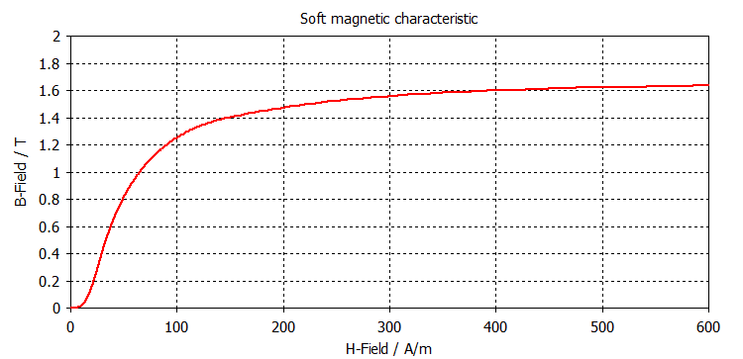
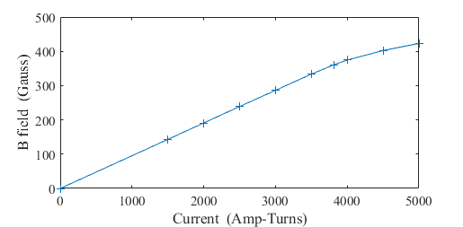
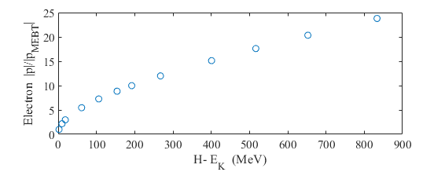
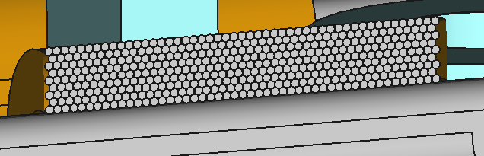
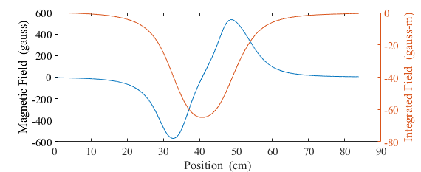
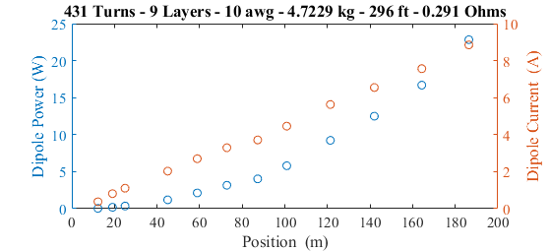
Magnet Design
Maximize field (avoiding saturation)
Minimize current (and thus heating)
Fit in available space
Provide correction field for H-
End of Linac
Saturation
-0.56 g-m

Slide 8
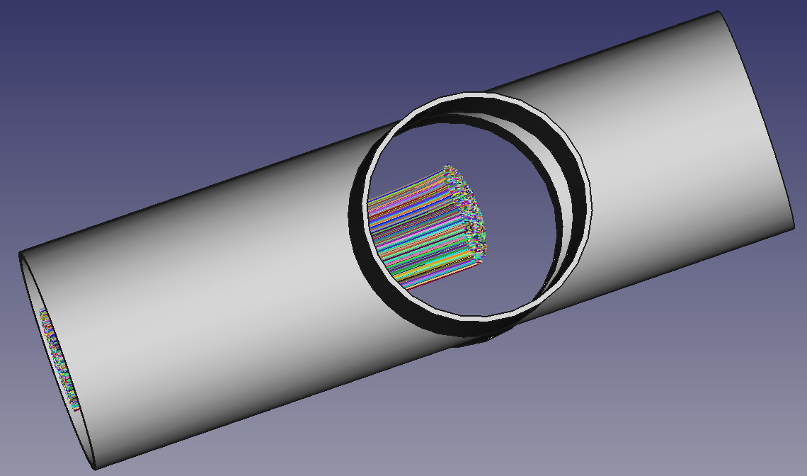
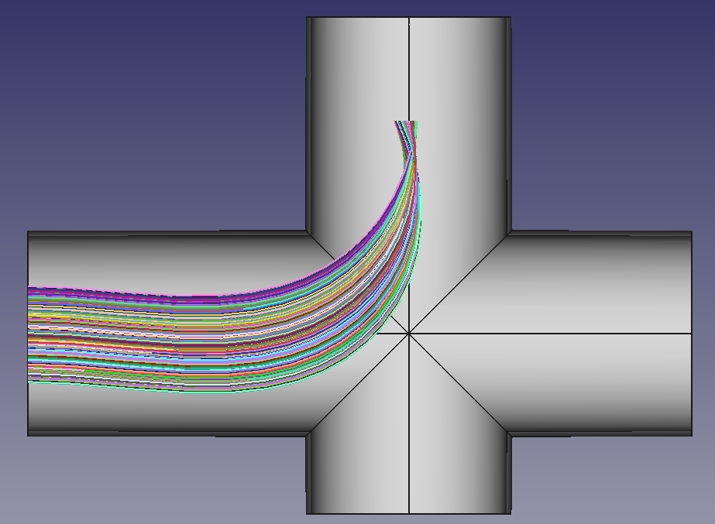
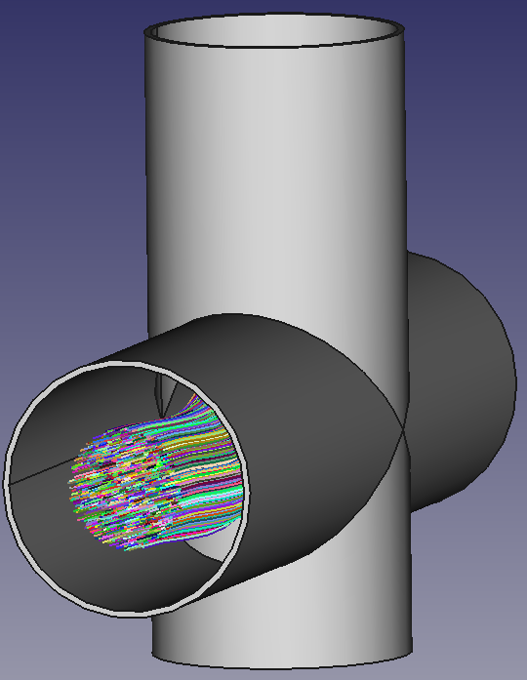
Electron Trajectories
Check for clearance throughout design range of laserwire = ±15 mm
End of Linac: HB650-4
Faraday Cup Region
0.421 in
Faraday Cup View
Stripping Point

Slide 9
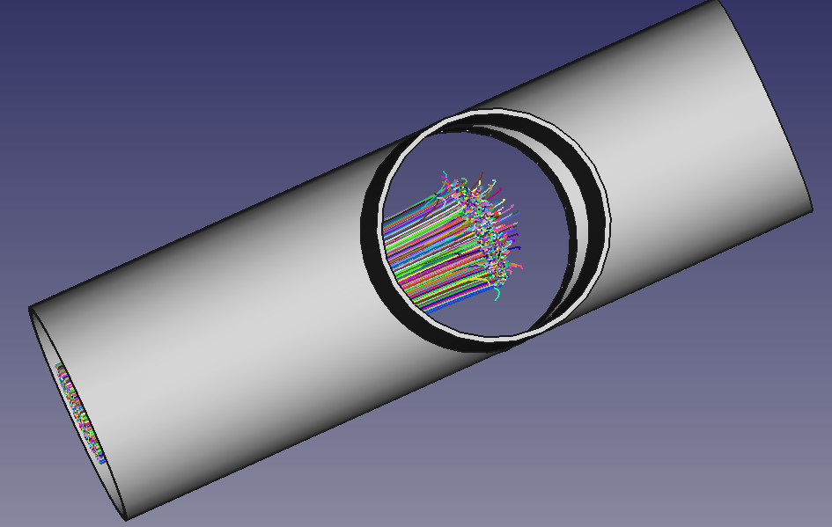
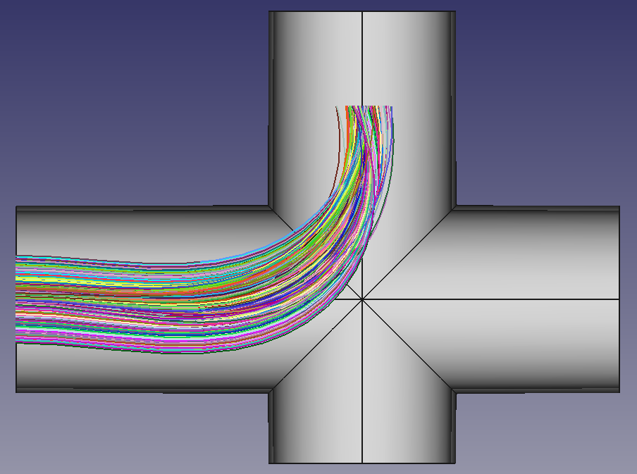
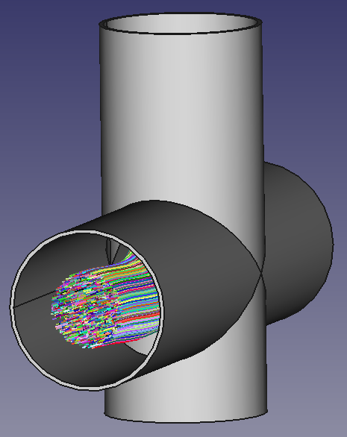
Electron Trajectories
Check for clearance throughout design range of laserwire = ±15 mm
After HWR (first cryomodule)
Faraday Cup Region
0.387 in
Faraday Cup View
Stripping Point

Slide 10
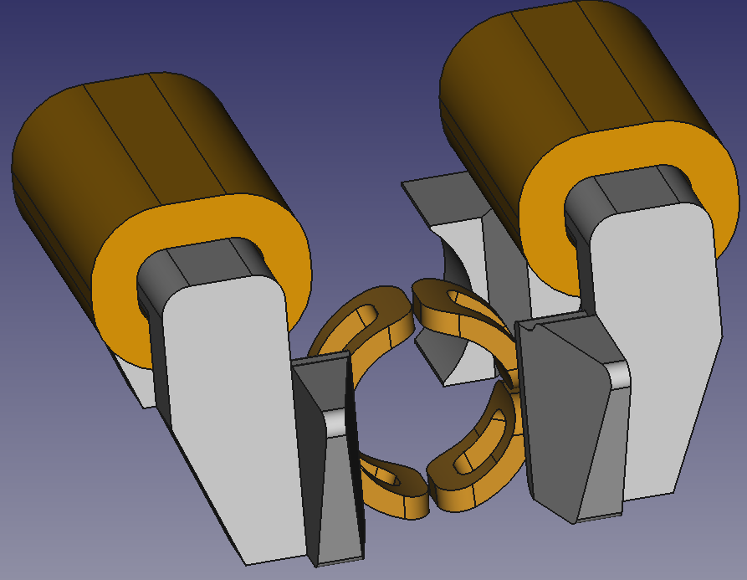
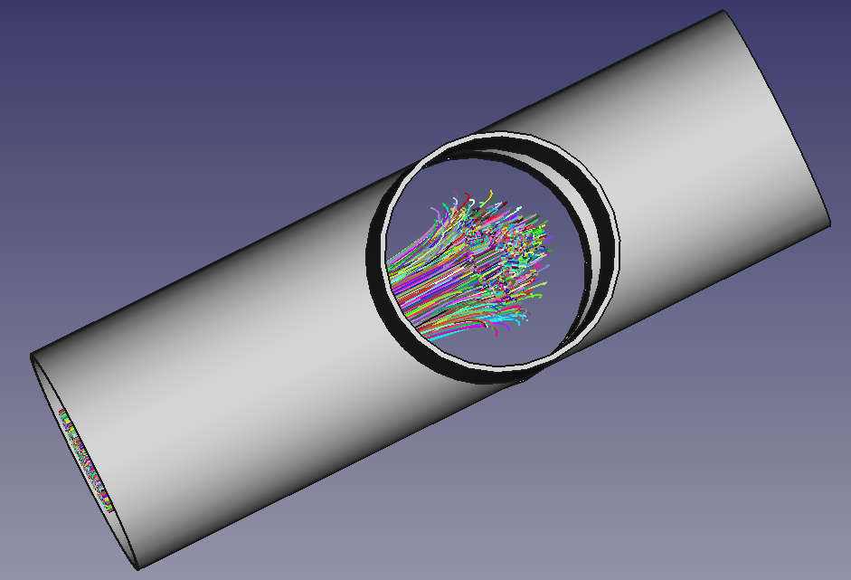
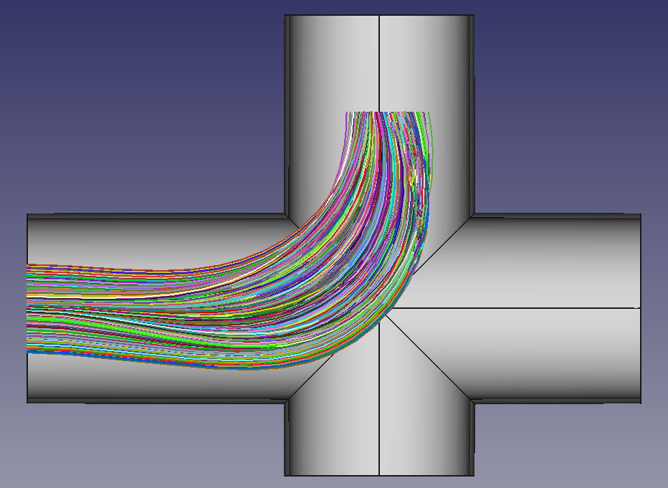
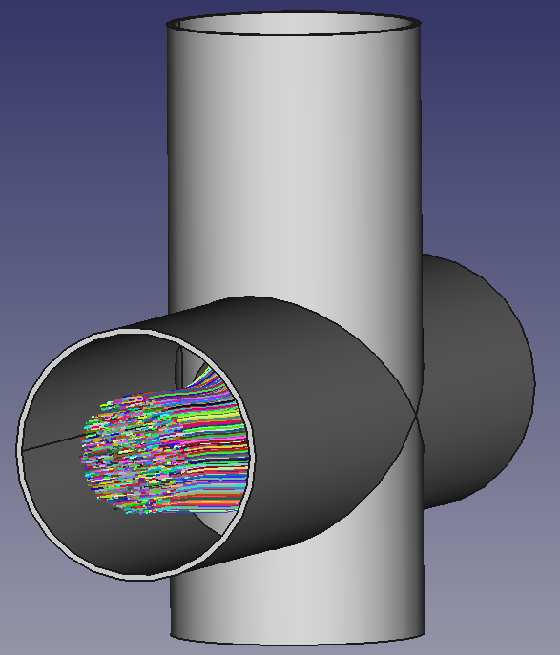
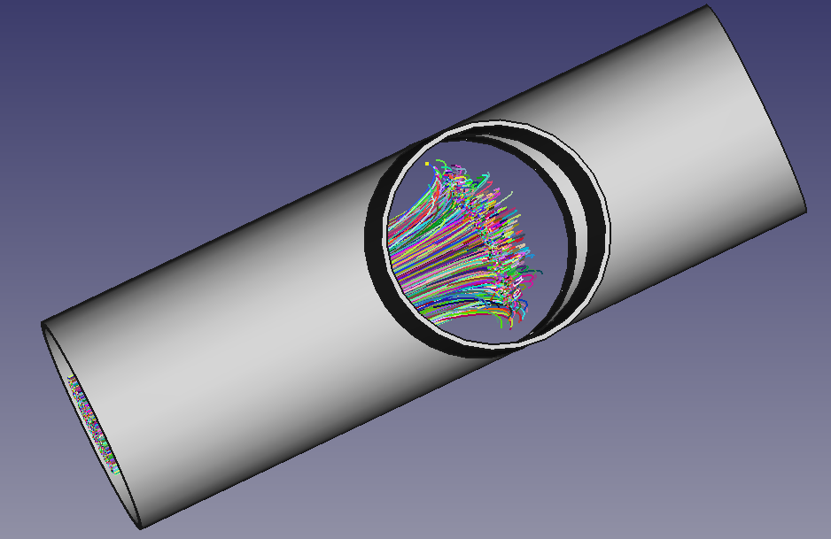
Electron Trajectories
Check for clearance throughout design range of laserwire = ±15 mm
MEBT with additional Quadrupole (not yet in CAD model)
Quad Power Requirements:
1.5 A and 0.04 W
Faraday Cup Region
Faraday Cup View
0.205 in
Without Quad
Larger Spread from H- Space Charge
Stripping Point

Slide 11
FARADAY CUP STUDIES

Slide 12
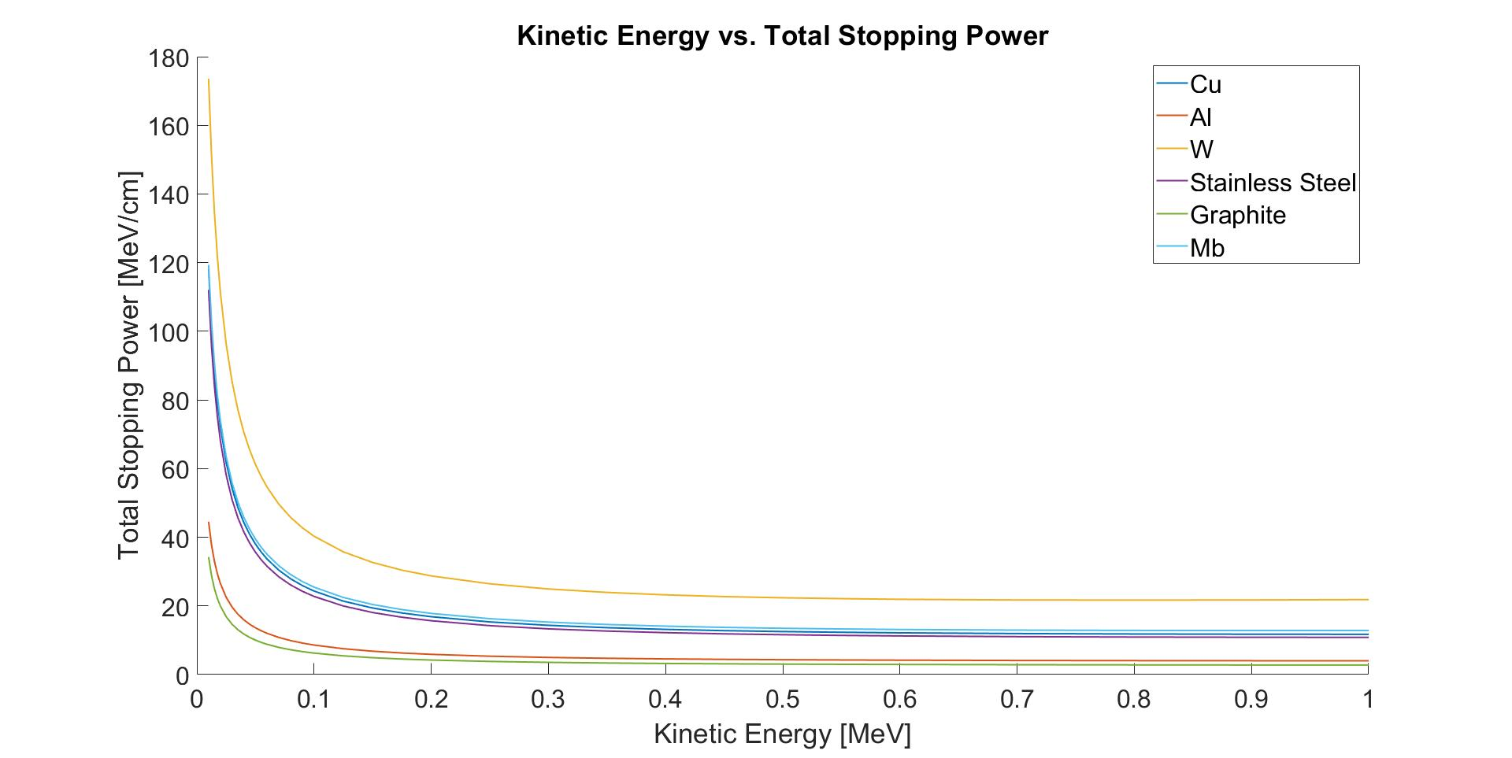
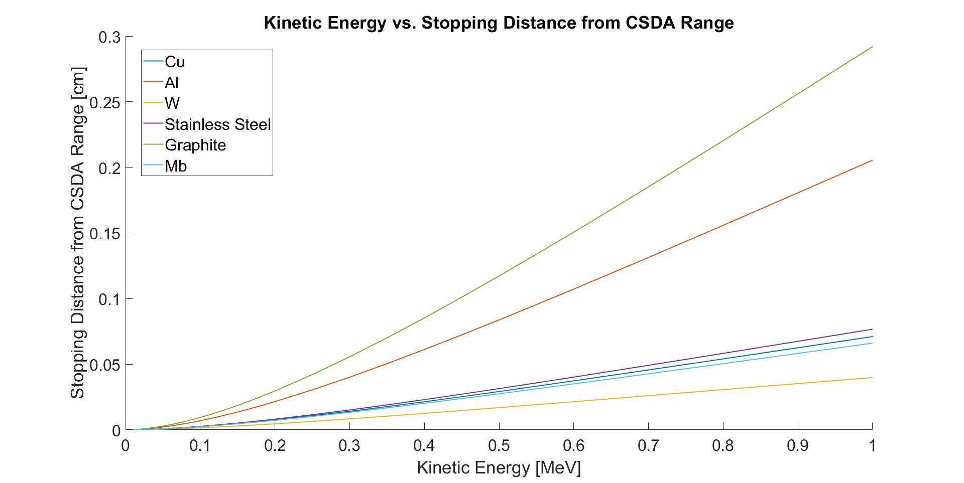


Electron Tracking
H⁻ beam energy at 1st laser wire scanner ~ 2.1 MeV, γ = 1.00226 E_{k} of the releasing electrons $≈$ 1 keV
H⁻ beam energy at last laser wire scanner ~ 800 MeV, γ = 1.8868 E_{k} of the releasing electrons $≈$ 450 keV
E_{k} at 800 MeV $≈$ 450 keV
E_{k} at 800 MeV $≈$ 450 keV
At E_{k} = 450 keV, the electron stopping distance for Stainless steel is ~ 0.25 mm.

Slide 13
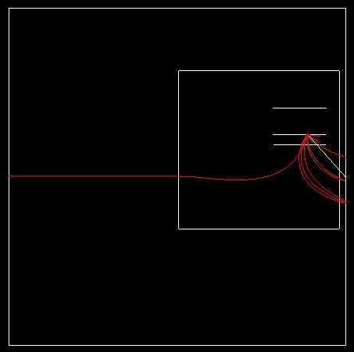
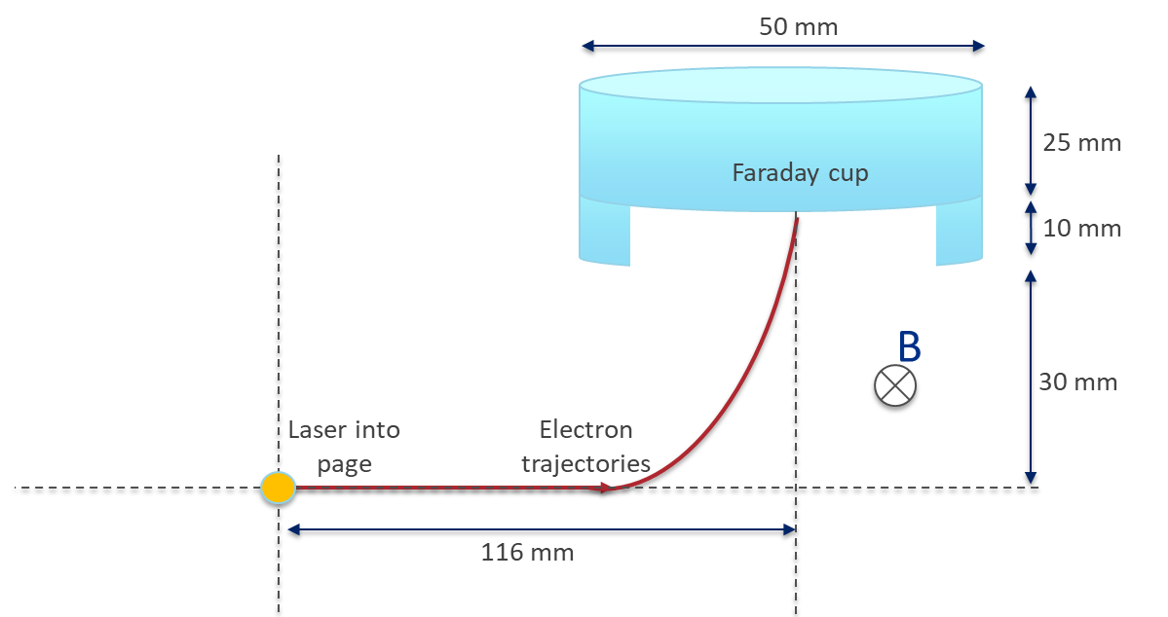
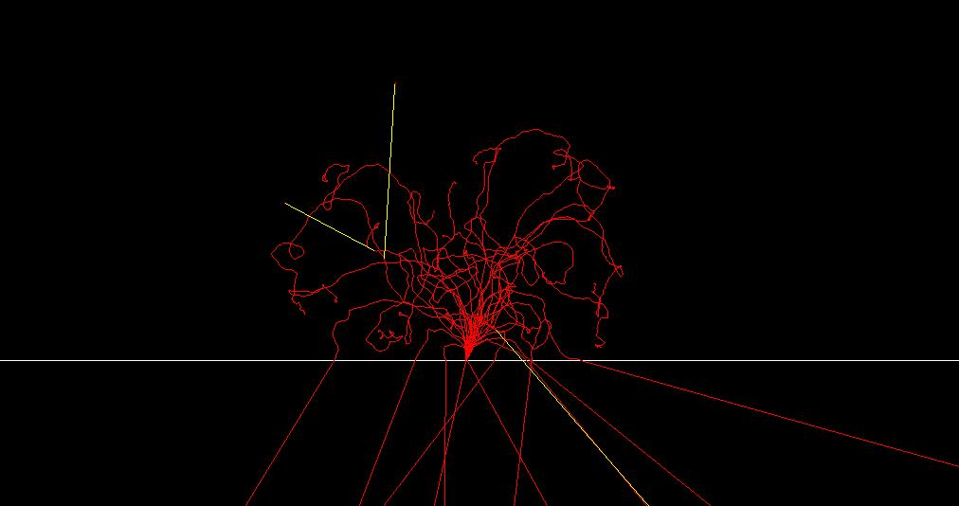
Geant4: Advanced Monte Carlo Simulation Toolkit
Geant4 is an object-oriented toolkit designed for simulating the complex interactions of particles with matter
It offers a wide range of physics models organized into physics lists
For electromagnetic (EM) physics, it supports both standard EM processes (above 1 keV) and low-energy EM processes (down to ~250 eV for electrons and gamma rays)
This study utilizes “G4EmStandardPhysics_option4,” which incorporates a comprehensive set of models for key interactions such as bremsstrahlung, pair production, Compton scattering, and ionization
This option strikes a balance between precision and computational efficiency
Stainless steel cup,
450 keV, 30 electrons
Magnetic field area
Faraday cup
Red - electrons
Yellow - gamma
Particle track inside the material
y
x
z

Slide 14
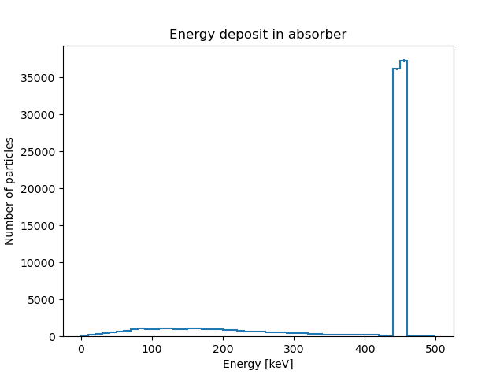
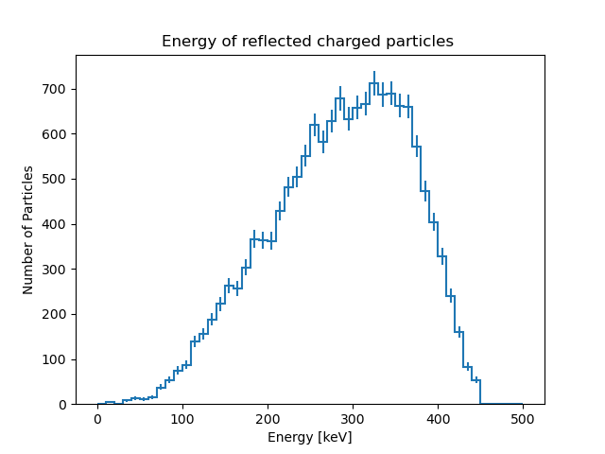
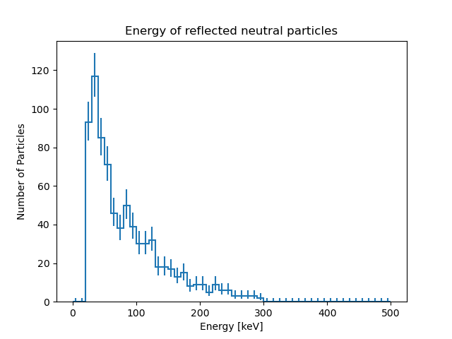
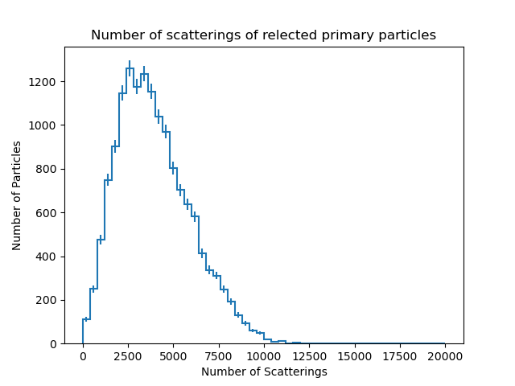
Electron Tracking for 450 keV electrons
Impacted
Reflected
Entries 15060
Mean 284.5
Std Dev 81.13
Entries 778
Mean 84.75
Std Dev 59.06
Entries 100000
Mean 378.2
Std Dev 129.3
Entries 15060
Mean 3950
Std Dev 1999
All the reflected particles are primary particles
Backscattering coefficient is ~15%
All the particles were impacted
None of the particles transmitted through the cup

Slide 15
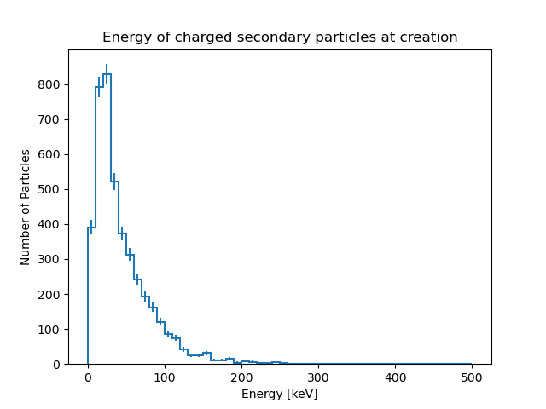
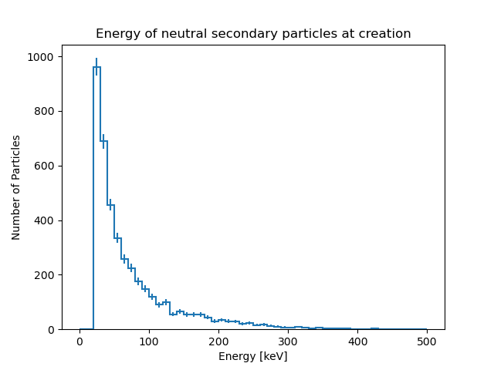
Electron Tracking for 450 keV electrons
Entries 4279
Mean 44.43
Std Dev 37.98
Entries 4151
Mean 73.11
Std Dev 62.28

Slide 16
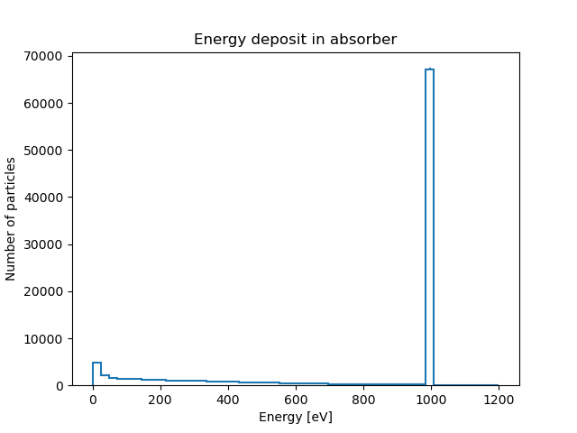
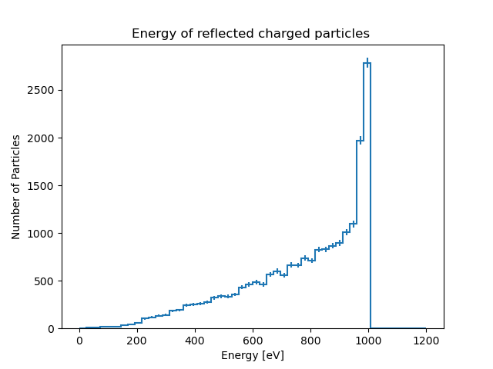
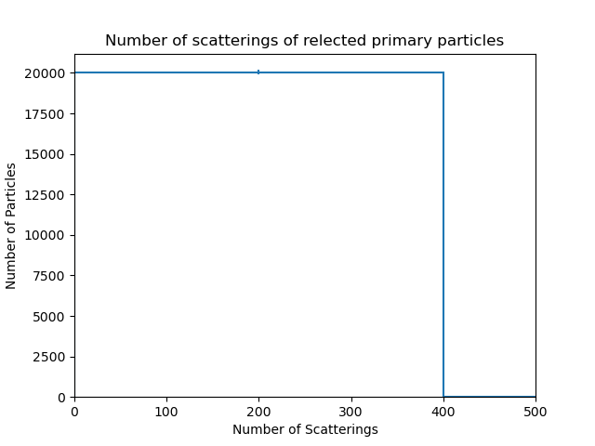
Electron Tracking for 1 keV electrons
Impacted
Reflected
Entries 20045
Mean 768.7
Std Dev 210.1
All the reflected particles are primary particles
Backscattering coefficient is ~20%
None of the neutral particles got reflected
Entries 99543
Mean 767.2
Std Dev 365.2
None of the particles transmitted through the cup
No secondary particles created
Entries 20045
Mean 14.91
Std Dev 11.75

Slide 17
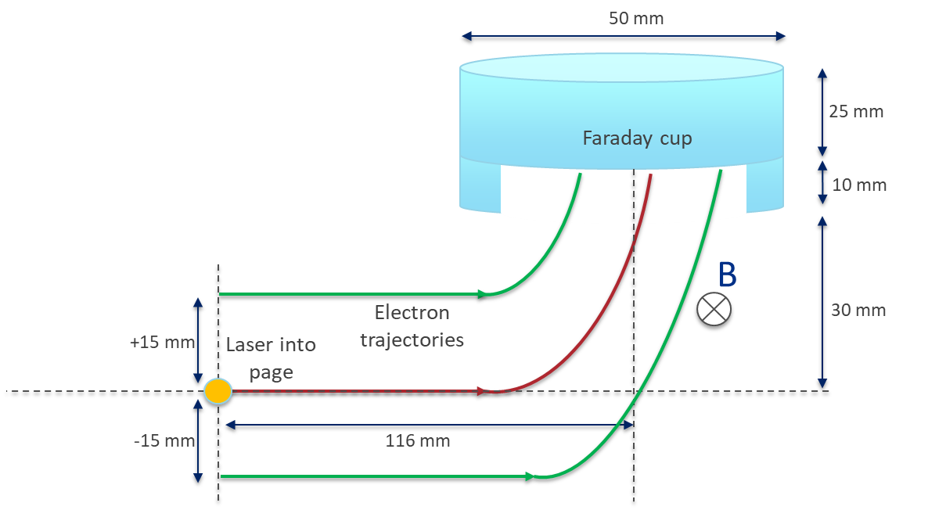
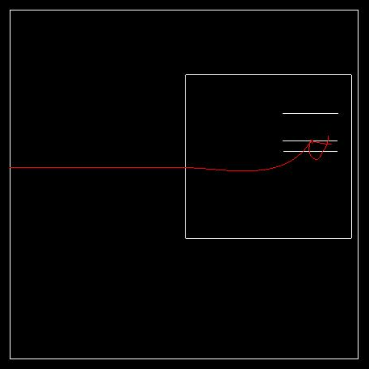
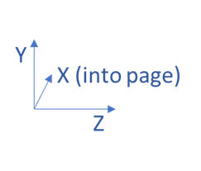
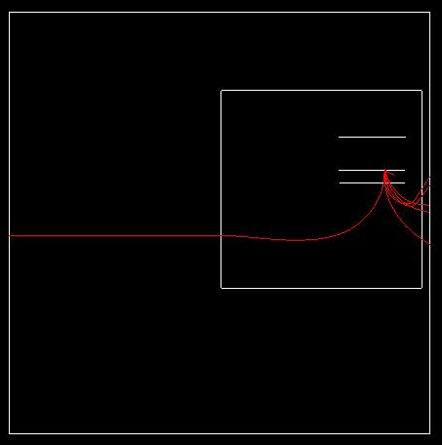
Electron Tracking
450 keV 30 electrons starting at y = +15 mm
Electron collection efficiency across the Faraday cup
y
x
z
Electron beam position [mm] | 450 keV |  | 1 keV
Location [mm] | Impacted [%] | Reflected [%] | Impacted [%] | Reflected [%]
-7.5 | 100 | 15.58±2.53 | 99.49 | 21.08±2.18
-5 | 100 | 14.98±2.58 | 99.48 | 20.47±2.21
-2.5 | 100 | 14.98±2.58 | 99.47 | 19.86±2.24
0 | 100 | 14.88±2.59 | 99.46 | 19.47±2.27
+2.5 | 100 | 14.63±2.61 | 99.58 | 19.10±2.28
+5 | 100 | 14.76±2.60 | 99.65 | 19.39±2.27
+7.5 | 100 | 14.58±2.62 | 99.65 | 18.78±2.31
+10 | 100 | 14.61±2.62 | 99.56 | 17.96±2.36
+12.5 | 100 | 14.72±2.63 | 99.66 | 17.88±2.36
+15 | 100 | 14.77±2.60 | 99.58 | 16.74±2.44
450 keV 30 electrons starting at y = -7.5 mm

Slide 18
Summary
We have simulated the generation and collection of electrons using multiple simulation techniques
Under various space constraints, we have attempted to optimize the vacuum chamber and the magnets to intercept all the electrons over a transverse laser interaction range of ±15 mm
We are utilizing GEANT4 to determine the collection efficiency of the intercepted electrons as a function of energy and source position

Slide 19
Backup Slides

Slide 20
Laserwire Locations
Twelve + one laserwire stations in the PIP2 Linac proper (last not shown below)
The laser room is upstream of the H- source which is at 0 m

Slide 21
Electron Generation
PIP2IT vs PIP2
Total # of stripped electrons = 7.699607e+02
Fraction of stripped electrons = 4.0092e-06
Energy/bunch @ lens (CW / Beam On / Single Pulse / Single Bunch) = 0.57693 / 5.7693e-05 / 2.8847e-06 / 3.5503e-09 J/cm^2
Energy/bunch @ window (CW / Beam On / Single Pulse / Single Bunch) = 2.3077 / 0.00023077 / 1.1539e-05 / 1.4201e-08 J/cm^2
Total # of stripped electrons = 1.415507e+06
Fraction of stripped electrons = 0.0073707
Energy/bunch @ lens (CW / Beam On / Single Pulse / Single Bunch) = 9457.882 / 0.94579 / 0.047289 / 5.8202e-05 J/cm^2
Energy/bunch @ window (CW / Beam On / Single Pulse / Single Bunch) = 37831.4297 / 3.7831 / 0.18916 / 0.00023281 J/cm^2

Slide 22
Electron Generation

