Slide 1
Cost and Schedule
D. Sherese Humphrey
PIP-II Beam Instrumentation Laser Wire Final Design Review
May 2, 2024

Slide 2
Contents
Schedule
Cost
Labor
Procurement
Summary

Slide 3
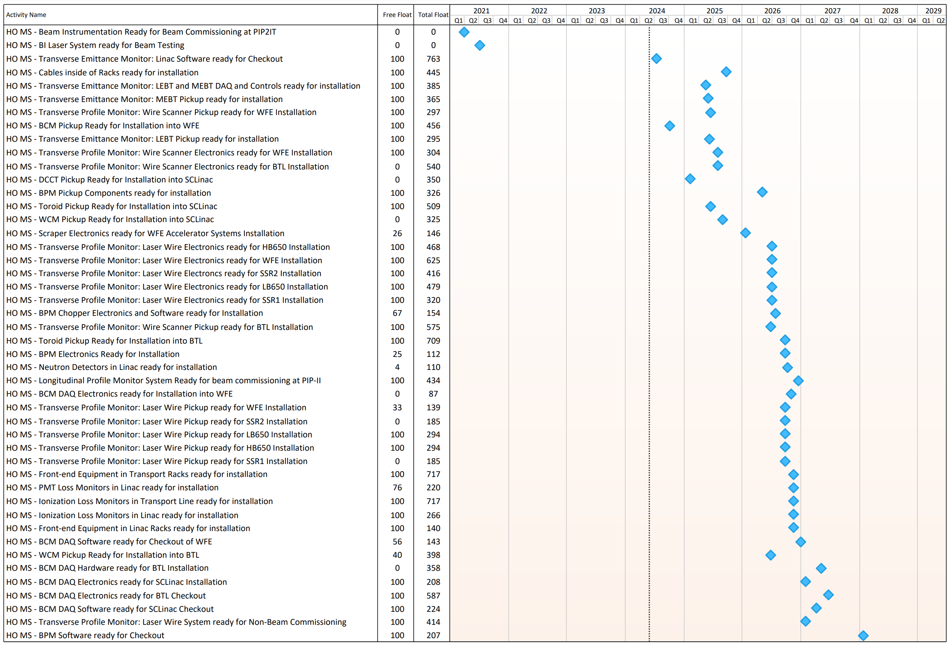
Summary Schedule
We have sufficient total float to accomplish milestones associated with the laser wire scope.

Slide 4
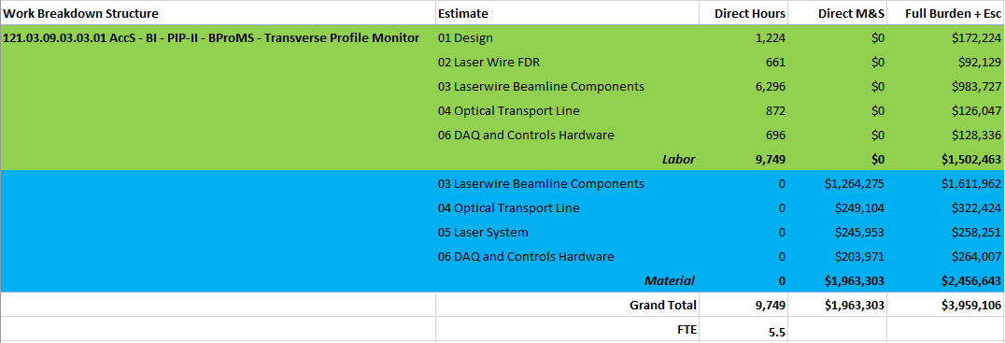
Cost
Materials
Labor

Slide 5
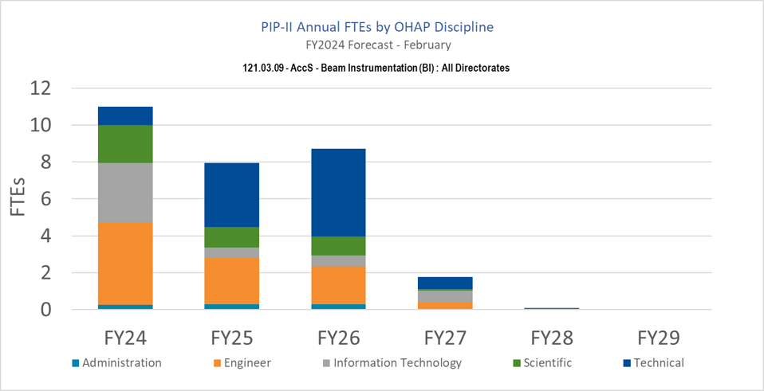
Resources
Laser Wire effort of order 5.5 FTE
Technical demand rises to build production units
Resource demand drop with handoff to installation and commissioning with beam
Still have BI personnel working under installation and commissioning
Resources needs identified in P6
Actively recruiting new hires
Engineering physicist hired in 2023
Two electrical engineers hired in 2023
Two electrical engineers lost in the past year
Part-time technicians coming from College Of DuPage
DOE funding agreement
Coordinating with directorate for additional personnel
Total PIP-II Beam Instrumentation Staffing Plan

Slide 6
Laser Wire Procurement Planning
Laser Wire Beamline Hardware
1st Units for Vacuum, Optical Components, and Stand
Remaining production ordering will occur post-first units assembly and evaluation
Orders from a single vendor exceeding $250K will require Procurement Readiness Review (PRR)
Bundled Procurements (primarily <$250K)
Optical Transport Line
Laser System
DAQ and Controls Hardware
Assembly and Testing will be performed in-house

Slide 7
Summary
Overall scheme, scope of work is $4M
Labor and M&S budget identified, working against this plan
Labor estimates will be reassessed to ensure staffing plans remain adequate
Bulk of cost is M&S
Work expected to be completed well before needed

