Slide 1
IOTA Proton Injector Update
Dean (Chip) Edstrom
07/21/2023

Slide 2
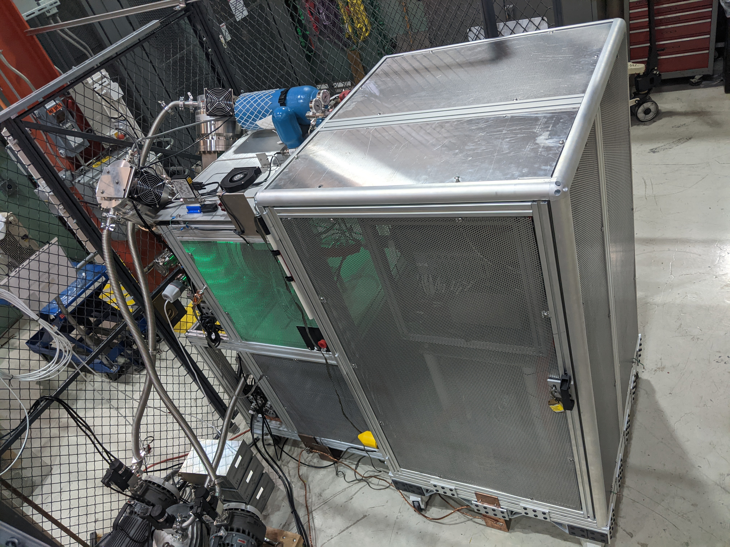
IPI Project Schedule
Action Items:
Source HV Testing (ORC-2176)
Began HV testing… Continuing
Hydrogen Distribution Checkout
HV Enclosure Control Checkout to follow
Mechanical Engineering
Engineering Notes: Steve Wesseln finalizing MEBT stand configuration
15-Deg Bend Chamber Req 346933 – No movement in purchasing…
Cable Pull / 600A Disconnect
Any Update?
24-Conductor cable backorder extended to Late August at earliest (!!)
Abandoning this and adjusting the cable pull to include more 10-Conductor runs.

Slide 3
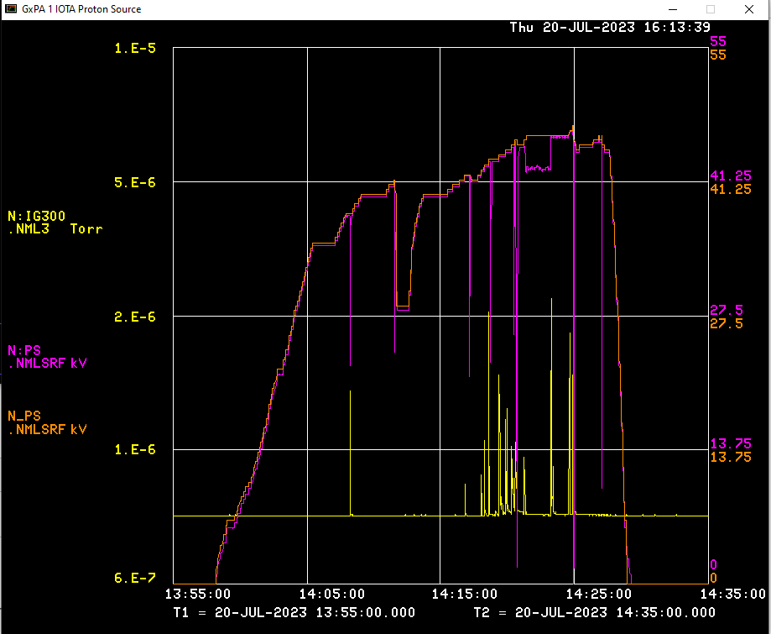
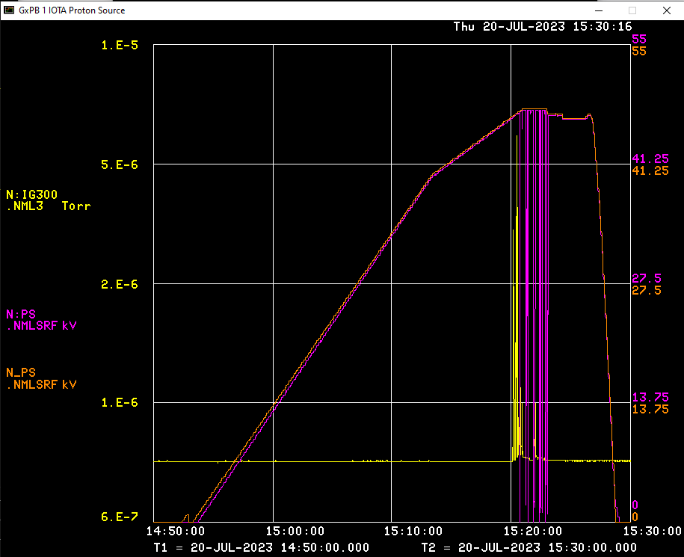
Source HV Test – ORC 2176
Initial attempt (7/19) ran into the Paschen curve
Arcing at 2 kV through the evacuated Hydrogen Distribution stand-off
Closed the bypass, let the distribution up to Atm, and ran to 5 kV
Next attempt (7/20) – 41kV max
Arcing from extraction anode corona suppressor contact to the source stand
Adjusted positioning from 8:00 to 10:00 position to maximize the gap
Latest attempt (7/20) – 47kV max
Persistent arcing found in the contactor section
Suggests failed cable insulation… Re-termination is the likely fix.

