Slide 1
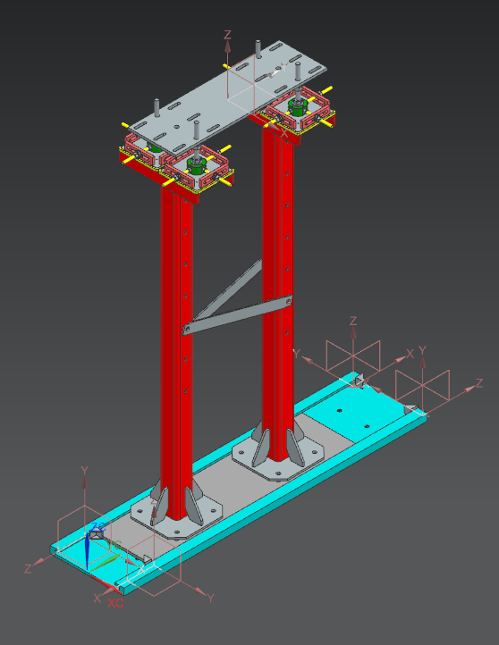
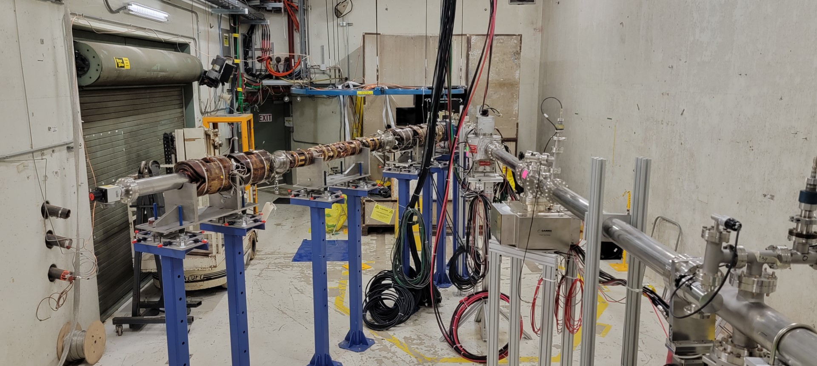
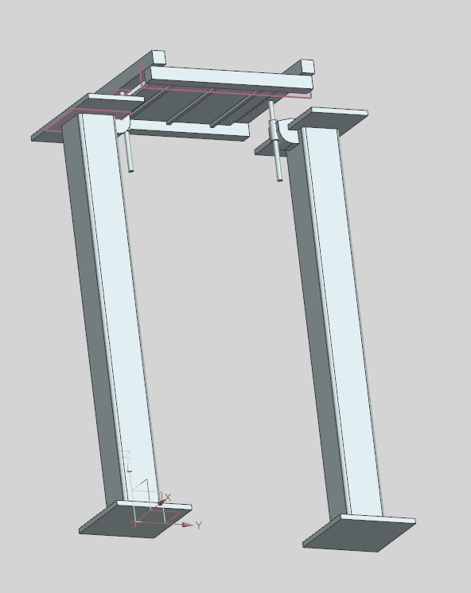
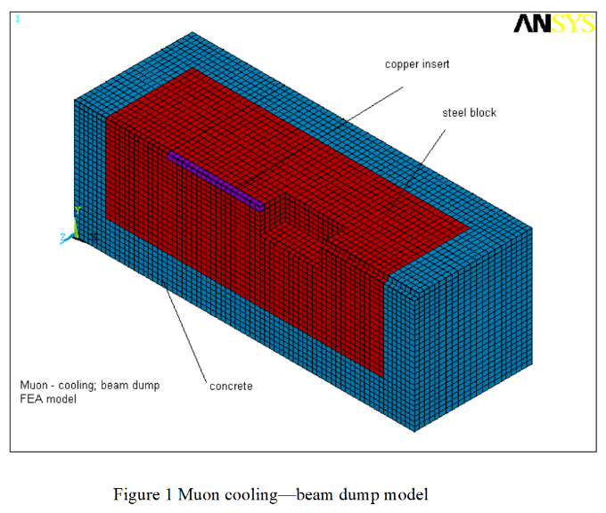
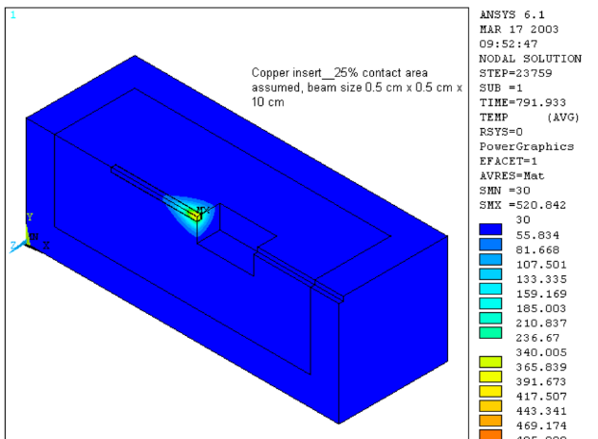
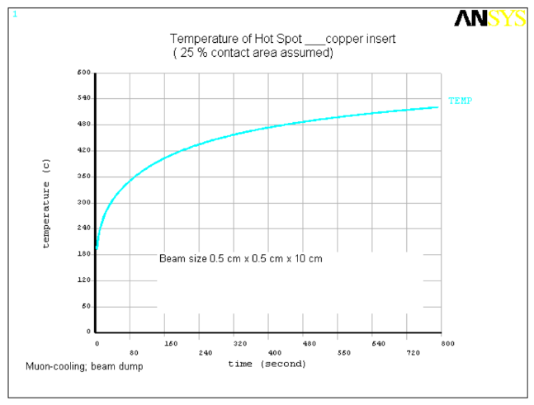
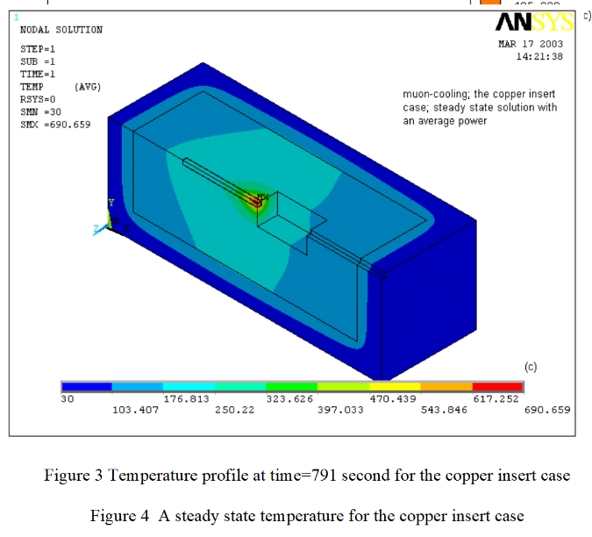


FERMILAB-POSTER-23-180-STUDENT
MTA Removable Beam Absorber
Intern: Efren Blas – Moraine Valley Community College
Supervisors: Carol Johnstone, Robert Ridgway - Fermi National Accelerator Laboratory
Abstract
Current RBA design (#3) utilizing a sliding plate instead of rails
The MeV Test Area (MTA0 houses 2 beamlines: the primary beamline transports the Fermilab 400-MeV LINAC proton beam, and a secondary production beamline collects pions from a 3cm tungsten target. Both lines connect to the steel vacuum housing with the tungsten production target that produces pions which decay in the secondary line into muons. A longer target or beam absorber downstream of the production target is required to stop the remaining proton beam.
Secondary beamline
Primary beamline
Concept/Design Phase
First model of RBA, utilized Idea #2 after further evaluation the MTA and a potential solution to Idea #1
The process of designing a removable beam absorber that protects personnel radiation exposure and limits work within a contamination zone in the MTA hall involved 3 sperate design approaches (ideas) to address all the issues:
Sliding the RBA on rails to remove it without contact
Screw and lever for vertical movement of beam absorber platform for alignment
A sliding platform with sliding plate that supports the entire RBA to enable horizontal movement for final alignment (within contamination area)
ANSYS Analysis of Existing HI Absorber
PTFE Multifil will cover the space between the Sliding plate guide and sliding plate
A shorter hall absorber can be constructed from an inner copper block (4” x 4” x 4”) encased within 1’ of steel (6” on each side) and surrounded by marble which forms the outermost layer (marble has low residual activation and reducing radiation and contact exposure
Caption Text – Helvetica / Arial Bold 24pt RGB 0,76,151
The copper/steel beam absorber will be recreated with a larger copper core, the current design can support a steady-state beam reaching 700°C
Melting pt. of Cu: 1000° C
~25% contact between steel and copper blocks (air gaps, contact resistance)
High conductive material (Cu) used for effective heat dispersion throughout target
ANSYS temperature analysis of 400 MeV proton beam at 15Hz pulses with 1.6 x10¹³ p per pulse (Steady State)
Temperature distribution simulated for the high intensity absorber buried in berm outside the MTA hall - consisting of a 3.5”x 3.5”x 3.5” copper core encased in 4’ of steel. A scaled version of this design design will be used to ensure less radiation exposure in the MTA hall combined with effective heat dispersion in the steel casing (heat sink).
Acknowledgements
This manuscript has been authored by Fermi Research Alliance, LLC under Contract No. DE-AC02-07CH11359 with the U.S. Department of Energy, Office of Science, Office of High Energy Physics.
This work was supported in part by the U.S. Department of Energy, Office of Science, Office of Workforce Development for Teachers and Scientists (WDTS) under the Community College Internships Program (CCI)

