Slide 1
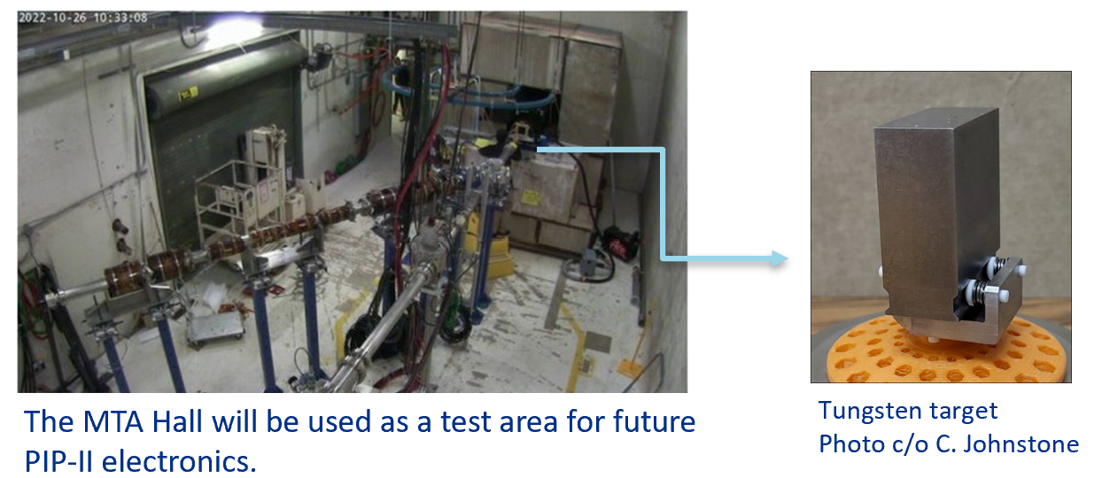
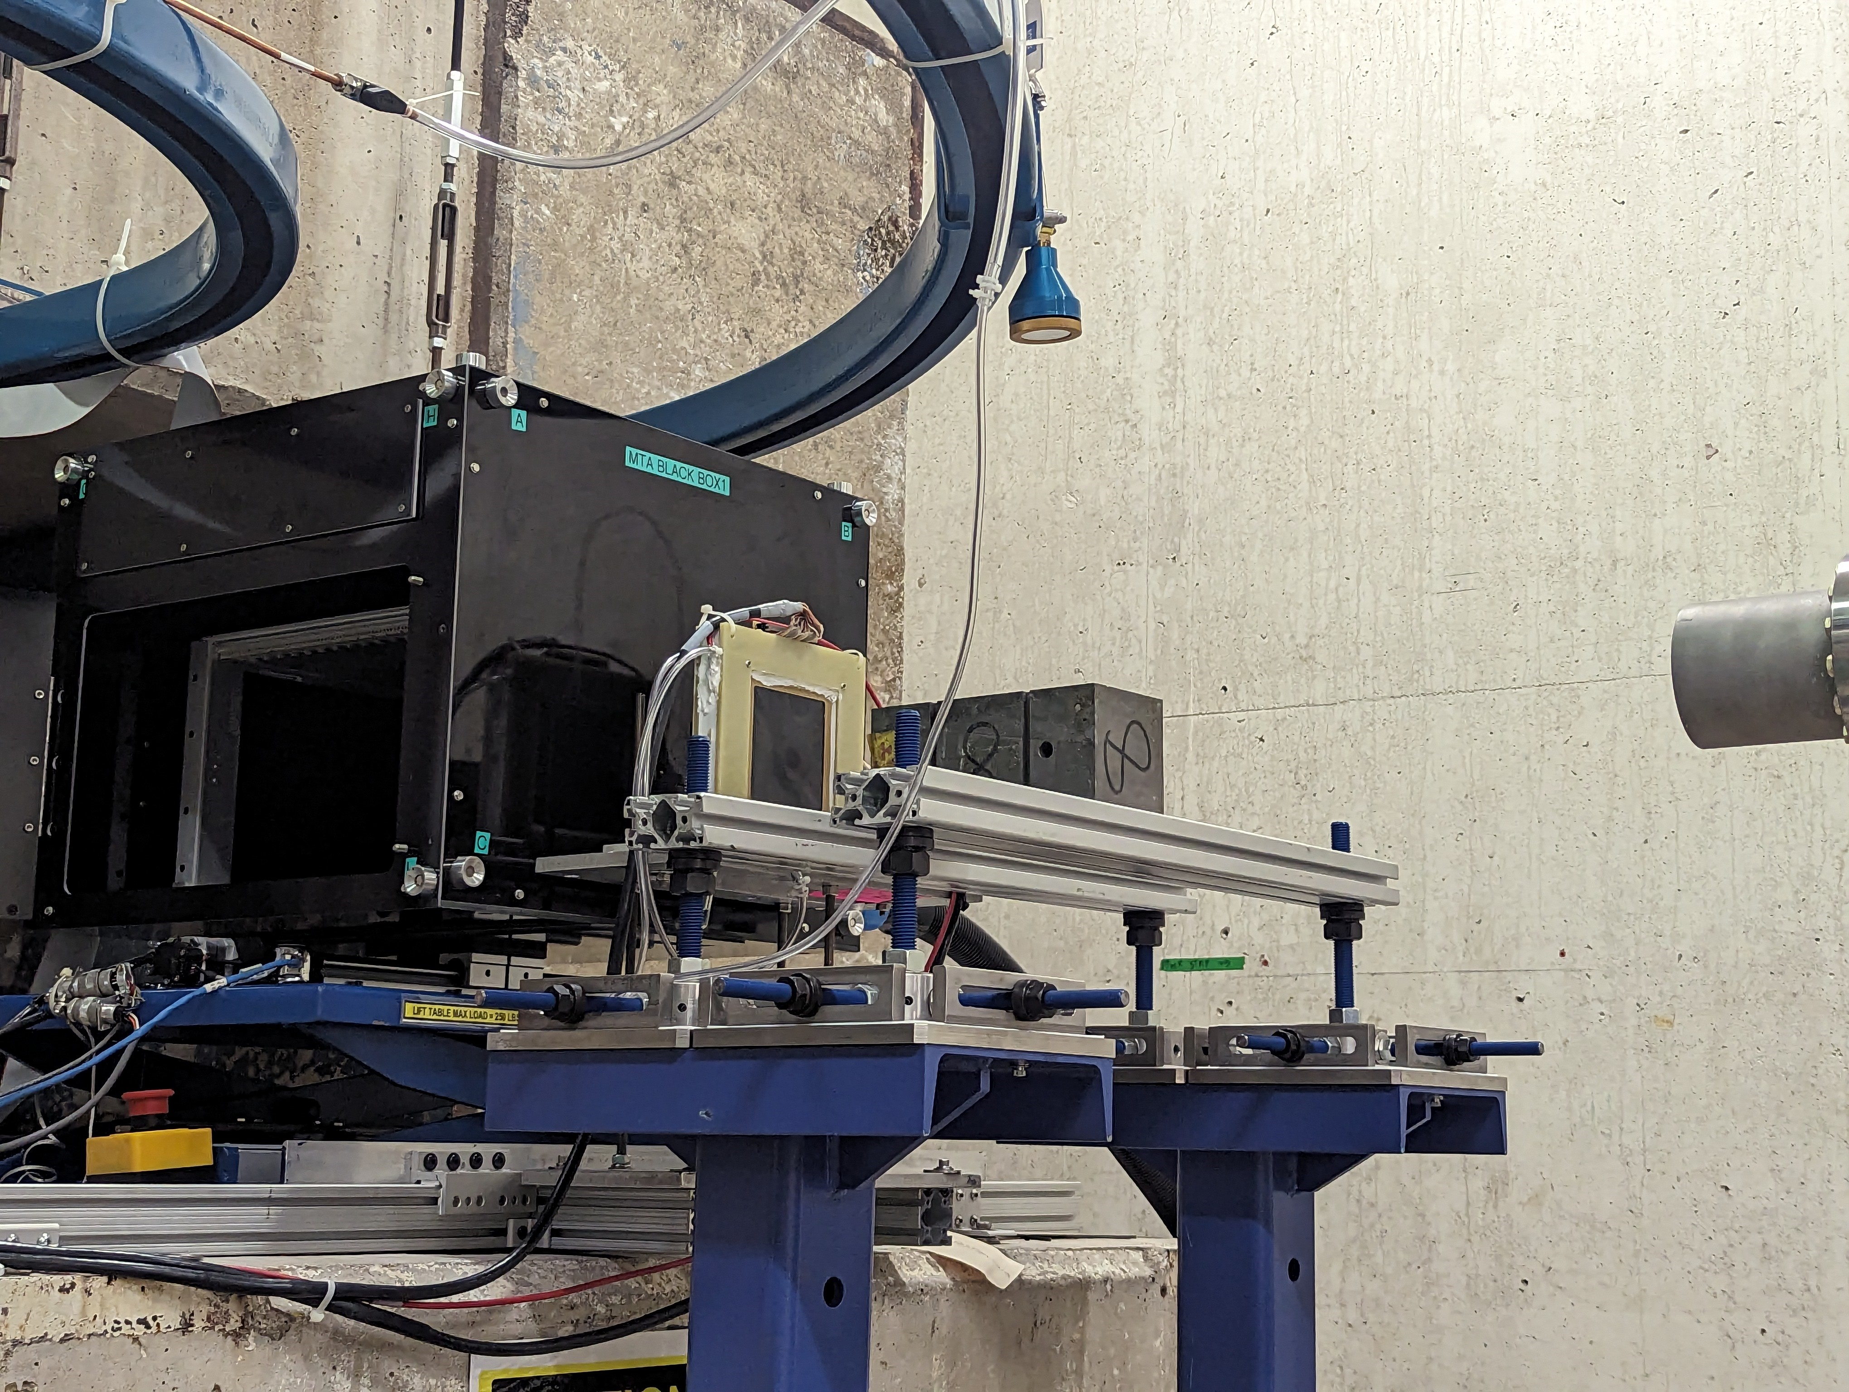
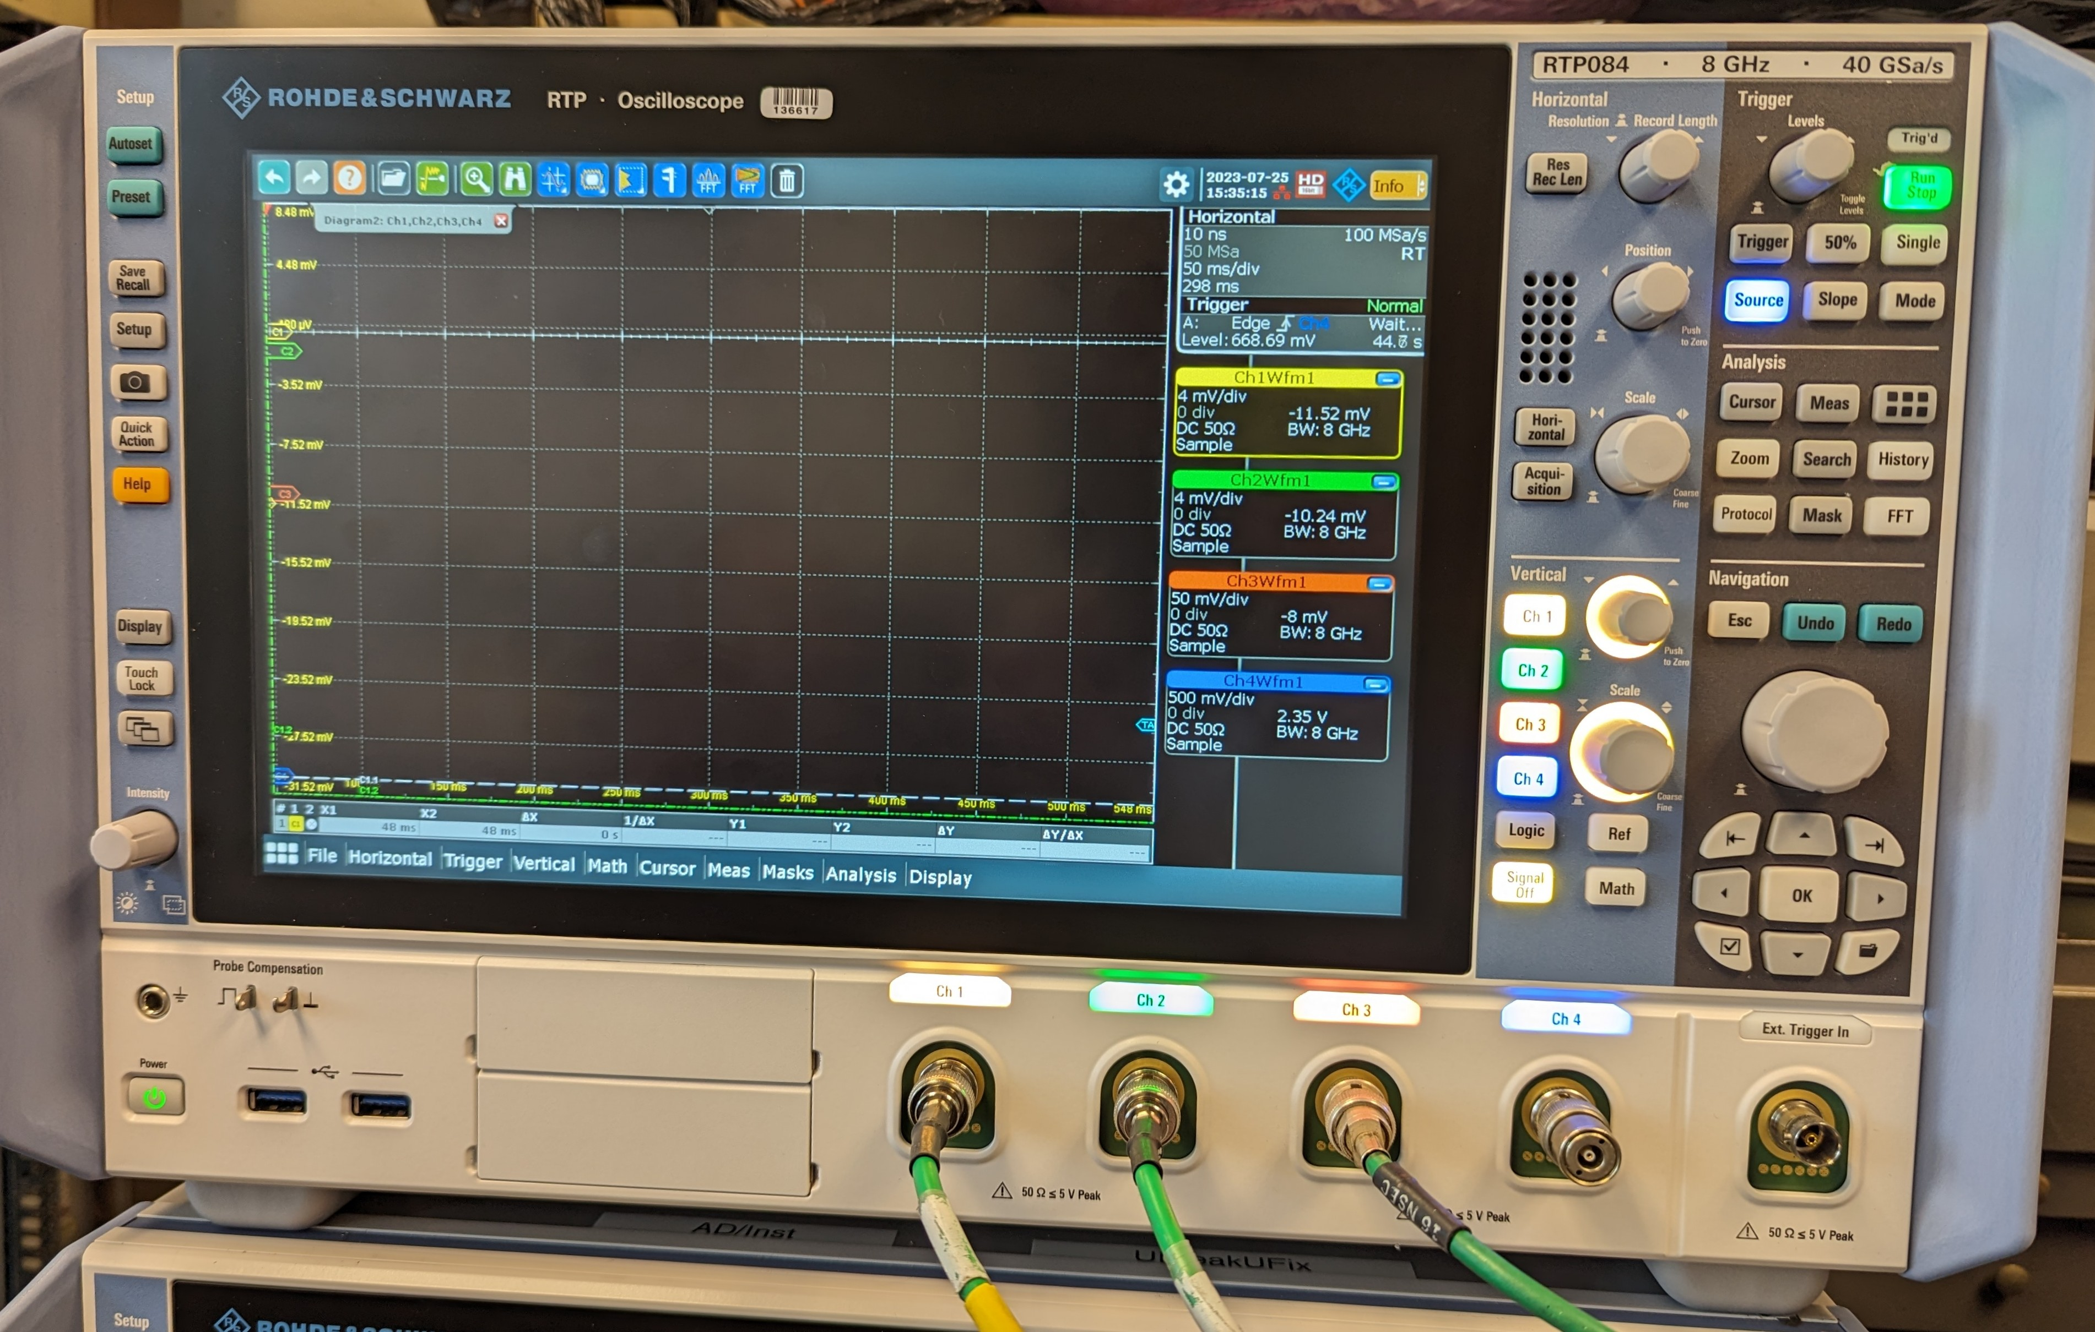
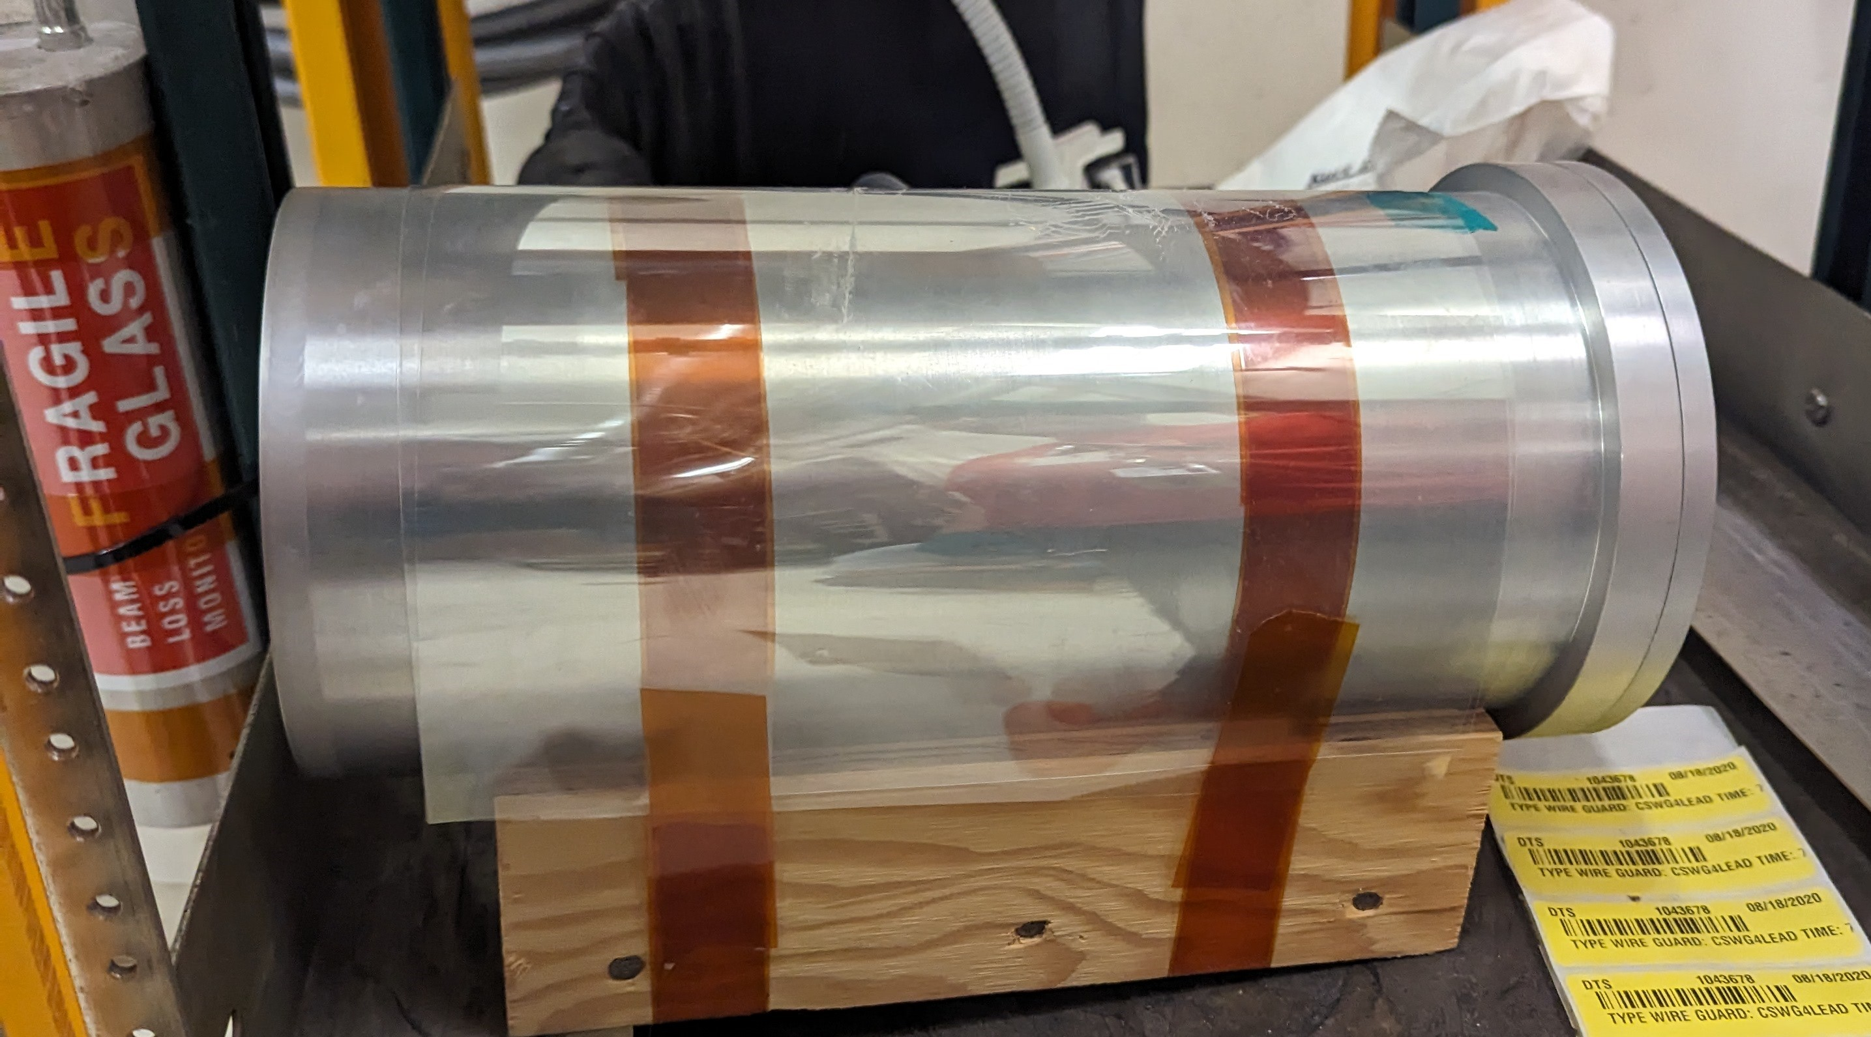
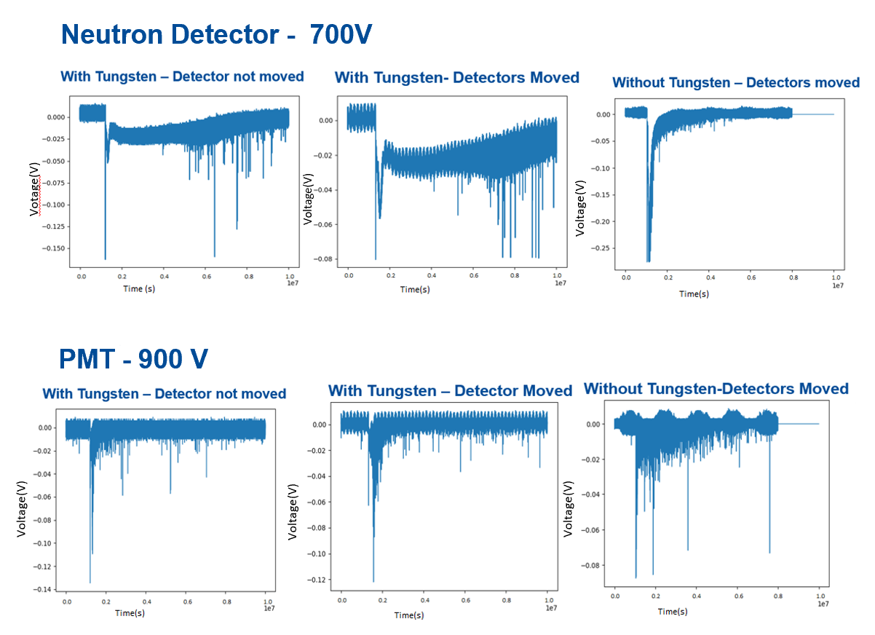
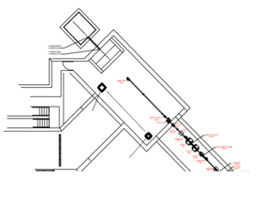
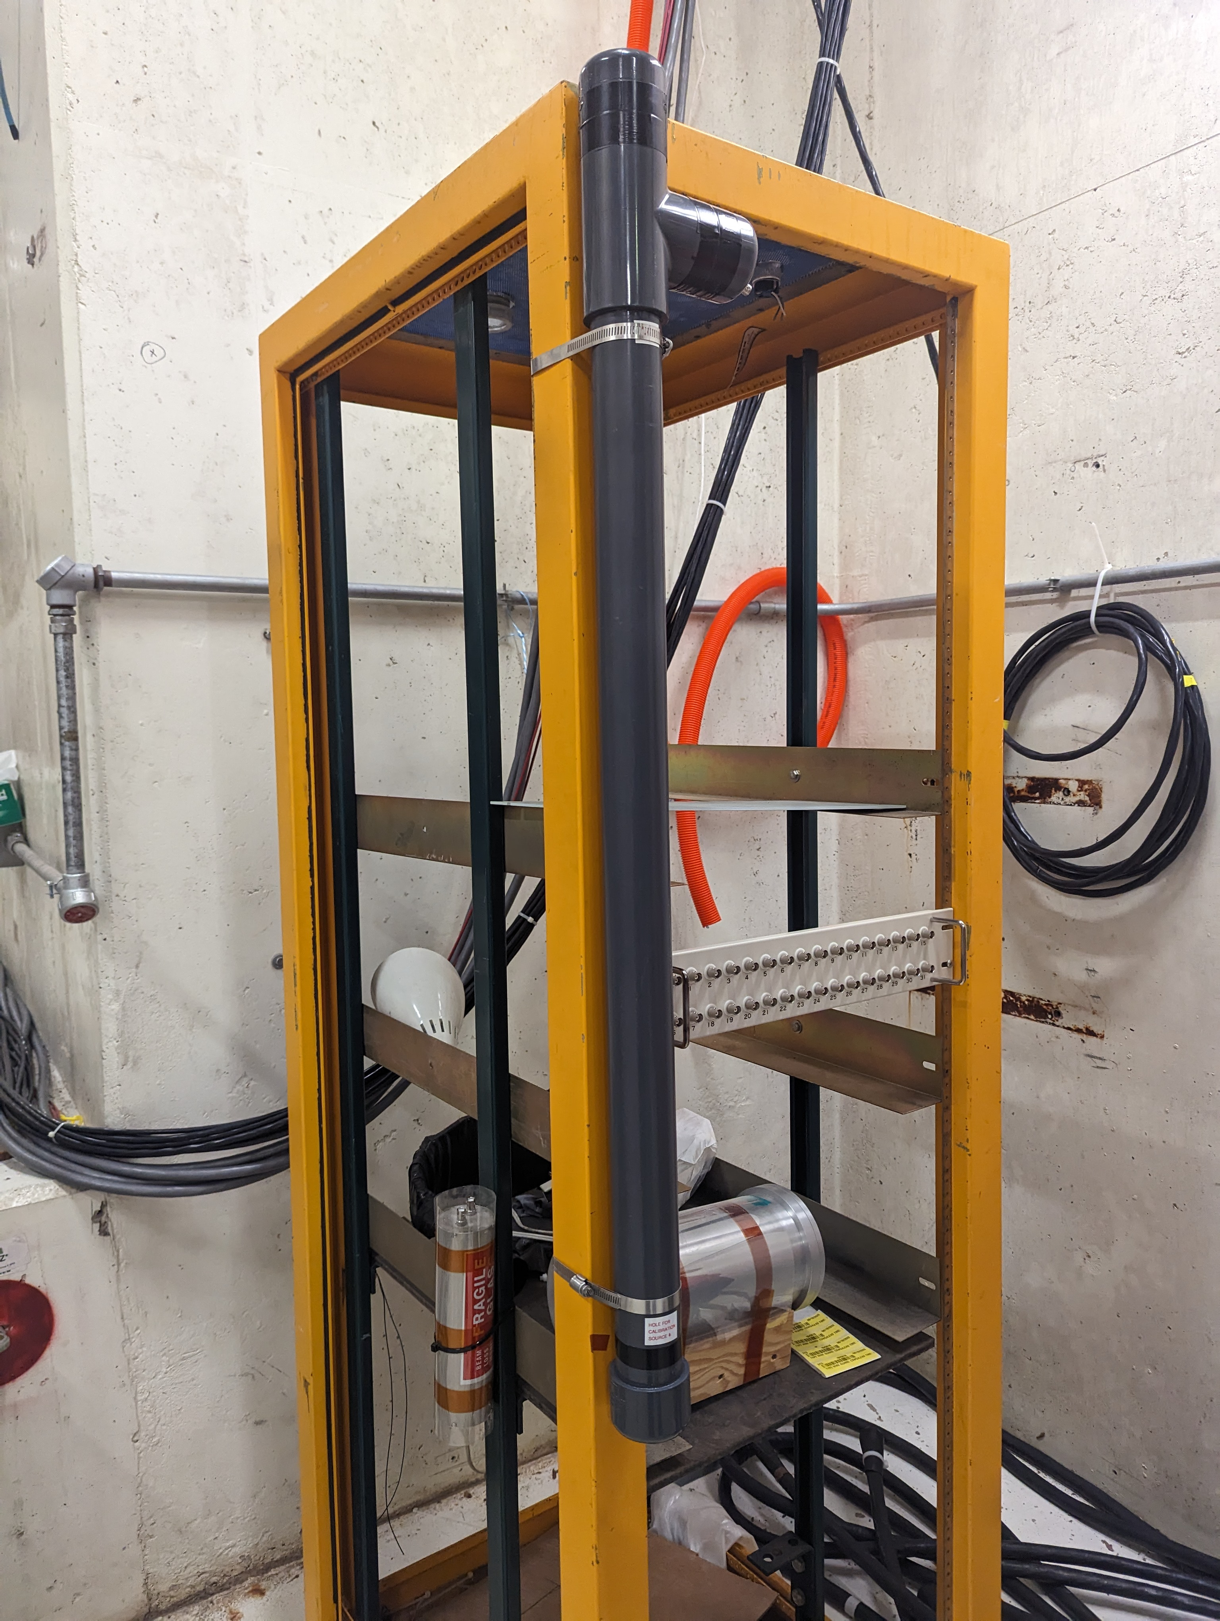
Instrumentation development for measuring background radiation in the MTA Hall
Stefana Sas-Pawlik, Moraine Valley Community College – CCI Intern
Randy Keup-Thurman and Carol Johnstone – Fermilab Mentors
FERMILAB-POSTER-23-176-STUDENT
Introduction
Background radiation was measured in the MTA Hall with and without a tungsten target to better characterize the radiation environment for future studies, such as electronic radiation hardness and muon-catalyzed fusion.
Tungsten Target
Why Tungsten?
Tungsten has a high melting point (3410 °C) and high thermal conductivity (170 W/m·K), allowing it to withstand the high heat and energy of the particle beam. It is also a dense material (19.3 g/cm3) that acts as a good spallation source that
creates large amounts of radiation that can be used for future experiments.
Objectives
In characterizing the radiation in the MTA Hall, special attention was given to the level of neutron radiation in comparison to other radiation with and without a tungsten target. Background radiation levels must be considered during the design and construction of accelerator facilities such as PIP-II. Neutrons interacting with electronic components can displace atoms and generate free electrons, resulting in temporary malfunctions or permanent damage to electronics in accelerator enclosures
Experimental Setup
The 400 MeV proton beam line transported H- ions from the Fermilab LINAC to the MTA beam alcove. The tungsten target was located near the end of the 40’ MTA Hall. Part of the experiment involved moving the detectors rack from across from the tungsten target to 12 meters back and upstream in order to observe variance in the quantity of neutrons recorded by the detectors. The intense 400 MeV proton beam strikes this neutron rich heavy target which produces secondary subatomic particles which strike the detectors. An 8-channel CAEN high-voltage power supply was used to power the detectors.
Signals from the particle detectors, a neutron detector, a photomultiplier tube(which detects gammas), and an ion chamber
8-channel CAEN high-voltage power supply
Results
The experiment yielded important data on neutrons generation using a tungsten target in an operational accelerator environment. The graph below shows a significant increase in the number of neutrons measured by the neutron detector, while the PMT doesn’t increase because the signal is reading only photons and does not detect non-charged particles; i.e. neutrons. Tungsten, with neutron-rich nuclei, produces highly enhanced neutron background radiation in accelerator enclosures. Python was employed for data analysis, enabling efficient handling of large datasets and effective data visualization techniques.
Rohde & Schwarz RTP Oscilloscope
Channel 1 - Neutron detector
Channel 2 – PMT – Photo Multiplier Tube
Channel 3 –
Ion chamber
MTA Hall
Original location
Detectors Rack
New Location
were connected to a fast oscilloscope (channels 1, 2, and 3, respectively). The ion chamber does not amplify the signal from particles; instead, it directly measures the electrical current induced by the ionization process and is effectively an overall charge or current measurement.
The relocation of the detectors provided crucial data into how the presence of the tungsten target produced neutrons – both energy and trajectories and these data were compared to a background measurement without the tungsten target. Data collecting and analysis will reflect the degree to which background radiation has increased due to the heavy target and correlated with relative position – 90 deg or far backward angles.
Acknowledgments
This manuscript has been authored by Fermi Research Alliance, LLC under Contract No. DE-AC02-07CH11359 with the U.S. Department of Energy, Office of Science, Office of High Energy Physics.
This work was supported in part by the U.S. Department of Energy, Office of Science, Office of Workforce Development for Teachers and Scientists (WDTS) under the Community College Internships Program (CCI)
Thank you, Randy Keup-Thurman and Carol Johnstone, for your mentorship, support, and encouragement during this project.

