Slide 1
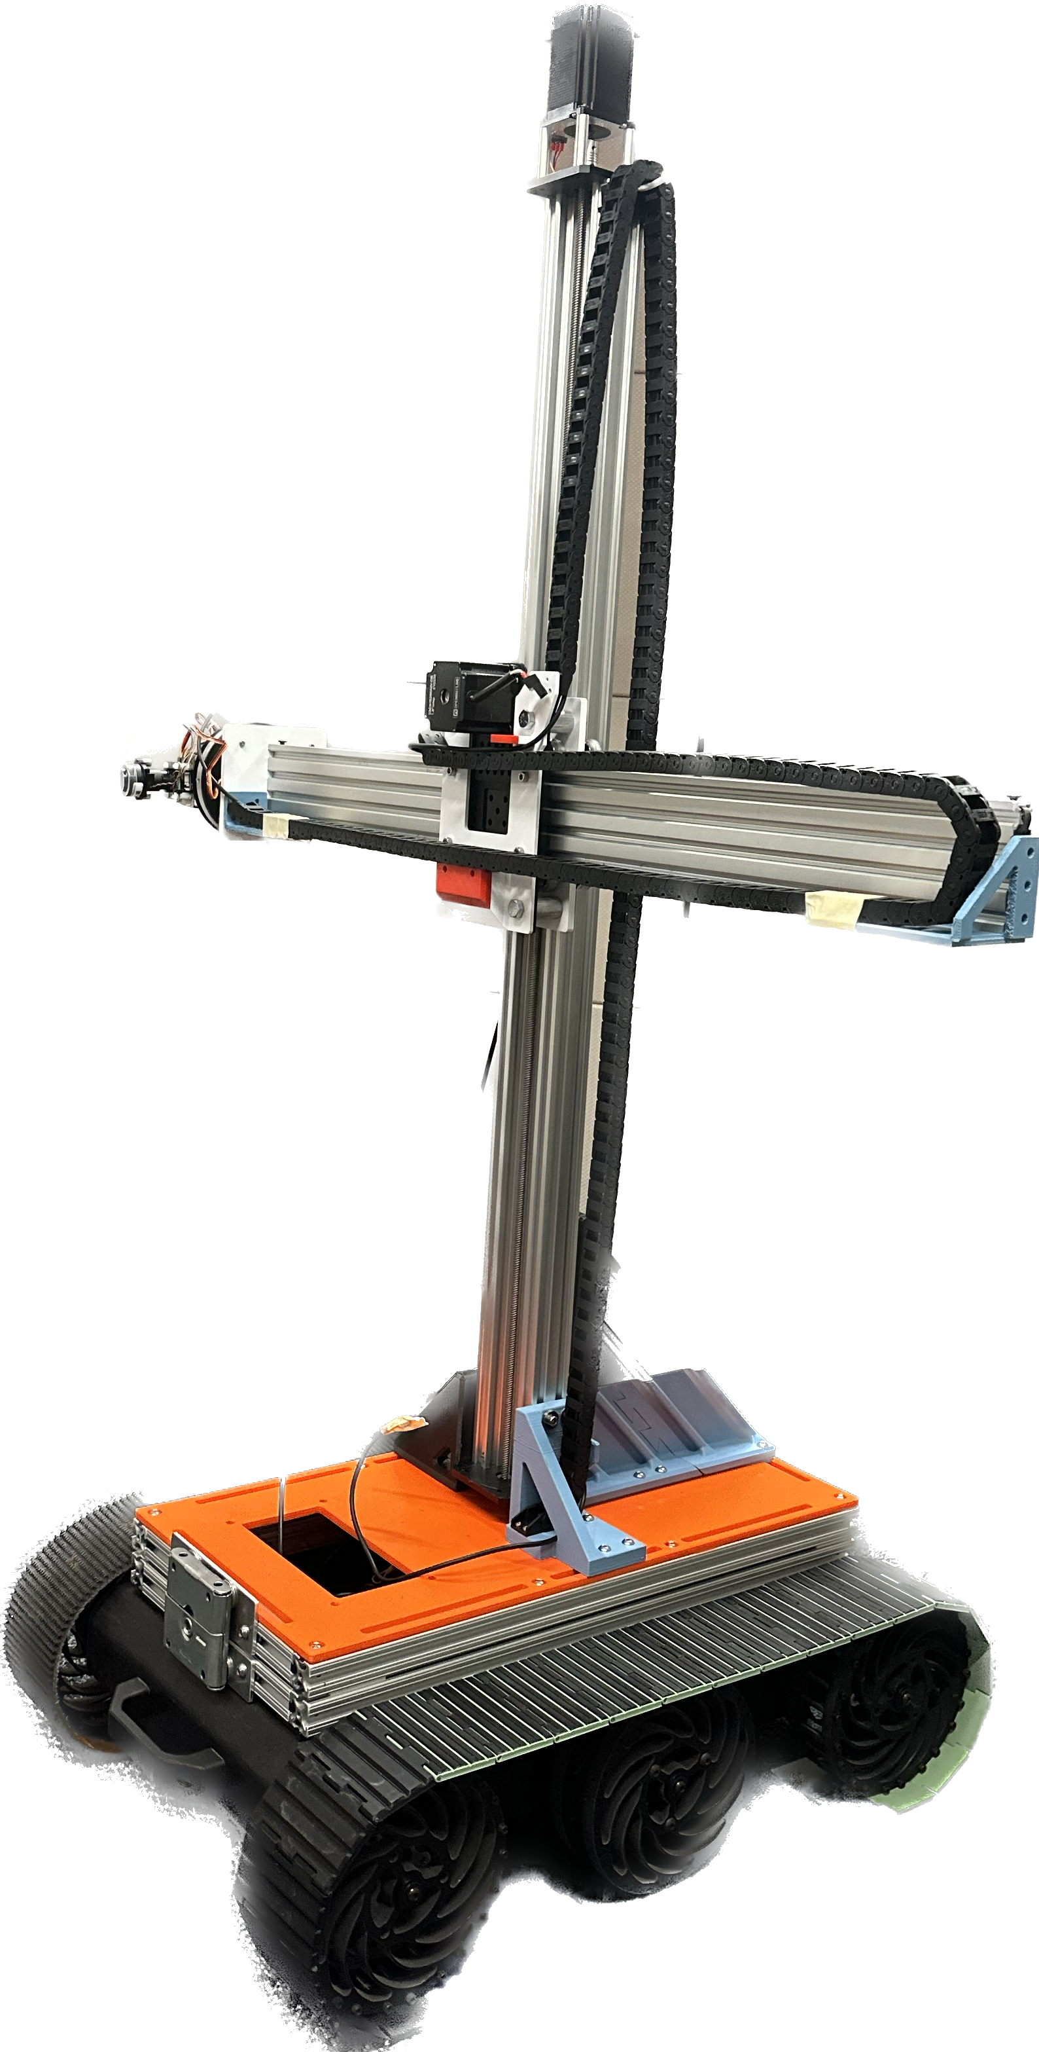
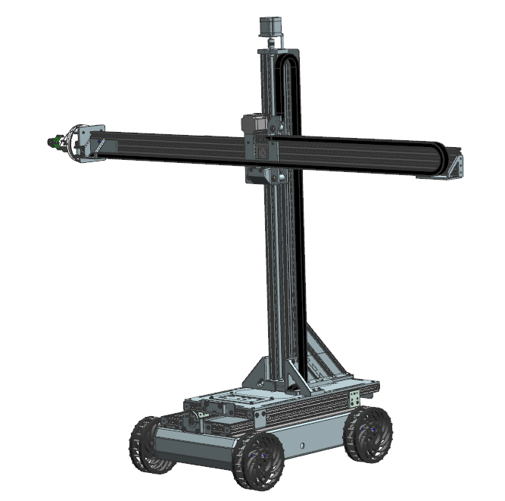
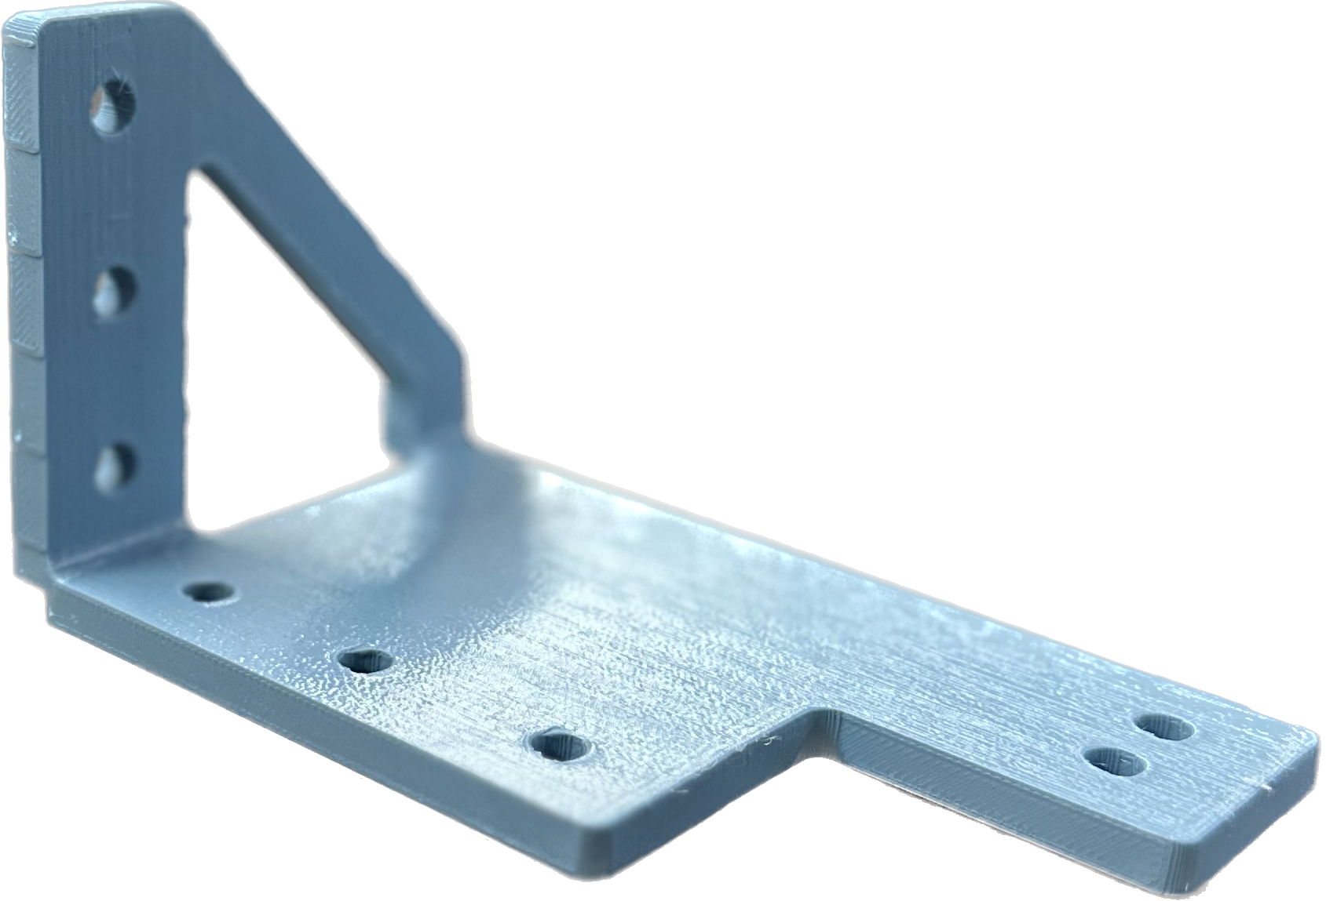
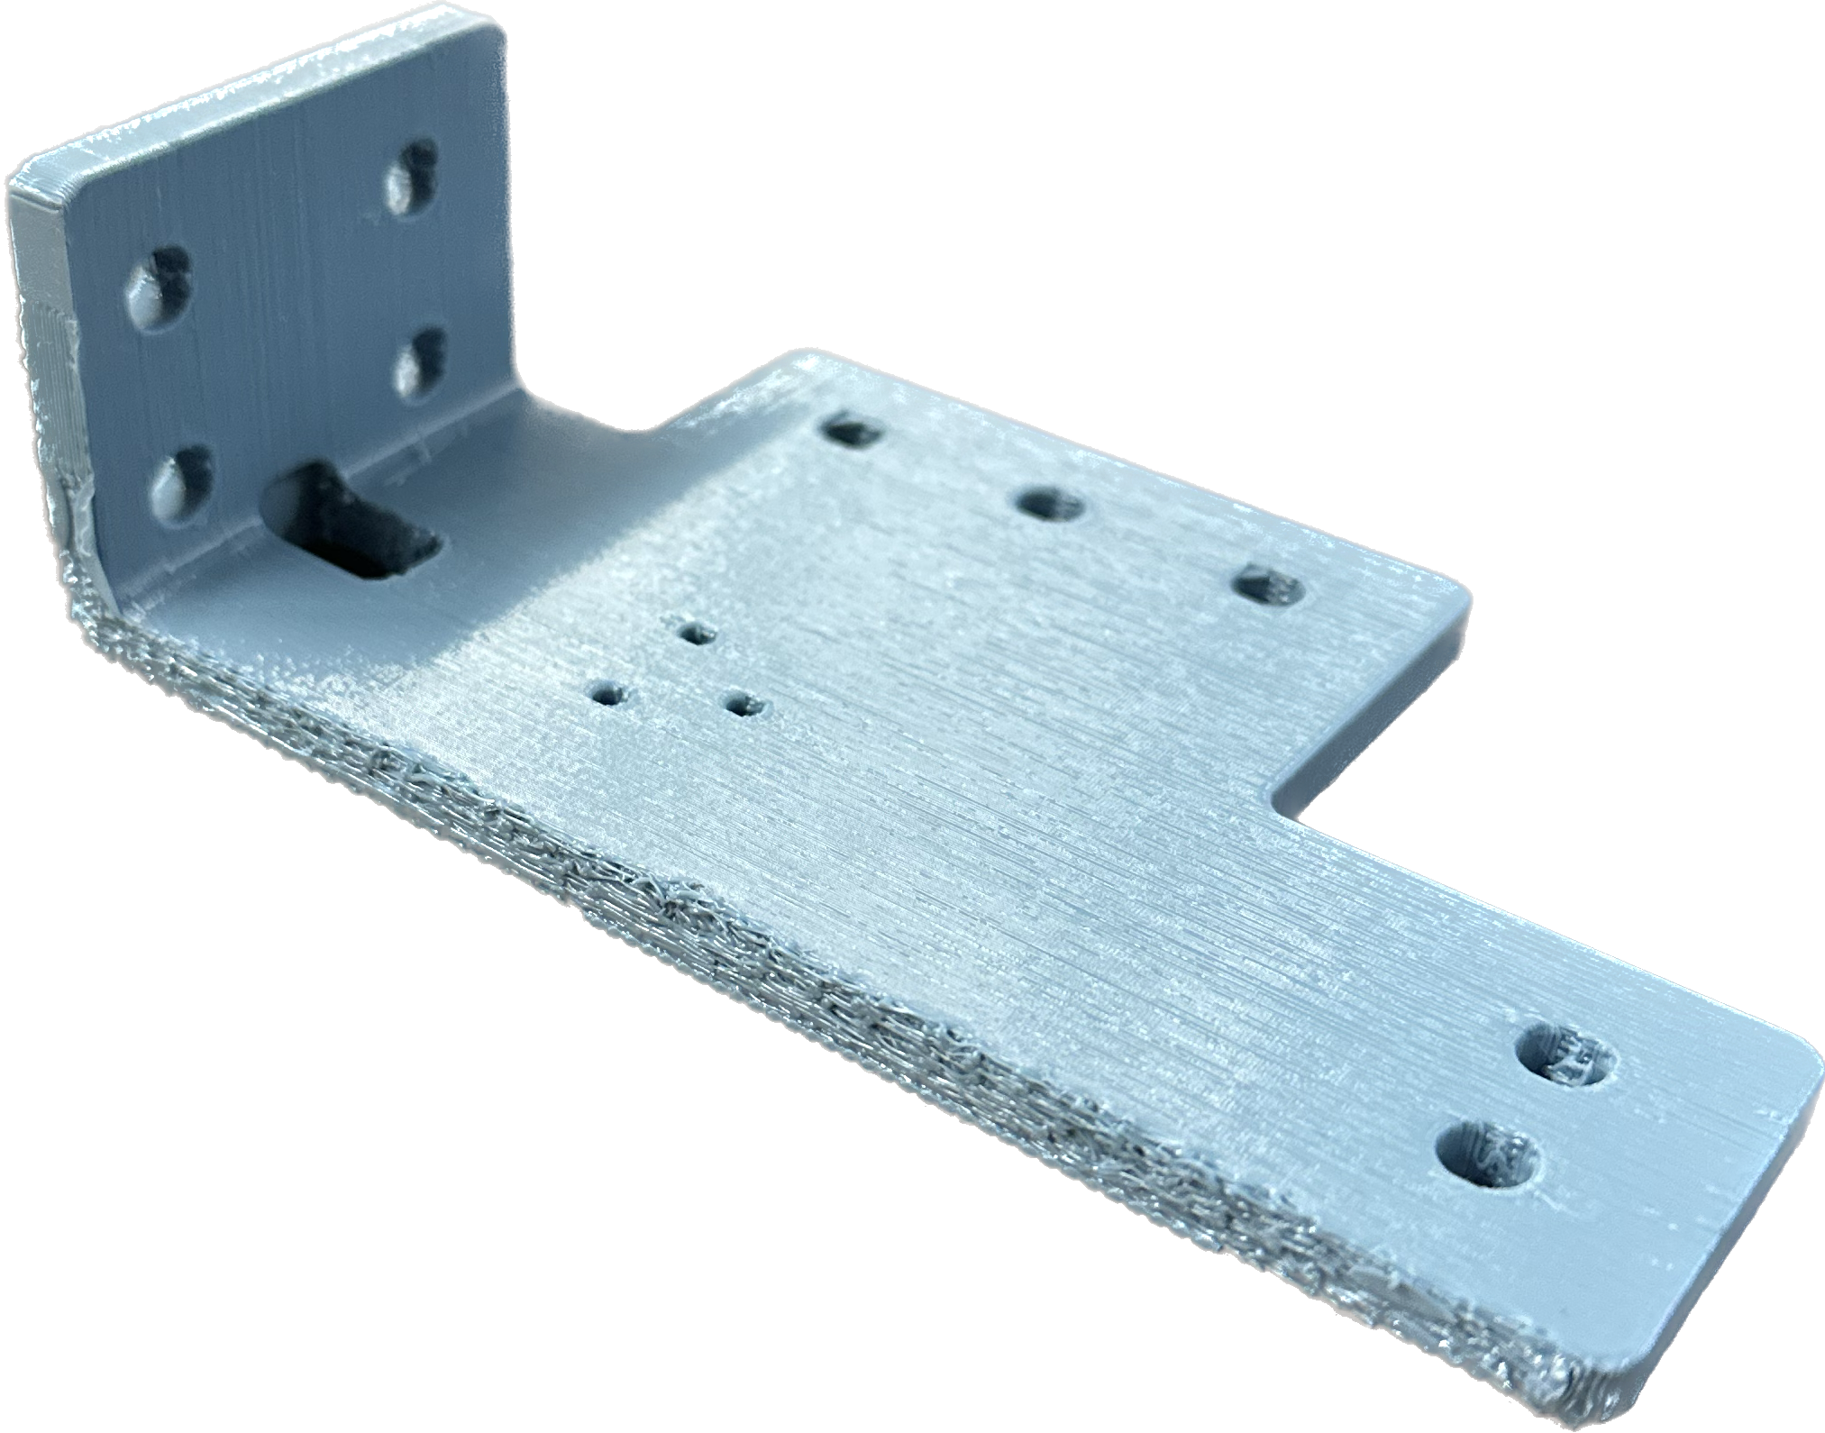
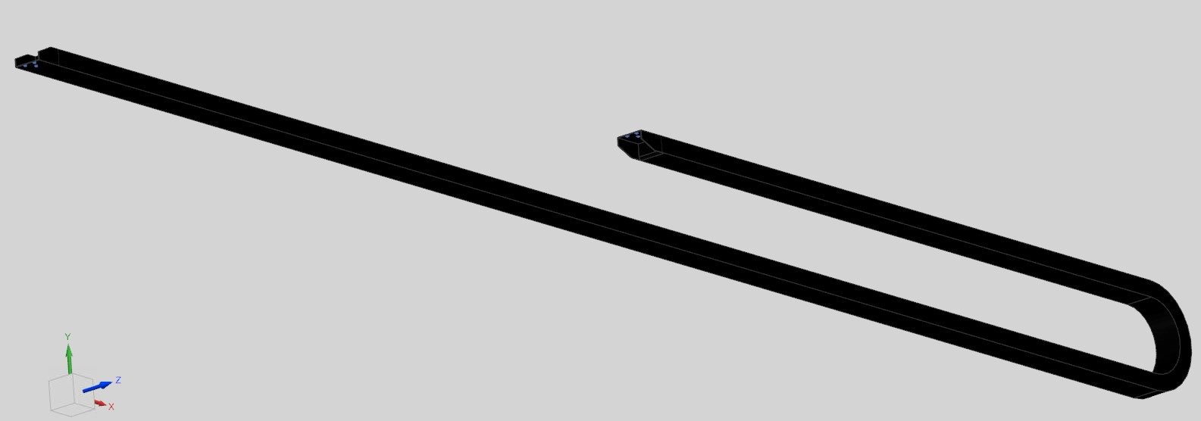
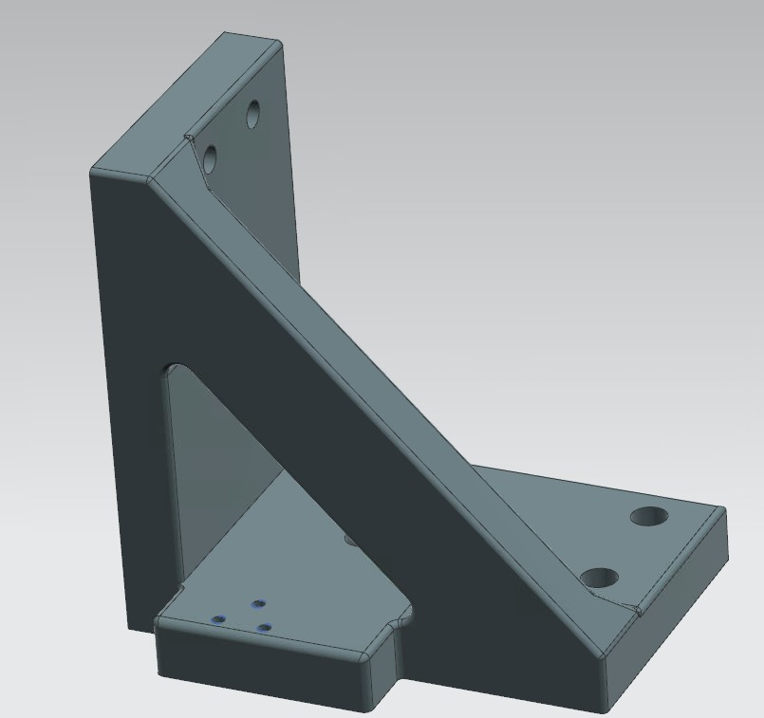
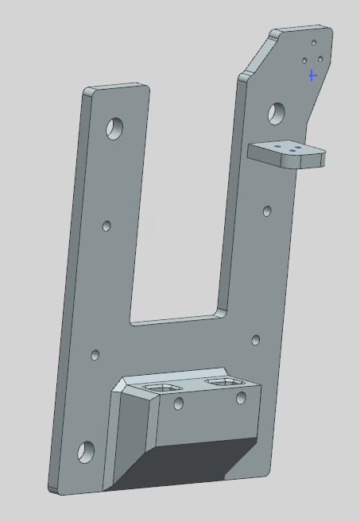
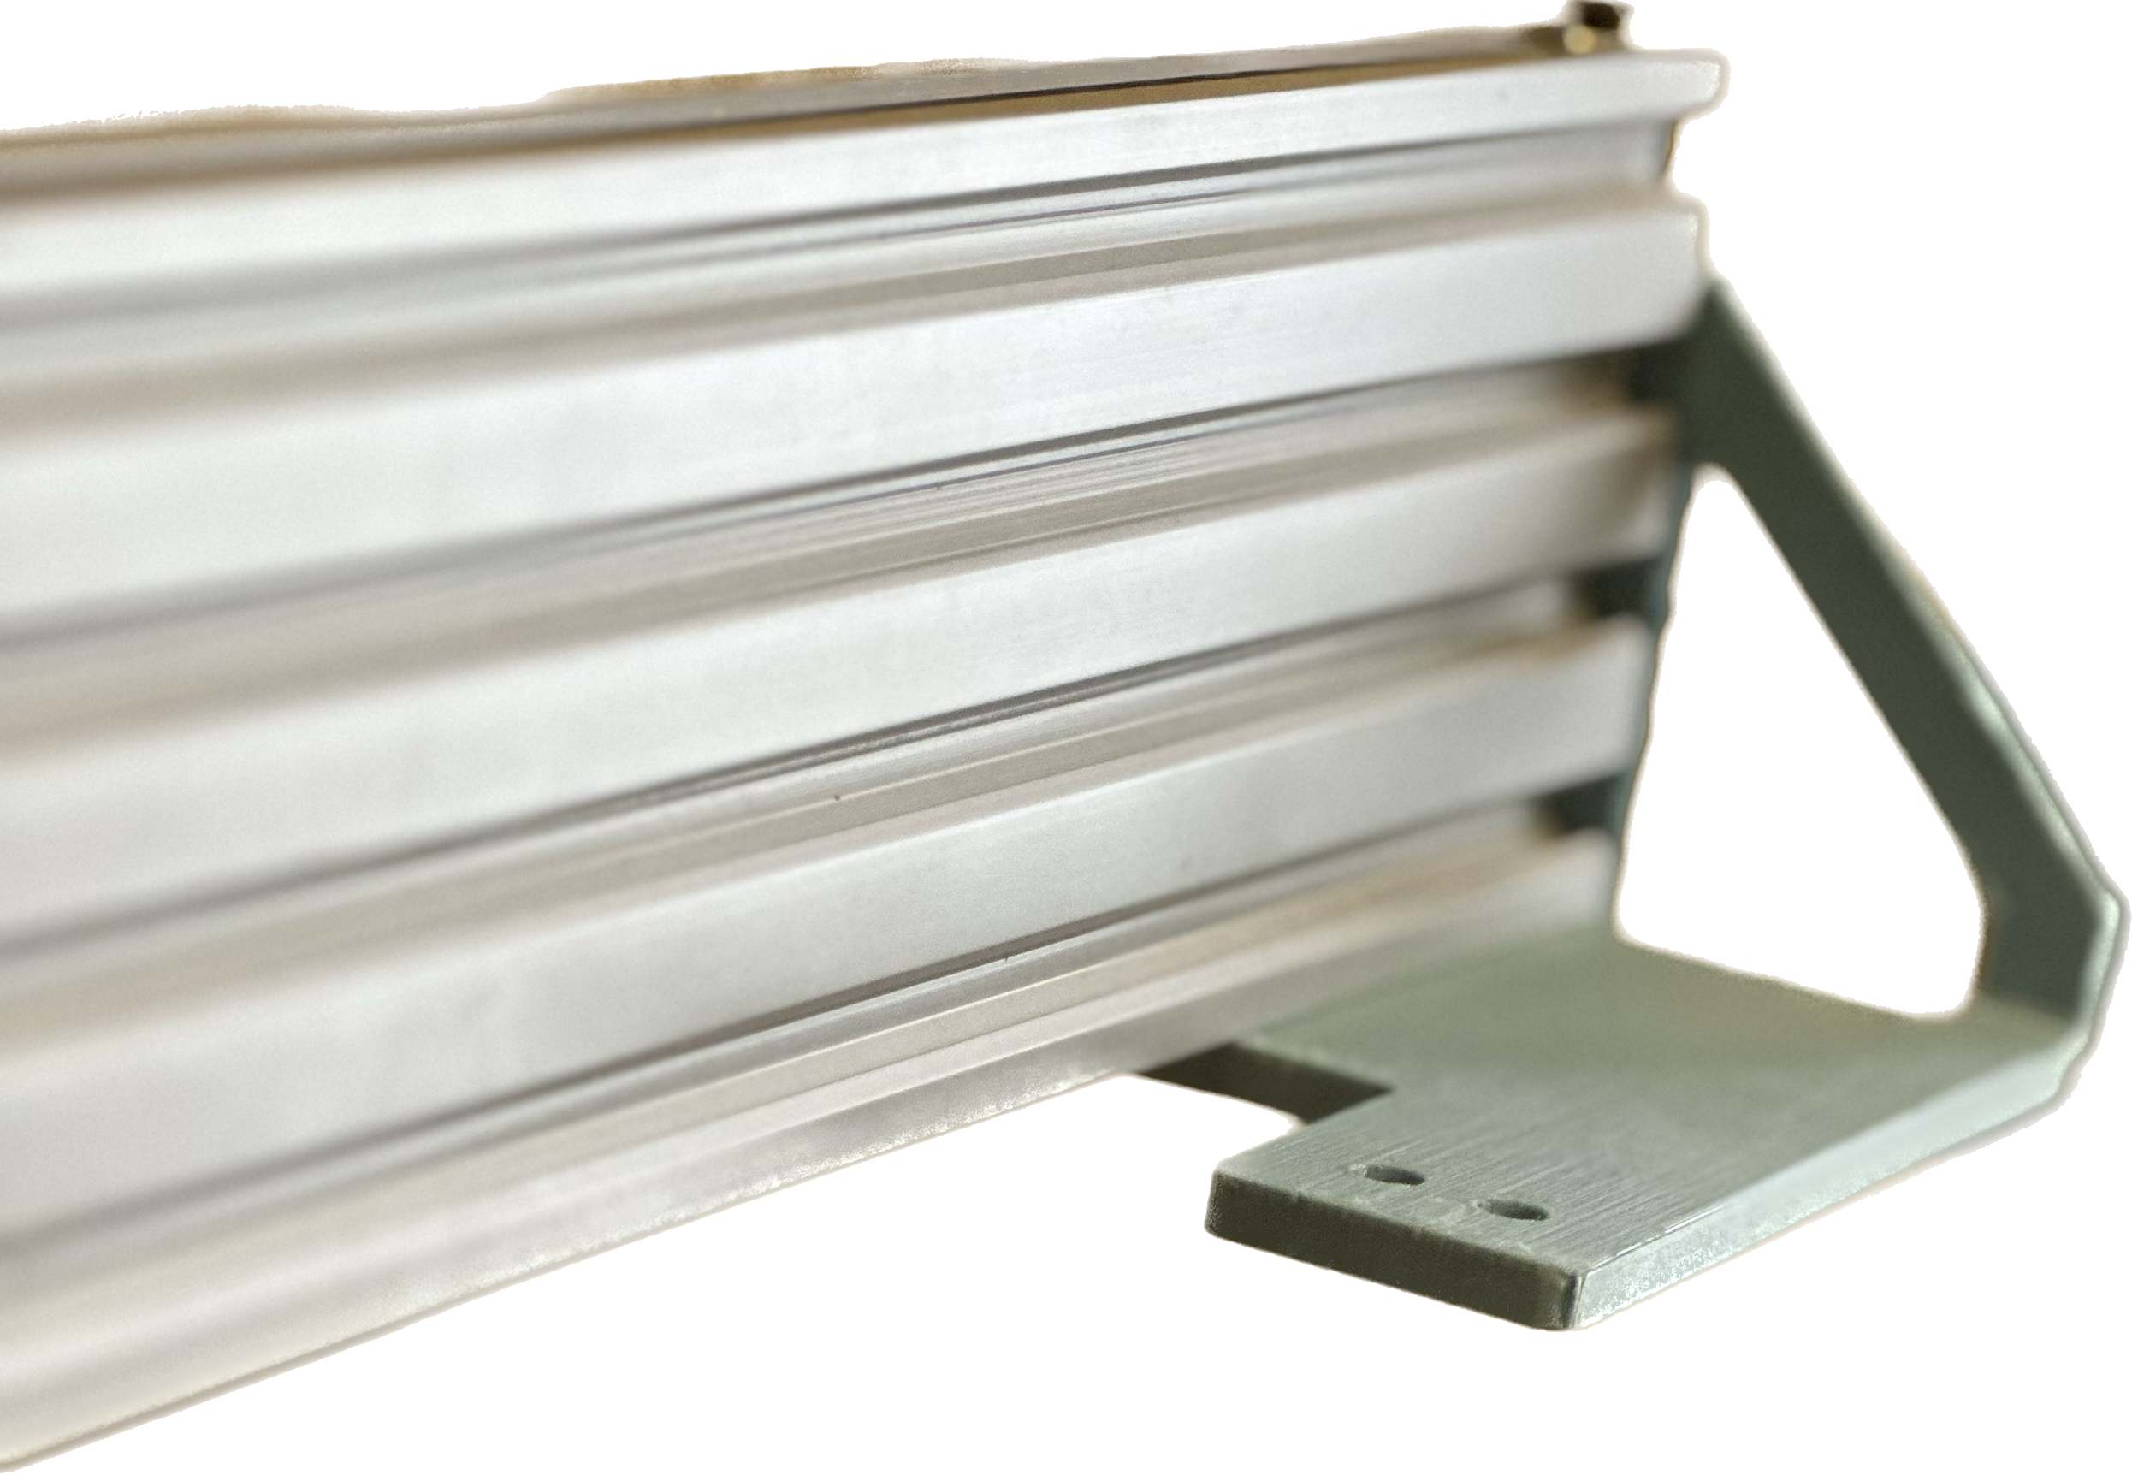
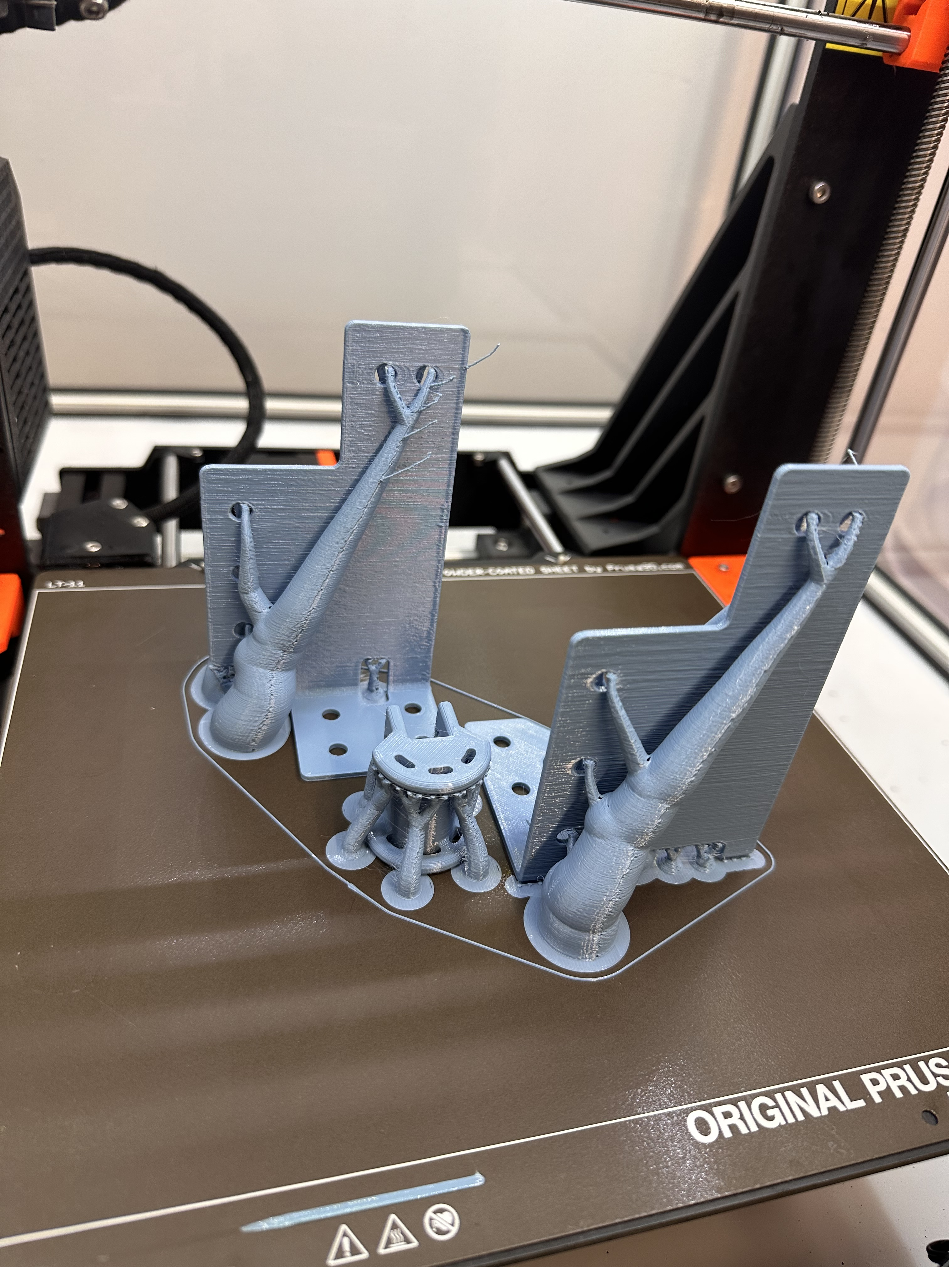
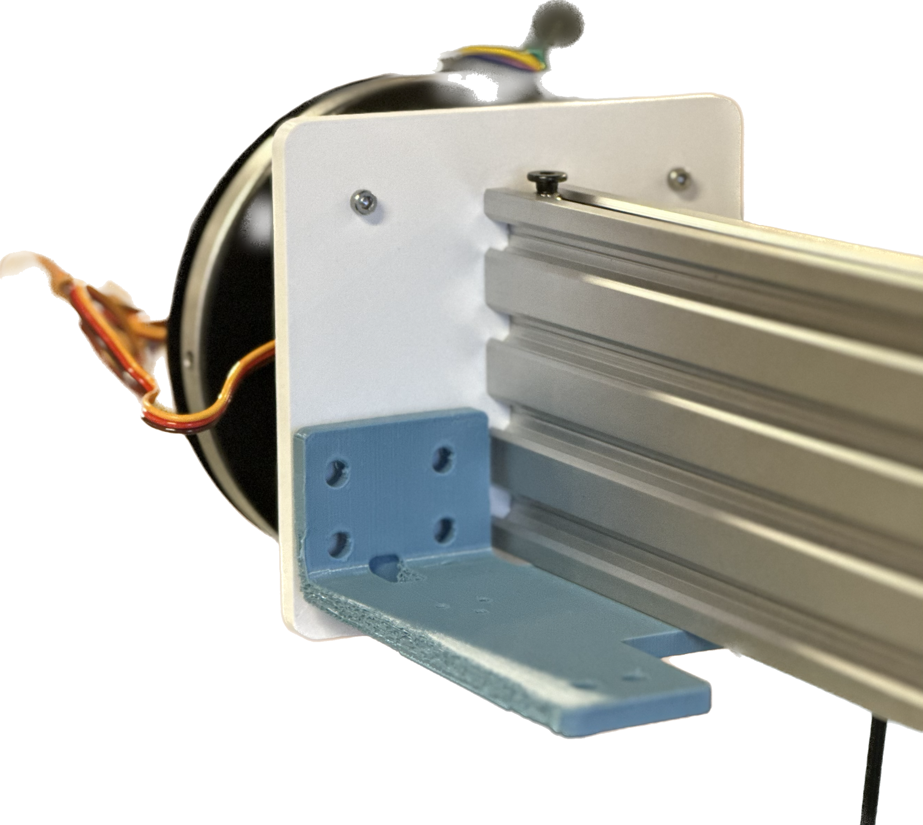
Cable management design for Inspection Robot FERMILAB-POSTER-23-213-STUDENT
Josue Emanuel Garcia Gonzalez, Fermilab National Laboratory. Advisor: Noah Curfam
OVERVIEW
Real picture of two-actuator gantry
Screenshot taken from Fermilab 3D modeling program NX
The main goal of the project is to design a cable support system connecting two electrically powered stepper motors in a gantry on an inspection robot or Remote Viewing Robot “RVR” as well as an electric-powered camera through cable carriers to prevent said cables to intertwine, bend or even rip apart.
The support for the horizontal drag chain needs to be braced by the horizontal actuator through brackets which were designed and printed out of PETG filament for extra support.
INSTALLING AND SECURING CABLE CARRIERONTO RVR
One of the goals of the project was to secure the cable carrier in place as the actuators moves making sure both cable carriers have support where needed. This was solved by modeling parts that would allow screw holes for installing as well as back and lower support for both drag chains in the shape of aluminum plates.
Though PLA is more rigid, PETG has more flexibility and layer adhesion that allows the braces to hold more weight without snapping.
horizontal brace bracket for lower support for horizontal cable carrier.
3D model of horizontal and vertical cable carriers for Fermilab 3D modeling program NX
Lower right and middle bracket with 3-point screw holes for cable carrier installation
RESULTS
Successfully printed and assembled both cable carrier onto gantry allowing for easier cable management process.
Screenshots of both vertical and horizontal drag chain supports models from 3D modeling program NX
DRAG CHAIN SUPPORT
Another objective was to allow support for the cable carriers. Both cable carriers needed support when the gantry moved achieved with two pieces of aluminum that were measured and modeled to fit the standards.

