Slide 1
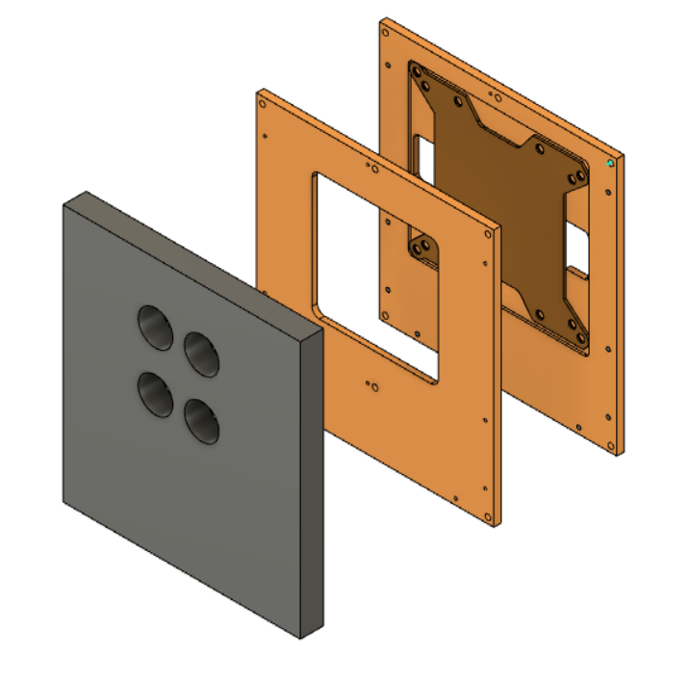
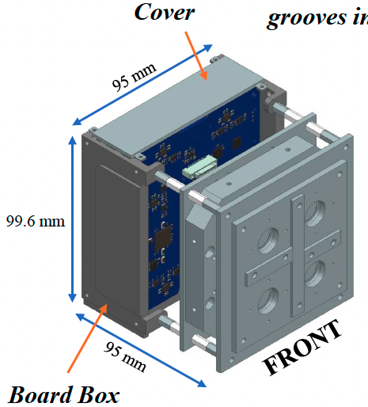
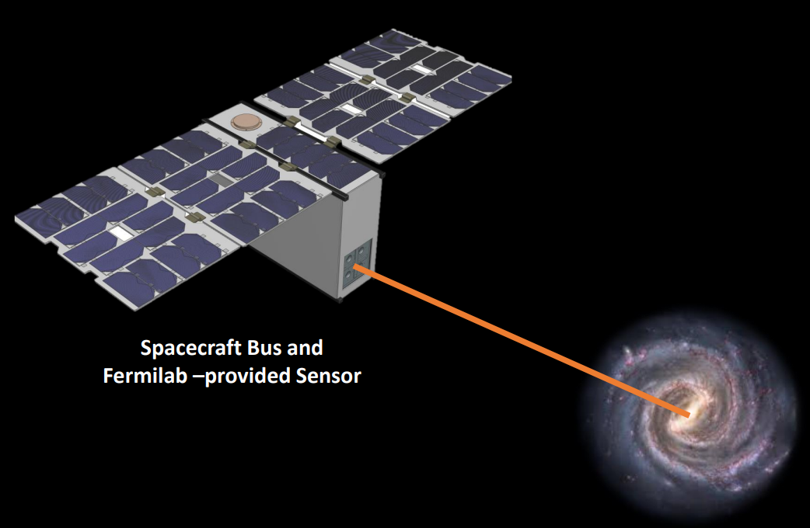
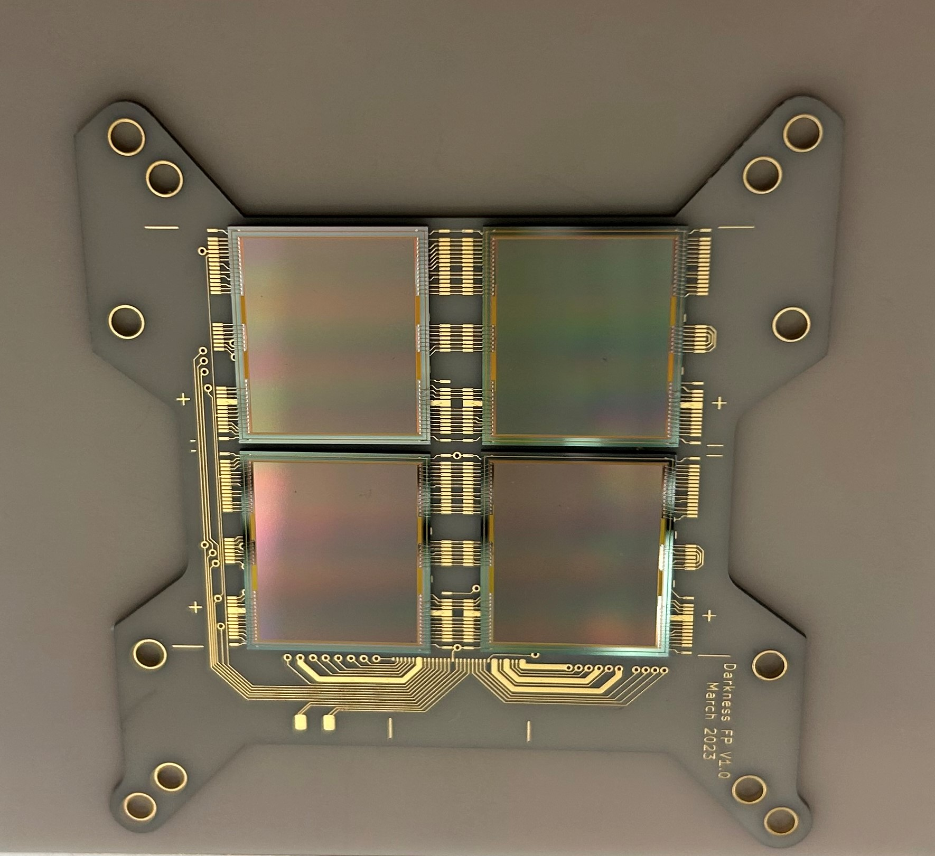
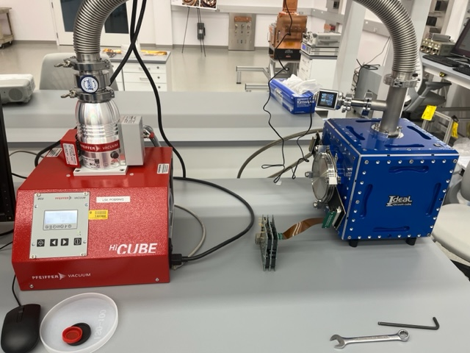
DarkNESS Project Testing
Kodjo Akouedjinoude, NC State University | Nate Saffold & Juan Estrada, Fermilab | FERMILAB-POSTER-23-154-STUDENT
Abstract
This internship involved the design and assembly of a mechanical system for testing skipper-Charge Couple Devices (CCDs) for the DarkNESS project. Skipper-CCDs are highly-sensitive sensors with ultra-low readout noise that are deployed for direct detection of dark matter. DarkNESS is a CubeSat that aims to use skipper-CCDs to search for dark matter decaying into X-rays. Currently, in the testing phase, the design process involved creating 3D models of mechanical adapters to operate a prototype space-Multi Chip Module (sMCM) package in existing testing chambers in the CCD lab at Fermilab's IERC. The drawings were sent out to be machined, and while waiting to receive the finished adapters, we assembled a vacuum chamber for skipper-CCD testing and performed initial testing of a single CCD controlled by the space-Low Threshold Acquisition (sLTA) board that will be employed on the CubeSat. The results showed that the testing conditions are optimal for data to start being taken and analyzed.
Here we have also designed an aluminum window to restrict the field of view (FOV) that the skipper-CCDs are exposed to, following the preliminary design of DarkNESS.
3D view of the aluminum window shielding sMCM adapter
Current Results
Preliminary design of DarkNESS detector payload
We were able to read the data from a single CCD in the vacuum chamber. Tracks from cosmic ray muons and electrons can be observed which demonstrates that the sLTA is operating well in the lab environment. We are currently waiting to receive the mechanical adapter and flex cable for the sMCM but have plans to perform X-ray calibration with the integrated sMCM and sLTA system in future testing.
Schematic of the DarkNESS CubeSat pointing towards the center of the Galaxy
Photo of a space Multi-Chip Module (sMCM) with 4 CCDs mounted on a ceramic plate
Image of cosmic ray events from skipper-CCD in testing setup
Methods
Conclusion
The design involved using Autodesk Fusion 360 to create an adapter to mount and electrically isolate the sMCM in the vacuum vessel. The assembly work involved installing mechanical parts in the vacuum cube for testing a single CCD. After the setup was completed we achieved an operational pressure of ${10}^{−4}$ bar using a Pfeiffer vacuum HiCube turbo pumping station.
This work developed a suitable design for a mechanical adapter that will be manufactured and installed for calibration of the DarkNESS mission’s detector module. The next steps consist of mounting the space-MCM adapter in the vacuum chamber to collect the X-ray calibration data, analyze the data, and assess if the CCD readout electronics meet the DarkNESS performance requirements in preparation for the Critical Design Review.
Acknowledgment
I would like to extend my thanks to Nate Saffold and Juan Estrada for their guidance and support this summer. I would also like to thank the SIST/GEM Committee for providing the opportunity for me to conduct this research.
Final thanks to the Fermilab team, especially Donna Kubik, Brenda Cervantes, Ana Botti, Jorge Montes, and Hemanth Gutti for their mentorships, and my colleague Trino Jaime.
Photo of the general testing setup. Skipper-CCDs operated in vacuum chamber, with signals passed out of vacuum to sLTA through Vacuum Interface Board
3D view of the CCD ceramic plate and adapter
References
Carroll D, et al, DarkNESS “the Search for Dark Matter at the Center of the Milky Way” Preliminary Design Review (2021)
R. Adhikari, et al, "A White Paper on keV Sterile Neutrino Dark Matter," JCAP 01 (2017) 025
This manuscript has been authored by Fermi Research Alliance, LLC under Contract No. DE-AC02-07CH11359 with the U.S. Department of Energy, Office of Science, Office of High Energy Physics.

