Slide 1
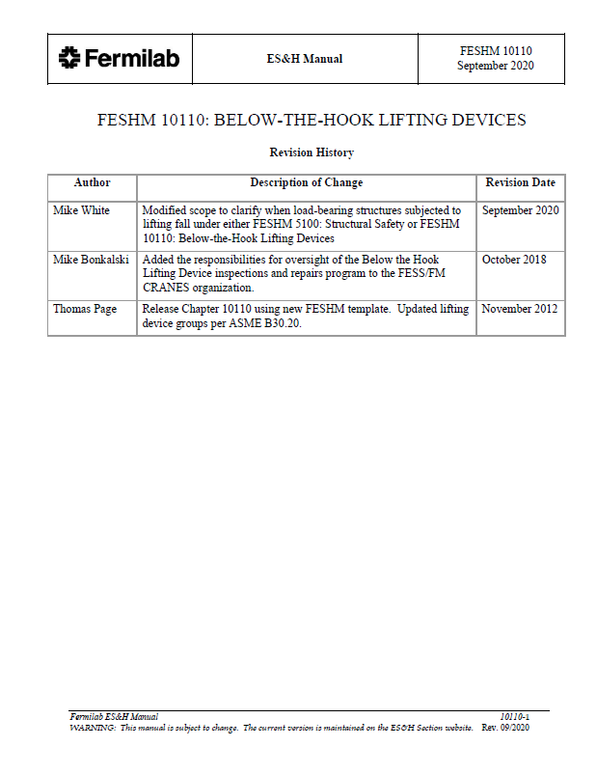
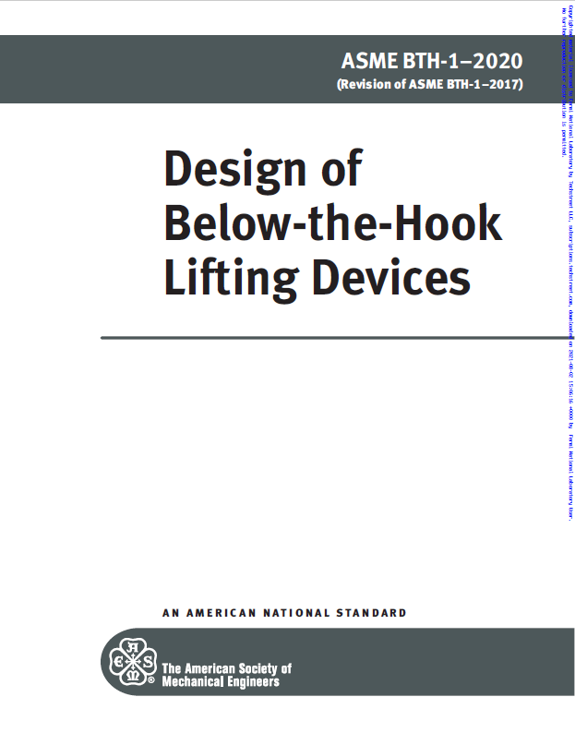
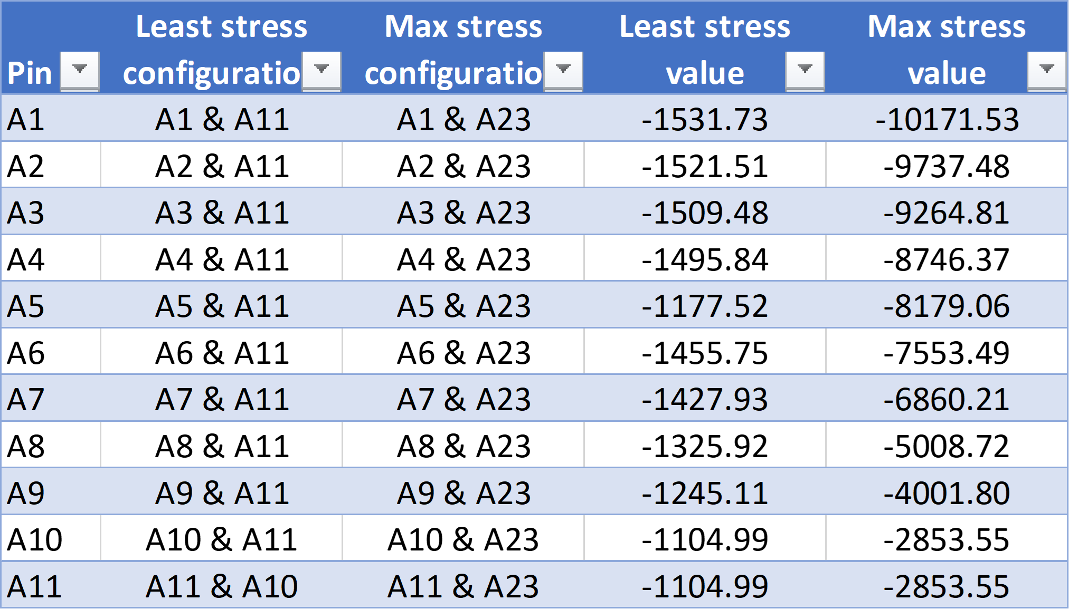
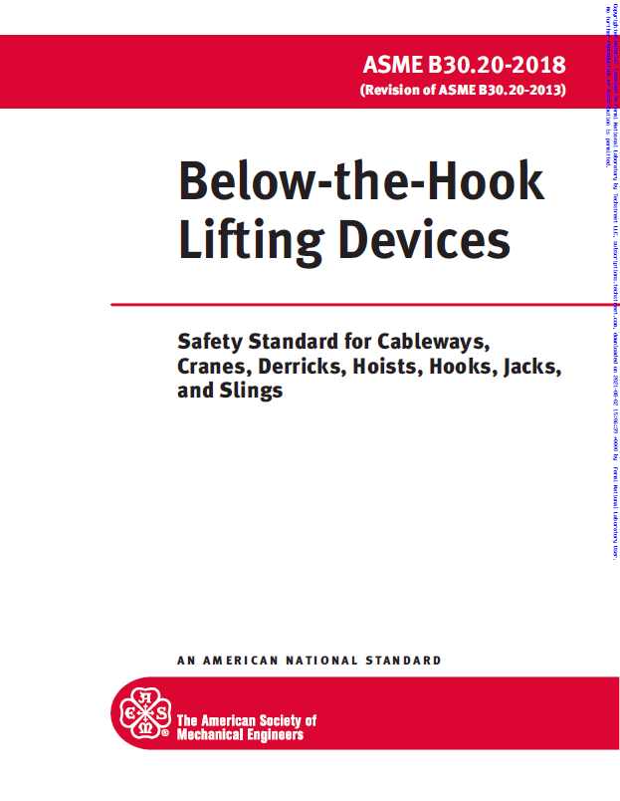
Code Compliance of APS-TD Lifting Devices
Minani Alexis, Illinois State University
FERMILAB-POSTER-23-153-STUDENT
Introduction to BTH Lifting Devices
Below the hook lifting devices are mechanical devices used to attach loads of different shapes and sizes to a crane to facilitate lifting and handling. These fixtures are governed by FESHM 10110, ASME B30.20, and ASME BTH-1.
FESHM 10110
Fermilab Environment, safety, and health Manuel (FESHM) is a living document that contains Fermilab’s policies and procedures designed to manage environmental, safety and health (ES&H) hazards. FESHM 10110 deals with BTH fixtures.
ASME B30.20/BTH-1
ASME B30.20 provides safety standards for BTH lifting devices, while ASME BTH-1 provides design criteria for BTH lifting devices.
Purpose of project
The purpose of this project is to locate all active and inactive lifting devices and verify their compliance with the current versions of the applicable codes such as ASME B30.20 and ASME BTH-1.
Engineering Note
An Engineering note is a documentation prepared by a qualified person that serves to provide the user with the design and fabrication of a lifting device. The note incudes Design calculations, Load tests, certifications, manufacturer information, etc.
Methods
To locate active lifting devices, the principle investigator interfaced with multiple building/floor managers throughout the department and entered the data collected into an Excel spreadsheet. The investigator also created a Teamcenter Engineering Note item for each lifting device. Finally, as a case study, the investigator took measurements of a sample device to perform calculations from the Machinery's Handbook and ASME BTH-1 to establish code compliance.
Results and Conclusions
The data revealed that while newer actively-used lifting devices in APS-TD are compliant with the relevant codes, certain older devices may require updated analysis, markings, etc. to comply with the most recent revisions to those codes.
Future Work
With up-to-date knowledge of active lifting fixtures compiled, the directorate can better target its code compliance efforts.
Data on Lifting Device and Engineering Note
Lifting Device
Eng. Note
Rated Load
Manufacturer Info
Lifter weight
BTH-1 Design category
BTH-1 Service class
Rated Voltage
Cold Current
Operating Controls
Product safety labels
EN Teamcenter #
Manufacture Info
Calculations
Safety precautions
Operating procedure
Maintenance procedure
Service rating
Duty Cycle
Inspection frequency
Load Test
BTH-1 Design Category
BTH-1 Service class
Max/Min Bending stress values in the beam
Acknowledgements
Special thanks to my supervisor Charles Orozco, Martel Walls, Kelly Sedgwick, and Wayne Shaddix for their Guidance and Support. Thanks to the SIST committee for this wonderful opportunity.
This manuscript has been authored by Fermi Research Alliance, LLC under Contract No. DE-AC02-07CH11359 with the U.S. Department of Energy, Office of Science, Office of High Energy Physics.

