Slide 1
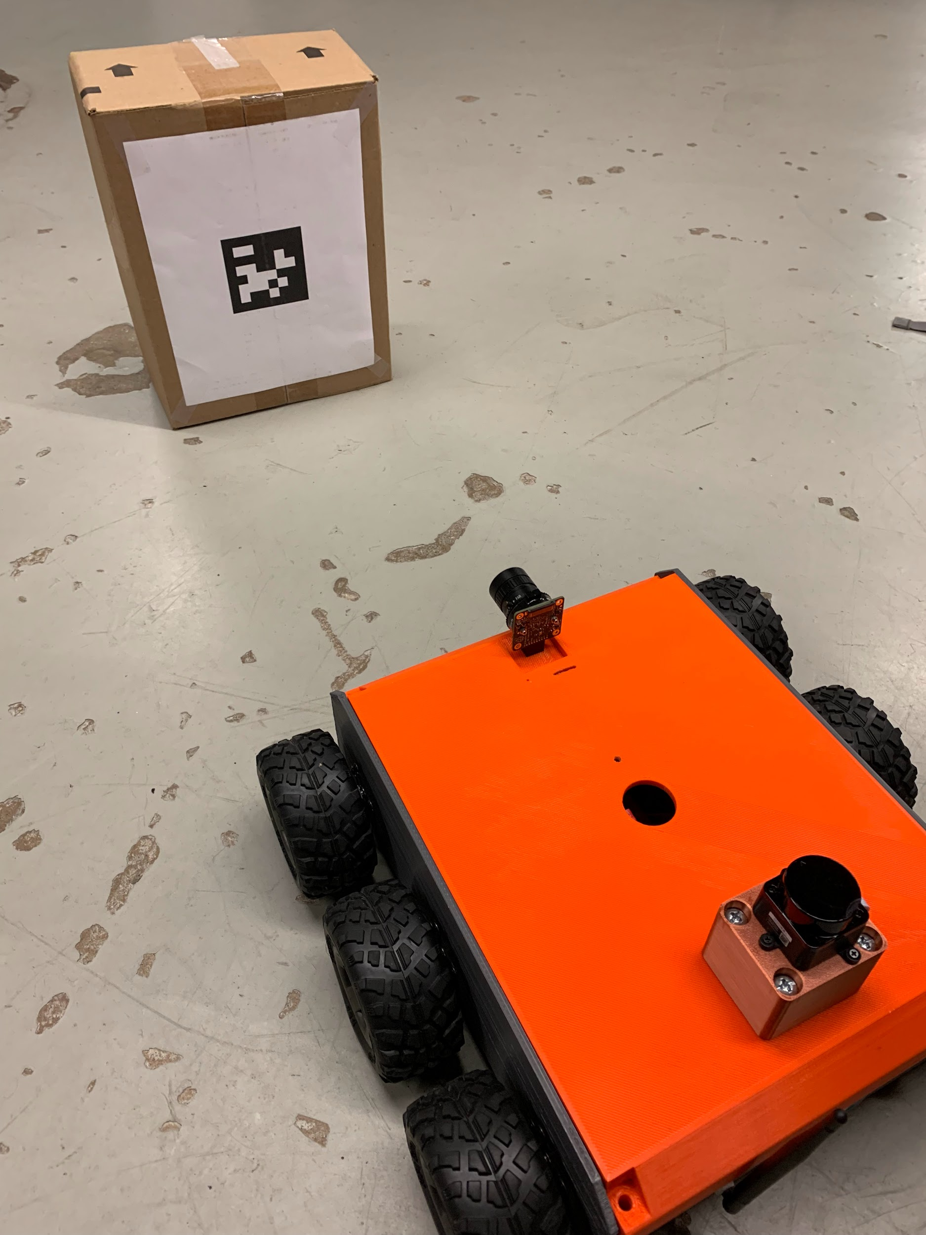
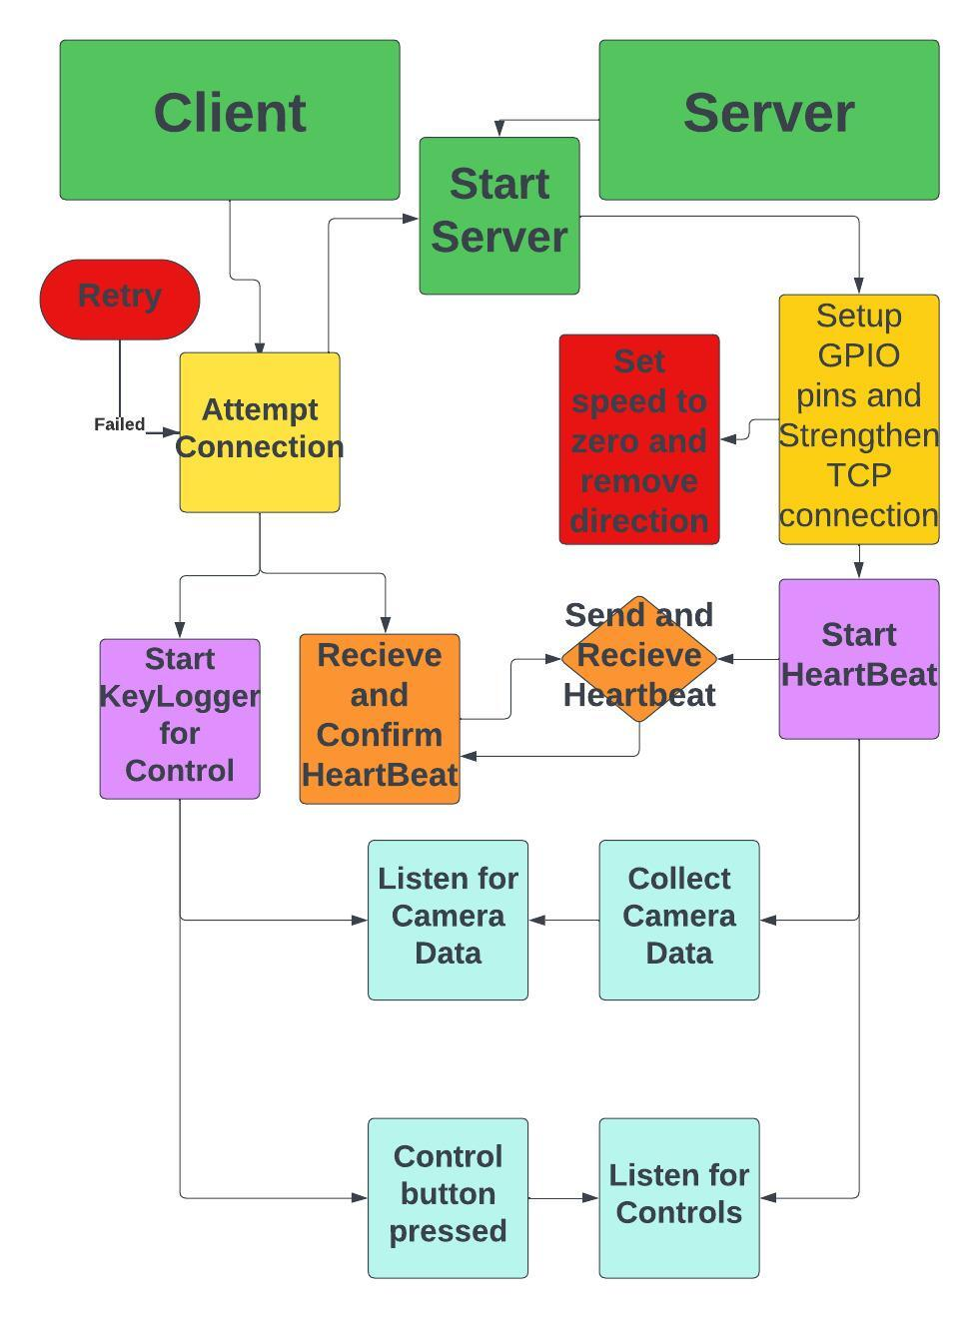
FERMILAB-POSTER-23-221-STUDENT
H.E.R.M.E.S – HElpful Robotic MESsenger
Justin Ellis, University of Utah-SIST-intern | Susanna Stevenson , Finley Novak, Fermilab
Overview
Recent Accomplishments
The overall goal of HERMES is to travel into the accelerator tunnels for routine surveillance reducing the radiation exposure to Fermilab employees. HERMES was a project started by a senior design team at NIU. The goal of the project was to add to HERMES by implementing new sensors, algorithms and making HERMES more user-friendly.
Established network connection to the Fermilab network to allow wireless communication following safety protocols making HERMES more user-friendly. HERMES will now be able to be used in the tunnels without the need for a tether.
Programmed the ultrasonic sensor to measure accurate distance. The Realsense depth camera with the ultrasonic sensor will help with object detection within the tunnels.
Wrote test programs for the Intel Realsense camera and was able to detect AprilTags. This will allow for mapping and localization within the tunnels.
Combined ultrasonic sensor, camera, AprilTags and algorithms for image-based object recognition, enabling basic object detection and autonomous movement.
Redesigned chassis to be able to hold ultrasonic sensor, the wifi adapter and the HQ camera without exposing internals improving HERMES safety.
HERMES modified with multiple mounts for camera, ultrasonic sensor and wifi adapter
HERMES internals after rewiring
Parts
Intel Realsense D435i - Provides high quality images and distance measurements allowing for depth sensing applications (Figure A)
A2 RPLidar - Generates point cloud data, enabling 2D mapping and localization (Figure B)
Parallax Ultrasonic Sensor - Used for proximity sensing and object detection (Figure C)
HQ Pi Camera - used for high quality images and video stream (Figure D)
Next Steps(or rolls) for HERMES
HERMES’ end goal is to be an autonomous “tunnel detective”. The next iteration of HERMES will be run on a Nvidia Jetson Nano. This will allow more computational power and the ability to leverage the built-in GPU for machine learning. AprilTags will also be placed in the tunnels to allow mapping of the area.
Figure A
Figure B
FIgure C
Figure D
HERMES looking at an AprilTag
Code Architecture diagram
This manuscript has been authored by Fermi Research Alliance, LLC under Contract No. DE-AC02-07CH11359 with the U.S. Department of Energy, Office of Science, Office of High Energy Physics.

