Slide 1
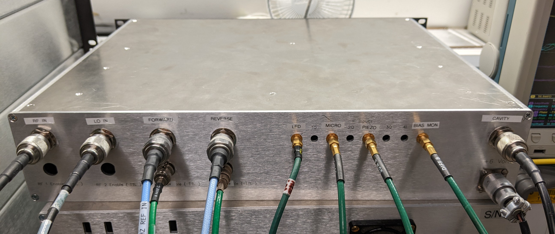
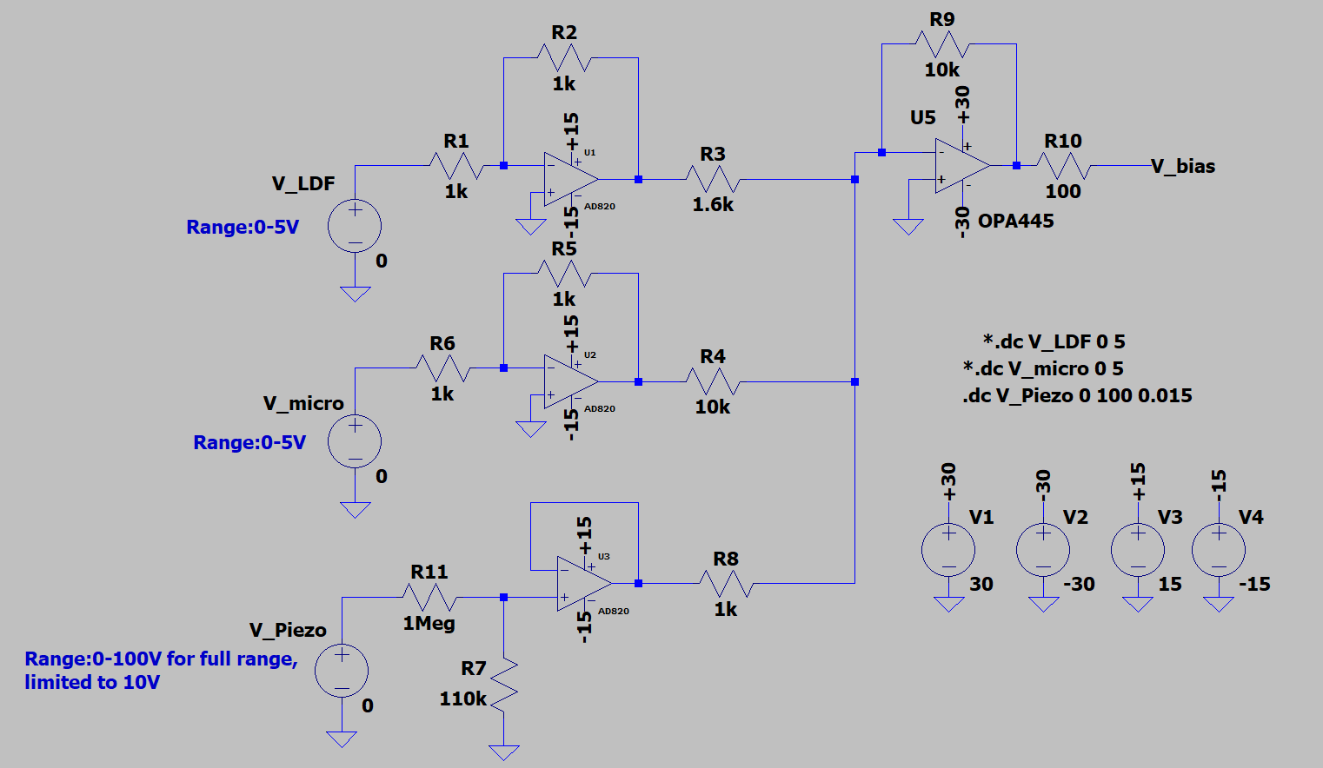
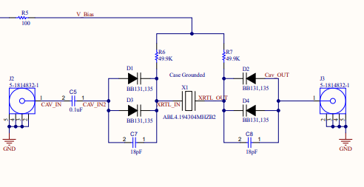
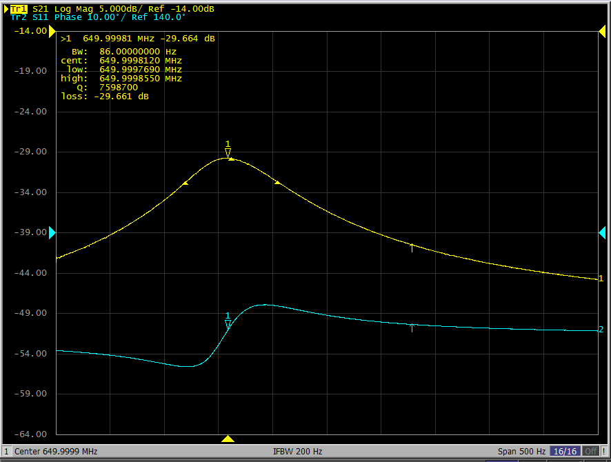
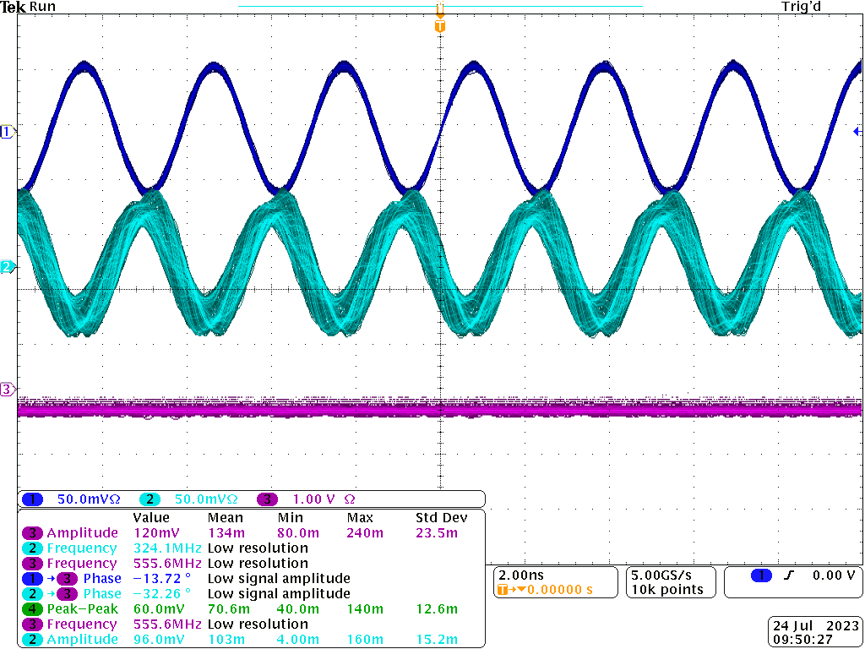
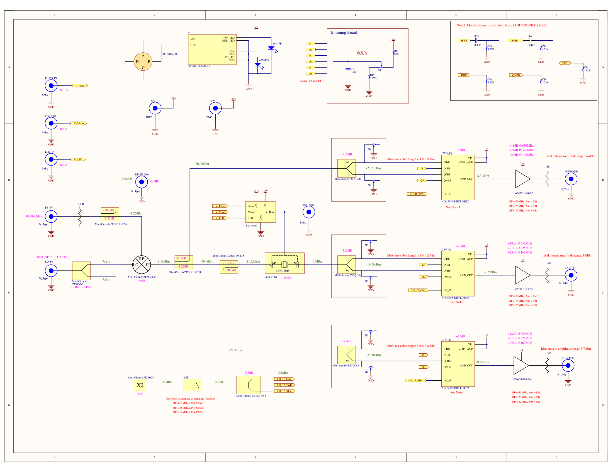
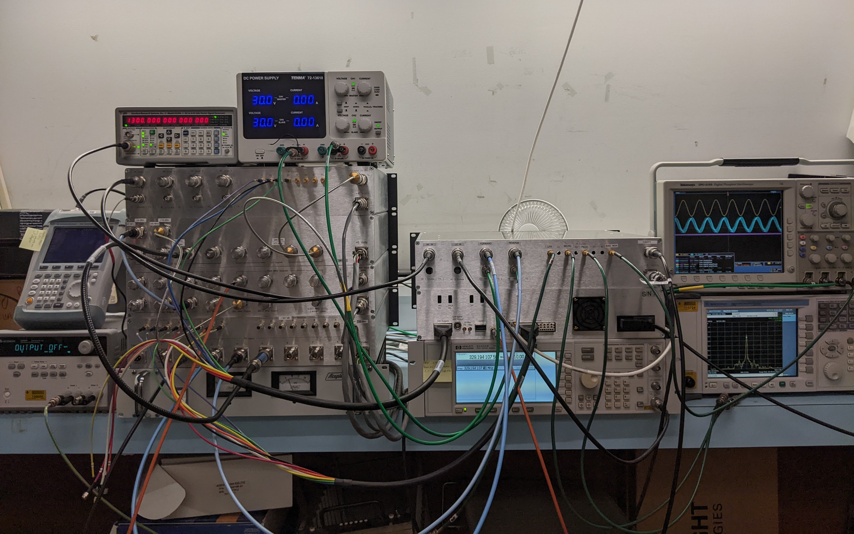
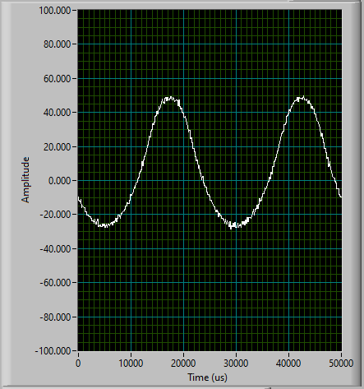
SRF Cavity Emulator for PIP-II LLRF Development
Christopher Fultz, North Central College – SIST internship
Introduction
Microphonics, LFD, and Piezo Electric Tuning
To aid in development and testing of cavity control hardware and software, a system has been developed to provide signal emulation of superconducting RF cavities for the PIP-II linac. An analog circuit is leveraged to simulate the bandwidth, high Q factor, and detuning effects from microphonics and Lorentz force detuning.
The emulator has two detuning inputs for microphonics caused by mechanical vibrations and Lorentz force detuning resulting from deformations in the cavity caused by the high-power RF drive. . An additional input is included to allow for corrective piezo electric drive signals for tuning. A summing circuit to generate a bias voltage is used to change the resonant frequency
Objectives and features
Operable at cavity frequencies: 162.5MHz, 325MHz, 650MHz with minor component changes
Simulate cavity probes for input forward and reverse power, as well as transmitted power.
Provide a proportional output amplitude to input RF drive signal.
Allow for detuning of the system to emulate microphonics and LFD effects
High Q factor ~ $8x{10}^{6}$ and Bandwidth 77Hz
Detuning Range: ~ 120Hz
I/Q modulation for up-conversion to cavity frequencies.
Fig.3 Bias voltage summing circuit
Fig.4 Tunable 4.1943MHz filter schematic
Test Results
The emulator was tested to characterize the frequency detuning response under different bias conditions.
Fig.1 Assembled Cavity Emulator
Fig.5 Graph of Bias voltage to resonant frequency
Fig.6 Bandwidth and phase under bias conditions
Design Details
A ~4MHz crystal resonator in combination with varactor diodes form a tunable bandpass filter with a high Q factor. A simple weighted summing circuit is used to produce a varactor bias voltage for detuning. RF drive signals are down-converted, passed through a pair of directional couplers, and then fed to the crystal filter. The output of the filter and the forward and reverse coupler outputs are then each split and undergo I/Q modulation to up-convert them back to the input RF frequency. The signal levels are amplified to provide sufficient power levels to the downconverter.
Fig.7 Resonant Frequency range with varying DC bias.
Fig.8 Waveform of RF monitor (Ch1), Reverse probe (Ch2) and Bias voltage monitor(Ch3)
Test Stand Application
A full test stand was constructed to exercise the LLRF controller with the cavity emulator in the loop. Detuning properties were confirmed with data from SRF tests. Running a QL test measured a half bandwidth of ~32Hz and Q of ~1.05x10⁷ at 325MHz.
Fig.9 Diagram of Test stand system
Fig.10 Wired test stand system
Fig.2 Cavity Emulator circuit schematic
Fig.12 Frequency detuning with a sinusoidal bias signal waveform at 2Vpp @ 40Hz
Acknowledgments
This manuscript has been authored by Fermi Research Alliance, LLC under Contract No. DE-AC02-07CH11359 with the U.S. Department of Energy, Office of Science, Office of High Energy Physics.
Fig.11 Ql Measurement waveform

