Slide 1
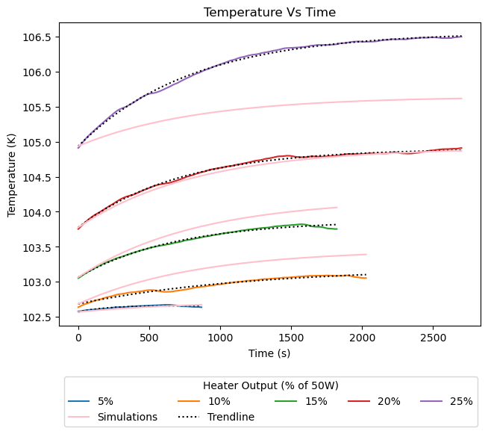
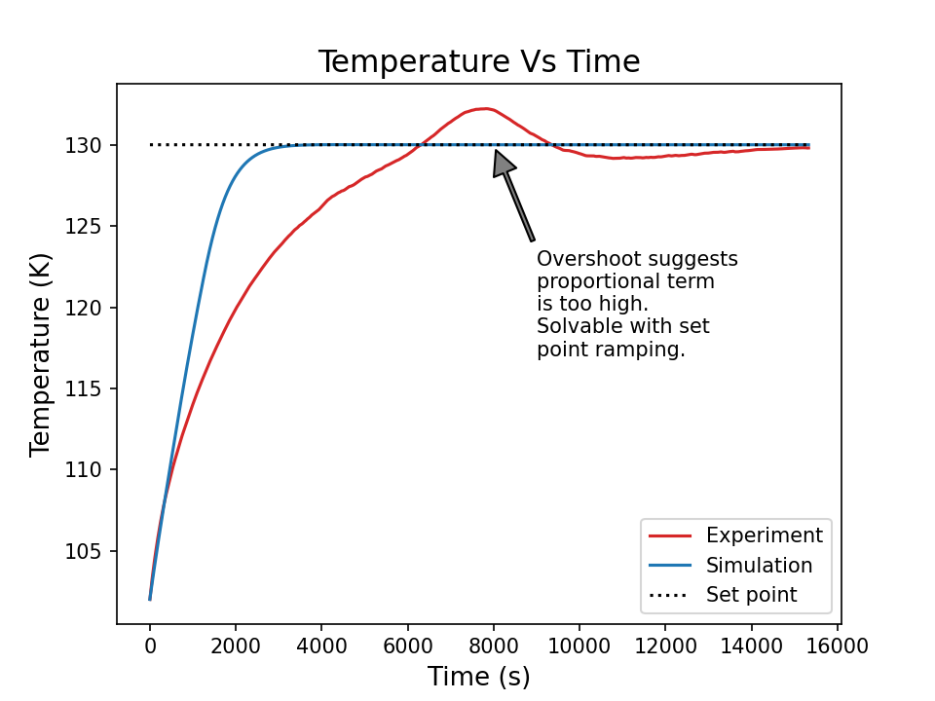
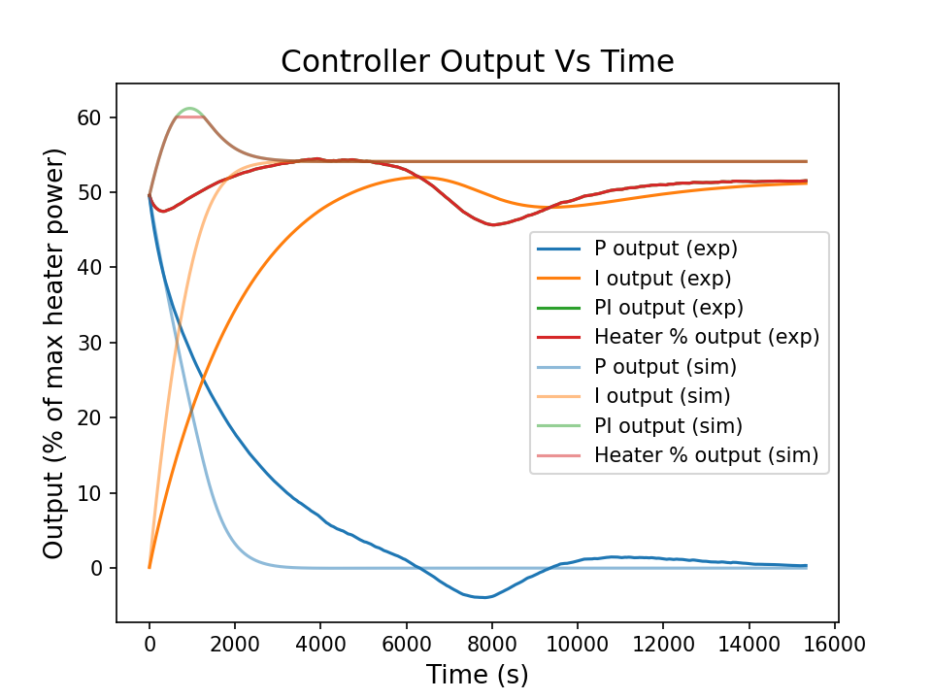
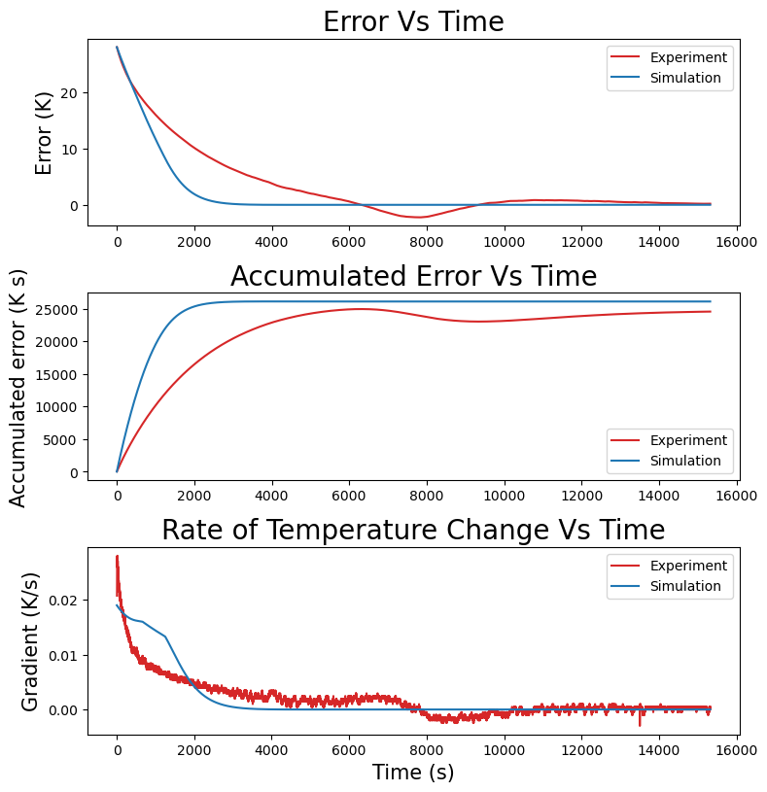
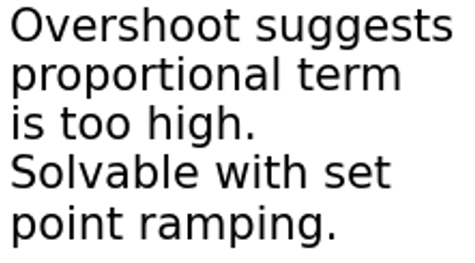
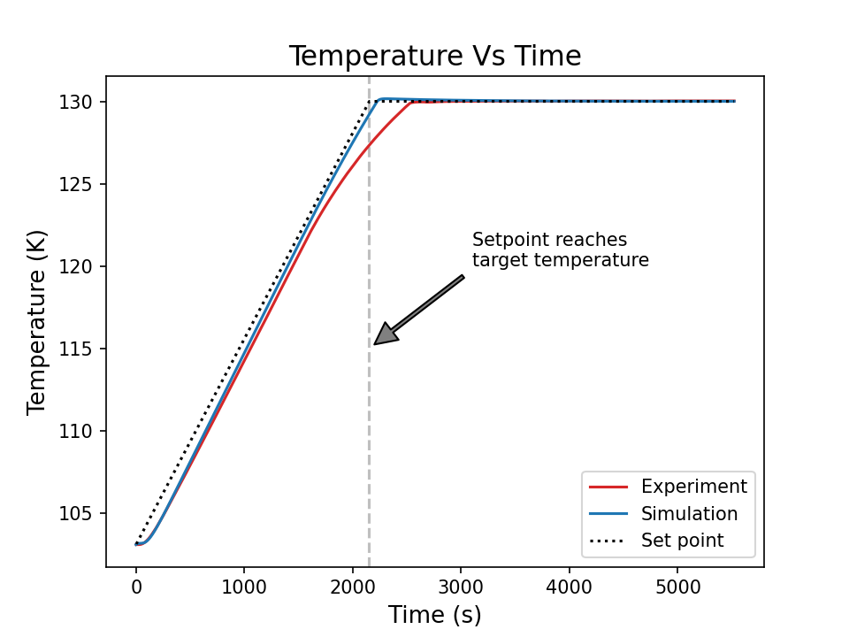
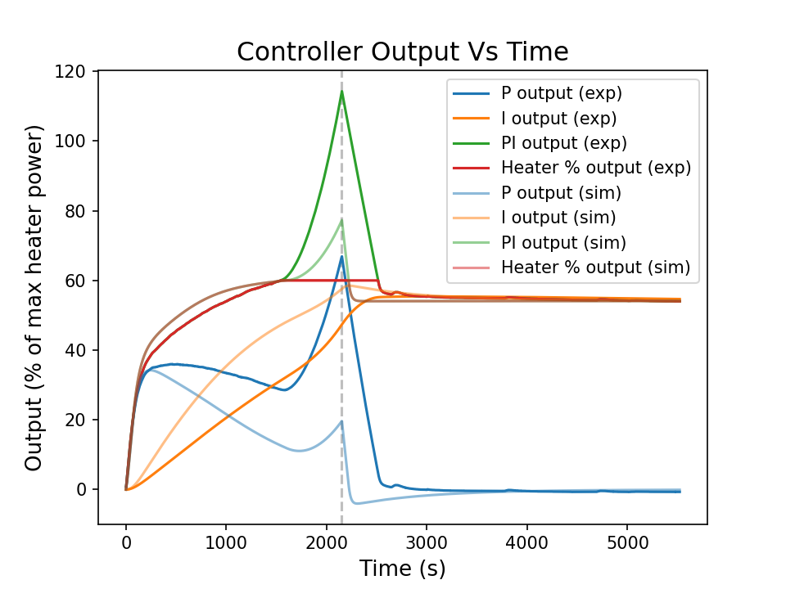
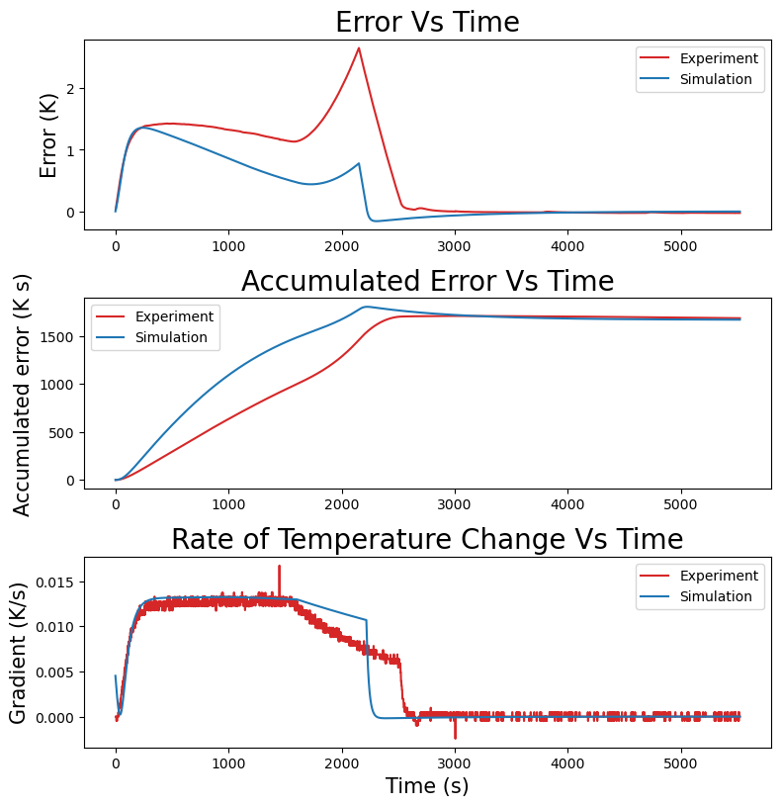
FERMILAB-POSTER-23-151-STUDENT
PID Temperature Controller Autotuning for Skipper-CCDs
Evan Jones, Wellesley College, 2023 SIST Intern | Supervisor: Ana Martina Botti
Introduction
Set up
Proportional-integral-derivative (PID) temperature control of Skipper-CCDs is important for dark matter direct-detection experiments, e.g., SENSEI@MINOS. The project goal is to create an autotuned PID controller in Python to replace expensive Lake Shore temperature controllers.
Skipper-CCD on metal block inside Ideal Vacuum Cube
~10⁻⁴ Torr with Hi Cube pump
~102 K with Polycold PCC cryocooler
Lake Shore 336 Temperature Controller for reading temperature, providing heater power
Perform step tests and fit with first order response equation
Fig. 1. Skipper-CCD inside an Ideal Vacuum Cube
First order step test response with bias and no deadtime
Ideal Approach
Phenomenological Approach
Approximates block with uniform temperature for each time step
Physical system-specific variables incorporated into scale factors
Unsuccessful fitting — scale factors insufficient for fitting heater output responses (Fig. 2)
Further investigation of unaccounted factors needed
Finds rate of temperature change vs. temperature for each step-tested output
Uses this to simulate changes in block temperature
(a)
(b)
Fig. 2. Experimental step test results for outputs 5% to 25% fitted with first order response trendline, alongside simulated results. Simulation aligns well with 20% step test, poorly with others.
Fig. 3. Experimental step test results for outputs 5% to 55% with first order response equation (a) and linear trendline (b), alongside simulated results. 0% and 60% omitted for figure readability.
(a)
(b)
Heat transfer equations for physics-based simulation. Calculated each time step.
Fig. 4. Slope (a) and intercept (b) of Fig. 3(b) trendlines. Outputs 0% to 60%. Third degree polynomial trendlines. 5% output (slope -0.0043 K²/s, intercept 0.44 K/s) considered an outlier due to noise at temperatures close to 102 K. Step tests <20% seem out of range for reliable results.
PID Controller Results
(a)
(b)
(c)
Working solution achieved!
Simulated and experimental results have similarly shaped curves with potential for improvement
Data-based simulation gives estimate for initial parameters
Easily scalable for future applications on other systems
Error informs proportional and integral outputs.
(d)
(e)
(f)
Controller output is the sum of proportional, integral, and derivative terms, with a 60% maximum cut-off due to range of step test data. The proportional term reacts to the current error, the integral term to accumulated error, and the derivative term to rate of change of temperature.
Fig. 5. Temperature control experiments and simulations. Target temperature 130 K. No derivative term due to its destabilizing tendency and lack of system deadtime. Discrepancies show room for improvement, possibly by collecting more or different step test data.
Fig. 5. (a) (b) (c) No set point ramping, KP = 1.768, TI = 848.7
Fig. 5. (d) (e) (f) Set point ramping of 0.75 K/min, KP = 25.2, TI = 777
This manuscript has been authored by Fermi Research Alliance, LLC under Contract No. DE-AC02-07CH11359 with the U.S. Department of Energy, Office of Science, Office of High Energy Physics.

