Slide 1
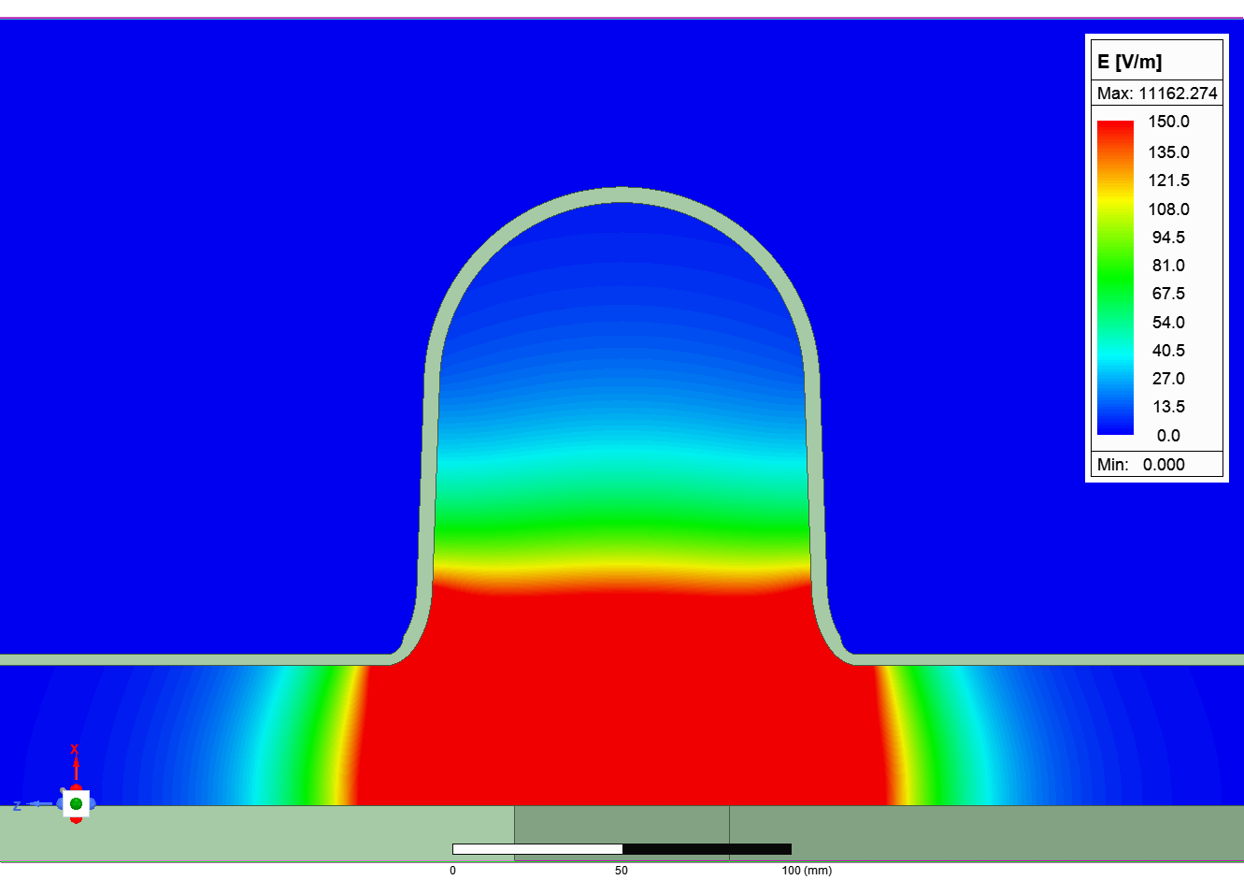
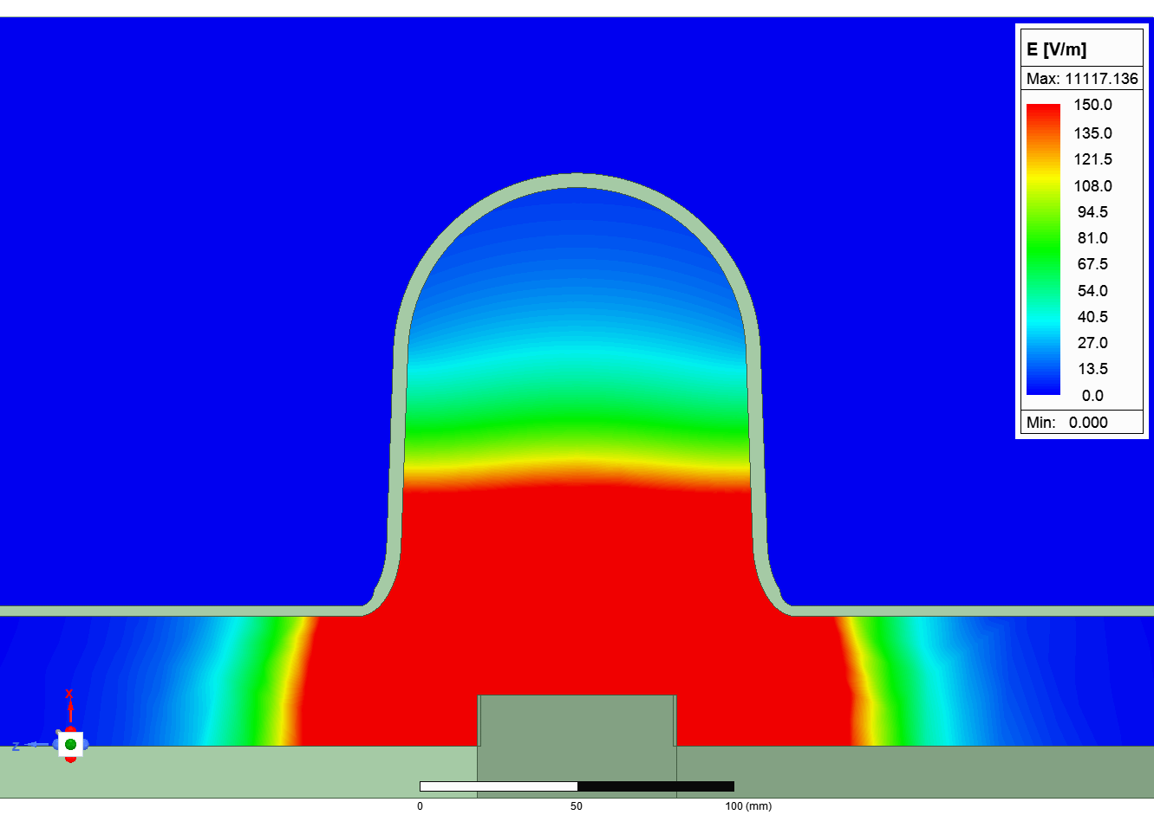
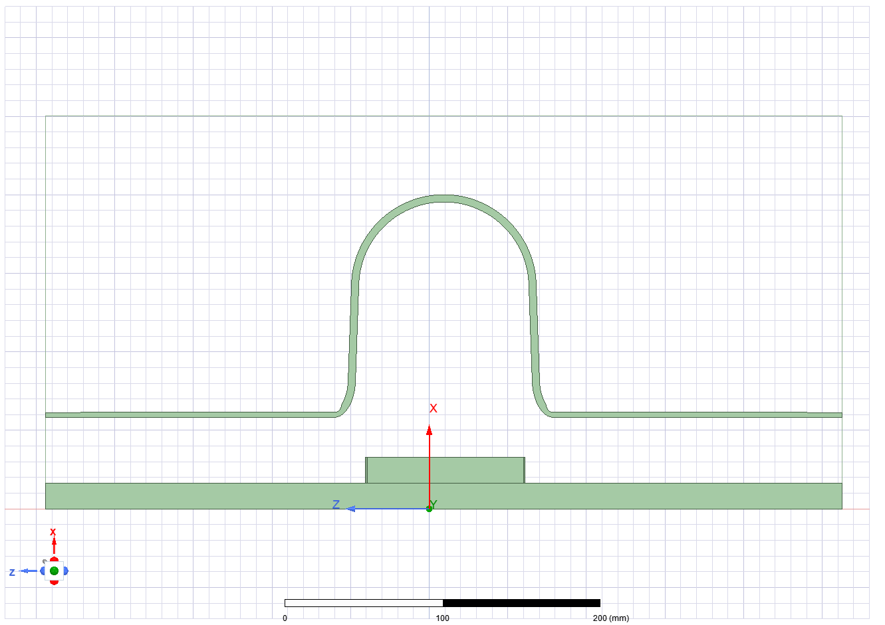
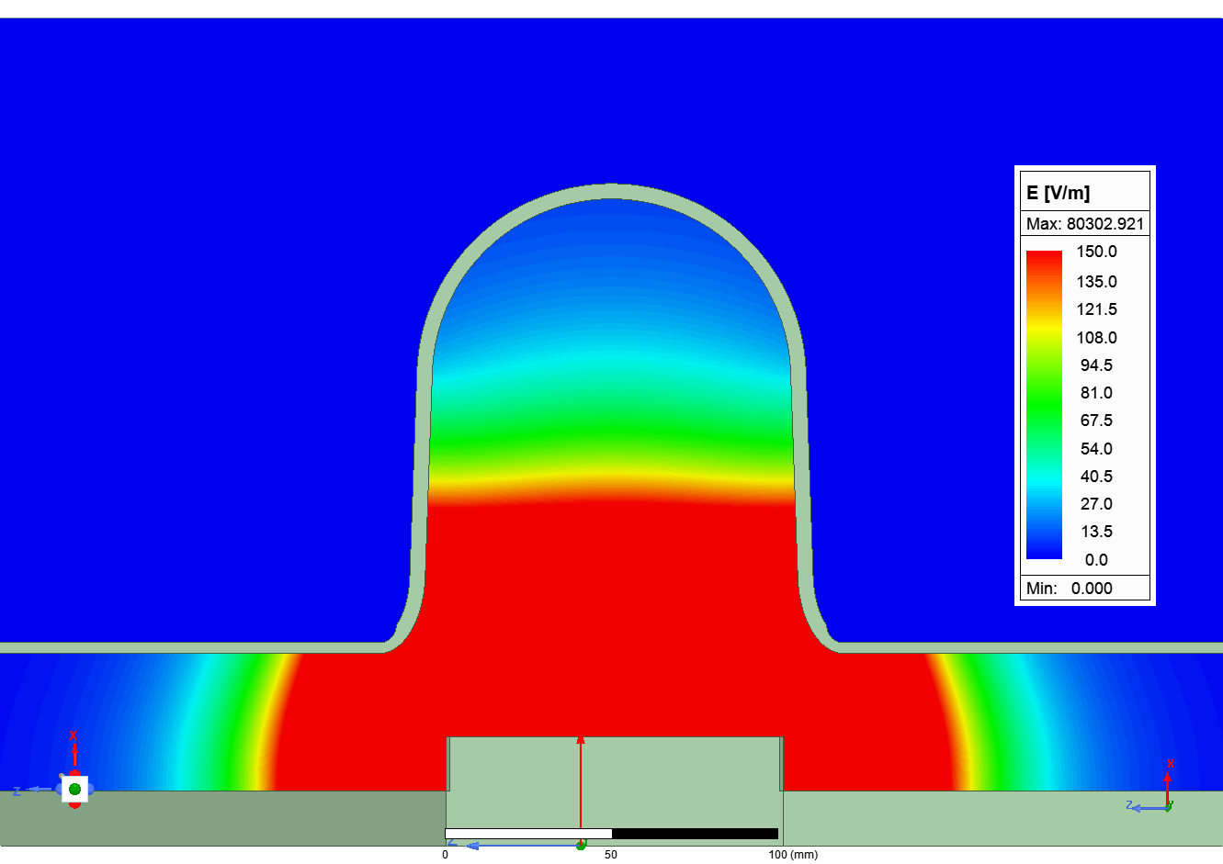
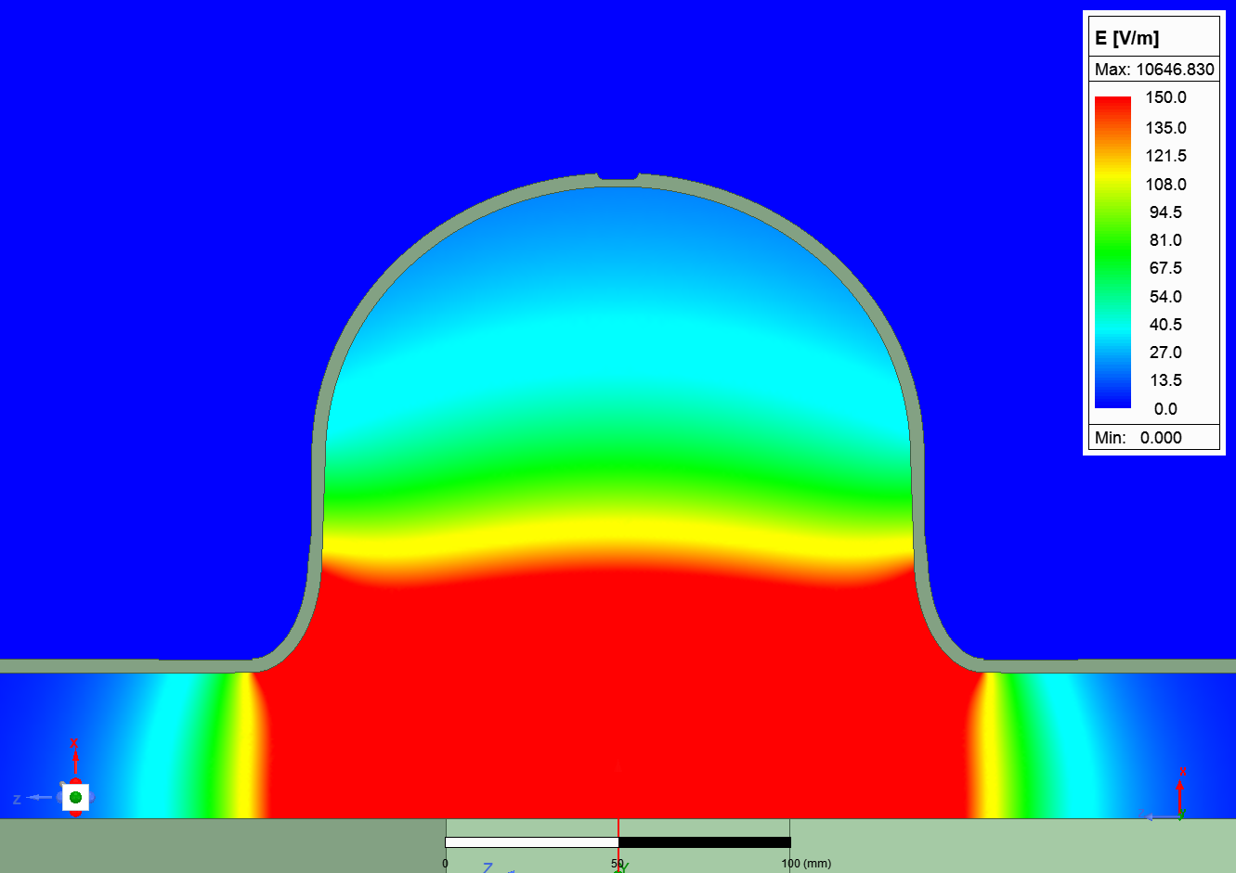
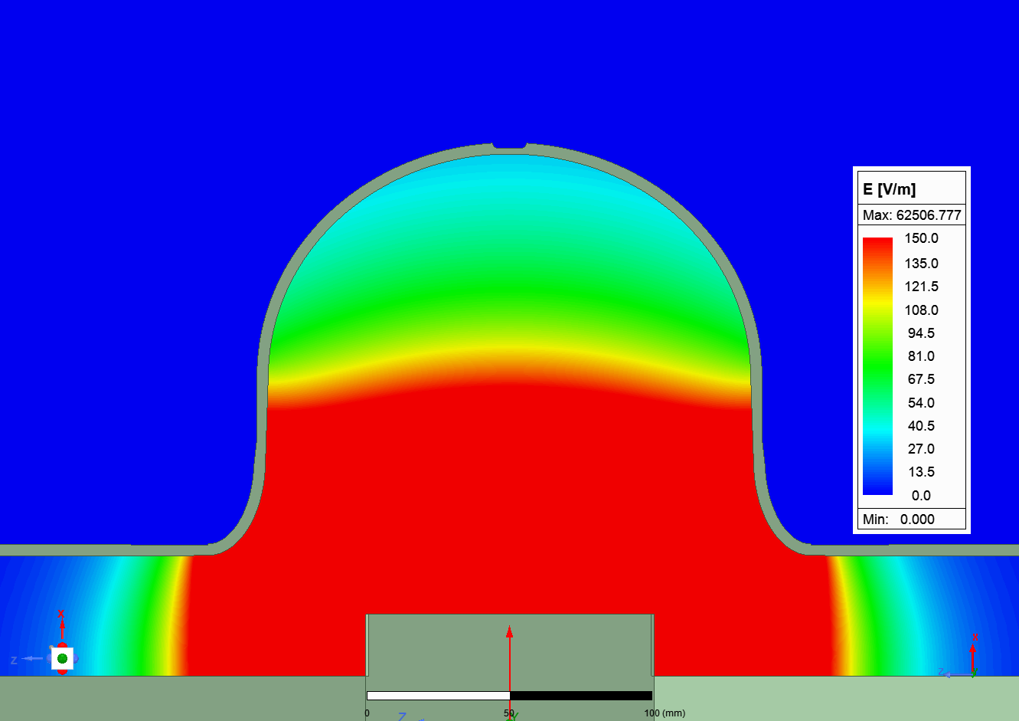
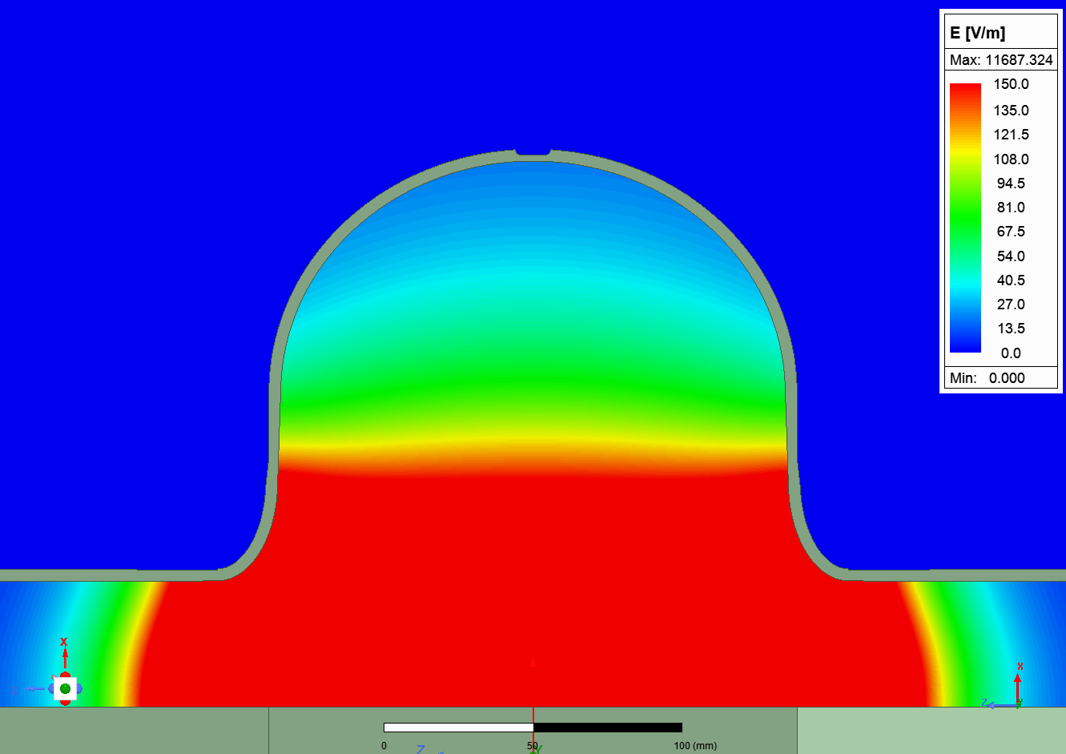
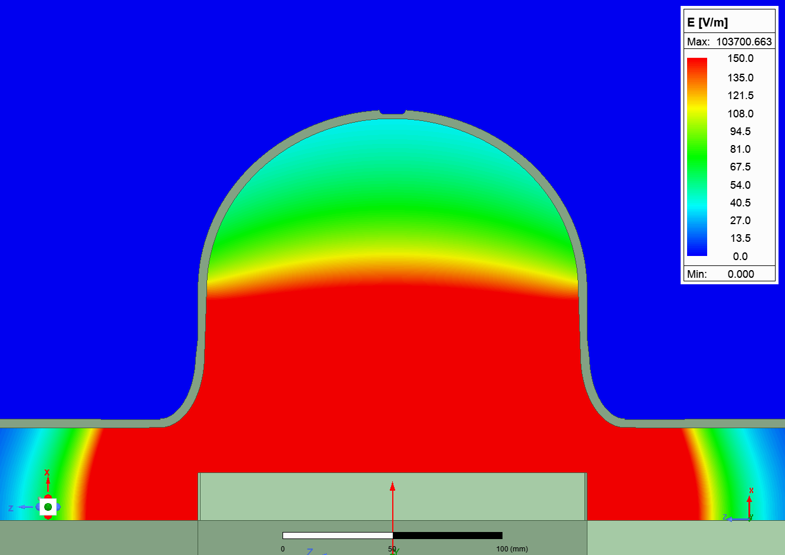
6
Study of Cathode and Cavity Geometries in Electropolishing (EP): Electric Field Simulation
Bereket Loer, Vijay Chouhan
Introduction and Motivation
# FERMILAB-POSTER-23-191-STUDENT
Niobium (Nb) superconducting radio frequency (SRF) cavities require electropolishing surface treatment to reach high acceleration gradient. EP performed in the plateau region of an I-V curve [1] leads to a smooth finish of the cavity surface including the equator surface. The equator surface is vital because a rough equator surface leads to premature quench and limit the cavity performance. Previous experimental work was performed to optimize EP parameters for low-beta (LB) 650 MHz Nb cavity [1]. It was found that different cathode surface areas vary the plateau onset voltage. A lower onset voltage was achieved for HB650 cavity with an enlarged cathode surface area. The aim of the study is to perform electrostatic and electrochemical simulation to understand the impact of both cavity geometry and cathodes. This report covers an initial result on electric field simulation performed with HB and LB 650 MHz cavities.
I-V curves with different donut sizes
surface area ratio
(Cathode: Cavity)
5%
10%
28%
Methods
Results
Electric field simulation was performed using Ansys Maxwell 2D to find E-field on the equator.
E-Field distribution in HB650 and LB650 cavities with different cathodes
Rod: 2”
Donut: 2”
The E-field magnitude on the equator surface varies with both the shape of the cathode and the shape of the cavity.
Extended cathode (donut) enhances electric field on the equator.
The HB650 cavity had a higher E-field on equator than that in LB650 cavity.
E-field variation doesn’t corroborate with the variation in the onset voltage in I-V curves.
This suggested that the cathode polarization has greater impact on the onset voltage.
Cathode surface area controls the cathode polarization.
Max E_{equator}≈5 V/M
Max E_{equator}≈9.5 V/M
Region
Equator
Anode
100 mm
100 mm
Insulator
Donut cathode extension
LB650
Rod: 4”
Donut: 4”
Axis symmetry
Max E_{equator}≈6 V/M
Max E_{equator}≈11 V/M
Rod
Cathode
100 mm
100 mm
Conditions | LB650 |  | HB650
Cathode rod diameter | 1.29”
Materials | Anode: tantalum Cathode: aluminum Insulator: PVC Region: User defined sulfuric acid*
Cathode configuration | Rod: 2” and 4” #Donut: 2” and 4” | Rod: 4” and 7” **Donut: 4” and 7” | Rod: 2” and 4” Donut: 4” and 7”
Simulation | Max 10 passes, 1% error convergence |  | Max 10 passes, 1% error convergence
Excitation | 20 V to anode, -20 V to cathode | 20 V to anode, -20 V to cathode | 20 V to anode, -20 V to cathode
Rod: 4”
Donut: 4”
Max E_{equator}≈17 V/M
Max E_{equator}≈33 V/M
HB650
100 mm
100 mm
Rod: 7”
Donut: 7”
Max E_{equator}≈20 V/M
Max E_{equator}≈37 V/M
100 mm
100 mm
Summary
*Relative permittivity of acid: 84,
Acid conductivity: 1.044×10⁻⁴ Siemens/m
**HB donut: 3-inch diameter
# LB donut 2.6-inch diameter
The study explored electric field distribution in niobium SRF cavities, considering cavity geometry and cathode size. The HB 650 cavity with a 4-inch cathode showed higher electric field (V/M) than the LB 650 cavity with the same cathode size. E-field variation did not align with onset voltage changes in I-V curves, suggesting cathode polarization resistance has greater impact on onset voltage. Cathode surface area influences cathode polarization. Further simulation work could be done by coupling a chemistry interface, adding better material approximation, and coupling fluid flow.
References
[1] V. Chouhan et al., Electropolishing parameters study for surface smoothening of low-β 650 MHz five-cell niobium superconducting radio frequency cavity. Nuclear Instruments and Methods in Physics Research Section A: Accelerators, Spectrometers, Detectors and Associated Equipment, 1051, 168234 (2023). doi:10.1016/j.nima.2023.168234
The work was supported by Fermi Research Alliance, LLC under contract no. DEAC02-07CH11359 with the United States Department of Energy.

