Slide 1
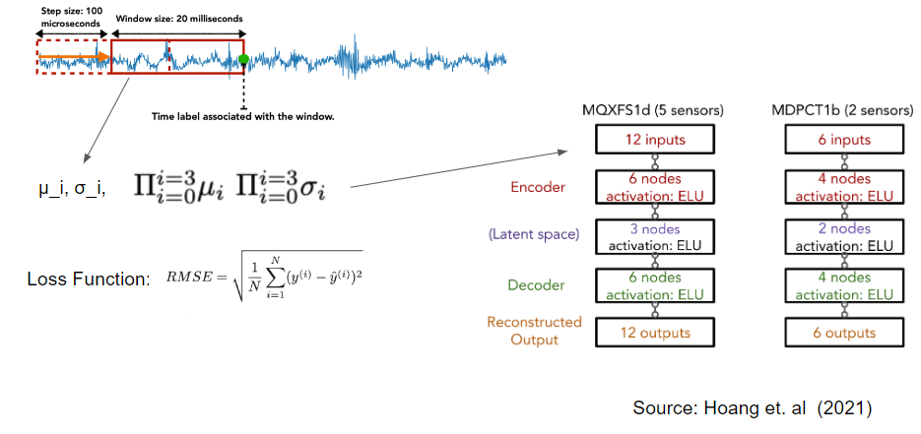
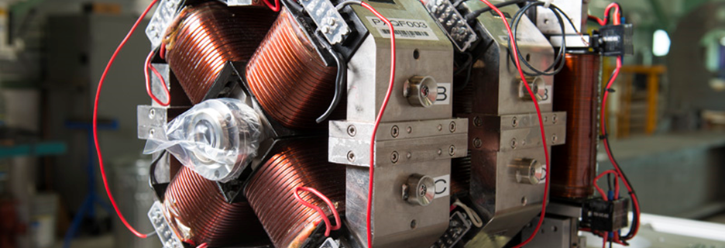
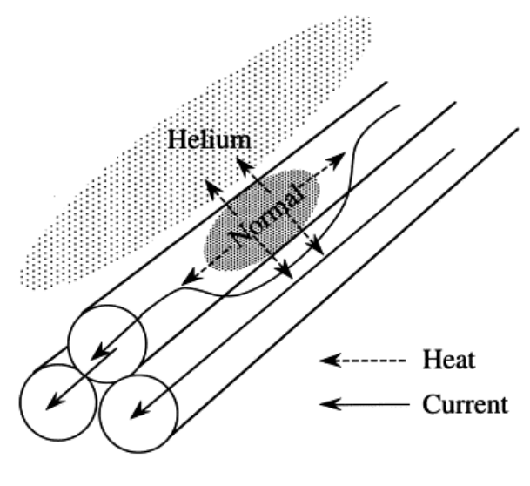
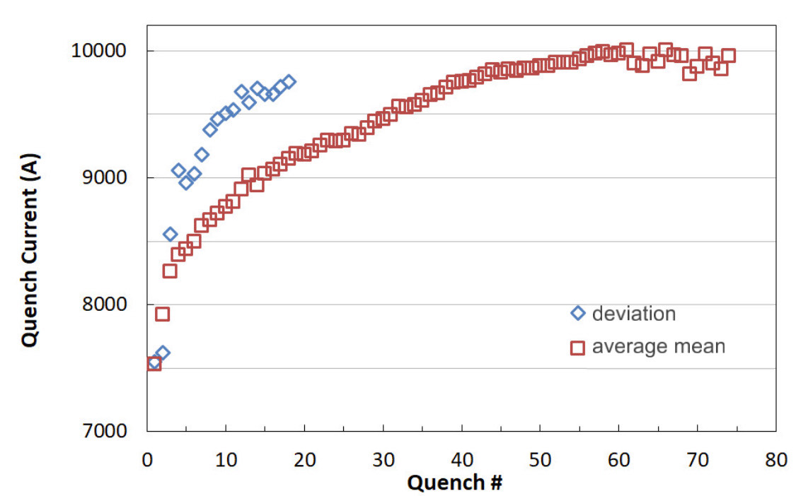
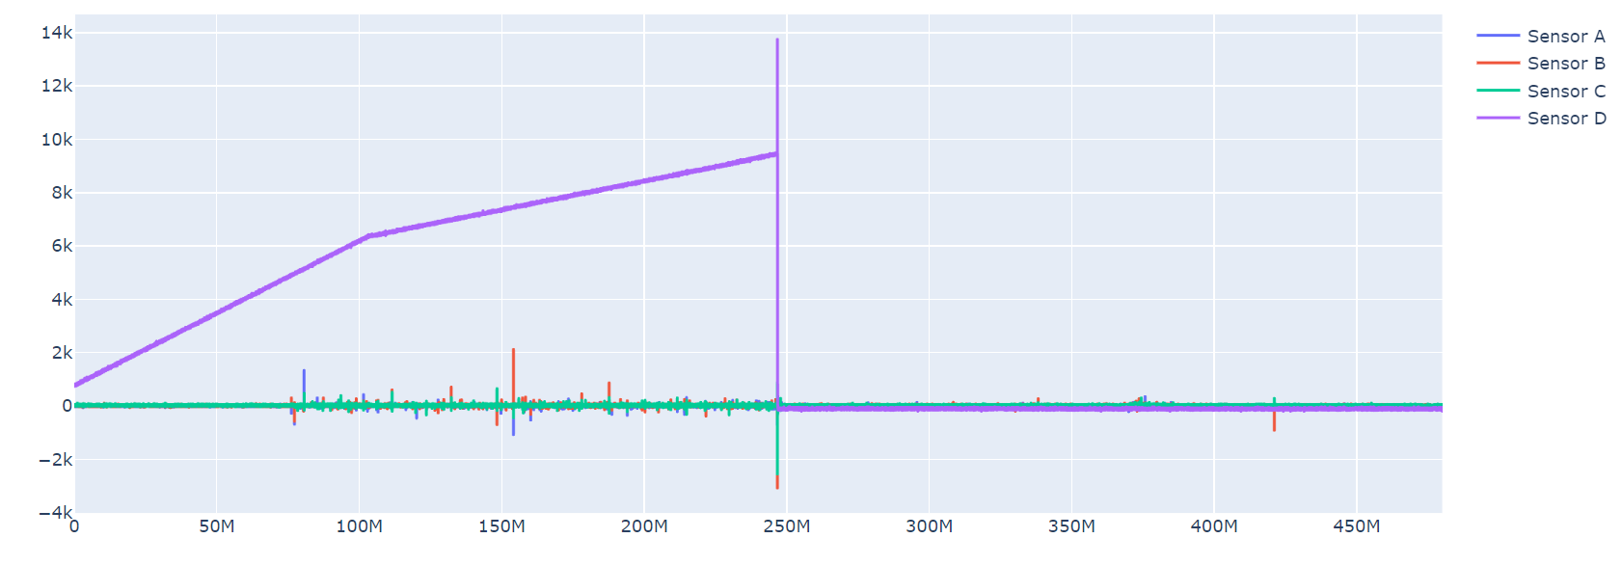
Anomaly Detection of Quenches in Superconducting Magnets Acoustic Data
Boro Zorigtbaatar, SIST Program (2023) | Luciano Elementi | Maira Khan
FERMILAB-POSTER-23-234-STUDENT
Introduction
Methodology
A superconducting magnet is an efficient type of magnet that uses special materials that can conduct electricity without any resistance. The use of superconducting magnets provides several advantages over traditional electromagnets, including the ability to generate much stronger magnetic fields and operate more efficiently, since they don't dissipate energy as heat. However, they require sophisticated cooling systems, typically using liquid helium to maintain their superconducting state. They also need careful monitoring and management to prevent "quenches", where parts of the magnet abruptly lose their superconductivity.
The use of a rolling window in detecting anomalies in superconducting magnet data is vital due to its capacity to capture temporal dependencies in the data, a key aspect for recognizing anomalous patterns. It aids in reducing noise by averaging over a specified interval, enhancing the model's ability to identify genuine anomalies against the backdrop of minor fluctuations. Furthermore, the technique offers adaptability and efficiency, permitting real-time monitoring and early anomaly detection without overwhelming computational resources.
Fig.1: Superconducting magnets at Fermilab
Quench events occur when a superconducting material loses its superconductivity and returns to a normal, resistive state. Repeated quenches in superconducting magnets can be costly due to the potential damage they can cause to the magnets. Minimizing the occurrence of quench events is desirable to optimize the performance, reliability, and cost-effectiveness of superconducting magnet systems.
Fig.4: Rolling window for quench detection
Conclusion
Utilizing a rolling window approach, the study successfully identified anomalies within the 'Ramp 1' data set. The analysis indicated specific instances where quenches were triggered, as highlighted by standard deviation and mean amplitude calculations. This demonstrates the efficacy of rolling window techniques in discerning subtle irregularities in complex data.
Fig.2: Helium cools down magnet heats
Purpose of the project
This study employs Artificial Intelligence (AI) algorithms to bolster the detection and characterization of quench events in superconducting magnets, primarily focusing on data from Ramp 1. A network of strategically positioned acoustic sensors captures unusual sound signatures, aiding in early quench detection.The goal is to refine and broaden the scope of current algorithms for real-time anomaly detection in realistic, continuous ramping systems, thus improving reliability and enabling multi-modal data analysis. This methodology is anticipated to assist in future categorization of diverse quench events.
Fig.5: Anomaly trigger examples in Ramp 1
Fig.6: Anomaly detection in Ramp 1
Acknowledgement & Reference
This manuscript has been authored by Fermi Research Alliance, LLC under Contract No. DE-AC02-07CH11359 with the U.S. Department of Energy, Office of Science, Office of High Energy Physics.
¹Hoang, D. (Rhodes College), Kazi, S. (MIT), Tran, N., Boffo, C., Krave, S., Marinozzi, V., & Stoynev, S. (Fermilab). Real Time Detection of Magnet Quenches in Superconducting Accelerator Magnets.
²Gourlay, S., & Prestemon, S. (Year). Overview of Superconducting Magnets for Particle Accelerators. Lawrence Berkeley National Laboratory (LBNL).
Fig.3: Acoustic sensors information from Ramp 1

