Slide 1
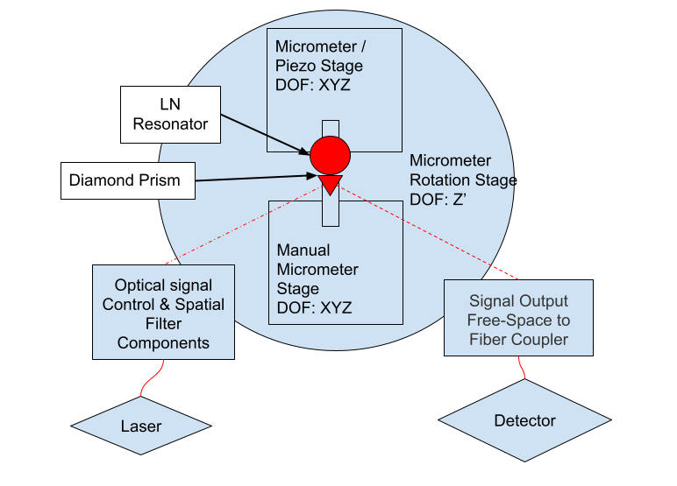
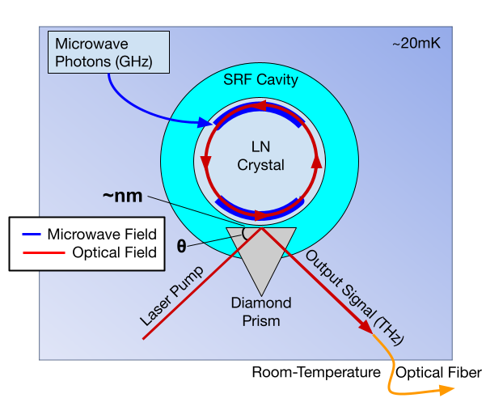
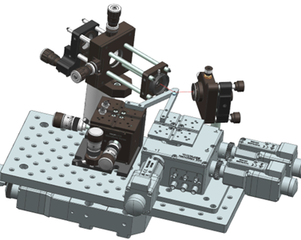
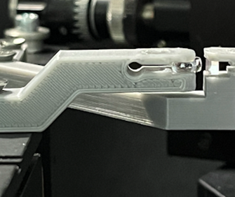
Ultrahigh-precision Mechanical Platform for Quantum Transduction
Author: Julian Delgado¹
Advisors: Silvia Zorzetti², Changqing Wang²
¹ GEM Fellow, Northwestern University
² SQMS, Fermi National Accelerator Laboratory
Microwave-to-Optical Quantum Transduction
Superconducting quantum devices operate at cryogenic temperatures in a dilution refrigerator. Optical photons are more resistant to thermal noise at room-temperature and have longer lifespans. A quantum transducer could convert quantum information from microwave to optical frequency.
We are working on quantum transduction using the electro-optic effect to couple microwave and optical fields in a Lithium Niobate (LN) nonlinear crystal at record efficiencies. A laser pump is coupled to the LN resonator by a diamond prism to bridge the 5-order energy gap between microwave and optical frequencies.
Block diagram of room-temperature testbench mechanical system
Motion Stage Trajectory & Controls
Achieving optical coupling requires scanning a large area (mm) of space with small (nm) movement steps. Automating the scanning process is necessary to quickly and repeatably find the target position. I developed a python code to send serial commands to the motor and piezo controllers for each actuator.
I used this code to create scanning trajectories. I implemented common exhaustive search trajectories such as spiral and raster scans. In addition, we could potentially automate the detector readout, create a coupling objective function and implement a search algorithm to optimize the coupling process.
Overview of cryogenic electro-optic quantum transducer
Multi-Axis Nano-Positioning System
The evanescent optical coupling to the LN crystal is sensitive to nm-scale steps in distance and mrad-scale angles between each component, requiring a multi-DOF positioning system. We needed a room-temperature testbench to measure the transmission spectrum of the optical coupling. I worked on designing a mechanical system using piezo actuators and stepper motor actuated micrometers to position the diamond prism and LN crystal.
CAD of multi-motion stage system to position optical components
Diamond prism and LN crystal mounted on 3D-printed brackets
Next Steps
Once we have characterized the coupling and transduction process in room-temperature, we will be implementing it in the cryogenic condition. I’ll be working on an initial design for a similar platform in a dilution refrigerator.
FERMILAB-POSTER-23-225-SQMS-STUDENT
References
Wang, C., Gonin, I., Grassellino, A. et al. High-efficiency microwave-optical quantum transduction based on a cavity electro-optic superconducting system with long coherence time. npj Quantum Inf 8, 149 (2022). https://doi.org/10.1038/s41534-022-00664-7
Acknowledgements
This manuscript has been authored by Fermi Research Alliance, LLC under Contract No. DE-AC02-07CH11359 with the U.S. Department of Energy, Office of Science, Office of High Energy Physics. This work is funded by the Fermilab’s Laboratory Directed Research and Development (LDRD) program.
This research used resources of the U.S. Department of Energy, Office of Science, National Quantum Information Science Research Centers, Superconducting Quantum Materials and Systems Center (SQMS) under contract number DE-AC02 07CH11359. The NQI Research Center SQMS contributed by supporting the design of SRF cavities and access to facilities.

