Slide 1
Security through Radioisotope Replacement with Accelerators
Nick Butler
Deputy Director
Office of Radiological Security
September 20, 2023

Slide 2
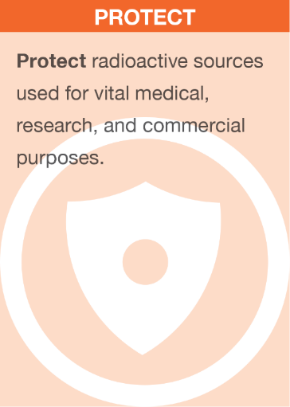
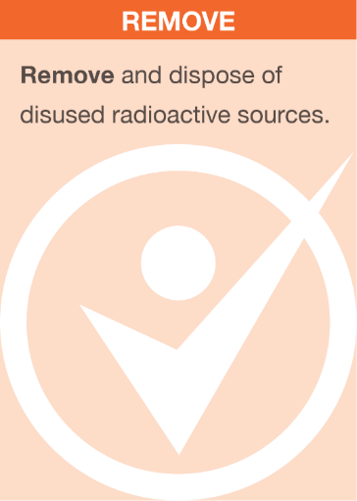
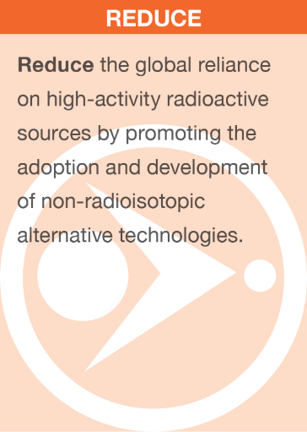
Office of Radiological Security
Enhance global security by preventing high-activity radioactive materials from use in acts of terrorism.

Slide 3
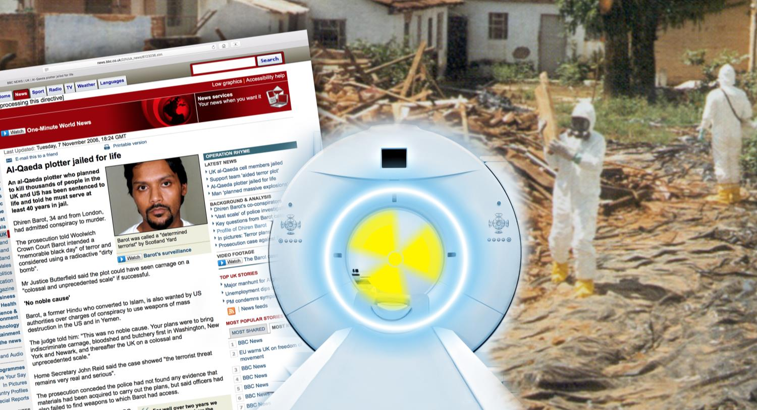
The Risk of Malicious Use of Radioactive Material Requires Action
ORS works with partners to enhance global security by preventing high-activity radioactive materials from being used in acts of terrorism.

Slide 4

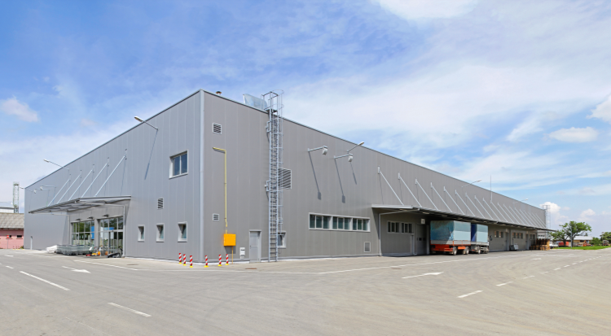


Radioactive Materials Are Relatively Easy to Obtain because They Can Be Found in Many Locations
Hospitals
Commercial Irradiation Facilities
Universities
Materials in Transit

Slide 5
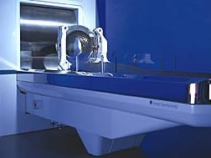
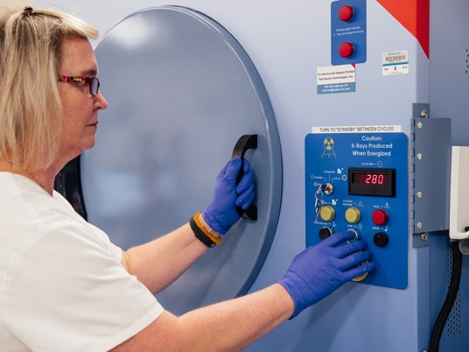
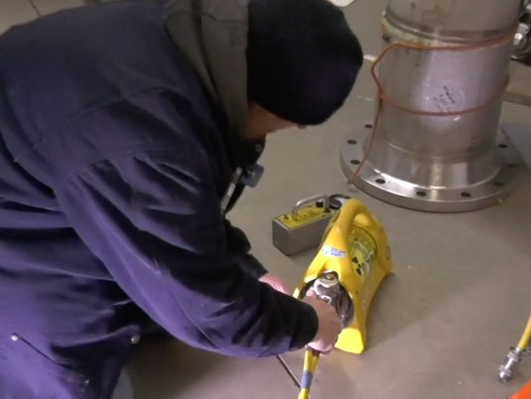

High-Activity Sources
Cancer Treatment
Industrial Sterilization
Blood/Medical Research Irradiators
Dosimeter and Detector Calibrators
Co-60
1,000 – 1,000,000+ Ci
Normal Device Activity
Cs-137
1,000 – 50,000 Ci
Normal Device Activity
Industrial Radiography
Oil Well Logging
Ir-192
10-100 Ci
Normal Device Activity
Am-241
8-20 Ci Normal Device Activity

Slide 6
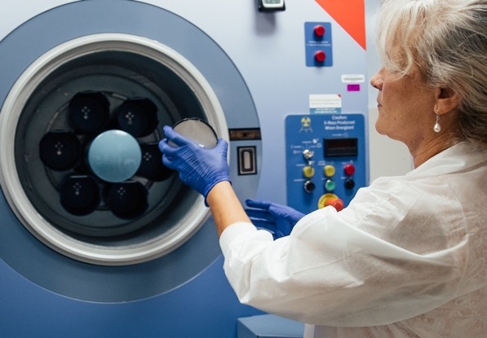
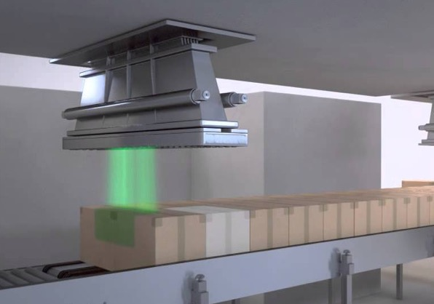
What are “Alternative Technologies”?
Technologies which do not contain radioactive materials and which perform an equivalent or better function as a comparable device.
Alternative technologies may use electricity to emit ionizing radiation (machine-based technologies, like X-ray irradiators). Some alternative technologies, like UV pathogen reduction systems, may not emit ionizing radiation.
Self-shielded X-ray Irradiators
Research Irradiation
Blood Irradiation
Sterile Insect Technique (SIT)
Seed Irradiation
Plant Mutation Breeding
Industrial Electron Beam and X-ray
Medical Device Sterilization
Phytosanitary Treatment and Food Irradiation
Plastics and Material Modification
Wastewater Treatment

Slide 7
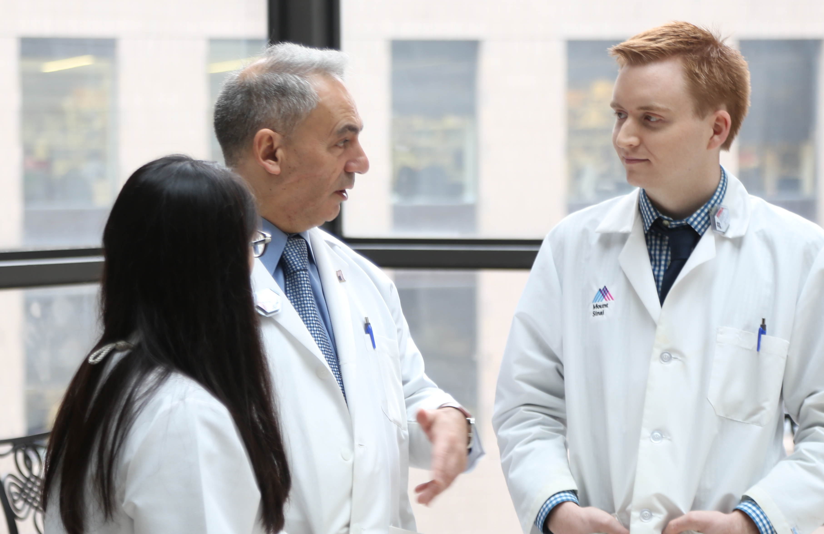
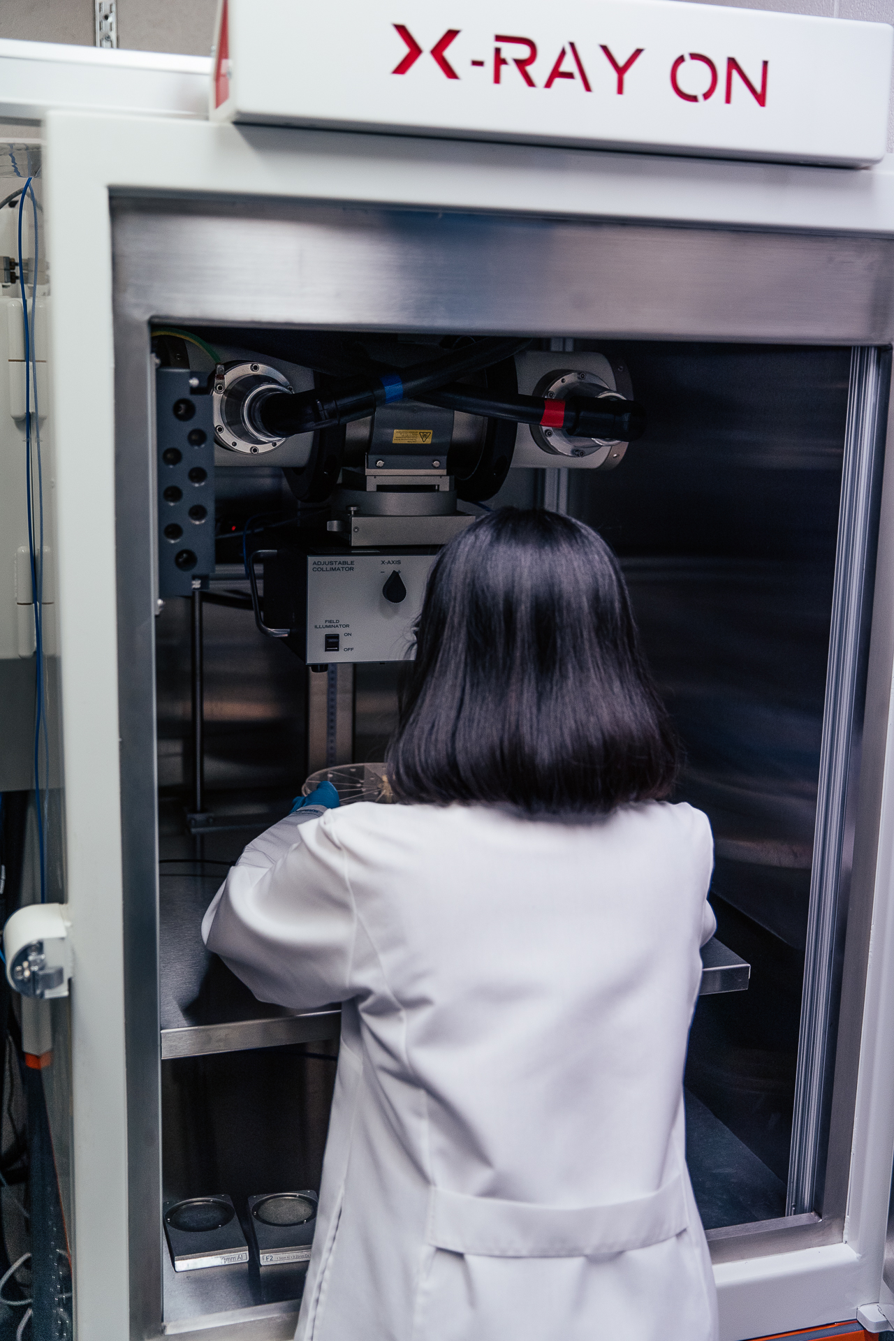
Considerations for Alternative Technologies
Cost/Limited Budget
Facility and Maintenance Needs
Device Preference and Training Needs
Research or Clinical Standards
Operational Protocols
Technical Performance
Maintenance Schedule Requirements
Government and Industry Approvals, Licensing, or Accreditation

Slide 8
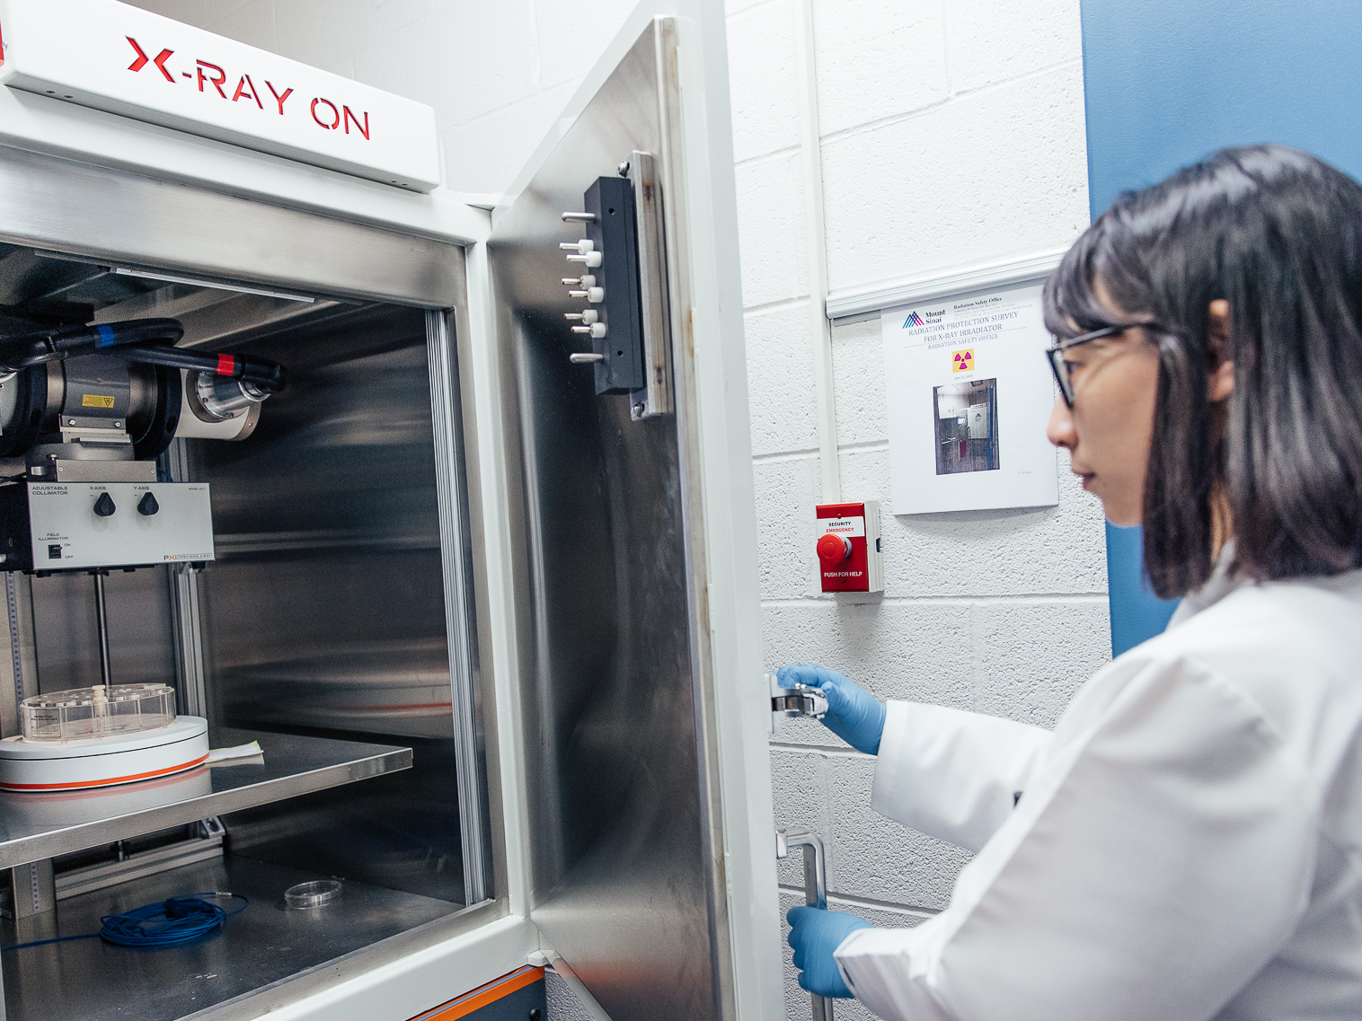




Reduce Radiological Risks with Alternative Technologies
Strategies to Promote Alternative Technologies
Policy
Outreach & Education
Device Replacements
Research

Slide 9

Support U.S. Government Policy
National Security Strategic Guidance:
“We will continue to lead the world in coordinated efforts to lock down nuclear and radiological materials and prevent terrorist acquisition.”
National Security Memorandum 19:
“Reducing, eliminating, and securing radioactive and nuclear materials are the most effective means to prevent their acquisition and use…”
NNSA Strategic Vision:
“We must detect possible proliferation activities as early as possible and minimize pathways to attaining nuclear or radiological devices.”

Slide 10
Outreach and Education
Activity | Examples
Organize targeted U.S. and international workshops to increase awareness of technology options and their benefits | Co-chaired 8 meetings of the Ad Hoc Alt Tech Working Group with Germany and France (alttechwg.org) National-level workshops with government and technology user communities Workshops with NGO partners
Provide educational materials via media engagements, websites, handouts | Brochures, fact sheets, and videos Publication search engine (in development)
Present papers or exhibit booths at industry conferences | IAEA International Meeting on Radiation Processing Institute for Nuclear Material Management
Meet directly with source users to discuss source security and technology options, including source alternatives | Bilateral meetings to understand needs and challenges SME consultations, via technical exchanges and report writing

Slide 11







Accelerators for Research and Sustainable Development
Expanding global interest in using ionizing radiation technologies for issues related to the UN Sustainable Development Goals (SDGs)
ORS encourages the use of accelerator-based ionizing technologies over radioactive sources:
  Support research that investigates/papers that highlight how accelerator technologies can be more advantageous than sources in achieving SDGs
  Support projects that advance sustainability of accelerator technologies in LMICs
  Outreach to development community (USAID, development banks, NGOs, etc)
United Nations Sustainable Development Goals (SDG) | SDG Description | Applications of Interest
Zero Hunger | End hunger, achieve food security and improved nutrition, and promote sustainable agriculture | Phytosanitary treatment & food irradiation Sterile Insect Technique (SIT) Plant mutation breeding Seed irradiation
Good Health & Well-Being | Ensure healthy lives and promote well-being for all at all ages | Radiotherapy Blood irradiation Medical research Medical product sterilization
Clean Water & Sanitation | Ensure availability and sustainable management of water and sanitation for all | Wastewater treatment
Industry, Innovation, & Infrastructure | Build resilient infrastructure, promote inclusive and sustainable industrialization, and foster innovation | Non-Destructive Testing
Life Below Water | Conserve and sustainably use the oceans, sea and marine resources for sustainable development | Plastics/polymer reuse and recycling
Partnerships for the Goals | Strengthen the means of implementation and revitalize the global partnership for sustainable development | ORS contributes to IAEA Technical Cooperation & PUI

Slide 12
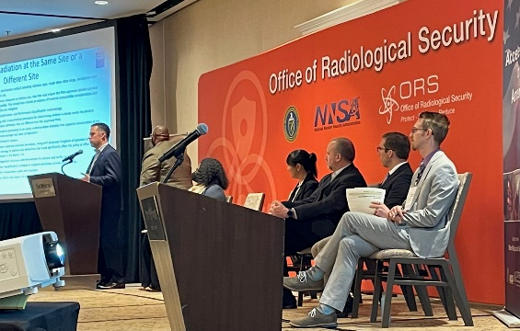




Industry Engagement for Alternative Technologies
Goal: Enhancing U.S. accelerator manufacturing and service industries to support risk reduction efforts and to better understand how to get more accelerators into the market
Impacts:
  Meet the growing demand for accelerator services in the U.S.
  Promote industry collaboration through workshops such as the ORS Industry Day and the Fermi Medical Device Sterilization Workshops to maintain awareness of technology trends
  Stimulate Government-industry collaboration to seek solutions to technology gaps and overcome funding and regulatory challenges
  Collaboration with industry partners on analyses of vulnerable accelerator components and accelerator power usage
  How to improve our support for research on novel applications for accelerators
ORS Industry Day June 13-14, 2023

Slide 13

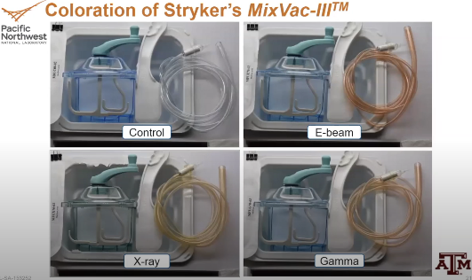
Research, Studies, and New Ideas
ORS collaborates with external subject matter experts and other R&D offices within the U.S. Government to support projects aimed at developing new and affordable accelerator-based technologies.
Small Business Innovation Research Projects (SBIR)
Comparison/Demonstration Studies
Pictured: Tibaray concept

Slide 14
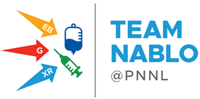








Team Nablo
Fermilab (2017) and IAEA (2019) reports conclude data and education gaps remain impediments for device manufacturers to transition from gamma-ray and ethylene-oxide sterilization modalities to electron-beam (e-beam) or X-ray.
ORS asked Pacific Northwest National Laboratory (PNNL) to build a collaborative team that included major players in the medical device industry, which now includes the biopharma production industry.
Goals
Identify polymers with data gaps for radiation effects and of greatest industry impact if transitioned to E-beam or X-ray.
Measure physical effects materials exhibit when given sterilization-level radiation doses from E-beam or X-ray.
Determine whether effects preclude the use of E-beam or X-ray for associated medical products.
Industry & public outreach to identify & fill gaps that impede transition to E-beam and X-ray sterilization.

Slide 15
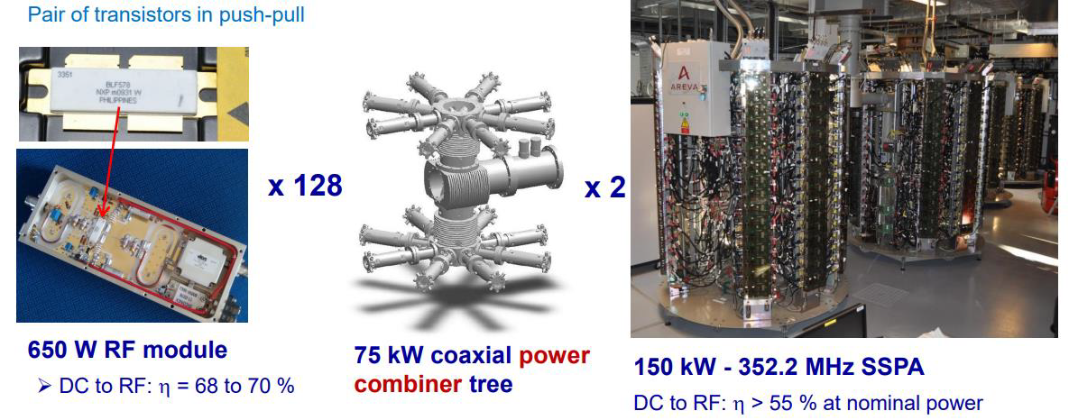
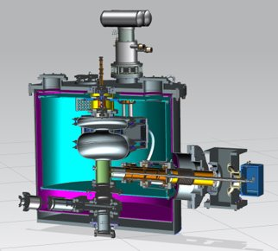
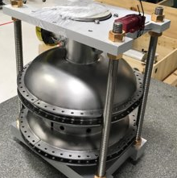
NNSA Supported Fermi Laboratory Research
2017: Accelerator-based Medical Device Sterilization Report
    Outcome: Highlighted the landscape of irradiation technologies for medical device sterilization and barriers to transition to eBeam and X-ray
Ongoing: Compact Superconducting RF (SRF) Accelerator for Co-60 Irradiator Replacement for Medical Device Sterilization
    2020: Comparison of Radiofrequency Sources for 10 MeV, 1MW Industrial Accelerators
    2023: High Power 650 MHz Magnetron RF Power Source
SSA amplifier for SOLEIL
Render of Complete
Prototype Accelerator
1.5-Cell SRF Cavity
Render of Complete Prototype Accelerator​

Slide 17

Contact
Nick Butler
Deputy Director
Office of Radiological Security
nicholas.butler@nnsa.doe.gov
Evan Thompson
Alternative Technology Program Manager
Office of Radiological Security
evan.thompson@nnsa.doe.gov
Vanessa Vargas
Alternative Technology Deputy Program Manager
Office of Radiological Security
vanessa.vargas@nnsa.doe.gov

