Slide 1

Packaging & Sterilization – KiiP
WICKED STABILITY: PROJECT PROGRESS & WORKSTREAM UPDATES
Sopheak Srun, Principal Sterilization Scientist, Cretex Medical – QTS
Dr. Henk P. Blom, VP of Research and Technology, PAXXUS, Inc.

Slide 2




What are we going to cover today?
KiiP overview: who we are and what we’re doing
Project Wicked Stability
Applying what we’ve learned through collaboration
Notes:
Rod

Slide 3
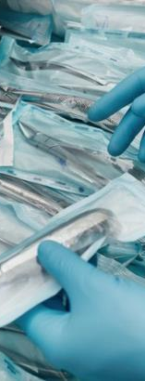
An Overview
            Our Vision
Improving patient outcomes and clinician delight
through the science and engineering of sustainable packaging
Our Mission
Collaboration, connection, education, and promotion of the
value of medical device sterility assurance and its maintenance
throughout the value chain for protecting patient safety
and improving healthcare outcomes
Programs
❶ Breaking Bad Biases​
❷ Last 100 Yards (L100)​
❸ Aseptic Presentation (AP)​
❹ Sustainability & End-of-Life (SEOL)​
Committees
Education / Provocation (KiiP’ED)
​Marketing Communications Branding (MCB)
Membership
Fund Raising

Slide 4






KiiP Executive Committee
Vice-Chairperson
OFFICERS
Jennifer Benolken, CPPL – Chairperson; MDM Packaging & Regulatory Specialist, DuPont Tyvek® Medical Packaging
(open) – Vice-Chairperson
Dhuanne Dodrill –Treasurer; President, PAXXUS
Ralph Basile –Secretary; Vice President, Healthmark
MEMBERS AT LARGE
Sopheak Srun– Member at Large; Principal Sterilization Scientist, Cretex Medical – QTS
Amanda Benedict – Member at Large; Vice President, Sterilization, AAMI
Rod Patch – Member at Large; Senior Director, Johnson & Johnson Vision

Slide 5

KiiP – What’s Going On
We’re Growing Up
  Bylaws developed and approved
  Officers nominated
    Chair, Vice-Chair, Treasurer, Secretary
  Mechanism to Handle Funds
  Establishing Committees
    Membership
    Communications
    Funding

Slide 6


Breaking Bad Biases (formerly LTSU)
Mission: How can we improve time-to-market
Predictive testing – what else can we do
Wicked Stability:
The effect of the real time aging (post sterilization) on commonly available sterile barrier packaging systems (SBS) materials is not significant. Typical materials of construction (MOC) for SBS’s do not need to start from time zero, but rather, enough supported data exists to show that certain MOC combinations and modalities of sterility (MOS) treatments could be placed on market with a known and supported minimum shelf life.
Build Samples for Test
Sterilize
Real Time Aging
2-year real time
5-year real time
At least
2-year Acc
before filing
Test packaging at each time point
Accelerated Aging
2-year real time
5-year real time
Repeat for each material, every product, at multiple sealers, at every company

Slide 7

The Last 100 Yards (or metres)
Mission: Better understand the challenges of delivering sterile goods from the time they arrive at the healthcare organization to the point of use.
Junk in the Trunk
New team to study sterile medical devices and kits that are often transported in car trunks of medical device company representatives.
Observed and developed flow charts of OR and SDPs product handling practices.
Develop terminology repository to describe key environments through the last 100 yards
Learning tool for healthcare professionals and packaging engineers
The Real World
Flow Chart

Slide 8

More from the Last 100 Yards (or metres)
Repetitive Handling Study
Conducted studies to support the theory that repeated handling by healthcare professionals can pose additional risk for increasing surface contamination on a device’s Sterile Barrier System.
Preparing a peer-reviewed article for publication
Soil Dry Time
Conducted studies to support the theory that repeated handling by healthcare professionals can pose additional risk for increasing surface contamination on a device’s Sterile Barrier System.
Peer-reviewed article has been developed and submitted for publication
Evaluated the mechanical and environment conditions medical devices and their packaged are exposed to during the external transportation to and from central sterile processing and storage areas to external healthcare facilities
Preparing a peer-reviewed article for publication
External Transport

Slide 9

Aseptic Presentation
Mission: How do we accurately assess aseptic presentation success?
Michigan State University research indicates that we have a problem
What’s the best way to aseptically present a medical device?
Observed hospital settings to identify how packages are presented – pick, dump, flip, toss.
How to evaluate the risk of contamination associated with each method?
We need a Test Method

Slide 10
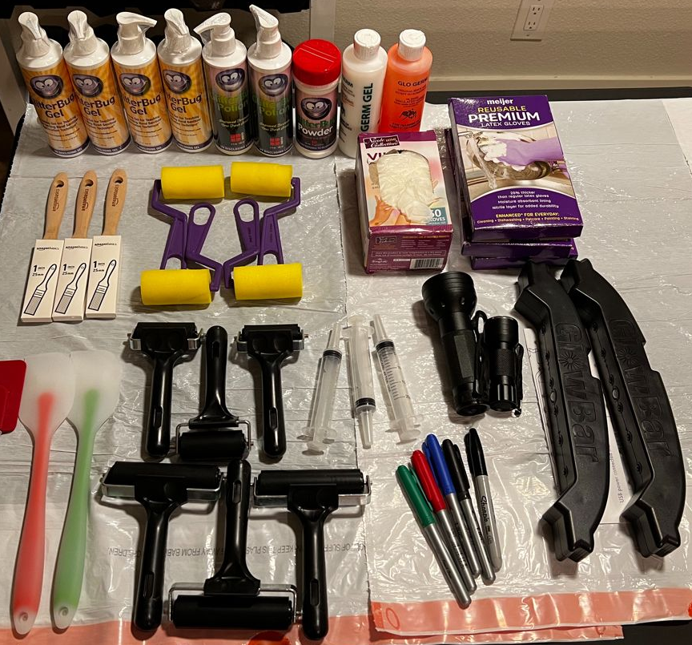
Test Method Development

Slide 11
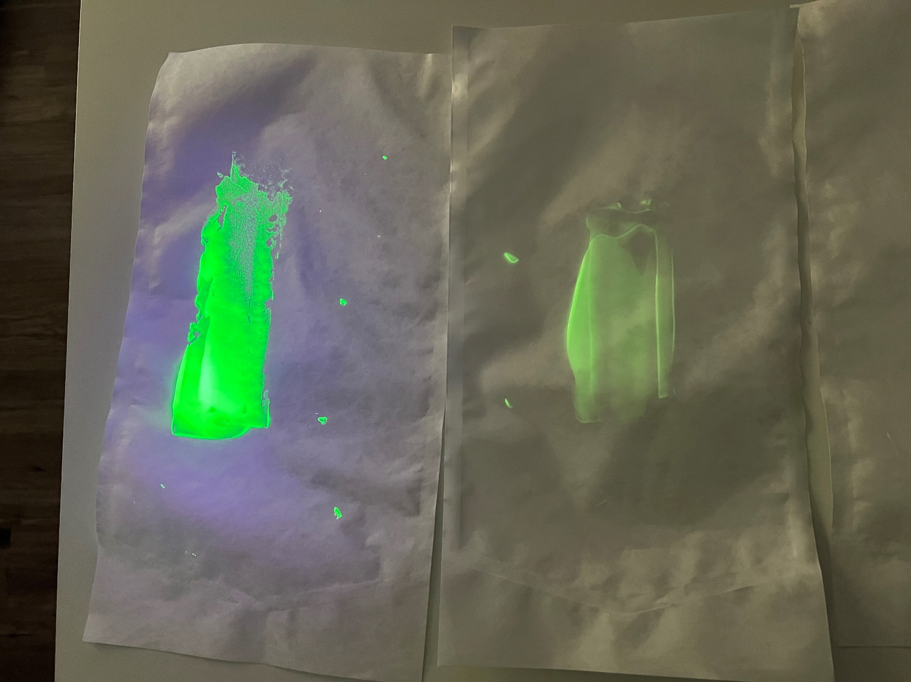
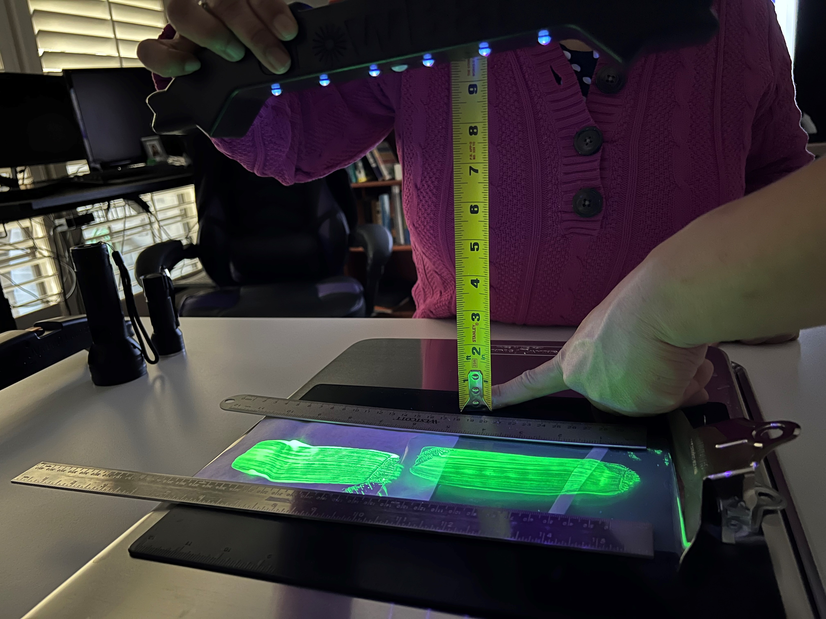
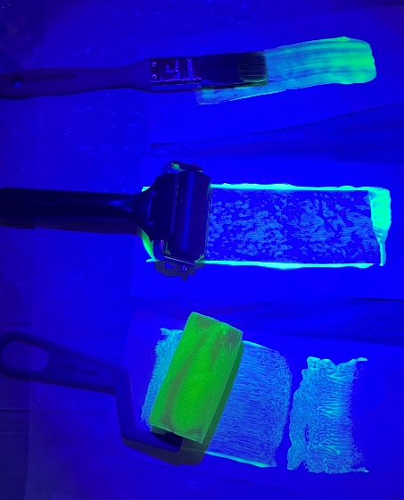
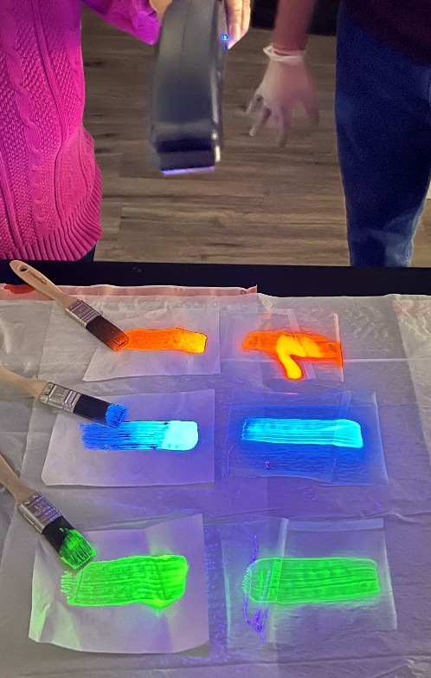
Test Method Development
UV Fluorescent | Applicator (If applicable) | UV Light Source | Distance of UV Light Source to Evaluation Surface | Evaluation Surface Background Color
GlitterBug Gel | Paint Brush | GlitterBug GloBar | 6-9 Inches | Black
9 inches
Next Step: ASTM Test Method

Slide 12

Sustainability and End-of-Life
Mission: Advance sustainability of sterile packaging
Awareness, Education
  Plan to develop / share resources
  Encourage, evolve, and socialize (make acceptable) industry understanding and where we are going with it
  Provide business cases to support sustainability in medical device packaging
Correlation between Continuity, Supply Chain Resiliency, and Sustainability in Healthcare Packaging
  Presented at 2022 Kilmer Conference

Slide 13

KiiP’ED
Problem Statement: Packaging Engineers and Healthcare Professionals have different interpretations or limited knowledge on how sterile packaging are manufactured, sterilized, stored, transported, delivered, and discarded.
Sterile Re-Processing Education
  Limited training materials and education for performing sterilization reprocessing
  Identifying current-state pain points
  Generating training / educational materials
  Goal is to set industry standard practices
Student Engagement and Professional Advancement
  Bring packaging and nursing students together to develop relationships that will carry forward into industry
  Creating a “Packaging Kit” with typical packaging formats for both packaging and nursing students
  Goal is to gain data for potential curriculum change and standardized course content with regard to packaging and healthcare cross-interaction

Slide 14
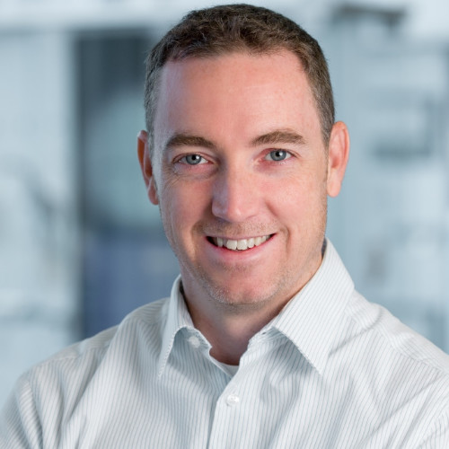


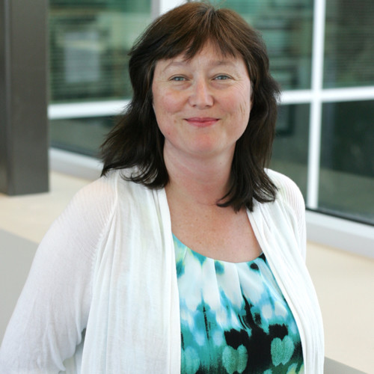
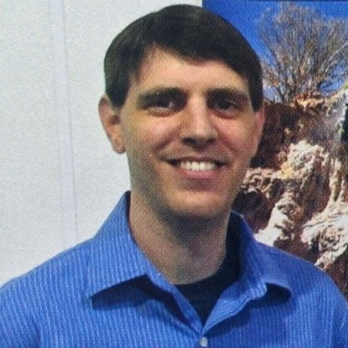
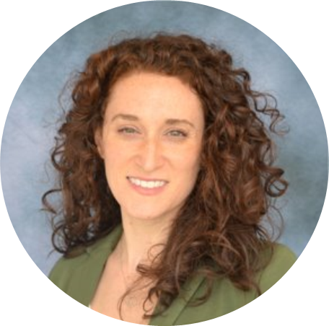

Wicked Stability – Core Team
Rod Patch – Sr. Director Package Engineering & Product Labeling, Johnson & Johnson Vision
Jordan Montgomery – WS Project Lead; Distinguished Packaging Engineer, Medtronic
Dan Burgess – Fellow, Packaging Engineering, Boston Scientific
Dr. Henk Blom – VP of Research and Technology, PAXXUS, Inc.
Wendy Mach – Sr. Sterilization Scientist, Integra LifeSciences
Jennifer Benolken, CPPL – MDM Packaging & Regulatory Specialist, DuPont Tyvek® Medical Packaging
Nancy Battaglini – Global Account Manager, PAXXUS, Inc.
Haley Schrauben – Product Manager, Oliver Healthcare Packaging
Chris Sarantos – Principal, Shine Medical
Notes:
Rod

Slide 15

Where We Left Off…
Stability studies do not fail
Questionable use of Arrhenius theory
Resins are built inherently stable
Stability evidence through measurement of degradation factors
Notes:
Rod

Slide 16
Hypothesis
WS Hypothesis - Certain MOC/MOS combinations have successfully and repetitively demonstrated inherent stability
We believe that typical materials of construction (MOC) for sterile barrier systems (SBS) have been demonstrated as stable, with redundancy across the industry, and that repetitively evaluating stability on these MOCs is wasteful, produces limited value, limited new knowledge and limited risk mitigation.
Understand the science
Validate the Understanding
Publish for Peer Review
Educate Market Access Authorities
We believe sufficient data exists that can be leveraged to show certain MOCs and modalities of sterilization (MOS) have successfully demonstrated stability and these MOC + MOS combinations have repetitively met the requirements for stability and should be accepted with a known and supported minimum shelf life for on market placement.
Notes:
Rod

Slide 17
What is the Work
Market Access Authorities
MDM & SPM
MPTP
Degradation Factors
Reviewing public databases for evidence of stability concerns.
Engaging MAAs with hypothesis, approach and path to acceptance
World-record SBS database of successful stability on a common MOC with many MOS and many sealing process technologies
Industry data supporting stability of medical device packaging MOCs and SBSs
Evaluating how to measure degradation factors.
Assessing OIT as a proven ASTM method for measuring time to oxidation
Notes:
Rod
We understand that regardless of what we believe, we have to provide proof for MAAs to believe. You will hear about some of the work with public databases and MAA engagements.
Regarding the evidence that does exist, there is a world record stability database in the MPTP.
In addition, every device on the market has stability evidence from MDMs and SPMs supporting its SBS. Another rich source of information. How do we leverage and access?
Lastly, you will hear about the science and understanding the factors of degradation.
I would like to present Haley Schrauben, to review the Market Access Authority topic.

Slide 18

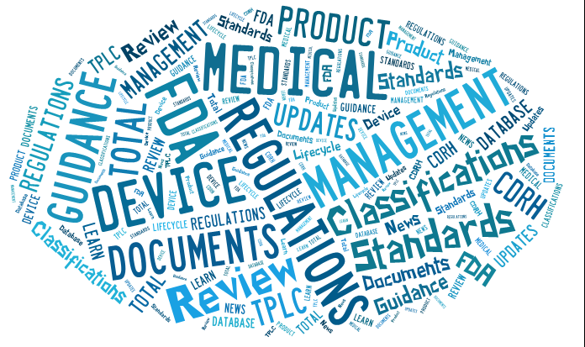

Market Access Authorities
WS Hypothesis - Certain MOC/MOS combinations have successfully and repetitively demonstrated inherent stability
TEAM: Chris Sarantos, Wendy Mach, Haley Schrauben
Assess Market Surveillance
Share Evidence
Engage MAA’s
OPPORTUNITY:
Assess Market Surveillance databases against WS Hypothesis:
FDA, MAUDE, etc..
Where are the Stability Failures?
ENGAGE MAA’s:
Discuss Project Purpose and Assess Feedback against WS Hypothesis:
Feedback – Encouraging Concept but where is the Evidence?
Notes:
Haley
This is a build slide.
MAA – initial feedback was positive, but the evidence must support the hypothesis
Opportunity – reviewed public databases for evidence that stability failures occur. Initial assessment, extremely limited to almost no entries related to stability failures. What little information was found, pointed to a root cause that was not material stability related.
Continue to assess and review.
Summarize and share the evidence.
Continue to engage with MAA’s with evidence and ongoing feedback.

Slide 19
Wicked Stability–DuPont Tyvek® Medical Packaging Transition Project (MPTP)
WS Hypothesis - Certain MOC/MOS combinations have successfully and repetitively demonstrated inherent stability
TEAM: Nancy Battaglini (PAXXUS), Rod Patch (J&J Vision), DuPont
OPPORTUNITY: Assess MPTP data against WS Hypothesis:
APPROACH:
  No cell data will exit DuPont control. 3-WAY NDAs Persist.
  “No Objection Agreements” (@160) allowing repurposing MPTP data
  No Single Cell data display – multicell aggregation of related data
  Output: Publication for Industry and MAA Engagement
STATUS: DuPont processing agreements with cell participants.
NEXT: Data summarization, analysis and presentation. Publication.
MPTP
World-record SBS database of successful stability on a common MOC with many MOS and many sealing process technologies
Notes:
Haley

Slide 20
Wicked Stability – MDM Data
WS Hypothesis - Certain MOC/MOS combinations have successfully and repetitively demonstrated inherent stability
TEAM: Wendy Mach (Integra Life Sciences), Jen Benolken (DuPont), MDM Participants (7+)
OPPORTUNITY: MDMs to share stability data for assessment against WS Hypothesis.
APPROACH:
  Blinded and controlled - collated by independent data collector
  Available and Voluntary to:
    any/all MDMs
    any/all SBS material combinations
  Requested Data to include, but not limited to:
    MOCs
    MOS
    Sealing Technology
    Peel Strength
MDM
Industry data supporting stability of medical device packaging MOCs and SBSs
Notes:
Jen

Slide 21

Wicked Stability – MDM Data
WS Hypothesis - Certain MOC/MOS combinations have successfully and repetitively demonstrated inherent stability
Value and Impact:
  Building block in foundation of overarching Wicked Stability project
Output: Peer Review Publication
Call to Action:
  Participant Data Submission
MDM
Industry data supporting stability of medical device packaging MOCs and SBSs
Notes:
Jen

Slide 22
Wicked Stability – SPM Data
WS Hypothesis - Certain MOC/MOS combinations have successfully and repetitively demonstrated inherent stability
TEAM: Henk Blom + SPMC Members (Amcor, PAXXUS, Beacon, Printpack, Technipaq, PPC, DuPont, SteriPax)
SPM
OPPORTUNITY: SPMs to share stability data for assessment against WS hypothesis
APPROACH
  SPMs to submit blinded data of their stability studies
  Open to any/all SPMs that want to submit data
  Data to include, but not limited to:
    Materials
    Sterilization
Value and Impact: Building block in foundation of overarching Wicked Stability project demonstrating additional evidence that MOCs commonly used do not start degrading in the timeframe we use them for SBSs
Output: Peer Review Publication
Industry data supporting stability of medical device packaging MOCs and SBSs
Notes:
Henk

Slide 23
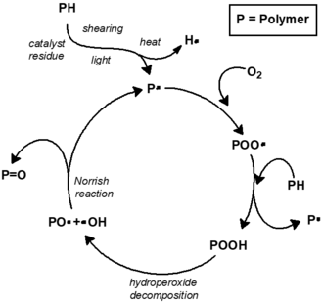
Wicked Stability – OIT
WS Hypothesis - Certain MOC/MOS combinations have successfully and repetitively demonstrated inherent stability
Degradation mechanism for oxidative degradation
Antioxidant inhibits degradation
Notes:
Henk

Slide 24
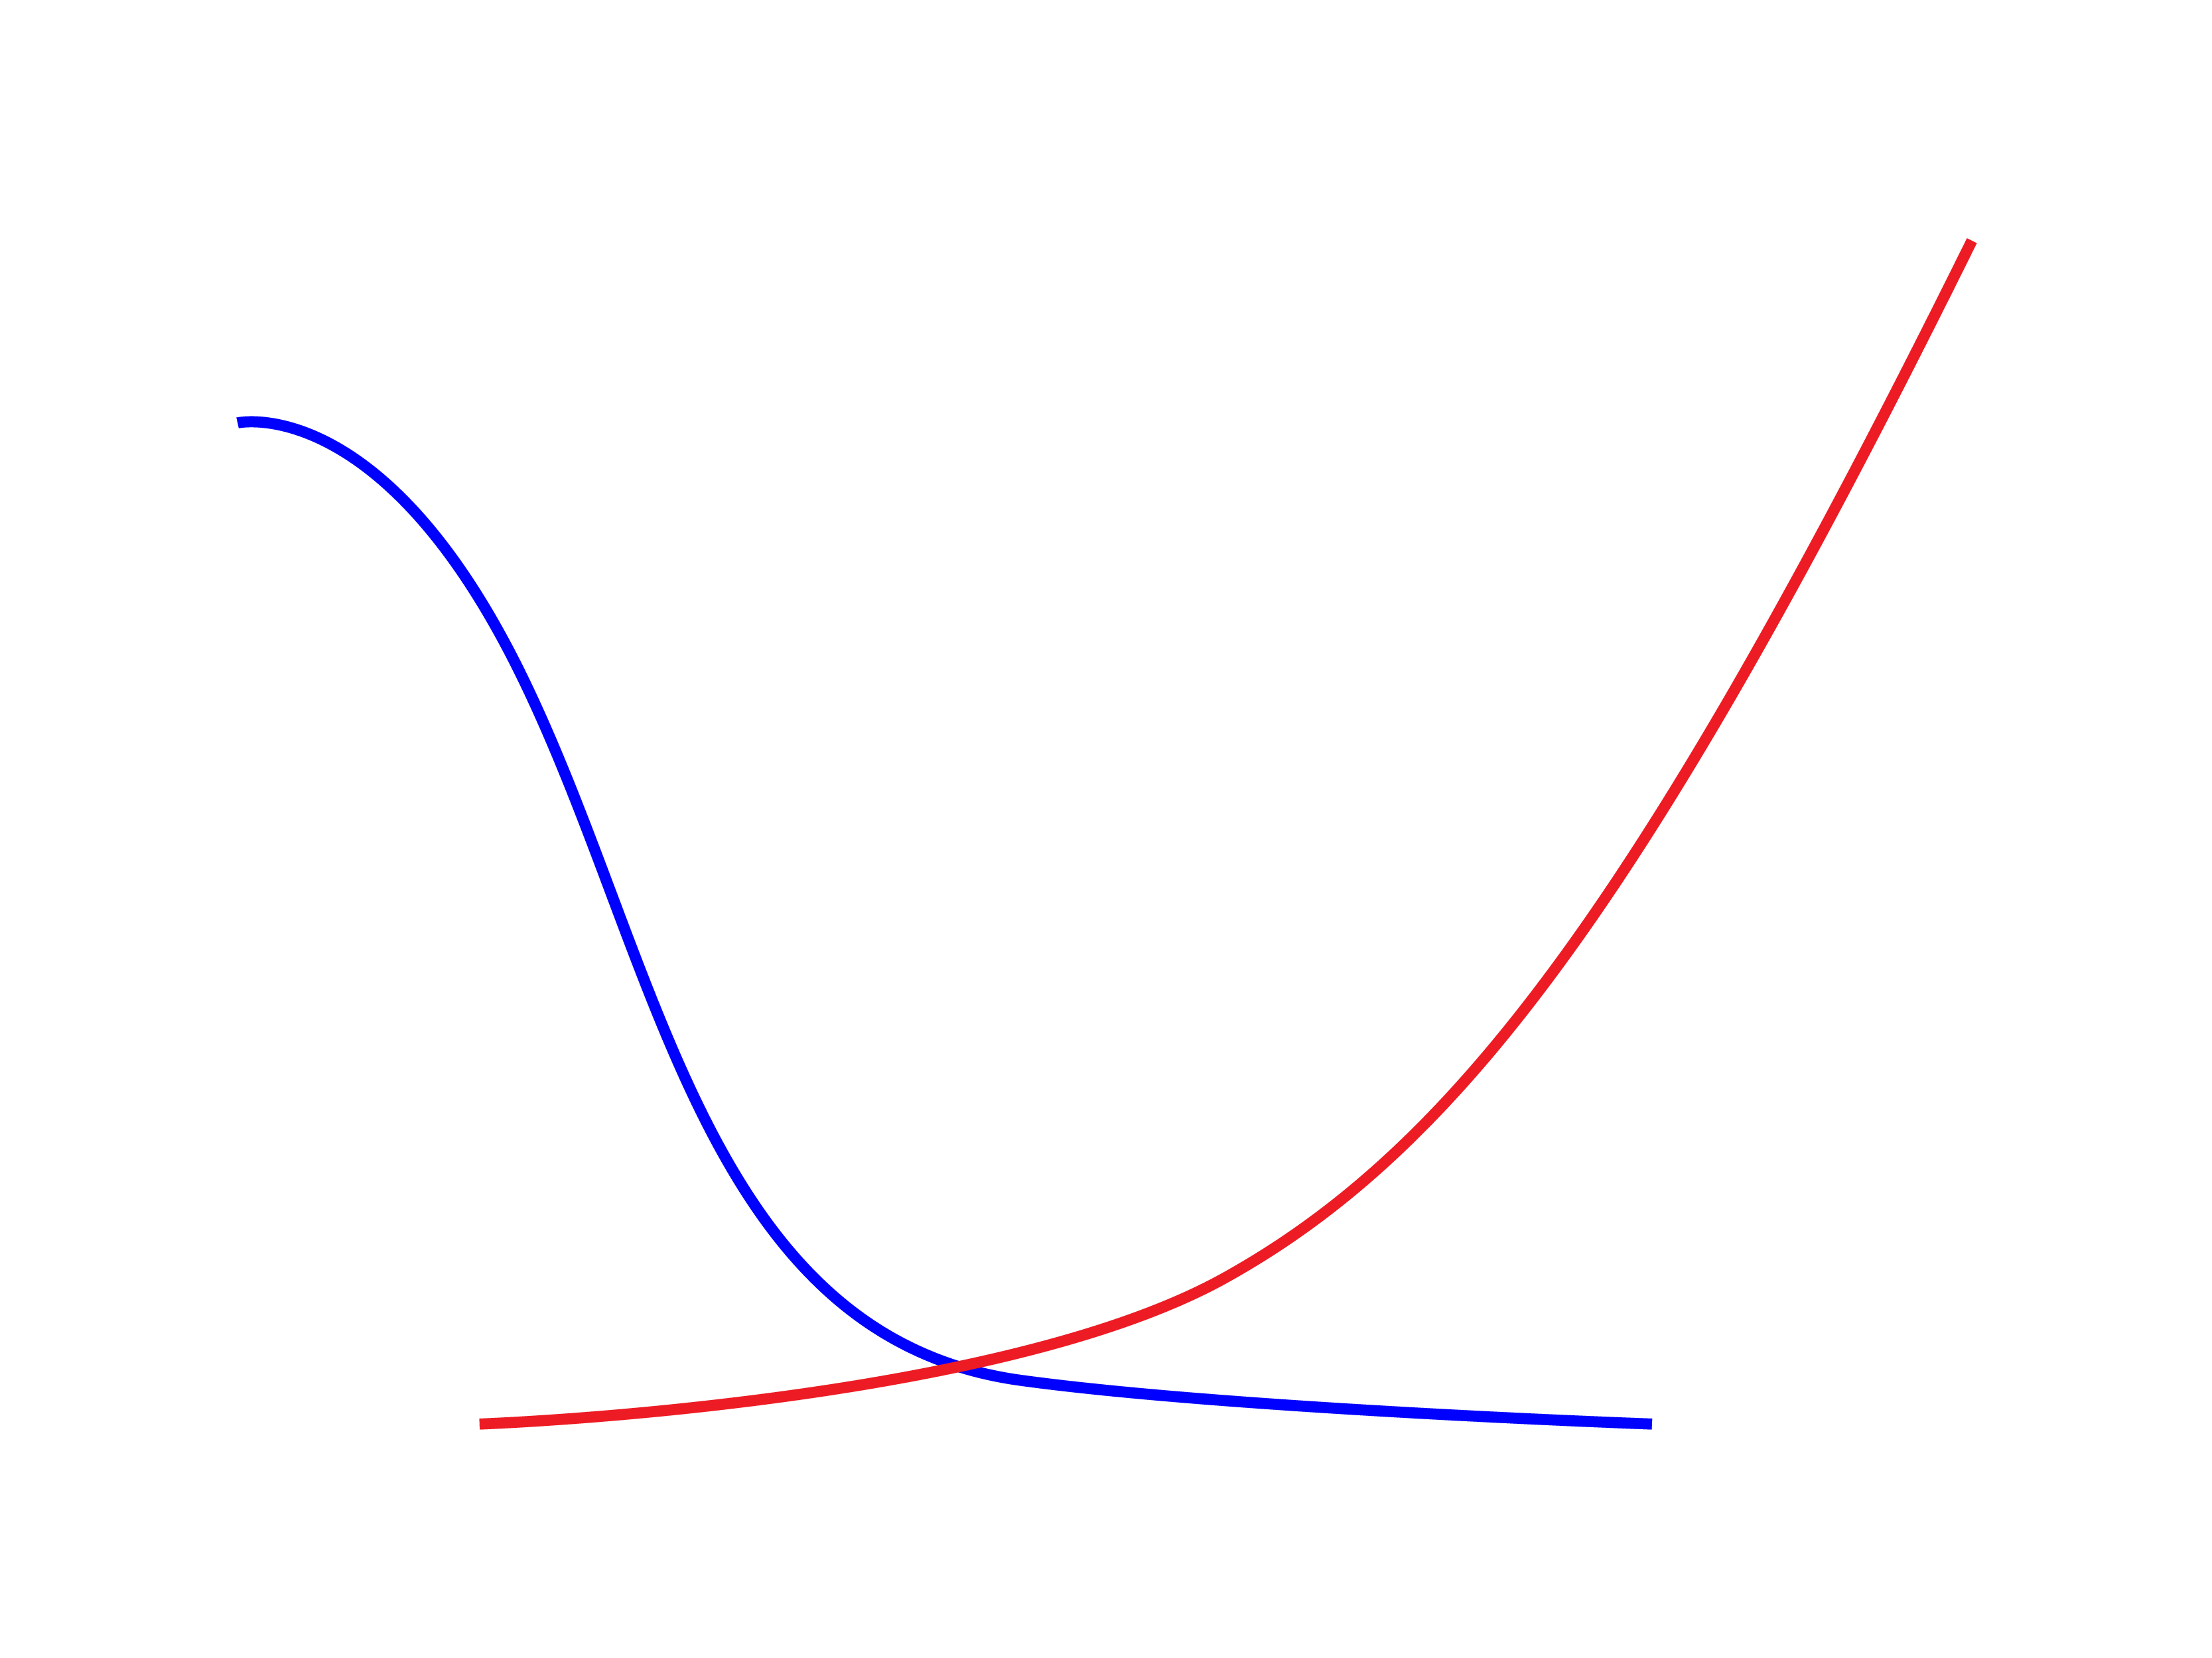

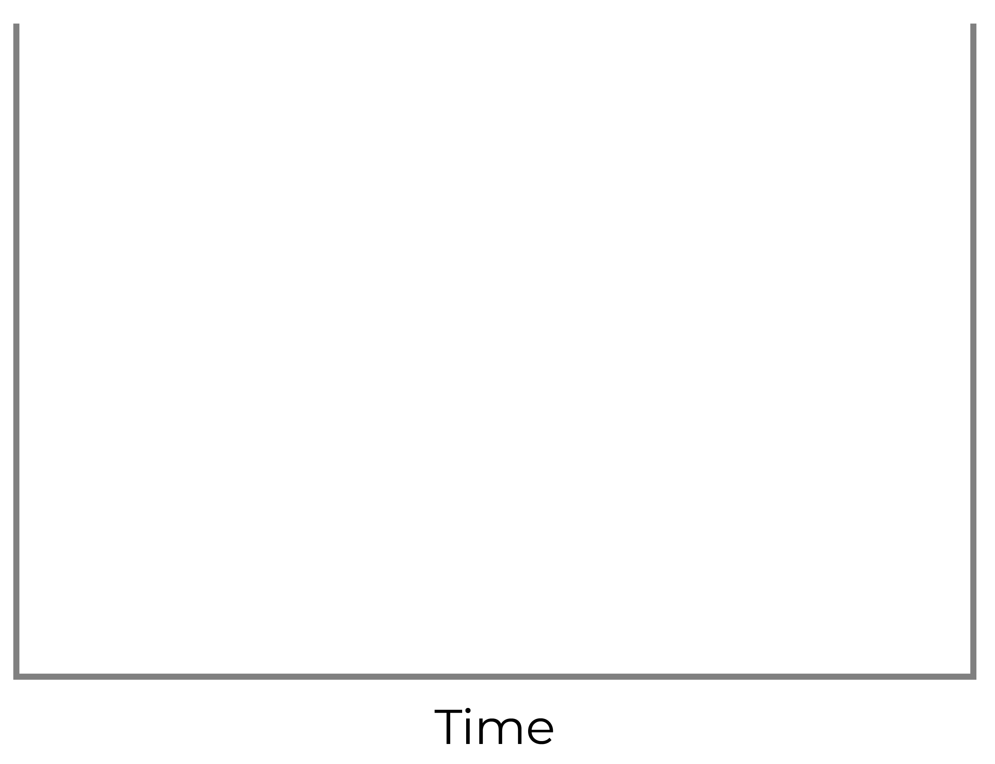
[AO] and material degradation
Anti-oxidant is consumed at some rate
Degradation accelerates
[AO]
Rate of degradation (k_{d})
Functionally significant degradation initiates when most of the AO is depleted
Note: Curves are not based on actual data but are for demonstration purposes only
Notes:
Henk

Slide 25
Wicked Stability - OIT
While [AO] > 0, functionally-important degradation does not occur
Can we generate experimental data that supports hypothesis?
RESIN | FILM | Unsterilized | EO Sterilized | Gamma Sterilized
BAREFOOT | LDPE_{B} | LDPE_{B} UNST | LDPE_{B} EO | LDPE_{B} G
With AO | LDPE_{AO} | LDPE_{AO} UNST | LDPE_{AO} EO | LDPE_{AO} G
Experiment
Notes:
Henk

Slide 26
Experiment Test Matrix
LDPE
  2 Material
  3 Sterilization exposures
  4 Temperature conditions
  7 Time points
Notes:
Henk

Slide 27
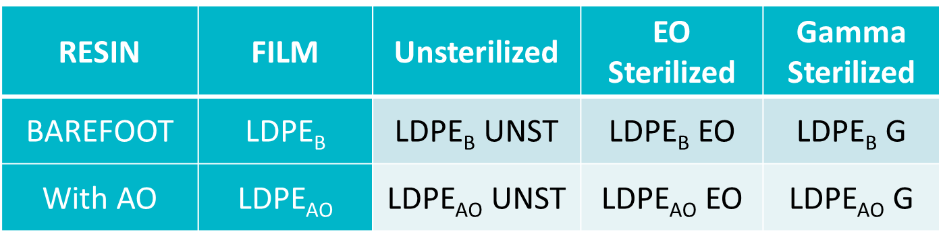
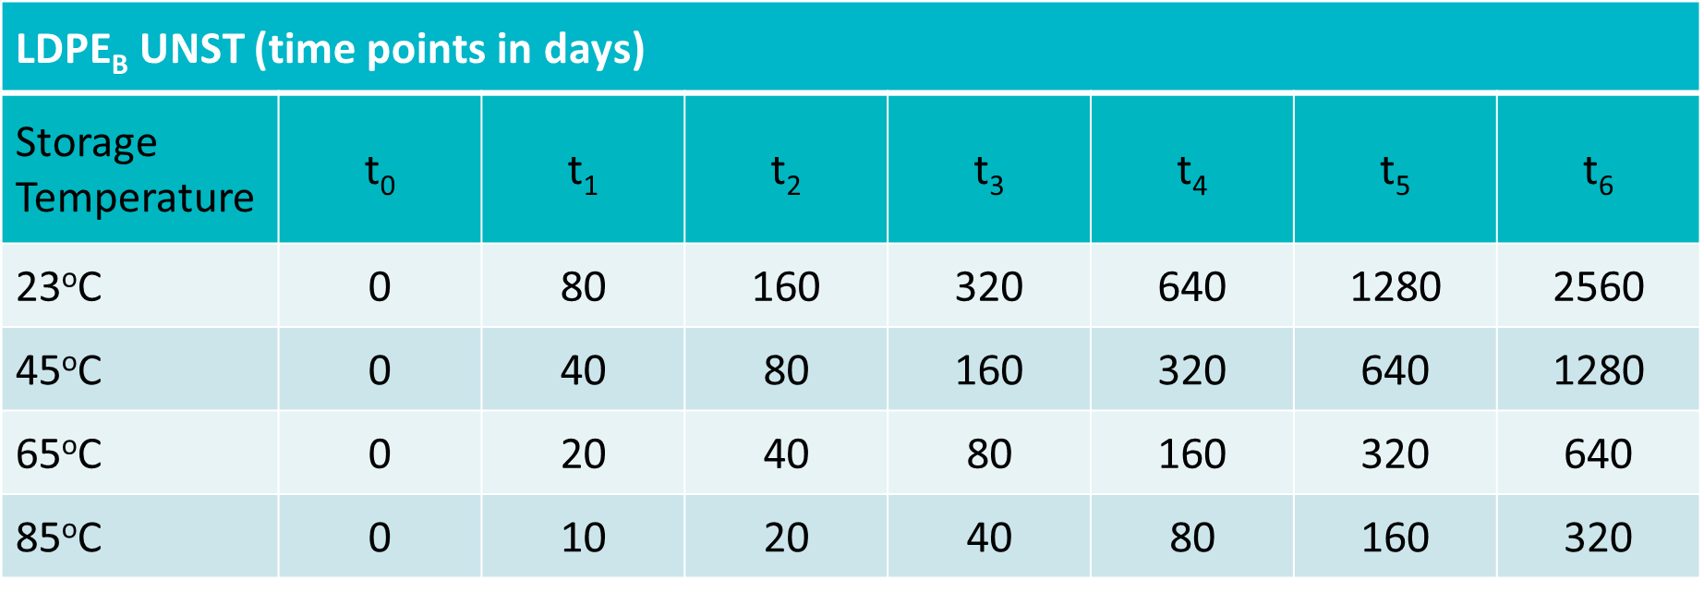
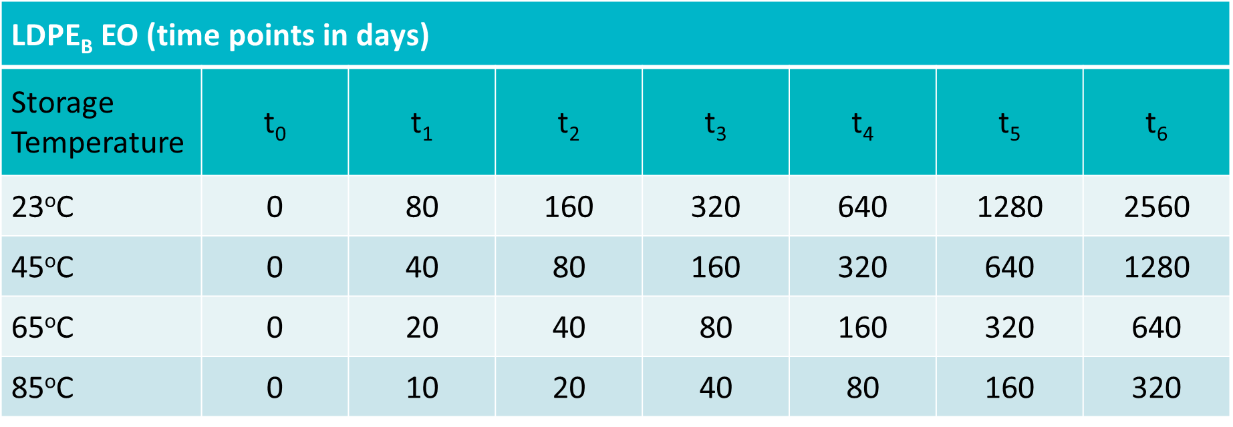
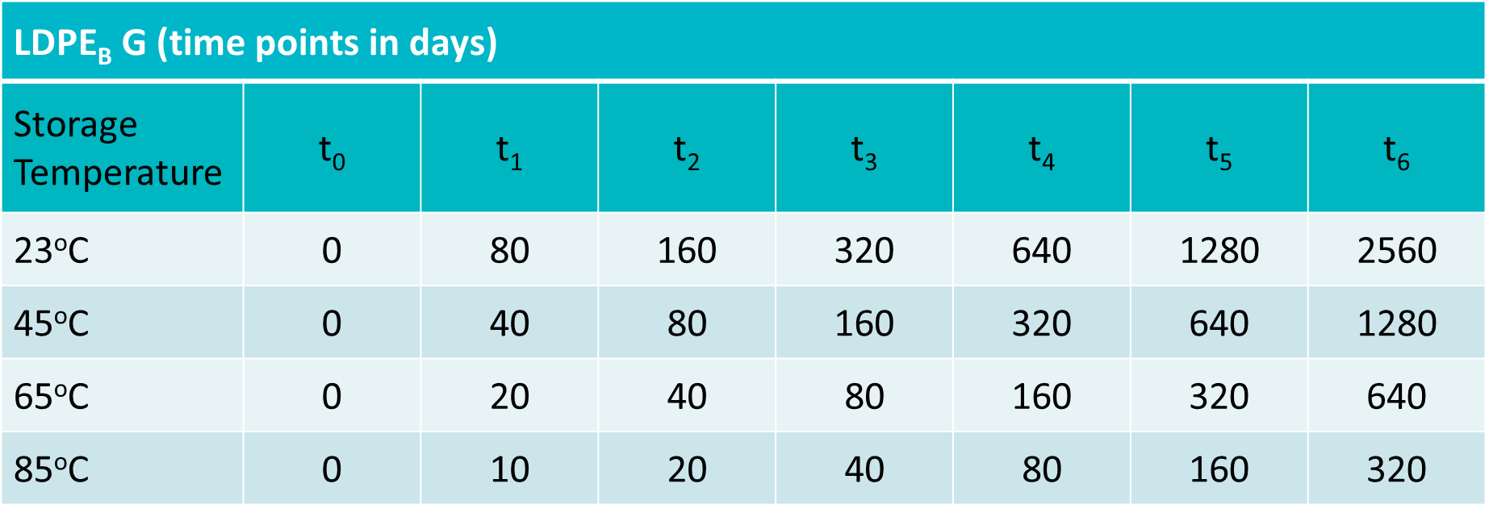
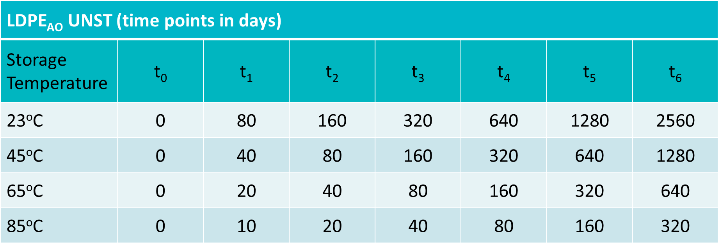
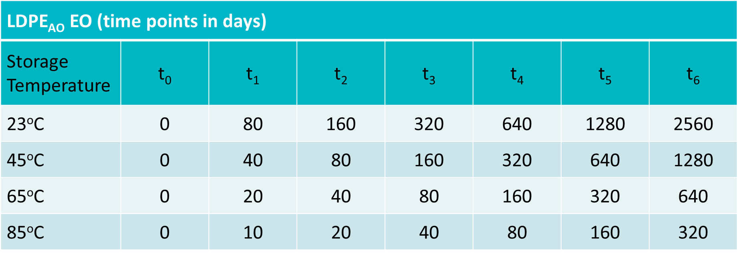

Notes:
Henk

Slide 28
Testing
Molecular
  OIT
  MW
  GC/MS
  DMA
Functional
  Tensile properties (MD & TD)
  Tear (MD & TD)
    Initiated
    Un-initiated
  Puncture
  Seal strength
Goal: Demonstrate relationship between molecular-level changes and functional performance
Notes:
Henk

Slide 29
Knowledge Expectations
Barefoot LDPE
  Will functionally important degradation be observed at extreme conditions?
  Can we drive the system to failure that we can observe?
    Yellowing, brittleness, etc.
AO LDPE
  Does AO inhibit functionally important degradation?
  When is AO consumed in these materials?
Notes:
Henk

Slide 30
Applying what we’ve learned through collaboration
What good is our data if we don’t do anything with it?
Ultimate goal: future updates to ASTM & ISO standards
Elements of successful collaboration:
  Collaborate and connect:
    Involvement of key stakeholders at key stages
    Networking and connections
  Educate and promote:
    Sharing our findings through presentations, articles, and other publications

Slide 31
Applying what we’ve learned through collaboration: AAMI TIR17
AAMI TIR17, Compatibility of materials subject to sterilization
State of collaboration:
  Previous state: a guidance document largely written by microbiologists, but intended to be used by engineers; document was largely unknown in the packaging community
  Current state: significant amount of involvement by material scientists and engineers

Slide 32
Applying what we’ve learned through collaboration: AAMI TIR17
New concepts introduced into working draft of AAMI TIR17:
  For aging studies, consider the presence of free radicals and anti-oxidants
  New test methods introduced, including EPR (electron paramagnetic resonance) and OIT (oxidative induction time)

Slide 33
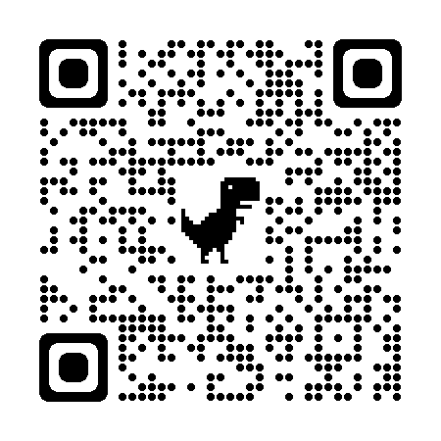

Get Involved!
Join and follow our LinkedIn group directly by scanning below QR Code
Talk to us
Get involved in the joint effort to reduce HAIs and improve patient outcomes
This is just the beginning…
Scan QR code with your phone
KiiP

Slide 34


Gratitude
In-Kind Industry Support
LDPE Films
Sterilization
Aging Chambers Shine Medical, LLC
Notes:
Henk

Slide 35

Thank You!

