Slide 1
The evolution of a standard – AAMI TIR104 and beyond
Emily Craven, Boston Scientific

Slide 2
Building new standards
How does a New Work Item Proposal (NWIP) become a published consensus standard?
It starts with an Idea
Supported by Peer Reviewed data
With Input and Support from committee members
And several Revisions
Then Publication!
NWIP
Image courtesy of Schoolhouse Rock
Medical Device Sterilization – Past, Present, and Future, September 20-21, 2023
Notes:
The example I just gave was about using a new idea to strengthen an existing standard. We can also think about how to build new standards from scratch.
(Amanda)
Go through list, then use example.
Around 5 years ago, we as an industry recognized that gamma capacity wasn’t growing at a rate that could support the expected growth of the medical device industry. This led to an investment by several companies in both e-beam and x-ray technology to try to fill that gap, but at the same time there was a recognition that it is not trivial to switch between radiation sources and more guidance was needed. So we wrote an NWIP for a new guidance document on transferring health care products between radiation sterilization sources. We leveraged peer reviewed data on studies on dose rate difference on microbicidal efficacy to simplify the approach that was in part 1 (relied on language about “identical sources” and specifics on water in a liquid state), reexamined some of the initial published data that led to the original recommendations, also cited recent references on material effects with different sources, all to provide better guidance to allow health care companies to make these transfers. The Radiation Sterilization group at AAMI is one of it’s largest, and we were able to get input from close to 100 members. The review process can be tedious, and we went through several iterations, even the title changed, but in the end the new document was completed in 2021 and officially published in 2022.

Slide 3
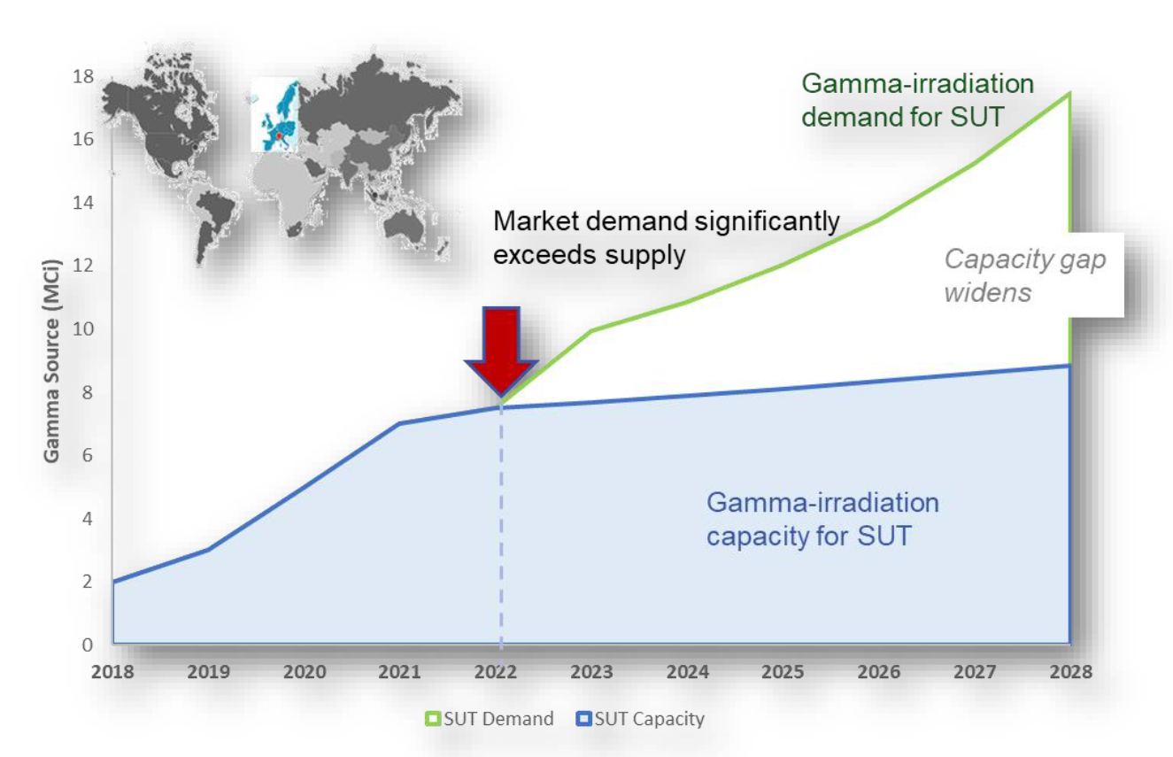
TIR104 Origin story
Recognized that in order to grow radiation sterilization with gamma maxed out, the industry would need to transition products into e-beam and x-ray as well as between gamma facilities
Additional guidance could help relieve the supply chain pressure on gamma sterilization
Image credit: Bio-Processing Systems Alliance, X-ray sterilization of single-use bioprocess equipment: Part I – Industry need, requirements and risk evaluation
Medical Device Sterilization – Past, Present, and Future, September 20-21, 2023

Slide 4
What did the standard say?
Guidance existing in ISO 11137-1:2006 on transfer of maximum and minimum dose (8.4 and A.8.4):
Maximum dose
An assessment shall be made demonstrating that difference in irradiation conditions of the two radiation sources do not affect the validity of the dose.
The assessment should consider dose rate and temperature
Typically, increasing dose rate requires minimal qualification, decreasing more substantial
If dose rate and temperature are “equivalent” then transfer is appropriate
Minimum dose
Data are available to demonstrate that differences in operating conditions do not effect microbicidal effectiveness
For product that does not contain water in liquid state, transfer of dose is permitted when not changing source type
For product containing water in liquid state, e-beam and x-ray are required to operate under “identical” operating conditions
Medical Device Sterilization – Past, Present, and Future, September 20-21, 2023

Slide 5
What was missing?
What is equivalent?
What is the relevance of identical?
What should be included in an assessment?
What data supports microbicidal effectiveness with dose rate?
Medical Device Sterilization – Past, Present, and Future, September 20-21, 2023

Slide 6
What did we know going in?
Minimum Dose
ISO 11137-2 and ISO 13004 dose setting methods do NOT have different doses based on source type
Dose audits are commonly done at a site which is not the same as the site where sterilization occurs
The time between manufacture and sterilization for products that can support microbial growth, including water in a liquid state IS critical to sterilization dose
Maximum dose
There is published data that supports that material effects can be better with higher dose rate processes
E-beam processes tend to have higher DURs which may lead to higher maximum doses than for photon processes
Higher temperatures are known to affect materials
Medical Device Sterilization – Past, Present, and Future, September 20-21, 2023

Slide 7
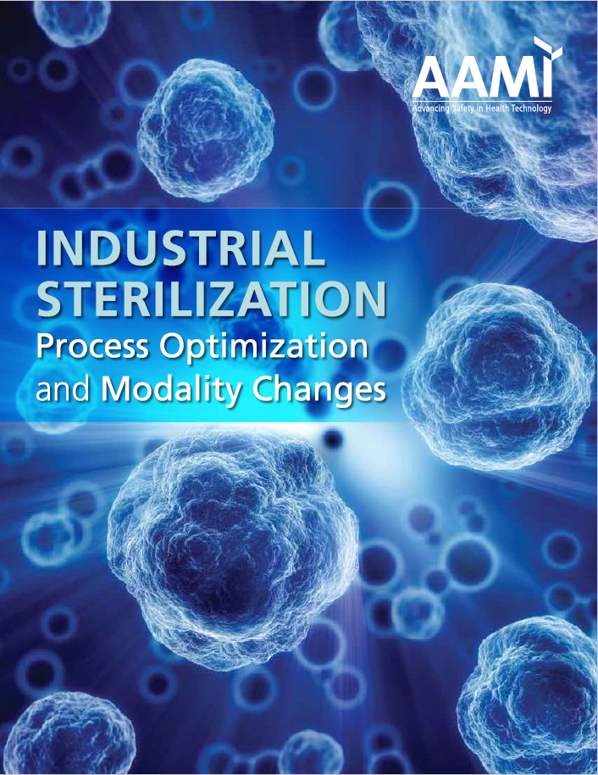
Gaps
Is there data out there than can support the fact that when it comes to sterility assurance “Dose is Dose”?
“Radiation Sterilization: Dose is Dose”, Hansen, Fidopiastis, Bryans, Luebke, Rymer
What is the origin of the requirement for identical operating conditions for machine source radiation when there is water present in a liquid state?
Tallentine and Powers, 1963
Mitigate through verification dose experiment
What about products that support microbial growth?
Medical Device Sterilization – Past, Present, and Future, September 20-21, 2023

Slide 8
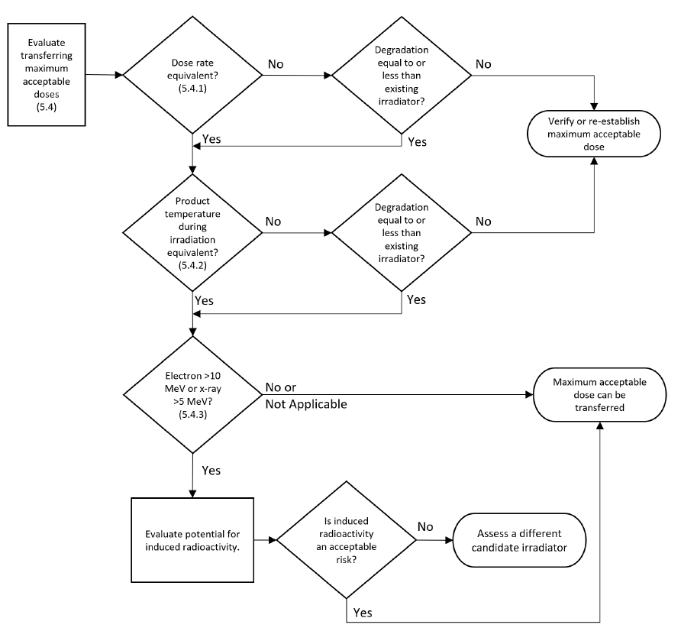
Outputs – Max
Transfer of maximum dose considerations:
Dose rate,
Temperature,
Potential for induced radioactivity
Medical Device Sterilization – Past, Present, and Future, September 20-21, 2023

Slide 9
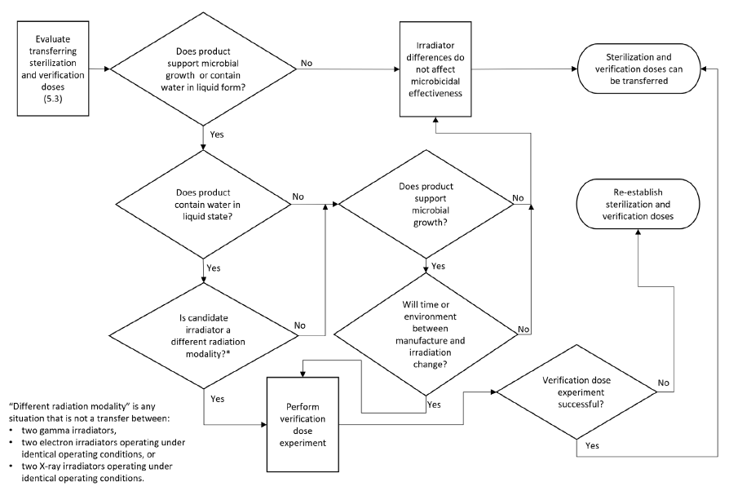
Outputs – Min
Transfer of sterilization and verification dose considerations:
Microbial growth possible,
Liquid water,
Different radiation source type,
Time between manufacture and sterilization
Medical Device Sterilization – Past, Present, and Future, September 20-21, 2023

Slide 10
Contents of the assessment
Irradiator related
Original and new irradiator descriptions
Anticipated differences in
Dose rate
Temperature
Dose distribution
Microbicidal efficacy
Results of performance qualification dose measurements
Results of verification dose experiment (if applicable)
Reference to data supporting the transfer of sterilization or verification dose without further testing
Product related
Description or Identification
Doses that are being transferred
Characteristics of product design and materials and statement as to whether source difference will have material effects
Results of tests and measurements of product functionality (if applicable)
Reference to data supporting the transfer of maximum dose without further testing
Conclusions
Could be reference to TIR104!
Medical Device Sterilization – Past, Present, and Future, September 20-21, 2023

Slide 11
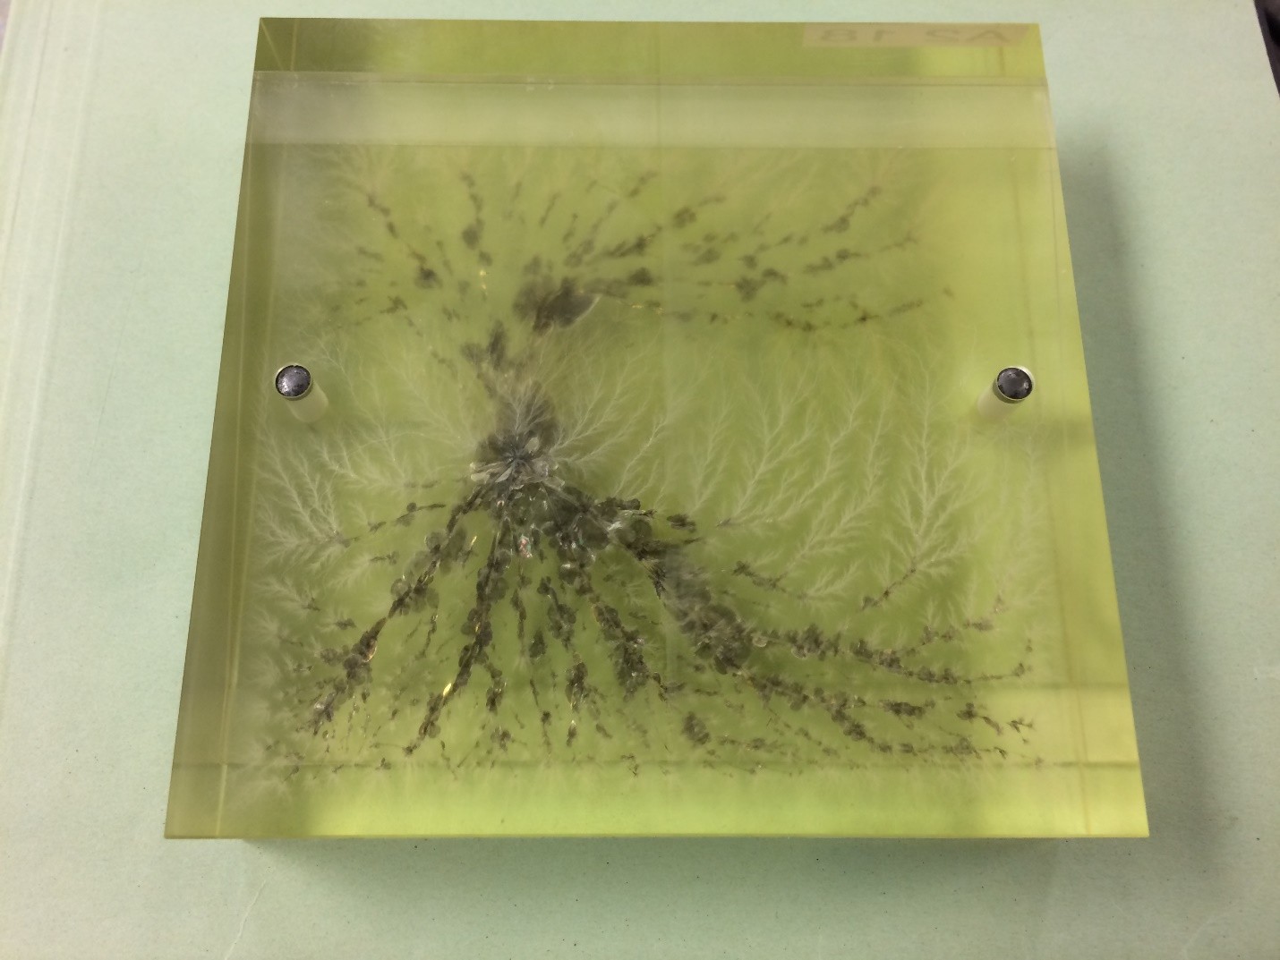
Reality kicks in
Going through the assessment – the most likely source “type” change scenario where an assessment can be made without testing is Gamma to X-ray.
X-ray has higher dose rate, and a different incremental path through the radiation field than gamma which is likely to result in lower temperature
Gamma to e-beam likely means new maximum dose due to higher DUR
Weird watch outs
Unintended “positive” effects of higher temperature processing such as curative effects
Static build up in e-beam products resulting in discharges that can cause harm to the product
Medical Device Sterilization – Past, Present, and Future, September 20-21, 2023

Slide 12
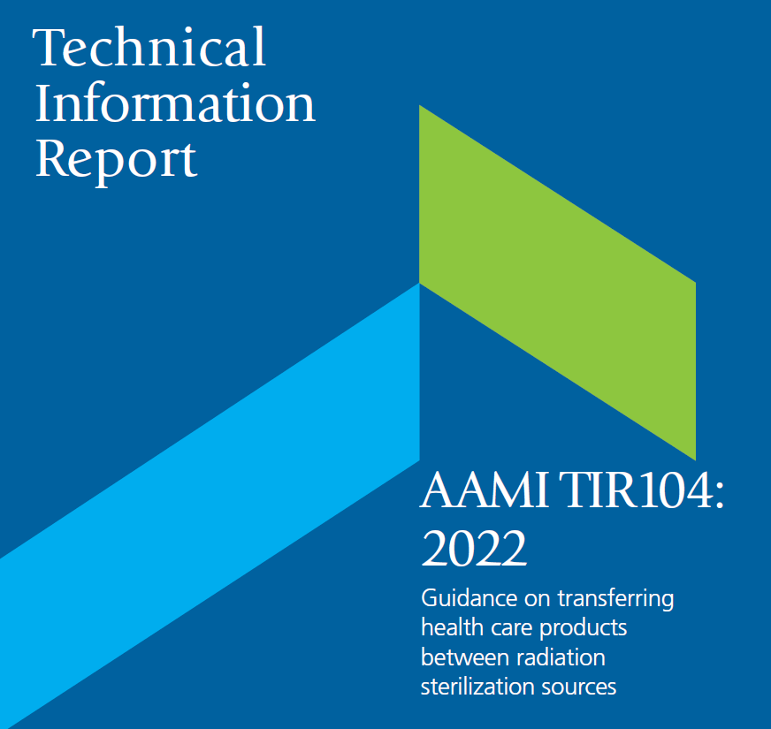
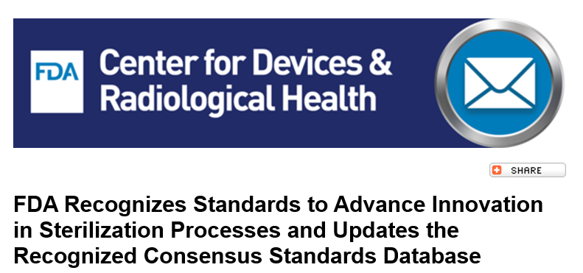
Getting it right
Revision process
NWIP approved project started Dec 2018
Is the guidance clear?
Is the guidance correct?
Does the guidance add value?
Working draft for committee review 2020
Committee drafts
2x committee drafts (January and July 2021)
68 member organizations
332 + 133 = 465 comments
No negative votes on second draft
Publication April 2022
FDA recognition Summer 2023
Medical Device Sterilization – Past, Present, and Future, September 20-21, 2023

Slide 13
How standards evolve
AAMI develops TIR
TIR provides foundation for change in ISO documents
New ISO standards published to replace or reference
AAMI provides a pipeline
AAMI develops consensus report
NEW!
Medical Device Sterilization – Past, Present, and Future, September 20-21, 2023
Notes:
AAMI provides a great conduit for standards development. Pipeline for new ideas.
Allude to anything Amanda said
Go through the arrow
Talk about how standards organizations also evolve, new consensus reports – will be hearing more about that at this conference as well

Slide 14
Next steps
ISO 11137-1 publication (2024)
TIR 104 is referenced multiple times
Publication references from TIR 104 added to 11137
TIR 104 is still a useful stand-alone resource – but fundamental principals will now be contained in ISO 11137-1, and references to 2006 version obsolete
Possible paths forward
Maintain/revise TIR 104 to reflect ISO 11137-1:2024
Move to ISO as a TS or TR document
ISO or AAMI NWIP will be required to get things moving!
Medical Device Sterilization – Past, Present, and Future, September 20-21, 2023

Slide 15
Takeaways
Moving the dial in the industry takes time
Publishing data helps build the foundation for standards
AAMI provided the means to make a useful change
Anyone who participates in standards development can effect change
TIR 104 is an FDA recognized guidance document that can be used to help transfer product between radiation sources…
… We should use it!!!
Medical Device Sterilization – Past, Present, and Future, September 20-21, 2023

Slide 16
Thank you! Questions?
Medical Device Sterilization – Past, Present, and Future, September 20-21, 2023

