Slide 1
Competencies for Sterility Assurance Professionals
Kim Patton, September 21, 2023

Slide 2
What is SfSAP?
Society for Sterility Assurance Professionals (SfSAP)
SfSAP has been established as a collaborative not-for-profit initiative by iia, AAMI, ASTM, and PDA. It aims to enable the healthcare industry to:
Collaborate and formulate a standard approach to meeting regulatory requirements related to the competency of those involved in the field of Sterility
Create frameworks that can be used as a career development pathway, that will enable the sterilization community to attract and retain sterility assurance professionals throughout their sterility assurance career.
Assist education delivery organisations in refining and maintaining content that supports the development of individuals in order to demonstrate “competency” as a sterility assurance professional.
Medical Device Sterilization – Past, Present, and Future, September 20-21, 2023

Slide 3
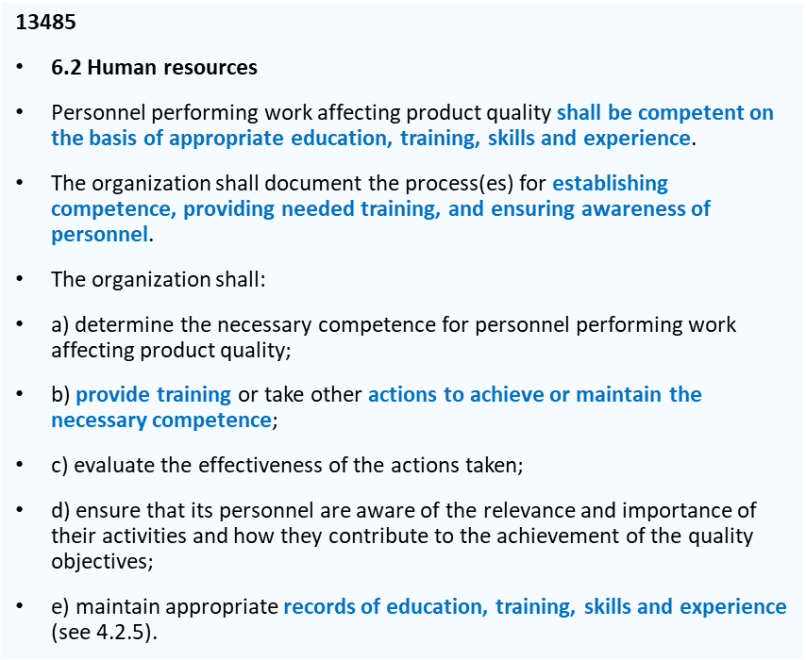
Contributing to meeting regulatory requirements
The SfSAP Learning Framework and Learning Outcomes addresses the requirements for there to be documented evidence of competency and defined in the MDR, 13485
MDR Annex VII Requirements to be met by Notified Bodies
3. Resources
3.2 Qualification criteria in relation to personnel
3.2. 1 The Notified Body shall establish and document qualification criteria and procedures for selection and authorization of persons involved in conformity assessment activities, including as regards knowledge, experience and other competency required and the required initial and ongoing training. The qualification criteria shall address the various areas within the conformity assessment process, such as auditing, product evaluation or testing, technical documentation review and decision making, as well as devices, technologies and areas, such as biocompatibility, sterilisation, tissues and cells of human and animal origin and clinical evaluation, covered by the scope of designation.
Medical Device Sterilization – Past, Present, and Future, September 20-21, 2023

Slide 4
SfSAP - Our areas of focus
Developing learning frameworks (curricula)
Identifying and recognizing educational delivery organizations
Identifying ways to qualify and document individual’s development
Medical Device Sterilization – Past, Present, and Future, September 20-21, 2023

Slide 5
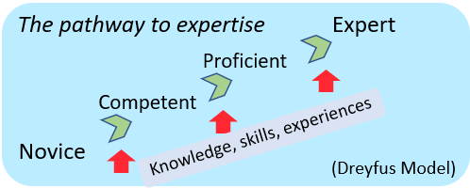
What are we looking for when hiring a new person?
What is the collective set of Knowledge & Skills we need?
How can we help our people grow their K&S?
What experiences will shape one’s competence?
Organi-zation
Why formalize curricula?
How can we attract new talent?
How can we develop professionals that will be critical to the future of our industry and our patients?
How can we retain professionals who will become industry experts?
Industry
Curricula
Individual
If I want to become an expert in this field, what’s my path?
How can I do this in a step-wise manner?
What is the set of K&S that industry experts and practitioners say are needed to be competent as an expert?
What is the collective set of skills a firm needs?
What is the set of education, training, and experiences an expert should have?
What set of K&S should a sterilization auditor have?
Regulators
Medical Device Sterilization – Past, Present, and Future, September 20-21, 2023

Slide 6
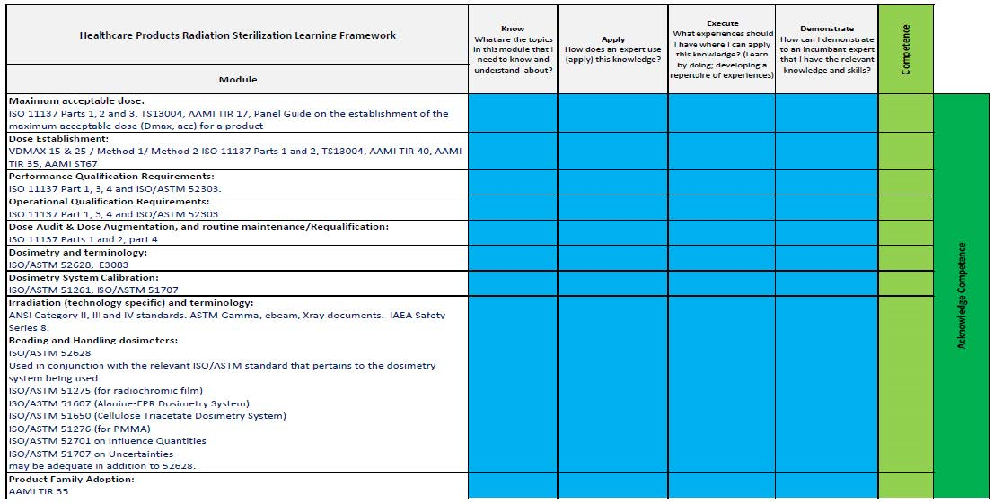
Current Version - Radiation Learning Framework
Approach
Know
Apply
Execute
Demonstrate
Levels:
Competent
Proficient
Expert
Medical Device Sterilization – Past, Present, and Future, September 20-21, 2023

Slide 7
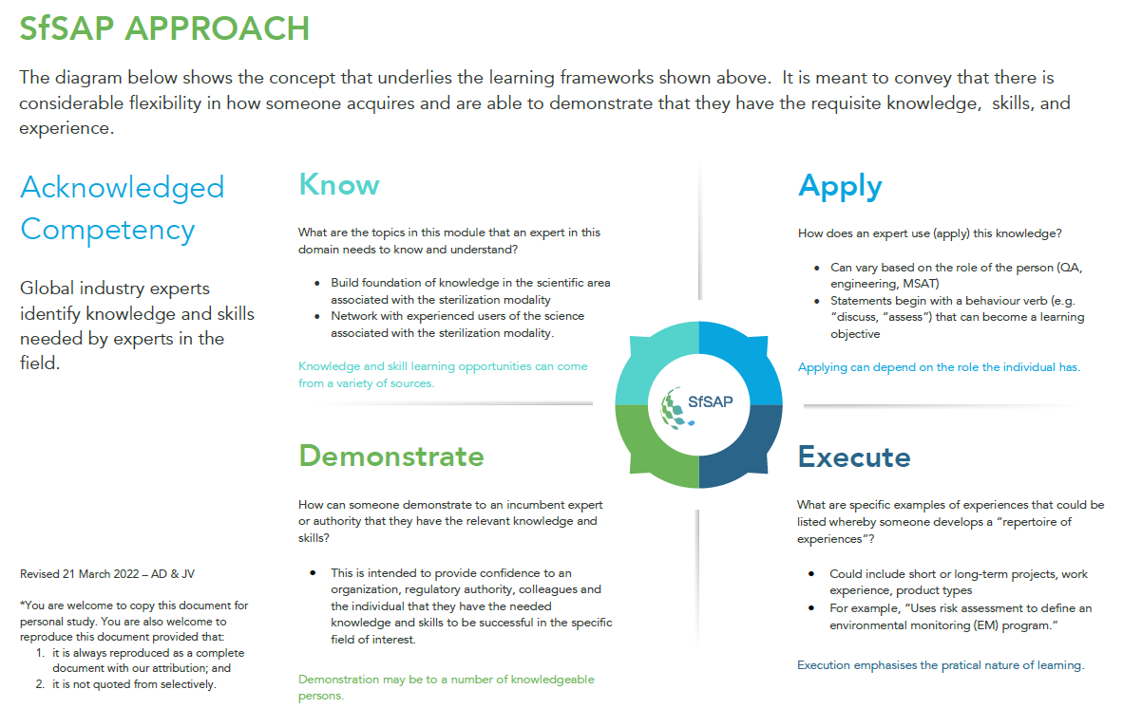
Medical Device Sterilization – Past, Present, and Future, September 20-21, 2023

Slide 8
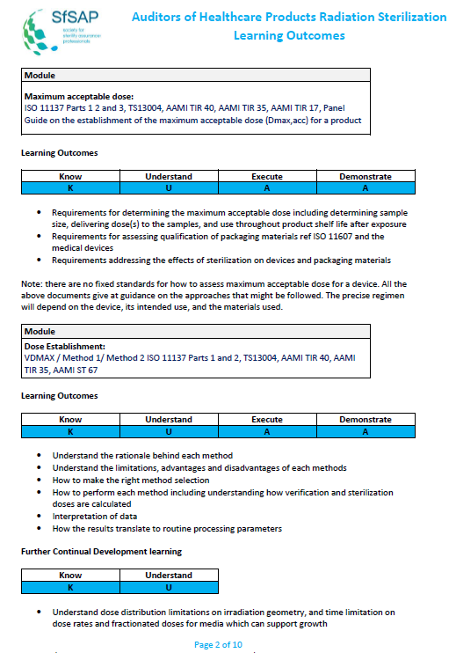
Learning Outcomes – Connecting the framework to the desired outcomes
Medical Device Sterilization – Past, Present, and Future, September 20-21, 2023

Slide 9
Individuals/organizations using the learning frameworks and learning outcomes
To support individuals and organisations in gaining the appropriate education, training, skills and experience the SfSAP has a Learning Outcomes Guide:
Individuals and Organizations
The SfSAP Curricula and learning outcomes can be used by individuals and organisations for the following:
Develop training plans
Determine training courses that should be attended
Understand the Competency elements (Know, Apply, Execute and Demonstrate) that are required
Understand the learning outcomes required for courses attended or training taken.
Monitor progress towards demonstrating competency.
Medical Device Sterilization – Past, Present, and Future, September 20-21, 2023

Slide 10
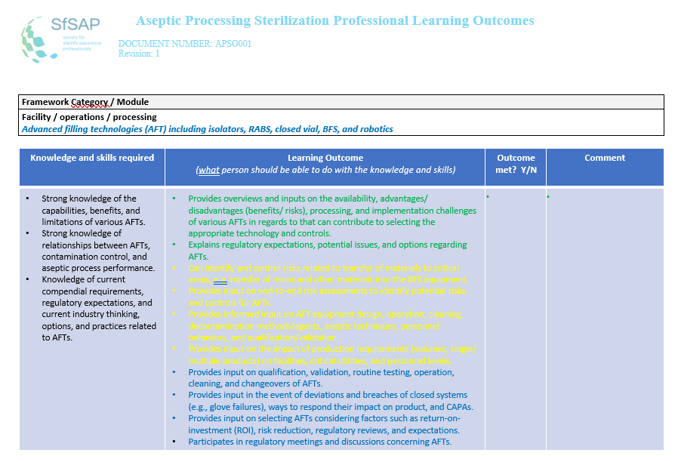
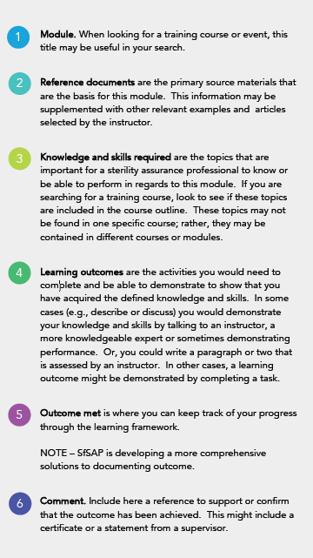
Medical Device Sterilization – Past, Present, and Future, September 20-21, 2023

Slide 11
Documenting one’s journey: Portfolios
Courses / education completed (Certificates of completion, course titles and course outlines)
Relevant work experiences
(Specific problems / solutions and activities that were performed [”executed”])
Portfolio
Resume / CV
Curriculum checklist (summary of knowledge, skills, experiences accomplished, examples of work products)
Work history
(Job titles and job descriptions)
Contributions to the profession
(Articles or book chapters, standards written, membership in associations)
Medical Device Sterilization – Past, Present, and Future, September 20-21, 2023

Slide 12
Continuing our path forward
What SfSAP is working on:
Refining learning frameworks and learning outcomes
Identifying activities (e.g., auditing, designing facilities) that would then be mapped to items in the frameworks and outcomes
Working with experts to identify key experiences important in developing expertise
Categorizing framework items and outcomes that provide a three-level, step-wise approach for moving through the curriculum
“Validating” competency curricula with experts
Sharing the model and results with industry, regulators, and training / educational organizations
Medical Device Sterilization – Past, Present, and Future, September 20-21, 2023

Slide 13
Medical Device Sterilization – Past, Present, and Future, September 20-21, 2023

