Slide 1

Finding the optimal sterilization configuration using simulations
Tobias Funk, PhD and Daniel Badali, PhD

Slide 2
Acknowledgments
This work was partially funded by FDA SBIR grants
  1R43FD007584-01 and 1R43FD007313-01
  (The contents are those of the authors and do not necessarily represent the official views of, nor an endorsement, by FDA/HHS, or the U.S. Government)

Slide 3


/
Co-development company
100+ employees in Newark, CA and Boston
Focus on life sciences and medical device development
Internal R&D partially funded by government grants
Spins out internal ideas as independent products
Has a virtual dose mapping tool
Offers virtual dose mapping to:
  Medical device developers
  Sterilization vendors
Visit us at: www.doseinsight.com

Slide 4
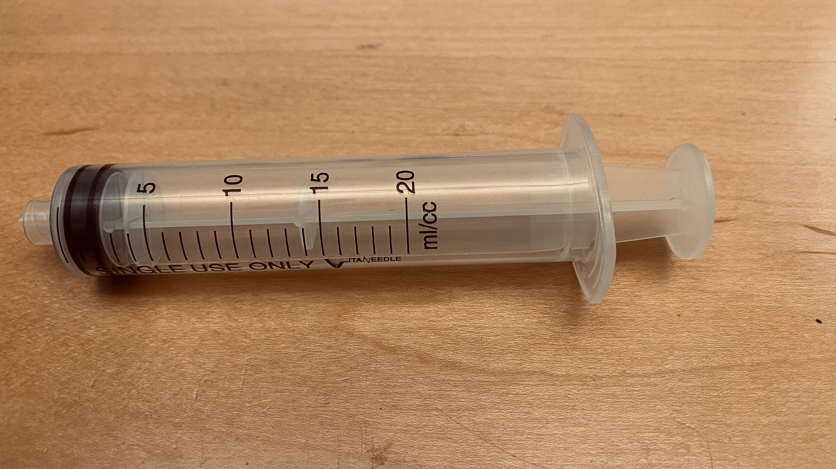
What is the right configuration for my device?
Case study using syringes from McMaster
Radiation sterilization technique?
90 degrees
Beam orientation?
0 degrees
3 cm
12 cm

Slide 5
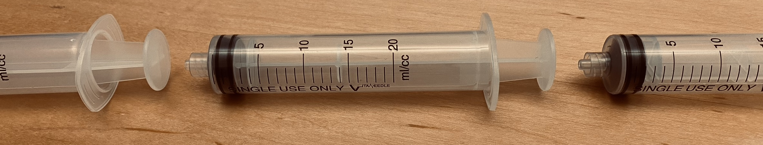
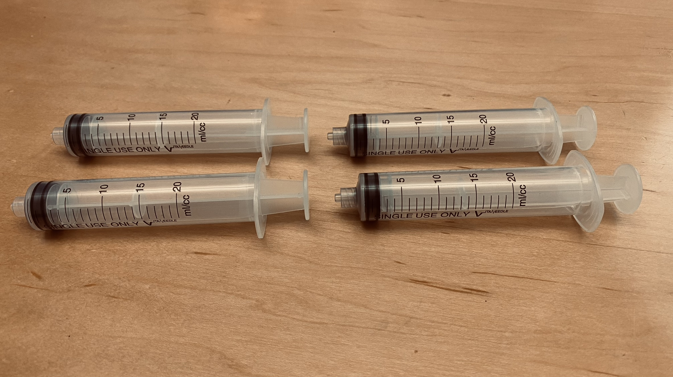
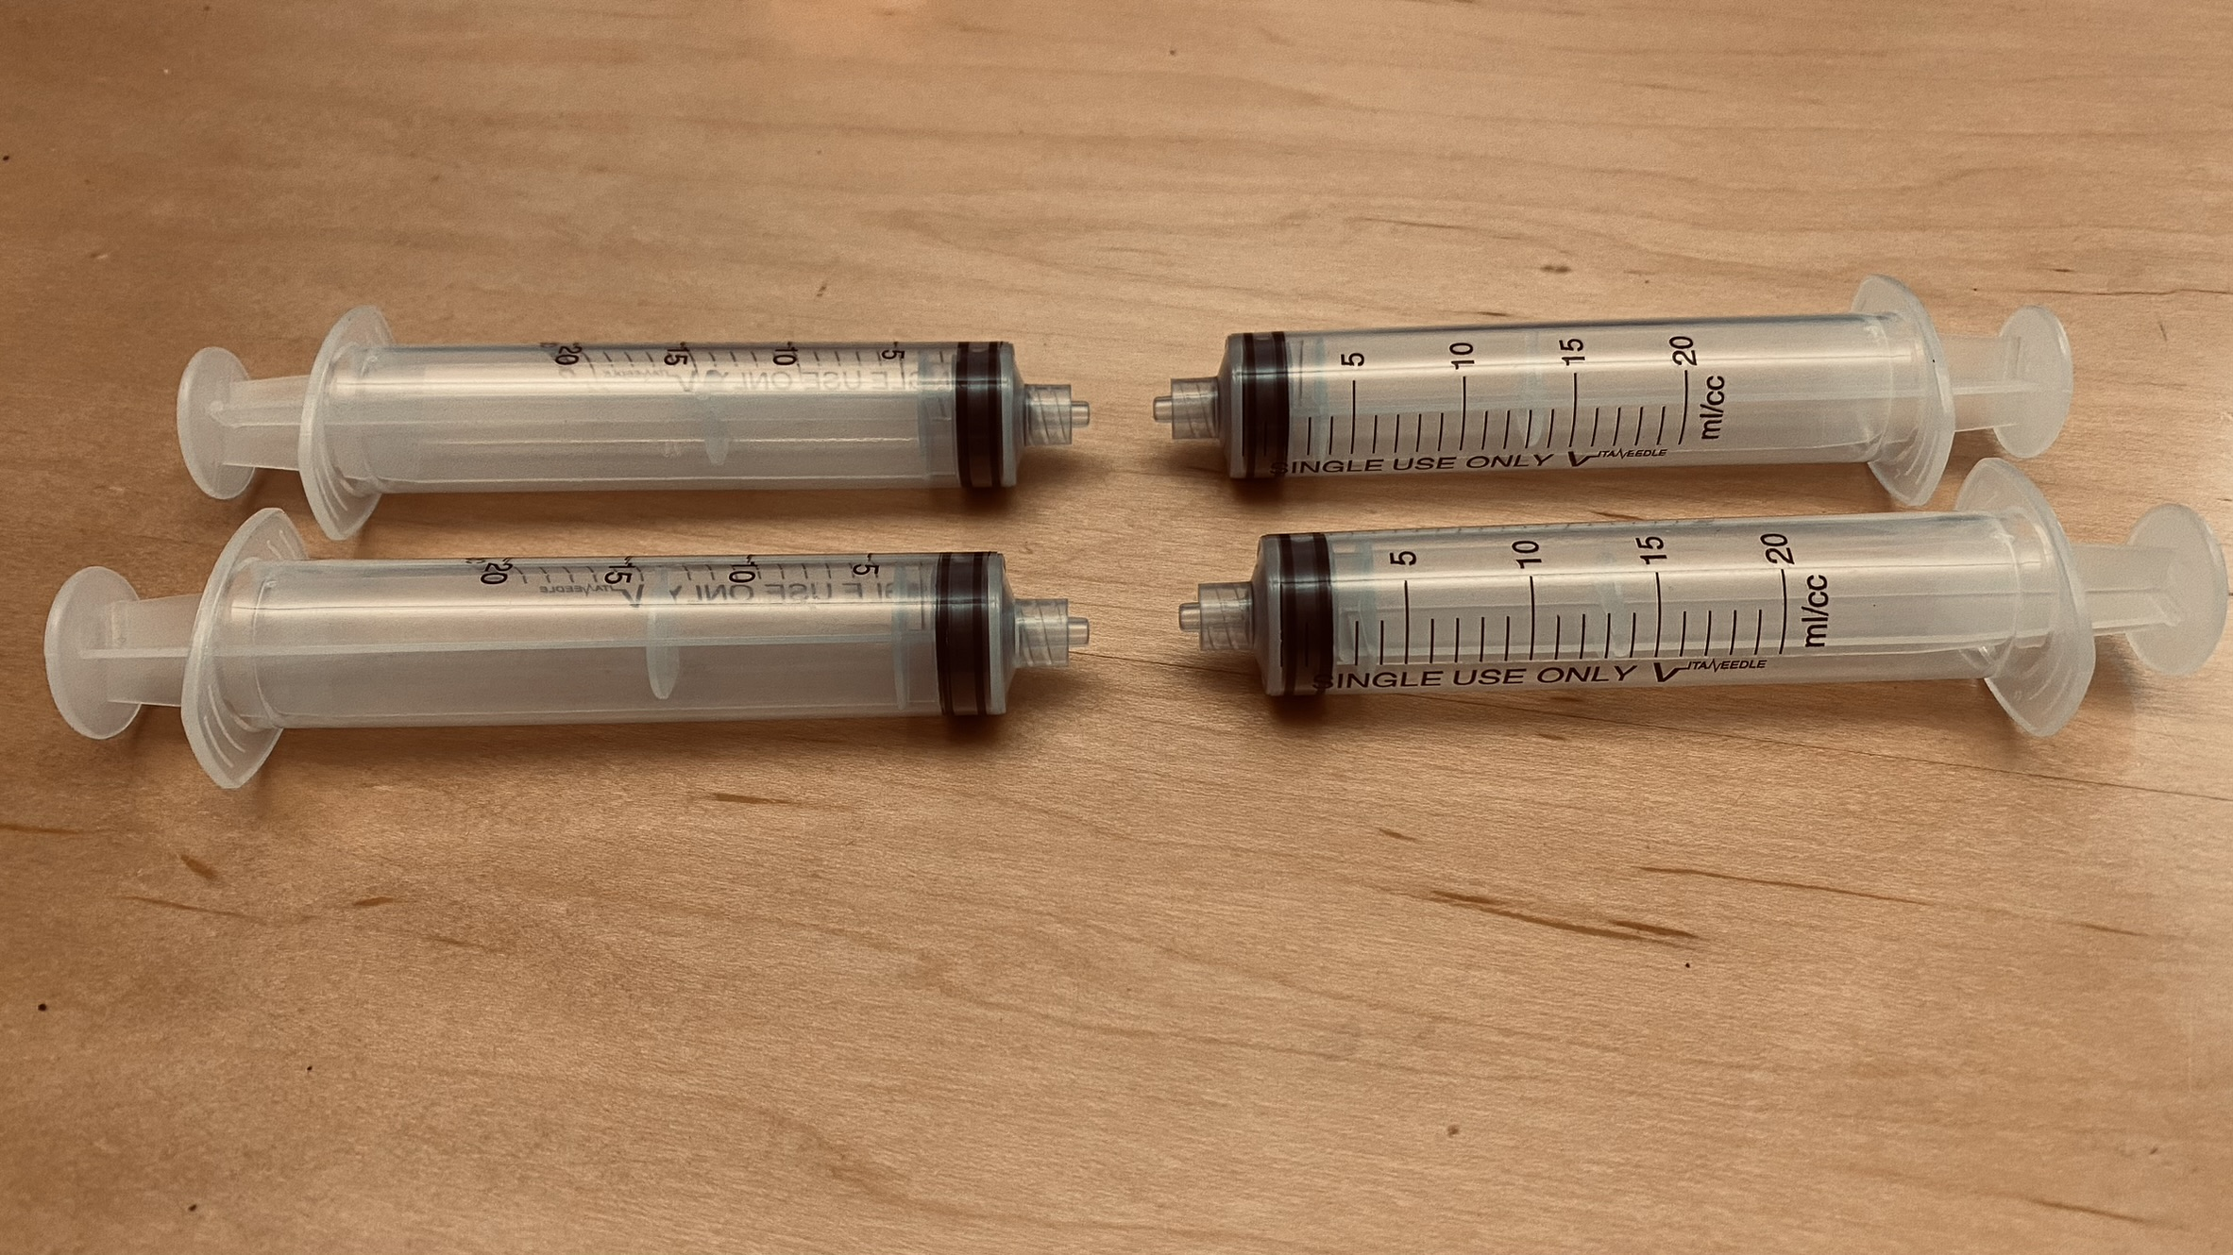
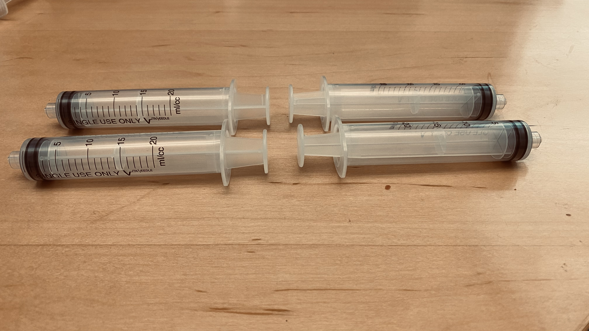
What is the right packaging for my device?

Slide 6
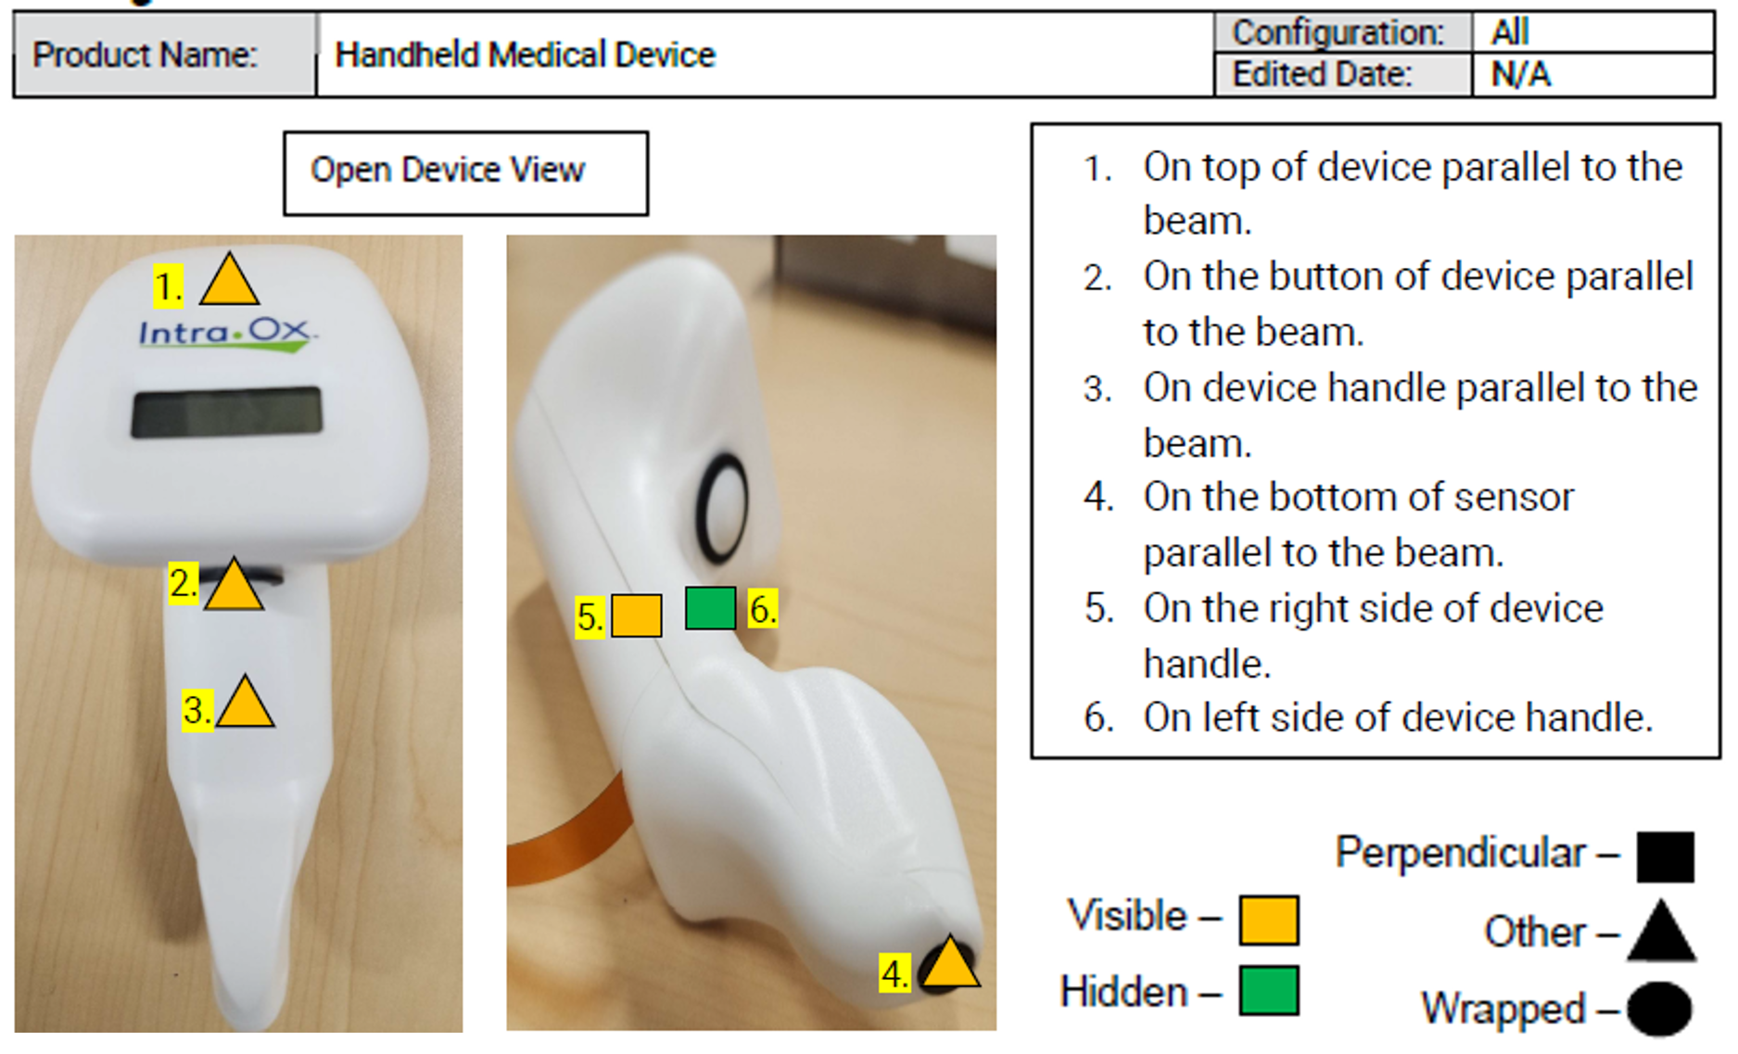
Comparison: Measurement vs. Modeling

Slide 7
From Design Guidelines to Design for Sterilization (DFS)
Design rules
EtO: avoid cavities where gas can get trapped, conformally coated circuit boards, etc.
Material compatibility
AAMI TIR17 Compatibility of materials subject to sterilization, 2017
Consulting with vendors
Leverage decades of experience
Design guidelines
Notes:
What does all this have to do with sterilization? Following a similar approach as DFM for injection molding will unlock similar benefits
We might not use this terminology in the industry, but you are probably already doing Design for Sterilization
Following the evolution of other DFX efforts, for example DFM for injection molding, we see modeling as the next step for Design for Sterilization
To take advantage of the benefits provided by modeling as were experienced for injection molding, we can do modeling for sterilization
This talk will focus on how modeling can be used for DFS, specifically for radiation sterilization
For radiation sterilization, dose is the key ingredient to achieve sterility, and modeling refers to calculating dose. But what is dose? The survey showed us that there is a range of familiarity with dose modeling, so let’s start with a basic understanding of how radiation delivers dose to achieve sterility

Slide 8
From Design Guidelines to Design for Sterilization (DFS)
Modeling
Design guidelines
Dose Insight
Enables Design for Sterilization through modeling
Many industries went from design guidelines to modeling.
Examples: flow simulations for injection molding, data center design.
Notes:
What does all this have to do with sterilization? Following a similar approach as DFM for injection molding will unlock similar benefits
We might not use this terminology in the industry, but you are probably already doing Design for Sterilization
Following the evolution of other DFX efforts, for example DFM for injection molding, we see modeling as the next step for Design for Sterilization
To take advantage of the benefits provided by modeling as were experienced for injection molding, we can do modeling for sterilization
This talk will focus on how modeling can be used for DFS, specifically for radiation sterilization
For radiation sterilization, dose is the key ingredient to achieve sterility, and modeling refers to calculating dose. But what is dose? The survey showed us that there is a range of familiarity with dose modeling, so let’s start with a basic understanding of how radiation delivers dose to achieve sterility

Slide 9
What is dose?
Dose is the energy of electrons or photons absorbed in the medical device
Particles interact with matter
Get absorbed
Change direction
Change energy
Generate new particles
15.3 kGy
24.2 kGy
10.7 kGy

Slide 10

How do we model dose deposited in the device?
Emulate the real statistical nature of particle transport by simulating each particle’s history
Source produces particles with random direction and energy
We model the particle interactions
Each particle’s history is tracked
Where did it get absorbed?
How much energy did it deposit?
15.3 kGy
24.2 kGy
10.7 kGy
Monte Carlo simulations

Slide 11
Predicting the dose map using modeling
Source model
Radiation
modeling
Dose map
Product model
Geometry
Materials
Design For Sterilization

Slide 12
Are Monte Carlo simulations accurate?
Yes!
See for example:
"Monte Carlo methods for device simulations in radiation therapy,"
by Park et al.
in: Physics in Medicine and Biology, vol. 66, no. 18, pp. 1361-6560, 2021

Slide 13
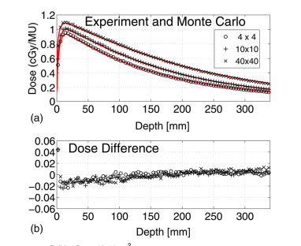
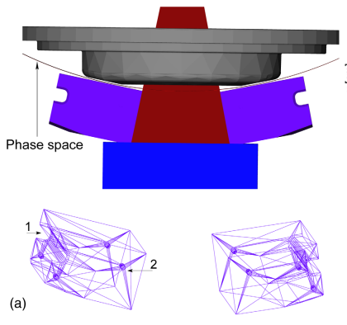
Validation of Geant4 with a 6 MeV X-ray beam
M. Constantin et al., Medical Physics, 38 (2011). Collaboration between Stanford and Varian
CAD model of treatment head Measured (black) vs. simulated (red) dose
Collimator jaws
98% of measurement values are within 2% of simulated dose

Slide 14
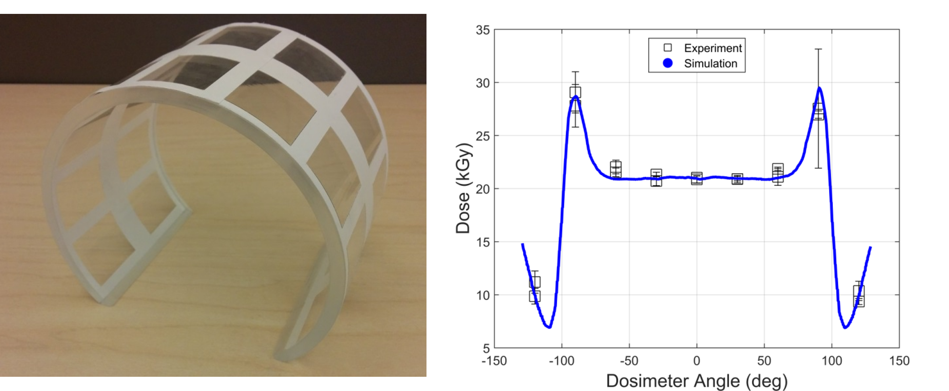
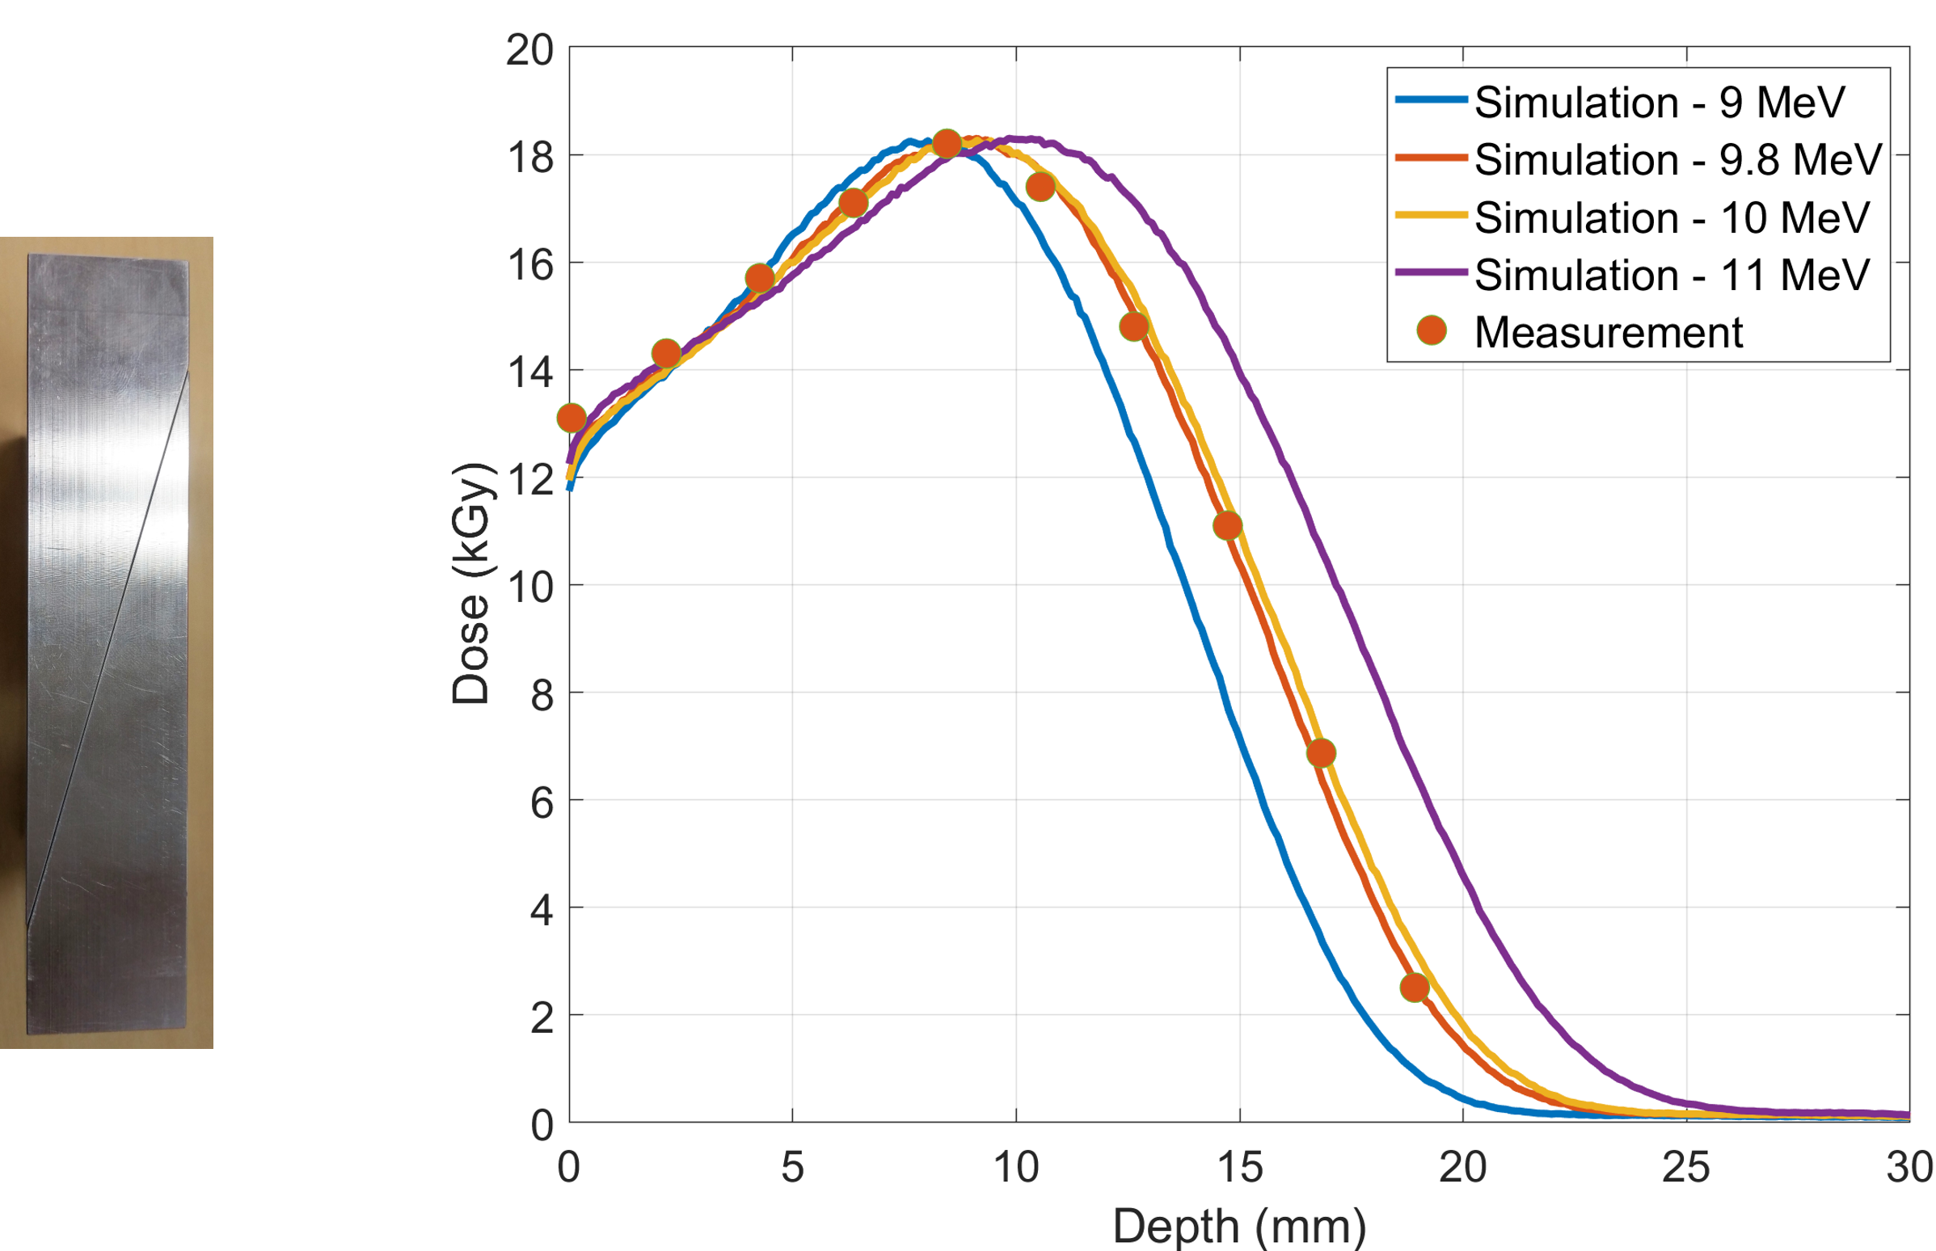
Validation of sterilization simulations

Slide 15
Monte Carlo Simulations are increasingly used for sterilization simulations
Specialized MC tools for sterilization
  RayXpert
  Puffin
  Dose Insight

Slide 16
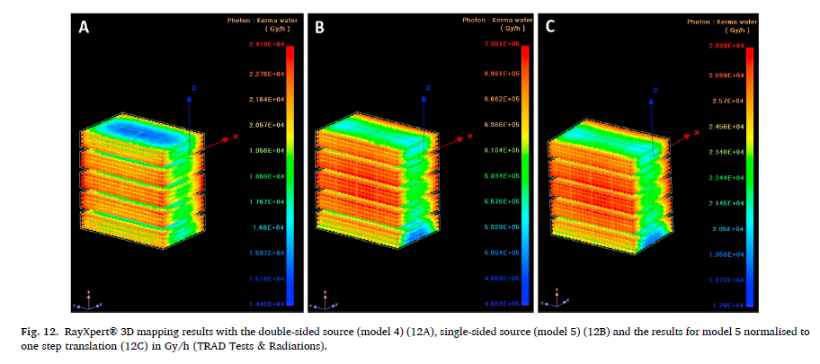
RayXpert by TRAD
From:

Slide 17
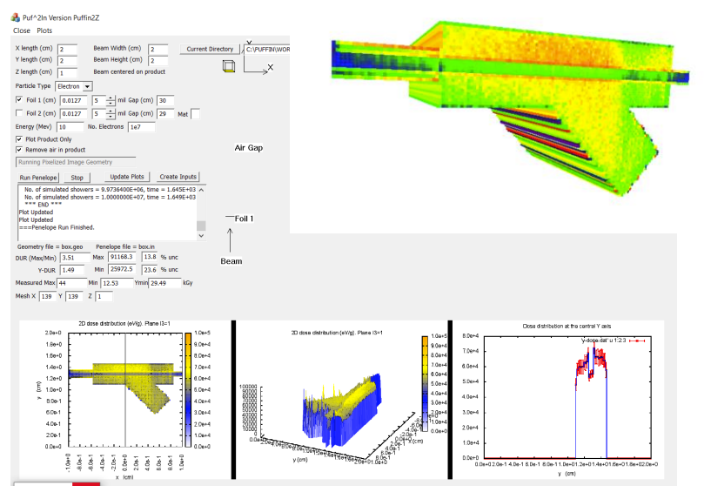
Puffin by Pacific Northwest National Laboratory
From:
Schwartz presented at IAEA

Slide 18
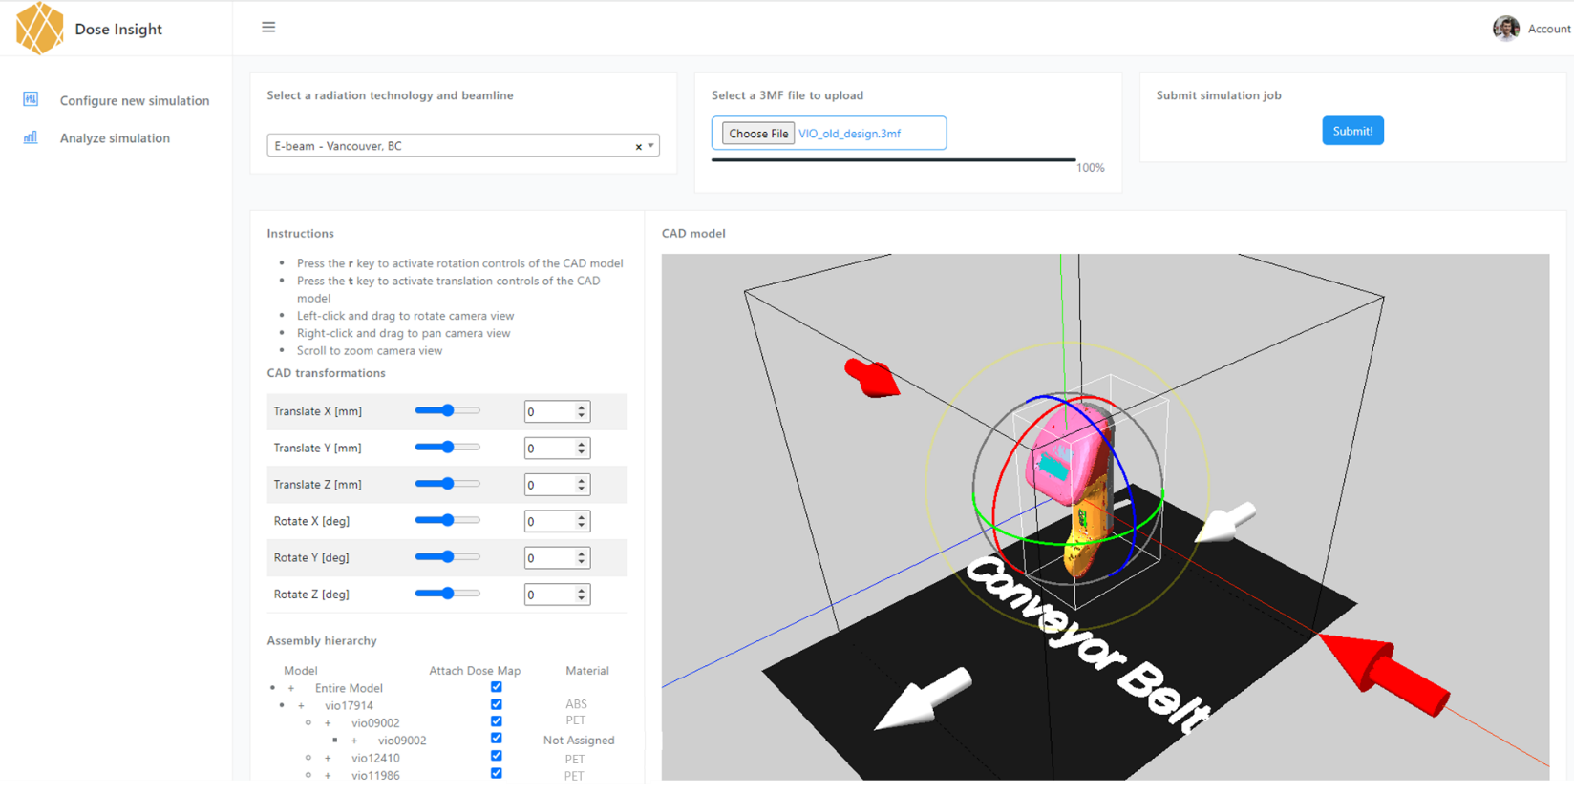

Slide 19
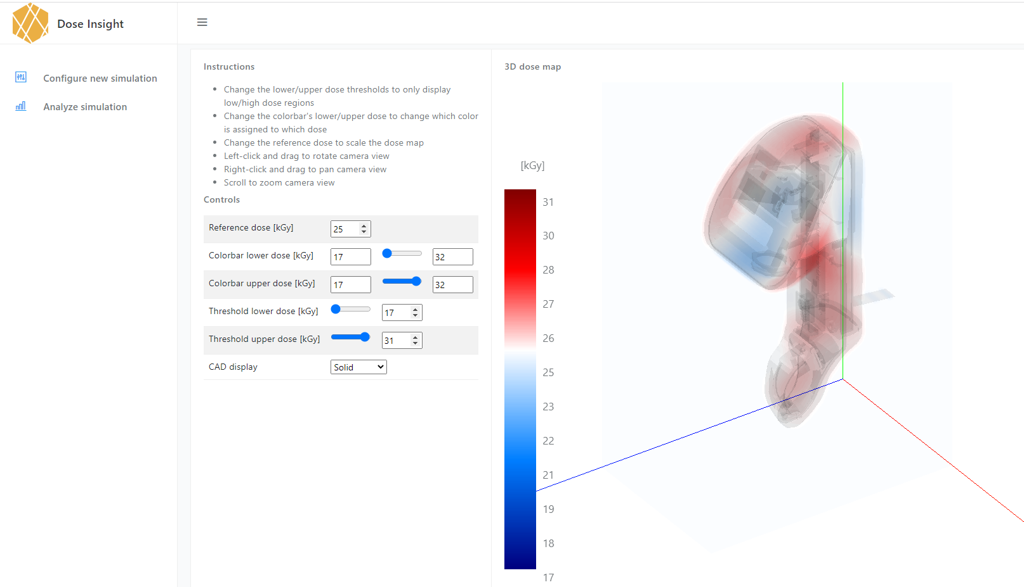

Slide 20
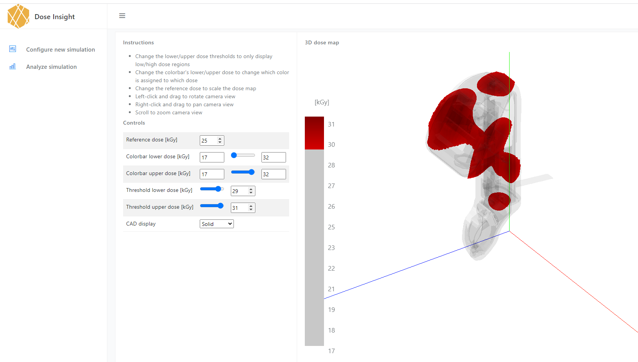

Slide 21
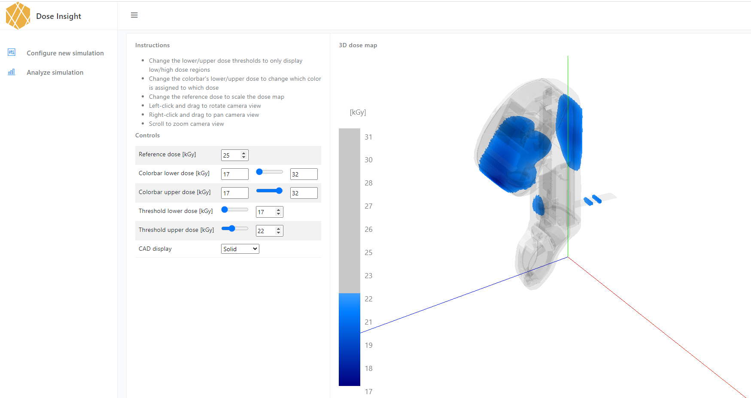

Slide 22
Comparison: Measurement vs. Modeling

Slide 23
Are Monte Carlo simulations fast?
Not really, but ….

Slide 24
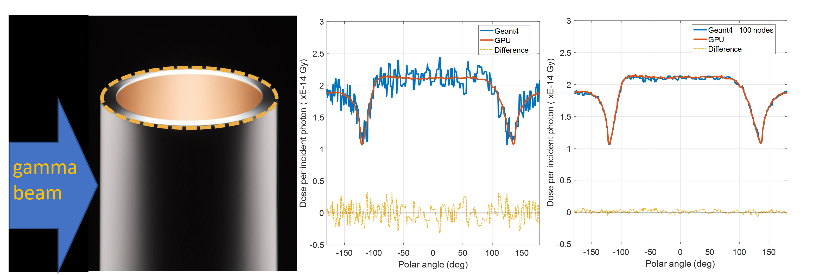
Acceleration with cloud computing

Slide 25
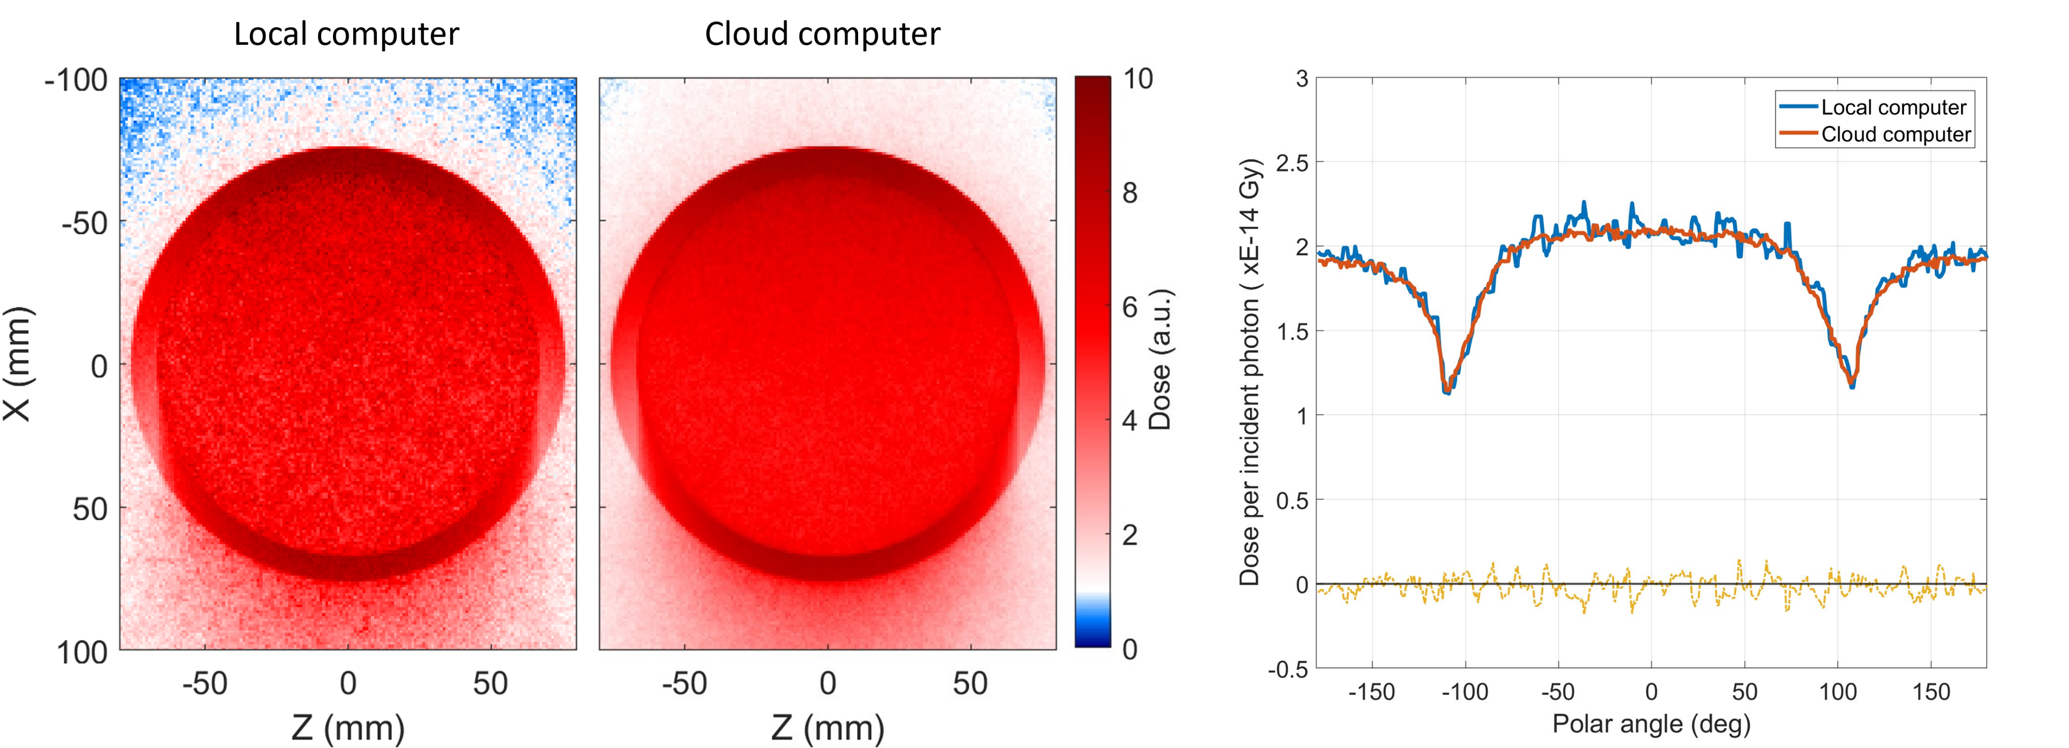
Acceleration with cloud computing
>30x speed-up

Slide 26
Acceleration with GPU computing
Current GPU implementation is only working on high energy photons.
900x faster than on CPU (single computer)

Slide 27
What is the right packaging for my device?

Slide 28
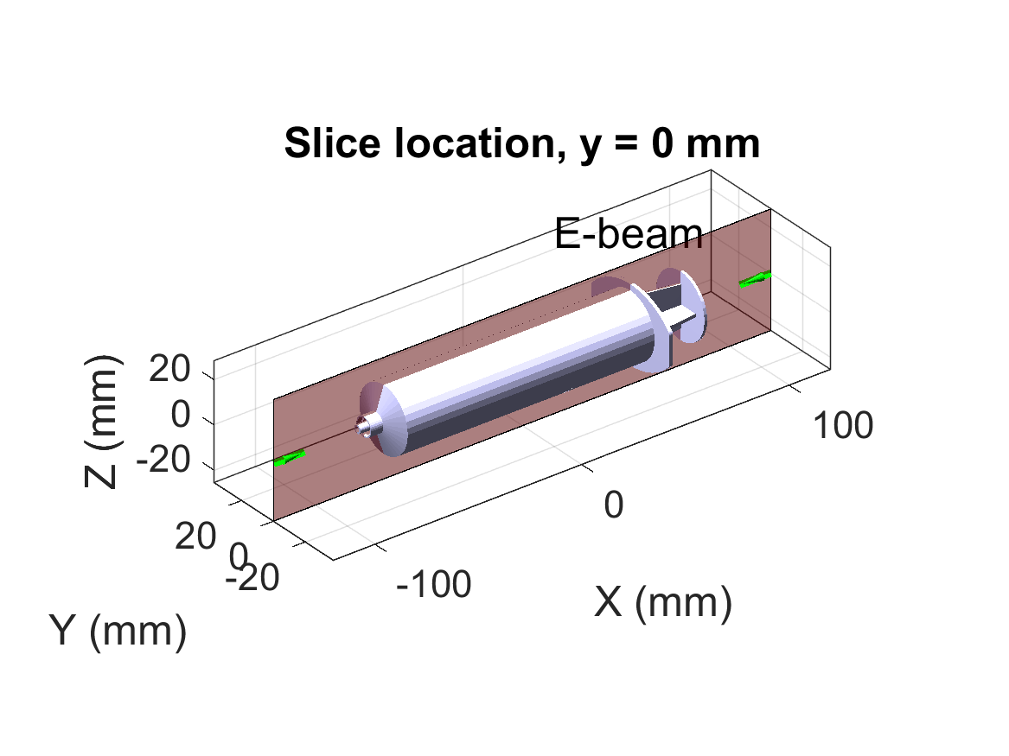
Dose map of a single syringe

Slide 29
Understanding the dose map
Generate a 3d dose map of just the surface dose
Produce histogram of surface 3d dose map and calculate the DUR
~DUR

Slide 30
Which beam direction is better?

Slide 31
How much does simulation uncertainty skew the results?
DUR and histograms as function of number of particles

Slide 32
Comparison of packaging configurations
Beam direction is 90 degree
Antiparallel Parallel

Slide 33
Comparison of packaging configurations
Beam direction is 90 degree
Antiparallel Parallel
No significant difference in the two configurations

Slide 34
Comparison of packaging configurations
Beam direction is 0 degree
Tip-to-tip Plunger-to-plunger

Slide 35
Comparison of packaging configurations
Beam direction is 0 degree
Tip-to-tip Plunger-to-plunger
Tip-to-tip configuration has significantly lower DUR

Slide 36
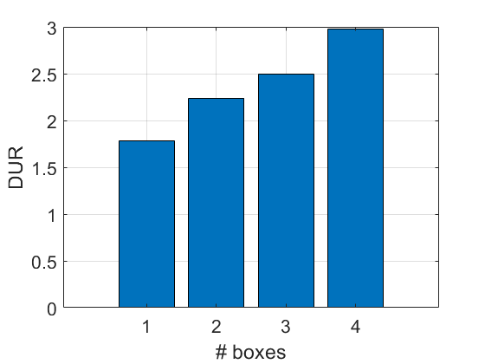
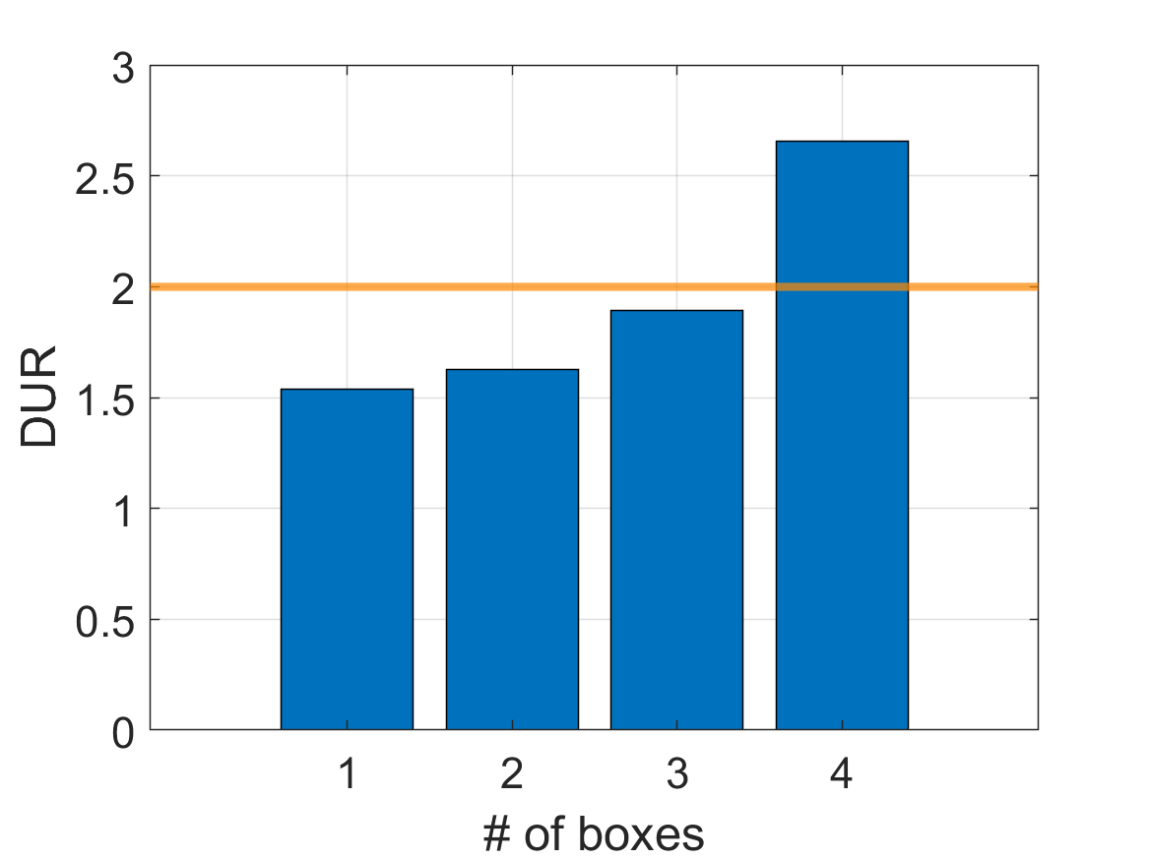
How many syringes can we stack?
Beam direction:
0 degrees
2 3 4
# syringes
Beam direction:
90 degrees
2 4 6 8
# syringes

Slide 37
Final packaging configuration: 3x6x3 syringes

Slide 38
Final packaging configuration: 3x6x3 syringes

Slide 39
Conclusions
Monte Carlo simulations predict dose maps and dose uniformity ratios accurately
Measurements are the gold standard; however, measurement uncertainty can make meaningful conclusions difficult
Device and packaging design can be optimized for radiation sterilization using simulations

Slide 40
Dose Insight’s approach
Device orientation/packaging
Compare modalities
Dosimeter placement
Design for Sterilization
Shielding design
Dose Insight enables any engineer to produce virtual dose maps
Collaborate with us to use modeling in your development process
Get in touch today! https://doseinsight.com or info@doseinsight.com

