Slide 1

Beyond Read & Learn
Vu Lekate, September 21, 2023

Slide 2
Agenda
Content development
Curriculum / Framework
Training & Development
Immersive Training
  Show versus tell
  Why and how versus what
Gamification
Medical Device Sterilization – Past, Present, and Future, September 20-21, 2023

Slide 3
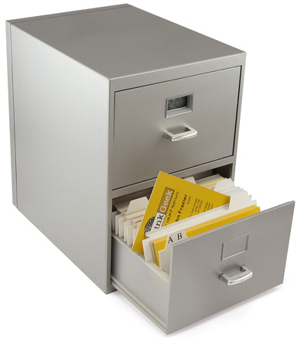
Content Development
Autonomy
Active
Visual / Auditory / Kinesthetic
Problem oriented
Medical Device Sterilization – Past, Present, and Future, September 20-21, 2023

Slide 4

Medical Device Sterilization – Past, Present, and Future, September 20-21, 2023

Slide 5
Curriculum
110 Learning Outcomes
Medical Device Sterilization – Past, Present, and Future, September 20-21, 2023

Slide 6
Training & Development
Know & Apply
Competent
Computer Based Modules
Exam
Execute & Demonstrate
Proficient
Role / Experience
Projects
Rotation
Trainer
Expert
Radiation
Gas & Heat
Microbiology
Packaging
Medical Device Sterilization – Past, Present, and Future, September 20-21, 2023

Slide 7
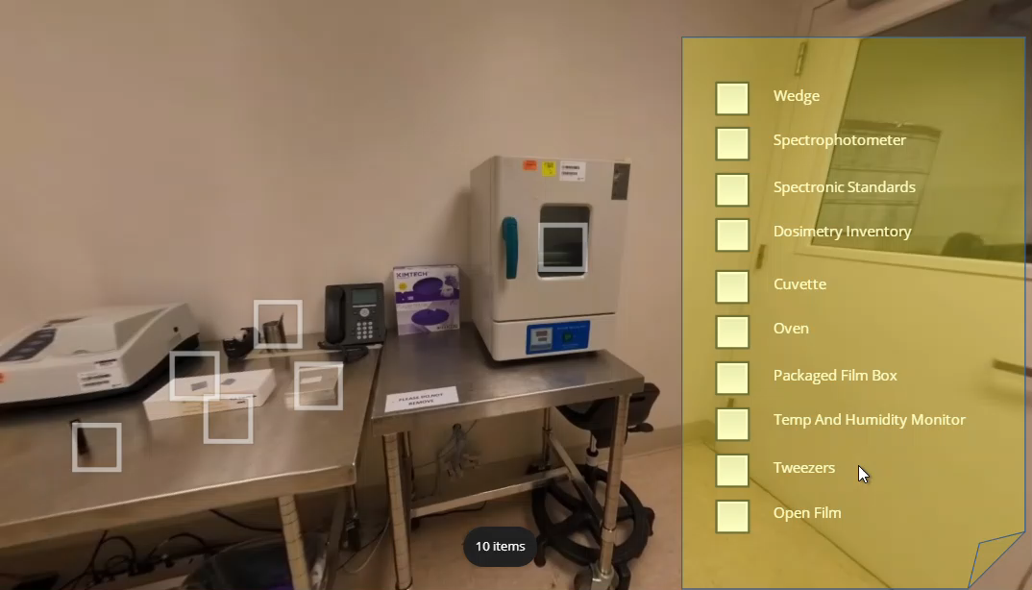
Immersive Training
Dosimetry & Terminology
Learning outcomes
Understand the different dosimeter types
Understand influence quantities of dosimetry systems
Choice of dosimeters
Medical Device Sterilization – Past, Present, and Future, September 20-21, 2023

Slide 8
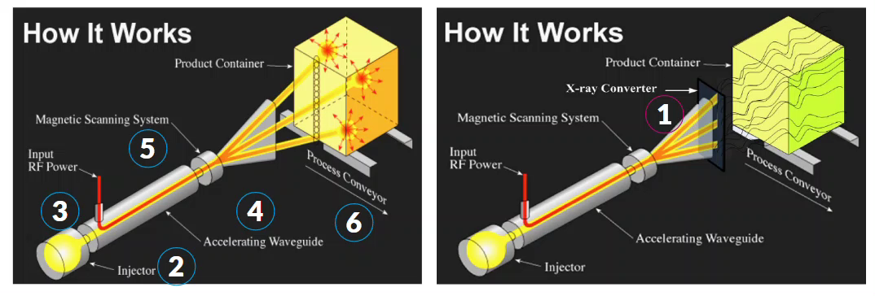
Interactive
Irradiation & terminology
Learning outcomes
Understand the principles with regards to technology specific radiation processing
Understand the terminology : photons, electrons, gamma etc
Differences between different types of irradiator
Medical Device Sterilization – Past, Present, and Future, September 20-21, 2023

Slide 9
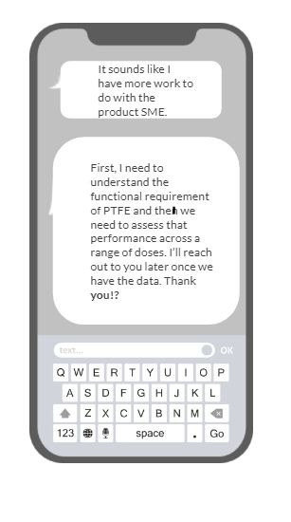
Problem based training
Maximum acceptable dose
Learning outcomes
Requirements for determining maximum acceptable dose including determining sample size, delivering dose(s) to the samples, and use throughout product shelf life after exposure
Interaction allows learners to choose different answers to material compatibility questions → each answer takes them down an alternate path
Medical Device Sterilization – Past, Present, and Future, September 20-21, 2023

Slide 10
Gamification
Interactive games and puzzles in CBTs
Pre-work and assignments after modules
Points rewarded for completing
Points can be used towards raffles for prizes throughout the program
Medical Device Sterilization – Past, Present, and Future, September 20-21, 2023

Slide 11
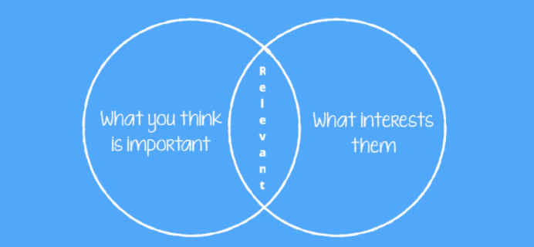
Medical Device Sterilization – Past, Present, and Future, September 20-21, 2023

