Slide 1

Risk Evaluations in implementing X-ray for Single-Use Systems sterilization
Samuel Dorey, Principal Scientist Materials & Irradiation | Sartorius

Slide 2
Biotech Only Succeeds Working Together
Qualification Package review by biomanufacturers &
Supply Chain Considerations
Pre-change notification 2021
01
02
03
04
05
Risk assessment, Equivalency evidence and validation package definition through the BPSA protocole and other guidelines
Implementation in mid-2024
Change Notification in 2021 & 2022
.

Slide 3
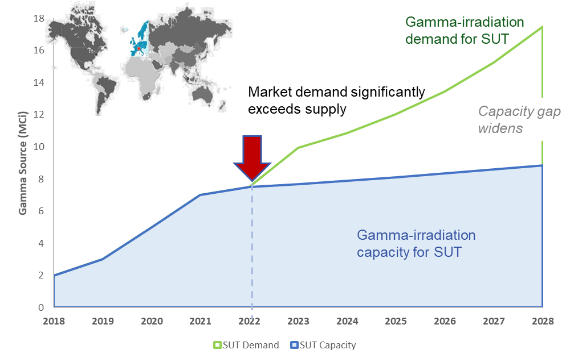


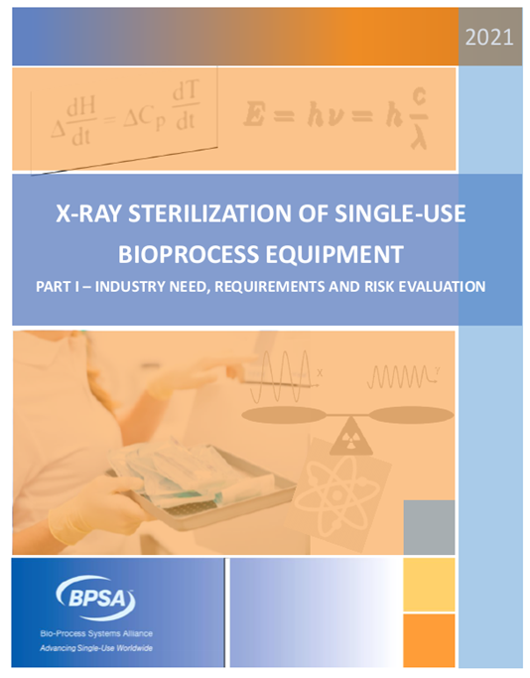
Demand, Capacity & Implementation
Contract Irradiation Capacity Bottle-Neck for Single-Use
Timelines
*
Integrators Pre-change Notification Issued
Change Notifications Issued
Pandemic changed SUS landscape
Implementation Targets
*
We are here
Industry workgroups created
2021 BPSA White Paper. Part I
2023 BPSA White Paper. Part II: Representative qualification data
Notes:
Images: https://commons.wikimedia.org/wiki/File:Supply_Chain_Clustering.JPG

Slide 4

EU Annex 1 Specific Guidance on SUS Safety Assessment Needs
Validated Sterilisation processes for SUS with no adverse impact on system performance
SUS integrity maintained throughout intended operational conditions
Evaluated impact of extractable and leachable profiles of the SUS on the product quality

Slide 5
Standards and Guidance
Standards that should be used are¹
ISO 11737-1:2018 - Sterilization of health care products — Microbiological methods — Part 1: Determination of a population of microorganisms on products
  As part of the sterilization of medical devices, quantitative analysis alone is not sufficient, but needs to be supplemented by qualitative analysis. , i.e. identification of present species.
ISO 11737-2:2019 - Sterilization of health care products — Microbiological methods — Part 2: Tests of sterility performed in the definition, validation and maintenance of a sterilization process
AAMI TIR 100 - End-to-end microbiological quality and sterility assurance
ISO 11607: Packaging for terminally sterilized medical devices — Part 1: Requirements for materials, sterile barrier systems and packaging systems.
  It provides the requirements and test methods for packaging intended to maintain the sterility of terminally sterilized medical devices until the point of use. It also provides the requirements for the development and validation of processes including forming, sealing, and assembly of packaging used for sterilized medical devices.

Slide 6
How standards for radiation sterilization works¹
Product development
Process development
Sterilization Dose
ISO 11137-2, ISO/TS 13004
TIR40, TIR35
ASTM Dosimetry and processing standards, IQ/OQ
ISO 11137-3
Product and packaging Design
TIR 17
ISO 11137-1
TIR 100
ASTM PQ ISO/ASTM 52303
Design Validation
Aging
Process Control ISO 11137-4
TIR 104
¹Emily Craven, Medical Device Sterilization Workshop, 2021, How standards are accelerating the adoption of machine source radiation

Slide 7
Standards and Guidance
Managing concepts in Quality System meeting Regulatory Requirements in Medical Devices Industry
Risk management principles used throughout the lifecycle of a product (design, manufacturing, post-production, and retirement)
  ANSI/AAMI/ISO 13485:2016: Medical devices — Quality management systems — Requirements for regulatory purposes
  using ANSI/AAMI/ISO 14971:2019: Medical devices — Application of risk management to medical devices
  and ANSI/AAMI/ISO TIR24971:2020: Medical devices — Guidance on the application of ISO 14971

Slide 8

SUS qualification in Ionizing Radiation Sterilization
Key considerations for qualification of X-ray
Irradiation Physics
ISO 11137 requirements
Testing recommendations & data package
Material Science
SUS Application – which criticality? How to use data? filing update?
SUS
Integrators
Component Manufacturers
Biomanufacturers
Communication is key
.

Slide 9

Agenda
ISO1137 requirements
Irradiation physics
Radiation technologies
Material science
BPSA guidance
Vendor assessment
BioPhorum risk evaluation guidance

Slide 10
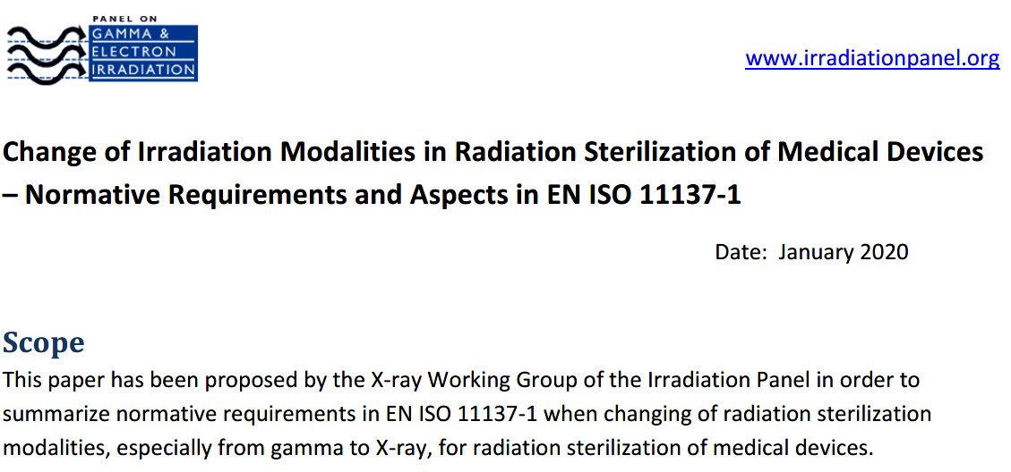


ISO 11137 Requirements
❶
Radiation source. Assess potential for radioactivity in the product for X ray >5 MeV (~ 7 MeV is typical). Most materials covered by existing published guidances.
Establishing/transferring the sterilizing dose. Addressed through dose verification studies (e.g. quarterly dose audits)
Establishing/transferring the maximum acceptable dose. ‘Guidance refers to dose rate and temperature during irradiation, with the remark that higher dose rates may lower the unwanted effects upon product.’
✓
❷
✓
❸

Slide 11

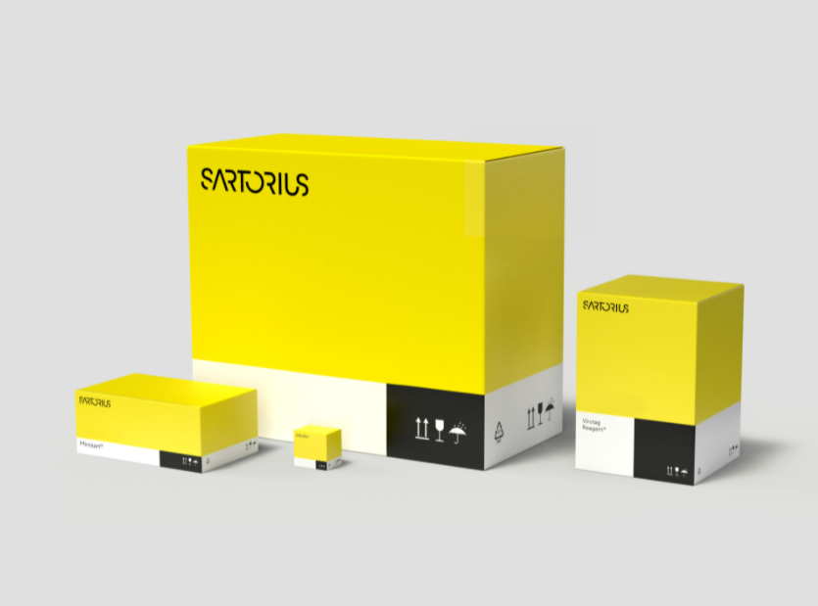
Activation ❶
The section 5.1.2 of ANSI/AAMI/ISO 11137-1 states that "the potential for induced radioactivity in product shall be assessed” , when processed with X-ray Energy > 5 MeV¹
Literature: Plastics typical of single-use systems not expected to pose concern
Higher Risk Materials: Na, Cr, Mn, Cu, Ar, Br, Mo, Te, Ba, W, Pt, Au
Verification performed on representative products with stainless steel parts, mixing magnets, etc.
The radioactivity check was performed on freshly irradiated samples (i.e. < 2-4hours after irradiation) with ~7 MeV X-rays
No significant measurement of photonic rays and no significant equivalent dose has been detected
→ No external exposure has been highlighted in contact with boxes
¹Hervé Michel, Thomas Kroc, Brian J McEvoy, Deepak Patil, Pierre Reppert, Mark A Smith, Potential Induced Radioactivity in Materials Processed with X-ray Energy Above 5 MeV, Biomedical instrumentation & technology, 2021, 55(s3), 17–26. https://doi.org/10.2345/0899-8205-55.s3.17

Slide 12
Sterility

Slide 13

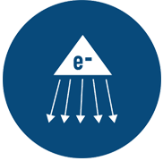


Sterility
Sterilization possible with ionizing radiations: gamma & X-rays, and electron beam
Radioactive
Isotope ⁶⁰Co
Electron
accelerator
Gamma ray
X-Ray
E-Beam
All irradiation technologies have the same goal: obtaining sterility by disrupting the biologic processes of micro-organisms ^{a,b}
Dose is dose. 25 kGy is achieved in gamma,
X-rays & E-beam
Microorganisms DNA breakage
ª Study from Steris: D10 values on bacteria, yeast, fungi. Vegetative forms and spores. Up to 6kGy.
^{b}Tallentire, A. and Miller, A. (2015) ‘Microbicidal effectiveness of X-rays used for sterilization purposes’, Radiation Physics and Chemistry, 107, pp. 128–130.
Notes:
γ rays originate from the nucleus of an atom
X-rays originate from transitions in the electrons from an atom or Bremsstrahlung
X-ray radiation is an electromagnetic energy (photons) with wavelengths similar to gamma photons (no charge or mass).
X-rays are generated when accelerated (energetic) electrons interact with nuclei of atoms in a ‘target’ element. As the high energy electrons approach atoms in the target material, the interaction slows them down and energy is released in the form of an x-ray, a process known as Bremsstrahlung radiation.
X-ray & gamma target DNA and destroy living cells
Both gamma-irradiation and X-ray-irradiation are fundamentally the same in that they both rely on a stream of well-penetrating photons to interact with the product, eliciting Compton-scattering effects whereby scattered electrons generate the killing effects on microorganism DNA [22]. However, the way the initial stream of photons is generated is different [6]. In other words, the key feature demarcating X-rays from gamma-rays is how they originate [23]. Gamma-rays arise from atomic nuclei through isotopic decay while X-rays are produced when high energy electrons decelerate on impact with the nucleus of another molecule [23]. X-ray irradiation equipment are basically electron beam systems where a tantalum (or Tungsten) target is added in front of the e-beam. As the high energy, directed electrons interact with the nucleus of the target, energy is released in the form of a similarly-directed X-ray photon (Brehmsstrahlung effect) [4]. The conversion efficiency of the electron to X-ray photon is approximately 12% for a typical 7 MeV electron beam indicating equipment power and cost requirements are substantially higher than e-beam.
γ rays originate from the nucleus of an atom
X-rays originate from transitions in the electrons from an atom or Bremsstrahlung
X-ray radiation is an electromagnetic energy (photons) with wavelengths similar to gamma photons (no charge or mass).
X-rays are generated when accelerated (energetic) electrons interact with nuclei of atoms in a ‘target’ element. As the high energy electrons approach atoms in the target material, the interaction slows them down and energy is released in the form of an x-ray, a process known as Bremsstrahlung radiation.
X-ray & gamma target DNA and destroy living cells
Both gamma-irradiation and X-ray-irradiation are fundamentally the same in that they both rely on a stream of well-penetrating photons to interact with the product, eliciting Compton-scattering effects whereby scattered electrons generate the killing effects on microorganism DNA [22]. However, the way the initial stream of photons is generated is different [6]. In other words, the key feature demarcating X-rays from gamma-rays is how they originate [23]. Gamma-rays arise from atomic nuclei through isotopic decay while X-rays are produced when high energy electrons decelerate on impact with the nucleus of another molecule [23]. X-ray irradiation equipment are basically electron beam systems where a tantalum (or Tungsten) target is added in front of the e-beam. As the high energy, directed electrons interact with the nucleus of the target, energy is released in the form of a similarly-directed X-ray photon (Brehmsstrahlung effect) [4]. The conversion efficiency of the electron to X-ray photon is approximately 12% for a typical 7 MeV electron beam indicating equipment power and cost requirements are substantially higher than e-beam.

Slide 14
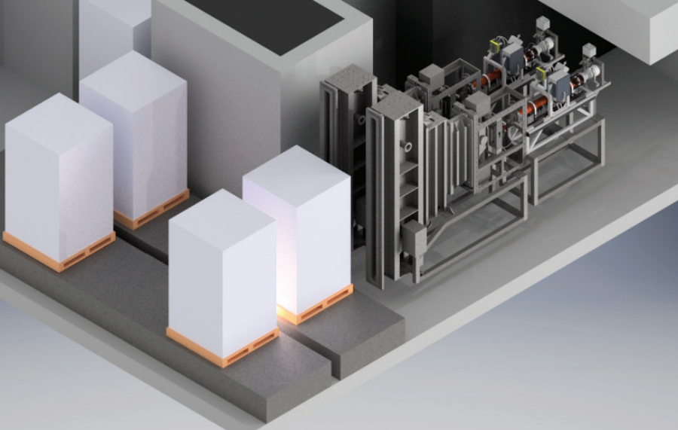
Sterility
X-ray & Ebeam sterilization requires for the SUS the same regulatory compliance than gamma
Regulatory requirements
  ISO 11137 requirements to be fulfilled for sterilization method validation
  ISO 11137-1 “Sterilization of health care products — Radiation — Part 1”, is agnostic with respect to the technology of irradiation, and treats the requirements for gamma, X-ray or e-beam equally
  ISO 11737-1:2018/Amd 1:2021 - Sterilization of health care products — Microbiological methods — Part 1: Determination of a population of microorganisms on products — Amendment 1
  ISO 11737-2:2019 - Sterilization of health care products — Microbiological methods — Part 2: Tests of sterility performed in the definition, validation and maintenance of a sterilization process
iia: International Irradiation Association – May 2020
https://iiaglobal.com/wp-content/uploads/2020/05/FactSheet_X-rays_WEB.pdf
Notes:
With regard to ionizing radiation, the definitive standard employed and referenced for sterility validation of single-use systems, ISO 11137-1:2006 “Sterilization of health care products — Radiation — Part 1” [21], is agnostic with respect to the modality of irradiation, and treats the requirements for gamma, X-ray or e-beam equally. In this sense, both X-ray and e-beam offer similar technical and validation strategies to gamma, and avoid complications associated with gas and vapor-based sterilization techniques. Both X-ray and e-beam could be used to sterilize single use systems mainly depending on their configuration and thickness.
In this sense, both X-ray and e-beam offer similar technical and validation strategies to gamma, and avoid complications associated with gas and vapor-based sterilization techniques.

Slide 15
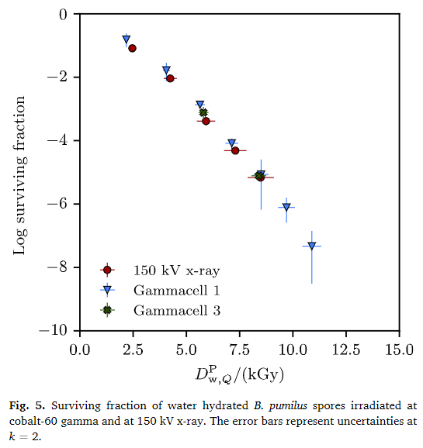
Sterility
Microbicidal effectiveness of ionizing radiations
The radiation response of spores of Bacillus pumilus to X-rays was examined
  The response was found to be the same as that cobalt 60, and high and low energy electrons.
Statistical analysis show that the D10 values of the studied micro-organisms are not significantly different when treated with Gamma or X-Ray irradiators.
Alan Tallentire, Arne Miller, Microbicidal effectiveness of X-rays used for sterilization purposes, Radiation Physics and Chemistry, Volume 107, 2015, Pages 128-130, https://doi.org/10.1016/j.radphyschem.2014.09.012.
J Hjørringgaard, A Miller, C Andersen, S Cloetta, W Wandfluh, A Tallentire. Comparison of the microbicidal effectiveness of 150 kV x-rays and cobalt-60 gamma rays, Radiation Physics and Chemistry. (198) 2022.
.

Slide 16
Sterility Verification
❷ Transferring the minimum Sterilizing Dose
Initial Validation done per ISO11137 (VD_{max} 25) per product range and manufacturing site considering therefore the type and the nature of the microorganisms → initial bioburden
The experiment dose is defined according to the initial validation (initial bioburden level)
This validation is common whatever the irradiation technology
The experiment dose on 10 units has been applied for each technology allowing assessing the dose efficiently with SAL 10⁻¹
Notes:
Considering as a starting point that the initial validation is avalable (by Gamma) the experiment dose has been established, a dose is a dose but we need to prove that if another sterilization modaility is applied the ability of microbial kill remain the same

Slide 17
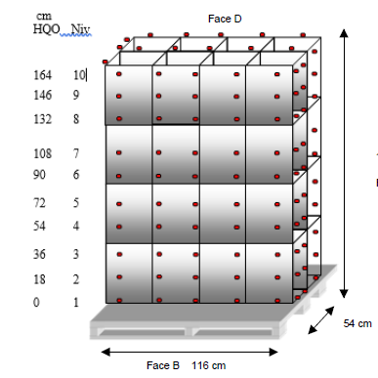
Sterility – Performance Qualification(Dose mapping)
Transferring the Performance Qualification
The transfer of Performance Qualification Results is not possible → almost each installation and site are different
•A new PQ has to be done by changing from on site to another (also within same technology)
•ISO11137 requires to conduct dose mapping in triplicate by bracketing approach considering at least density as the critical attribute
→ Expected dose range 25-45 kGy with X Rays and Gamma for single use biopharma products

Slide 18
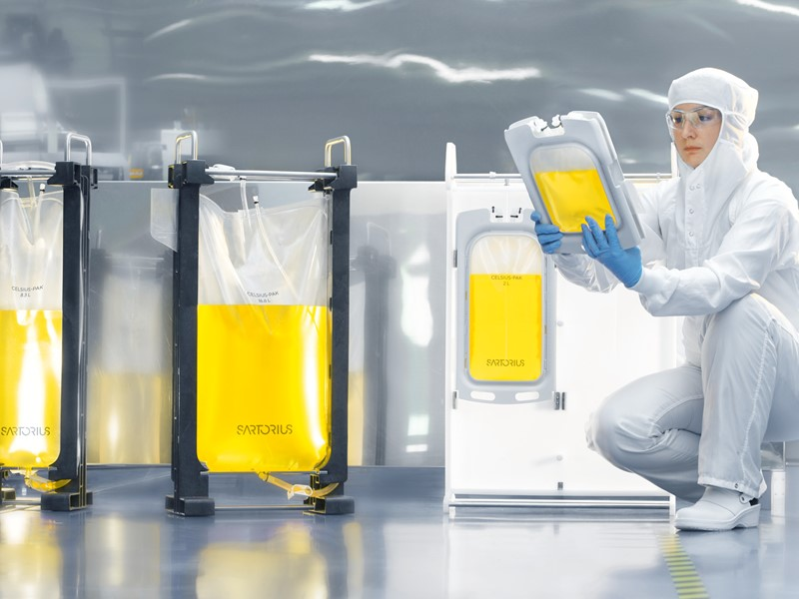
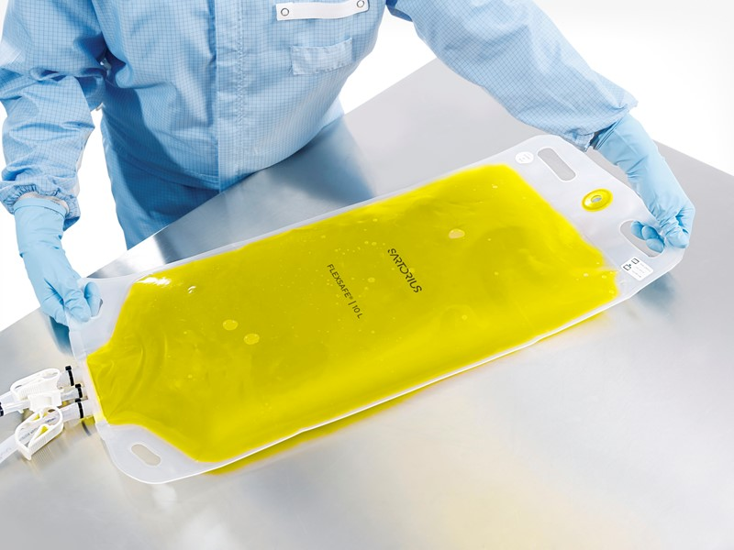
Validating Sterility (ISO11137) and Maintaining Processes
    1. Initial Validation SAL10⁻⁶
    2. Verification (Dose audit)
    3. Dose mapping
Bioburden on 3 batches of 10 units
10 units
(Legacy process)
Bioburden determination
Irradiate at verification dose
Gamma Rays
Determine verification dose (ISO11137-2: table 9)
(low dose for verifying 10-1 SAL)
Sterility testing
X Rays
≤ 1 units positive
Gamma Rays
    Transfer product family strategy & validation of min dose SAL10⁻⁶
Substantiation of sterilization dose

Slide 19
TIR104 – Transfer between radiation sources¹
TIR104 was initiate to clarify (and correct) information in ISO11137-1 on transfer between radiation sources
Evaluation of process capability when making the decision to transfer
  Can the irradiator physically deliver the dose required?
  Will dose specifications need to be updated (and what is the likelihood
of success?)
Guidance on transfer of both:
  Sterilization dose
  Maximum acceptable dose
¹Emily Craven, Medical Device Sterilization Workshop, 2021, How standards are accelerating the adoption of machine source radiation

Slide 20
Finding Guidance
ISO 11137 - Part 1 - Requirements for development, validation and routine control of a sterilization process for medical devices
ISO 11137 - Part 3 – Guidance on dosimetric aspects
ISO 11137 - Part 4 - Guidance on control of the irradiation process
AAMI TIR 29, Guidance for process in radiation sterilization
ISO/ASTM 52628 – Standard practice for dosimetry in radiation processing
ISO/ASTM 52303 - Guide for absorbed-dose mapping in radiation processing facilities

Slide 21
Transferring the maximum acceptable dose
❸
As written in ISO 11137-1: 8.1.1, The maximum acceptable dose for product shall be established. When treated with the maximum acceptable dose, product shall meet its specified functional requirements throughout its defined lifetime
This statement is not specific to X-Ray or Gamma or Ebeam process
A confirmation study from the maximum dose established should be conducted
For example, a comparison between worst case results from Gamma or E-Beam and X-Ray on maximum dose could be realized
Clause 8.4.1 states that an assessment must be made to ensure that differences in conditions of two radiation sources do not affect the validity of the maximum acceptable dose
The Guidance to this Section (A.8.4.1) mentions specifically dose rate and product temperature as the two most likely conditions that need to be considered

Slide 22
Physics

Slide 23


Radiation Technology: Introduction
Sterilization Modalities & Technologies
Sterilization Modalities
Heat
Chemical
Gamma
g
X-Ray
Technologies / Processes
x
Beta / E-beam
e⁻
Ionizing Radiation

Slide 24
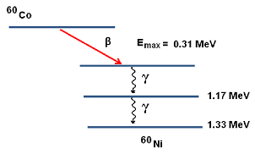
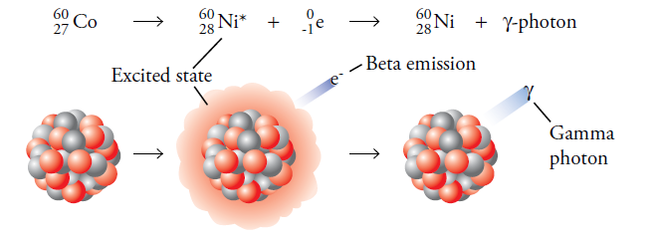
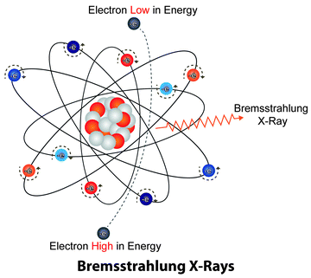
Radiation Technology: Introduction
Photon is a Photon
Both γ-rays and X-rays are electromagnetic energy – both are photons
The different names come from their different origins
γ-rays originate from the nucleus of an atom:
X-rays originate from transitions in the electrons from an atom or Bremsstrahlungª
ª Cognetta A.B., Morse K.F. (2013) Physical Aspects of Dermatological Radiotherapy. In: Cognetta Jr. A., Mendenhall W. (eds) Radiation Therapy for Skin Cancer. Springer, New York, NY

Slide 25
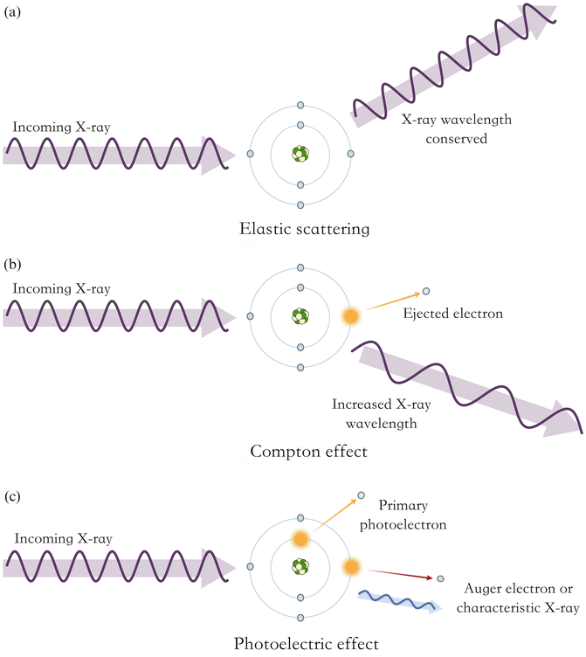
Radiation Technology: Introduction
(a)
Incoming X-ray or γ-rays
Ionizing radiations in the form of γ, Eb, X, produce abundant secondary electrons ª
Photon collision with molecules causes an electron to be ejected via the Compton effect
Thus nearly all physical and chemical changes in polymers are produced by energetic electrons and not by the initiating photons
Kinetics of reactions induced by photons are similar to those obtained if electrons are used as the primary irradiation
X-ray or γ-rays wavelength conserved
(b)
Incoming X-ray or γ-rays
Increased X-ray or γ-rays wavelength
(c)
Incoming X-ray or γ-rays
Auger electron or characteristic X-ray
ª A.G. Chmielewski, Future development in radiation processing, in Applications of ionizing radiation in material processing, vol2, p501, 2017.

Slide 26
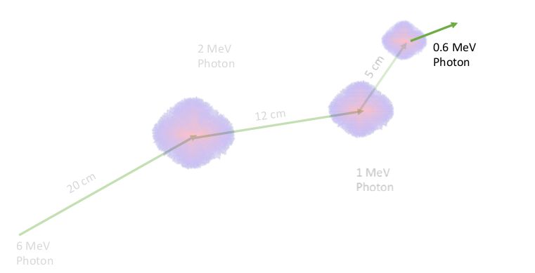
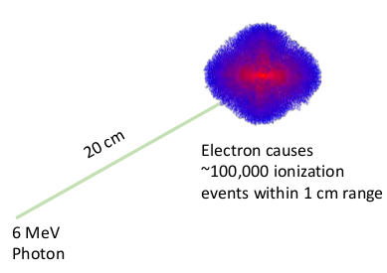
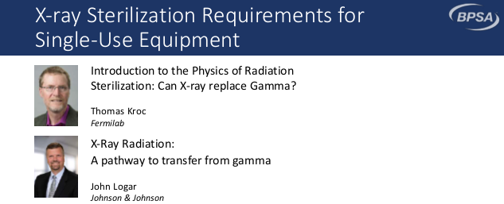
Photons Deliver Dose, Electrons Do the Killing
2020 BPSA Webinar by Tom Krocs and John Logar
Electrons! They get the job done!
.

Slide 27
Radiation Technology

Slide 28
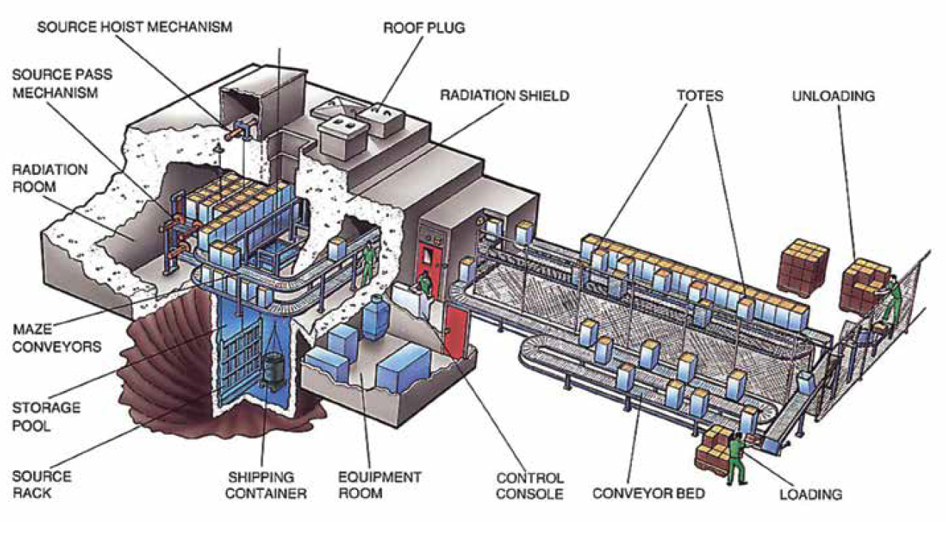
Radiation Technology: Gamma-ray
Source: Image of a gamma irradiator. © 2020 Nordion (Canada) Inc.

Slide 29

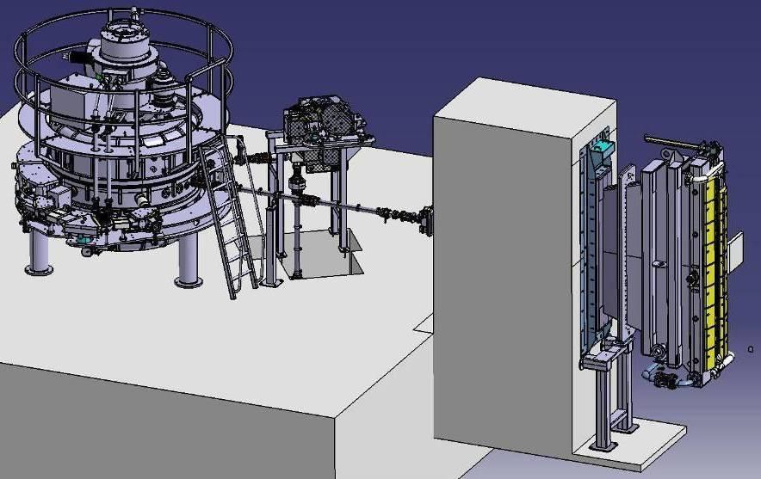
Radiation Technology: X-ray
Electrons produced in the Rhodotron or Linear Accelerator bombard a tantalum plate (converter) to become X-rays
Rhodotron
Linear Accelerator

Slide 30
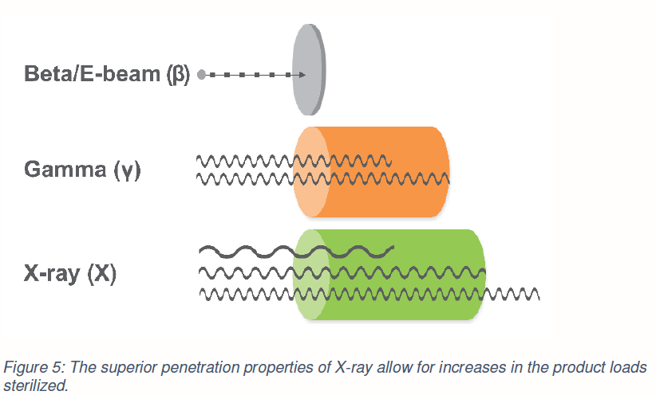


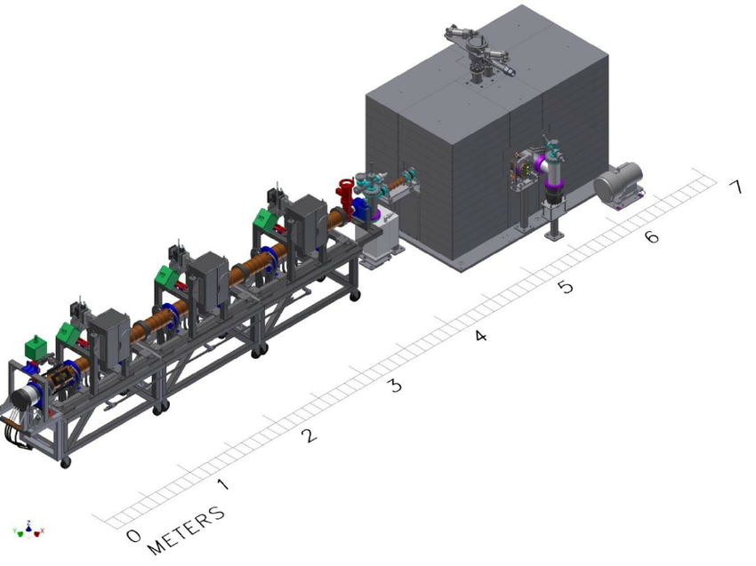
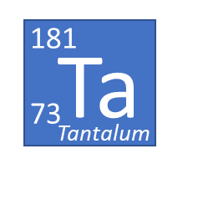
Radiation technologies’ comparison
Maturation of X-ray Sterilization
(electron)
(photon)
(photon)
+

Slide 31
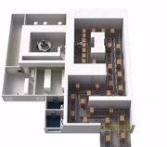
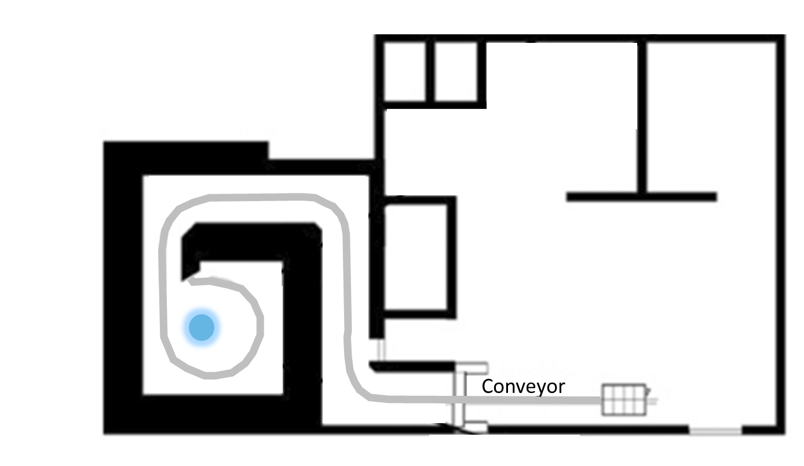


Radiation technologies’ comparison
Maturation of X-ray Sterilization
Gamma
X-ray
Ebeam
Directionality
Dose Rate
<10 kGy/h
<100 kGy/h
<30 000 kGy/h
Penetration and Dose Uniformity
Temperature
Entire vault absorbs
Material under beam absorbs
Material under beam absorbs

Slide 32
Material science

Slide 33
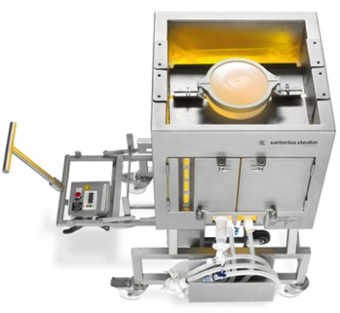
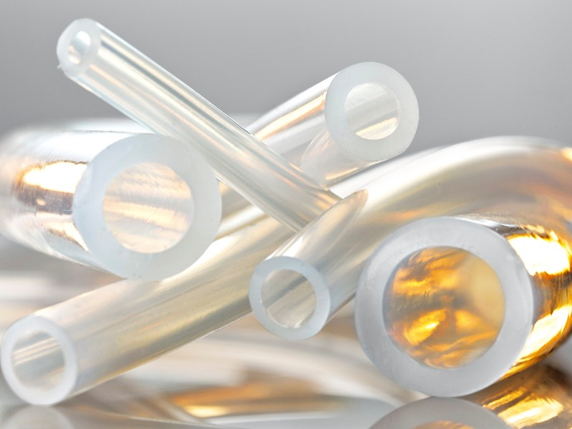
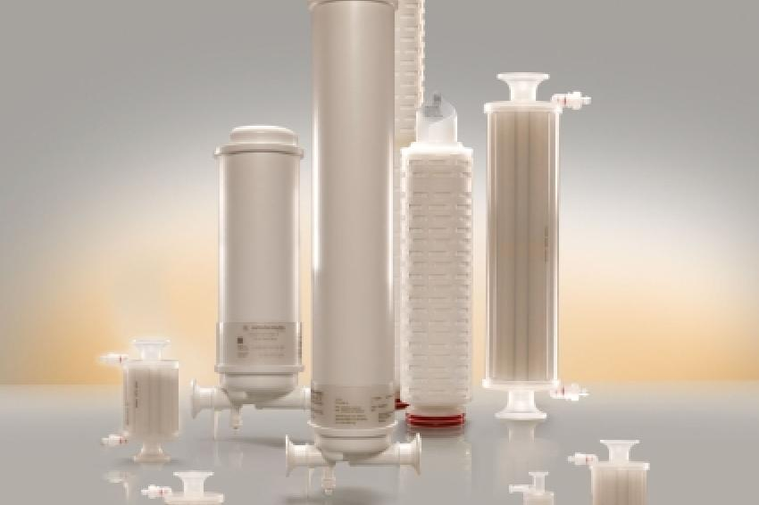
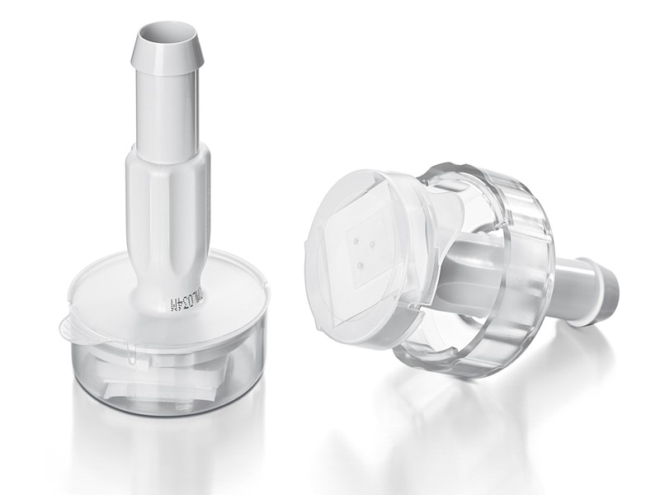
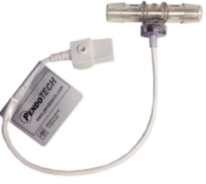
Single-Use Bioprocessing
Many components involved
To manufacture large variety of single-use systems (SUS)
Bags & Film
Sensors
Tubing (TPE, Silicone)
Filters
Aseptic Connectors

Slide 34
Material science
The interaction of gamma and X-rays with matter is identical
By-product production mechanisms and levels are expected to be equivalent, and E&L levels
No expected change of the chemical compatibility
Source: S. Dorey et al, Identification of chemical species created during γ-irradiation of antioxidant used in polyethylene and polyethylene-co-vinyl acetate multilayer film, Journal of Applied Polymer Science, April 2020, DOI: 10.1002/app.49336
.
Notes:
Chemical Process Compatibility is generally assessed based on the materials of construction and process contact conditions including process fluid formulation, temperature, and exposure duration. As these parameters remain identical between X-ray and gamma- irradiation, no additional risks are expected, or testing recommended.
Extractables are typically generated by suppliers following reasonable worst-case application conditions, including following exposure to heat or ionizing radiation. As the expectation, data, and scientific arguments to date indicate X-ray irradiation yields a less deleterious impact on the materials, limited scope verification testing on representative components using the USP <665> moderate-risk component testing protocol may be appropriate.

Slide 35

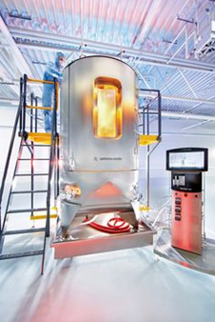
Material science
Polymer property changes upon ionizing irradiations
Chemical changes
Physical changes
Crosslinking and chain scission
Structural weakness
Gas formation
Double bond formation
Oxidation
Living radical effects after irradiation
Effects on additives
Changes in mechanical properties (mechanical strength, flexibility, Young’s moduli, torsional resistance, etc.)
Color change
Changes in conductivity
Changes in crystallinity
Thermal stability and transitions

Slide 36
Material Consideration in Radiation Processing
Summary of general ionizing radiation resistance of polymers
(Loss on the elongation at break by 25% ^{a,b})
ªM. Tavlet, A. Fontaine and H. Schönbacher, Compilation of radiation damage, CERN 98-01 test data, CERN, Geneva, 1998
^{b}AAMI TIR17
Notes:
in CERN 98-01 – Compilation of radiation damage
test data, pt.2.; M. Tavlet, A. Fontaine and H.
Sch¨onbacher, CERN, Geneva, 1998
criteria: For most of the thermoset resins and composites the critical property (most radiation-sensitive property) is the flexural strength, while for most of the thermoPolymerss it is the deflection (deformation at break or Flexural strain). [CERN 98-01]

Slide 37
TIR17 – Compatibility of materials¹
TIR17 is a resource that can be used in new product design when selecting materials for a health care product
Valuable update provided in 2017, but as materials evolve and new sterilization methods develop, new information should be incorporated
Work on the next revision is underway
  Better guidance on ranking systems for material compatibility
  Modality selection process guidance
  Guidance on appropriate challenge conditions and testing
  Guidance on evaluating changing modalities?
¹Emily Craven, Medical Device Sterilization Workshop, 2021, How standards are accelerating the adoption of machine source radiation

Slide 38
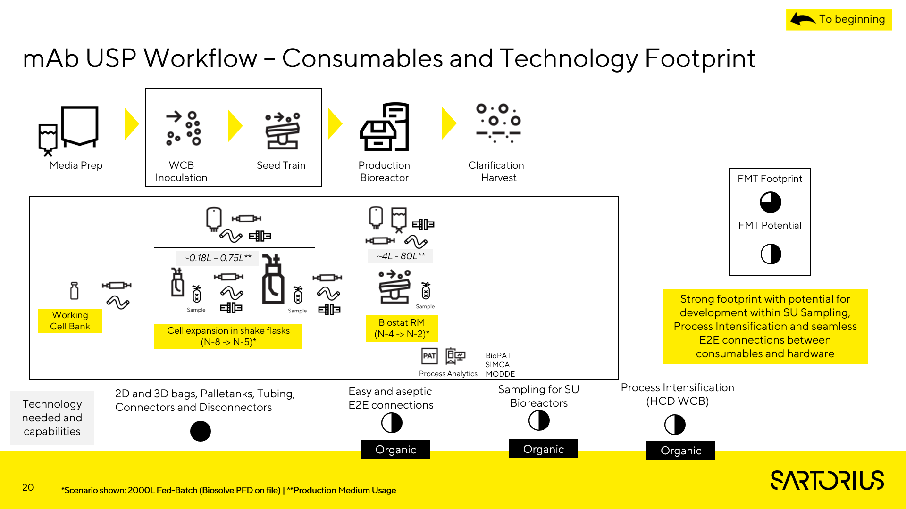


Materials Impact Assessment
⬥ Transferring the Maximum Acceptable Dose (~50 kGy)
Focus on polymers with limited irradiation compatibility (worst case)
Couple material-science assessments with component testing

Slide 39
BPSA risk assessment guidance

Slide 40
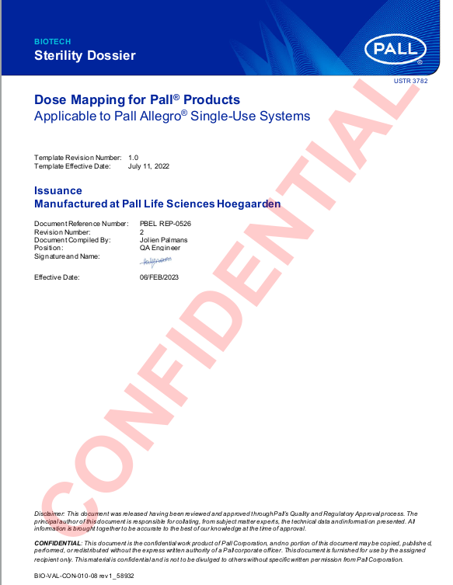
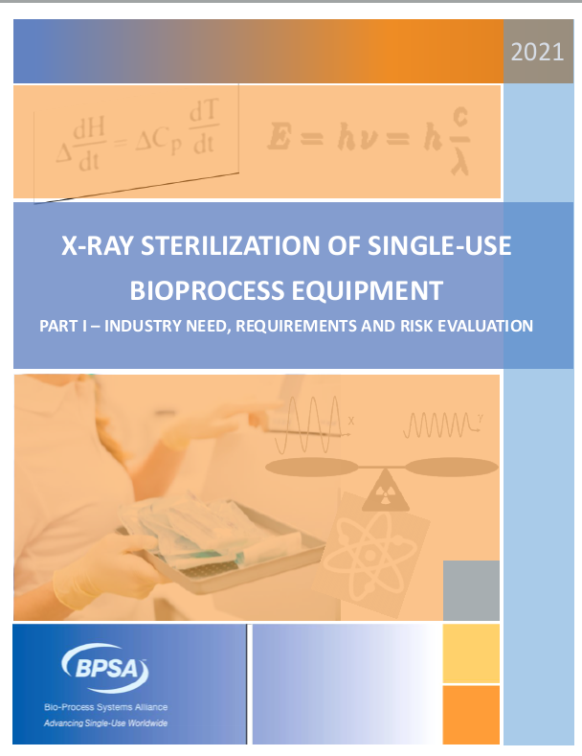
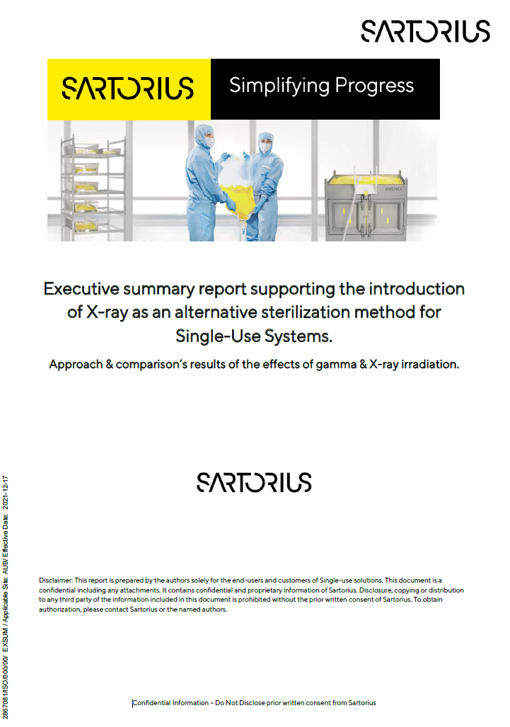
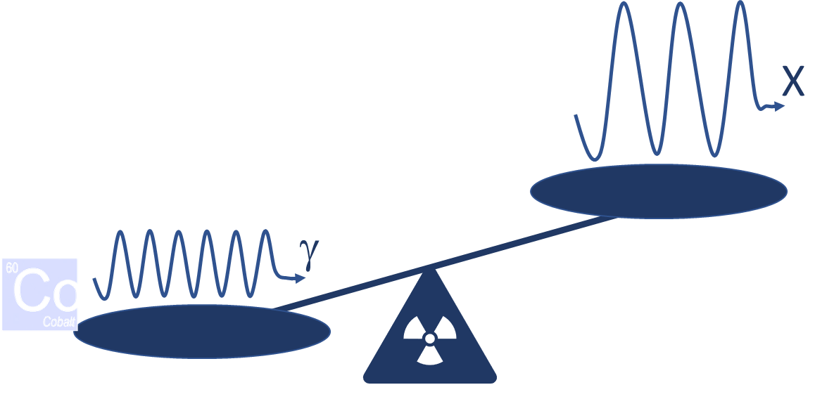


X-ray Vision
2019
2020
2021
2022
2023
2024

Slide 41
BPSA Quality Test Matrices (2015)
Test Categories
A. Physical
B. Functional
C. Biological
D. Chemical
E. Regulatory
F. Sterilization/Sanitization
Component Categories
Chromatography
Connectors, Valves and Retainers
Containers and Film
Sensors
Tubing
Filters

Slide 42
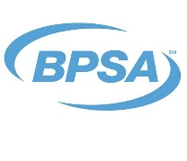
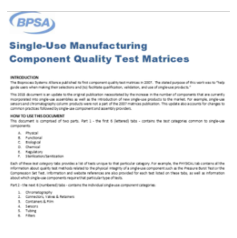

Materials & Assemblies Impact Assessment
⬥ Transferring the Maximum Acceptable Dose (~50 kGy)

Connectors & Valves
Containers & Film
Sensors
Tubing
Filters
Assemblies
Materials Assessment
Color, DSC*, TGA*, FTIR*
particulates

Materials Tests*
Physical Tests
Functional Tests
Biological
Chemical
Regulatory
Pressure Burst Test

Bacterial Retention (ASTM F838)
Quality Test Matrices

USP <87> or ISO 10993-5

Extractables
USP <665>
Moderate Risk or equivalent
USP <88>

Shelf life
(limited based on risk analysis)
endotoxin

Collectively assessed each test (High/Med/Low) value to X–Ray assessment
* Differential Scanning Calorimetry (DSC), Thermogravimetric Analysis (TGA), and Fourier Transform Infrared Spectroscopy (FTIR).

Slide 43
Materials Impact Assessment
⬥ Transferring the Maximum Acceptable Dose (~50 kGy)
Focus on polymers with limited irradiation compatibility (worst case)
Couple material-science assessments with component testing
Not retest every
component.
Demonstrate existing
data packages remain
valid for X-ray

Slide 44
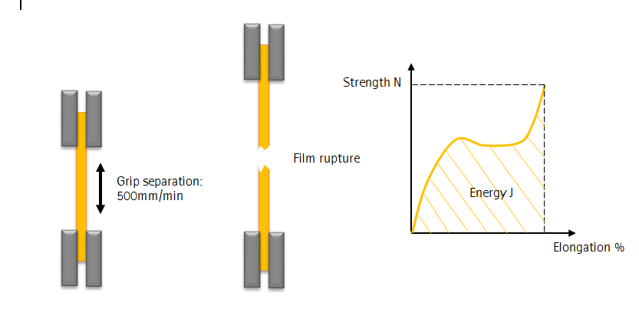
Risk-based Testing Approach for X-ray Qualification
⬥ Transferring the Maximum Acceptable Dose (~50 kGy)
Materials/Components/Assemblies assessment
Select representative materials/ Components/ Assemblies
Time zero assessment
Worse case dose, i.e. ~50 kGy
Comparison between gamma and X-ray irradiated samples
Starting point of further subassembly’s and assembly's functionality evaluation
Assess the materials properties and performances to verify materials equivalency after gamma and X-rays
.
Notes:
Materials assessment
“As the higher dose rates associated with X-ray are thought to result in lower unwanted effects on the product to X-rays, then it can be argued that the material impact profiles and component functionalities following gamma irradiation may generally be regarded as a worst-case. To verify that materials are equivalently or less impacted by X-ray, fundamental physicochemical characterization of representative materials will be performed for all component types following irradiation (i.e. time zero assessment). FTIR can be employed to assess fundamental information on the modification of polymers due to irradiation. Any changes due to irradiation can be estimated by the relative increase or decrease in band intensities of functional groups present in the polymeric chain, Differential scanning calorimetry (DSC) can also be used to determine any changes in the transition temperatures and heat capacity. It is expected that such testing will verify that the impact of gamma and X-ray irradiation are equivalent. Packaging materials must be evaluated as well. “

Slide 45

Risk-based Testing Approach to Qualification of X-ray
⬥ Transferring the Maximum Acceptable Dose (~50 kGy)
Shelf life
“[…] The needs and magnitude of a full-term shelf life study can be evaluated through a risk assessment based on existing information (e.g. gamma shelf-life data) and time zero materials data comparing X-ray and gamma. If results demonstrate meaningful differences in materials properties at time zero then further evaluation of shelf-life requirements may be warranted.“
Part of the risk assessment
Current shelf-life data after gamma will serve as a comparison standpoint
Sterility is part of the shelf-life evaluation
.
Notes:
“Shelf life, which indicates the length of time a component may be stored while remaining fit for use, is not expected to be impacted by X-ray as compared to gamma irradiation. Although the process of irradiation may impact shelf life, it is expected that the thermal and mechanical materials analysis described above, will verify that any detrimental impact of X-ray on polymers is equivalent or better to that expected from gamma. The needs and magnitude of a full-term shelf life study can be evaluated through a risk assessment based on existing information (e.g. gamma shelf-life data) and time zero materials data comparing X-ray and gamma. If results demonstrate meaningful differences in materials properties at time zero then further evaluation of shelf-life requirements may be warranted.“

Slide 46
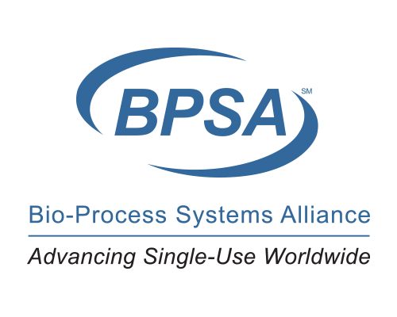
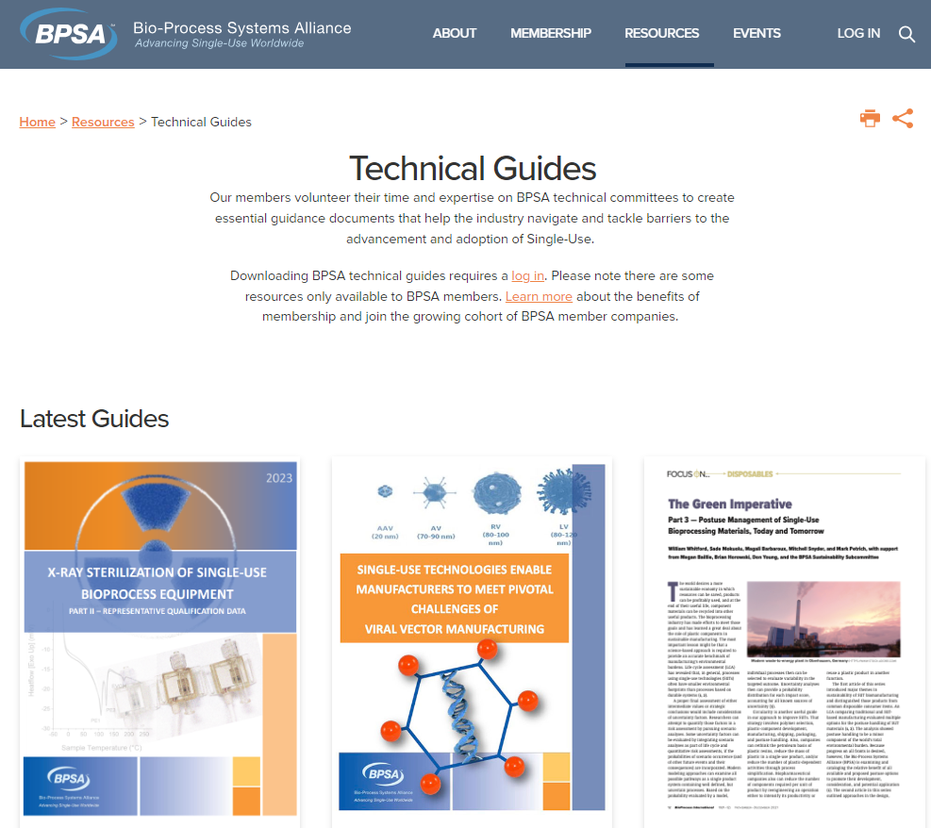
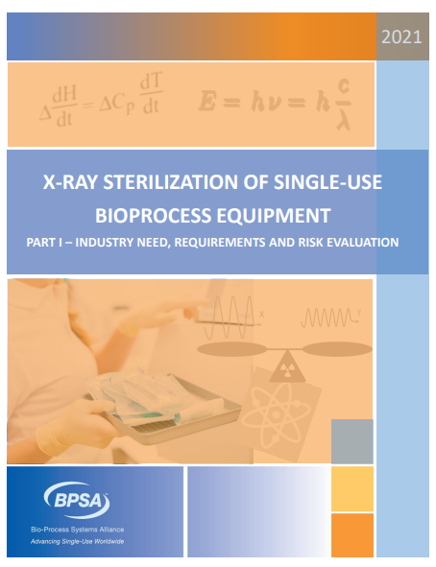
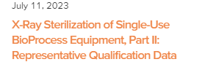
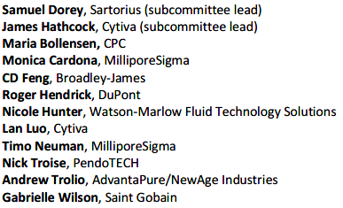
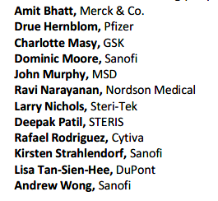

X-Ray: Representative Qualification Data
X-Ray: Representative Qualification Data
Part II X-ray paper now available
Authors and Reviewers
bpsalliance.org/resources/technical-guides/
Please share the link, not the guide

Slide 47


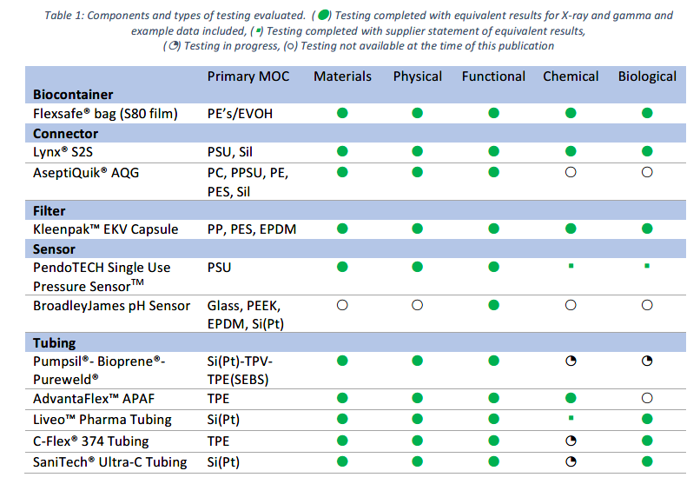
X-Ray: Representative Qualification Data
Temperature and Activation
Assessment
(45 polymer formulations)
Material Test Data & Assessments
Component Test Data & Assessment
Assembly Integrity
Next Steps

Slide 48
Recent Publications
Arthur Charlesby
Fermilab
Team Nablo
https://doi.org/10.1039/D1CC02871E (2021)
Cytiva (Pall)
Activation
Steris-Sterigenics-Sabic
Sartorius
https://doi.org/10.1016/j.radphyschem.2020.109282 (2021)
https://doi.org/10.1016/j.radphyschem.2022.110702 (2023)
https://doi.org/10.1016/B978-1-4831-9776-0.50007-3 (1960!)
https://dc.engconfintl.org/sut_v/54/ (2022)
https://doi.org/10.2345/0899-8205-55.s3.17 (2021)
https://doi.org/10.1016/j.radphyschem.2007.01.014 (2007)
https://doi.org/10.1002/btpr.3339 (2023)
https://doi.org/10.1016/j.radphyschem.2021.109505 (2021)
Supplementing Gamma Sterilization – BioProcess (2022)
https://doi.org/10.3389/fchem.2022.888285 (2022)
https://doi.org/10.1002/btpr.3214 (2021)
https://dc.engconfintl.org/sut_v/55/ (2022)
https://doi.org/10.1016/j.radphyschem.2022.109999 (2022)
https://doi.org/10.1016/j.ijpharm.2023.122677 (2023)
https://doi.org/10.1016/j.radphyschem.2023.110915 (2023)
https://doi.org/10.3390/polym15132799 (2023)

Slide 49
SUS vendors risk assessment
SUS = Single Use Systems

Slide 50






Eligibility of Products to sterilization technologies
BPSA X-ray Paper I¹ and other guidelines² define protocol to verify/validate equivalency
Components, sub-assemblies incl. Raw materials, resins, …
Equivalent impact of gamma and X-ray (and may be Eb) for the 3 levels
Product eligible all technologies
Functionalities / Use case / Application / Shelf life
Finished Products
One or more level(s) is/are not equivalent for one technology
Sterility
SAL 10⁻⁶ achievement
Dose mapping
Product not eligible for all technologies
¹ 2021 BPSA White Paper. X-ray Sterilization of Single-Use Bioprocess Equipment: Part I – Industry Need, Requirements, and Risk Evaluation
² N. Dupuy et Al, Supplementing Gamma Sterilization with X-Ray and E-Beam Technologies, An International Industry and Academia Collaboration, BioProcess International, 20(3), 2022, 24-28

Slide 51

Risk-based Testing Approach to Qualification of X-ray
Irradiation physics
Material Science
The interaction of gamma and X-rays with matter is identical
By-product production mechanisms and levels are expected to be equivalent, and E&L levels
No expected change of the chemical compatibility
Source: www.sartorius.com
.
Notes:
Chemical Process Compatibility is generally assessed based on the materials of construction and process contact conditions including process fluid formulation, temperature, and exposure duration. As these parameters remain identical between X-ray and gamma- irradiation, no additional risks are expected, or testing recommended.
Extractables are typically generated by suppliers following reasonable worst-case application conditions, including following exposure to heat or ionizing radiation. As the expectation, data, and scientific arguments to date indicate X-ray irradiation yields a less deleterious impact on the materials, limited scope verification testing on representative components using the USP <665> moderate-risk component testing protocol may be appropriate.

Slide 52



Assessment of the impact of X-rays vs gamma rays
Provide evidence that X-ray irradiation
at the maximum dose impacts single-use materials/
products in a way that is equivalent than
gamma, through a science-based rationale​
GOAL
Keep current Validation & Extractable guides
in regards to specifications and properties
Keep current shelf life and sterility (e.g. SAL)
Keep product compliance with standards
& regulations

Slide 53
Selection of the testing components, sub-assemblies & products
Rational for components & sub-assemblies, final products selection
Bracketing & worse case approach depending on the applications criticality and functional stress levels
Notes:
Chosen representative product families: Octoplus, Celsius Pak, Celsius FFT/FFTp, Flexsafe ProMixer, Flexel Magnetic mixer, Flexsafe STR, Opta, Clipster

Slide 54
Validation testing program defined based on risk analysis
Risk Analysis (FMEA) is the tool used to assess the difference of impact between gamma and X-ray irradiated products
What happens?
Failure Effect
Failure Mode
Failure Cause
Why?
Focus Element
Selection of highest priority of failures have been identified and transposed in the testing protocol

Slide 55
Validation testing program defined based on risk analysis

Slide 56
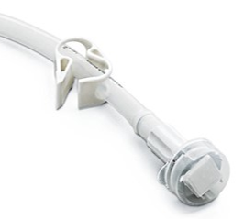

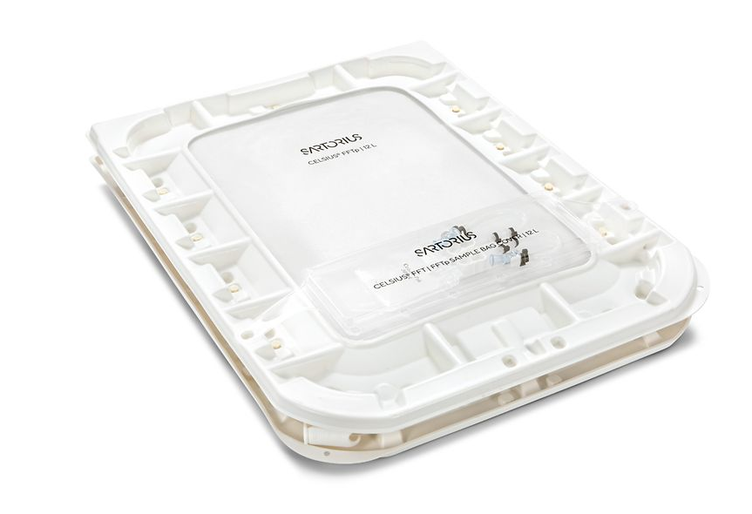
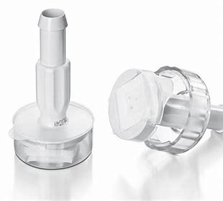
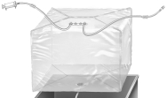


How to revalidate Sartorius products/sub-assemblies/ materials ?
Products
Sub-assemblies & components
Materials
Selection of representatives acc. to stress, worse case applications, consumption, polymer resistance, etc.
Materials & Products properties:
  Sterility
  Physical & chemical analysis
  Biocompatibility
  E/L profile
  Cell culture assay
  Functional testing
Sub-assemblies
Multilayer polymer films (S40;S71;S80)
Tubes
Tuflux SIL ®, Tuflux TPE ®
Aseptic connectors (i.e. Opta® SFT Sterile connectors)
Clamps
Notes:
Mettre une poche + détailler En considérant tous les matériaux Sarto 200 matériaux, sélection de 60
Approche multiniveau → Produit fini, sous assemblages, matériaux

Slide 57
Equivalency

Slide 58

Proof of equivalency
Equivalency of results means…equivalency of testing conditions!
Gamma and X-ray irradiated materials & products tested side by side
Same lot(s) and Same time gap between irradiation and testing
Same dose range (i.e. ~50±5 kGy)
Lessons learnt:
Avoid comparing X-ray results with gamma results obtained years previously
Difficulty to assess to X-ray irradiation services
Timelines to get irradiated samples is up to 2-6 months!

Slide 59


Proof of equivalency
Confirm statistically that the evaluated property is equivalent (impact of irradiation only – same batch –same production)
Statistical approach is used to confirm
Equivalency is used on test not related to Compliance or Regulation: compliance with a standard or regulation
rational | tool |  | inputs
Sampling | Sample size |  | Actual variation – measurement error
Equivalence | Equivalence test |  | Max acceptable difference based on bibliography or internal studies

Slide 60
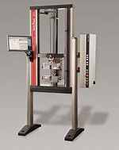

Tensile strength – Equivalence criteria defining
Bibliography inputs and internal knowledge inputs to build equivalence criteria:
Elongation at F_{max} : 25% loss in elongation → significant change in mechanical properties of thermoplastics^{1,2}
Example of a stress-strain curve for a S80 film sample in TD direction
¹Association for the Advancement of Medical Instrumentation (AAMI), “Compatibility of materials subject to irradiation,” 2017. ² European organization for nuclear research, CERN, compilation of radiation damage test data, PART II, 2nd edition: Thermoset and thermoplastic resins, composite materials, CERN 98-01 , 1998
Notes:
Détailler à l’oral ce qui a été réalisé pour déterminer les critères

Slide 61
Biomanufacturers risk evaluation

Slide 62
Guidance for risk evaluation of X-Ray irradiation of single use systems

Slide 63
The challenge
No standardized industry guidance to inform evaluation, qualification / validation and documentation of the change
There is a risk of individual companies interpreting and approaching the change and submitting filing changes in diverse ways

Slide 64
The challenge
Physical, chemical, and biological impacts of the two irradiation methods are expected to be very similar and some data exists to demonstrate equivalency based on physics and material compatibility with Gamma
However, regulations apply to all manufactured drug products requiring documented scientific evidence to demonstrate that Good Manufacturing Practice (GMP)-compliant materials used in manufacturing processes meet the needs of their intended applications.
Clear expectation from Reg Authorities that end users need to perform and document their own risk assessment
With the requirement to implement X-Ray Irradiation as an additional irradiation technology becoming urgent due to capacity constraints, it is not feasible to perform an in-depth risk assessment of every component subject to the change
A data-driven, risk-based, harmonized approach is required to proactively evaluate equivalency between GI and XI treated products to ultimately reduce or mitigate any specific risk assessment needs at the local manufacturing site.

Slide 65
The solution
Authoring team developed guidance and tools to help pragmatically navigate the change and simplify evaluation of addition of X-Ray as an ionizing sterilization technology with an aligned, one industry voice
Industry consensus
20 Companies
~50 SMEs
Notes:
As demand for SUS increases and capacity for sterilization by Gamma Irradiation rapidly becomes a restricting factor, the industry is introducing X-Ray irradiation as an additional ionizing radiation sterilization technology to mitigate the risk of supply chain shortages; SUS suppliers have begun to notify their customers of the pending change.
This guidance and the accompanying tools which were developed and endorsed by a BioPhorum collaboration of 50 industry experts from 25 leading Biopharma companies and suppliers, is intended to support navigation of the change and to pragmatically leverage existing data and prior knowledge of material compatibility to demonstrate equivalency based on documented scientific evidence. It utilizes established material data to pragmatically inform likely component sensitivities within the scope of adding XI to the sterilization technology capabilities for SUS, and further highlight applicable risks that may require mitigation
Using this approach, the interests of the patient are advanced through improved SUS supply continuity, carefully evaluated implementation and critically ensures risks to product quality and patient safety remain acceptably low.
We recognize that there is no “one-size-fits-all” approach to change management, therefore the guidance was designed to introduce key concepts and tools which are flexible and adaptable to fit your own quality management systems and local procedures.
Please use in conjunction with the paper and the spreadsheet.

Slide 66

The solution
Define key concepts and tools to simplify application of published (BPSA) data
Two-parts toolkit
Focus on materials of construction compatibility with X-ray irradiation
Focus on the intended use of the assembly.
Notes:
This guidance document and the accompanying X-Ray Irradiation risk evaluation tool define key concepts and tools to simplify application of the previously published BioProcess Systems Alliance (BPSA) data.
To guide evaluation efforts this BioPhorum toolkit has 2 parts that focus on materials of construction compatibility with X-ray irradiation and the intended use of the assembly.

Slide 67



Development of the Guidance & Tools
Established implementation
cycle
Established flowchart/
decision tree
Developed tools & templates

Slide 68

Overview of Guidance
Step 1:
Trigger
Step 7:
Close
Step 2:
Review Data
Step 3: Categorize
Step 4: Evaluate
Step 5:
Mitigate
Step 6:
Update matrix
X-Ray implementation
cycle
End-to-end risk evaluation flowchart
Notes:
120 sec- speak from box in the word file.
7 steps – self explanatory – in this video we will focus on 3 steps that have generated most frequently asked questions (step 2, 3 and step 4)
Trigger: Inputs :
Supplier change notification or internal plan
Data packages from supplier
Any internal knowledge/data on previous risk assessments
It is anticipated that evaluations should take xx hours the first few times however as industry knowledge and your internal library of MoC compatibility evolves the exercise will become less resource and time dependant.

Slide 69



Guidance Steps
Excel sheet logo, an
Notes:
240 sec- David to make 200 words script.
Emphasise that a number of deciosns
4 criteria are used to assess materials of construction;
-
known material compatibility with ionizing radiation,
suppliers documentation packages for x-ray treatment,
historical use with gamma irradiation and
the number of successful similar Materials of Construction
This ICC score indicates the overall risk based on material compatibility with ionising radiation and is further utilised to determine an impact level according to where the component or assembly under evaluation is used. The tools provided in this guidance demonstrate this process in a decision tree and a spreadsheet based tool, again both of these were created as a framework for simplified consolidation and documentation and can be adapted to suit local procedures and quality management systems.
Additional information to guide evaluators on determining the weightings, scoring and selecting decision pathways is provided throughout the guidance document.

Slide 70
The Teams Approach
Risk evaluation based upon understanding the specific steps in a bioprocess (upstream and downstream) and their criticality
Simplified consolidation and documentation and can be adapted to suit local procedures and quality management systems

Slide 71
The Teams Approach
Building on the 7 step cycle and a template decision tree from a member organization, an end to end process flow/decision tree was established
Provides guidance to facilitate categorization of impact level based on existing supplier data, prior knowledge and SUS use application
4 impact levels defined
Guidance provided on suggested action to be taken at each level
The BioPhorum guidance and associated tools and template spreadsheet provides a robust, consistent, and repeatable methodology

Slide 72
Summary

Slide 73
SUS qualification in Ionizing Radiation Sterilization
Key considerations for qualification of X-ray
Irradiation Physics
ISO 11137 requirements
Testing recommendations & data package
Material Science
SUS Application – which criticality? How to use data? filing update?
Sterilization services
SUS
Integrators
Component Manufacturers
Biomanufacturers
Communication is key
.

