Slide 1
THE STANDARD DISTRIBUTION OF RESISTANCES – SDR
Martell Winters

Slide 2
GOALS
Review background of SDR
Gain insight into how we use it now
Understand some imperfections of the SDR
Discuss appropriateness of SDR in 2023
Are there other options to the SDR?
Medical Device Sterilization – Past, Present, and Future, September 20-21, 2023

Slide 3
HOW DID IT ALL BEGIN?
1977 J&J conference “A North American Viewpoint on Selection of Radiation Sterilization Dose”
John Masefield, James Whitby
Many companies using 25 kGy with no substantiation and some countries requiring 25 kGy minimum
“Class 1” approach:
Requires a sterility test to release product “has serious statistical limitations”
17% nonsterile samples would pass the test 5% of the time
“No one needs this type of protection!”
“Class 2” approach:
An arbitrary minimum sterilization dose, usually 2.5 Mrad (25 kGy) “unduly restrictive” due to material effects
“Class 3” approach:
“specifies no set dose but requires that the probability of sterility be defined as a function of the distribution and sterilization resistance of presterilization bacterial contamination (bioburden), and of the margin of safety sought, as determined by the intended use of the products”
Medical Device Sterilization – Past, Present, and Future, September 20-21, 2023

Slide 4
IMPORTANT CONCEPTS
Recognized that “sterility should be classified in a probabilistic way”
Proof “requires extensive product bioburden knowledge”
We’ve gotten away from having “extensive” knowledge
“must be practicable so that they do not impose excessive costs on the manufacturer and therefore the consumer”
“a microbial inactivation level of one contaminated item in 1000, together with a less than 1 in 1000 chance of potential untoward effect in use”
Risk-based approach
Combined chance of harm is 1 in 1 million
Let’s not provide “a greater margin of safety attending the use of a surgical drape than is demanded for an implanted heart valve”
Used terms such as “one in one million” and “margin of safety” – not SAL yet…
Absorbed dose was described in terms of Megarad or Mrad → 1 Mrad = 10 kGy
Medical Device Sterilization – Past, Present, and Future, September 20-21, 2023

Slide 5
STANDARD DISTRIBUTION OF RESISTANCES BEGINNINGS
1979, Radiation Physics and Chemistry, Dr. James Whitby
Follow up article also 1979 in PDA
“microbes derived from the constituents of large surgical operating room packs”
Bioburden ~160,000 CFU
Applied 2, 4, 6, 8, and 10 kGy to products
Minimum 2 kGy dose weeded out less-resistant microorganisms
Tested in TSB at 30°C for up to 3 weeks
Microorganisms grown on TSA and inoculated inside test tubes and Kaycel and dried overnight
Started with 673 isolates – very iterative series of tests
Highest D₁₀ obtained was 4.2 kGy
Mean D₁₀ on glass = 2.7 kGy and on Kaycel = 1.6 kGy
Used the term “desired level of sterility” and “desired probability of sterility”
Medical Device Sterilization – Past, Present, and Future, September 20-21, 2023

Slide 6
STANDARD DISTRIBUTION OF RESISTANCES BEGINNINGS
“In early experiments anaerobic incubation was also carried out on samples of all materials, but since samples incubated anaerobically consistently gave sterile results after lower irradiation doses than aerobically incubated samples, aerobic incubation was used exclusively in later experiments.”
Two screening mechanisms
1st: isolates survived a minimum dose of 2 kGy (2-10 kGy)
How many microorganisms didn’t make the 2 kGy cut?
2nd: isolates survived a minimum dose of 5 kGy (5-24 kGy)
How many microorganisms didn’t make the 5 kGy cut?
Isolates were “almost exclusively” Gram positive rods, Gram positive cocci, and fungi
All proved tolerant of drying conditions
“…a small radiation-resistant portion of the population would determine the dose and could be overlooked…”
Medical Device Sterilization – Past, Present, and Future, September 20-21, 2023

Slide 7
THE SDR IS BORN…AND SAL
Refined 1980 J&J Second Kilmer Conference
“It has become standard to define sterility assurance level in terms of the probability that a randomly chosen item will be nonsterile. In this paper we will refer to the desired probability of a nonsterile item as the Sterility Assurance Level (SAL)…”
Explains how to “…allow the probability of product nonsterility at a given dose to be related to the probability of nonsterility at another dose…”
“This makes it possible to calculate the probability of nonsterility at a selected dose without actually experimenting at that dose.”
“…the sterilizing dose will be set by extrapolation rather than interpolation, even though extrapolation is undesirable.”
Refined previous work on 673 isolates, after screening dose of 4 kGy
Rationale: “Although these resistances were chosen somewhat arbitrarily for universal use, it is our belief that this distribution will, in most cases, represent a more severe challenge to radiation microbial inactivation than the natural bioburden on items to be sterilized.”
Other populations were considered, but the Whitby population was well-characterized and resulted in a 1,000 CFU sterilization dose being 24.9 kGy
Medical Device Sterilization – Past, Present, and Future, September 20-21, 2023

Slide 8
Medical Device Sterilization – Past, Present, and Future, September 20-21, 2023

Slide 9
SUBSTANTIATION APPROACHES
Using the SDR to set doses – First version of Method 1
First versions of Methods 2A and 2B
A simplified batch-by-batch approach to verify 25 kGy – The “Kilmer Method”
Uses a modified SDR assuming a higher average D₁₀
Never got into AAMI/ISO methods
No bioburden required
Irradiate 10 units at 10.1 kGy ± 0.5 kGy
0 (+) of 10: pass
1 (+) of 10: test 10 more at 10.1 kGy, 0 (+) = pass
2 (+) of 10: fail
For “product by product” basis, same approach but with 3 batches
This sample size concept, combined with the Method 1 approach evolved to Methods 3A and 3B
Then ISO 13408, then VDmax
Medical Device Sterilization – Past, Present, and Future, September 20-21, 2023

Slide 10
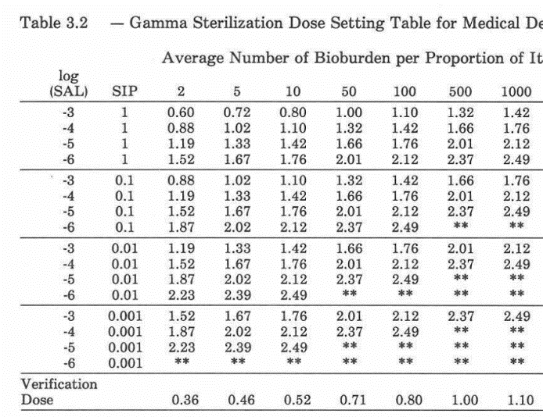
SIP – go to next lowest
Bioburden – go to next highest
Original Method 1 Table

Slide 11
HOW MUCH VARIATION DO WE EXPECT?
Note that the focus is on averages…
Medical Device Sterilization – Past, Present, and Future, September 20-21, 2023

Slide 12
DOSE AUDITS
Medical Device Sterilization – Past, Present, and Future, September 20-21, 2023

Slide 13
SDR – POPULATION C
D-value | 1.0 | 1.5 | 2.0 | 2.5 | 2.8 | 3.1 | 3.4 | 3.7 | 4.0 | 4.2
% | 65.5 | 22.5 | 6.3 | 3.2 | 1.2 | 0.8 | 0.4 | 0.1 | 0.07 | 0.007
Medical Device Sterilization – Past, Present, and Future, September 20-21, 2023

Slide 14
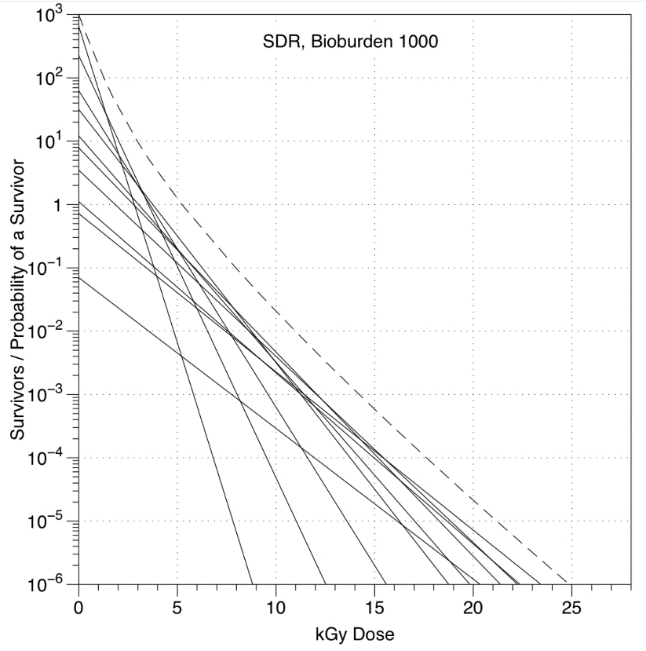

Slide 15
6%
3%
1%
2.0 kGy
2.5 kGy
Do all components of the SDR influence the test of sterility outcome equally?
2.8/3.1 kGy
Will a general increase in bioburden cause a failure?
How frequently should we see these?
VDmax
Method 1
2.5 kGy
2.0 kGy
2.8/3.1 kGy

Slide 16
1% 3.1 kGy
How about influence on the SAL?
Called a pass/fail (P/F) scenario
0.4/0.1% 3.4/3.7 kGy
0.07% 4.0 kGy
Is the sky falling?
Now at 0.7%
~27 kGy
3.1 kGy
3.4/3.7 kGy
4.0 kGy

Slide 17
IS THE SKY FALLING?
D-value | 1.0 | 1.5 | 2.0 | 2.5 | 2.8 | 3.1 | 3.4 | 3.7 | 4.0 | 4.2
% | 65.5 | 22.5 | 6.3 | 3.2 | 1.2 | 0.8 | 0.4 | 0.1 | 0.07 | 0.007
Can we “fix” it?
TIR76
Test 30-90 or 100 samples always?
Test 30-90 initially?
Consider other populations (e.g., A, B, D, E, F)?
VD selected based on different criteria
Resistant bugs are not infectious – usually
How can we use Population C to understand dose audit failures?
Is Population C still valid?
How would it manifest itself if Population C was no longer valid?
Are there other reasons for wanting something different from Population C?
Medical Device Sterilization – Past, Present, and Future, September 20-21, 2023

Slide 18
THANK YOU
Medical Device Sterilization – Past, Present, and Future, September 20-21, 2023

