Slide 1

Training Sources
John A. Williams, Medtronic

Slide 2
AGENDA
AAMI
ASTM
iiA
RISO National Laboratory
Texas A&M
The Irradiation Panel
Medical Device Sterilization – Past, Present, and Future, September 20-21, 2023

Slide 3

Radiation Sterilization for Medical Devices
Oct 10 to Oct 13, 2023 (Virtual)
Overview
This 3.5-day program covers principles, processes, industry best practices, and industry standards in radiation sterilization for medical devices. Some of the topics covered are: FDA expectations regarding successful submissions and inspections, recalls, problem solving, and risk avoidance; scientific theory and principles of radiation sterilization; and the 11137 series radiation sterilization standards.
Objectives
Participants will understand FDA expectations regarding successful submissions and inspections, recalls, problem solving, and risk avoidance and scientific theory and principles of radiation sterilization. The course examines the global ANSI/AAMI/ISO 11137 series on radiation sterilization standards. Participants will learn integration of industry standards with the Quality System regulation, auditing processes for contract laboratories and sterilizers, and radiation sterilization processing, including safety precautions, characteristics, constraints, and impact of radiation operations
Medical Device Sterilization – Past, Present, and Future, September 20-21, 2023

Slide 4
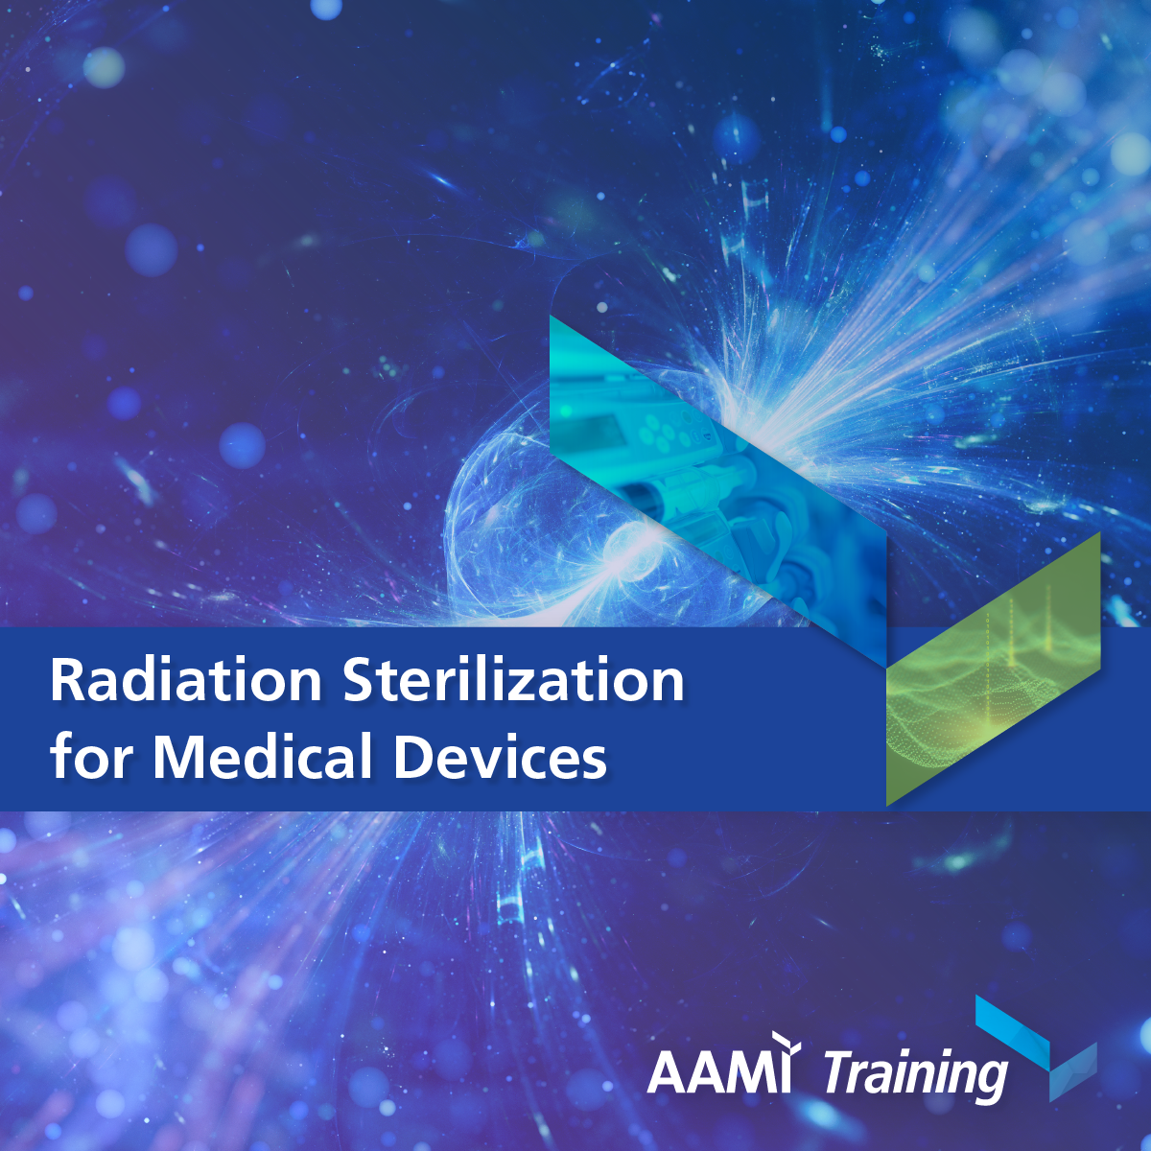
Radiation Sterilization for Medical Devices
Oct 10 to Oct 13, 2023 (Virtual)
MODULES/TRAINING TOPICS
Overview of ISO 11137
Microbiological testing
Gamma design and operation
E-beam and X-ray design and operation
Sterility assurance
Product and process definition
Process definition – Maximum dose
Method 2 process definition
Method 1 process definition
Dosimetry
Sterilizer equipment validation
Method VDmax process definition
Routine processing
Maintaining process effectiveness – Microbiological
Contract sterilizers and labs
Maintenance of validation equipment
Changing sites
Medical Device Sterilization – Past, Present, and Future, September 20-21, 2023

Slide 5

10th INTERNATIONAL WORKSHOP ON RADIATION PROCESSING
February 5-9, 2024
San Diego, CA
ASTM International’s Committee E61 on Radiation Processing is pleased to announce that the 10th International Workshop on Radiation Processing will be held in San Diego, CA, United States, February 5-9, 2024.
The workshop follows the very successful nine previous workshops given in North America and Europe. The tenth workshop continues to evolve in order to provide the most value to those attending. Attendees will get an end-to-end view of radiation processing, including dosimetric aspects. In keeping with the previous workshops this workshop will focus on practical examples and case studies, highlighting the way in which ASTM documents can be utilized to meet the requirements in the ISO radiation standards.
This workshop will provide a combination of plenary presentations, hands-on practical exercises, informal "roundtable" sessions, and case studies. Limit of 75 technical participants.
Medical Device Sterilization – Past, Present, and Future, September 20-21, 2023

Slide 6
10th INTERNATIONAL WORKSHOP ON RADIATION PROCESSING
February 5-9, 2024
San Diego, CA
WORKSHOP FORMAT
The Workshop will address the following major topics during the plenary and hands-on sessions:
Radiation Physics & Statistics
Microbiology & Establish Dose Requirements
Dosimetry Calibration, Uncertainty & Application
Operational Qualification & Performance Qualification
Process Capability assessment (Cpk), Establishment & Control
Proactive Change Control
Gamma, X-ray and Electron Beam Change Control
ASTM EO Update
Medical Device Sterilization – Past, Present, and Future, September 20-21, 2023

Slide 7


International Meeting on Radiation Processing
November 4-8, 2024
Costa Rica
The International Meeting on Radiation Processing (IMRP) is recognized as the leading international event for those involved in the application or science of radiation processing. It is where the business and science of irradiation come together to discuss recent advances, current trends as well as the issues and opportunities that impact the commercial use of ionizing radiation.
IMRP is organized every 2-3 years on a different continent by the International Irradiation Association (iia). The first IMRP meeting was held in Puerto Rico in 1976 and this 21st IMRP will be held in Costa Rica.
The IMRP program is always topical and includes regional, technology and application updates from industry leaders. The IMRP exhibition, side events and technical tours are great opportunities to learn and to meet industry colleagues.
Medical Device Sterilization – Past, Present, and Future, September 20-21, 2023

Slide 8

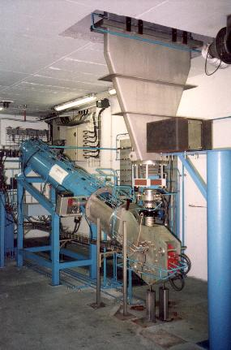
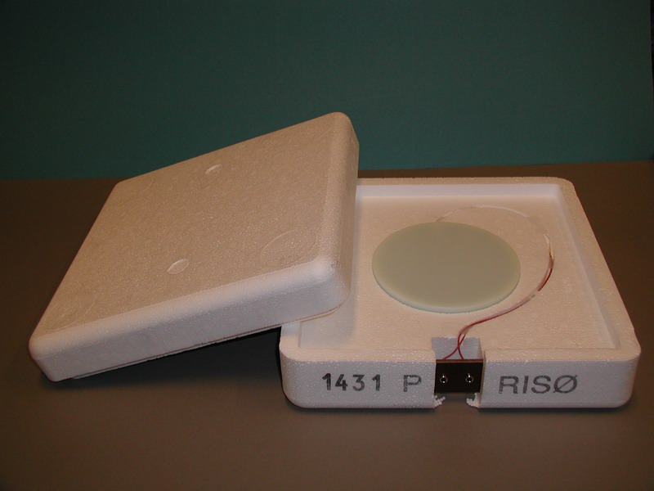
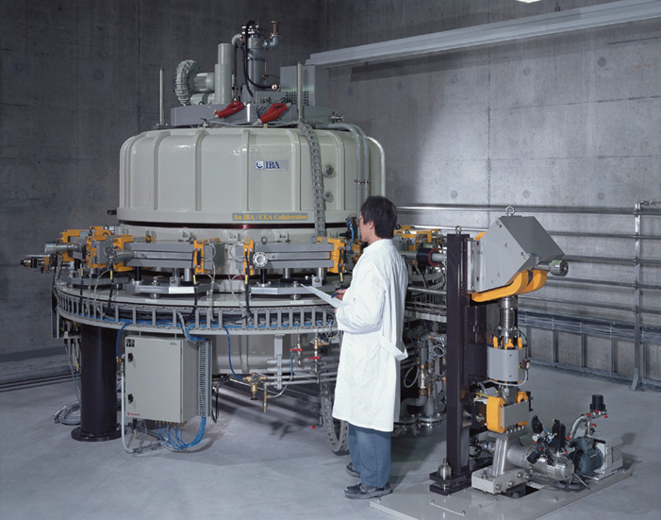
Validation and Process Control for Electron Beam Sterilization
September 11-15, 2023
RISO National Laboratory, Roskilde, Denmark
This RISO course gives background for understanding and implementing the requirements of EN ISO 11137. The emphasis of this course is on high energy (10 MeV) electron beam sterilization, but aspects of low energy (100-200 keV) electron beam and of gamma sterilization will also be addressed
The focus points of the course are:
1. Calibration of dosimetry systems
2. Dose measurements as required and used in validation
- IQ/OQ, Installation / Operational Qualification
- PQ, Performance Qualification
- Routine monitoring and Process Control
3. Establishing the sterilization dose using the methods in EN ISO 11137-2 and EN ISO 13004.
4. Establishing maximum acceptable dose by investigating effect of dose on product.
Medical Device Sterilization – Past, Present, and Future, September 20-21, 2023

Slide 9
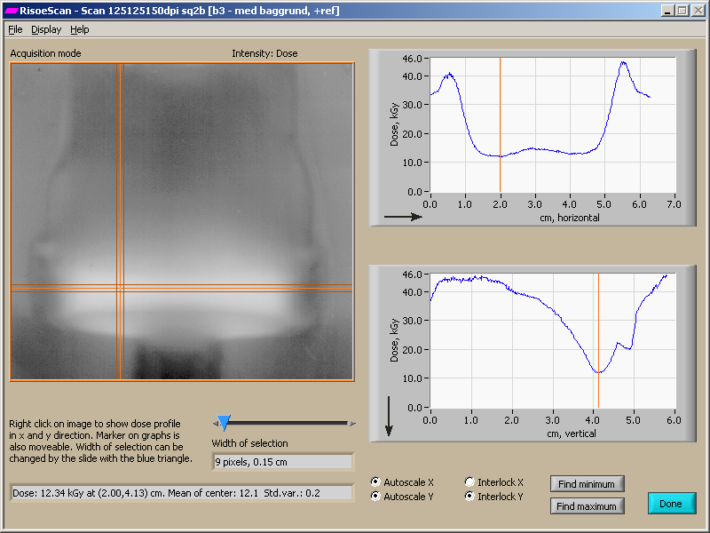
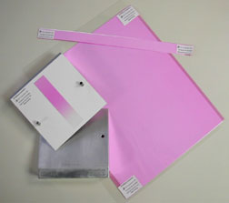
Validation and Process Control for Low Energy Electron Beam Sterilization
October 10-12, 2023
RISO National Laboratory, Roskilde, Denmark
Irradiation with electron beams in the energy range lower than 300 keV is used in the polymer industry for curing and crosslinking. These beams are also used in the pharmaceutical and medical device industries for sterilization of surfaces. Both applications may require that delivered doses are traceable to national standards and that the low energy electron beam processes is validated.
The Course provides the background for understanding the validation requirements of the radiation sterilization standards with focus on the dosimet­ric aspects as used in
IQ/OQ, Installation / Operational Qualification
PQ, Performance Qualification
Routine monitoring and Process Control
Medical Device Sterilization – Past, Present, and Future, September 20-21, 2023

Slide 10

2023 Hands-On Electron Beam Technology Workshop
April 15-19, 2024
Texas A&M – National Center for Electron Beam Research
Offer unique opportunity to learn about eBeam technology at a commercial scale facility
Facilitate deep understanding of electron beam technology and how to harness this technology for commercial applications
To provide attendees with an understanding of the relationships existing between material density, penetration, and dose distribution
Provide attendees with information about the core eBeam technology equipment needed for commercial applications
Provide hands-on experience with dose-mapping medical products and agricultural products, handling alanine dosimeters, dosimetry, working and single and double beam configurations
Facilitate interaction with leading eBeam technology equipment providers and sub-system suppliers
Provide attendees with a clear understanding of the actual costs, equipment, permits and other critical information necessary to adopt the technology
Provide attendees with actionable information to adopt eBeam and or X-ray technology in different specific applications such as medical device sterilization, food pasteurization, phytosanitary treatment, environmental applications, and biomedical applications.
Medical Device Sterilization – Past, Present, and Future, September 20-21, 2023

Slide 11

Theoretical and Practical Dosimetry Course for Radiation Processing
October 2-6, 2023
Strasbourg, France
Radiation and Dosimetry Fundamentals
Reference Dosimetry Systems
Routine Dosimetry Systems
Influence quantities and Uncertainties
Practical session on dosimetry system calibration
Practical session on dosimetry system calibration (cont.)
Overview of standards/guides (ISO 11137-1, -3, and -4, ASTM 51261, 52628, ...)
Process Qualification (IQ/OQ)
Practical session on Operational Qualification
Practical session on Operational Qualification (cont.)
Overview of ISO 11137-2 (Microbiology aspects)
Impact of radiation dose on polymeric material properties
Process Definition – Sterilization Dose and Maximum Acceptable dose
Process Qualification PQ
Practical session on Performance Qualification
Establishing the process
Control and monitoring the process (ISO 11137-4)
Maintaining Process Effectiveness
Medical Device Sterilization – Past, Present, and Future, September 20-21, 2023

Slide 12
Links
AAMI: https://aami.org/training/training-suites/sterilization/radiation-sterilization-for-medical-devices
ASTM: https://na.eventscloud.com/website/54394/e61_10th_radiation_processing_feb_2024/
iiA: https://imrp-iia.com/
RISO National Laboratory: https://www.healthtech.dtu.dk/services-and-products/industrial-and-medical-dosimetry/courses
Texas A&M: https://ebeam-tamu.org/
The Irradiation Panel: https://www.irradiationpanel.org/
Medical Device Sterilization – Past, Present, and Future, September 20-21, 2023

