Slide 1
Introduction and Description of ARR Process & Plan
Maddie Schoell
ARR – External Validation of Updated SAD & ASE
August 15-17, 2023

Slide 2
Outline
Safety Notes
Scope
ARR Determination
ARR Plan
Fermilab Safety Assessment Document (SAD) Structure
Fermilab Accelerator Safety Envelope (ASE) Structure
Current Status
Summary

Slide 3
Safety Notes
In the event of an emergency or alarm, we’ll go to the south (enclosed) stairs and go downstairs
For tornados: proceed to the basement/ground floor
For fire: proceed outside
Emergency phone number
From cell phone: 630-840-3131
From lab phone: x3131
Safety briefings and PPE will be provided to you for Site Visits today and tomorrow
As Business Visitors, you are required to be escorted by a Fermilab employee. We’ll guide you in the event of an emergency.

Slide 4
Scope – Fermilab
Fermilab Overview
6,800 acre site
High energy physics and particle beam physics research
Frontiers:
Energy
Intensity
Cosmic
Managed fully within DOE O 420.2D (no nuclear facilities)

Slide 5
Scope
This is not your typical Accelerator Readiness Review (ARR)
We have not built, modified or upgraded an accelerator that is looking to ensure readiness prior to operations
What we do have is a large complex, with many currently operating facilities, that is looking to ensure readiness to comply with DOE O 420.2D and meet the expectations of the Fermi Site Office (FSO).
Fermilab received a letter from FSO describing comments/concerns related to the SAD/ASE on 1/4/2023.
FY23 PEMP Notable to “update and externally validate an updated SAD and ASE to reflect the requirements in the DOE O 420.2D, the current configuration, and a consistent authorization operating limit”.
This is a pre-submittal review – all documents are pending FSO approval.

Slide 6
ARR Determination
Fermilab’s ARR Determination Form to document the scope of the review, the level of the review, and discussion summarizing the considerations that went into the determination
Determined a Limited Scope ARR for this review
Elements included: SAD, ASE, training/procedures for Test Stand Accelerators, USI Process, listing of accelerators and equivalencies/exemptions
Determination approved by the Chief Safety Officer (CSO) and Senior Radiation Safety Officer (SRSO)
Determination provided to the Fermi Site Office (FSO) for review and comment prior to the review

Slide 7
Charge
We ask that the review team look at the updated documents to validate that the approach taken in the updates is appropriate and in alignment with the requirements of DOE O 420.2D and FSO Expectations per the January 4, 2023 letter.
Updates that have been made include:
Revamped organizational structure of the Fermilab SAD & ASE
Incorporation of three new test stand accelerators (currently RGDs)
New and expanded Risk Assessments within SAD Chapters
New Risk Matrix Tables for Standard Industrial Hazards
Expanded template for the ASE, detailing how Configuration Management and USI Programs apply, and detailing required Credited Controls
Implementing Credited Controls for ODH systems within applicable accelerator facilities

Slide 8
Charge Questions
Pending FSO approval of updated programs and documents, is the Lab’s updated approach appropriate for meeting the requirements of DOE O 420.2D and addressing the comments provided by FSO in the January 4, 2023 letter?
Is the approach for use of Compensatory Measures appropriate?
Is the methodology used for Risk Assessments appropriate?
Is the approach for instituting Credited Controls for ODH components within applicable accelerator facilities appropriate?
Is the approach for implementing a consistent authorization operating limit appropriate?

Slide 9
ARR Plan
Fermilab Main Accelerator and FAST Accelerator are currently operating facilities under DOE O 420.2C with multiple previous ARRs for their operation (with all pre-start items closed and ASE approved). (See list on next slide.)
Personnel/training and equipment is unchanged and will not be part of this review.
SAD & ASE have been updated, and will be part of this review.
Test Stand Accelerators are currently operating RGDs under 10CFR835 and will need to be managed as accelerators under DOE O 420.2D.
SAD Chapters and ASEs will be generated for these facilities.
Personnel/training and equipment is unchanged, but should be verified to be compliant with requirements in DOE O 420.2D.

Slide 10
ARR Plan – List of Previous ARRs
October 2013 Accelerator Readiness Review of Main Injector, Recycler, and NuMI for 700 kW Operations (https://esh-docdb.fnal.gov/cgi-bin/sso/ShowDocument?docid=2647) (https://indico.fnal.gov/event/7445/)
January 2015 ASTA Injector Phase 1 ARR (https://esh-docdb.fnal.gov/cgi-bin/sso/ShowDocument?docid=3020)
March 2017 Muon Campus g-2 ARR (https://esh-docdb.fnal.gov/cgi-bin/sso/ShowDocument?docid=3495) (https://web.fnal.gov/experiment/MuonG2/Reviews/Pages/Accelerator-Readiness-Review.aspx)
September 2017 IOTA/FAST Electron Injector Phase 2 ARR (https://esh-docdb.fnal.gov/cgi-bin/sso/ShowDocument?docid=3746) (https://indico.fnal.gov/event/15275/)
July 2018 IOTA/FAST Phase 3 ARR (https://esh-docdb.fnal.gov/cgi-bin/sso/ShowDocument?docid=4534) (https://indico.fnal.gov/event/17342/)
February 2020 Muon Campus 13W Beam to DA (https://esh-docdb.fnal.gov/cgi-bin/sso/ShowDocument?docid=5630) (https://indico.fnal.gov/event/22898/)
September 2020 MeV Test Area (https://esh-docdb.fnal.gov/cgi-bin/sso/ShowDocument?docid=6086) (https://indico.fnal.gov/event/45027/)

Slide 11
ARR Plan – Schedule
Tuesday 8/15
Welcome
Introduction & Description of ARR Process & Plan
Alignment with DOE O 420.2D and FSO Expectations (Charge Question 1)
USI Process & Compensatory Measures (Charge Question 2)
Authorization Operating Limits (Charge Question 5)
Overview of Accelerator Equivalency Process
Site Visits: Test Stand Accelerators (CMTS1, PIP2IT, VTS)
Wednesday 8/16
Implementation of ODH Credited Controls (Charge Question 4)
Site Visit: Location of ODH System that will have Credited Controls (NM4)
Overview of Risk Assessment Methodology (Charge Question 3)
Time for interviews, discussion, document review
Thursday 8/17
Time for interviews, discussion, document review
Closeout scheduled for 3:15pm

Slide 12
Fermilab Safety Assessment Document (SAD) Structure
Fermilab has one modular Safety Assessment Document (SAD)
Section I – Overview of Fermilab Facilities
Section II – Support Facilities
Section III – Fermilab Main Accelerator (Accelerator Segments)
Section IV – Fermilab Main Accelerator (Experimental Areas & Detectors)
Section V – FAST Accelerator
Section VI – Test Stand Accelerators
Section VII – Appendices
VII-A – Accelerator Safety Envelopes
VII-B – Fermilab Accelerator Safety Policies & Programs
VII-C – Standard Industrial Hazard (SIH) Risk Matrix Tables

Slide 13
Fermilab SAD Structure
Section I – Overview of Fermilab Facilities
Section II – Support Facilities
Section III – Fermilab Main Accelerator (Accelerator Segments)
Section IV – Fermilab Main Accelerator (Experimental Areas & Detectors)
Section V – FAST Accelerator
Section VI – Test Stand Accelerators
Section VII – Appendices
VII-A – Accelerator Safety Envelopes
VII-B – Fermilab Accelerator Safety Policies & Programs
VII-C – Standard Industrial Hazard (SIH) Risk Matrix Tables
I-01 Executive Summary
I-02 Introduction
I-03 Site, Facility Design Criteria and Operations
I-04 Safety Assessment
I-05 Accelerator Safety Envelope Basis
I-06 Environmental Monitoring
I-07 Quality Assurance
I-08 Post-Operations Planning
I-09 Acronyms
I-10 References

Slide 14
Fermilab SAD Structure
Section I – Overview of Fermilab Facilities
Section II – Support Facilities
Section III – Fermilab Main Accelerator (Accelerator Segments)
Section IV – Fermilab Main Accelerator (Experimental Areas & Detectors)
Section V – FAST Accelerator
Section VI – Test Stand Accelerators
Section VII – Appendices
VII-A – Accelerator Safety Envelopes
VII-B – Fermilab Accelerator Safety Policies & Programs
VII-C – Standard Industrial Hazard (SIH) Risk Matrix Tables
II-01 Railhead
II-02 Radiation Protection Calibration Facility (RPCF)
II-03 Radionuclide Analysis Facility (RAF)
II-04 Waste Handling Facilities
II-05 Technical Division Facilities
II-06 Shipping and Receiving Operations
II-07 Other Radioactive Material Storage Areas

Slide 15
Fermilab SAD Structure
Section I – Overview of Fermilab Facilities
Section II – Support Facilities
Section III – Fermilab Main Accelerator (Accelerator Segments)
Section IV – Fermilab Main Accelerator (Experimental Areas & Detectors)
Section V – FAST Accelerator
Section VI – Test Stand Accelerators
Section VII – Appendices
VII-A – Accelerator Safety Envelopes
VII-B – Fermilab Accelerator Safety Policies & Programs
VII-C – Standard Industrial Hazard (SIH) Risk Matrix Tables
III-01 Linac
III-02 400 MeV Test Area (MTA)
III-03 PIP-II Line *
III-04 Booster
III-05 8 GeV Line
III-06 Booster Neutrino Beam (BNB)
III-07 Main Injector / Recycler
III-08 NuMI
III-09 LBNF *
III-10 Muon Campus
III-11 Tevatron
III-12 Switchyard
III-13 Meson
III-14 Neutrino
III-15 Proton
* placeholder

Slide 16
Fermilab SAD Structure
Section I – Overview of Fermilab Facilities
Section II – Support Facilities
Section III – Fermilab Main Accelerator (Accelerator Segments)
Section IV – Fermilab Main Accelerator (Experimental Areas & Detectors)
Section V – FAST Accelerator
Section VI – Test Stand Accelerators
Section VII – Appendices
VII-A – Accelerator Safety Envelopes
VII-B – Fermilab Accelerator Safety Policies & Programs
VII-C – Standard Industrial Hazard (SIH) Risk Matrix Tables
IV-01 CDF Detector
IV-02 DZero Detector
IV-03 Switchyard 120 Experimental Areas
IV-04 MiniBooNE Detector
IV-05 NOvA Detector
IV-06 MINOS Hall Detectors
IV-07 SBN Experimental Areas

Slide 17
Fermilab SAD Structure
Section I – Overview of Fermilab Facilities
Section II – Support Facilities
Section III – Fermilab Main Accelerator (Accelerator Segments)
Section IV – Fermilab Main Accelerator (Experimental Areas & Detectors)
Section V – FAST Accelerator
Section VI – Test Stand Accelerators
Section VII – Appendices
VII-A – Accelerator Safety Envelopes
VII-B – Fermilab Accelerator Safety Policies & Programs
VII-C – Standard Industrial Hazard (SIH) Risk Matrix Tables
V-01 Fermilab Accelerator Science & Technology (IOTA/FAST) Electron Injector

Slide 18
Fermilab SAD Structure
Section I – Overview of Fermilab Facilities
Section II – Support Facilities
Section III – Fermilab Main Accelerator (Accelerator Segments)
Section IV – Fermilab Main Accelerator (Experimental Areas & Detectors)
Section V – FAST Accelerator
Section VI – Test Stand Accelerators
Section VII – Appendices
VII-A – Accelerator Safety Envelopes
VII-B – Fermilab Accelerator Safety Policies & Programs
VII-C – Standard Industrial Hazard (SIH) Risk Matrix Tables
V-01 Fermilab Accelerator Science & Technology (IOTA/FAST) Electron Injector
VI-01 Overview of Test Stand Accelerators *
VI-02 Cryomodule Test Stand 1 (CMTS1)
VI-03 PIP-II IT
VI-04 Vertical Test Stand (VTS)
* placeholder

Slide 19
Fermilab SAD Structure
Section I – Overview of Fermilab Facilities
Section II – Support Facilities
Section III – Fermilab Main Accelerator (Accelerator Segments)
Section IV – Fermilab Main Accelerator (Experimental Areas & Detectors)
Section V – FAST Accelerator
Section VI – Test Stand Accelerators
Section VII – Appendices
VII-A – Accelerator Safety Envelopes
VII-B – Fermilab Accelerator Safety Policies & Programs
VII-C – Standard Industrial Hazard (SIH) Risk Matrix Tables
VII-A.01 ASE – Fermilab Main Accelerator
VII-A.02 ASE – FAST Accelerator
VII-A.03 ASE – CMTS1 Accelerator
VII-A.04 ASE – PIP-II IT Accelerator
VII-A.05 VTS Accelerator

Slide 20
Fermilab SAD Structure
Section I – Overview of Fermilab Facilities
Section II – Support Facilities
Section III – Fermilab Main Accelerator (Accelerator Segments)
Section IV – Fermilab Main Accelerator (Experimental Areas & Detectors)
Section V – FAST Accelerator
Section VI – Test Stand Accelerators
Section VII – Appendices
VII-A – Accelerator Safety Envelopes
VII-B – Fermilab Accelerator Safety Policies & Programs
VII-C – Standard Industrial Hazard (SIH) Risk Matrix Tables
VII-B.01 Fermilab Shielding Policy
VII-B.01 Fermilab Unreviewed Safety Issue (USI) Process

Slide 21
Fermilab SAD Structure
Section I – Overview of Fermilab Facilities
Section II – Support Facilities
Section III – Fermilab Main Accelerator (Accelerator Segments)
Section IV – Fermilab Main Accelerator (Experimental Areas & Detectors)
Section V – FAST Accelerator
Section VI – Test Stand Accelerators
Section VII – Appendices
VII-A – Accelerator Safety Envelopes
VII-B – Fermilab Accelerator Safety Policies & Programs
VII-C – Standard Industrial Hazard (SIH) Risk Matrix Tables
VII-C – Standard Industrial Hazard (SIH) Risk Matrix Tables

Slide 22
Fermilab SAD Structure – SAD Chapters
SAD Chapters prepared by Machine/Area Owner, Department Head, or Primary Point of Contact
SAD Chapters reviewed by Line Organization Owner, ES&H Division Accelerator Safety Department Head and SAD Review Subcommittee Chair
All Chapters have same Outline, consistency in formatting and creates ease for reader to find the same type of information across Chapters
Chapter nomenclature
II-1.2.1.1
SAD Section
Information section within the Chapter
Chapter within the SAD Section

Slide 23
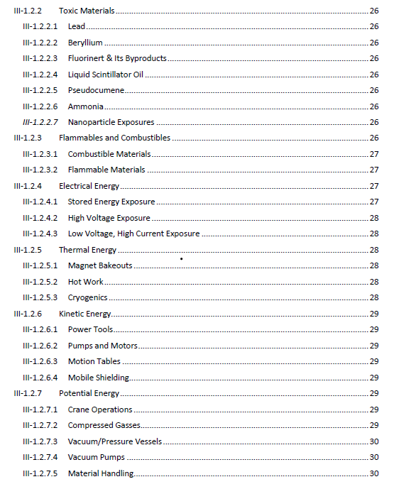
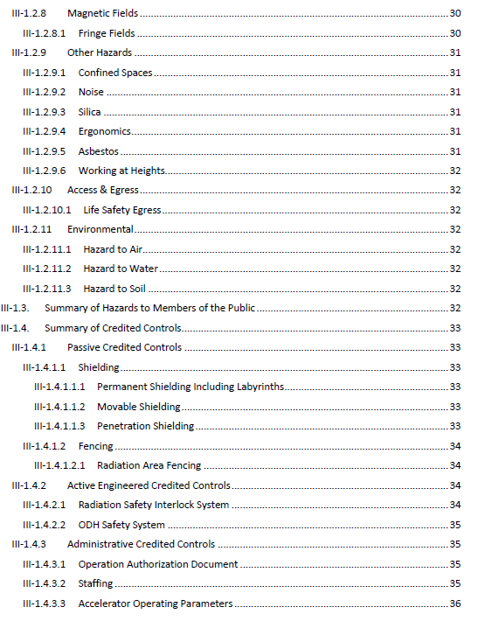
Fermilab SAD Structure – SAD Chapters
Example SAD Chapter Outline from II-01 Linac

Slide 24
Fermilab Accelerator Safety Envelopes (ASEs) Structure
Multiple Accelerator Safety Envelopes (ASEs)
One ASE for each accelerator
ASEs prepared by the ES&H Division Accelerator Safety Department Head and Accelerator Machine/Area Owner, Department Head, or Primary Point of Contact
ASEs Reviewed and Recommended for approval by the Directorate Associate Lab Director or Division Senior Director, the Accelerator Safety Department Head and SAD Review Subcommittee Chair
Final approval of the ASE granted by the Fermilab Director and the DOE Field Element Manager

Slide 25
Fermilab ASE Structure
ASE Outline
Section 1 Introduction and Scope
Section 2 Select Definitions and Acronyms
Section 3 Description of Credited Controls
Section 4 ASE Violation Determinations and Actions
Section 5 Configuration Management for Credited Controls
Section 6 Unreviewed Safety Issue (USI) Process
Section 7 Summary of Credited Controls for [all Segments of] the Accelerator
For the Fermilab Main Accelerator, this will be subdivided for each segment (i.e., Linac, Booster, Main Injector, Switchyard, etc.)

Slide 26
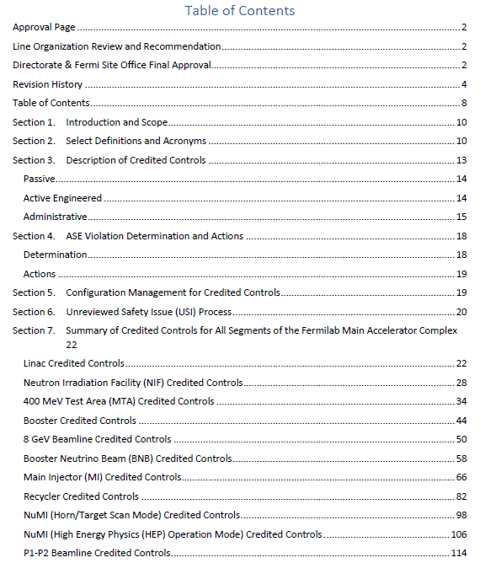
Fermilab ASE Structure
Example ASE Outline from VII-A.01 Fermilab Main Accelerator ASE

Slide 27
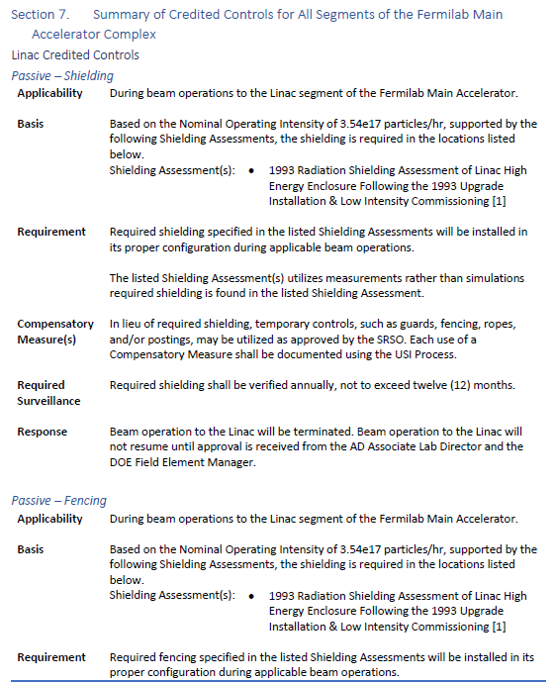
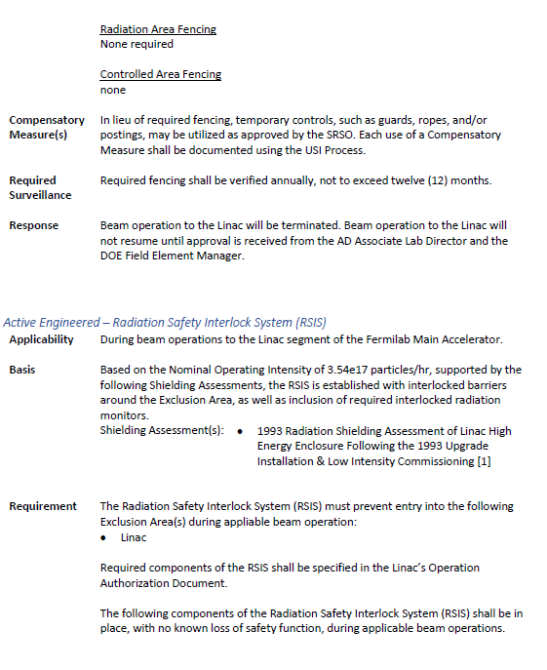
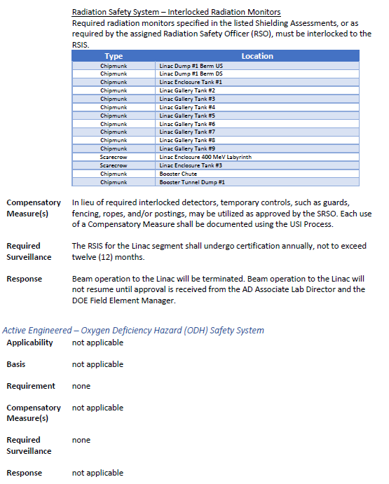
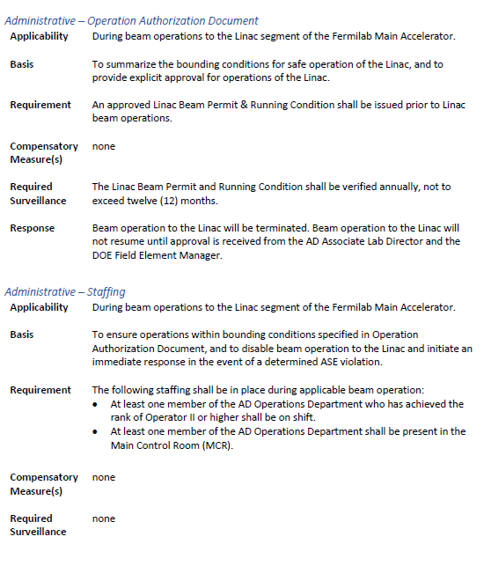
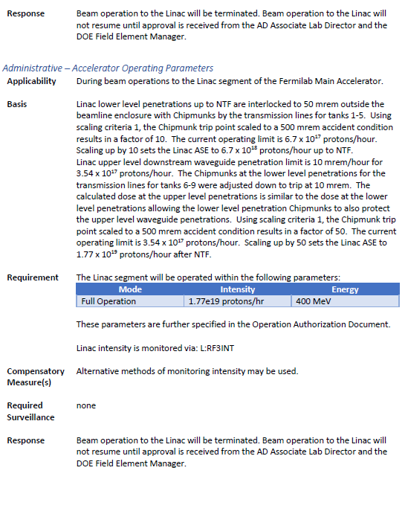
Fermilab ASE Structure
Example Credited Controls Summary within VII-A.01 for Linac

Slide 28
Current Status
SAD Chapters and Risk Matrix Tables:
Technical edits/updates: 98% complete. One Chapter remaining
Line Organization reviews: 56% complete
Awaiting formatting double checks and printing
Once complete, entire SAD will be provided to Director for approval
ASEs
Technical edits/updates: 80% complete. One ASE being finalized
Line Organization reviews: 0% complete
Currently being reviewed by Line Organization
Once complete, will be provided to Director for approval, then to FSO for approval

Slide 29
Summary
Presentations will provide the review committee members with an overview of the program elements, discuss implemented changes, and provide evidence to answer the Charge questions
Site visits will be at areas of key interest: new test stand accelerators and facility with ODH Credited Controls
Ample time to perform document review and hold additional interviews/discussion as requested
Fermilab believes that this plan will support your evaluation and validation that our approach is in alignment with the requirements of DOE O 420.2D an FSO expectations.
We look forward to your observations and any recommendations you may have.

Slide 30
Questions?

