Slide 1
Alignment with DOE O 420.2D and FSO Expectations
Maddie Schoell
ARR – External Validation of Updated SAD & ASE
August 15-17, 2023

Slide 2
Outline
Alignment with DOE O 420.2D Requirements
Alignment with FSO Expectations from 1/4/2023 Letter

Slide 3
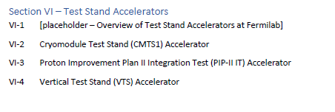
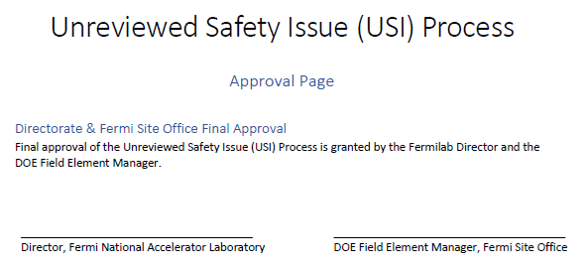
Alignment with DOE O 420.2D Requirements
New requirements for Fermi that come from 420.2D
New Exemption/Equivalency Process
Three cryomodule test stands now managed as accelerators. New Section in SAD with new chapters
RSI step in USI Process
RSI step added at the end of the evaluation
DOE Field Element Manager approval of USI Process
Approval Page added to USI Process
Section for Test Stand Accelerators from SAD Outline
Excerpts from the USI Process, within VII-B

Slide 4
Alignment with FSO Expectations from 1/4/23 Letter
Revision 13 of the Fermilab Accelerator Safety Envelope (ASE) was submitted to FSO requesting Fermi Site Officer Manager on November 21, 2022.
On January 4, 2023 FSO submitted a letter to FRA including 39 comments and a request that FRA provide a proposed solution for each comment
First Rows of Comment Resolution Form from FSO to FRA

Slide 5
Alignment with FSO Expectations from 1/4/23 Letter
Fermilab presented FSO with a proposal on 3/14/2023
Fermilab submitted formal response with proposed solutions on 4/21/2023
FSO notified Fermilab on 5/9/2023 that the initial proposed solutions were not accepted in whole
46% accepted, 54% not accepted
Fermilab submitted updated proposed solutions on 7/5/2023
Awaiting FSO formal response on updated proposed solutions, moving forward with proposed solutions with the assumption that they will be accepted

Slide 6
Alignment with FSO Expectations from 1/4/23 Letter
Example Hazard Identification Table from II-01 Linac
Updates to the SAD
Expanded Hazard Identification Table within SAD
Provides positive confirmation of what hazards exist and what hazards don’t exist in that accelerator or accelerator segment
Updated SAD Chapter outline to discuss each applicable hazard, or re-confirm that the hazard is not applicable

Slide 7
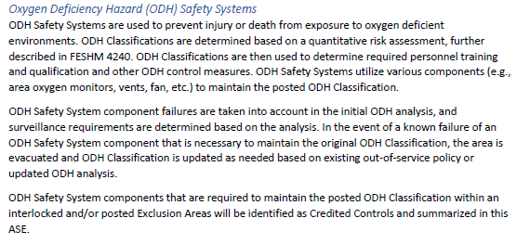
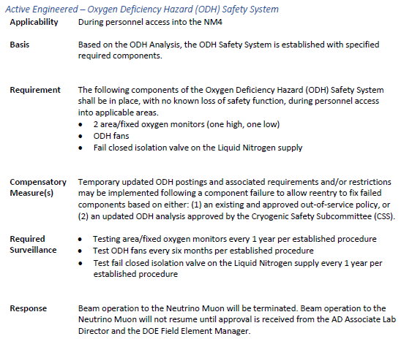
Alignment with FSO Expectations from 1/4/23 Letter
Example Hazard Identification Table from IV-03 SY120 Experimental Areas
Example ODH Safety System Excerpt from VII-A.01 Fermi Main Accelerator ASE
Example of ODH Safety System Credited Controls for NM4 from VII-A.01
Updates to the SAD & ASE
Include Cryogenics and ODH as Credited Control for applicable accelerator facilities (shown in bold purple in the HID table)
Discussion of ODH Safety System Credited Controls within Section 3 of the ASE
List specific requirements for ODH Safety System Credited controls for applicable accelerators/segments within Section 7 of the ASE
Addresses Comment/Issue #1
In accordance with DOE‐HDBK‐1163‐2020, Standard Industrial Hazards(SIH) are hazards that are generally well understood and coverered by codes, standards, or other consensus standards. I am not sure if FERMI considers ODH as a SIH but since it is not covered by any codes, standards, or other consensus standard then this ASE must develop CC that will address the ODH concerns assocaietd with applicable accelerator facilities.

Slide 8
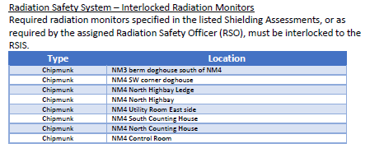
Alignment with FSO Expectations from 1/4/23 Letter
Updates to the SAD
List required interlocked radiation detectors for applicable accelerators/segments within Section 7 of the ASE
Example of Interlocked Radiation Monitors in the Radiation Safety Interlock System ODH Safety System Credited Controls for NM4 from VII-A.01
Addresses Comment/Issue #2
Radiation detectors linked to the RSIS are required in the Shielding Assessment. These are not discussed in the ASE. Are the radiation area detectors/monitors (i.e Chipmunks, Fox, TLMs, etc) a credited control? They are not listed anywhere in the ASE. Further, how do other engineered controls that are required in the SA fit into the ASE as credited controls?

Slide 9
Alignment with FSO Expectations from 1/4/23 Letter
Updates to the SAD
Added Risk Matrix tables to the Appendix of each SAD Chapter
Discusses controls in place, and assurance that the residual qualitative risk is at an acceptable level
Addresses Comment/Issue #3
The ASE discusses controls and requirements that are to be implemented and followed to ensure the level of risk to all workers, the public and the environment is maintained at acceptable levels. However, there is no risk analysis or risk matrix included in the ASE to justify this statement
Addresses Comment/Issue #8
Where is the risk analysis/matrix to justify this statement and what is an acceptable level of risk? "Credited controls identified in the ASE are the primary controls that assure that the level of risk to all workers, the public, and the environment is maintained at acceptable levels.“
Addresses Comment/Issue #13
Where is the risk assessment to justify this statement and what is an acceptable level of risk? "Compliance with the requirements of the Beam Permit and Running Condition ensures that the level of risk to all workers, the public, and the environment is maintained at an acceptable level."
Example Risk Matrix Table from II-01 Linac

Slide 10
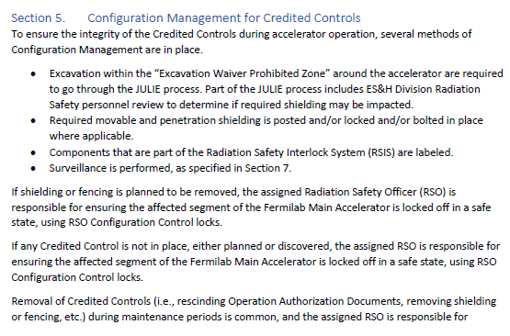
Alignment with FSO Expectations from 1/4/23 Letter
Updates to the ASE
Discuss how the Configuration Management Program is implemented for the accelerator within Section 5 of the ASE
Example of Configuration Management for Credited Controls from VII-A.01
Addresses Comment/Issue #4
There is no mention of the Configuration Management Program. Does this fall under administrative credited control process?

Slide 11
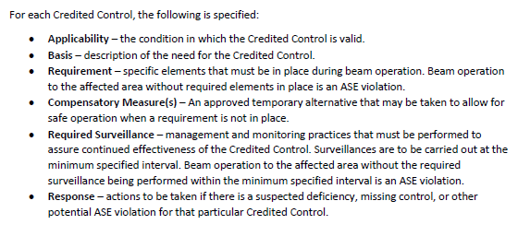
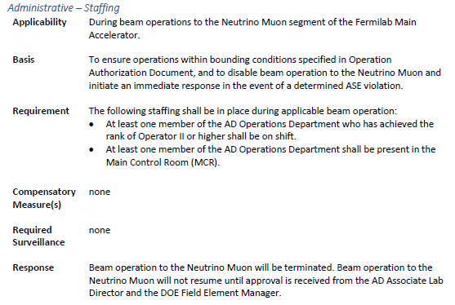
Alignment with FSO Expectations from 1/4/23 Letter
Updates to the ASE
Updated information provided for each Credited Control to specify
Applicability
Basis
Requirement
Surveillance
Compensatory Measure
Response
General description in Section 3 of the ASE
Specifics within Section 7
Excerpt from Section 3 of VII-A.01
Example of specifics from NM4 Staffing Credited Control within VII-A.01
Addresses Comment/Issue #5
In various areas throughout the ASE, it was observed that the use of other words to describe Credited Controls (CC's) are documented (e.g., Condition, Control, Surveillance, etc.).For consistancy, please update the entire document and only use "Credited Contol“.

Slide 12
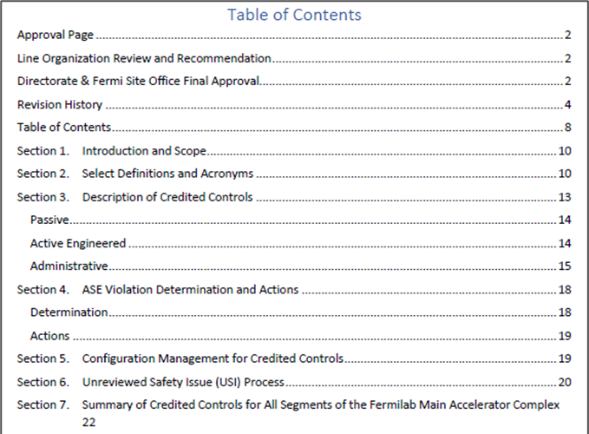
Alignment with FSO Expectations from 1/4/23 Letter
Updates to the ASE
Consistent formatting added throughout the ASEs
Basis included for each Credited Control
Addresses Comment/Issue #6
Consider changing the format of the ASE to a simple easy to use format. E.g., Section 1 Introduction to define the CC for the accelerator, unplanned lose of CC/ASE violations, planned and discovered USIs, USI high level process, Section 2 ALL CC (i.e, engineered, administrative, configuration management for CC, Required calibration, maintenance, and inspection schedules for CCs. I would also suggest that each of these areas allow for a brief write up documenting the Basis/Context.
Addresses Comment/Issue #11
This section contains background information, some questionable, that is better captured in the SAD. Please see comment 6 and an example in comment # 10.
Addresses Comment/Issue #12
This section contains background information, some questionable, that is better captured in the SAD. Please see comment 6 and an example in comment # 10.
ASE Outline from VII-A.01
Example of specifics from NM4 Staffing Credited Control within VII-A.01

Slide 13
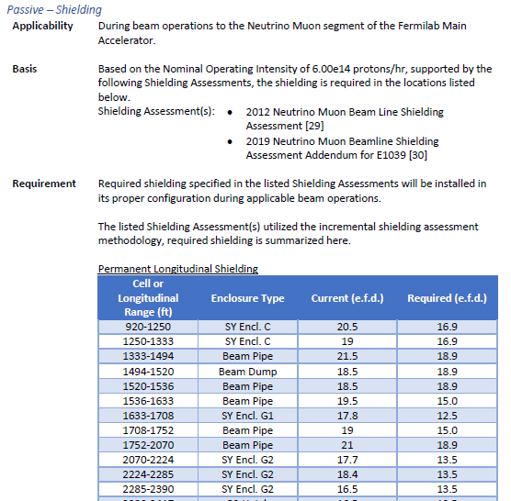
Alignment with FSO Expectations from 1/4/23 Letter
Updates to the ASE
Explicit requirements stated within Section 7 of the ASE
Example of specifics from NM4 Shielding Credited Control within VII-A.01
Addresses Comment/Issue #7
The statement "Variations beyond these limits are a violation of the ASE." is in contradiction to current practice. For example, overburden sink holes are a variation beyond the defined limit of credited passive controls defined in the current ASE (page 8 of 15). Any variation is a violation.

Slide 14
Alignment with FSO Expectations from 1/4/23 Letter
Updates to the ASE
Inclusion of Compensatory Measure for each Credited Control included within Section 7 of the ASE
Compensatory Controls implemented on a case-by-case basis with SRSO approval, documented using USI Process
More information on the use of Compensatory Measures in the next presentation
Example of Fencing Compensatory Measure from NM4 Credited Controls within VII-A.1
Addresses Comment/Issue #9
The following statement needs clarification. "The assigned Radiation Safety
Officer (RSO) may specify equivalent controls in accordance with the FRCM that do not reduce the level of safety to allow for maintenance or repairs." The use of any equivalent controls during beam operations needs to be added to the ASE and must approved by FSO prior to implementation.
Addresses Comment/Issue #10
The last sentence of the first paragraph states in part that the RSO may specify equivalent controls that do not reduce the level of safety to allow for maintanance or repairs. Is the intent to allow for use of equivalent cotrols during beam operations?

Slide 15
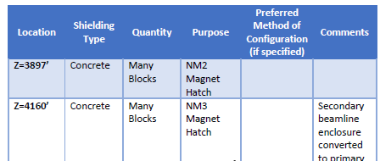
Alignment with FSO Expectations from 1/4/23 Letter
Updates to the ASE
Removed terminology “such as”
Listed required permanent, movable, and penetration shielding as determined by the Shielding Assessment
Removed reference to “berm” as a whole, and any overburden
Also directly answered question in initial response to FSO, which was accepted
Example of Shielding Requirement from NM4 Credited Controls within VII-A.1
Addresses Comment/Issue #14
Permanent Shielding including labyrinths Controls :The is a vague CC that could be interpreted differently. The CC states in part that the shielding encompases the strucural elements. What is meant by structural elements? Additionally it states that it includes built in design features such as. Use of "such as" could lead personnel to believe that these are simply examples. Lastly, listing the earthen berms and overburden indicates to DOE that if there is ANY change to the lanscape (e.g., sinkhole, runoff, etc.) would be an ASE violation.
Addresses Comment/Issue #16
Movable Shielding Control: The CC states in part that movable shielding is any shielding that can be moved. Does this include moved by hand and an euqipment (e.g., crane, for lift, etc.)?

Slide 16
Alignment with FSO Expectations from 1/4/23 Letter
Updates to the ASE
Identified specific surveillance requirements within Section 7 of the ASE
Removed references to procedures
Example of Shielding Requirement from Linac Credited Controls within VII-A.1
Addresses Comment/Issue #15
Permanent Shielding including labyrinths Surveillance: This CC should not refer personnel back to a procedure. This should simply state the requirement from the procedure (e.g., Inspect the integrety of the shielding prior to initial start up of the accelerator facility and every 12 months).

Slide 17
Alignment with FSO Expectations from 1/4/23 Letter
Updates to the ASE
Movable shielding requirements specified in Section 7 of the ASE
Preferred configuration method specified where applicable
“equivalent” removed from ASE, Compensatory Measure may be used as approved by SRSO
Example of Shielding Requirement from Meson Center Credited Controls within VII-A.1
Addresses Comment/Issue #17
Movable Shielding Control: The CC states in part that movable shileding shall be used as necessary in accordance with the Fermillab shielding policies specified in the FESHM and FRCM. The CC should document something that shielding must be installed in its proper configuration and list the type of shielding(e.g., steel, concrete blocks, etc.) This followed up with the addition of a configuration management CC would ensure consistancy.
Addresses Comment/Issue #18
Movable Shielding Control: The CC states in part that movable shielding shall be locked in place or equivalent controls placed to assure correct placement. How is shielding locked and what would be an example of equivalency?

Slide 18
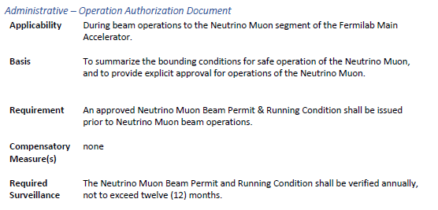
Alignment with FSO Expectations from 1/4/23 Letter
Updates to the ASE
Required surveillance specified in Section 7 of the ASE for:
Shielding (including permanent, movable & penetration)
Fencing
RSIS
ODH Safety System
Operation Authorization Document
Example of Operation Authoirzation Document for Neutrino Muon Credited Controls within VII-A.1
Addresses Comment/Issue #19
Movable Shielding Surveillance: This CC should not refer personnel back to a procedure. This should simply state the requirement from the procedure (e.g., Inspect the integrety of the shielding prior to initial start up of the accelerator facility and every 12 months).
Addresses Comment/Issue #24
Surveillance Section: The penetration surviellance requirements need to be defined in this section. Do not point the reader to another document.
Addresses Comment/Issue #26
Radiation fencing Surveillance: This CC should not refer personnel back to a procedure. This should simply state the requirement from the procedure (e.g., Inspect the integrety of the shielding prior to initial start up of the accelerator facility and every 12 months).

Slide 19
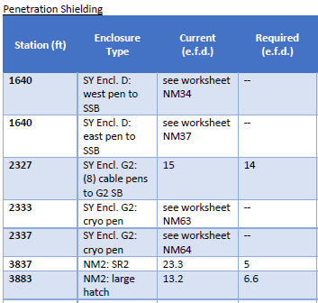
Alignment with FSO Expectations from 1/4/23 Letter
Updates to the ASE
Penetration Shielding Credited Control specified in Section 7 of ASE
Example of Penetration Shielding for Neutrino Muon Credited Controls within VII-A.1
Addresses Comment/Issue #20
Penetrating Shielding Control: This CC is vague, can be interperted differently and needs clarity such as listing the penetrations that can be tracked in configuration management process and also labled as cc.

Slide 20
Alignment with FSO Expectations from 1/4/23 Letter
Updates to the ASE
Only minimum required permanent (soil) shielding, movable shielding and penetration shielding listed within Section 7 of the ASE
Example of Shielding Requirement from NM4 Credited Controls within VII-A.1
Addresses Comment/Issue #21
Control section: Only list the minimum required shielding for the specific facility here. Any deviation from the ASE (sink hole of earthen berm or overburden) will be considered an ASE violation.
Addresses Comment/Issue #22
Control section: Only list the minimum required shielding for the specific facility here, in this case Spinquest.
Addresses Comment/Issue #23
Control section: Only list the minimum required shielding for the specific facility here, in this case Spinquest.

Slide 21
Alignment with FSO Expectations from 1/4/23 Letter
Updates to the ASE
Fencing Credited Control expanded to include both required Radiation Area fencing and Controlled Area fencing
Stated in Section 3
Specific requirements listed in Section 7
Excerpt from Section 3 of the ASE from VII-A.1
Addresses Comment/Issue #25
Radiation Fencing: This CC is ONLY applicable to radiation areas. What controls are in place for controlled areas? Since FERMI is open to the public, this CC needs to be more broad and include controls that ensure minors/members of the public and untrained employess do not receive 100mrem in a year.

Slide 22
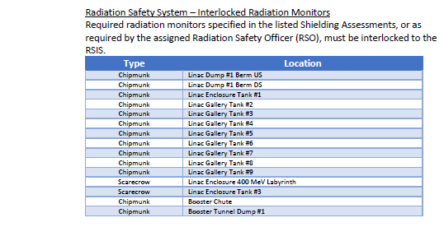
Alignment with FSO Expectations from 1/4/23 Letter
Updates to the ASE
Radiation Interlock Safety System (RSIS) Credited Control section within Section 7 of the ASE specifies
Areas where entry is prevented
Type and location of interlocked radiation monitors
Example from RSIS Credited Controls for Linac of the ASE from VII-A.1
Addresses Comment/Issue #27
Radiation Safety Interlock ControlSafety Envelope‐ Surveillance:This CC is vague and needs clarity. Additionally, the control needs to specify where interlocks are located to prevent beam during inadvertant accesses; ie are they located at all gates/doors/windows/emergency exit hatches/etc. An example could be the following ‐ Access controls‐ During beam opertions, where beam is present to...... the access controls system must prevent enrty to the .......

Slide 23
Alignment with FSO Expectations from 1/4/23 Letter
Updates to the ASE
Radiation Interlock Safety System (RSIS) description updated to clearly state: “All circuits within the RSIS are designed in such a way that if a circuit fails, or specified input is lost, the failure would initiate a system shutdown resulting in a safe condition.”
Excerpt from Section 3 of the ASE from VII-A.1
Addresses Comment/Issue #28
Control Section: The statement " All circuits are designed in such a way that if a
circuit fails, the failure would most likely initiate a system shutdown resulting in a safe condition." needs to be clarified. The wording "would most likely initiate" implies there is a chance the circuits are not fail safe.

Slide 24
Alignment with FSO Expectations from 1/4/23 Letter
Updates to the ASE
Specified information required to be included within the Operation Authorization Document within Section 3 of the ASE
Removed reference to procedure
Excerpt from Section 3 of the ASE from VII-A.1
Addresses Comment/Issue #29
Control: List the specific elements that are captured in the Beam Permit and Running Condition for clarification. Each element and associated admin control needs to be clearly stated in the ASE. Ie. List the beam power & operating parameters for Spinquest and required admin control. List theree are CDCs for Spinquest and associated administrative credited control in ASE. Do not point reader to an internal procedure. Summarize/define these in the ASE.

Slide 25
Alignment with FSO Expectations from 1/4/23 Letter
Updates to the ASE
Required staffing specified within Section 7 of the ASE
Minimum number of operators
Location of operators
Example from Staffing Credited Control for Neutrino Muon within Section 7 of ASE VII-A.1
Addresses Comment/Issue #30
Safety Envelope: List the number of required Operators for Spinquest and their
required location in ASE, in the remote control room or MCR?

Slide 26
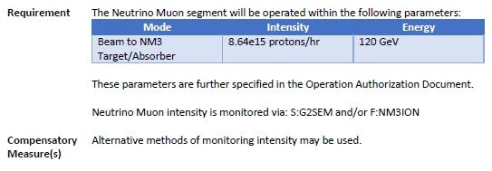
Alignment with FSO Expectations from 1/4/23 Letter
Updates to the ASE
Accelerator Operating Parameters (ASE Intensity) specified within Section 7 of the ASE
Specify preferred monitoring method
Basis for staffing includes “to ensure operations within the bounding conditions specified in Operation Authorization Document”
ASE Intensity specified in Operation Authorization Document
Examples from Staffing and Accelerator Operating Parameters Credited Control for Neutrino Muon within Section 7 of ASE VII-A.1
Addresses Comment/Issue #31
Accelerator Beam Intensity Limits ‐ Safety Envelope: The CC states in part that beam intensities are monitored. Who monitors the beam intensities? If monitoring is being performed then it appears as though an added CC should be for personel oversight where you list the # of operators required in the control room during operations.

Slide 27
Alignment with FSO Expectations from 1/4/23 Letter
Responses provided to FSO on initial response, subsequently accepted
All segments that make up the Fermilab Main Accelerator are included within one integrated ASE VII-A.01.
Maintaining one SAD Structure, but updating the layout to clarify separate accelerators
SAD Chapters updated to ensure detailed analysis for the facility within the Chapter (see Risk Assessment methodology)
Created separate ASEs for each accelerator
Benchmarked this approach with other Labs’ SAD/ASE
Addresses Comment/Issue #32
Why are all limits listed in this ASE for Spinquest? Only list the intensity limits for the Spinquest beamline that is being reviewed.
Addresses Comment/Issue #35
While DOE does not approve SADs, it should be understood that DOE needs to support the SAD otherwise there will be issues identified in the ASE. The contractor should benchmark how other laboratiories document there SADs, consider having seperate SADs and ASEs for each accelerator operations.
Addresses Comment/Issue #36
Having one SAD and one ASE is problematic. It causes the reader confusion and also leads to the development of CC's that are generic and vague. As noted in comments 1‐34 there are issues with the major portions of the ASE, including each of the listed CC’s.
Addresses Comment/Issue #37
The content in each of the SADs that were reviewed was broad. It lacked specific details explaining the facility, operational aspects, and function. They frequently referenced back to procedures/policies that may provide some or all of the details.

Slide 28
Alignment with FSO Expectations from 1/4/23 Letter
Updates to the ASE
Section 4 of ASE clearly specifies what constitutes and ASE violation
Excerpt from Section 4 of ASE VII-A.1
Addresses Comment/Issue #33
This section is confusing. The statement "Determining whether a condition is a violation of the ASE may be subjective." contradicts the statement on Page 7 that states "Variations beyond these limits are a violation of the ASE." This section needs to be clarified to state that any variations from the bounds defined in this ASE is an ASE violation. This section needs to list the actions that will be taken if an ASE violation is identified (e.g., stop the activity causing the violation, work with DOE, etc). Do not point readers to an internal procedure, list the steps in the ASE specific to Spinquest.
Addresses Comment/Issue #34
Clarification is needed. This statement, "Any deficiencies found in a credited control that are not an ASE violation are handled in accordance with FESHM and FRCM requirements." contradicts the statement on Page 7 "Variations beyond these limits are a violation of the ASE."

Slide 29
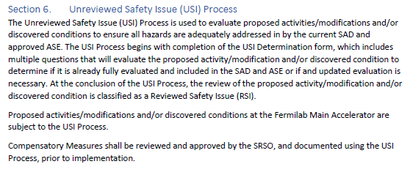
Alignment with FSO Expectations from 1/4/23 Letter
Updates to the ASE
Section 5 describes Configuration Management for Credited Controls for applicable accelerator
Section 6 describes implementation of Unreviewed Safety Issue (USI) Process for applicable accelerator
Removed references to internal procedures within the SAD/ASE
Excerpts from Section 5 and 6 of ASE VII-A.1
Addresses Comment/Issue #38
There was no reference to configuration management in the ASE and/or SAD's. This practice would prove useful (e.g., shielding set up, etc.).
Addresses Comment/Issue #39
Please clarify how the USI process is implemented when only an internal procedure is referenced in the SAD and/or ASE as the method to control a hazard and no specific details are documented.

Slide 30
Questions?

