Slide 1
Interfacial Width Analysis of Metal Capping Layers and Niobium in Superconducting Qubits
Ajeya Dixon
FRA-URA Women in STEM
August 3, 2023

Slide 2
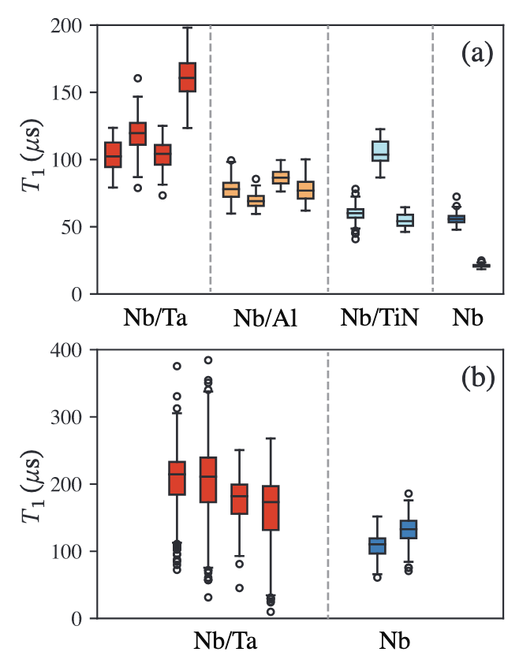
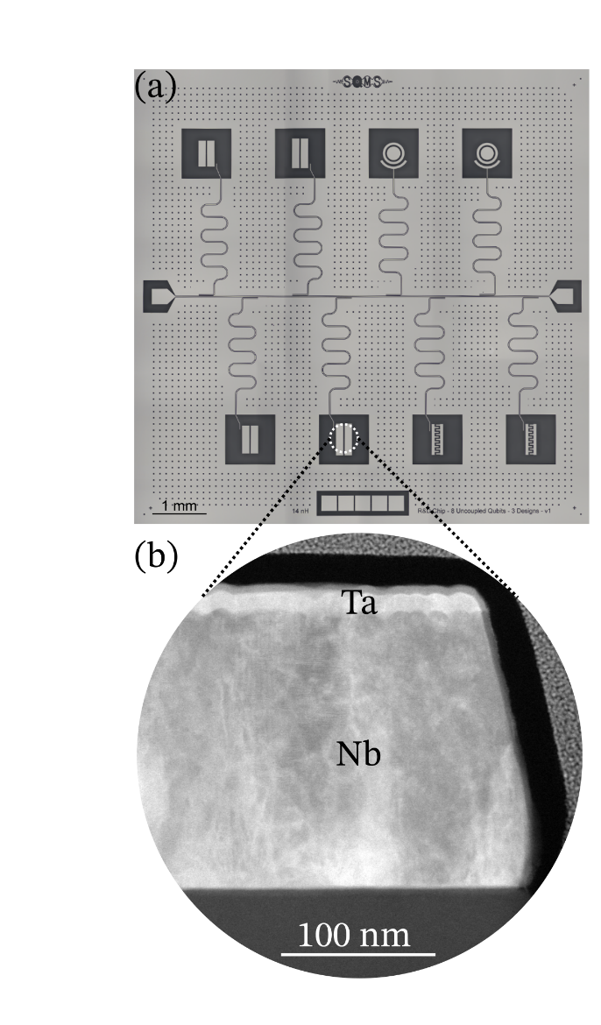
Improved Qubit Coherence Times With Surface Encapsulation
Recent improvements in qubit coherence times through the analysis of defects and impurities at the interfaces and surfaces of the device.
Reducing niobium oxides present on the device surface via metal encapsulation has led to a 2-5 times increase in coherence times.
M. Bal et al., 2023
M. Bal et al., 2023

Slide 3
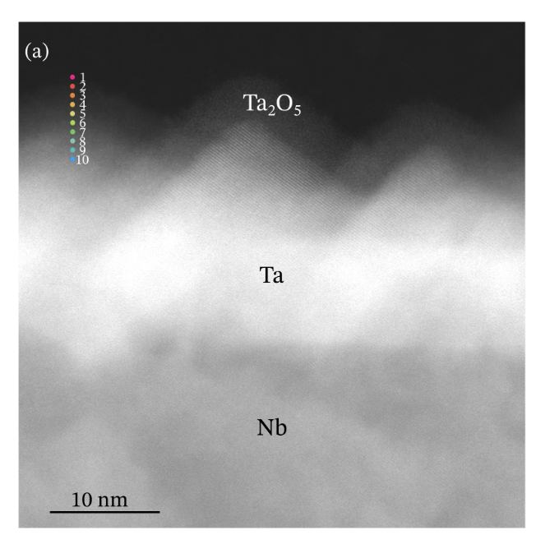
Key Questions
Oxide
Metal Cap
How can we identify intermixing (alloying) between the metal cap and niobium species
How will annealing a Ta/Nb sample at high temperatures (> 400°C) affect the interfacial width
Niobium
Silicon or Sapphire Substrate
Generalized schematic of a metal capped thin film
Intermixing
M. Bal et al., 2023

Slide 4
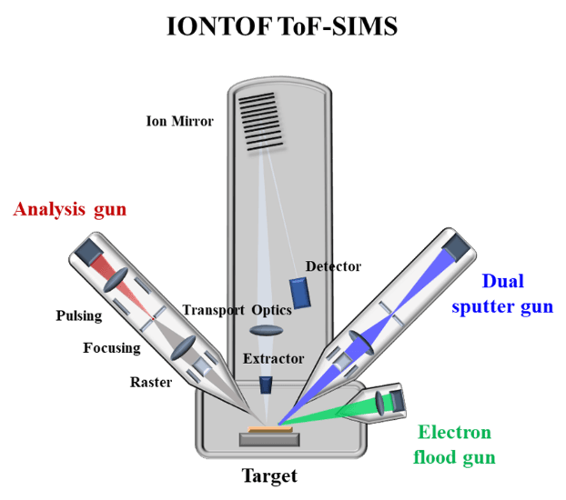
Secondary Ion Mass Spectrometry - Time of Flight
SIMS-ToF is an advanced technique that precisely detects and quantifies impurities and trace elements in materials through its sensitive mass spectrometry capabilities.
Key Elements:
  Analysis gun
  Dual sputter gun
  Detector
(Source: Tanguy Terlier, Ph.D., Rice University)

Slide 5
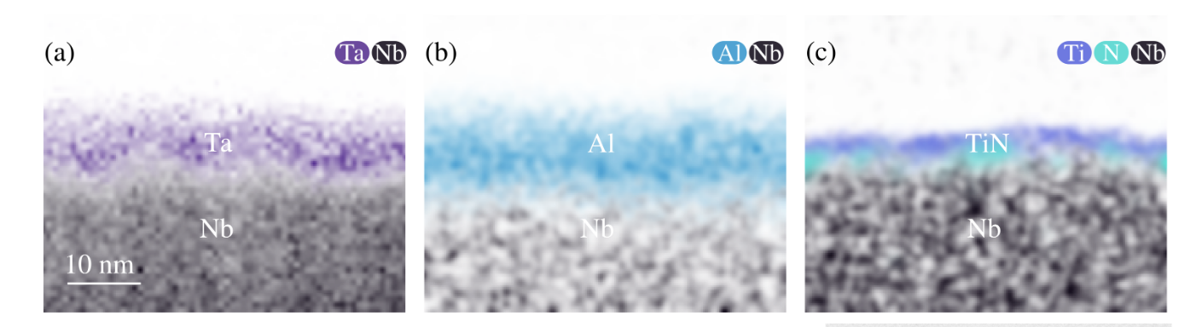
Interfacial Width of Different Metal Caps Overview
11 Pre-measured samples of niobium thin films encapsulated with different metals:
  Pt/Nb
  Al/Nb
  TiN/Nb
  Ta/Nb
  PdAu/Nb
  Au/Nb
M. Bal et al., 2023

Slide 6
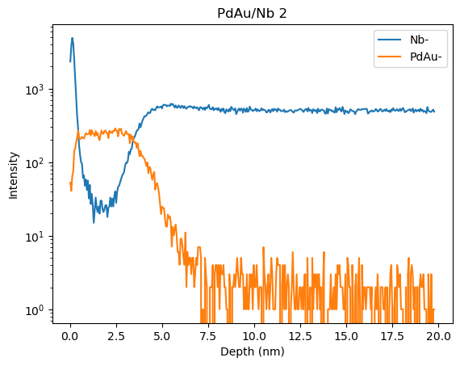
Analysis Procedure
90%
Interfacial Width
10%
SIMS-ToF spectra of a palladium and gold metal cap on a niobium thin film

Slide 7
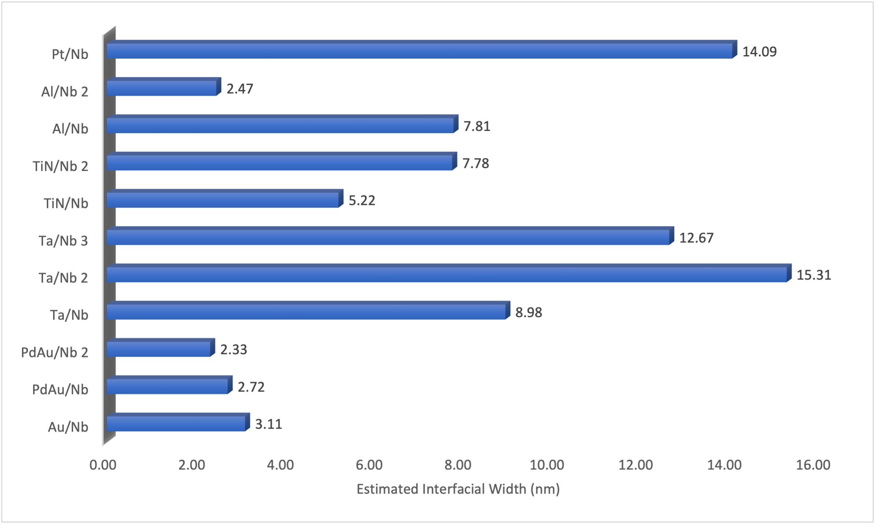
Interfacial Width of Different Metal Caps
Graphical representation of different metal cap interfacial widths

Slide 8
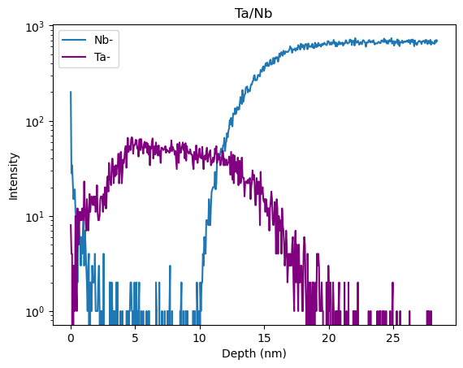
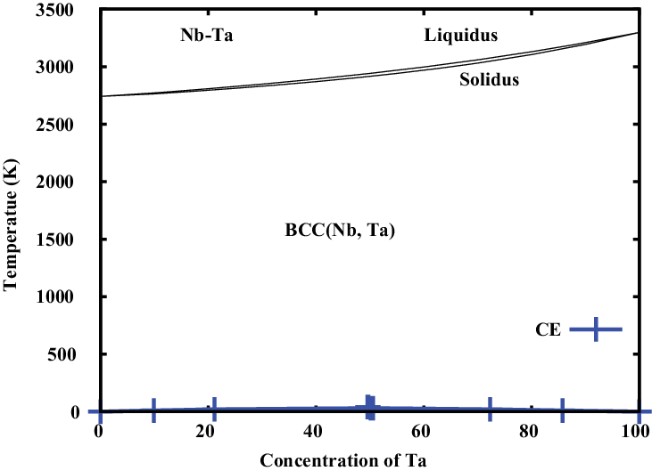
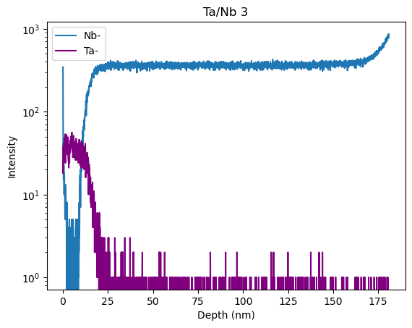
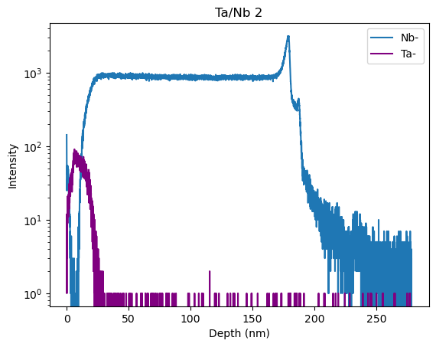
Interfacial Width Analysis of Tantalum Caps

Slide 9
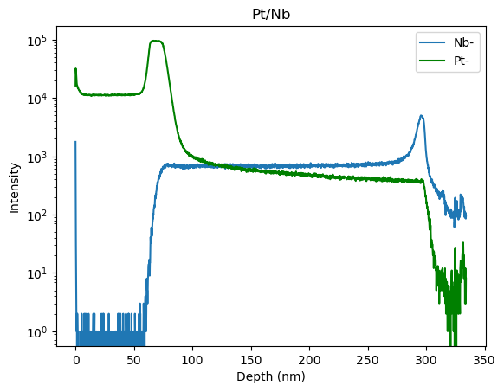
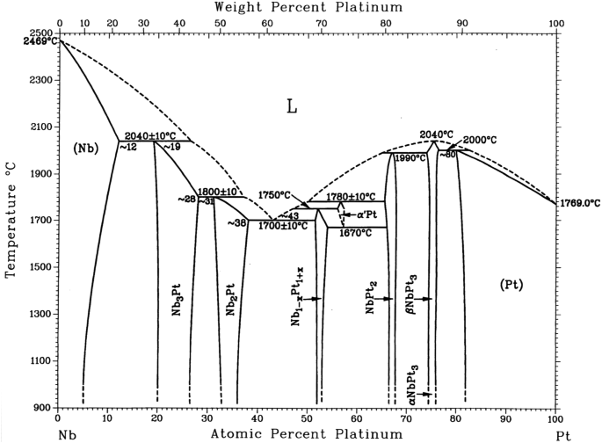
Interfacial Width Analysis of Platinum Cap

Slide 10
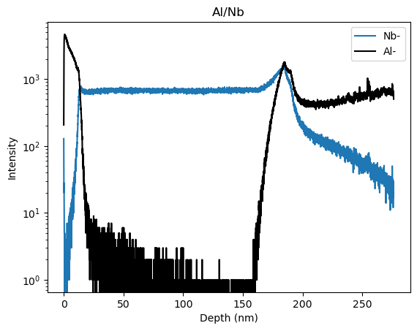
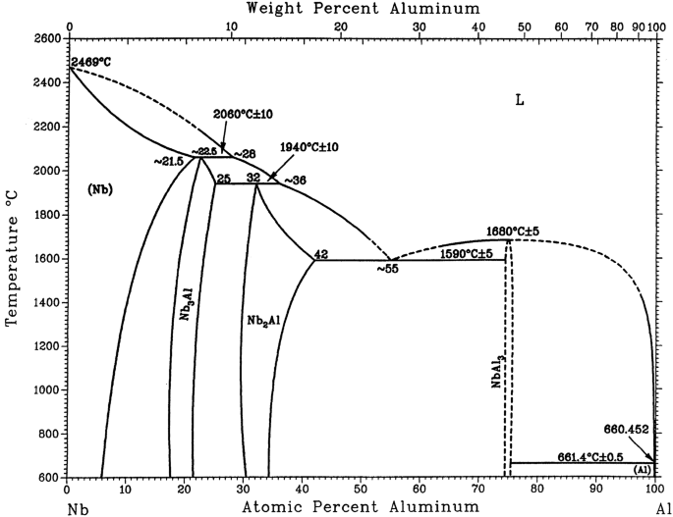
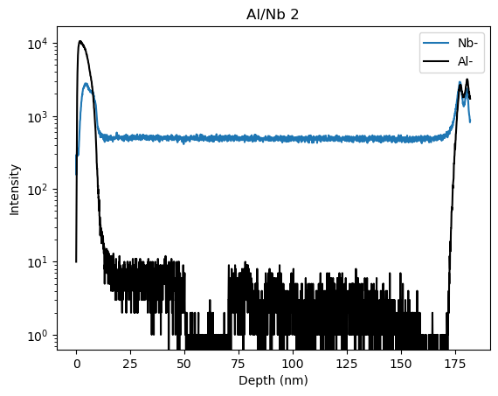
Interfacial Width of Aluminum Caps

Slide 11
Interfacial Width of Different Metal Caps Conclusion
We find that palladium and gold metal encapsulations have the least amount of alloying present on average.
More comprehensive analysis is needed to determine the cause of increased alloying in tantalum and platinum encapsulations.
Graphical representation of different metal cap interfacial widths

Slide 12
Interfacial Width of Annealed Tantalum Cap Overview
Sample: Nb thin film capped with Ta prepared on a Si substrate
Experiments (3 measurements for each)
  Reference (not annealed)
  400°C
  450°C
  500°C
  550°C
A roughly ~5nm TaOx is observed at the surface
(Source: Dr. Jae-Yel Lee, Fermilab)

Slide 13
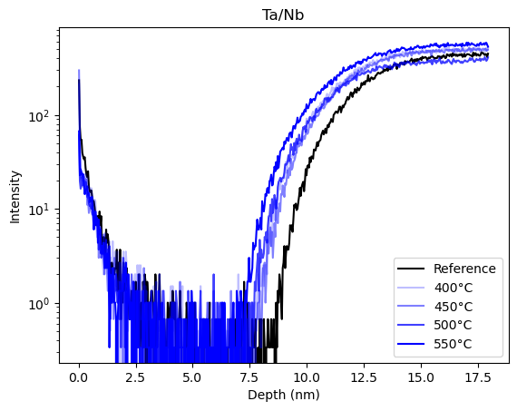
Interfacial Width of Annealed Tantalum Cap
Graphical representation of interfacial widths after 1hr anneal times
SIMS-ToF spectra of different anneal temperatures on a TaNb thin film

Slide 14
Interfacial Width of Annealed Tantalum Cap Conclusion
We find that the Ta/Nb interface is generally stable at 400°C.
Temperatures higher than 400°C present a higher presence of alloying between the niobium material and the metal cap.
Next Steps:
  Determine an improved method for analyzing interfacial widths between trials.
  Testing interfacial stability of other metal encapsulation layers with high temperature anneals.
Ta
Nb
Si
Typical columnar grain structure with 30-50 nm grain size
(Source: Dr. Jae-Yel Lee, Fermilab)

Slide 15
Acknowledgements
This manuscript has been authored by Fermi Research Alliance, LLC under Contract No. DE-AC02-07CH11359 with the U.S. Department of Energy, Office of Science, Office of High Energy Physics.
Dr. Akshay A. Murthy
Dr. Anna Grassellino
Maithilee Shinde
University Research Association

Slide 16
Questions?

