Slide 1
Streaming Infrastructure for Frequency Multiplexed Sensors
Sarah Marmolejos
Supervisor: Leandro Stefanazzi
URA – Women in STEM Final Presentation
3 August 2023

Slide 2
Microwave Kinetic Inductance Detectors (MKIDs)
When hit by a photon, superconducting properties change the Kinetic Inductance, resulting on a frequency shift of the resonator.
To use this device, an output sine wave tuned to the resonator frequency is sent, and it is read back to monitor phase changes.
Figure 1: resonator response with frequency shift (dashed line).
Notes:
Contains the multiplexed sensors, any of which can be excited by a photon.

Slide 3
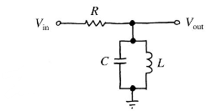
Electrical model of an MKID
Microwave Kinetic Inductance Detectors behave like resonator circuits.
High integration allows fitting hundreds or thousands of resonators on 2 GHz of bandwidth, which needs a complex system for readout and control.
Figure 2: Parallel resonator circuit, using an inductor (L), a capacitor (C), and a resistor (R).

Slide 4
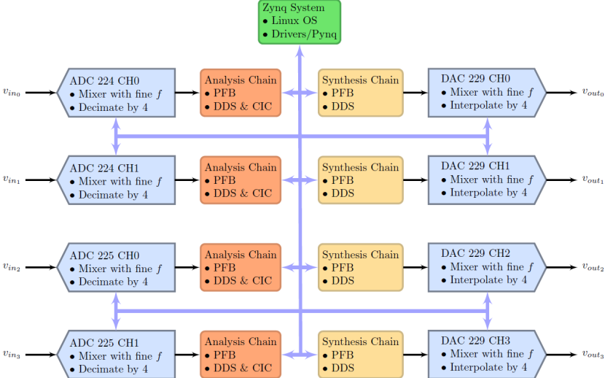
Control and readout of MKIDs
To excite and read MKIDs, Fermilab’s Quantum and Astrophysics Systems Department developed a firmware that is used to excite many different MKID’s using a single Radio Frequency Feed Line.
High logic integration allows for more than one independent feed line per FPGA chip.
This reduces overall system complexity for very high number of pixels (channels).
Figure 3: Firmware implementation with 4 independent RF feed-lines

Slide 5
Projects that benefit from RFSoC FPGAs
Many of the projects that utilize this firmware would benefit from having the ability to continuously stream data from an FPGA.
It could possibly impact the following:
Superconducting qubits
Squeezers Control
Quantum Networks
MKIDs
All these projects will require streaming data from the FPGA to the user with an Ethernet Network connection.

Slide 6
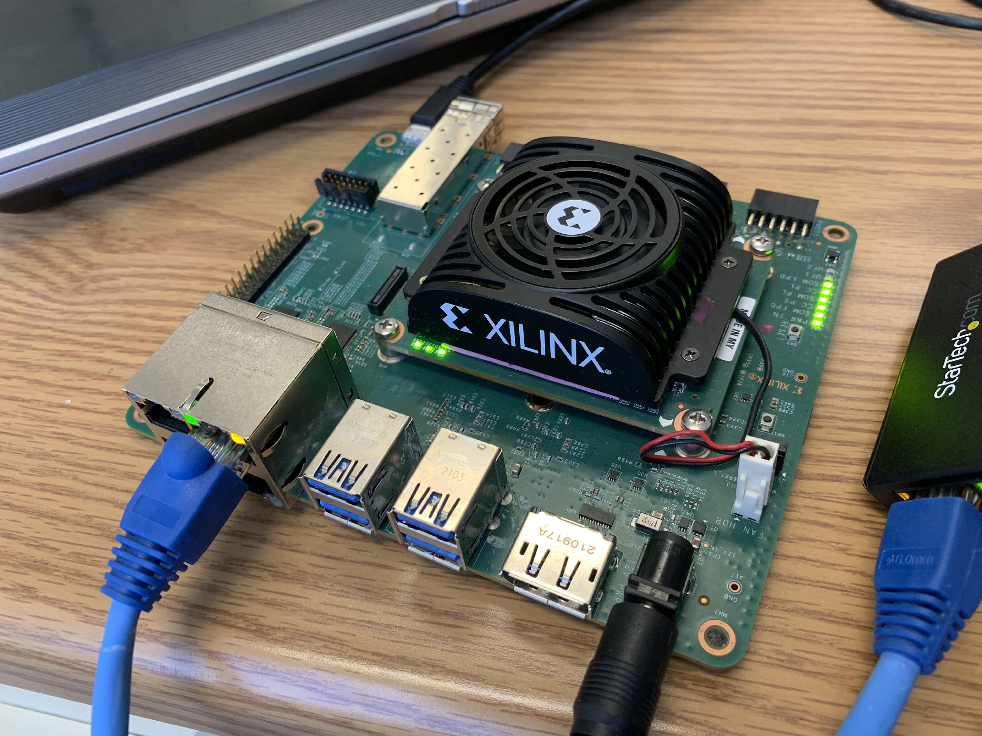
What is an FPGA?
Field Programmable Gate Arrays (FPGAs) are integrated circuits that have a programmable fabric made up of logic blocks.
Some can make use of higher-level programming by including additional interface functions and components.
Figure 4: Kria KR260 dev kit used for early development stages.

Slide 7
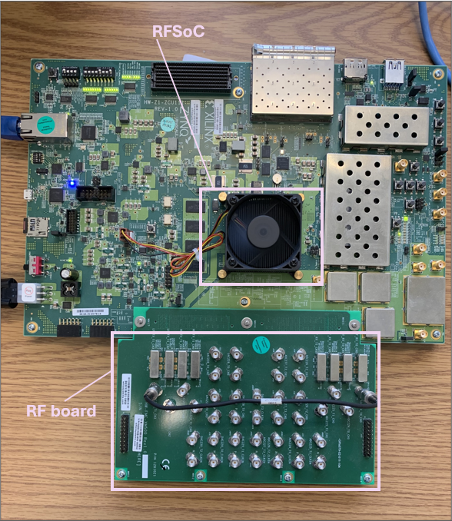
Advanced FPGA System
Modern FPGAs also include the Processing System, which is a multi-core system with DDR memory. A standard Operating System runs on this processing system.
Users can reload FPGA logic contents on the fly, unlocking a world of possibilities for system deployment.
Figure 5: The ZCU111 board is shown. Highlighted are the RFSoC (software, firmware, RF, and processor components) and the RF board. The RF blocks include the ADC (analog to digital), DAC (digital to analog), and digital output.

Slide 8
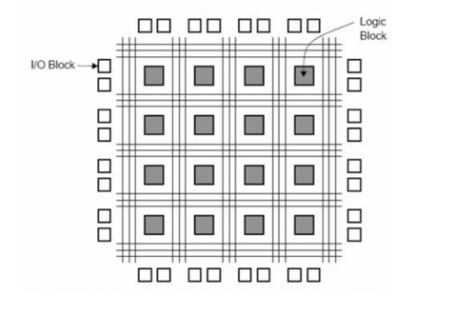
FPGA “fabric”
Logic blocks contain the following elements:
Flip Flops: smallest storage (1 bit) that can save the logic states of the FPGA.
Multiplexers: circuits that choose between multiple inputs, but returns the one that was selected
Look up Tables (LUT): arrays that store information, rather than performing calculations.
All of which are made up of logic gates.
Figure 7: Logic gates are devices that take two elements as inputs to produce a single output. Shown above are some of the most common logic gates.
Figure 6: The diagram shows a basic layout for the lower level programming of an FPGA [2] .

Slide 9
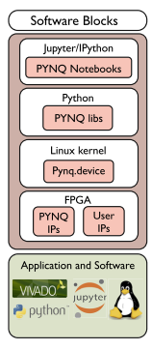
High Level Programming
Figure 8: display of the software used in this project.
This project mostly involved the use of higher-level programming of the FPGA using a Jupyter notebooks environment, and the ubuntu linux operating system.
The FPGA is able to run a full linux OS, while providing a high abstraction through the use of Python for user development.

Slide 10
Choosing the right transport protocol
UDP
TCP
Figure 9: User Datagram Protocol (UDP) is a type of communication protocol that doesn’t require any handshaking when transferring data. After an initial request is received, a device will continuously send information.
Figure 10: TCP (Transmission Control Protocol) communication consists of three steps in its handshaking process. First, it establishes a connection (SYN). Then another device synchronizes and acknowledges the message (SYN-ACK). Finally, this device sends the acknowledgement back (ACK).

Slide 11
Networking made easy: Pyro
Pyro is a python library that allows objects to interact over a server.
Unique to pyro is the Name Server, a tool that allows us to keep track of objects by using a logical name rather than an ID or location.
Using Pyro networking tasks become simple. User code can easily make use of this library for transporting data over the network.

Slide 12
Block diagram of the full system
PC
ZCU111
Processing System
Pyro (client)
Linux OS (Pyro Server)
Counter
Streamer
DMA
Figure 11: Block diagram showing the connections between different components. The PC has an ethernet connection with the ZCU111 board, and acts as the client. The ZCU111 utilizes the firmware a counter, streamer, and DMA (direct memory access) hardware blocks.

Slide 13
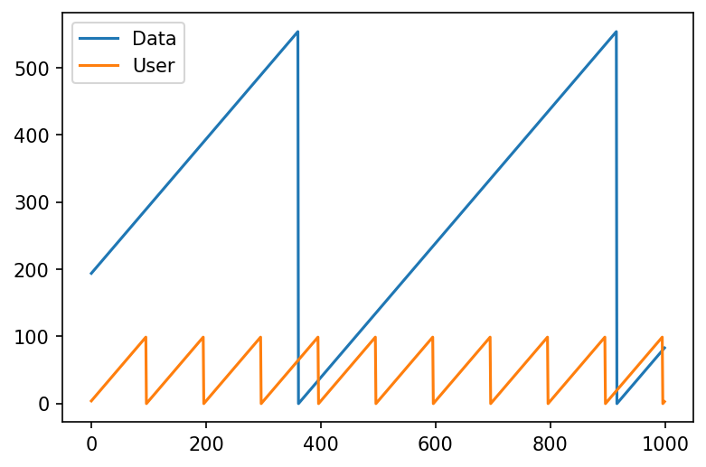
Data generation on board
System validation was done by simulating data using a simple counter block.
The streamer allows to ship data over the network for further processing.
A final experiment will differ only on the source of the data.
Figure 12: This plot was obtained after programming the ZCU111 to produce data. The board is plotting points from the counter, which resets to zero after reaching a set limit. The plot shows two counters, with limits of 500 and 100.
Notes:
This is the test we were expecting to perform within an experiment environment, the environment being the project setup that is on the board.

Slide 14
Summary
MKIDs
FPGA structure
UDP and TCP
Pyro library
Acknowledgements
I would like to thank my supervisor Leandro Stefanazzi, Sho Uemura, and my mentor Margaret Votava for their support and guidance throughout this project and the internship.

Slide 15
References
[1] L. Stefanazzi et al., “The QICK (Quantum Instrumentation Control Kit): Readout and control for qubits and detectors,” Review of Scientific Instruments, vol. 93, no. 4, p. 044709, Apr. 2022, doi: 10.1063/5.0076249.
[2] A.O. El-Rayis et al., “Reconfigurable architectures for the next generation of mobile device telecommunications systems, ” Nov. 2014.
[3] “http://web.physics.ucsb.edu/~bmazin/public_html/mkids.html,” web.physics.ucsb.edu. https://web.physics.ucsb.edu/~bmazin/mkids.html
[4] “Pyro - Python Remote Objects - 4.82 — Pyro 4.82 documentation,” pyro4.readthedocs.io. https://pyro4.readthedocs.io/en/stable/ (accessed Aug. 02, 2023).
‌

