Slide 1
Eliminating Bottlenecks in General Plant Projects Processes: Improving Documentation Flow
Loaiza Giovanska Medina Pérez
Supervisor: Mark Jeffers
URA: Undergraduate Women in STEM
3 August 2023

Slide 2
The Benefits of Successful Projects for Fermilab
A project that is successfully carried out without delays and has multiple benefits for an organization like Fermilab:
Credibility and reputation: A well-executed project reflects effective management by Fermilab. This enhances its credibility and reputation within the U.S. Congress and the HEP community.
Access to future funding: The success of a project and the demonstration of good management can open doors for future Congressional funding requests. When resources are sought for improvements and advancements, having a track record of meeting milestones and deliverables significantly improves the chances for continuing Congressional funding support.
Cost accuracy: Meeting the project's schedule and scope helps keep costs under control. Being off by factors of two to three has large consequences. Delays and changes in scope often lead to increased expenses, which can negatively impact the project’s value and viability.

Slide 3
Infrastructure Service Division (ISD)
ISD Overview
Purpose
Efficiently manage real and personal property assets for Fermilab operations.
Real Property
Planning, designing, constructing, renovating, and disposing of real property.
Operating, maintaining, repairing, and surveilling real property assets.
Overseeing real property data development, maintenance, and reporting, including data validation coordination.
Providing dedicated staff for Fermilab's real property data as the main point of contact internally and externally.
Personal Property
Managing Fermilab personal property from acquisition to disposition.
Ensuring efficient utilization and inventory control.
Handling loan documentation, reuse, and disposal processes.
Focus of this project is on the processes around the planning, design , and construction of real property

Slide 4
Construction Process Overview
The general process for construction of a new asset follows the general format of planning the project, designing the asset, physical construction activities, and then turning over the new asset to operations.
Specific requirements of the process are determined by the cost and complexity of the project. In general, the process falls into four major categories:
413 Projects
Established processes identified from DOE O 413
Tailored 413 Projects
Capital Minor Construction Projects (e.g., General Plant Projects)
Costs between $500k and $25M
Costs > $50M
Costs between $25M and $50M
Tailored processes identified from DOE O 413
Non-capital Improvement Projects
Further tailored processes identified from DOE O 413
Costs < $500k
The most simplified processes tailored from DOE O 413
Focus of this Project: GPP Processes

Slide 5
General Plant Projects
GPP Overview
Managed by the Head of the Engineering Department within the Infrastructure Services Division (ISD).
These projects provide for design, construction, additions and/or improvements to land, buildings, and utility systems.
Essential to adapt facilities to new or improved production techniques, achieve operational efficiencies, and address health, fire, and security concerns.
Goal is to execute the entire project from design through construction within two-three years.
The focus of this study is to identify any bottlenecks within the processes for executing GPPs at Fermilab, specifically focusing on internal processes to initiate the projects.
Methodology used was to review current procedures, interview staff members involved in the processes (e.g., project team members, program manager, procurement and financial staff), map out the process, and identify potential bottlenecks.

Slide 6
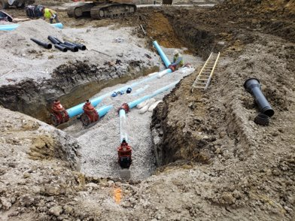
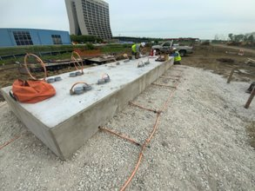
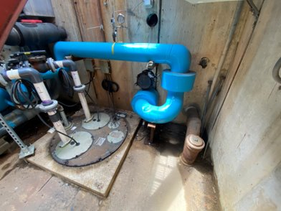
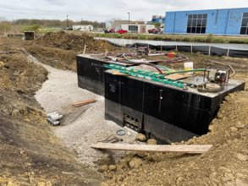
GPP Examples
GPP – Accelerator Campus Utility Corridor​
GPP – Accelerator Campus Master Substation Feeder​

Slide 7
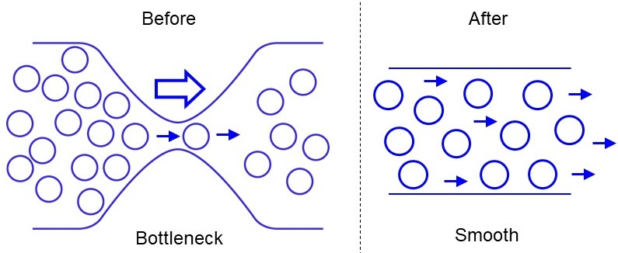
Bottleneck
It is a restriction or congestion point in a process.
It represents a stage or resource that limits the production capacity of the system.
It causes delays and accumulation of work in the workflow.
It is a factor that negatively affects the efficiency of the process.
It can be caused by various factors, such as lack of resources, inefficient communication, or unclear procedures.

Slide 8
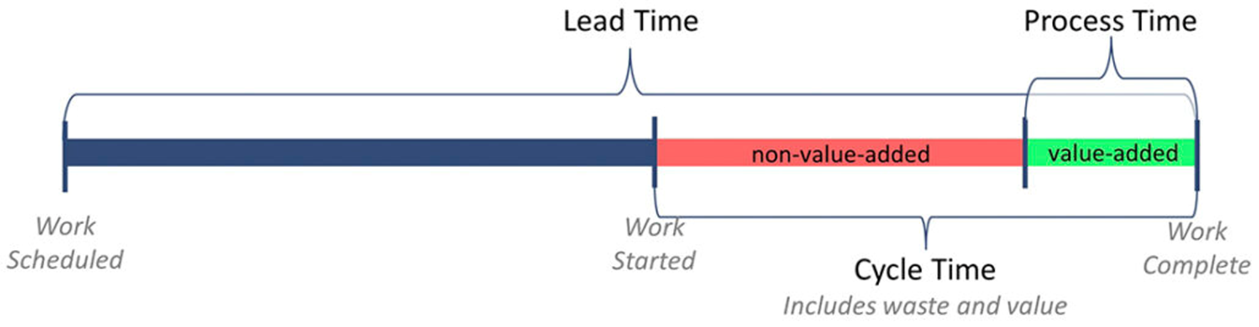
Methodology: Lead Time
It measures the time from the scheduling to the completion of a task, revealing efficiency and productivity.
It enables organizations to improve planning and decision-making for faster and more effective execution of activities.
Companies can identify areas of improvement in their processes and optimize resource allocation based on lead time analysis.

Slide 9
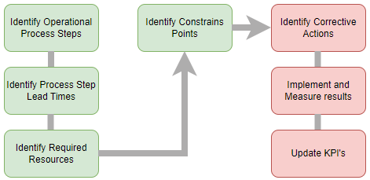
Methodology: Lead Time
Analysis

Slide 10
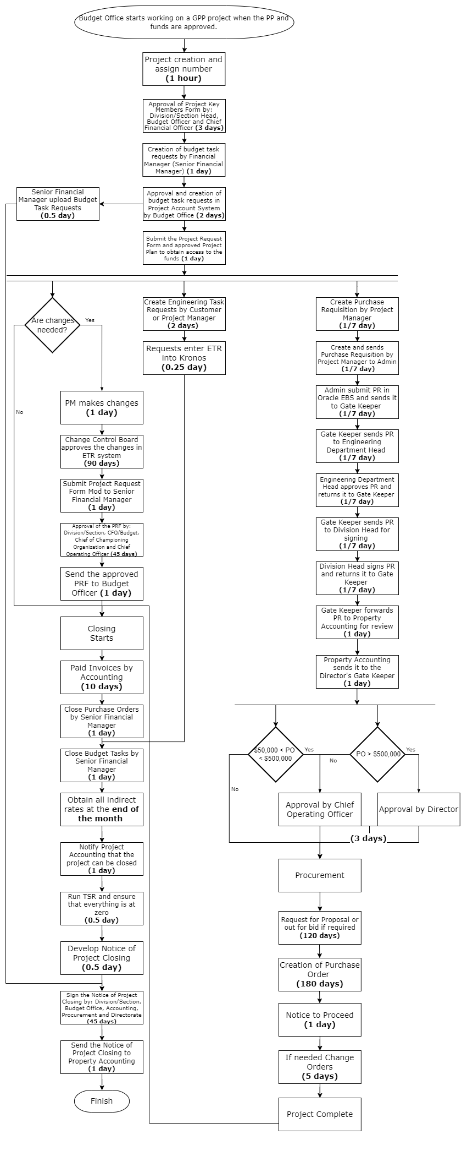
Visualizing GPP Processes Through a Flowchart

Slide 11
Methodology: Lead Time
Data

Slide 12
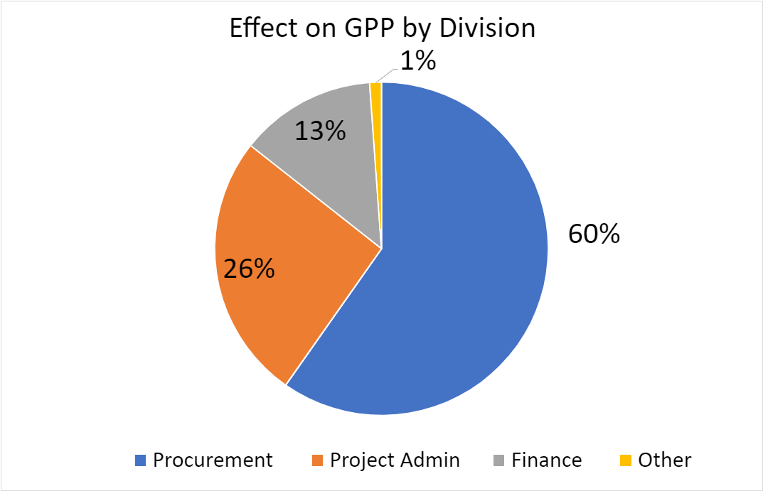
Results
The Procurement area accounts for 60% of the total time spent in the GPP document flow, despite handling only 18% of the total documentation.
The Finance area manages 53% of the total tasks and documents in the process but occupies only 13% of the total time in the documentation process.
Conducting a thorough analysis is crucial to understand the complexity of Procurement tasks and improve its processes, as they are the main contributors to GPP delays.

Slide 13
Conclusion and Future Work
Conclusion
Procurement area consumes 60% of the total time in documentation, approvals, and tasks in GPP projects, while Project Administrator manages 26%, and Finance handles 13%.
Future Work
Comprehensive investigation needed to identify factors impacting Procurement and Project Administrator divisions to provide recommendations for improving lead time.
Evaluation of human and technological resources to ensure efficient allocation.
Identification of internal and external obstacles affecting lead time.
Surveys, team feedback, and benchmarking to gather relevant insights.
Development of concrete recommendations and an action plan to improve efficiency in the Procurement and Project Administrator divisions.

Slide 14
Future Recommendations
Establish clear and efficient workflows for document review and approval, ensuring that tasks are assigned to the appropriate individuals and reasonable deadlines are set.
Provide training to the staff involved in the documentation flow, ensuring they are familiar with the procedures and tools used, which will enhance their efficiency and accuracy.
Promote a culture of open and collaborative communication throughout the organization, enabling quick resolution of any issues or questions related to documentation and avoiding unnecessary delays.
Conduct regular reviews of the documentation process to identify areas for improvement and adjust procedures as needed to optimize efficiency.

Slide 15
Thank You!

