Slide 1
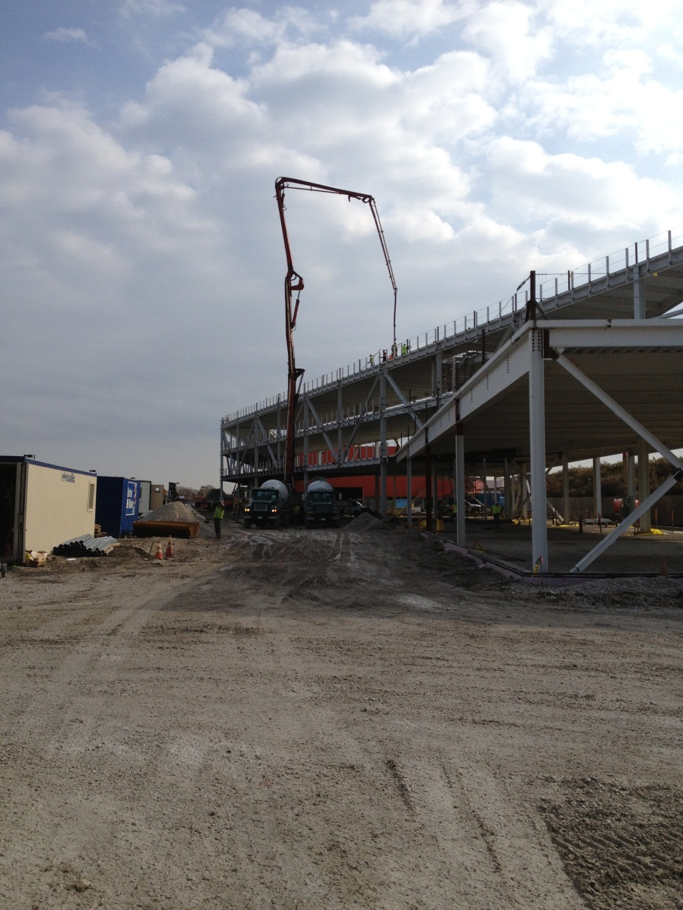
OTE Building PMG Report October 25, 2012 Rhonda Merchut

Slide 2
Agenda
Coordination
OTE Building Project State Activities
Fiscal & Schedule
Summary Action Items

Slide 3
IASU Update
Phase 1 has been complete.
CDF Coordination
OTE work on east side general assembly is complete & returned to CDF use.
West ramp remains closed
CDF roof reinforcing continues
OTE/CDF Bridge prep work underway

Slide 4
CDF Refurbishment
Project scope development underway
Priorities:
Building fire and life safety
Building Use to remain as science. No expansion of tours.
Update per Code required.
End of life equipment to be replaced
Regulatory compliance:
ADA,
Guiding principles
Building systems & infrastructure:
replacement vs repair evaluation underway
upgrade

Slide 7
(loaded)

Slide 10
OTE Project Status:
Schedule analysis, reporting, and cost curve continues.
Shop drawing review well underway. Approx 60% through anticipated 800+ submittals.
Subcontractor’s BIM model developed for coordination. Extensive coordination required.
Safety procedures continue to be expanded as more subs come onto the project.

Slide 11
OTE Project Status:
LEED procedures & Action Plan implemented.
91% construction waste has been recycled.
On track to meet goal of 20% (by cost) of regionally manufactured materials.
On track to meet goal of 20% (by cost) of recycled content in materials used.

Slide 12
OTE Building Construction Status:
Sub structure complete (SOG underway)
Under-slab utilities underway
Superstructure nearing completion
West decks poured
Slab pours for east side on-going
Interior CDF steel underway
Detailing perimeter vertical structural steel tubing underway
Transformer & Switchboard rec’d

Slide 13
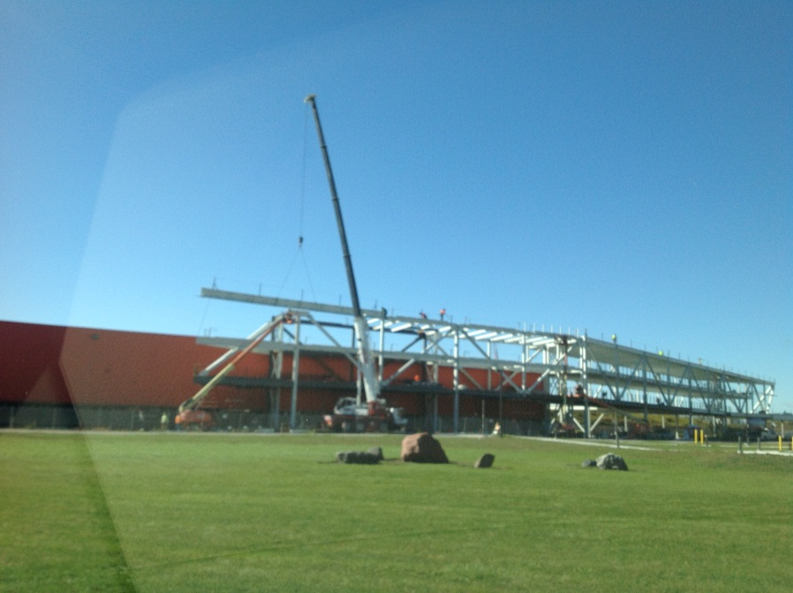
Super structure

Slide 14
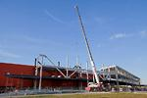
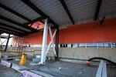
At CDF

Slide 15
Cantilever at CDF

Slide 16
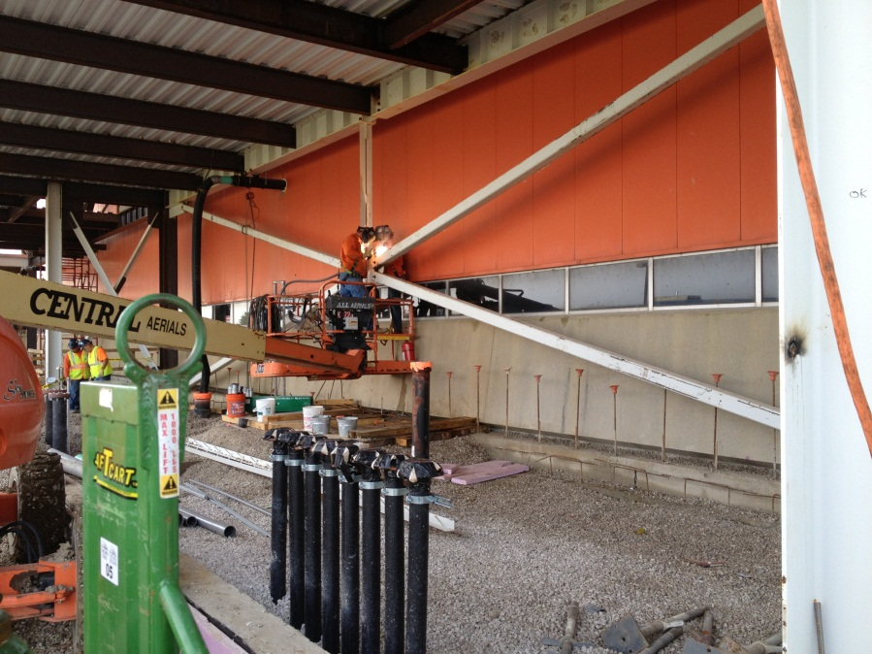
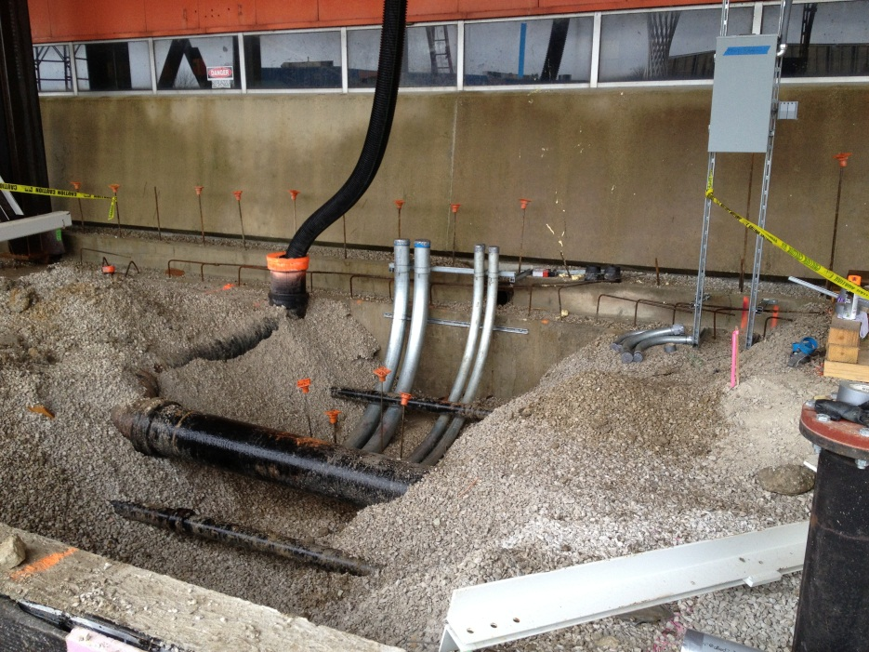
Utilities

Slide 17
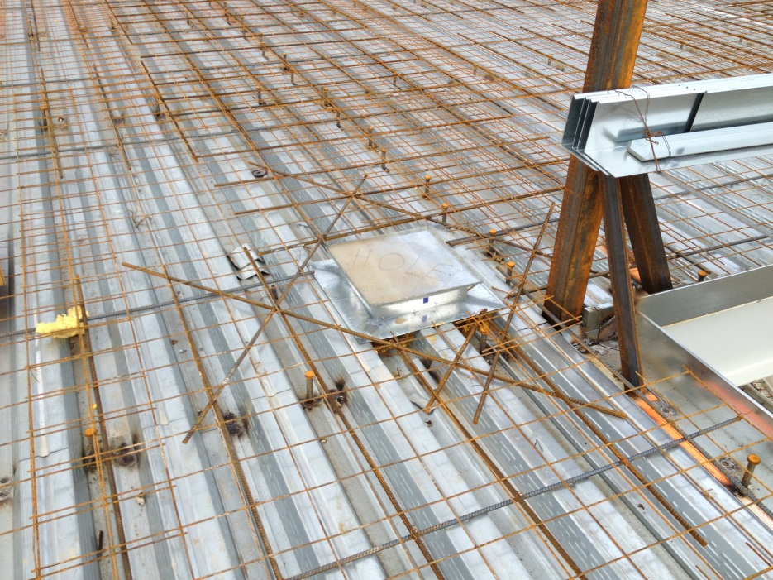
Deck

Slide 18
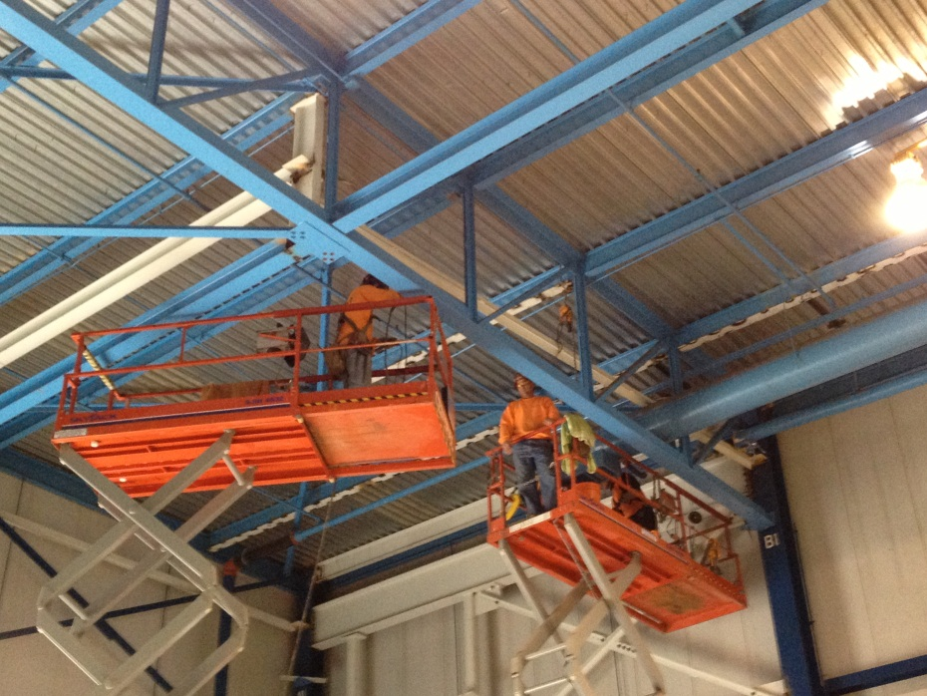
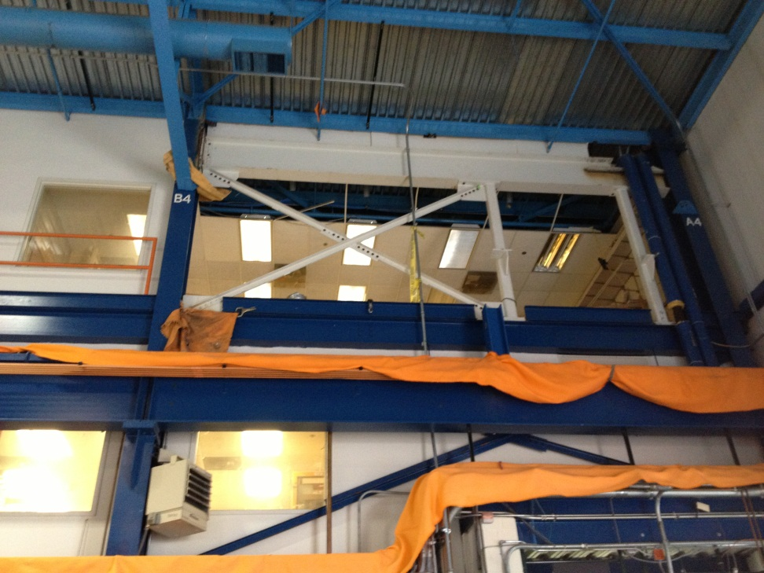
Inside CDF

Slide 19
Two Week Look Ahead
Prep and Pour west slab on grade (except polished concrete areas)
Begin interior MEP ceiling rough-in
Continue vertical steel tube work
Pour east decks

Slide 20
State DCEO Activities
DCEO line item budget revised based on Barton Malow schedule of values & revised burdens
Budget Modification Request approved 10/22/12

Slide 21
Schedule

Slide 22
Schedule

Slide 23
Schedule Adjustments
8 additional days for underground work (SA05)
Anticipated 10 additional days for deck penetration changes. (EC 049)
Anticipated revised MS 3, Project Complete: 12/10/13

Slide 24
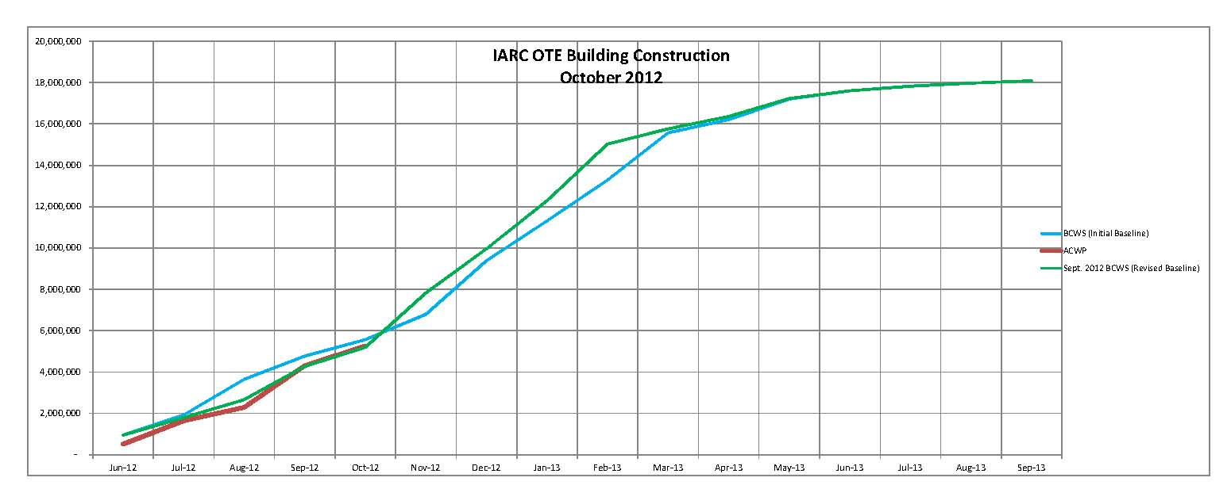
BCWS & ACWP Cost Curve
29% costed
30% time

Slide 25
Unaligned Activities

Slide 26
Change Order Tracking
Continue to maintain Change Order Log.
60 identified EC’s = +$119K
Existing Conditions, A/E omissions, value engineering are the primary categories
Discipline coordination remains a challenge
145 RFI’s to date
PA working diligently with BMC to insure timely submissions of Modification Requests

Slide 27
PP Tracking Milestones

Slide 28
Contingency Management
Sources available to fund change orders:
IGPP;
De-scope from anticipated T&M work;
ALL T&M has been cancelled:
Service Screen Wall, Bike path realignment, native prairie garden, Art & Science Window Film
De-scope from A/E support work;
DOE backstop – Subject to FY 13 funding;
De-scope from main construction work (will not recover all funds);
Value engineering main construction work

Slide 29
Contingency Opportunities status:
Change CMU 2-hour wall to Gyp Board 2-hour wall
Mechanical modifications
Glazing Type changes
To date $170K in savings

Slide 30
Summary Action Items
Obtain Status of block pivoter.
Obtain final decision on CDF tours. No public Tours
Obtain samples for polished concrete floor. Aggregate has been selected. EC must be issued.
Continue overarching IARC development: Outfitting needs , costs, and schedule including VoIP, CDF refurbishment scope. Coordinate Lecture Hall furnishings with under slab electrical placement. Under slab electrical finalized.
Continue contingency opportunities identification.
Submit to DCEO revised line item budget. Approval rec’d
Continue cost loaded schedule evaluation & cost curve analysis with Subcontractor.
Continue shop drawing & change order review, RFI responses
Continue construction coordination & oversight.
Next PMG re: Thanksgiving & Christmas?

