Slide 1
Efforts Toward
In-storage Processing of Astronomical Images using FPGAs
Semih Kacmaz , Fermi National Accelerator Laboratory
August 11, 2023

Slide 2
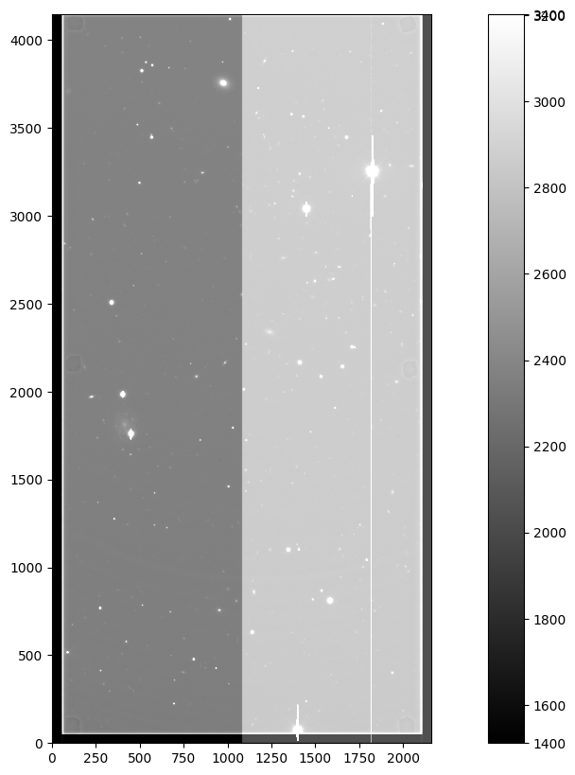
Science Image and Objectives
Raw science image is in 4146 x 2140. We see a sample image obtained as part of the Dark Energy Survey data.
Two amplifiers and several correction regions
The actual image data is contained between pixels [50: , 56:2104] — i.e. it has 4K resolution.
Our objective is to replicate a portion of the Dark Energy Survey’s pre-processing pipeline on several levels
We eventually aim to implement all those steps in FPGAs which can potentially accelerate the pipeline processing timeline by several orders of magnitude.
The accelerated pipeline performance is expected to be directly useful in supernova detection and GW astronomy.
Ideal scenario: our efforts become a part of the Rubin observatory prompt pre-processing pipeline
Semih Kacmaz | Efforts Toward In-Storage Processing of Astronomical Images Using FPGAs

Slide 3
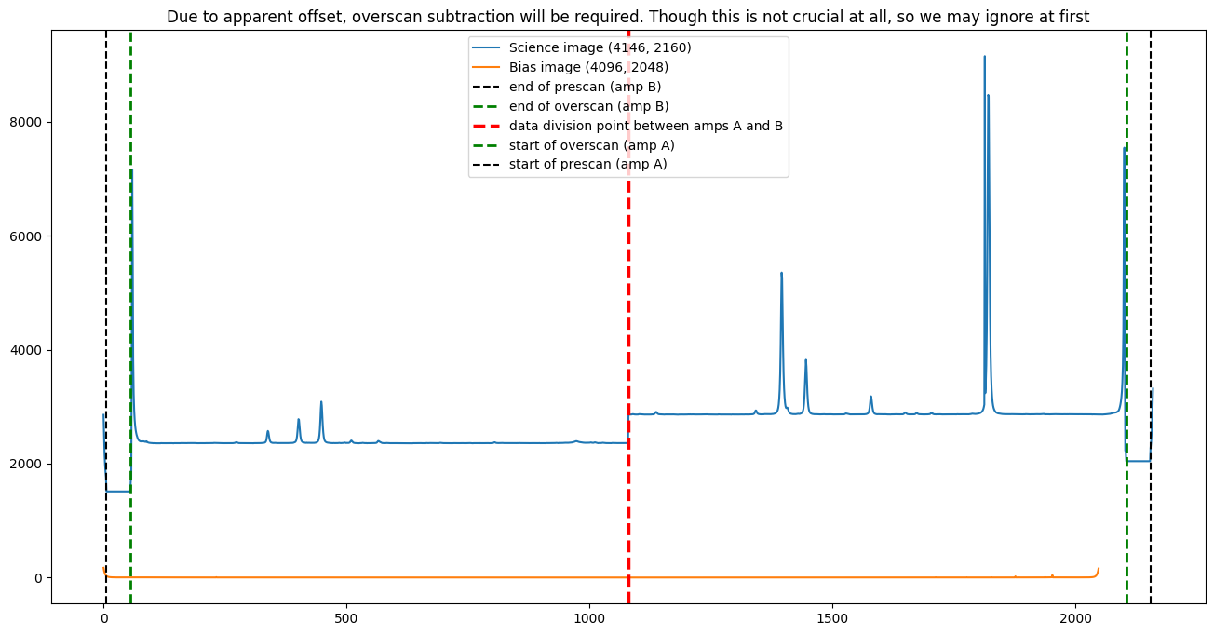
Science Image
Amp B
Amp A
Science Image (left) and Its Row-Averaged Distribution (right)
Semih Kacmaz | Efforts Toward In-Storage Processing of Astronomical Images Using FPGAs

Slide 4
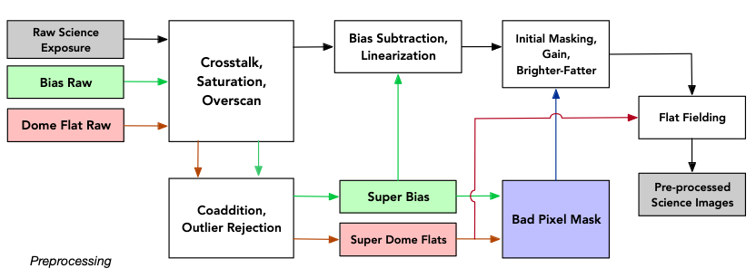
DES Preprocessing Pipeline
Schematic Illustrating the DES Preprocessing Pipeline
Adapted from Morganson et al., The Dark Energy Image Processing Pipeline Preprint Draft Version, 2018, https://arxiv.org/pdf/1801.03177.pdf
Semih Kacmaz | Efforts Toward In-Storage Processing of Astronomical Images Using FPGAs

Slide 5
DES Preprocessing Pipeline
Schematic Illustrating the DES Preprocessing Pipeline
Adapted from Morganson et al., The Dark Energy Image Processing Pipeline Preprint Draft Version, 2018, https://arxiv.org/pdf/1801.03177.pdf
Semih Kacmaz | Efforts Toward In-Storage Processing of Astronomical Images Using FPGAs

Slide 6
DES Preprocessing Pipeline
Schematic Illustrating the DES Preprocessing Pipeline
Adapted from Morganson et al., The Dark Energy Image Processing Pipeline Preprint Draft Version, 2018, https://arxiv.org/pdf/1801.03177.pdf
Semih Kacmaz | Efforts Toward In-Storage Processing of Astronomical Images Using FPGAs

Slide 7
DES Preprocessing Pipeline
Schematic Illustrating the DES Preprocessing Pipeline
Adapted from Morganson et al., The Dark Energy Image Processing Pipeline Preprint Draft Version, 2018, https://arxiv.org/pdf/1801.03177.pdf
Semih Kacmaz | Efforts Toward In-Storage Processing of Astronomical Images Using FPGAs

Slide 8
DES Preprocessing Pipeline
Schematic Illustrating the DES Preprocessing Pipeline
Adapted from Morganson et al., The Dark Energy Image Processing Pipeline Preprint Draft Version, 2018, https://arxiv.org/pdf/1801.03177.pdf
Semih Kacmaz | Efforts Toward In-Storage Processing of Astronomical Images Using FPGAs

Slide 9
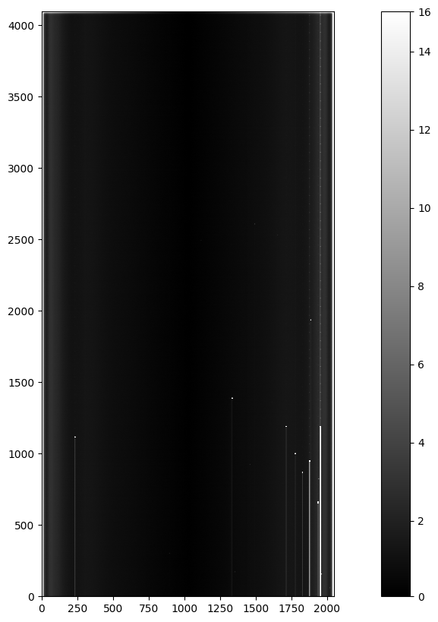
Bias Image
Bias: Positive DC Offset applied to all pixels
A picture taken with shutter closed and no exposure time
Ideally would be the same for each pixel but in practice there are slight variations.
Often numerous bias calibration pictures are taken and a combined median or averaged master bias is used (The case here).
This combination reduces the noise.
Dark current and hot pixels are eliminated with clipping and masking in the original pipeline
We are ignoring these operations for simplicity
Bias Image
Semih Kacmaz | Efforts Toward In-Storage Processing of Astronomical Images Using FPGAs

Slide 10
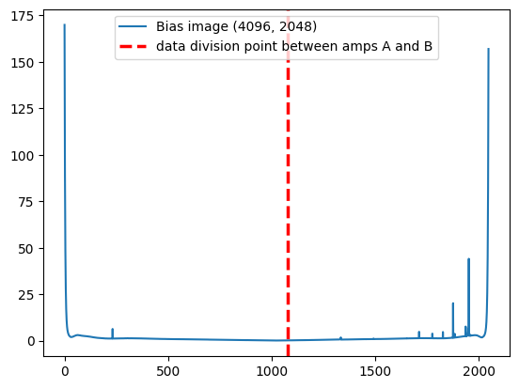
Bias Image
Bias Image
Row-Averaged Cross Section of the Bias Image
Semih Kacmaz | Efforts Toward In-Storage Processing of Astronomical Images Using FPGAs

Slide 11
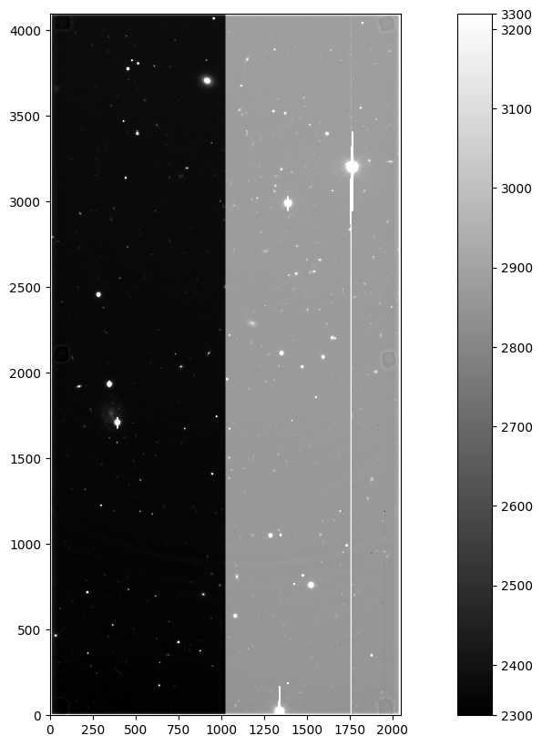
Bias Calibration (No Overscan Subtraction)
Raw Science Image
Bias Calibrated Science Image w/o OS
Semih Kacmaz | Efforts Toward In-Storage Processing of Astronomical Images Using FPGAs

Slide 12
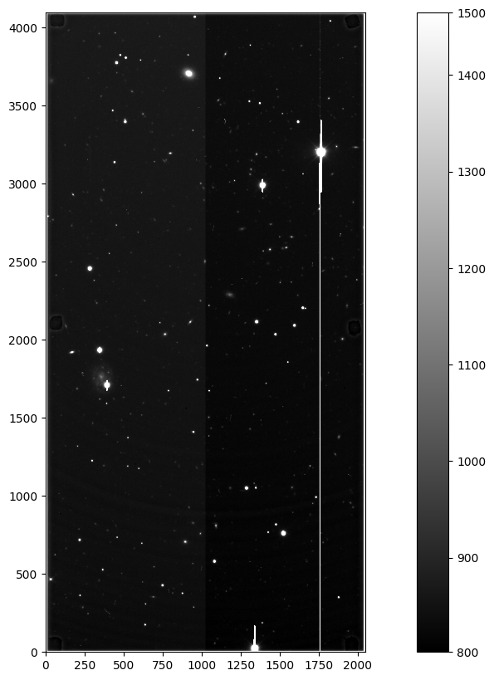
Bias Calibration (With Overscan Subtraction)
Raw Science Image
Bias Calibrated Science Image with OS
Semih Kacmaz | Efforts Toward In-Storage Processing of Astronomical Images Using FPGAs

Slide 13
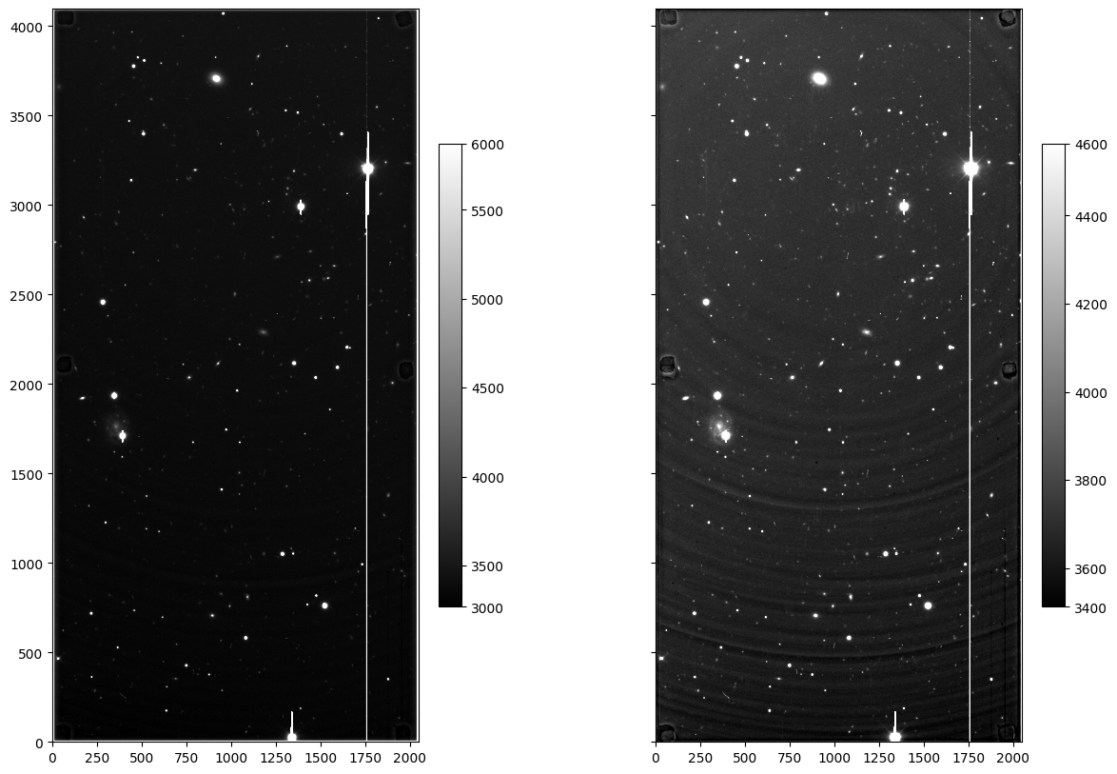
Gain, Nonlinearity, and Flat Corrections
Gain correction: Rescaling both the regions based on the gain of amps A and B.
In practice, this is a unit conversion from e- / ADU to e-
Nonlinearity correction refers to the correction of the nonlinear behavior of each CCD.
It is achieved by performing a simple interpolation utilizing a pre-calculated look-up table.
Flat-field corrections compensate non-uniformity of the CCD response to light
Potential non-uniformity sources are: pixel sensitivity, dust etc.
Flat-field calibration images are practically photographs of the dome in our specific case
Bias + Overscan + Gain + Nonlinearity Corrected Science Image
Bias + Overscan + Gain + Nonlinearity + Flat-field
Corrected Science Image
Semih Kacmaz | Efforts Toward In-Storage Processing of Astronomical Images Using FPGAs

Slide 14
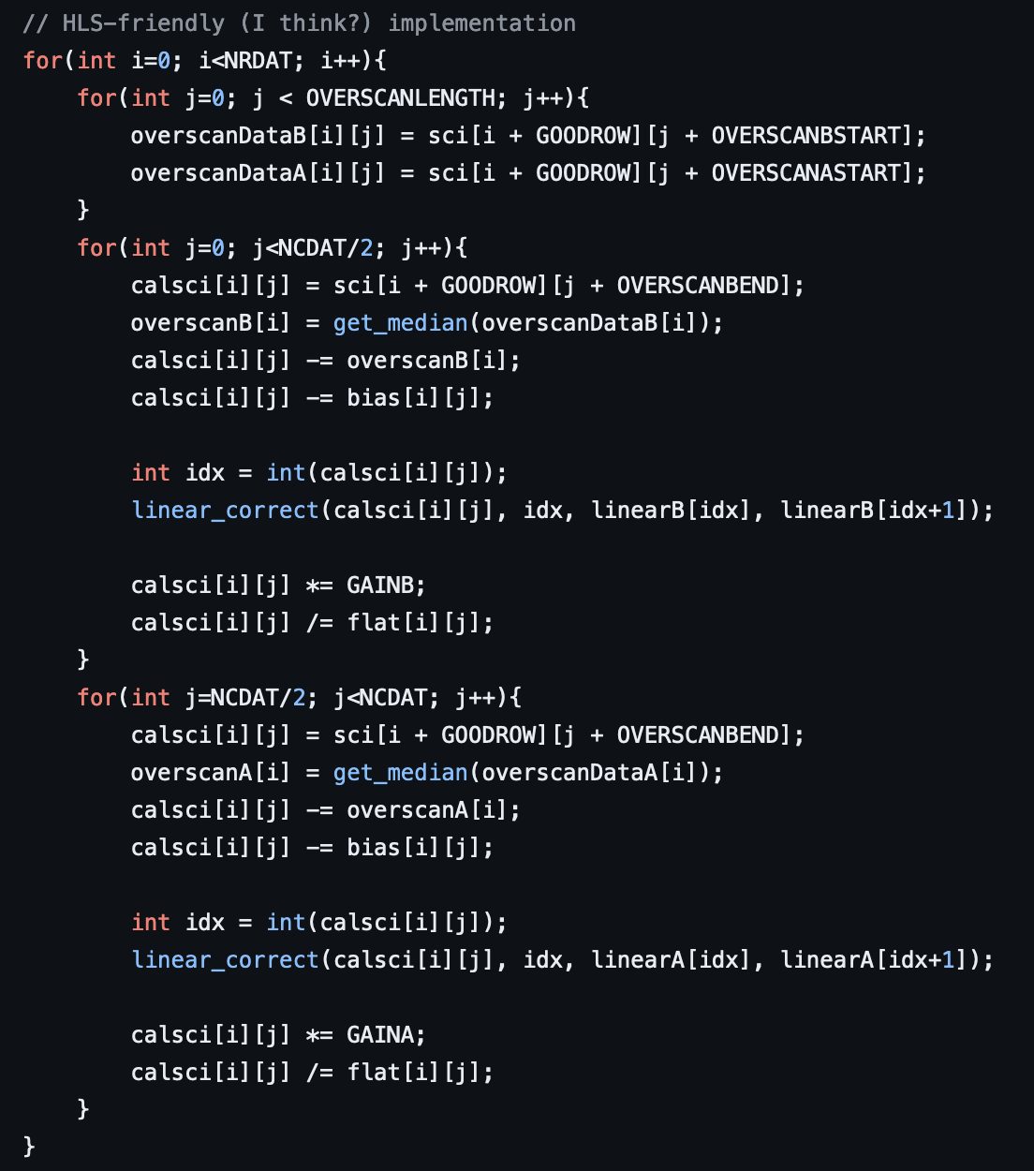
C++ Implementation for Testing
Semih Kacmaz | Efforts Toward In-Storage Processing of Astronomical Images Using FPGAs

Slide 15
C++ Implementation for Testing
Overscan Extraction
Amp B
Amp A
Semih Kacmaz | Efforts Toward In-Storage Processing of Astronomical Images Using FPGAs

Slide 16
C++ Implementation for Testing
Overscan Extraction
}
Overscan Subtraction
Amp B
}
Overscan Subtraction
Amp A
Semih Kacmaz | Efforts Toward In-Storage Processing of Astronomical Images Using FPGAs

Slide 17
C++ Implementation for Testing
Overscan Extraction
}
Overscan Subtraction
Bias Subtraction
Amp B
}
Overscan Subtraction
Bias Subtraction
Amp A
Semih Kacmaz | Efforts Toward In-Storage Processing of Astronomical Images Using FPGAs

Slide 18
C++ Implementation for Testing
Overscan Extraction
}
Overscan Subtraction
Bias Subtraction
Amp B
}
Nonlinearity Correction
}
Overscan Subtraction
Bias Subtraction
Amp A
}
Nonlinearity Correction
Semih Kacmaz | Efforts Toward In-Storage Processing of Astronomical Images Using FPGAs

Slide 19
C++ Implementation for Testing
Overscan Extraction
}
Overscan Subtraction
Bias Subtraction
Amp B
}
Nonlinearity Correction
}
Gain & Flat Corrections
}
Overscan Subtraction
Bias Subtraction
Amp A
}
Nonlinearity Correction
}
Gain & Flat Corrections
Semih Kacmaz | Efforts Toward In-Storage Processing of Astronomical Images Using FPGAs

Slide 20
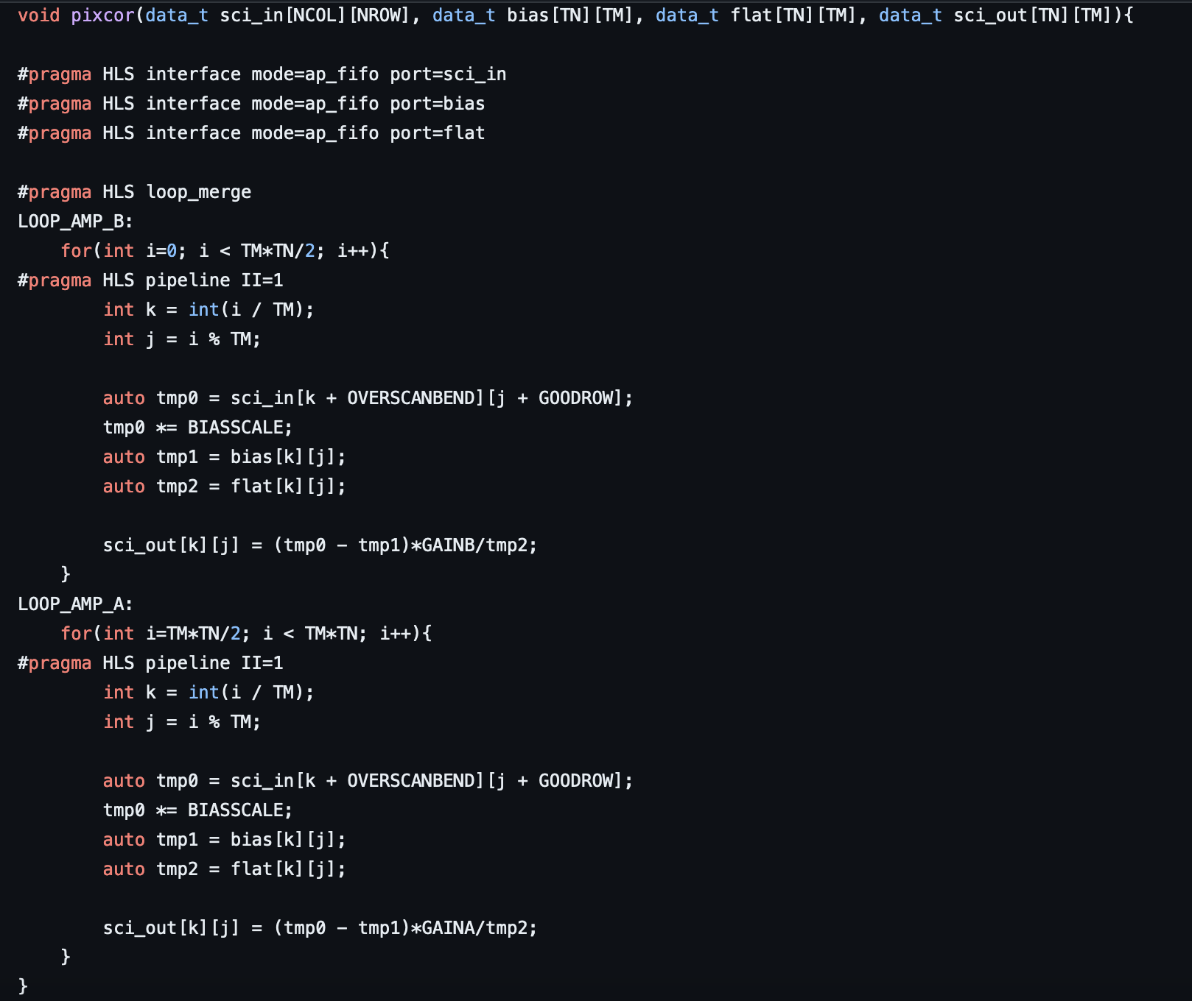
HLS Implementation of the Top Function
Transposed Inputs
}
Inputs are streamed
Amp B
Amp A
Semih Kacmaz | Efforts Toward In-Storage Processing of Astronomical Images Using FPGAs

Slide 21
HLS Implementation of the Top Function (Interfaces)
Interfaces: Designed channels for data flow into or out of the design.
Port protocols control the data flow.
Some possible options: ap_none (no protocol), ap_fifo (std FIFO), ap_memory (RAM)…
Initially selected port protocol: ap_fifo (default streaming protocol)
No special reason behind this choice: They are just easier to work with initially.
This choice is definitely going to change at later stages.
Eventual aim is P2P communication between storage device and FPGAs.
Semih Kacmaz | Efforts Toward In-Storage Processing of Astronomical Images Using FPGAs

Slide 22
HLS Implementation of the Top Function
Transposed Inputs
}
Inputs are streamed
}
Amp Loops are Merged
Amp B
}
Amp Loops are Merged
Amp A
Semih Kacmaz | Efforts Toward In-Storage Processing of Astronomical Images Using FPGAs

Slide 23
HLS Implementation of the Top Function
Transposed Inputs
}
Inputs are streamed
}
Amp Loops are Merged
}
Each Loop is Flattened
And Pipelined
Amp B
}
Amp Loops are Merged
}
Each Loop is Flattened
And Pipelined
Amp A
Semih Kacmaz | Efforts Toward In-Storage Processing of Astronomical Images Using FPGAs

Slide 24
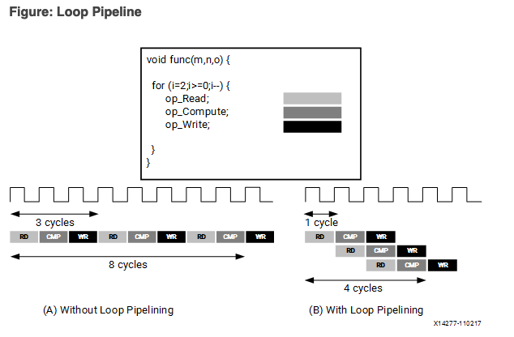
HLS Implementation of the Top Function (Pipelining)
“Pipelining a loop allows the operations of the loop to be implemented in a concurrent manner”
Measure of concurrency: Initiation Interval (II)
II: Launch frequency between consecutive iterations.
W/o pipelining RD, CMP, and WR operations have II: 3
With pipelining, II: 1 (The ideal scenario)
Obviously has direct effect on the final latency of the design
Illustration of the Behavior of the pipeline directive.
(Adapted from https://docs.xilinx.com/r/en-US/ug1399-vitis-hls/pragma-HLS-pipeline)
Semih Kacmaz | Efforts Toward In-Storage Processing of Astronomical Images Using FPGAs

Slide 25
HLS Implementation of the Top Function
Transposed Inputs
}
Inputs are streamed
}
Amp Loops are Merged
}
Each Loop is Flattened
And Pipelined
Amp B
Core Operations
}
Amp Loops are Merged
}
Each Loop is Flattened
And Pipelined
Amp A
Core Operations
Semih Kacmaz | Efforts Toward In-Storage Processing of Astronomical Images Using FPGAs

Slide 26
HLS Implementation of the Top Function (Performance)
We are only applying the simplest corrections, I.e. no parallelized overscan subtraction or linear correction (yet).
With overscan subtraction and linear correction the latency increased to 0.1 seconds (not reporting).
Recall that the science image is in 4K -> There are ~8.5 million pixels to concurrently operate on
So, even with II = 1, T = 5 ns, and perfect efficiency, concurrent operations on all the pixels gives the latency ~50 ms.
Vanilla C++ test code takes ~5 secs to run, so there is a considerable improvement.
Area use seems to be efficient, but that is expected given the ultra-simplistic design.
Semih Kacmaz | Efforts Toward In-Storage Processing of Astronomical Images Using FPGAs

Slide 27
Concluding Remarks
Disclaimer: This project is still at a very early stage and work-in progress and there are many aspects to improve and/or modify. We expect to keep working on improvements during the Fall and possibly beyond.
The steps were: Learn CCD image processing fundamentals —> Learn the basics of HLS. —> Pixcorrect (https://github.com/DarkEnergySurvey/pixcorrect) —> Python —> C++ —> HLS
Next mandatory step is to use ap_types instead of integers to get a better performance estimate and eliminate some overflow issues during rescaling process.
We still need to figure out a smart way to implement parallelized overscan subtraction.
The primary issue with parallelized OS: Calculating the median of each row/column is currently creating a massive bottleneck.
Concurrent nonlinearity correction should be simple yet it doesn’t mean much to implement it without the previous calibration operations
After resolving all of these issues, we furthermore aim to integrate P2P communication into the picture.
Semih Kacmaz | Efforts Toward In-Storage Processing of Astronomical Images Using FPGAs

Slide 28
THANKS!

